Slide 1
InVEST 3.16 (new settings button)

Slide 2
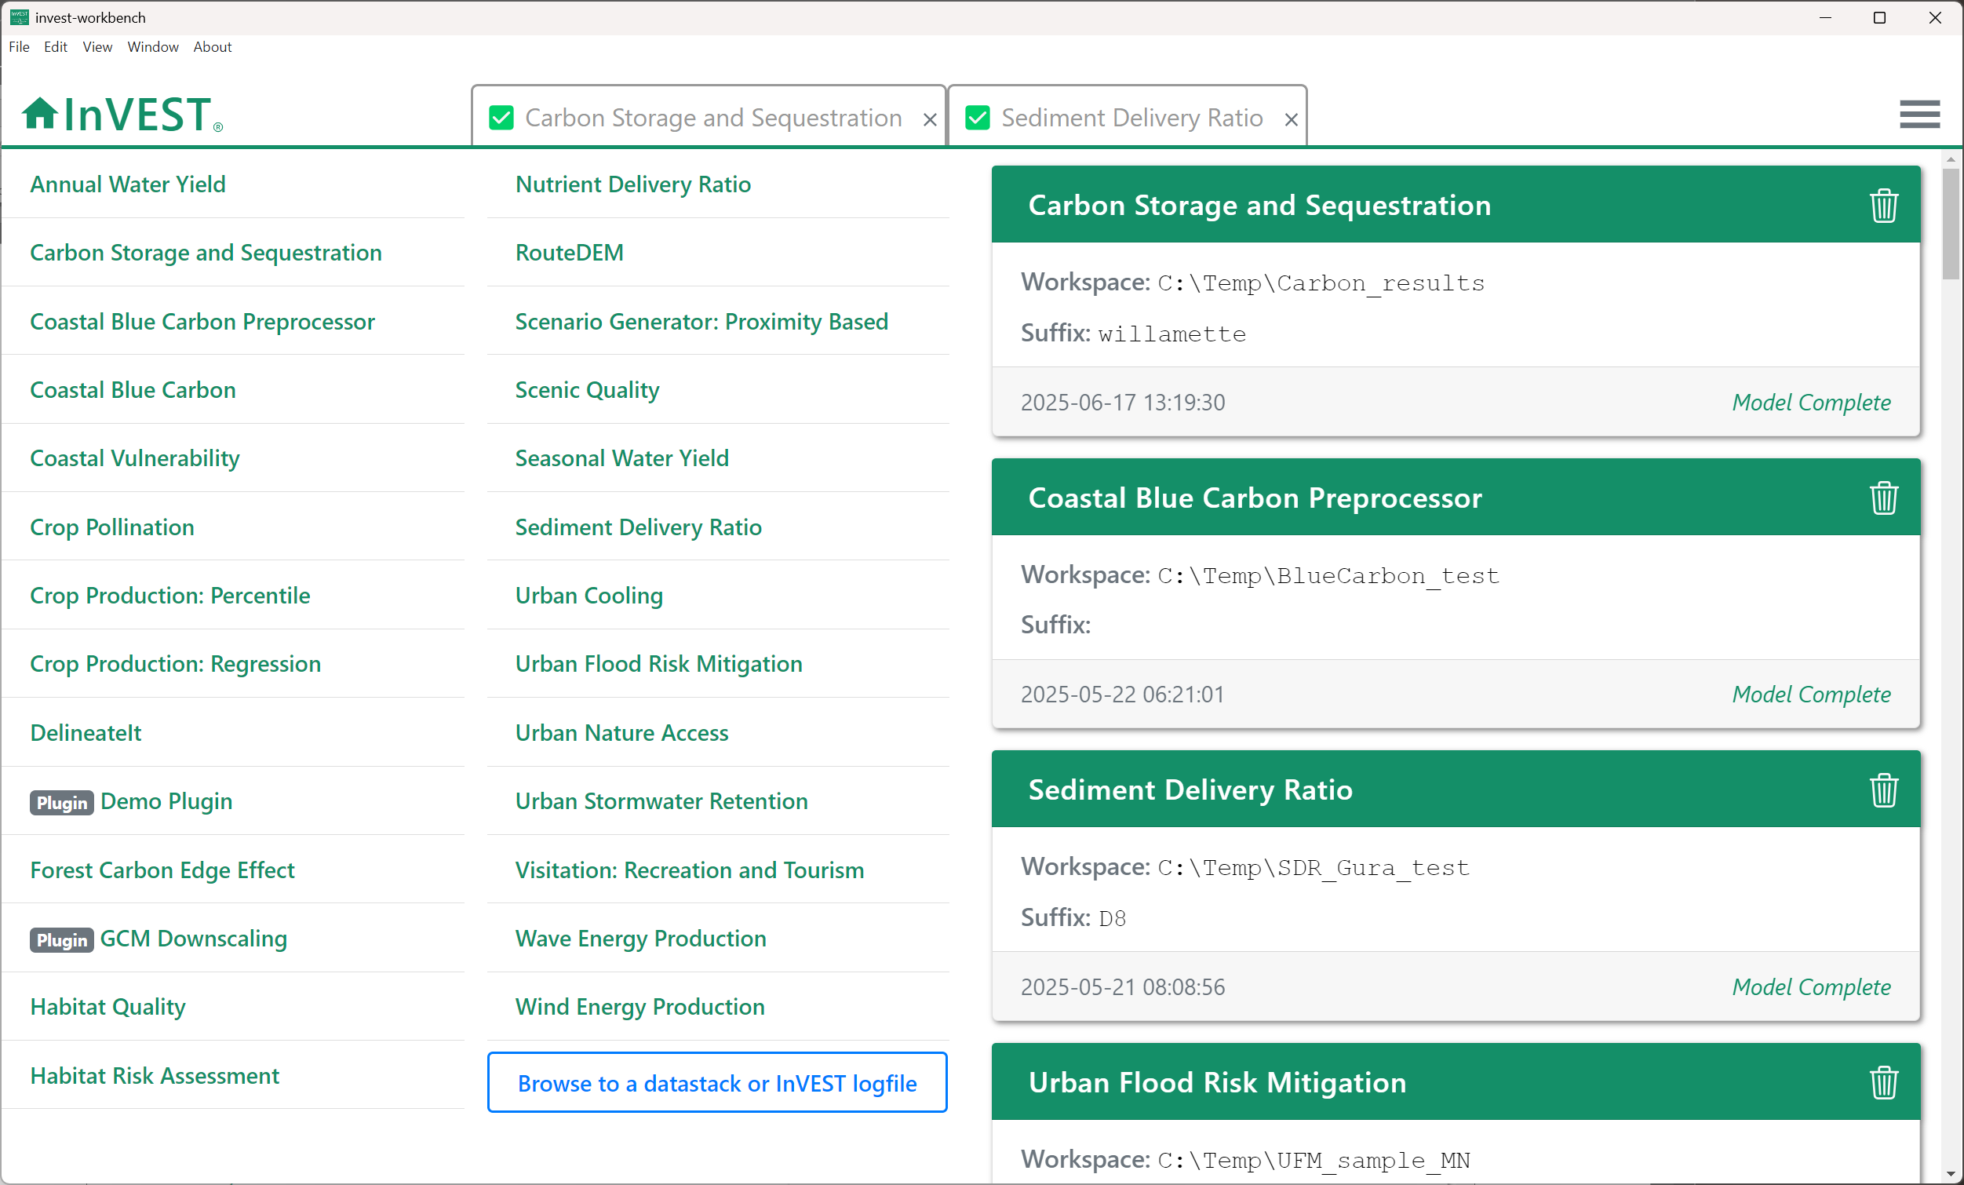
Home
screen
Previous
model runs
Settings/Plugins
Sample data
InVEST models

Slide 3
Settings/Plugins
Sample data

Slide 4
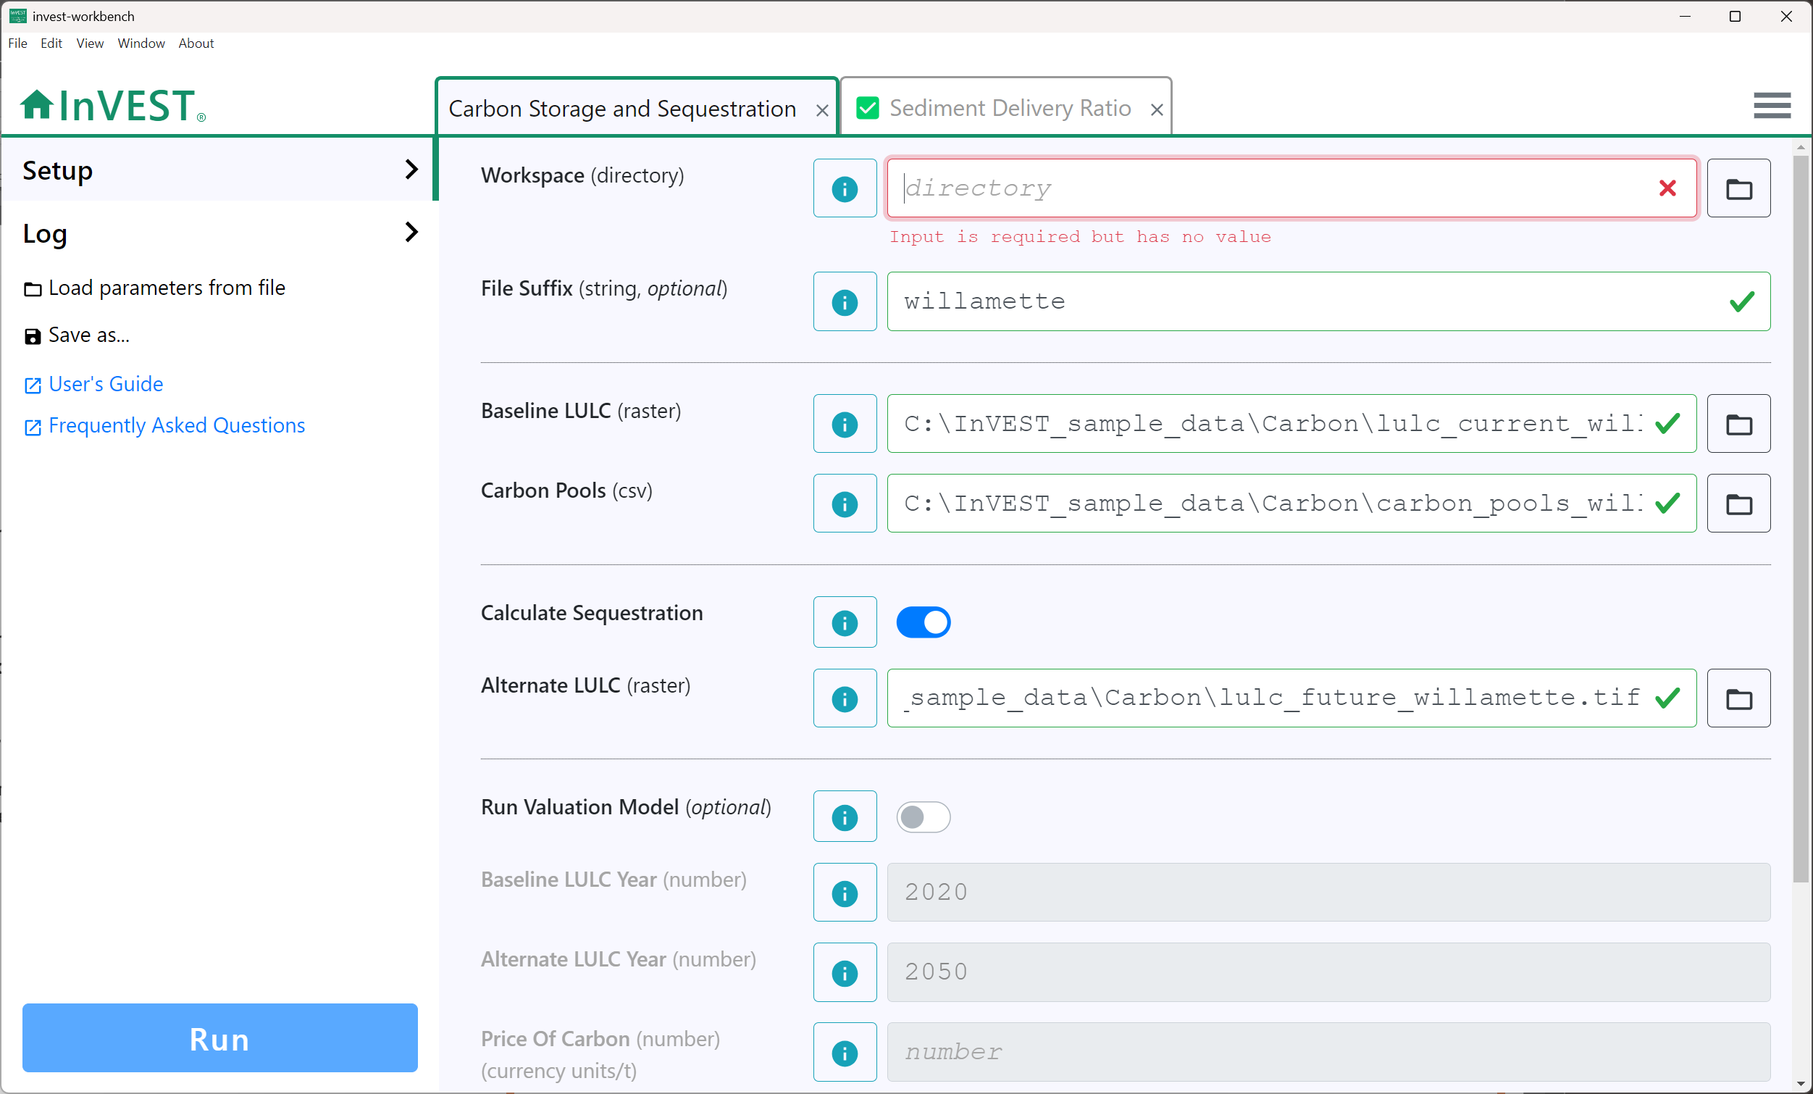
Tabs for multiple
model runs
Model
inputs
Load parameters and optionally data from a saved file
Save parameters and optionally data to a file
Link to User Guide
chapter for this model
Link to Community Forum posts related to this model
Click to run
the model

Slide 5
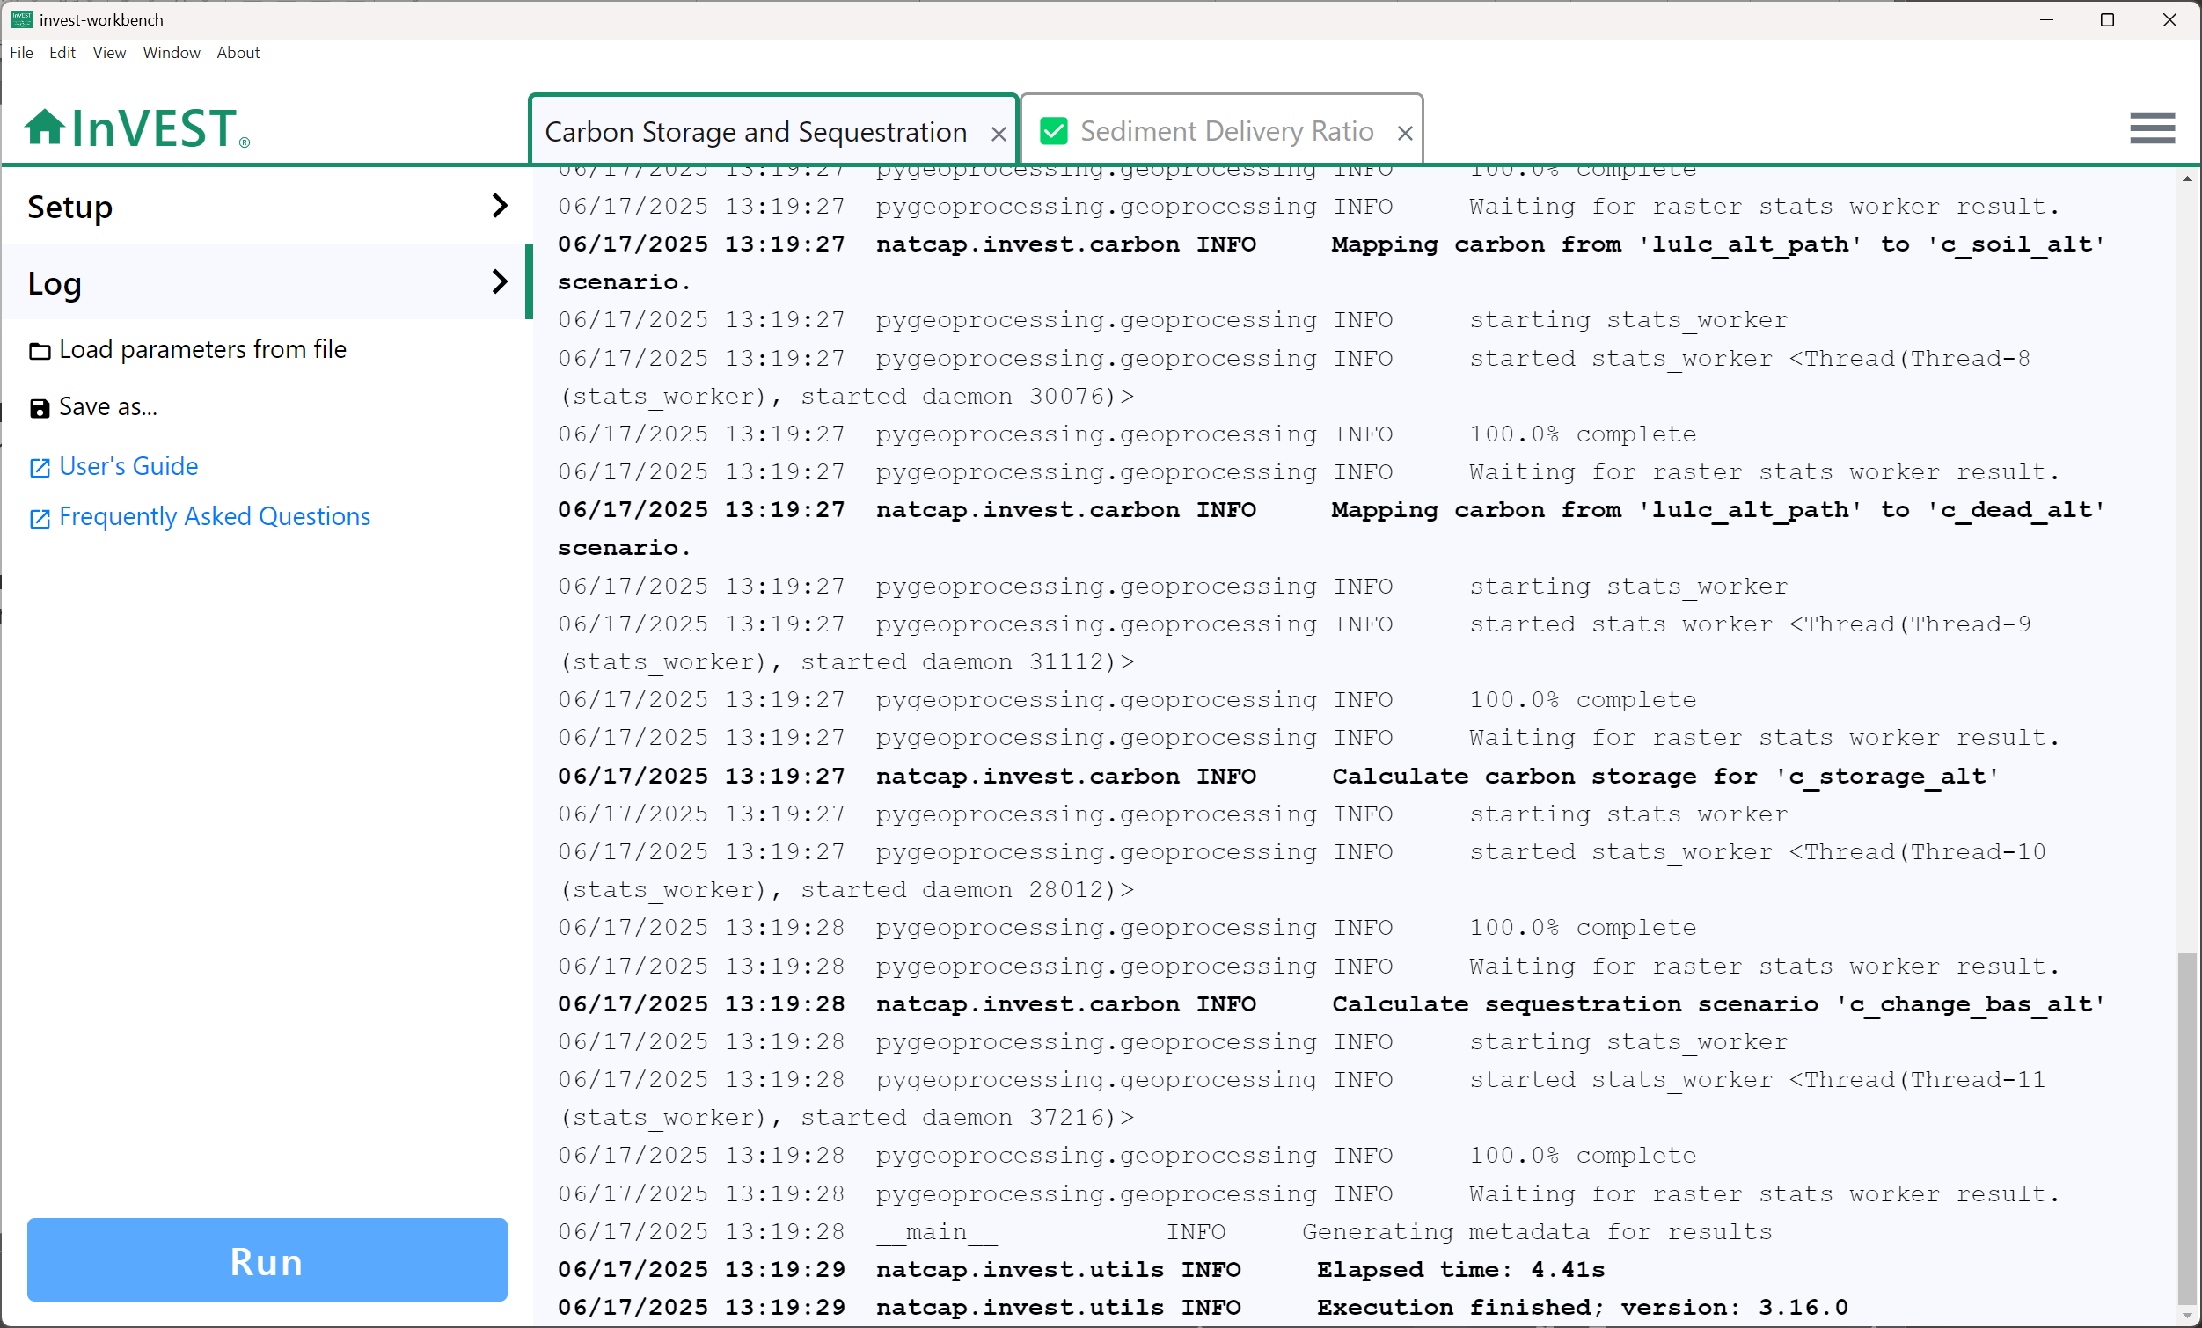
Logging
messages
Return to the model input screen
View logging messages for this model run
View
results

