Slide 1

Welcome to InVEST Training
October 21, 2011
Heather Tallis, NatCap Lead Scientist
Greg Guannel, NatCap Coastal Engineer
Stacie Wolny, NatCap GIS analyst
James Douglass, NatCap Software Developer
Doug Denu, NatCap Software Developer
Rich Sharp, NatCap Lead Software Developer

Slide 2
What will happen?
Introductions
Review Agenda
Model Theory
Run the model
Occasionally take breaks

Slide 3
What should you get out of this session?
Understand what NatCap does
Understand what InVEST can do and where its going
Get InVEST installed
Understand how to run InVEST models
Avoid the headache of doing it yourself
Understand where to go for more information and support

Slide 4
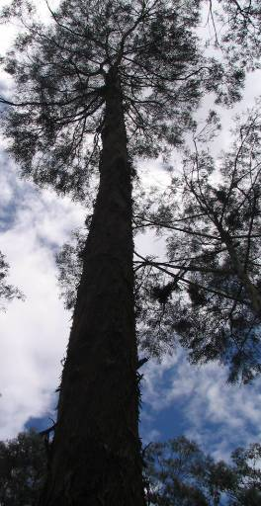
The Natural Capital Project
Partnership between TNC, WWF, University of Minnesota, and Stanford University
Co-founded by Gretchen Daily, Peter Kareiva, Taylor Ricketts, and Steve Polasky; directed by Mary Ruckelshaus
30+ researchers, postdocs, and support staff.

Slide 5
The Natural Capital Project
We want the goods and services from nature which are essential for human life to be included in land use decision making
Aligning Economic Forces with Conservation
Develop new science methods and tools
Apply new approaches to global demonstration sites
Magnify impact through communication

Slide 6
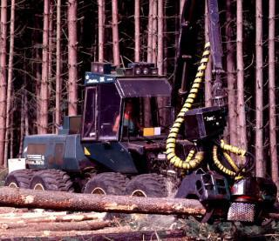
What’s the economic impact of harvesting timber
Value of the forest is more than the
value of the harvested timber

Slide 7
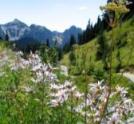
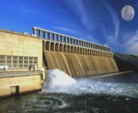
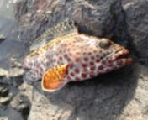
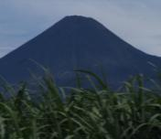
Improved Decision-Making
$17 million loss
12 species lost
$1 million loss
$5 million gain

Slide 8
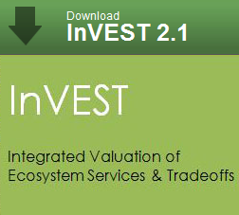
InVEST is a toolset to quantify, map, and value the benefits provided by terrestrial, freshwater, and marine systems

Slide 9
Marine Models
Wave Energy Model
Coastal Vulnerability Model
Marine Fish Aquaculture
Aesthetic Quality
Overlap Analysis Model: Fisheries and Recreation (Tier 0)
Habitat Risk Assessment

Slide 10
Terrestrial Models
Biodiversity: Habitat Quality & Rarity
Carbon Storage and Sequestration
Reservoir Hydropower Production
Water Purification: Nutrient Retention
Sediment Retention Model: Avoided dredging and water quality regulation
Managed Timber Production Model
Crop Pollination

Slide 11

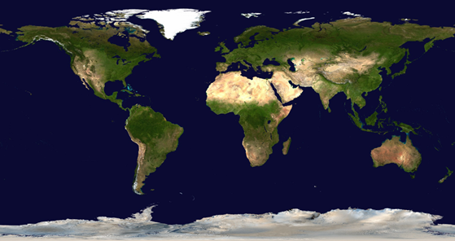
Applying InVEST
Minnesota
Delaware
West Coast
Uganda
China
Colombia
Hawai’i
Ecuador
Amazon Basin
Tanzania
Indonesia

Slide 12
Applying InVEST
WCVI
Puget Sound
Chesapeake Bay
Galveston Bay
Belize

Slide 13
Future of InVEST
Toward more efficient and user friendly implementations.
A class of online tools (InSEAM)
Automatic integration among InVEST tools
Tools to support science

Slide 14
InVEST Models We’ll Cover
Coastal Vulnerability
Carbon Storage and Sequestration
Sediment Retention

Slide 15

Install InVEST
Trainers are passing around USB drives
Copy the ‘InVEST21’ folder to your desktop
Install InVEST_2.1_beta-Setup.exe
Depending on your version of Arc (9.3 or 10) extract the MarinePythonExt_Py… files.
From that expansion install:
numpy...
scipy…
pywin32…

