Slide 1
InVEST Sediment Retention Model
Estimate the amount of watershet erosion and sedimentation and its economic impact on hydropower production and water quality
Two Steps:
Biophysical
Valuation

Slide 2

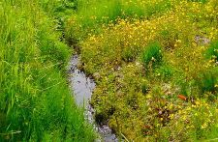
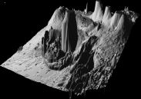
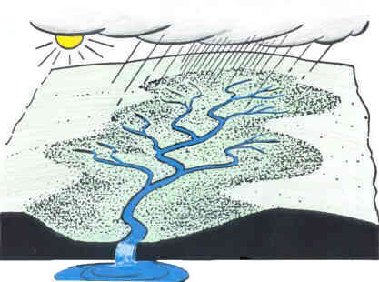
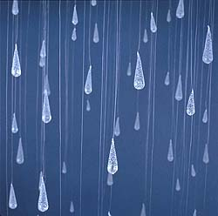
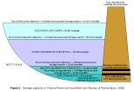
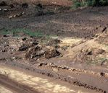
Sediment Retention Model
Biophysical Inputs
Land Use/Land Cover
Vegetation retention, land practice and management
Streams
Used to determine where sediment flows to
Slope
Digital elevation model, slope threshold
Watershed Areas
Main and sub for point of interest and water quality analysis
Erosivity
Based on intensity and kinetic energy of rainfall
Reservoir Features
Dead volume, lifetime of reservoir, allowed load
Erodibility
Soil detachment and transport potential due to rainfall

Slide 3
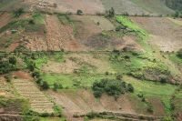
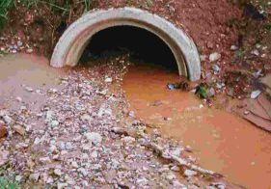
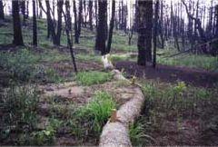
Sediment Retention Model
Biophysical Outputs
Potential Soil loss
Calculated from USLE per sub-watershed
Sediment Exported
Calculated per sub-watershed
Used in valuation
Sediment Retained
Calculated per sub-watershed

Slide 4
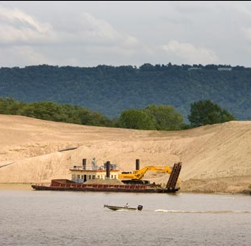
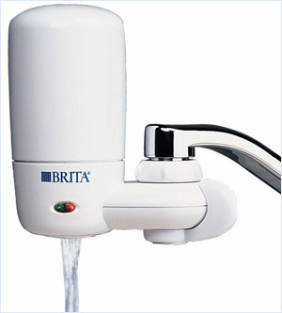
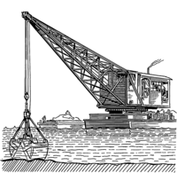
Sediment Retention Model
Valuation Inputs
Valuation Outputs
Watershed Areas
Main and sub for point of interest and water quality analysis
Value of Sediment Removal for Dredging
Sediment Exported
From biophysical analysis
Value of Sediment Removal for Water Quality
Sediment Retained
From biophysical analysis
Sediment Valuation
Reservoir dredging costs

Slide 5
Sediment retention model
How Does it Work?
Use the universal soil loss equation to determine potential soil loss
A connectivity model determines how much soil reaches the stream
Different land cover and practice can retain sediment!
Details in the user’s guide
Follow me to http://www.naturalcapitalproject.org
Bookmark the user’s guide

Slide 6

Sediment retention model
Universal Soil Loss Equation
$$A=R∙K∙LS∙C∙P$$
Variable | Description
A | Long term average annual soil loss
R | Rainfall erosivity
K | Soil erodability
LS | “Slope Length” Factor
C | Conservation Factor
P | Practice Factor

Slide 7
Sediment retention model
Connectivity Model
Corn
Forest
Corn
Forest
Stream

Slide 8
Results
Amount of sediment that reaches streams
Economic impact of sedimentation
Dredging
Water Quality

Slide 9
Future Features
Account for dams in removal of downstream sediment
It’ll run faster
Look for this in InVEST 2.3 in the near future

Slide 10

Sediment retention model
Do it!
Run the Soil Loss tool first, then Valuation
I’ll do a dry run
Trainers will help you
Your neighbor will help you
Okay to be rowdy

