Slide 1
Carbon storage and sequestration
InVEST Carbon Model
Estimate the amount and value of carbon stored, and sequestered on a landscape over time.

Slide 2


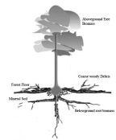


Carbon Storage and Sequestration
Inputs
Outputs
Land Use Land Cover
Carbon storage varies per land type and over time
Carbon Storage and Sequestration
Carbon Pools
Amount of carbon per LULC type, hardwood products
Value of sequestered and stored carbon
Economic values
Price of carbon, price change, discount rate

Slide 3
Carbon storage and sequestration
How Does it Work?
Details in the user’s guide
Follow me to http://www.naturalcapitalproject.org
Bookmark the user’s guide

Slide 4
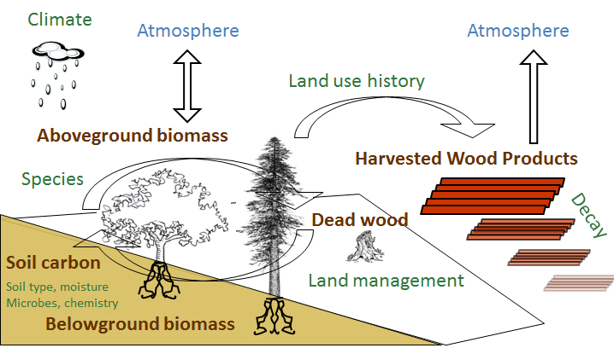
Carbon storage and sequestration
Models 5 Carbon Pools

Slide 5
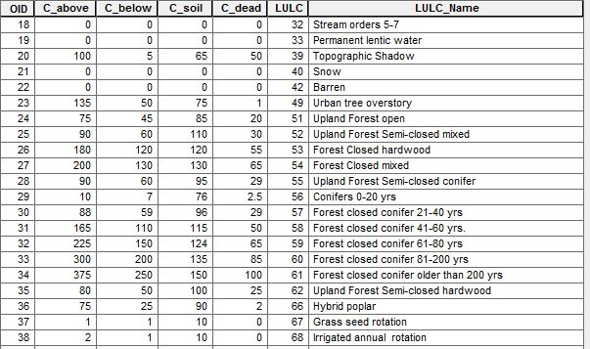
Carbon storage and sequestration
Carbon Pools: above, below, soil, dead

Slide 6
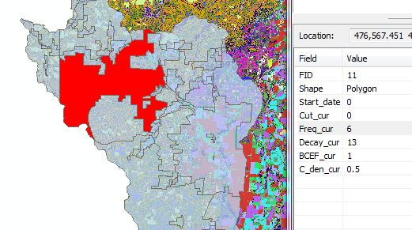
Carbon storage and sequestration
Carbon Pools: Hardwood Products

Slide 7
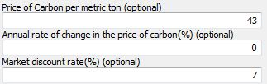
Carbon storage and sequestration
Economic Inputs

Slide 8
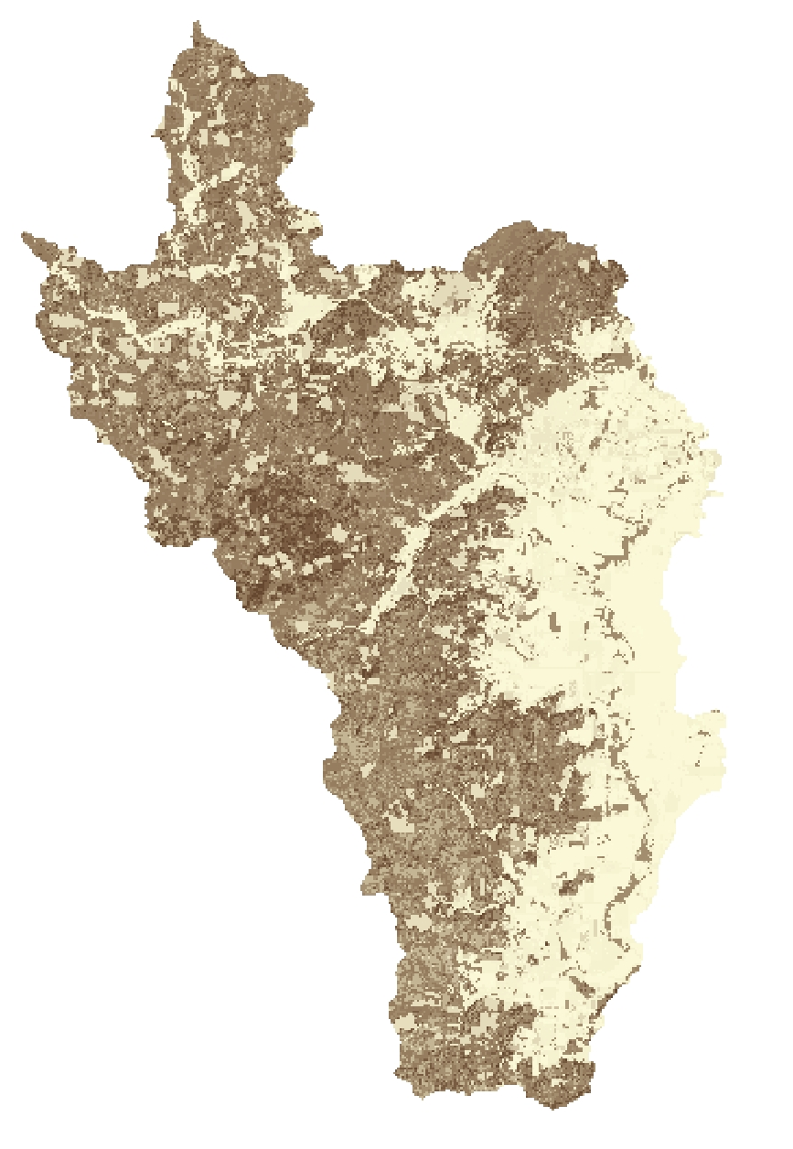
Carbon storage and sequestration
Outputs
Map of current carbon storage (Mg/cell)
Map of future carbon storage
- If future land use provided
Carbon sequestration map
= (future - present carbon storage)
Map of economic value of carbon sequestered

Slide 9
Carbon storage and sequestration
Strengths and/or Weaknesses
Data requirements are simple
Both biophysical and economic valuation modeling possible
Simplified carbon cycle; Carbon sequestration only occurs when land use changes over time or wood is harvested
Economic valuation assumes a linear trend in sequestration over time
Output is sensitive to accuracy of land use classes and carbon pool data

Slide 10
Carbon storage and sequestration
Future Features
Uncertainty module to handle variability in known values of carbon stocks
It’ll run faster
Coming soon in InVEST 2.2!

Slide 11

Carbon storage and sequestration
Do it!
Run the Carbon Model; I’ll do a dry run first
Trainers will help you
Your neighbor will help you
Okay to be rowdy

