Slide 1

ACC SMM Project
Web Chat Integration with Ask Aunjai
09 Mar 2016
Rev 0.2

Slide 2
Agenda
Chat on Ask Aunjai Design Flow
Chat on Ask Aunjai Design Screen
Development Plan

Slide 3
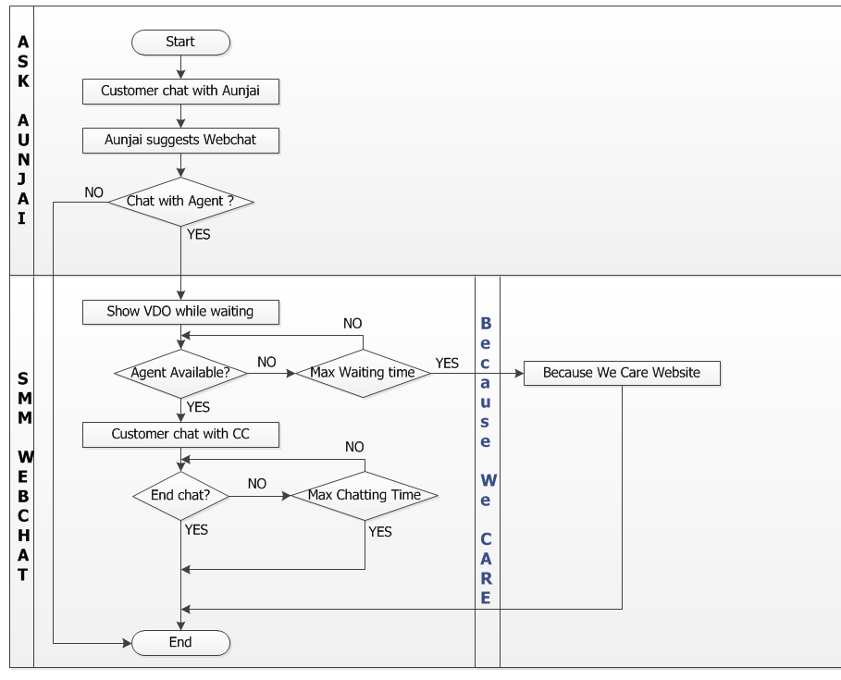
Design Flow

Slide 4
Design Screen
Requirement to integrated with SMM Chat:
Request from Ask Aunjai program go straight to Chat page (Don’t show submit form)
Show Chat in iFrame on Aunjai screen
Show VDO adv. while waiting for agent
Chat UI as corporate chat style
Separate Configuration from Residential Chat
If no available agent, show Because We Care website

Slide 5
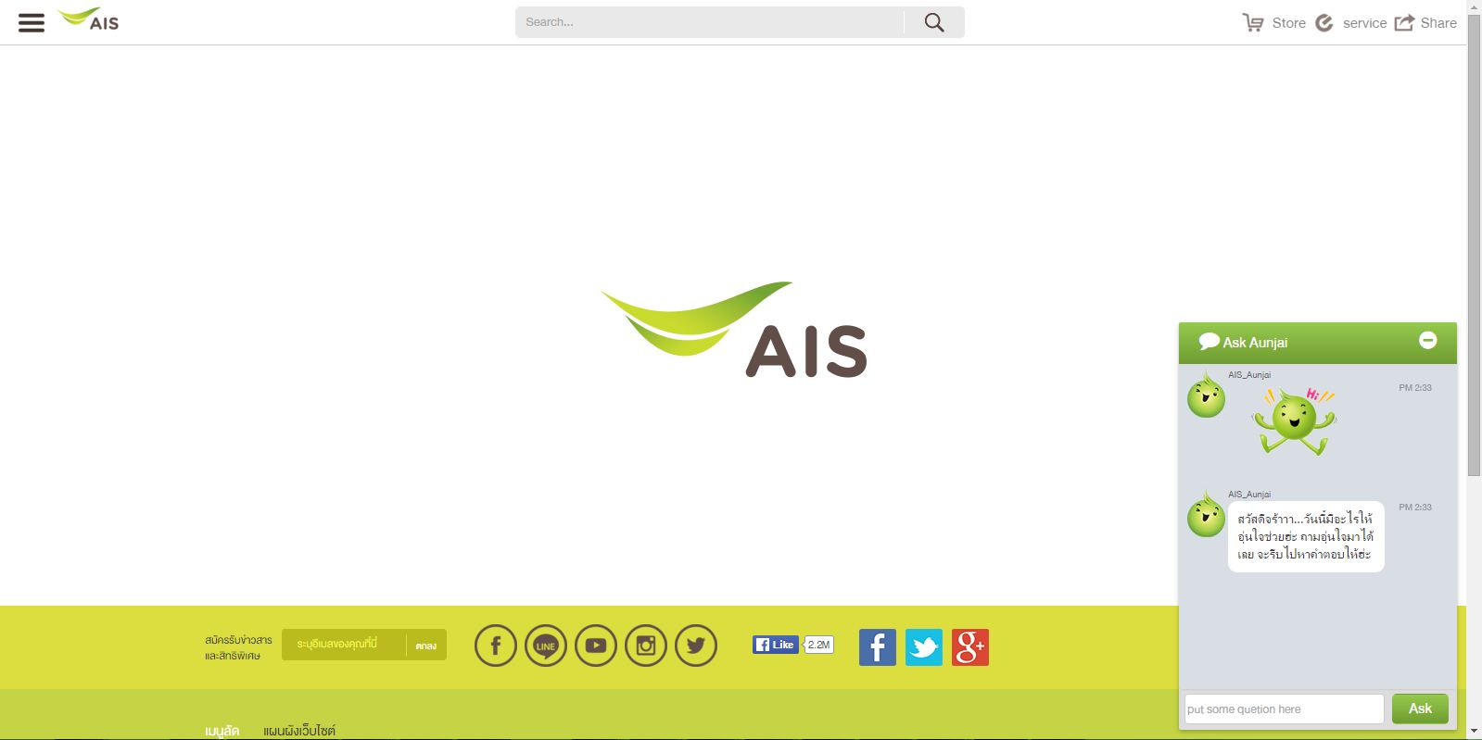
Design Screen (cont.)

Slide 6
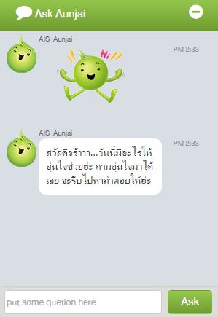
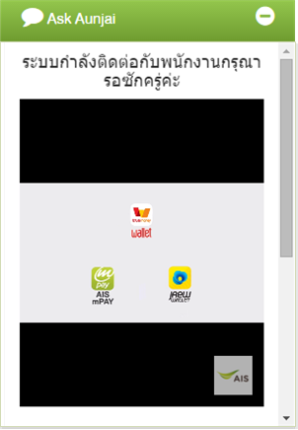
Design Screen (cont.)

Slide 7
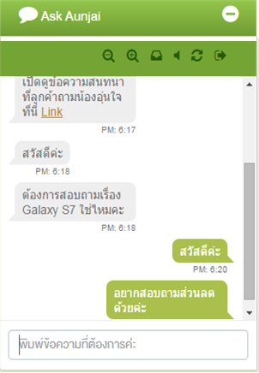
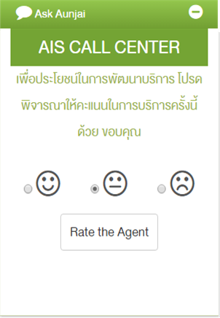
Design Screen (cont.)

Slide 8
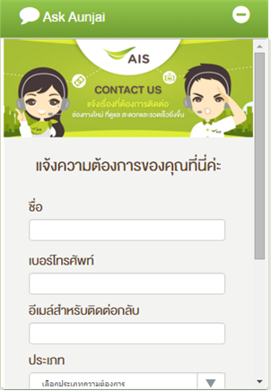
Design Screen (cont.)
No Agent Available

Slide 9
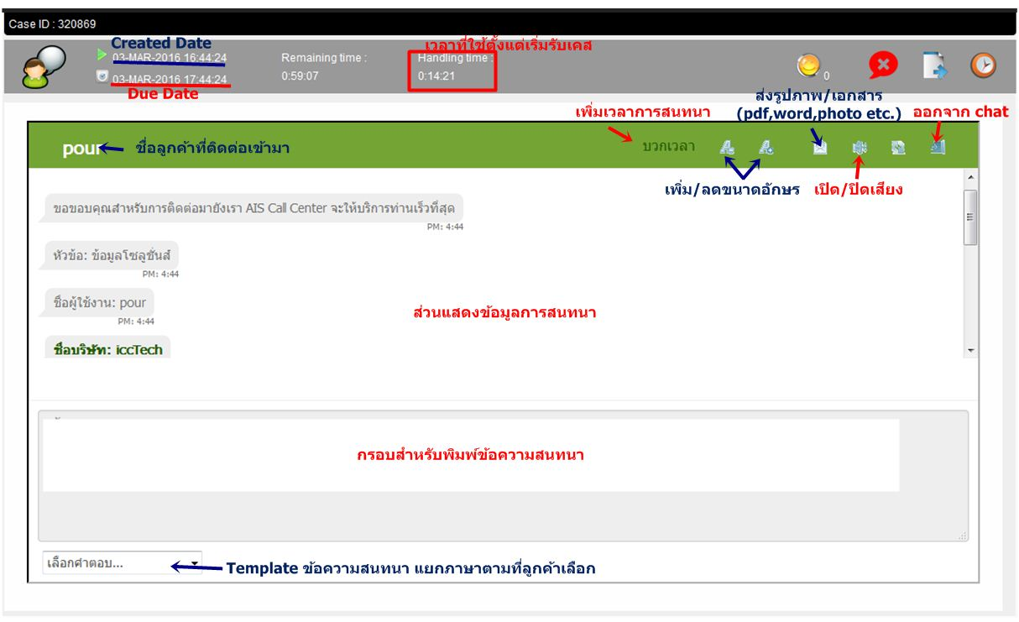
Design Screen (cont.)
SMM - Agent

Slide 10
Development Plan for Ask Aunjai
Development Task
Tasks | Status | Target
Testing chat connection (bypass submit form) | Completed | Wed 02, Mar
2. Develop Aunjai Chat Features exclude receiving text/url from Aunjai new API | Completed | Mon 07, Mar
3. Change Aunjai Chat UI | Completed | Mon 07, Mar
4. Chat Configuration Page | Completed | Fri 04, Mar
5. VDO Adv. Screen & Configure | Completed | Mon 07, Mar
6. Redirect to Because We Care | Completed
7. Develop Aunjai Chat Features receiving text/url from Aunjai new API | Completed

Slide 11
Development Plan (cont.)
Plan | Target | Result
SIT Test – connect with Aunjai | 08/03 | PASS
SIT Test – Aunjai script API* | 08/03 | PASS
End-to-End Test
UAT Test
On Production
* : required new web service api from Ask Aunjai development team

