Slide 1
Tellvoice Project Roadmap for ACC ACCTSR / ACC-SMM
Tellvoice Technology
7 Jan 2016
Rev 3.0 / 06JAN2016

Slide 2
Agenda
Overall Project Roadmap 2015-2016
ACC-SMM Roadmap 2015-2016

Slide 3
ACC-SMM Roadmap 2015-2016
2015 |  |  |  |  |  |  |  | 2016
SEP |  | OCT |  | NOV |  | DEC |  | JAN |  | FEB |  | MAR |  | APR |  | MAY |  | JUN |  | JUL |  | AUG |  | SEP |  | OCT |  | NOV |  | DEC
SERVICE ROLL-OUT PLAN
SMM Corporate
E-Mail and
Web Chat
Ph 1 – 15DEC
(Completed)
Ph 2 – 29APR
SMM Corporate E-Mail and Web Chat
Phase 1 Interim solution with separated domain Partial features for corporate e-mail
Phase 2 Complete solution within single SMM platform Complete enhanced corporate e-mail features
SMM Survey Platform
Social Analytic
Ph 1 – 31MAR
Ph 2 – 27MAY
Prod – 25NOV
Auto Survey
Social
Other Sites
Prod – 26FEB
Prod – 29JUL
Facebook Myanmar
SMM Agent
Quality
Assurance
Prod – 26FEB
Prod – 29JUL
PANTIP New Web Service
New PANTIP API implementation in SMM Include 12-month service fee for Pantip
SMM Corporate E-Mail and Web Chat
Currently
On-going Project
SMM Agent Quality Assurance
Phase 1
Interim Solution
Phase 2
Full Solution
SMM Agent QA
Provide information for QA
To improve operation efficiency
Ph 1 – 15DEC
Ph 2 – 31MAR
Prod – 29JUL
SMM Survey Platform
Social Analytic
Integrate to TV survey platform Sentimental analysis of AIS customers Sentimental analysis of competitors Identify customer intention, sentiment Comparison of 2 products/services Cloud keyword tag
Social Analytic
Platform
Social Analytic
S-Sense Integration
Analytical Tools
Survey Platform Integration
Ph 1 – 31MAR
Ph 2 – 27MAY
Social Other Sites
Prod – 25NOV
INFRASTRUCTURE
IMPLEMENTATION PLAN
Social Other Sites
Pantip New WS Development
Integration w/SMM
Prod – 29JUL

Slide 4
Update ACC SMM
LINE and LINE@ accounts
Auto Survey
Facebook Myanmar
Pantip and Social Other Sites
Social Analytic—Q1/2016
QA Analysis
Integration with Other AIS Systems
Workforce management
Siebel
SFF
SuperScreen

Slide 5
LINE and LINE@
Summary of features on Social Analytic Platform
Business—impact and benefits / Cost / Technical
Benefits
Most popular messaging platform in Thailand
Handling each customer individually
Group messaging

Slide 6
Auto Survey Facebook Myanmar
Auto Survey
Integration with AIS Survey system
Additional development for system integration
Facebook Myanmar
Supported on UNICODE encoding
Additional development on Zaw Gyi character encoding support

Slide 7
Pantip and Social Other Sites
Pantip New Web Service
Include 12-month service fee 33,000 Baht/month
Kapook / Manager
Already contact and able to provide information.
To be discussed about cost and technical information.
Sanook / M-Thai
Sanook—Not open publicly. Request to handle case-by-case only.
M-Thai—No policy to provide information.

Slide 8
Social Analytic Platform (1)
Summary of features on Social Analytic Platform
Sentimental analysis of AIS customers
Sentimental analysis of competitors
Identify customer intentions and sentiments
Comparison of 2 products/services
Cloud keyword tag
Customized Analysis Reports using BI Tool

Slide 9
Social Analytic Platform (2)
Summary new features on Sentimental Analysis Engine (S-Sense) V.2
สามารถวิเคราะห์ความคิดเห็นจากข้อความ (Sentiment) เชิงบวก (Positive) / เชิงลบ (Negative)
สามารถวิเคราะห์จุดประสงค์ของผู้เขียน (Intention) ประกาศและโฆษณา / ร้องขอ / คำถาม / แสดงความคิดเห็น
สามารถวิเคราะห์ข้อความเชิงเปรียบเทียบระหว่างชื่อสินค้า/บริการ 2 ชื่อ พร้อมทั้งระบุมุมมองที่เปรียบเทียบ ประโยคความคิดเห็น: “call center สินค้า A บริการดีกว่า call center สินค้า B” โดยระบบจะวิเคราะห์ผลว่า สินค้า A ได้รับความคิดเห็นเชิงบวก ในขณะที่ สินค้า B ได้รับความคิดเห็นเชิงลบในเรื่องของการให้บริการ เป็นต้น

Slide 10
Social Analytic Platform (3)
Summary new features on Sentimental Analysis Engine (S-Sense) V.2
สามารถวิเคราะห์ความเชื่อมโยงของชื่อสินค้ากับความคิดเห็นเชิงบวกลบ ประโยคความคิดเห็น “สินค้า A หน้าจอคมชัดและสีสันสดใส” ระบบจะวิเคราะห์ผลว่า “สินค้า A ได้รับความคิดเห็นเชิงบวกในเรื่องคุณสมบัติของหน้าจอ”
สามารถวิเคราะห์โครงสร้างของกริยาวลีได้ การใช้กริยาวลีของคำว่า “อยากใช้” “อยากใช้ สินค้า A จังเลย” “อยากจะกลับไปใช้ สินค้า A อีก” ซึ่งระบบสามารถให้ผลการวิเคราะห์ใช้กริยาวลีดังกล่าวเป็นเชิงบวกเหมือนกัน ทั้งในกรณีคำกริยาที่อยู่ติดกันหรือแยกจากกันได้

Slide 11
Social Analytic Platform (4)
Summary new features on Sentimental Analysis Engine (S-Sense) V.2
สามารถวิเคราะห์คำกำหนดทิศทางที่มีผลต่อความเห็นได้ เช่น คำว่า “ลดลง” “เพิ่มขึ้น” “น้อยกว่า” เป็นต้น “รถยนต์ยี่ห้อ A กินน้ำมันน้อยกว่ายี่ห้ออื่น” “สินค้า B มีความจุของแบต ลดลงกว่ารุ่นก่อน” ซึ่งระบบสามารถวิเคราะห์ผลในประโยคแรกได้ว่า ยี่ห้อ A ได้รับผลเชิงบวกในเรื่องการ “กินน้ำมัน” และวิเคราะห์ผลในประโยคที่สองได้ว่า สินค้า B ได้รับผลเชิงลบในเรื่อง “ความจุของแบต”

Slide 12
SMM Agent Quality Assurance
To provide information about Agent for QA.
Detailed analysis of each agent
Random pick-up cases for analysis
Compute handling time
For improving operational efficiency
Customized Analysis Reports using BI Tool

Slide 13
SMM Survey Platform
Summary of features on Social Analytic Platform
Sentimental analysis of AIS customers
Sentimental analysis of competitors
Identify customer intentions and sentiments
Comparison of 2 products/services
Cloud keyword tag
Customized Analysis Reports using BI Tool

Slide 14
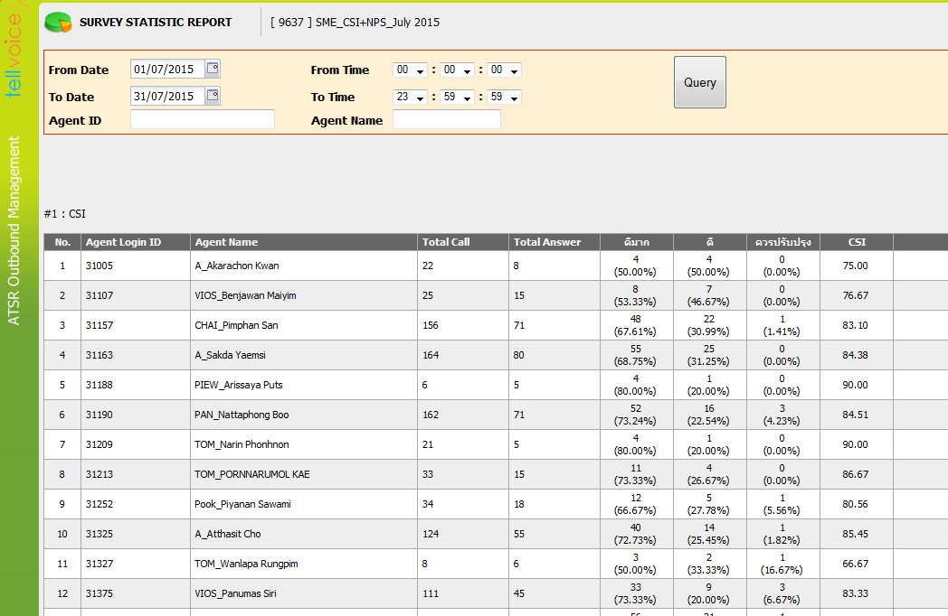
Survey Statistical Report by Agent

Slide 15
Update ACC SMM
LINE and LINE@ accounts
Facebook Myanmar
Social Other Sites
Auto Survey
Pantip
Social Analytic—Q1/2016
QA Analysis
Integration with Other AIS Systems
Requests from MD-ACC

Slide 16
Requests from MD-ACC
Requests (Web Chat) | Solutions Review | Duration
ปุ่ม extend time (ต่อเวลาครั้งละ 5 นาที) โดยปุ่มอยู่ฝั่ง agent | สามารถดำเนินการแก้ไขเพิ่มเติมได้ | 2 สัปดาห์ นับจากได้รับ CR
Auto message ของแต่ละ ปัญหา | ต้องการรายละเอียดความต้องการเพิ่มเติม
Enhance ต่อสายให้คุยกับ agent ได้เลย (ต้องไปคุยเรื่อง interface กับทีมไหนเพิ่มเติม) | ต้องการรายละเอียดความต้องการเพิ่มเติม หารือกับทีมคุณพิเชษฐ์ เพื่อขอข้อมูล Solution เพิ่มเติม
Self service ในมุมของ auto message คล้ายๆ ask aunjai | ต้องการรายละเอียดความต้องการเพิ่มเติม นัดหารือกับทีมงาน Ask Aunjai

Slide 17
Thank you

Slide 18
END OF SLIDE

Slide 19
Overall Roadmap 2015-2016
2015 |  |  |  |  |  |  |  | 2016
SEP |  | OCT |  | NOV |  | DEC |  | JAN |  | FEB |  | MAR |  | APR |  | MAY |  | JUN |  | JUL |  | AUG |  | SEP |  | OCT |  | NOV |  | DEC
Customer Track & Trace
Customer Track & Trace
Phase 3
Ph 1 - 19OCT
Ph 2 – 15DEC
Currently On-going Project
Started in SEP’2015
Phase 1-2 Cost
1.5 M Baht
TV SimplySurvey Platform
Phase 1-2 Cost – 8.2 M Baht
Engagement Survey
Phase 1
New Survey Engine
Multiple Channels
Reporting
Phase 2
Integration IVR Outbound
Integration ACC-SMM
Survey Analytic Report
Ph 1 - 27OCT
Ph 2 – 30NOV
Currently On-going Project
Phase 1-2 Cost – 1 M Baht
IVR Outbound Capacity Expansion
Ph 1 – 31JUL
Ph 2 – 31OCT
Phase 1
New 120 Ports
Phase 2
TV SimplyOutbound
New Framework
Full Capacity Expansion
Phase 1-2 Cost
7.2M Baht
Ph 1 – 26FEB
Ph 2 – 31MAY
SMM Corporate E-Mail and Web Chat
Currently On-going Project
Phase 1-2 Cost
2 M Baht
Phase 1
Interim Solution
Phase 2
Full Solution
TV SimplySurvey Platform Integration
Survey Platform Integration
* Included with Phase 2
TV Survey Platform
Ph 1 – 30NOV
Ph 2 – 31MAR
PANTIP New
Web Service
PANTIP New Web Service
New WS Development
Integration w/SMM
Prod – 31AUG
Social Analytic
Cost – 1.4 M Baht
Prod – 29APR
Social Analytic
S-Sense Integration
Analytical Tools
Web Board
Channels
Web Board Channels
Manager / Kapook
Cost – TBD
Prod – 29APR
Cost – 4 M Baht
Prod – 30NOV

Slide 20
ATSR Roadmap 2015-2016
2015 |  |  |  |  |  |  |  | 2016
SEP |  | OCT |  | NOV |  | DEC |  | JAN |  | FEB |  | MAR |  | APR |  | MAY |  | JUN |  | JUL |  | AUG |  | SEP |  | OCT |  | NOV |  | DEC
Customer Track & Trace
Customer Track & Trace
Phase 3
Ph 1 - 19OCT
Ph 2 – 15DEC
Currently On-going Project
Started in SEP’2015
Phase 1-2 Cost
1.5M Baht
TV SimplySurvey Platform
Phase 1-2 Cost – 8.2M Baht
Engagement Survey
Phase 1-2 Cost
1M Baht
Phase 1
Phase 2
Ph 1 - 27OCT
Ph 2 – 30NOV
Currently On-going Project
Ph 1 – 31JUL
Ph 2 – 31OCT
IVR Outbound Capacity Expansion
Phase 2 Cost
5.3M Baht
TV SimplySurvey Platform |  | 8.2 M Baht
Phase 1 TV Simply survey engine Survey template design Survey to various channels—IVR, Web, SMS, e-mail, Social channels (FB/TW) Survey analysis Reporting tools for survey Sentimental analysis | Phase 2 Integrate with ATSR Outbound new framework Integrate with NICE recording to trace back to customer and agent conversation
Phase 1
Phase 2
Phase 1 Cost
1.9M Baht
Ph 1 – 26FEB
Ph 2 – 31MAY
Customer Track & Trace | 2.5 M Baht
Phase 1—Trouble Ticket (TT) Go-Live 19OCT Phase 2—Service Request (SR) Go-Live 15DEC Phase 3—Device Repair Tracking (Phase 1-2 = 1.5M / Phase 3 = 1 M Baht)
Engagement Survey | 1 M Baht
Enhanced ATSR Outbound Survey Features Complex condition question and answer Category of customer’s response
IVR Outbound Capacity Expansion |  | 7.2 M Baht
Phase 1 New additional 120 ports (4 E1) with new server Interim solution using exist. IVR | Phase 2 New servers expansion New system architecture support additional capacity New framework to support TV SimplySurvey platform Enhanced features Reporting tools for TV SimplyOutbound

Slide 21
ACC-SMM Roadmap 2015-2016
2015 |  |  |  |  |  |  |  | 2016
SEP |  | OCT |  | NOV |  | DEC |  | JAN |  | FEB |  | MAR |  | APR |  | MAY |  | JUN |  | JUL |  | AUG |  | SEP |  | OCT |  | NOV |  | DEC
SMM Corporate E-Mail and Web Chat
Currently On-going Project
Phase 1-2 Cost
2 M Baht
Phase 1
Interim Solution
Phase 2
Full Solution
TV SimplySurvey Platform Integration
Survey Platform Integration
* Included with Phase 2
TV Survey Platform
Ph 1 – 30NOV
Ph 2 – 31MAR
PANTIP New
Web Service
PANTIP New Web Service
New WS Development
Integration w/SMM
Prod – 31AUG
Social Analytic
Cost – 1.4 M Baht
Prod – 29APR
Social Analytic
S-Sense Integration
Analytical Tools
Web Board
Channels
Web Board Channels
Manager / Kapook
Cost – TBD
Prod – 29APR
Cost – 4 M Baht
Prod – 30NOV
SMM Corporate E-Mail and Web Chat | 2 M Baht
Phase 1 Interim solution with separated domain Partial features for corporate e-mail
Phase 2 Complete solution within single SMM platform Complete enhanced corporate e-mail features
TV SimplySurvey Platform Integration
Phase 2 of TV SImplySurvey Platform Integration with SMM with TV SimplySurvey Platform Cost included with the other project
Social Analytic | 4 M Baht
Integrate to TV survey platform Sentimental analysis of AIS customers Sentimental analysis of competitors Identify customer intention, sentiment Comparison of 2 products/services Cloud keyword tag
PANTIP New Web Service | 1.4 M Baht
New PANTIP API implementation in SMM Include 12-month service fee for Pantip

Slide 22
Summary Projects 2015-2016
No | Project | Cost | Target | Status
1 | (CR) ATSR ACC Contact Analytic |  | 31 May 2015 | Completed on Prod.
2 | (CR) ATSR ACC Privilege Loyalty Survey |  | 22 Oct 2015 | Completed on Prod.
3 | ACC Customer Track & Trace | 2.5 M
 | 3.1 Phase 1—TT | 1.5 M | 19 Oct 2015 | Completed on Prod.
 | 3.2 Phase 2—SR |  | 15 Dec 2015 | Completed on Prod.
 | 3.3 Phase 3—Device Repair Tracking | 1 M | 31 Mar 2015 | (Tentative)
4 | ATSR ACC Engagement Survey | 1 M
 | 4.1 Phase 1 |  | 27 Oct 2015 | Completed on Prod.
 | 4.2 Phase 2 |  | 29 Jan 2016 | Ongoing Development
5 | IVR Outbound Capacity Expansion | 7.2 M
 | 5.1 Phase 1 | 1.9 M | 28 Feb 2016 | * Subject to approval
 | 5.2 Phase 2 | 5.3 M | 31 May 2016 | (Tentative)
6 | TV SimplySocial Platform | 8.2 M
 | 6.1 Phase 1 | 4.7 M | 31 Jul 2016 | (Tentative)
 | 6.2 Phase 2 | 3.5 M | 31 Oct 2016 | (Tentative)

Slide 23
Summary ACC-SMM Projects
No | Project | Cost | Target | Status
1 | SMM Corporate E-Mail and Web Chat | 2 M
 | 1.1 Phase 1 Interim Solutions |  | 30 Nov 2015 | Ongoing Development
 | 1.2 Phase 2 |  | 31 Mar 2016 | (Tentative)
2 | PANTIP New Web Service | 1.4 M | 31 Mar 2016 | (Tentative)
3 | Survey Platform Integration |  | 31 Aug 2016 | (Tentative)
4 | Social Analytic | 4 M | 30 Nov 2016 | (Tentative)

Slide 24
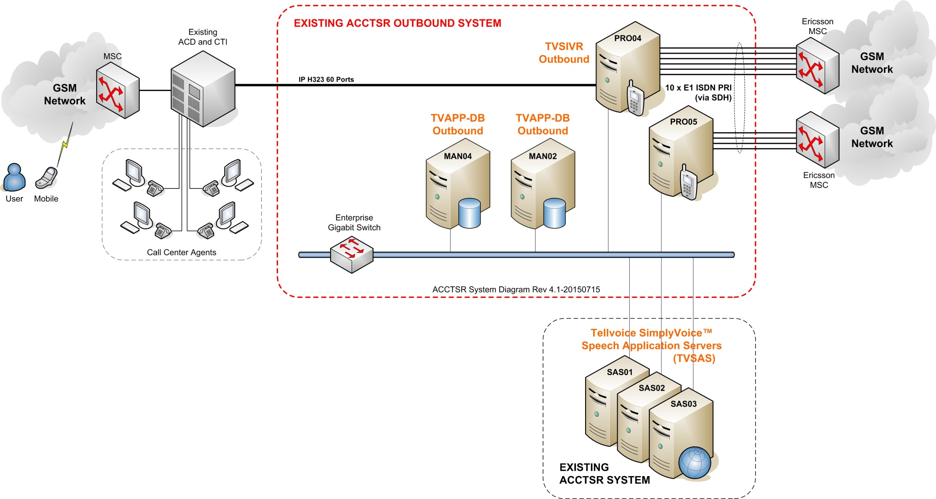
ATSR Outbound Existing Architecture
Current Capacity 10 E1 (300 ports)
IVR1 = 6 E1 (180)
IVR2 = 4 E1 (120)
Daily capacity at 9,000 calls/hour or at 90,000 calls/day at 10 peak-hours/day

Slide 25
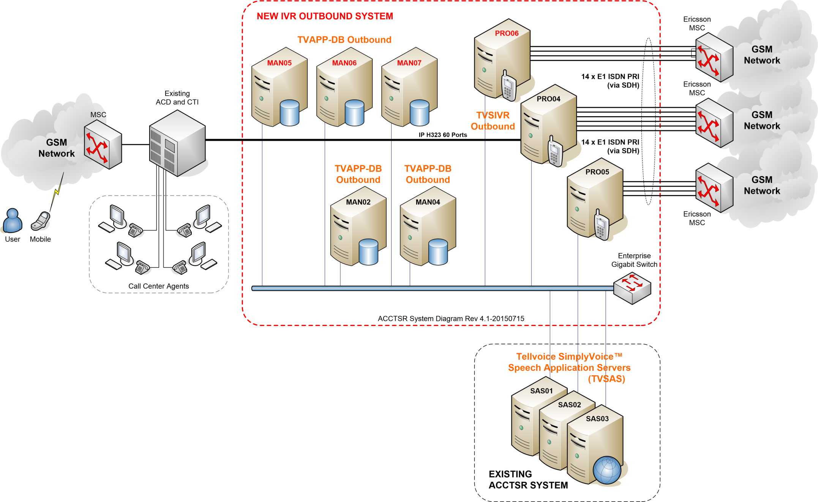
IVR Outbound New Architecture
Current Capacity 14 E1 (420 ports)
IVR1 = 6 E1 (180) / IVR2 = 4 E1 (120)
IVR3 = 4 E1 (120) – NEW
Daily capacity at 12,600 calls/hour or at 126,000 calls/day at 10 peak-hours/day

Slide 26
ATSR Outbound Enhancement
Existing ATSR Outbound System
10 Types
Lists
Siebel
PDS
QIS
Qmatic
Manual
AIS Shop
Telewiz
ATSR Outbound System
SMS GW
List
Management
Call Management
IVR
Systems
Agents
Survey
Management
Reporting
Customers
New ATSR Outbound System Enhancement
ATSR Outbound System
SMS GW
10 Types
Lists
Siebel
PDS
QIS
Qmatic
Manual
AIS Shop
Telewiz
List
Management
Call Management
IVR
Systems
Agents
Customers
Web
Facebook
Twitter
Pantip
E-Mail
Web Chat
Web Board
Sentimental Analysis Engine
Survey
Engine
Analysis and Reporting
Speech-to-
Text Engine
ACC Social Media Monitoring System (ACC-SMM)

Slide 27
END OF SLIDE

Slide 28
ATSR Outbound Enhancement Feature
Capacity expansion
Survey engine
Survey to various channels—IVR, Web, SMS, e-Mail, Social Channels (FB/TW)
Survey analysis
Reporting
Sentimental Analysis
Speech-to-Text Transcription

Slide 29
ATSR Outbound Enhancement Product
No. | Feature | Product
1 | Survey engine | Tellvoice customize
2 | Survey analysis | Tellvoice customize
3 | Reporting | Jaspersoft
4 | Sentimental Analysis | NECTEC S-Sense
5 | Speech-to-Text Transcription | NECTEC PARTY

Slide 30
ATSR Outbound Functionalities List Management
Imported File List
Filter Rule
Import File Action

Slide 31
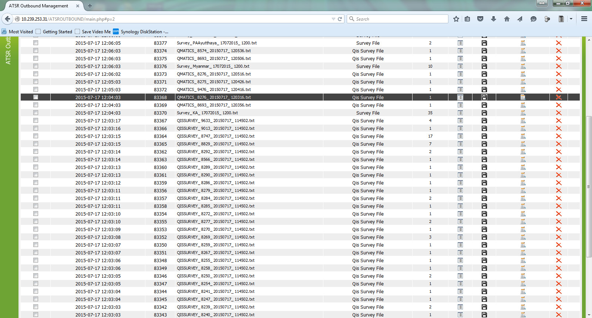
Imported File List

Slide 32
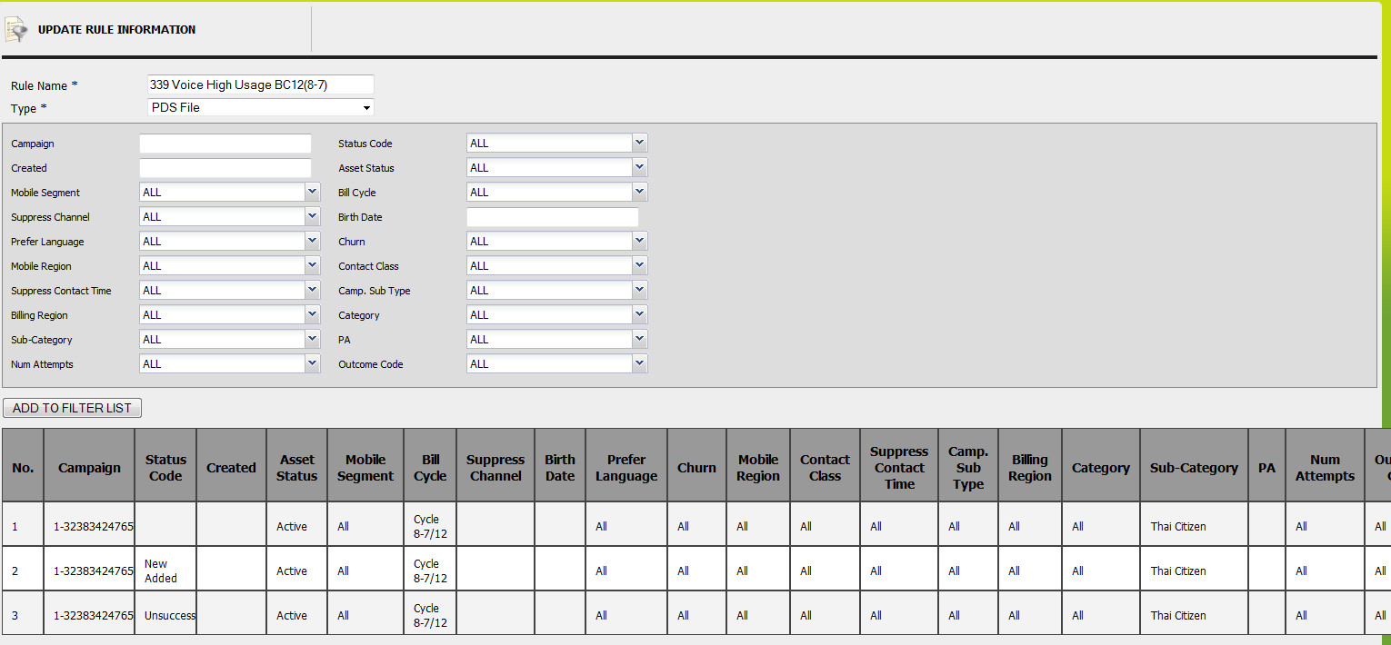
Filter Rule

Slide 33
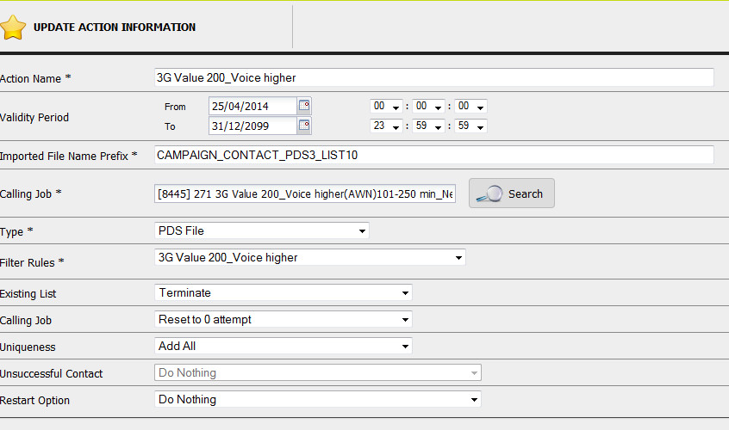
Imported File Action

Slide 34
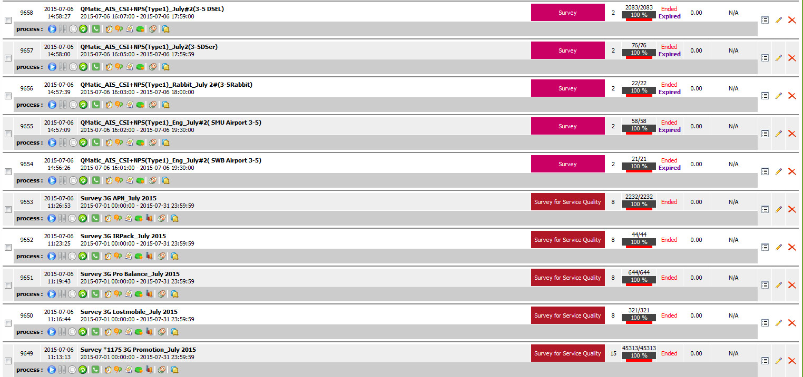
ATSR Outbound Job Management

Slide 35
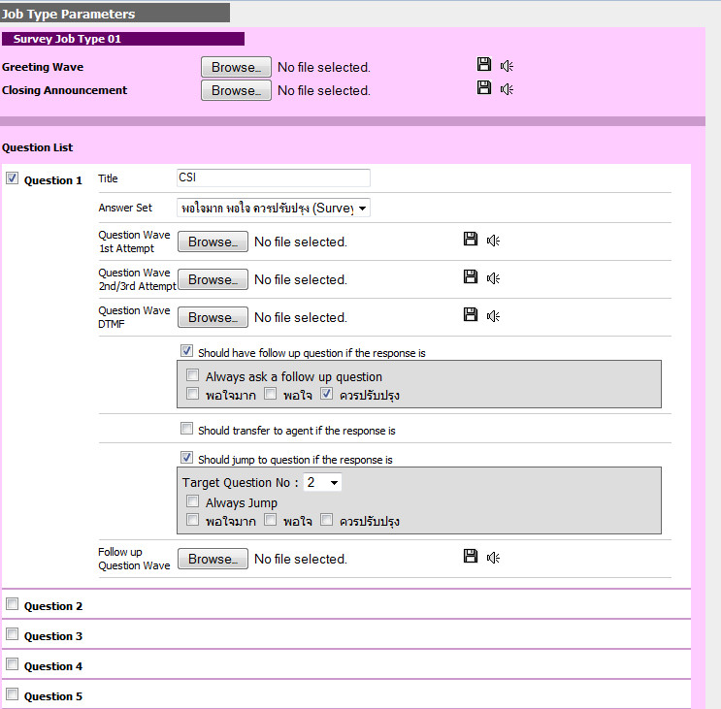
Survey Question Setting

Slide 36
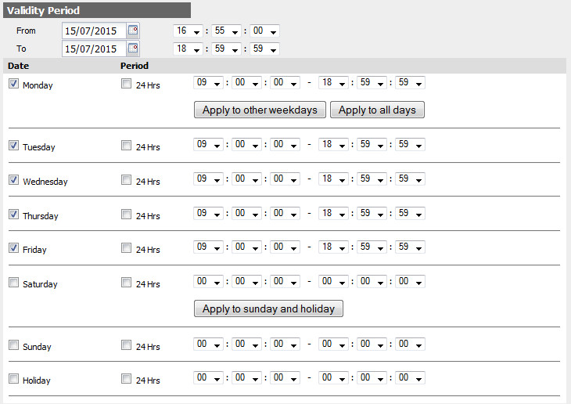
Survey Validity Period

Slide 37
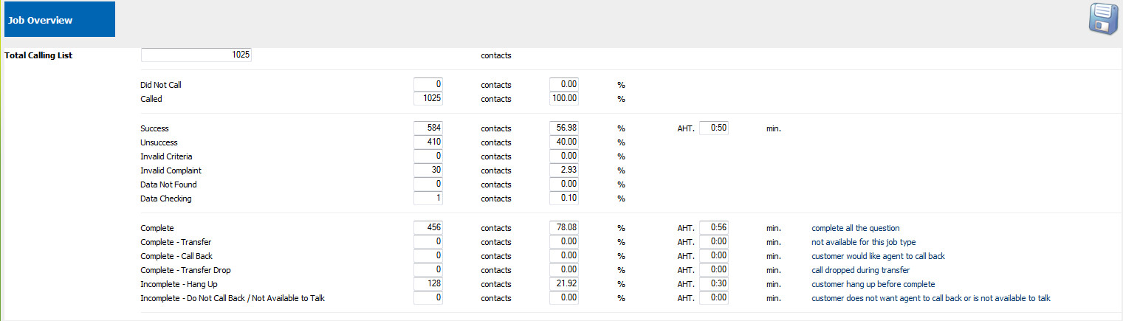
IVR Survey Job Overview

Slide 38
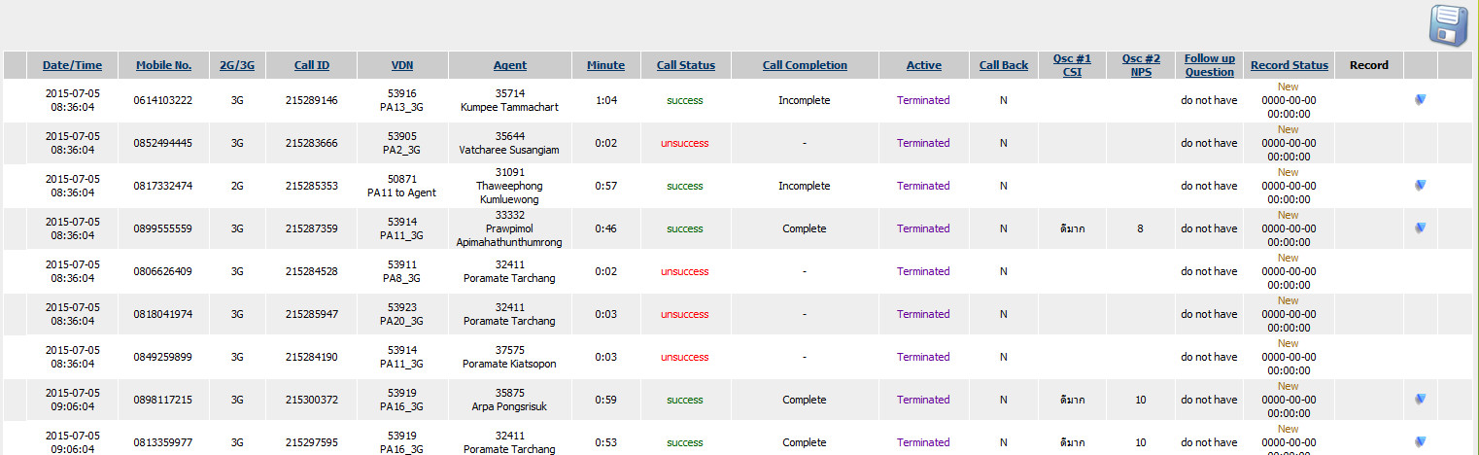
IVR Call History Report

Slide 39
Survey Statistical Report by Agent

Slide 40
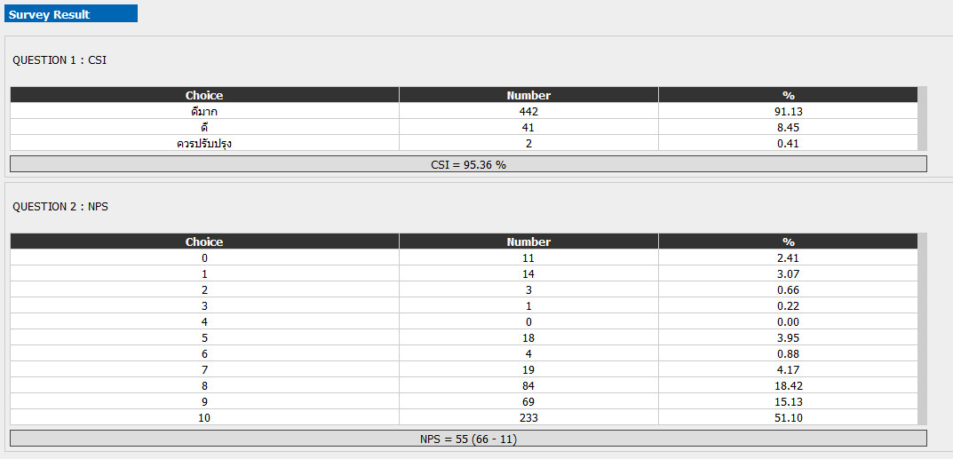
Survey Summary Result

Slide 41
Solutions for ATSR Outbound Enhancement
Enhanced feature on existing ATSR Outbound system
Capacity expansion
Survey engine
Survey to various channels—IVR, Web, SMS, e-Mail, Social Channels (FB/TW)
Survey analysis
Reporting
Sentimental Analysis
Speech-to-Text Transcription

Slide 42
ATSR Outbound Enhancement
Existing ATSR Outbound System
10 Types
Lists
Siebel
PDS
QIS
Qmatic
Manual
AIS Shop
Telewiz
ATSR Outbound System
SMS GW
List
Management
Call Management
IVR
Systems
Agents
Survey
Management
Reporting
Customers
New ATSR Outbound System Enhancement
ATSR Outbound System
SMS GW
10 Types
Lists
Siebel
PDS
QIS
Qmatic
Manual
AIS Shop
Telewiz
List
Management
Call Management
IVR
Systems
Agents
Customers
Web
Facebook
Twitter
Pantip
E-Mail
Web Chat
Web Board
Sentimental Analysis Engine
Survey
Engine
Analysis and Reporting
Speech-to-
Text Engine
ACC Social Media Monitoring System (ACC-SMM)

Slide 43
ATSR Outbound Plan
M1 |  | M2 |  | M3 |  | M4 |  | M5 |  | M6 |  | M7 |  | M8 |  | M9 |  | M10
Jul 15 |  | Aug 15 |  | Sep 15 |  | Oct 15 |  | Nov 15 |  | Dec 15 |  | Jan 16 |  | Feb 16 |  | Mar 16 |  | Apr 16
Interactive Survey Questions
Phase 1
Prod. Deploy 28/9
Phase 2
Capacity Expansion
Phase 2
Phase 2 – Enhancement Features
Prod. Deploy
30/10
Prod. Deploy
29/1
Prod. Deploy
25/3
Phase 1 Interactive Survey Questions
Application enhancement to support interactive survey questions design
Phase 2 Key Outcomes & Scope
Capacity expansion
Survey engine
Survey to various channels—IVR, Web, SMS, e-Mail, Social Channels (FB/TW)
Survey analysis
Reporting
Sentimental Analysis
Speech-to-Text Transcription

Slide 44
ATSR Projects
Projects | Planned Target
Engagement Survey | SEP 2015 – NOV 2015 Phase 1 Deployment 27 OCT Phase 2 Deployment 15 NOV
ATSR Outbound Capacity Expansion | * Proposed by Tellvoice
New ATSR Outbound Survey Framework | * May be combined with Item 4
New Survey Platform Multiple Channels—Voice, SMS, e-Mail, Web Chat, Facebook Reporting—Dashboard and Reports Integrate with NICE recording for reference back to recorded session
Personal Survey/Greeting | Integration with TTS platform
Customer Effort Score | Q1—MAR 2016
Customer Analytic (Speech Analytic)

Slide 45
ATSR Projects
Complete loop—when customer responds to survey with low score, the system alerts and reference back to the voice recording of that call sessions for evaluate. Then call back to customer within 3 hours.
Speech-to-Text engine
Emotion detection

Slide 46
END OF SLIDE

Slide 47
ATSR Roadmap 2015-2016
2015 |  |  |  |  |  |  |  | 2016
SEP |  | OCT |  | NOV |  | DEC |  | JAN |  | FEB |  | MAR |  | APR |  | MAY |  | JUN |  | JUL |  | AUG |  | SEP |  | OCT |  | NOV |  | DEC
Customer Track & Trace
Customer Track & Trace
Phase 3
Ph 1 - 19OCT
Ph 2 – 15DEC
Currently On-going Project
Started in SEP’2015
Phase 1-2 Cost
1.5M Baht
TV SimplySurvey Platform
Phase 1-2 Cost – 12M Baht
Engagement Survey
Phase 1-2 Cost
1M Baht
Phase 1
Phase 2
Ph 1 - 27OCT
Ph 2 – 15NOV
Ph 1 – 31JUL
Ph 2 – 31OCT
Currently On-going Project
IVR Outbound Capacity Expansion
Phase 1
Phase 2
Phase 1-2 Cost
6M Baht
IVR Outbound Capacity Expansion | 6 M Baht
Phase 1 New additional 120 ports (4 E1) with new hardware Phase 2 VM server relocation / VM server expansion New framework to support TV SimplySurvey platform Enhanced features Reporting tools for TV SimplyOutbound
Ph 1 – 15DEC
Ph 2 – 31MAR
Customer Track & Trace | 1.5 M Baht
Phase 1—Trouble Ticket (TT) Go-Live 19OCT Phase 2—Service Request (SR) Go-Live 15DEC Phase 3—Device Repair Tracking
TV SimplySurvey Platform |  | 12 M Baht
Phase 1 TV Simply survey engine Survey template design Survey to various channels—IVR, Web, SMS, e-mail, Social channels (FB/TW) Survey analysis Reporting tools for survey Sentimental analysis | Phase 2 Integrate with ATSR Outbound new framework Integrate with NICE recording to trace back to customer and agent conversation
Engagement Survey | 1 M Baht
Enhanced ATSR Outbound Survey Features Complex condition question and answer Category of customer’s response

Slide 48
ATSR Roadmap 2015-2016
2015 |  |  |  |  |  |  |  | 2016
SEP |  | OCT |  | NOV |  | DEC |  | JAN |  | FEB |  | MAR |  | APR |  | MAY |  | JUN |  | JUL |  | AUG |  | SEP |  | OCT |  | NOV |  | DEC
Customer Track & Trace
Customer Track & Trace
Phase 3
Ph 1 - 19OCT
Ph 2 – 15DEC
Currently On-going Project
Started in SEP’2015
Phase 1-2 Cost
1.5M Baht
TV SimplySurvey Platform
Phase 1-2 Cost – 12M Baht
Engagement Survey
Phase 1-2 Cost
1M Baht
Phase 1
Phase 2
Ph 1 - 27OCT
Ph 2 – 15NOV
Ph 1 – 31JUL
Ph 2 – 31OCT
Currently On-going Project
IVR Outbound Capacity Expansion
Phase 1
Phase 2
Phase 1-2 Cost
6M Baht
IVR Outbound Capacity Expansion | 6 M Baht
Phase 1 New additional 120 ports (4 E1) with new hardware Phase 2 VM server relocation / VM server expansion New framework to support TV SimplySurvey platform Enhanced features Reporting tools for TV SimplyOutbound
Ph 1 – 15DEC
Ph 2 – 31MAR
Customer Track & Trace | 1.5 M Baht
Phase 1—Trouble Ticket (TT) Go-Live 19OCT Phase 2—Service Request (SR) Go-Live 15DEC Phase 3—Device Repair Tracking
TV SimplySurvey Platform |  | 12 M Baht
Phase 1 TV Simply survey engine Survey template design Survey to various channels—IVR, Web, SMS, e-mail, Social channels (FB/TW) Survey analysis Reporting tools for survey Sentimental analysis | Phase 2 Integrate with ATSR Outbound new framework Integrate with NICE recording to trace back to customer and agent conversation
Engagement Survey | 1 M Baht
Enhanced ATSR Outbound Survey Features Complex condition question and answer Category of customer’s response

Slide 49
Overall Roadmaps 2015-2016
2015 |  |  |  |  |  |  |  | 2016
SEP |  | OCT |  | NOV |  | DEC |  | JAN |  | FEB |  | MAR |  | APR |  | MAY |  | JUN |  | JUL |  | AUG |  | SEP |  | OCT |  | NOV |  | DEC
Customer Track & Trace
Customer Track & Trace
Phase 3
Ph 1 - 19OCT
Ph 2 – 15DEC
NO COST
Currently On-going Project
Started in SEP’2015
TV Survey Platform
Engagement Survey
Phase 1
New Survey Engine
Multiple Channels
Reporting
Phase 2
Integration IVR Outbound
Integration ACC-SMM
Survey Analytic Report
Ph 1 - 27OCT
Ph 2 – 15NOV
Currently On-going Project
IVR Outbound Capacity Expansion
Ph 1 – 31JUL
Ph 2 – 31OCT
Phase 1
New 120 Ports
Phase 2
Full Capacity Expansion
with Enhancement Features
Ph 1 – 15DEC
Ph 2 – 31MAR
SMM Corporate E-Mail
Currently On-going Project
Survey Platform Integration
Phase 1
Interim Solution
Phase 2
Full Solution
Survey Platform Integration
* Included with Phase 2
TV Survey Platform
Ph 1 – 24NOV
Ph 2 – 31MAR
Prod – 31AUG
PANTIP New Web Service
Social Analytic
PANTIP New Web Service
Commercial Deal
Technical Implementation
Social Analytic
S-Sense Integration
Analytical Tools
Prod – 31MAR
Prod – 30NOV

Slide 50
ATSR Outbound Plan
2015 |  |  |  |  |  |  |  | 2016
SEP |  | OCT |  | NOV |  | DEC |  | JAN |  | FEB |  | MAR |  | APR |  | MAY |  | JUN |  | JUL |  | AUG |  | SEP |  | OCT |  | NOV |  | DEC
Engagement Survey
TV Survey Platform
Ph 1 - 27OCT
Ph 2 – 15NOV
Phase 1
New 120 Ports
Phase 2
Enhancement Features
Currently On-going Project
Ph 1 – 15DEC
Ph 2 – 31MAR
IVR Outbound Capacity Expansion
Phase 1
New 120 Ports
Phase 2
Enhancement Features
Ph 1 – 15DEC
Ph 2 – 31MAR
Customer Track & Trace
Customer Track & Trace
Phase 3
Ph 1 - 19OCT
Ph 2 – 15DEC
Currently On-going Project
Started in SEP’2015
Phase 1 Interactive Survey Questions
Application enhancement to support interactive survey questions design
Phase 2 Key Outcomes & Scope
Capacity expansion
Survey engine
Survey to various channels—IVR, Web, SMS, e-Mail, Social Channels (FB/TW)
Survey analysis
Reporting
Sentimental Analysis
Speech-to-Text Transcription

Slide 51
The Big Picture
FB
TW
WEB CHAT
CUSTOMER
MOBILE
ACC SOCIAL MEDIA
MONITORING
SURVEY
ENGINE
ATSR
OUTBOUND
WEB BOARD
EMAIL
PANTIP

Slide 52
ATSR Outbound Existing Modules
Agents
10 Types
Lists
Siebel
PDS
QIS
Qmatic
Manual
List Management
Call Management
IVR1
IVR2
SMS
Gateway

Slide 53
ATSR Outbound New Modules
Agents
10 Types
Lists
Siebel
PDS
QIS
Qmatic
Manual
List Management
Call Management
IVR1
IVR2
SMS
Gateway
Survey Analysis and Reporting
Survey
Engine
Web
Social Media
E-Mail
Sentimental
Analysis
Speech-to-Text
Engine

Slide 54
ACC-SMM Roadmap 2015-2016
2015 |  |  |  |  |  |  |  | 2016
SEP |  | OCT |  | NOV |  | DEC |  | JAN |  | FEB |  | MAR |  | APR |  | MAY |  | JUN |  | JUL |  | AUG |  | SEP |  | OCT |  | NOV |  | DEC
SMM Corporate E-Mail and Web Chat
Currently On-going Project
Phase 1-2 Cost
2 M Baht
TV SimplySurvey Platform Integration
Phase 1
Interim Solution
Phase 2
Full Solution
Survey Platform Integration
* Included with Phase 2
TV Survey Platform
Ph 1 – 30NOV
Ph 2 – 31MAR
Prod – 31AUG
PANTIP New Web Service
Social Analytic
PANTIP New Web Service
Commercial Deal
Technical Implementation
Social Analytic
S-Sense Integration
Analytical Tools
Cost – 1 M Baht
Prod – 31MAR
Cost – 4M Baht
Prod – 30NOV
SMM Corporate E-Mail and Web Chat | 2 M Baht
Phase 1 Interim solution with separated domain Partial features for corporate e-mail
Phase 2 Complete solution within single SMM platform Complete enhanced corporate e-mail features
TV SimplySurvey Platform Integration
Phase 2 of TV SImplySurvey Platform Integration with SMM with TV SimplySurvey Platform Cost included with the other project
Social Analytic | 4 M Baht
Integrate to TV survey platform Sentimental analysis of AIS customers Sentimental analysis of competitors Identify customer intention, sentiment Comparison of 2 products/services Cloud keyword tag
PANTIP New Web Service | 1 M Baht
New PANTIP API implementation in SMM

