Slide 1
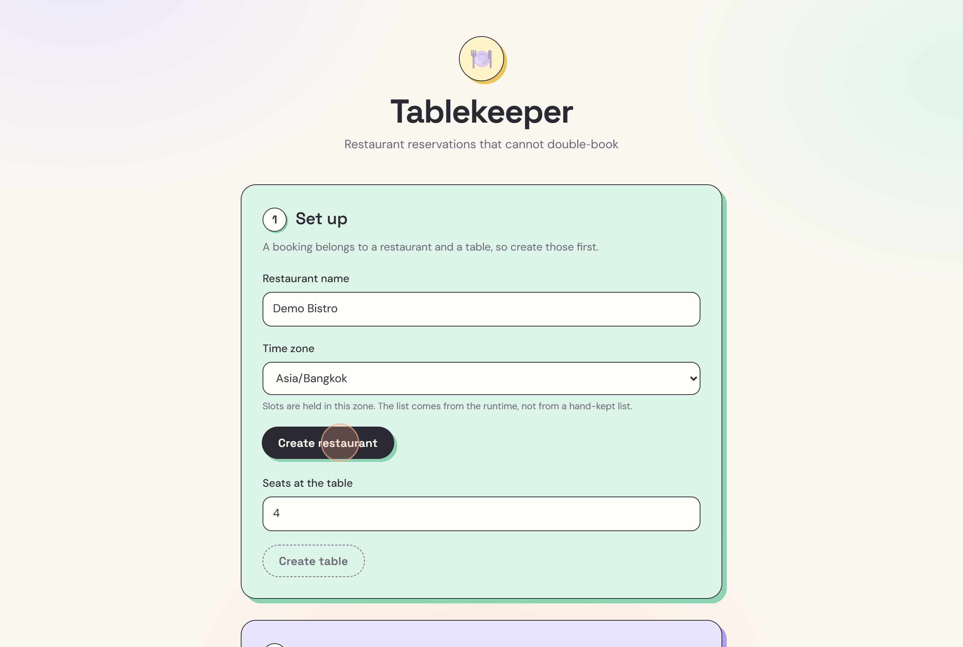
Tablekeeper
LIVE PRODUCT DEMO
Restaurant reservations that cannot double‑book.
0
57
0
double-bookings
tests passing
runtime dependencies
Notes:
Tablekeeper is a restaurant booking system with one promise: it never gives the same table to two parties at the same time. Not when two people click at once, not when a request is retried, and not when the clocks change. I will show the product live, then show how we know the promise holds.

Slide 2
One table, two parties, one bad night
01 THE PROBLEM
01
02
03
Simultaneous clicks
Retried requests
Clock changes
Two guests book the last table in the same second. A system that checks first and writes second lets both through.
A dropped connection or an impatient double-click sends the same booking twice, and creates two.
On daylight-saving nights 02:30 never happens, and 01:30 happens twice. Guessing moves a booking by an hour.
Tablekeeper closes all three in one place: the database, not the app code.
Notes:
Double-bookings come from three places. Two people racing for the same table. The same request arriving twice. And clock changes, where a time either does not exist or exists twice. Tablekeeper handles all three at the database layer.

Slide 3
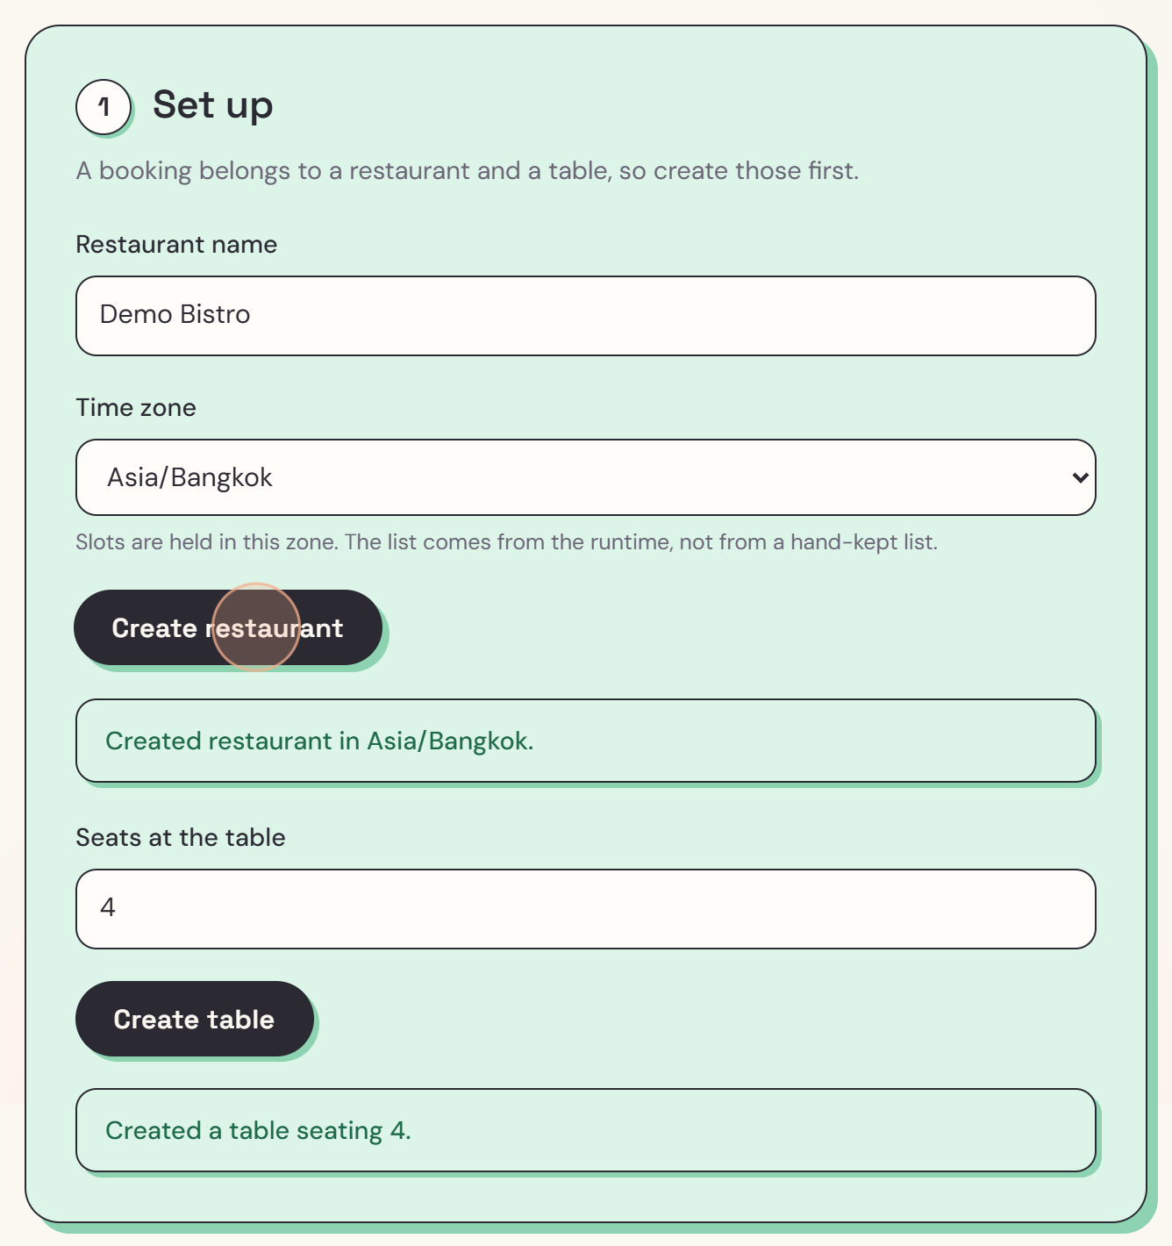
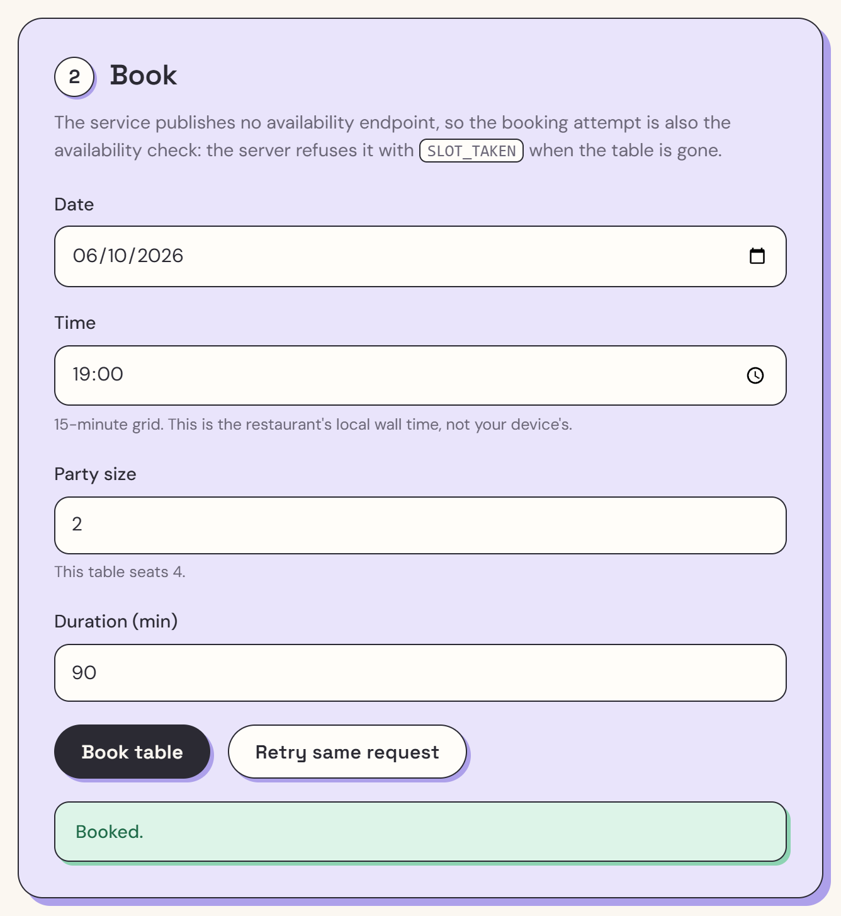
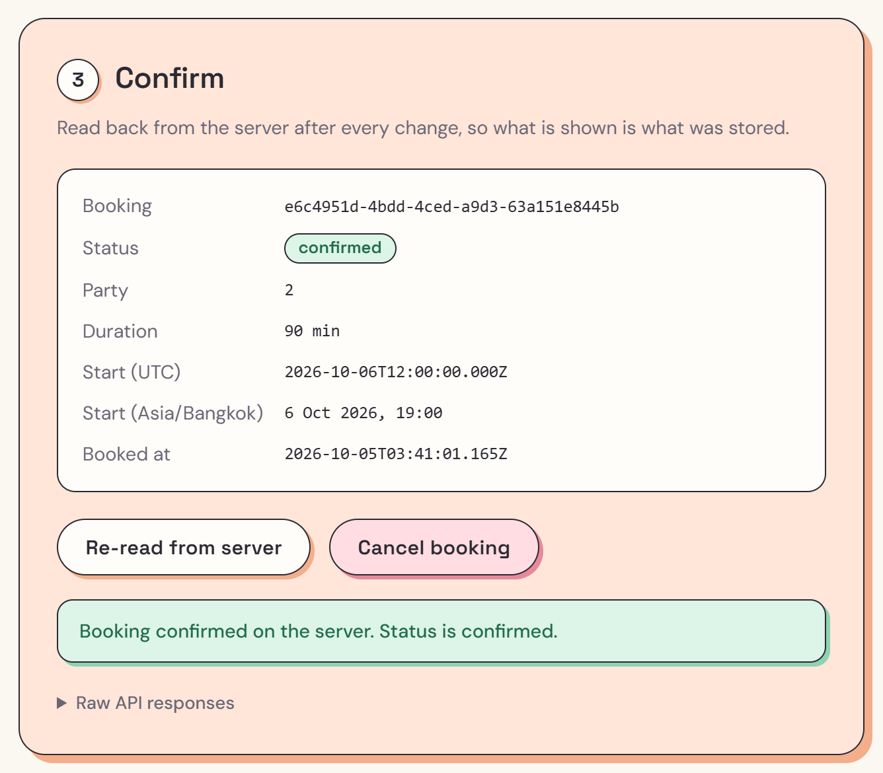
Three steps from set up to confirmed
02 THE PRODUCT
1 Set up
2 Book
3 Confirm
Create a restaurant in its own time zone, then add a table.
Choose a date, time, party size and duration.
Read back from the server, so what you see is what was stored.
Notes:
Demo: in Set up, keep Demo Bistro, choose a time zone, click Create restaurant, then Create table. In Book, pick tomorrow at 19:00 for 2 people, 90 minutes, and click Book table. Scroll to Confirm: everything shown is read back from the server, with the start time in UTC and in the restaurant's local time.

Slide 4

Press it twice, get one booking
03 RETRIES
Same request, same answer
Every booking carries a key tied to its content. Sending it again returns the original booking, never a second one.
Change anything, new request
Edit the time, party size or duration and a fresh key is made, so it counts as a new booking.
Safe on bad networks
A timeout or a busy server can be retried freely. Nothing is booked twice.
Notes:
Demo: click Retry same request. The page says Already booked, this request replayed the original booking. Double-clicks and dropped connections can never create a second booking.

Slide 5
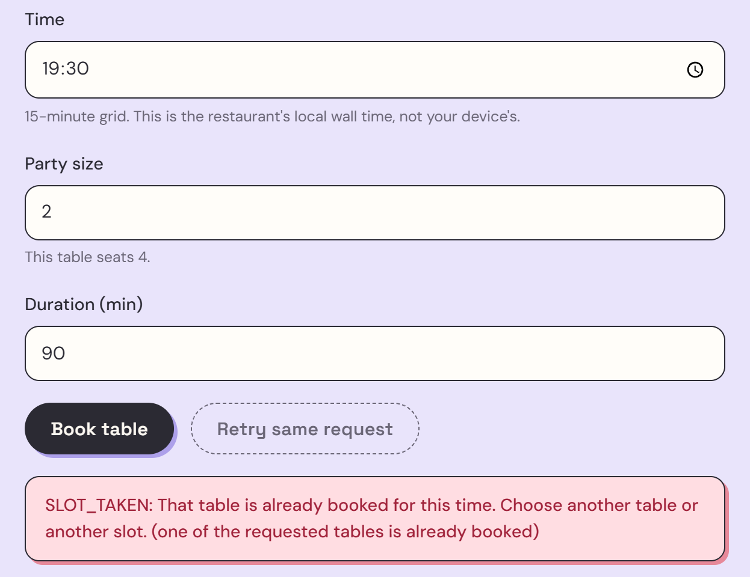
Overlaps are refused by the database itself
04 THE GUARANTEE
One row per table, per 15-minute block
Existing booking 19:00 for 90 min
New request 19:30 for 90 min
19:00
19:30
20:00
20:30
21:00
4 blocks are already taken, so the new row is refused: SLOT_TAKEN
PRIMARY KEY (table, block)
The only check. No locks, no availability lookup first.
Notes:
Demo: change the time to 19:30 and click Book table. It is refused with SLOT_TAKEN because it overlaps the 19:00 booking. Under the hood every booking is stored as 15-minute blocks, and a table can hold each block only once. Then change the time to 21:00 and book again: that one succeeds.

Slide 6
Twenty requests at once. One booking.
05 PROOF
1
19
57
12
booking created
refused with SLOT_TAKEN
automated tests passing
processes racing one database file in the tests
$ node stage-4/demo-race.mjs 20
request 1 -> 201 BOOKED
request 2 -> 409 SLOT_TAKEN
... 18 more requests, all 409 SLOT_TAKEN
1 booked, 19 refused. Zero double-bookings.
Notes:
This is a live run on this machine: twenty booking requests for the same table and the same time, fired at the same instant. Exactly one wins and nineteen are refused. Request 1 is not special: whichever reaches the database first wins. The automated suite goes further, with 12 separate processes racing on one database file.

Slide 7
Booked in the restaurant's time, not the guest's
06 TIME
Spring forward
02:30 on a spring-forward night does not exist. It is refused, never guessed.
Fall back
01:30 on a fall-back night happens twice. The request must say which one.
Stored once in UTC. Shown in the restaurant's own time zone, whatever device the guest uses.
Any zone, any server
Tested with zones like Kathmandu (+05:45). The server's own time zone plays no part.
Notes:
Times are stored once in UTC and shown in the restaurant's time zone. On daylight-saving nights, a time that does not exist is refused, and a time that happens twice must say which one is meant. The server's own clock setting never changes the answer.

Slide 8
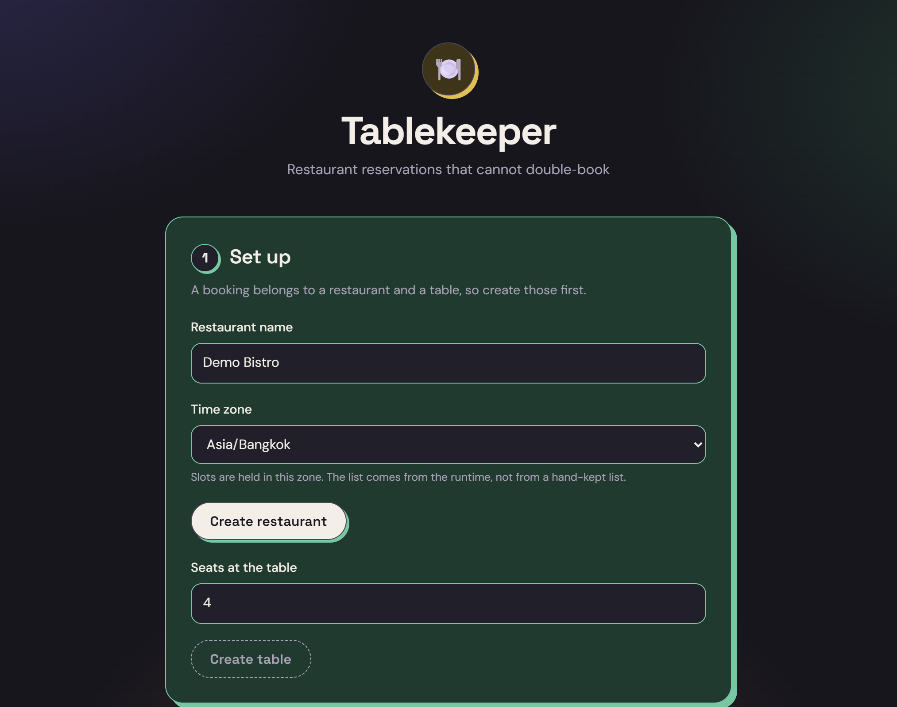
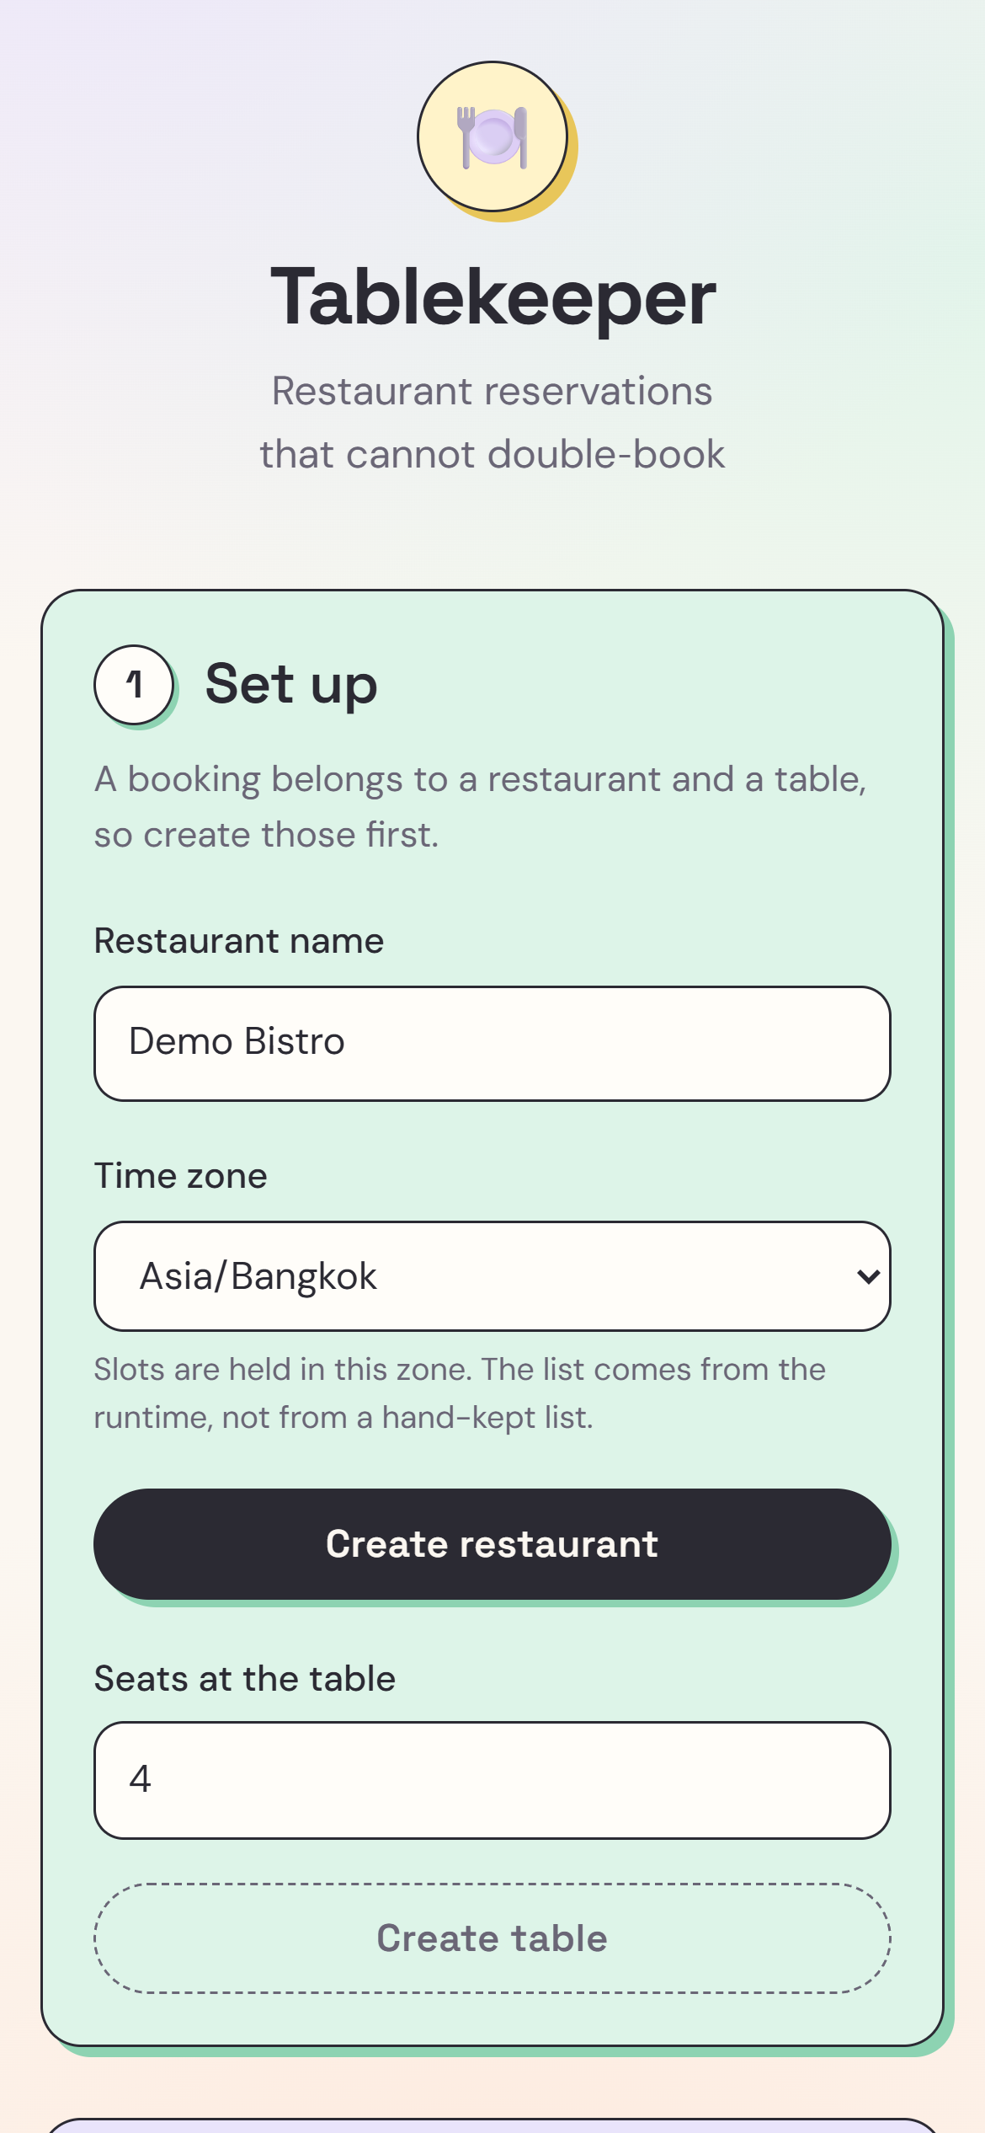
Soft, clear, and at home on any screen
07 EXPERIENCE
Light
Dark
Phone
Pastel steps and a cursor that follows you.
Follows the system setting automatically.
One column, full-width buttons.
Notes:
The interface uses soft pastel cards, one per step, with a custom cursor that grows over anything clickable. It follows the system dark mode and collapses to a single column on phones.

Slide 9
Built in four stages, each proven before the next
08 UNDER THE HOOD
STAGE 1
STAGE 2
STAGE 3
STAGE 4
Booking core
Availability search
Hardening
Product
The no-double-booking guarantee, proven with 12 processes racing one database file.
Search never offers a slot the booking step would refuse. A parity test proves it.
Auth, rate limits, an audit trail, migrations and a wide time zone suite.
This interface: book, retry, confirm and cancel, in light, dark and on phones.
Zero runtime dependencies: just Node.js and its built-in SQLite.
Notes:
The project was built in four stages, and each stage had to prove its claims before the next one opened. The guarantee came first, then search, then hardening, and finally the product you just saw. It runs on Node.js alone.

Slide 10
Zero double-bookings.
THANK YOU
Tablekeeper: restaurant reservations you can trust.
github.com/natchaphat5106-collab/dark-factory-tablekeeper
Notes:
One promise, kept at the database: zero double-bookings. Thank you. Happy to take questions.

