Slide 1
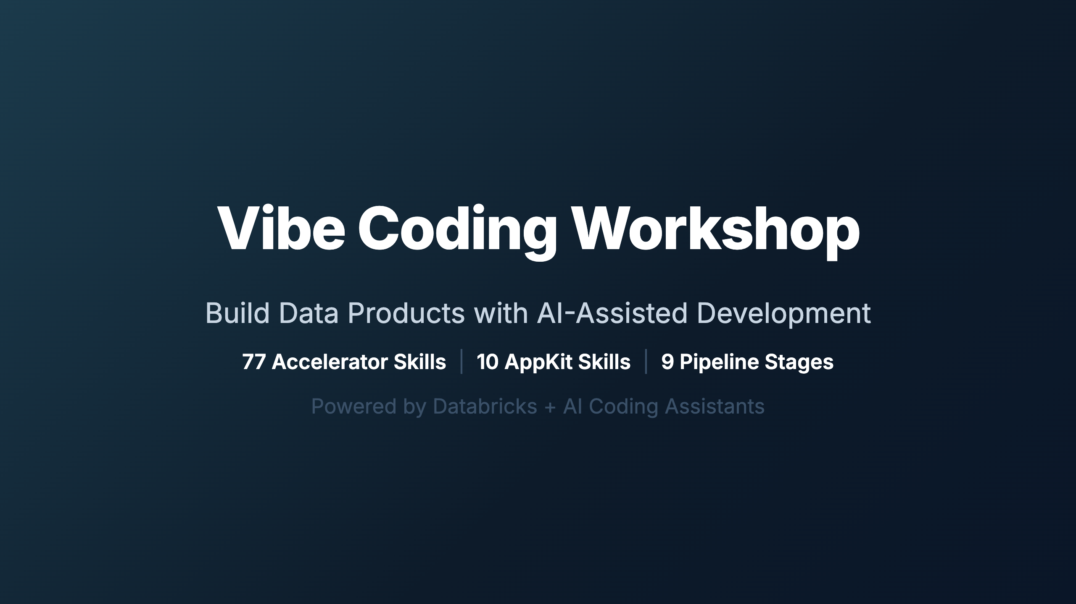
Notes:
_transition: cover Speaker: Welcome everyone to the Vibe Coding Workshop. Over the next session, we'll take an animated journey through the entire framework — from raw schema CSVs to production data products, Databricks Apps, and AI agents. Everything is driven by agent skills that encode best practices into reusable, AI-readable instructions. Timing: ~2 min for introductions and orientation.

Slide 2
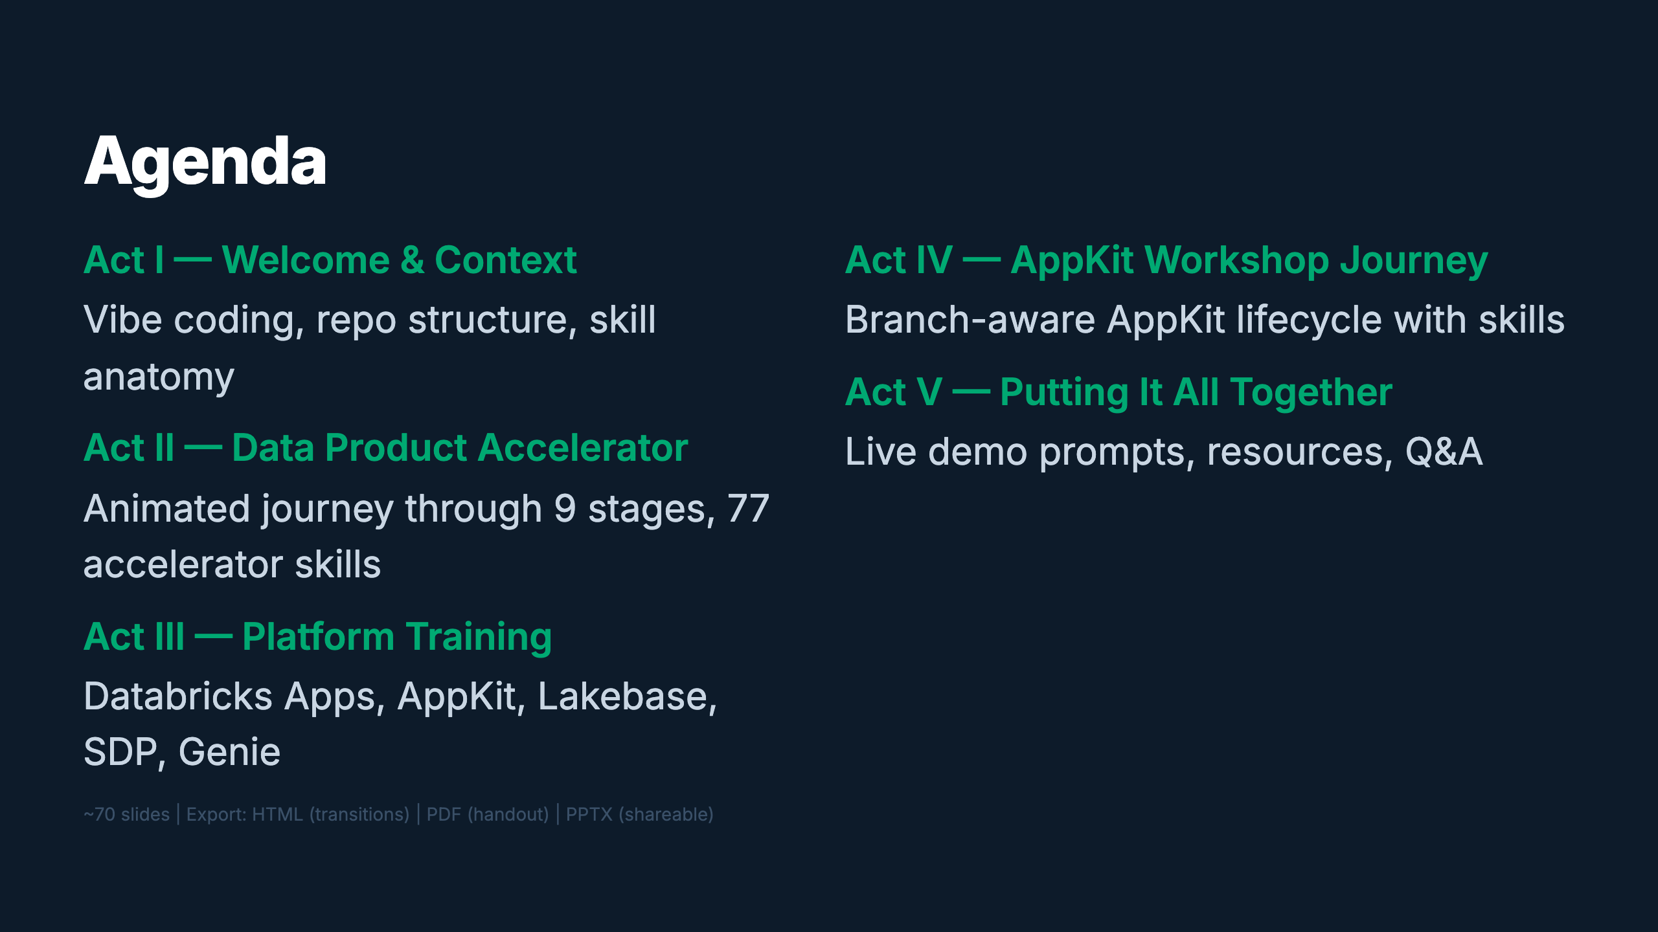
Notes:
Speaker: Here's the roadmap. We start with concepts, then dive into the 9-stage data pipeline animated as a journey through skill trees. Next, platform training on the building blocks. Then hands-on with AppKit. Finally, you'll get copy-paste prompts to try it yourself. Timing: ~1 min

Slide 3
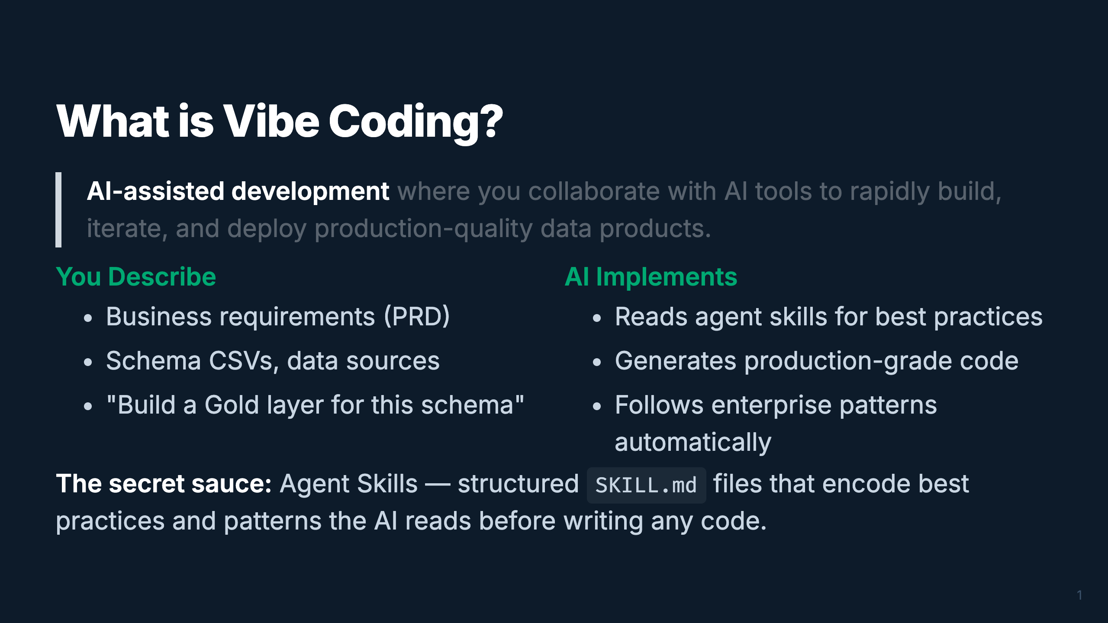
Notes:
_transition: cover Speaker: Vibe coding flips the ratio — you spend more time describing WHAT you want and less time writing HOW. The AI handles implementation, guided by 59 agent skills that encode Databricks best practices. You're the architect; the AI is the builder. Timing: ~2 min

Slide 4
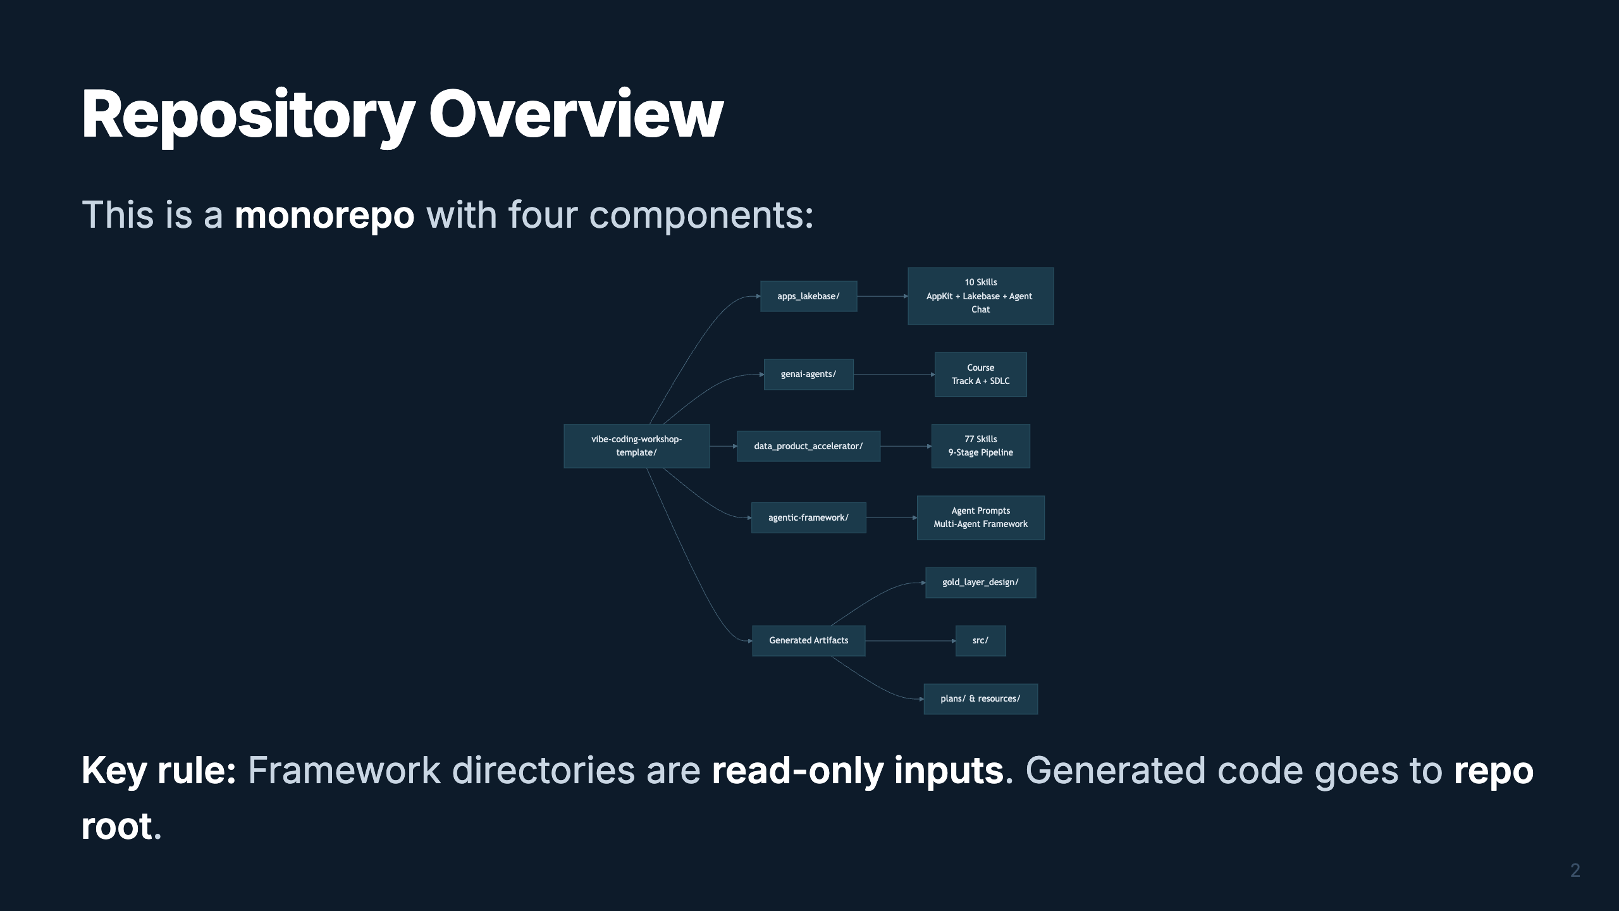
Notes:
Speaker: Four components live here. The Data Product Accelerator has 77 skills for the full medallion architecture, AppKit has 10 skills for apps and agent chat, and the standalone genai-agents course owns the Track A + SDLC agent path. The Agentic Framework is for multi-agent systems. All generated code goes to the repo root — never inside the framework dirs. Timing: ~2 min

Slide 5
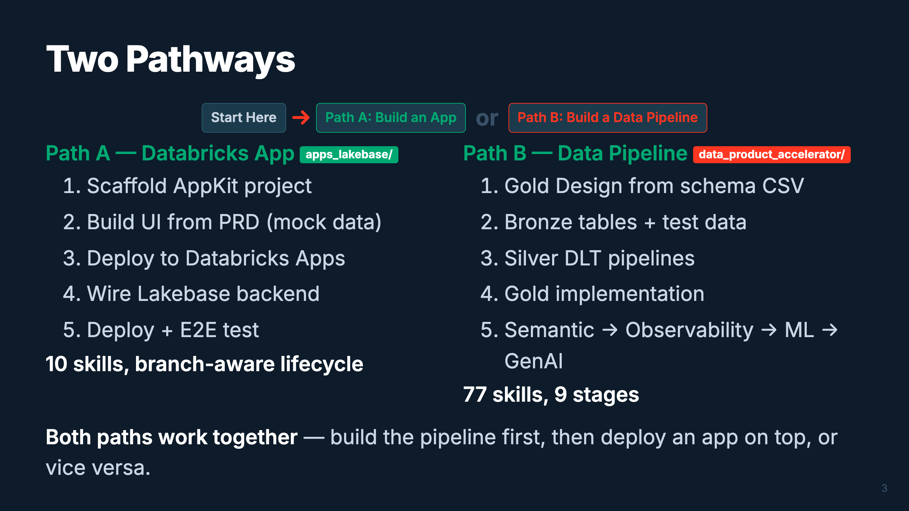
Notes:
Speaker: Two entry points, same destination. Path A is for the "I want an app" crowd — build a full-stack Databricks App through a branch-aware lifecycle. Path B is for the data engineers — design-first pipeline through the full medallion architecture. They converge: your app can query your pipeline's Gold tables. Timing: ~2 min

Slide 6
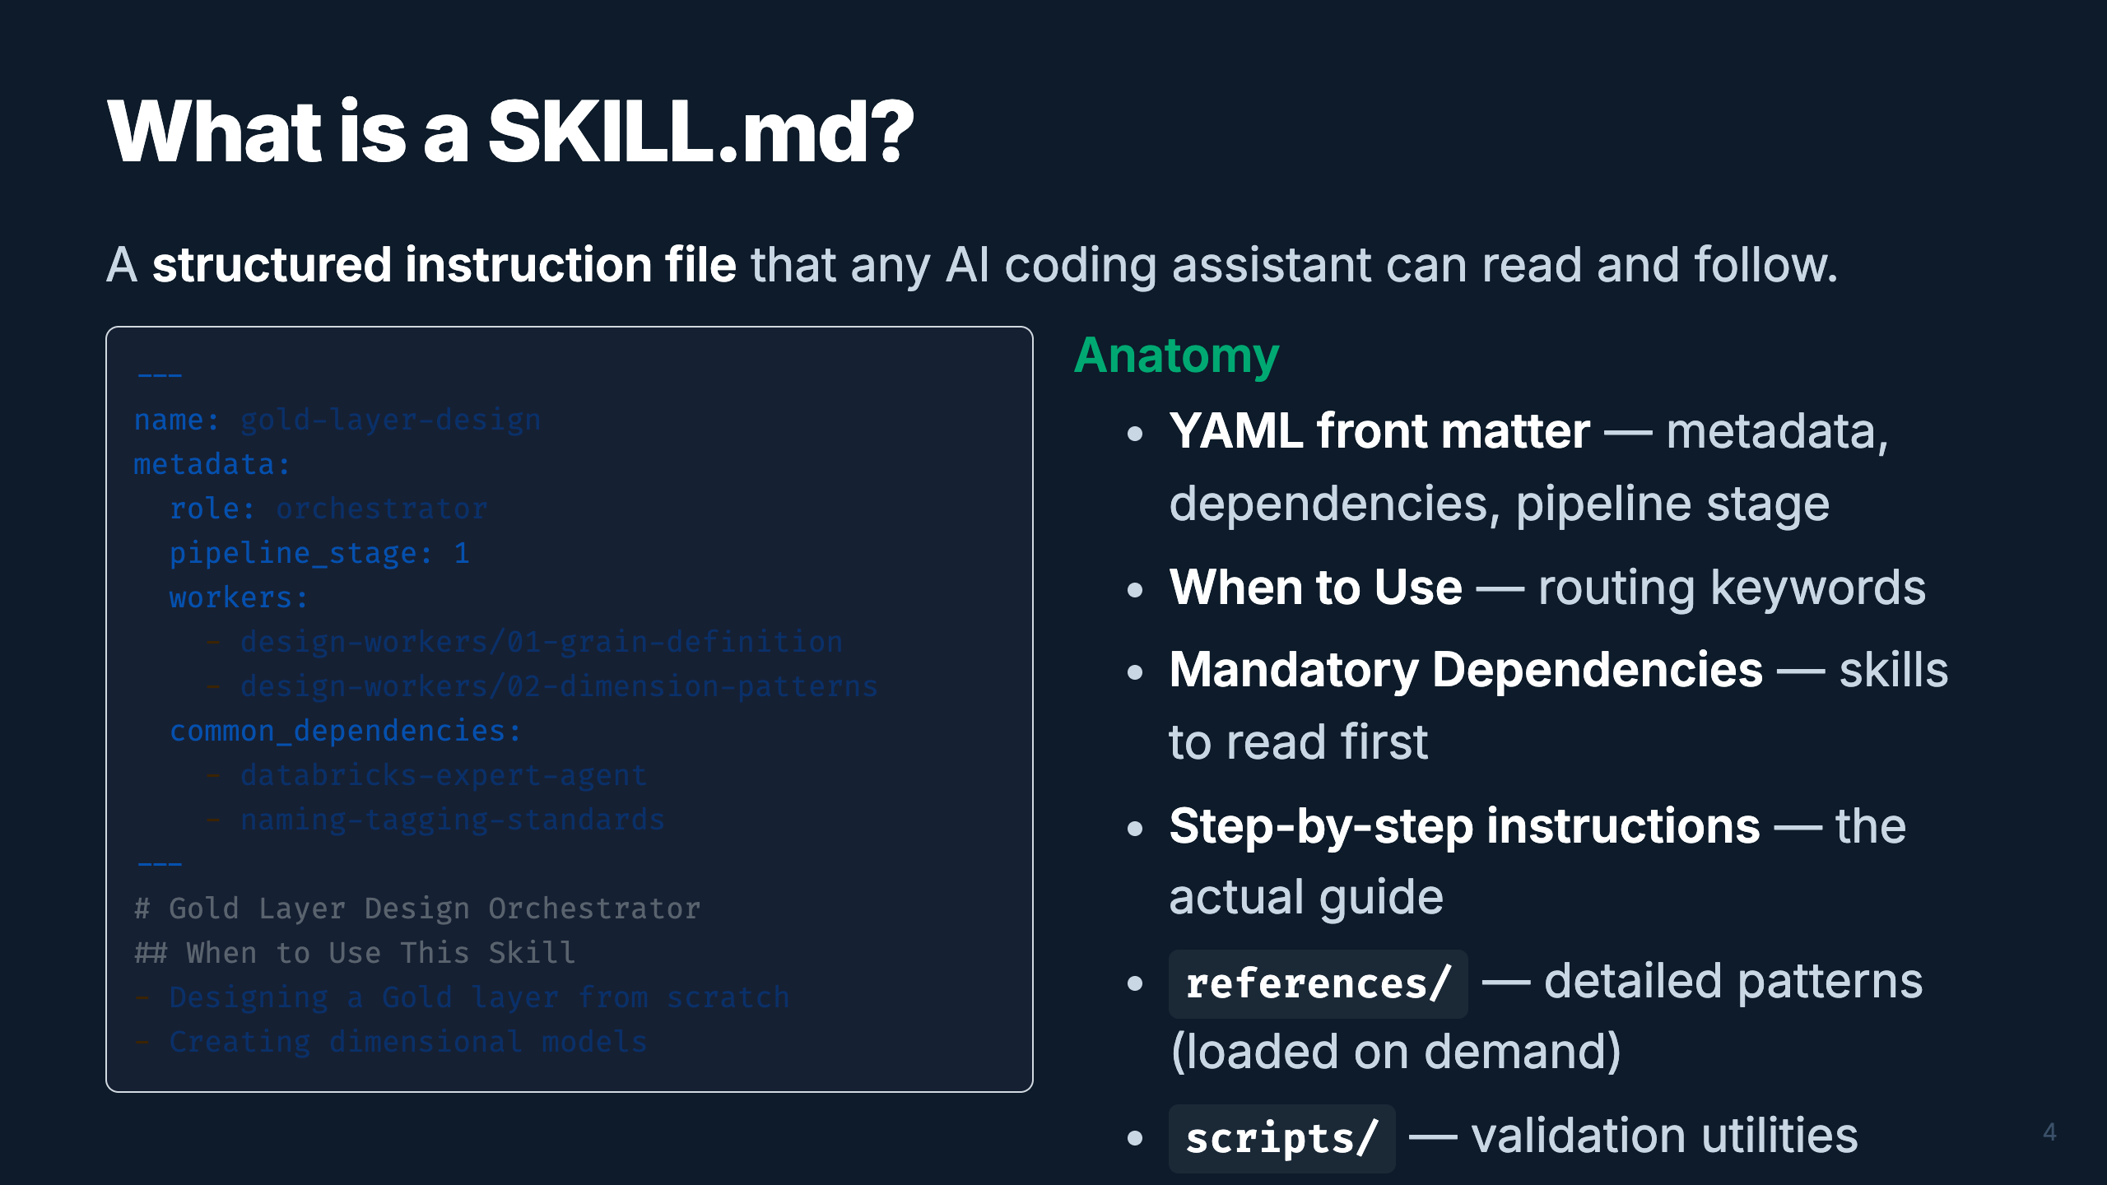
Notes:
Speaker: Every skill follows the same structure. YAML front matter has machine-readable metadata for routing. The body has human-readable instructions. References directories hold the heavy content, loaded only when needed. This keeps each SKILL.md under 2K tokens — lightweight for the AI's context window. Timing: ~2 min

Slide 7
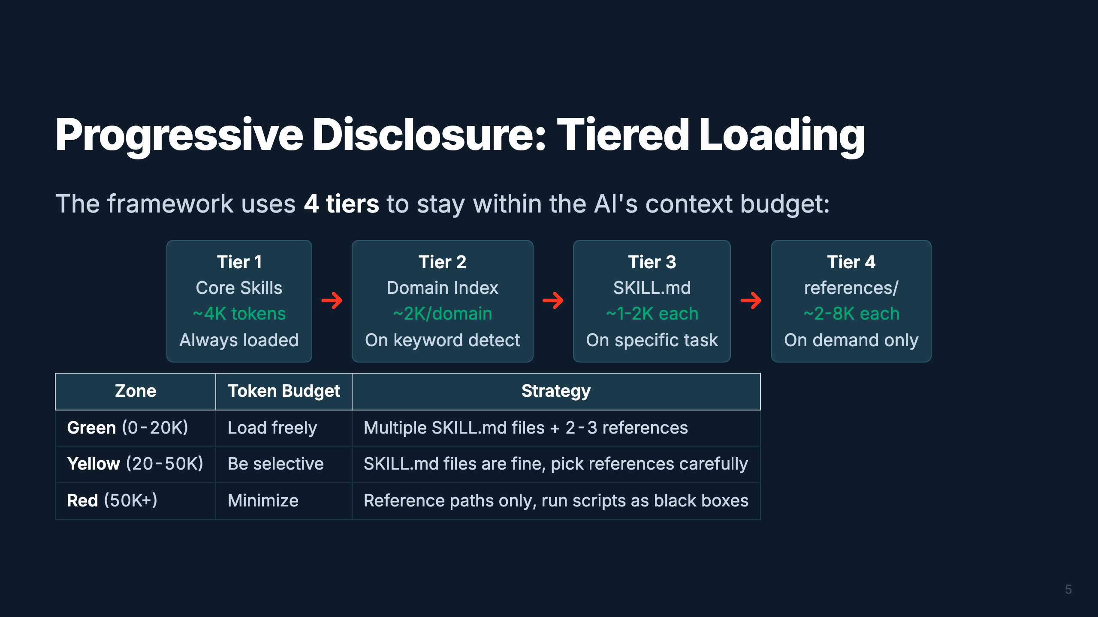
Notes:
Speaker: Why tiers? Claude Opus has a 200K token window, but performance drops if you overload it. We keep the operating budget at 40-60K tokens. Tier 1 is always loaded. Each subsequent tier loads only what's needed for the current task. This is how 77 skills fit without blowing the context. Timing: ~2 min

Slide 8
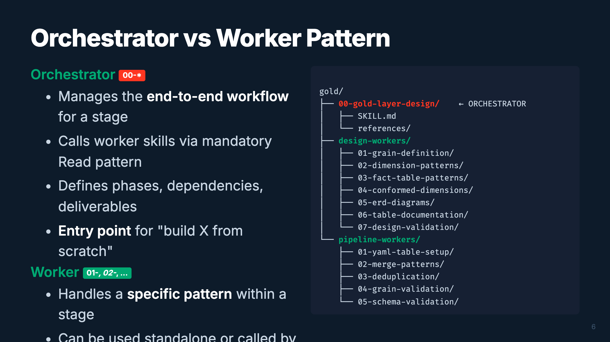
Notes:
Speaker: The orchestrator/worker pattern is the backbone of the framework. Orchestrators are your "00-" numbered entry points — they manage the full workflow for a pipeline stage. Workers are the specialists — they handle one specific pattern. The Gold domain is unique: it has two sub-groups of workers (design-time vs implementation-time). Timing: ~2 min

Slide 9
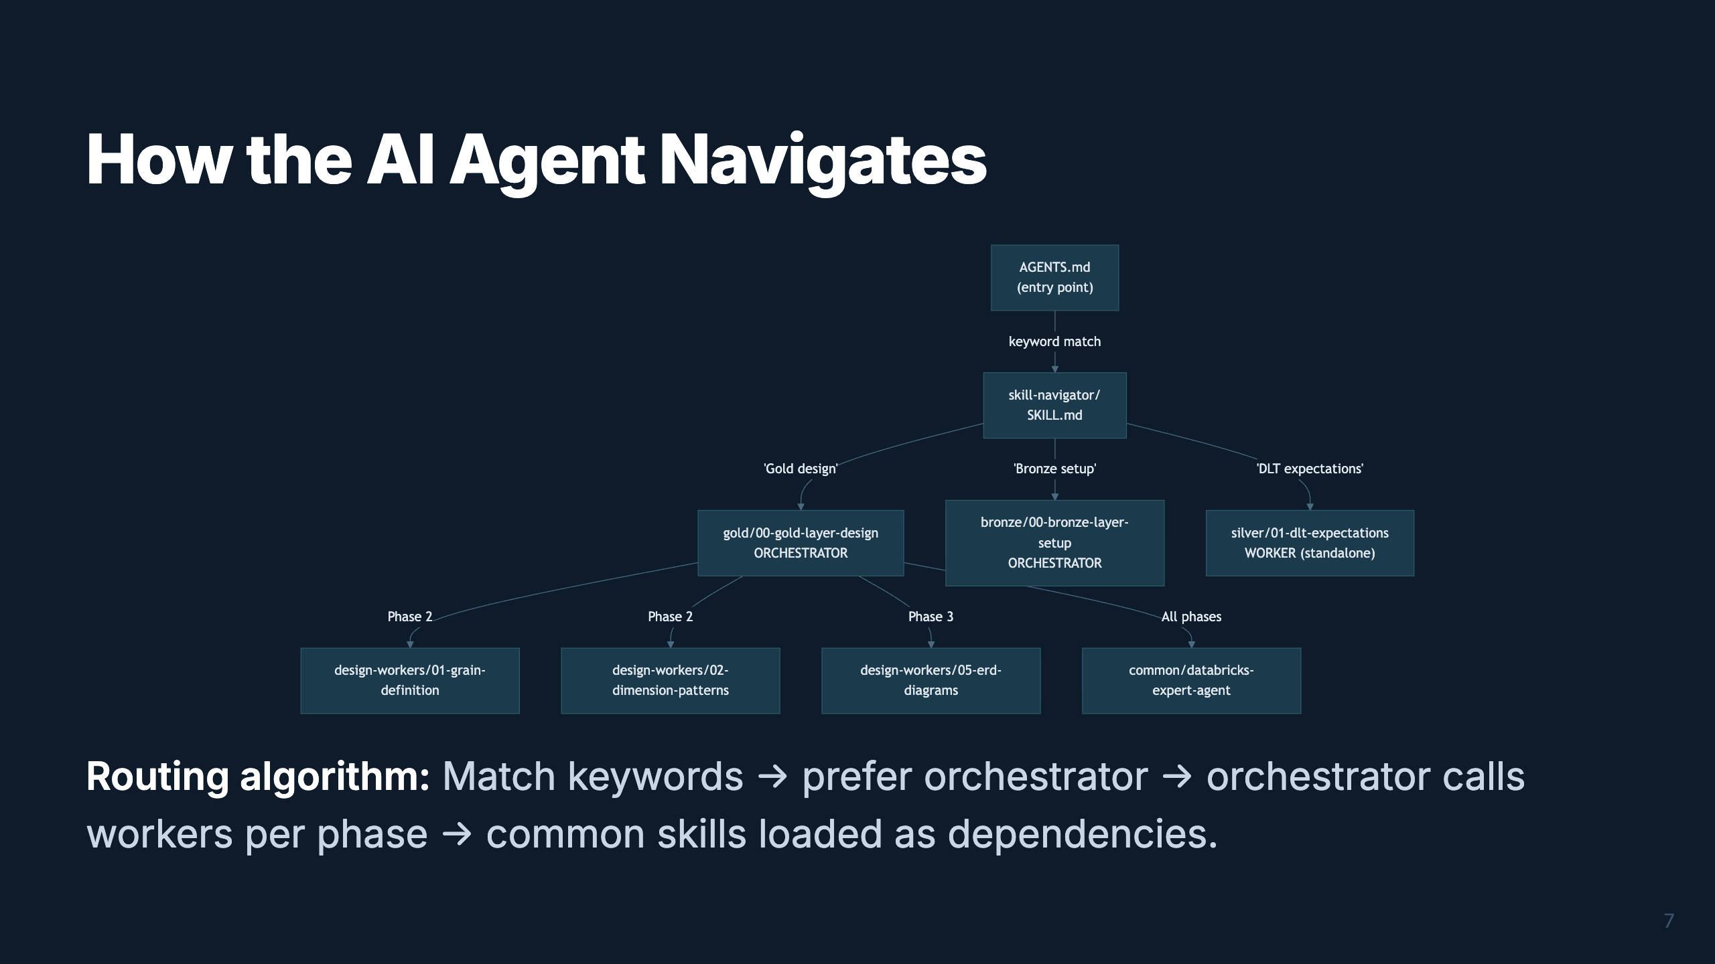
Notes:
Speaker: This is the navigation flow. The AI reads AGENTS.md at the repo root, which routes to the skill-navigator. The navigator matches keywords to the right orchestrator or worker. Orchestrators then progressively load workers phase by phase. Common skills like naming-standards and expert-agent are loaded as cross-cutting dependencies. Timing: ~2 min

Slide 10
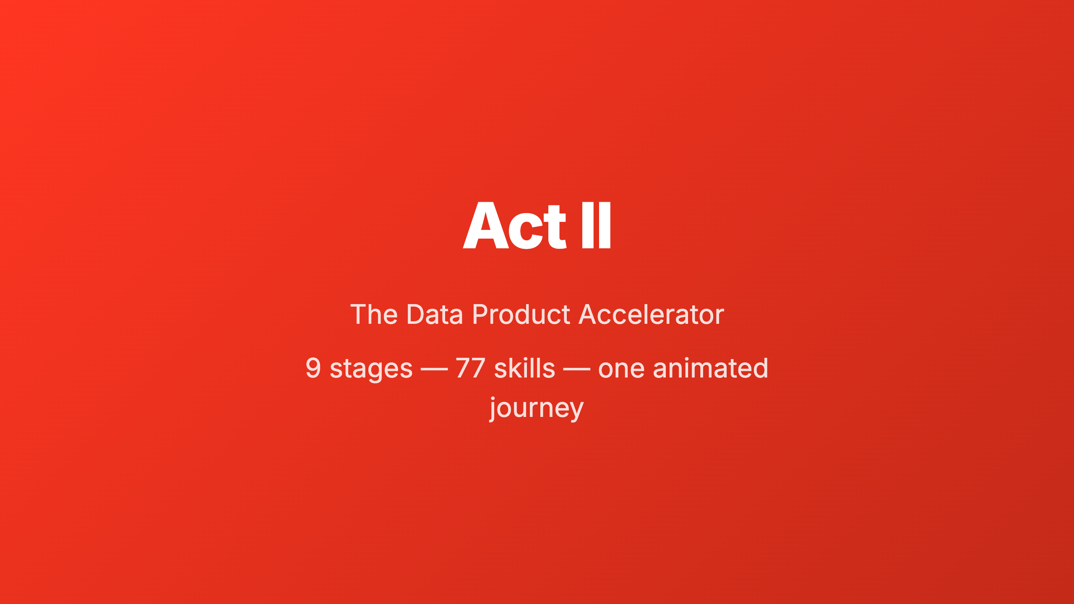
Notes:
_transition: cover Speaker: Now let's walk through the entire Data Product Accelerator pipeline. I'll show you each of the 9 stages as a journey through the skill tree, progressively revealing how the orchestrators and workers connect. Watch the pipeline bar at the top — it tracks our position. Timing: ~30 sec transition

Slide 11
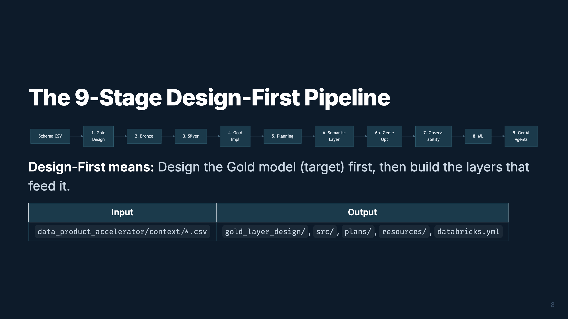
Notes:
Speaker: This is the full pipeline. It starts with a customer schema CSV and ends with GenAI agents in production. The key insight is "design-first" — you design the Gold dimensional model BEFORE building Bronze and Silver. This prevents rework. Let's walk through each stage. Timing: ~2 min

Slide 12
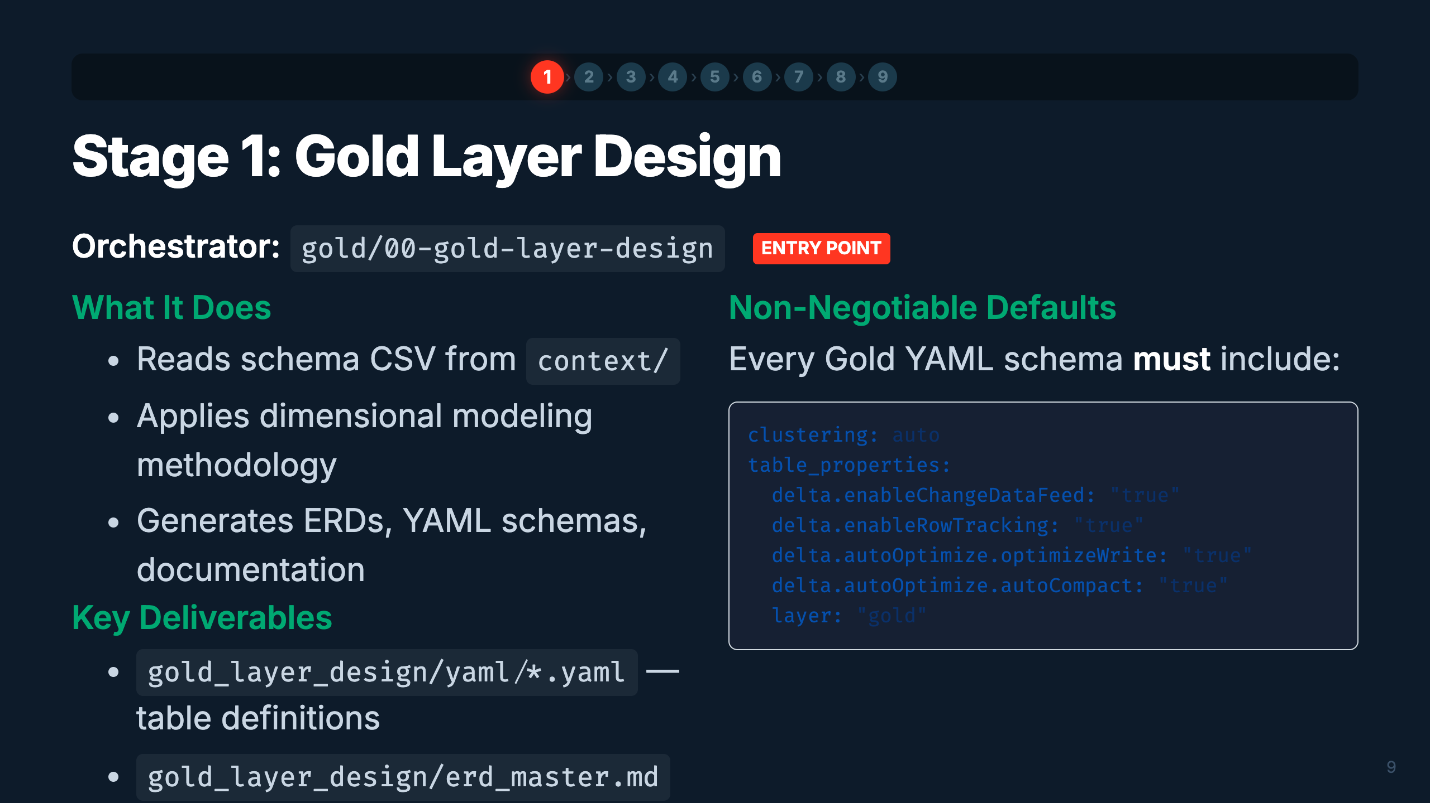
Notes:
Speaker: Stage 1 is where everything begins. You feed in a schema CSV and the orchestrator drives dimensional modeling — grains, dimensions, facts, conformed dimensions, ERDs, and documentation. The YAML schemas it produces become the contract that drives ALL downstream stages. Notice the non-negotiable defaults — every table gets auto liquid clustering, change data feed, etc. Timing: ~3 min

Slide 13
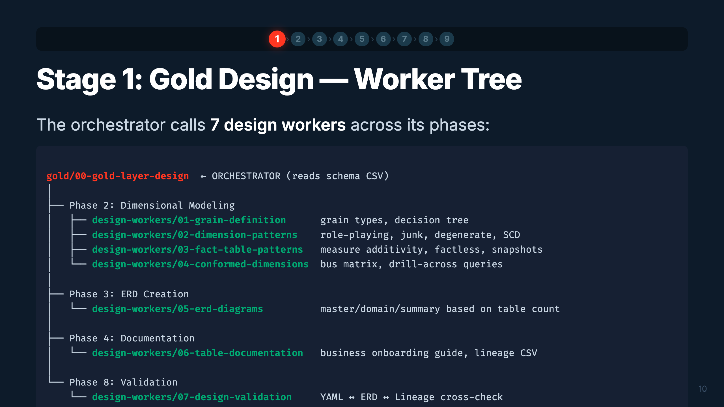
Notes:
Speaker: Here's the worker tree for Gold Design. Each worker is loaded by the orchestrator at the right phase. Grain definition comes first — it determines the granularity of each fact table. Then dimension and fact patterns. ERDs get created, then documentation, and finally validation cross-checks everything. The orchestrator manages the sequence. Timing: ~2 min

Slide 14
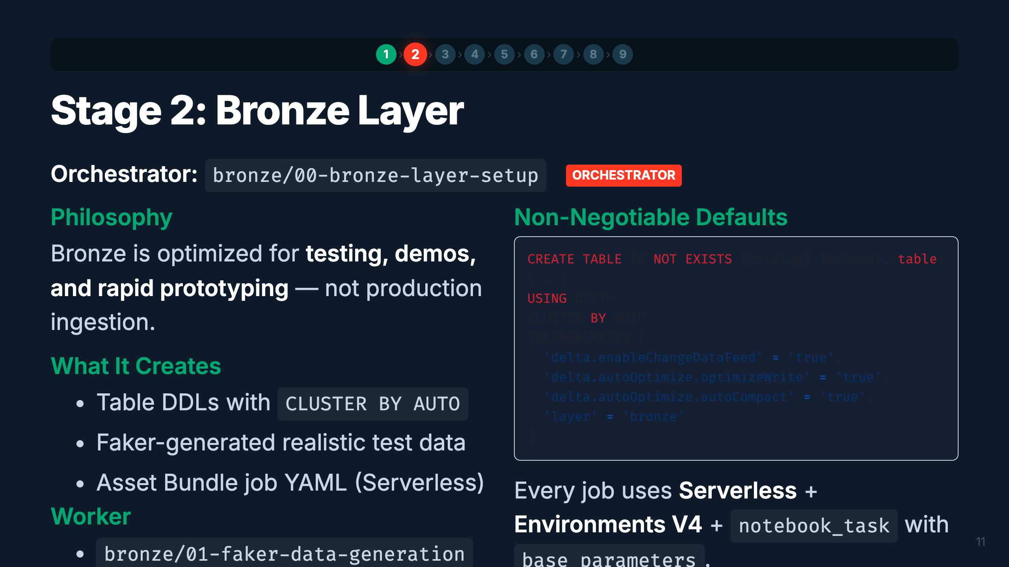
Notes:
Speaker: Bronze is our test data factory. The orchestrator reads the same schema CSV and creates DDLs that match the source system. The Faker worker generates realistic synthetic data with configurable corruption rates for testing data quality rules downstream. Everything runs Serverless. Timing: ~2 min

Slide 15
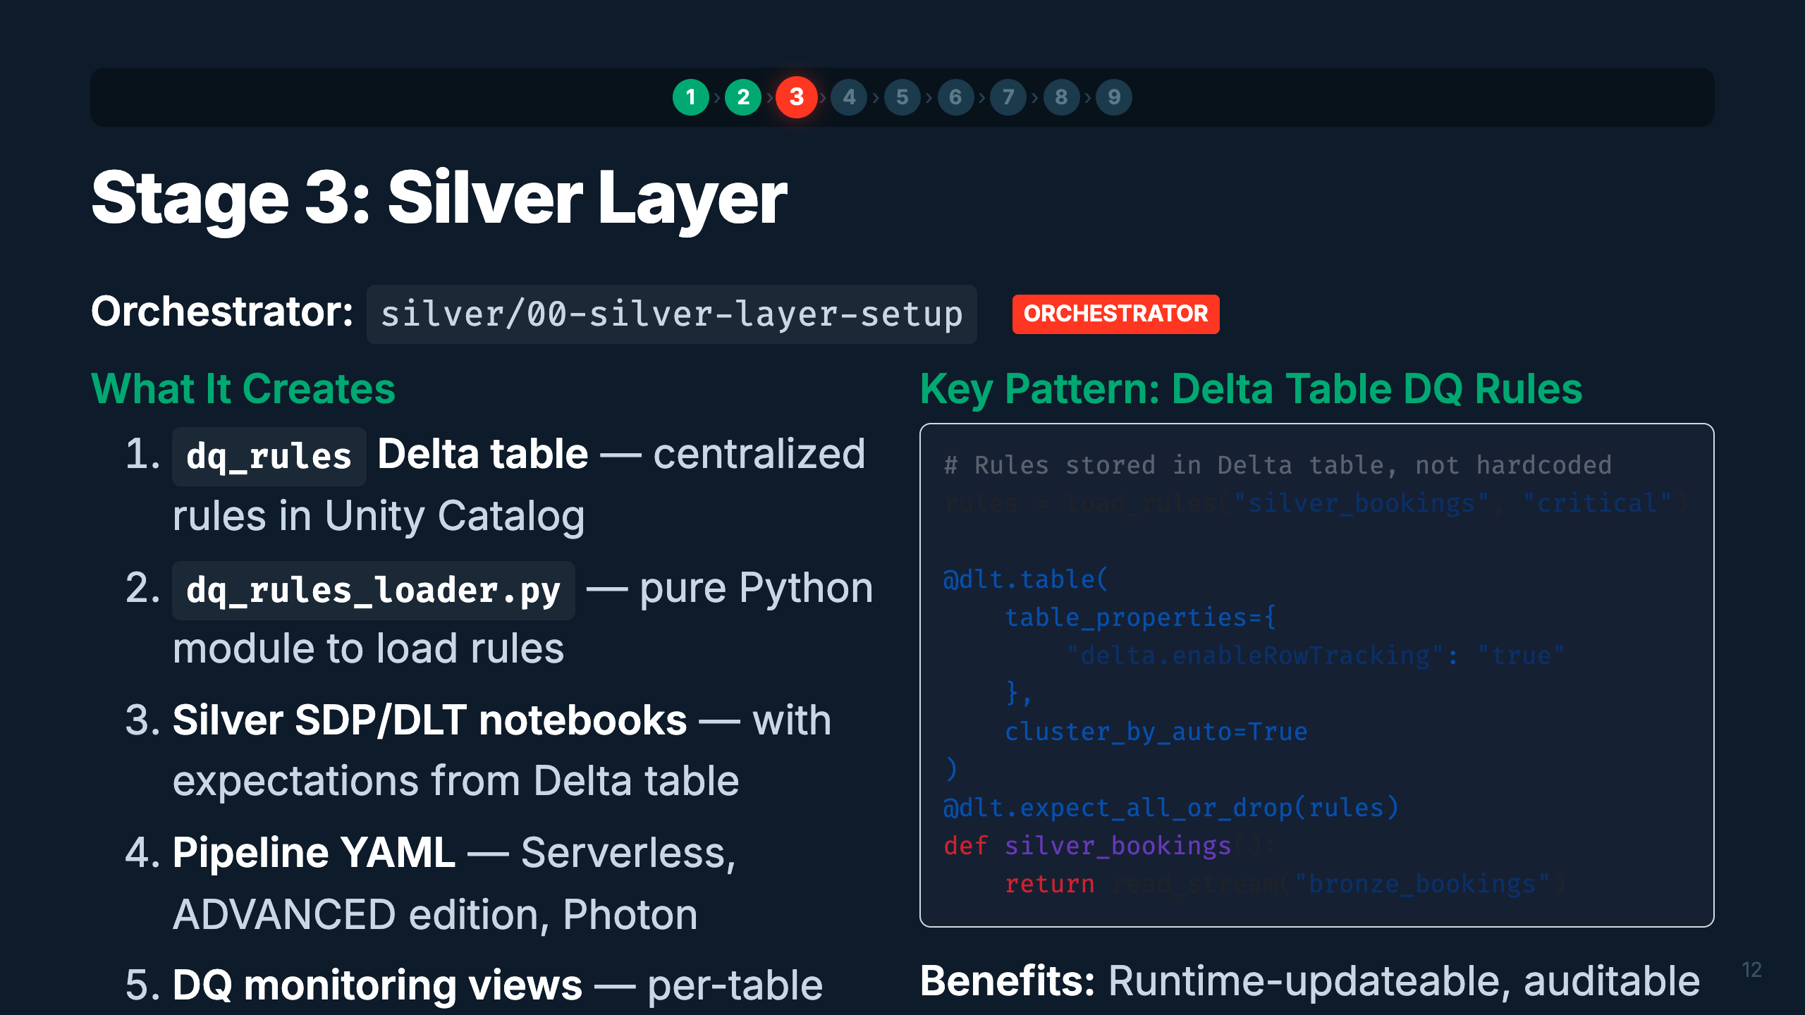
Notes:
Speaker: Silver is where data quality lives. The key pattern is storing DQ rules in a Delta table rather than hardcoding them. This means you can update rules with a simple SQL UPDATE — no redeployment needed. The orchestrator creates the rules table, the loader module, and the DLT/SDP pipeline that applies them. Timing: ~3 min

Slide 16
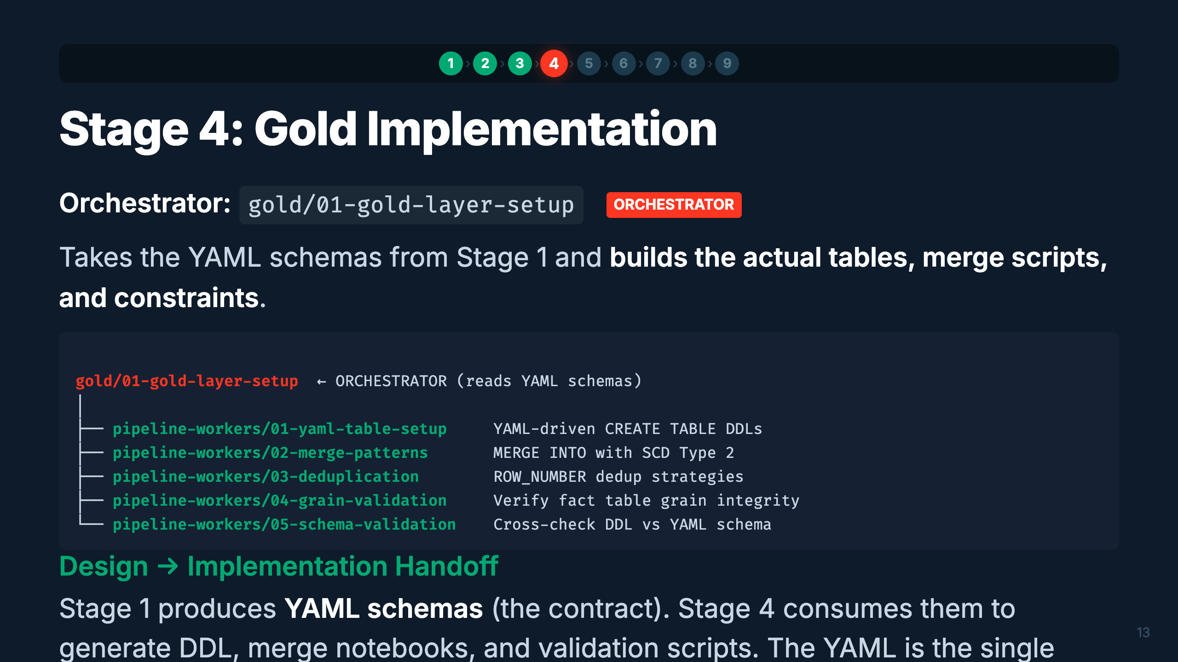
Notes:
Speaker: Stage 4 is the implementation counterpart to Stage 1's design. It reads the YAML schemas and materializes them as actual Delta tables with proper MERGE scripts, deduplication logic, and validation. Notice this is the same gold/ directory but different workers — pipeline-workers vs design-workers. The YAML contract ensures design and implementation stay in sync. Timing: ~2 min

Slide 17
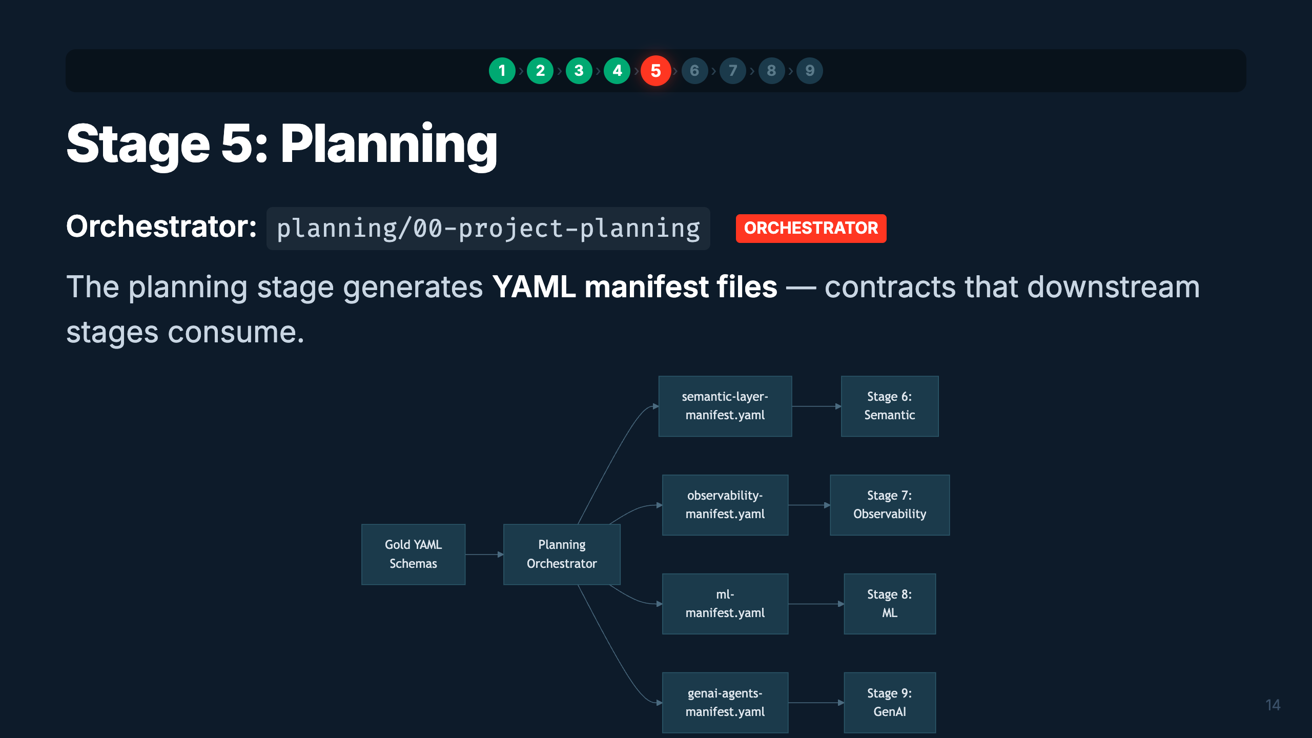
Notes:
Speaker: Planning is the coordination layer. It reads the Gold schemas and produces 4 YAML manifests — one for each downstream stage. These manifests are contracts: they specify exactly what metric views, monitors, ML models, and agents to build. If a manifest is missing (user skipped planning), orchestrators fall back to self-discovery from Gold tables. Timing: ~2 min

Slide 18
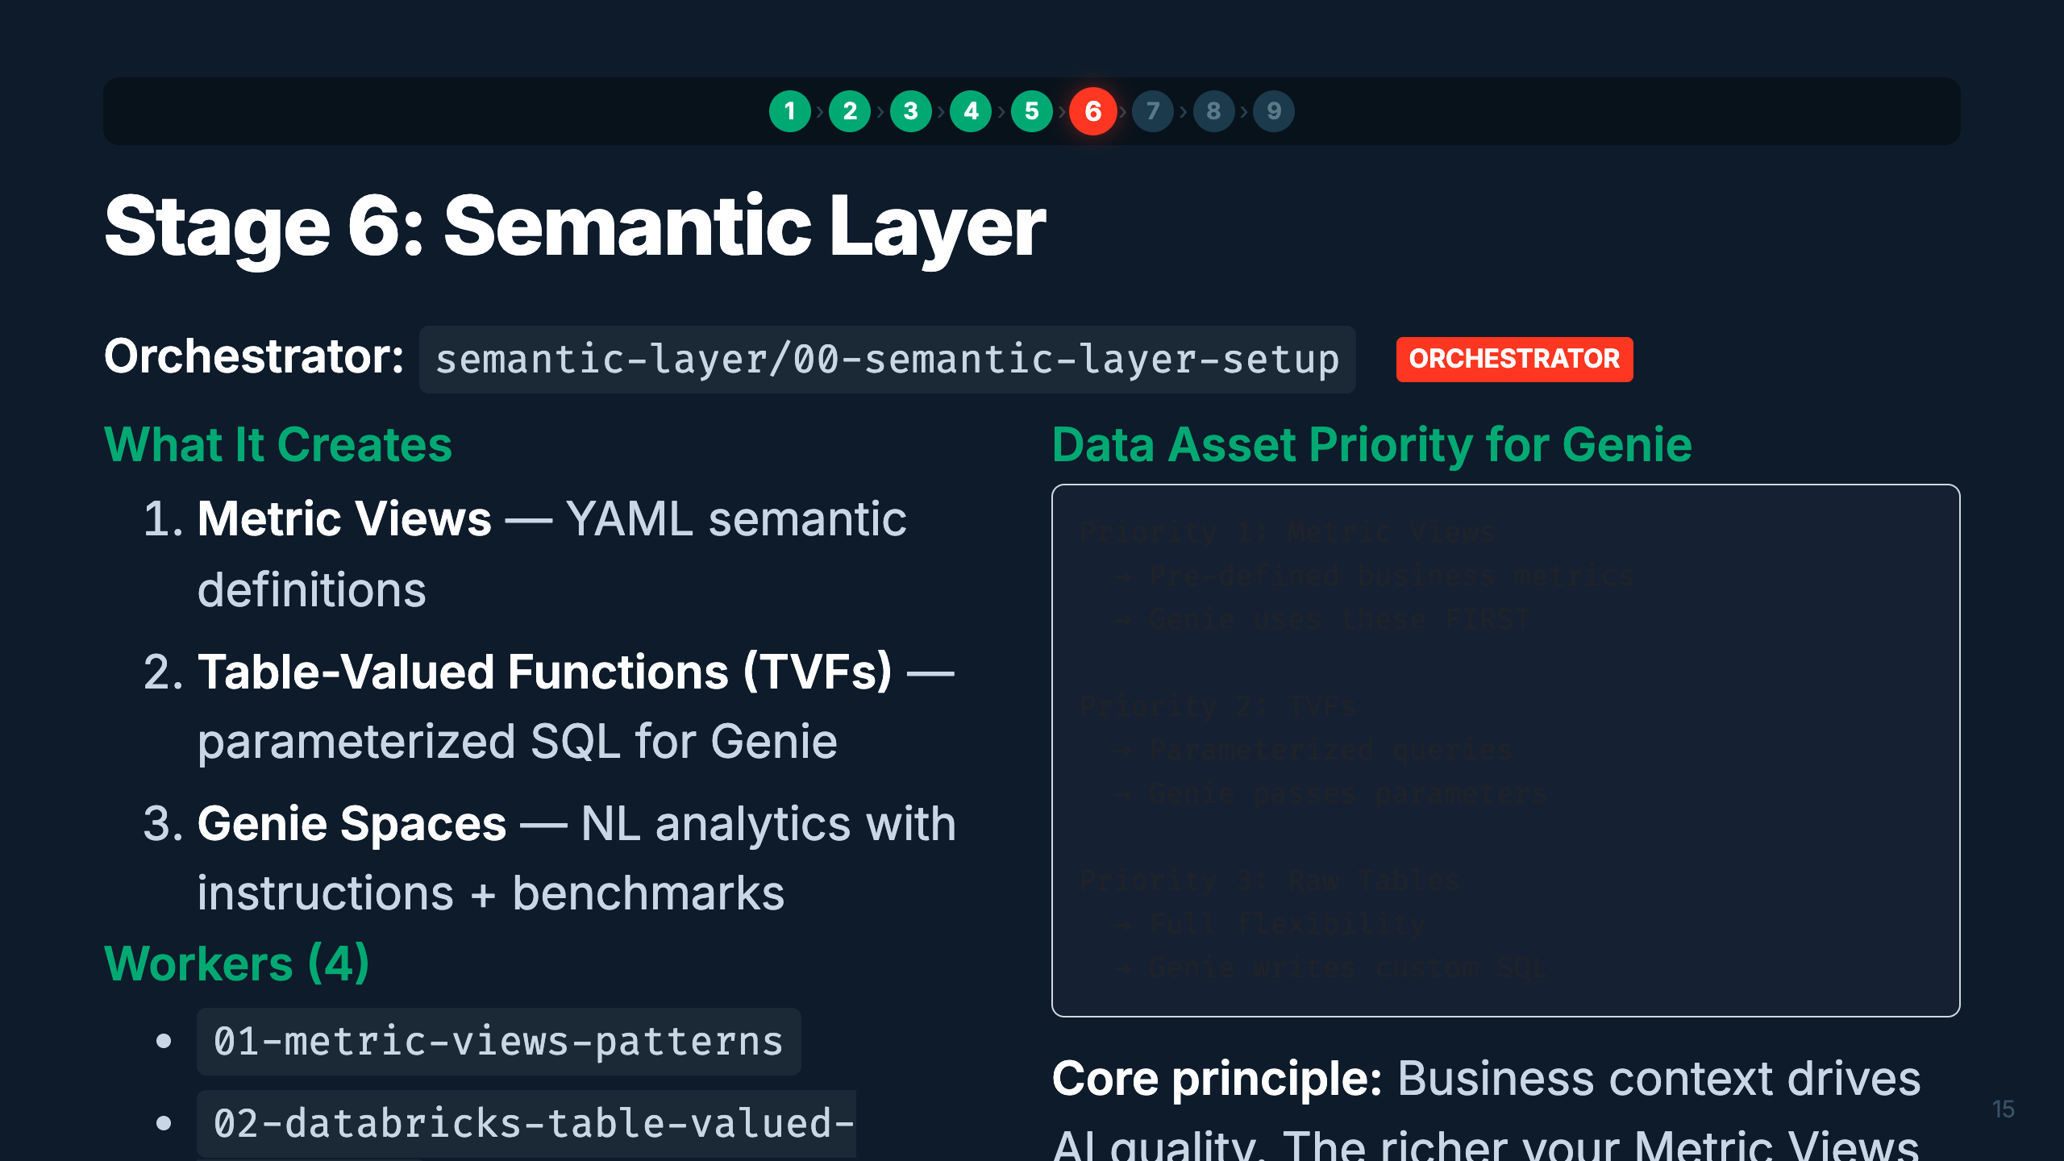
Notes:
Speaker: The semantic layer sits on top of Gold tables and makes them accessible to business users via natural language. Metric Views are the highest priority — they pre-define business metrics so Genie doesn't have to figure them out. TVFs handle parameterized patterns. Raw tables are the fallback. The quality of Genie responses directly correlates with the depth of context you provide. Timing: ~3 min

Slide 19
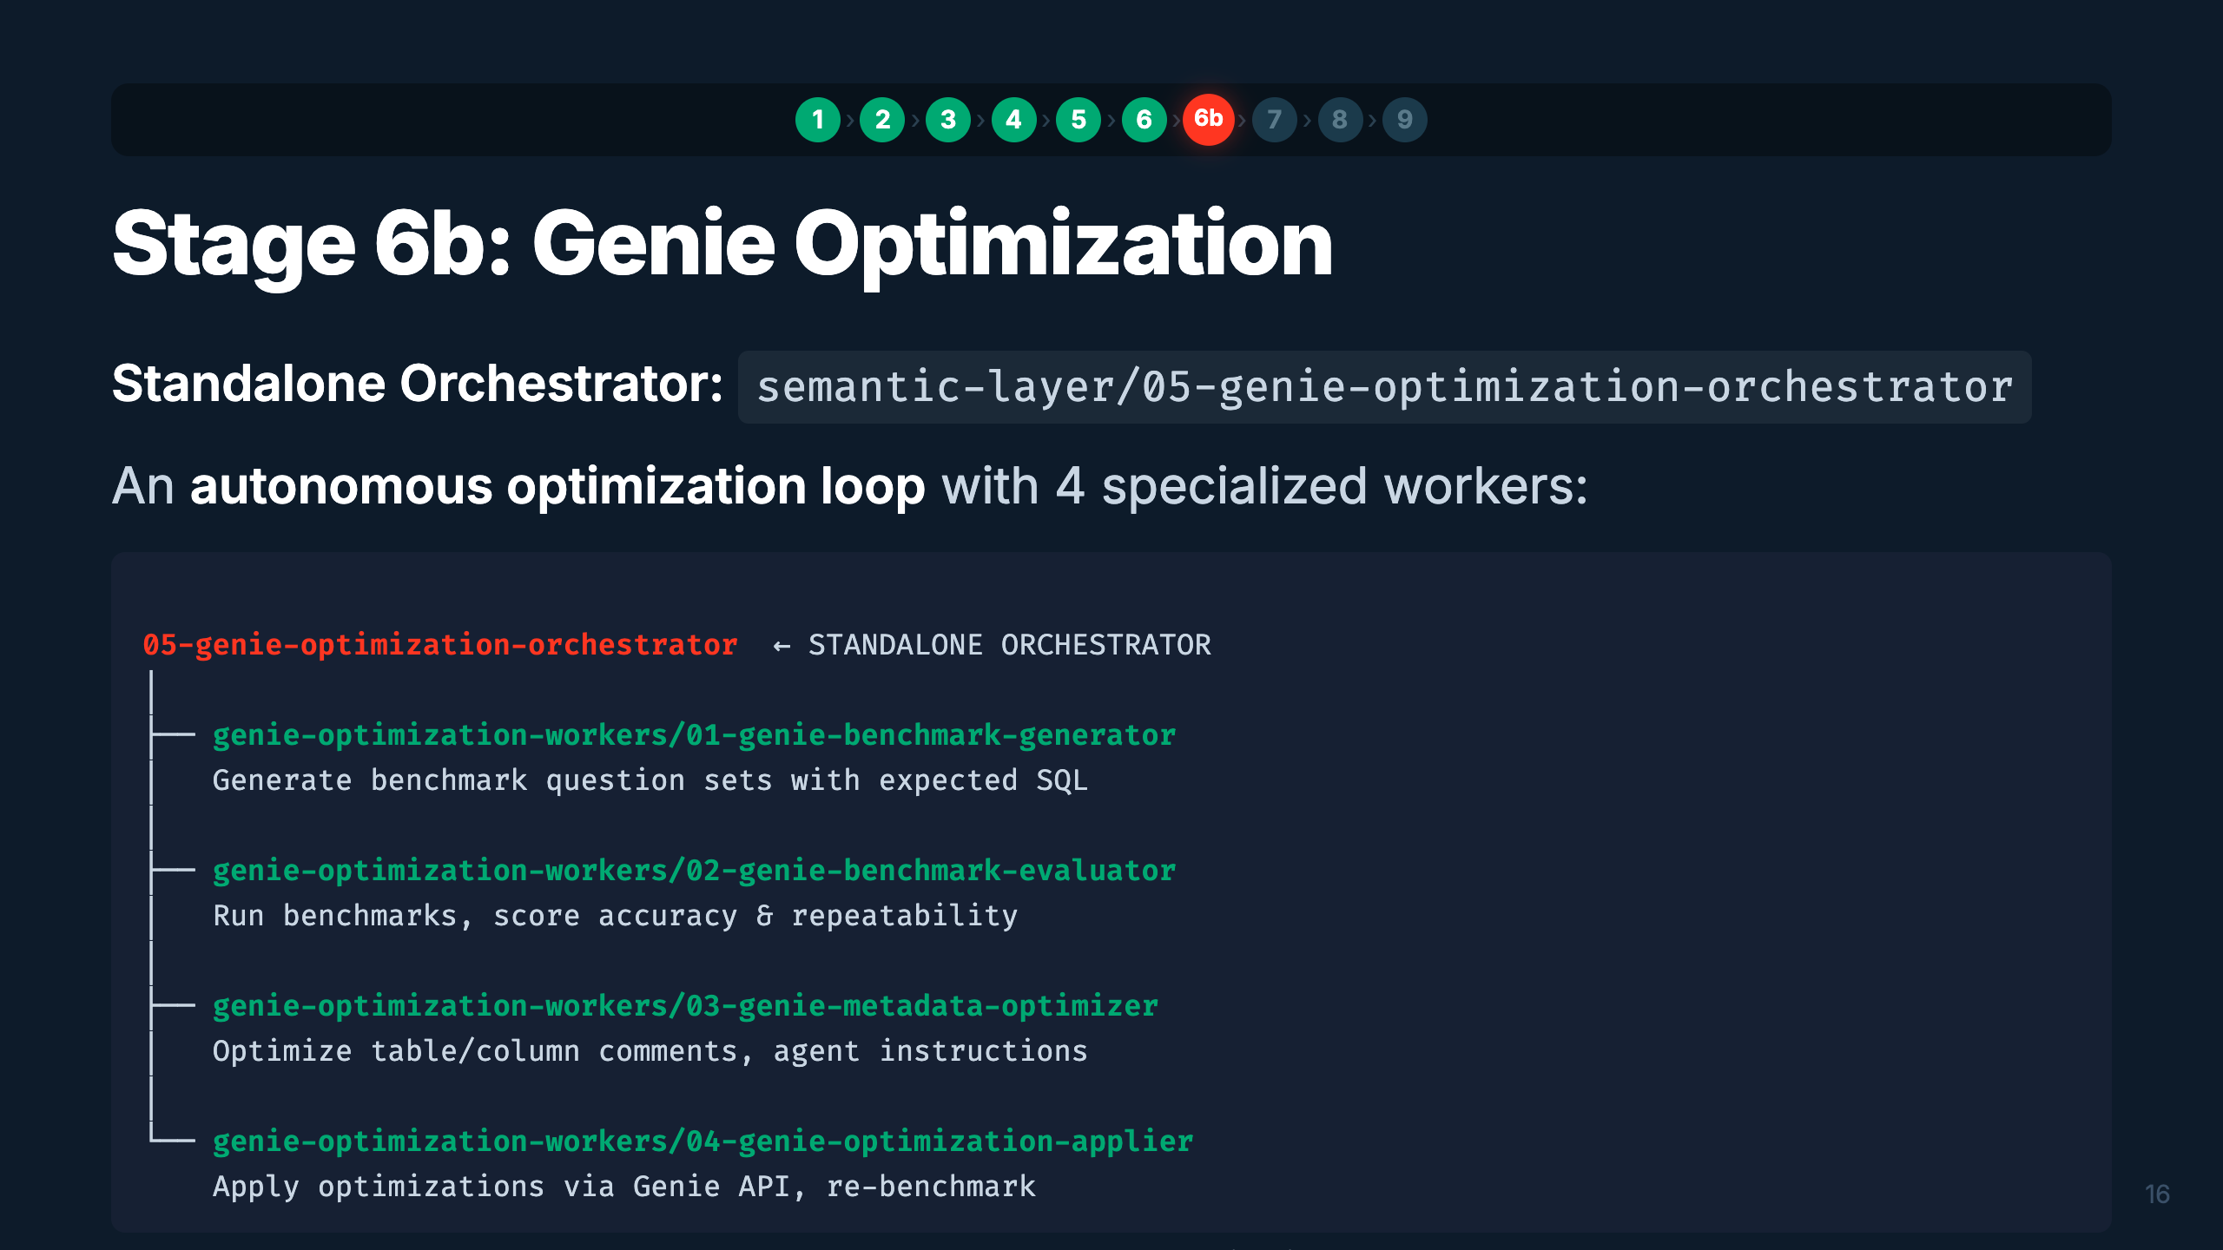
Notes:
Speaker: Stage 6b is unique — it's a standalone orchestrator with its own optimization loop. It generates benchmark questions, evaluates Genie's accuracy, optimizes the metadata (comments, instructions), applies changes via the API, and re-benchmarks. It's like a training loop for your Genie Space. Timing: ~2 min

Slide 20
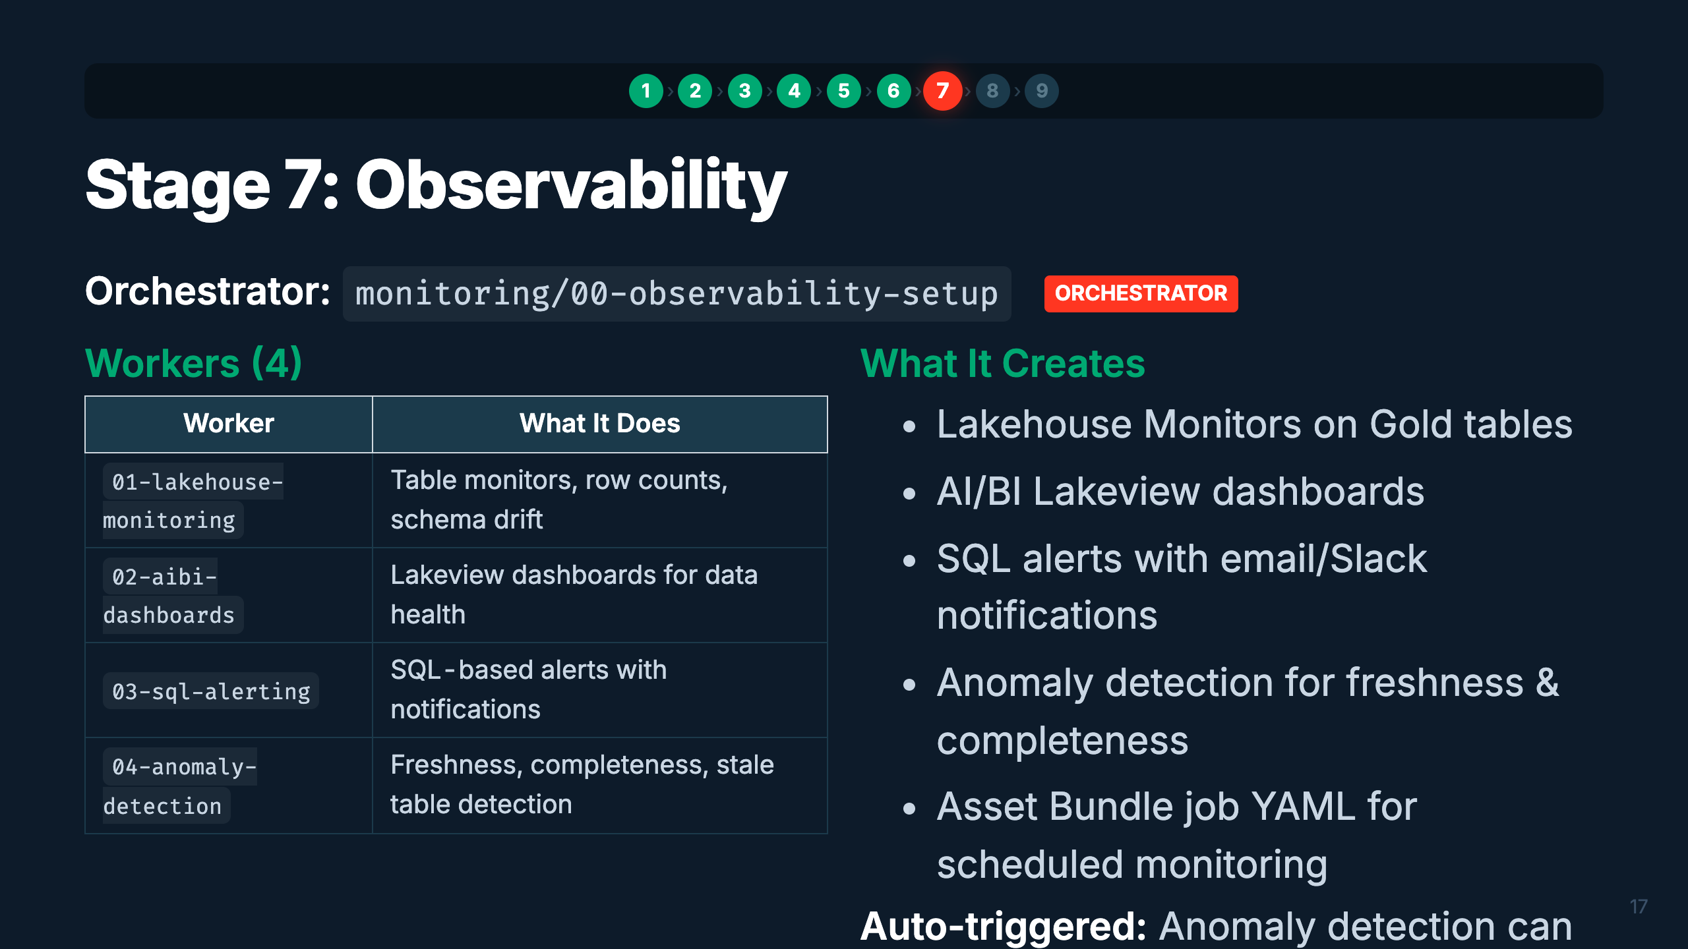
Notes:
Speaker: Observability ensures your data products stay healthy in production. Four workers cover different aspects — monitoring tables, building dashboards, setting up alerts, and detecting anomalies. The anomaly detection worker is special — it can auto-trigger after Silver or Gold setup, adding freshness and completeness checks proactively. Timing: ~2 min

Slide 21
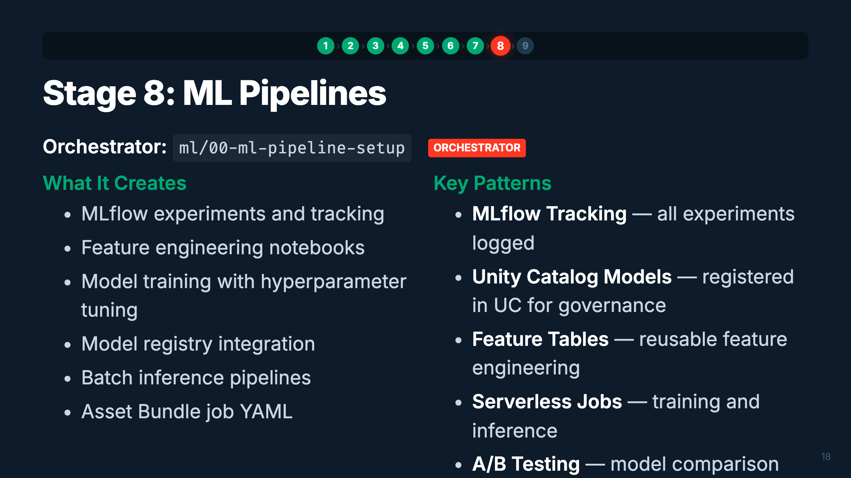
Notes:
Speaker: ML pipelines consume Gold tables as feature sources. The orchestrator sets up the full MLflow workflow — experiments, training, model registry, and inference. Everything is governed through Unity Catalog. Models registered here can be served as endpoints for GenAI agents in Stage 9. Timing: ~1.5 min

Slide 22
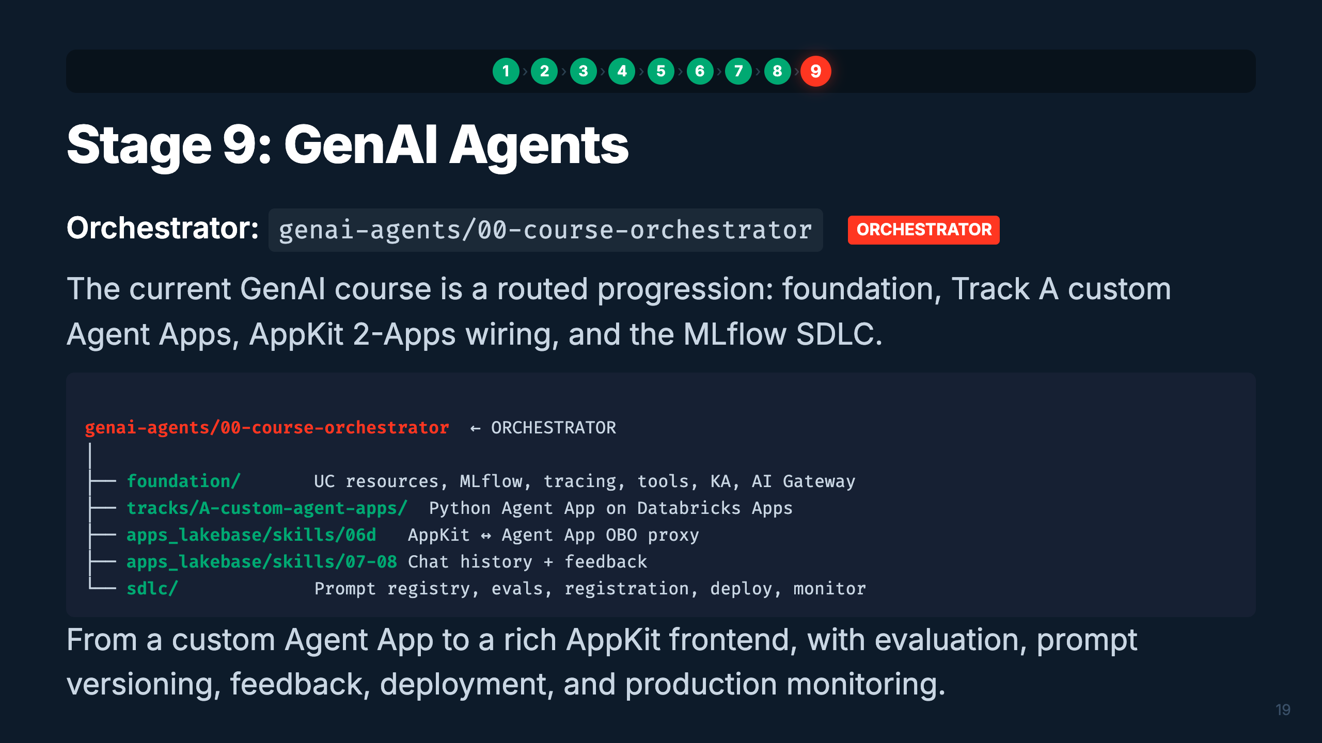
Notes:
Speaker: Stage 9 now starts at the course orchestrator. It routes to foundation setup, Track A custom Agent Apps, the AppKit 2-Apps proxy, chat history and feedback, then the MLflow SDLC: prompt registry, evaluation, registration, deployment, monitoring, and iteration. Timing: ~2 min

Slide 23
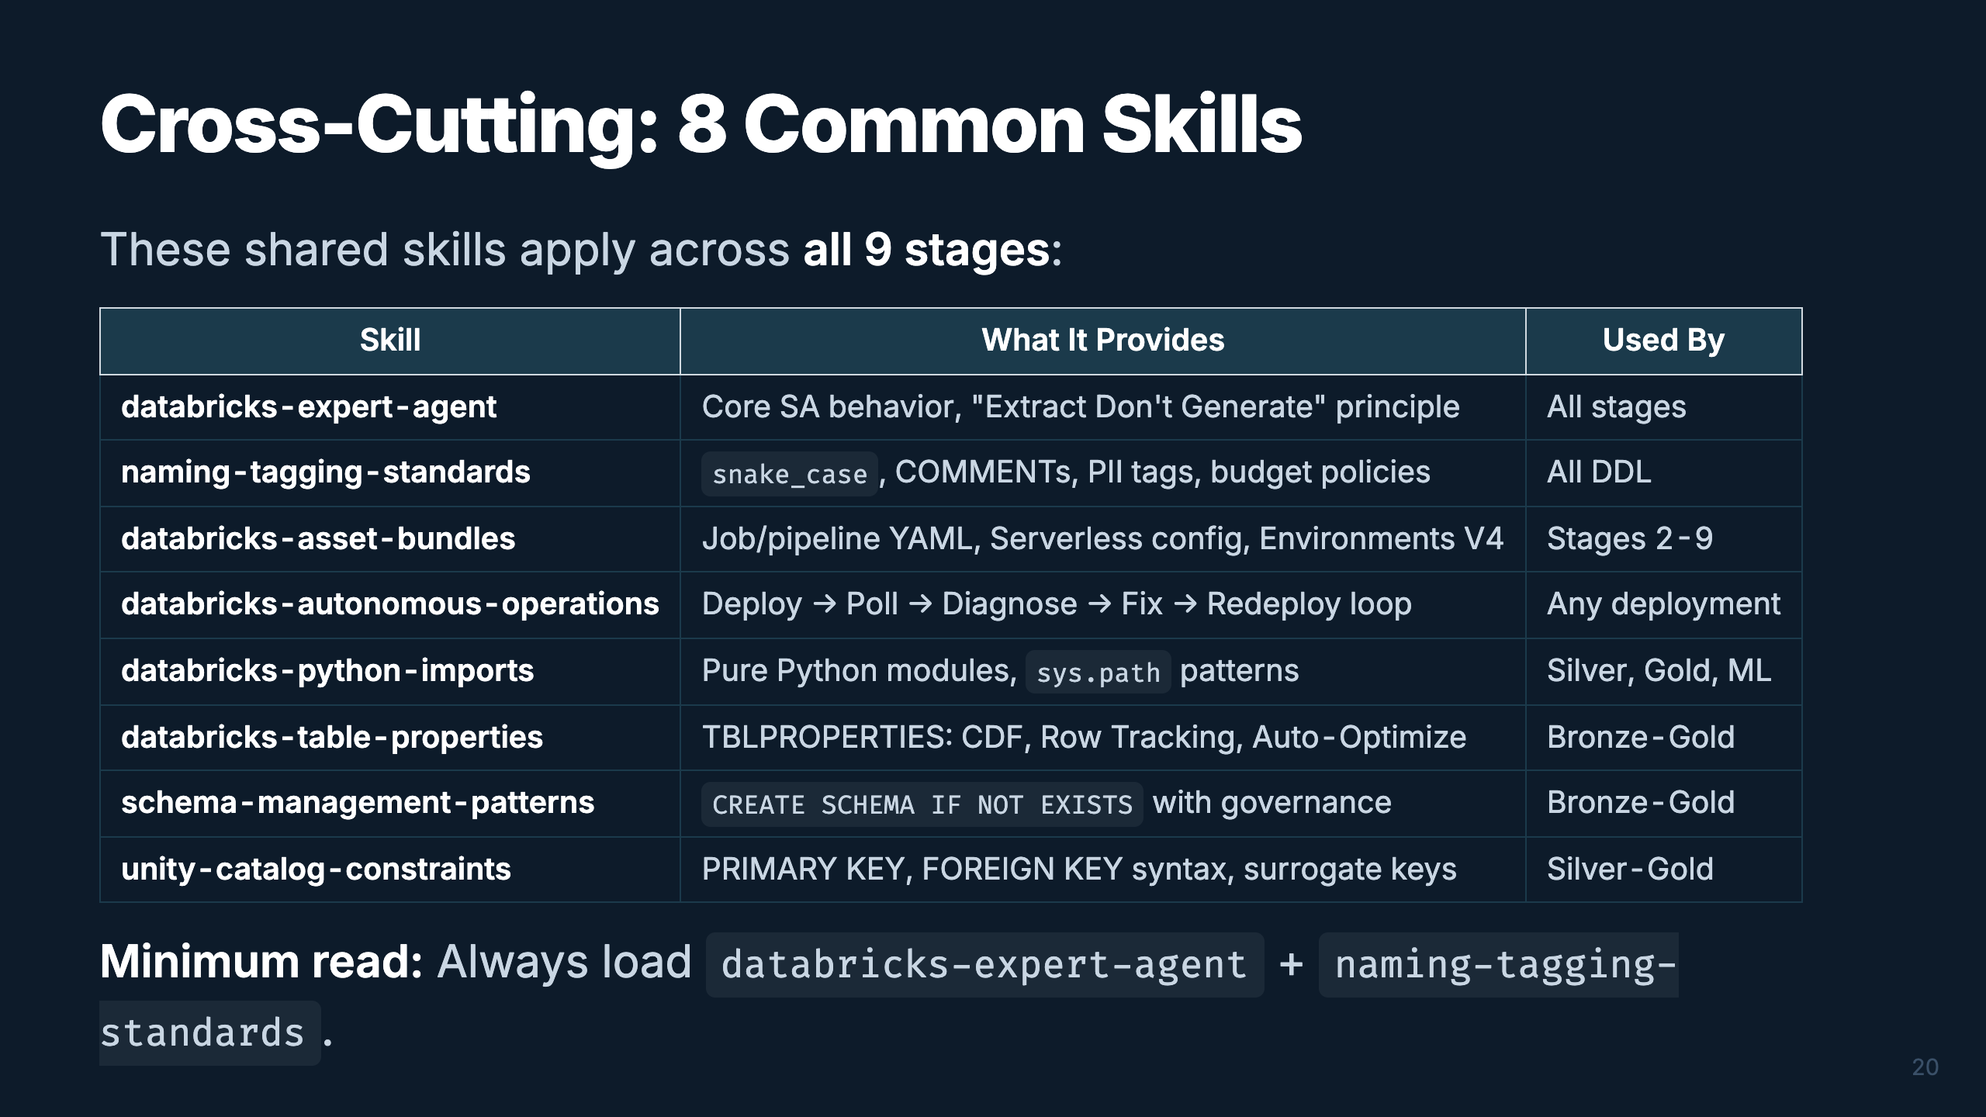
Notes:
Speaker: These 8 common skills are the shared foundation. They're not tied to any single stage — orchestrators pull them in as dependencies. The two you should always have loaded are expert-agent (core behavior) and naming-tagging-standards (enterprise naming). Asset-bundles is critical for any deployment. Autonomous-operations handles the "deploy, wait, diagnose, fix, redeploy" loop automatically. Timing: ~2 min

Slide 24
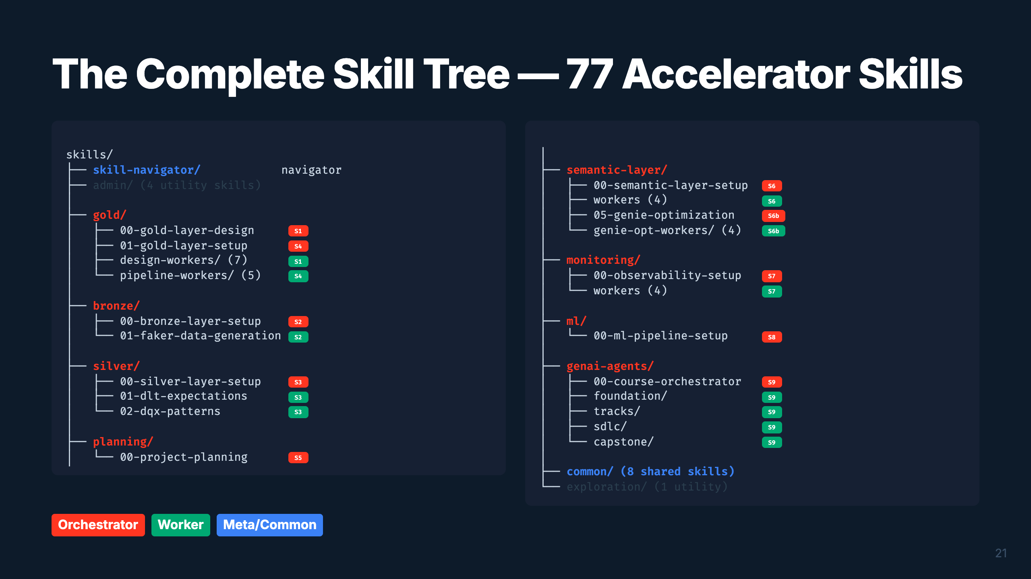
Notes:
Speaker: Here's the accelerator tree — 77 skills organized by domain. Orange badges are orchestrators (entry points), green are workers (specific patterns). The skill-navigator routes to the right one based on keywords. Common skills (8) are shared dependencies. This tree IS the framework. Timing: ~2 min

Slide 25
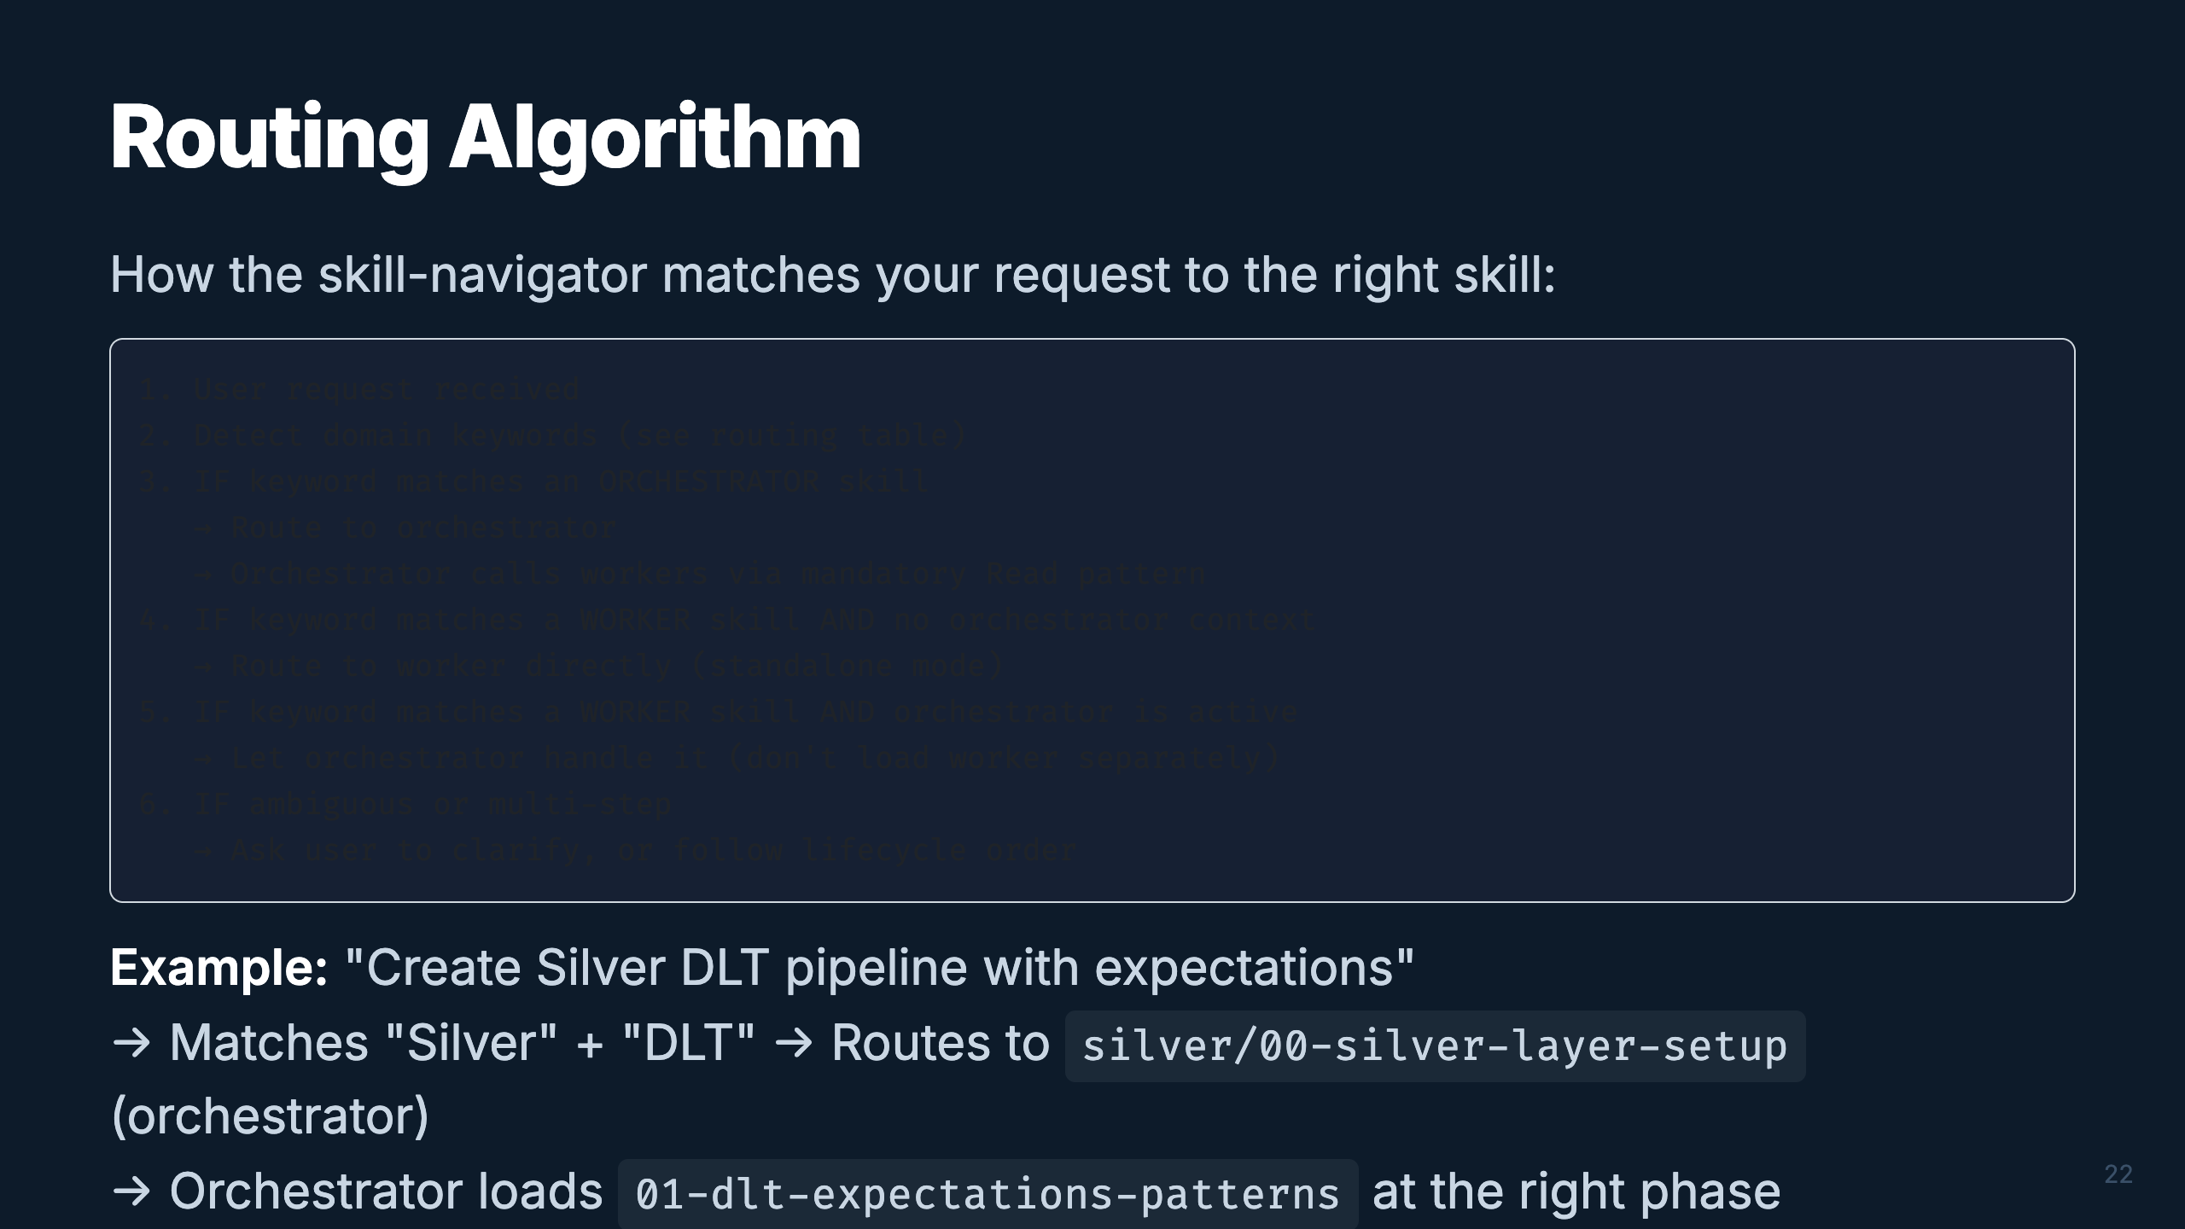
Notes:
Speaker: The routing algorithm is simple but effective. Keywords drive everything. The key rule: prefer orchestrators for end-to-end work, workers for specific standalone tasks. The orchestrator manages when to load each worker — you never need to manually sequence them. Timing: ~1.5 min

Slide 26
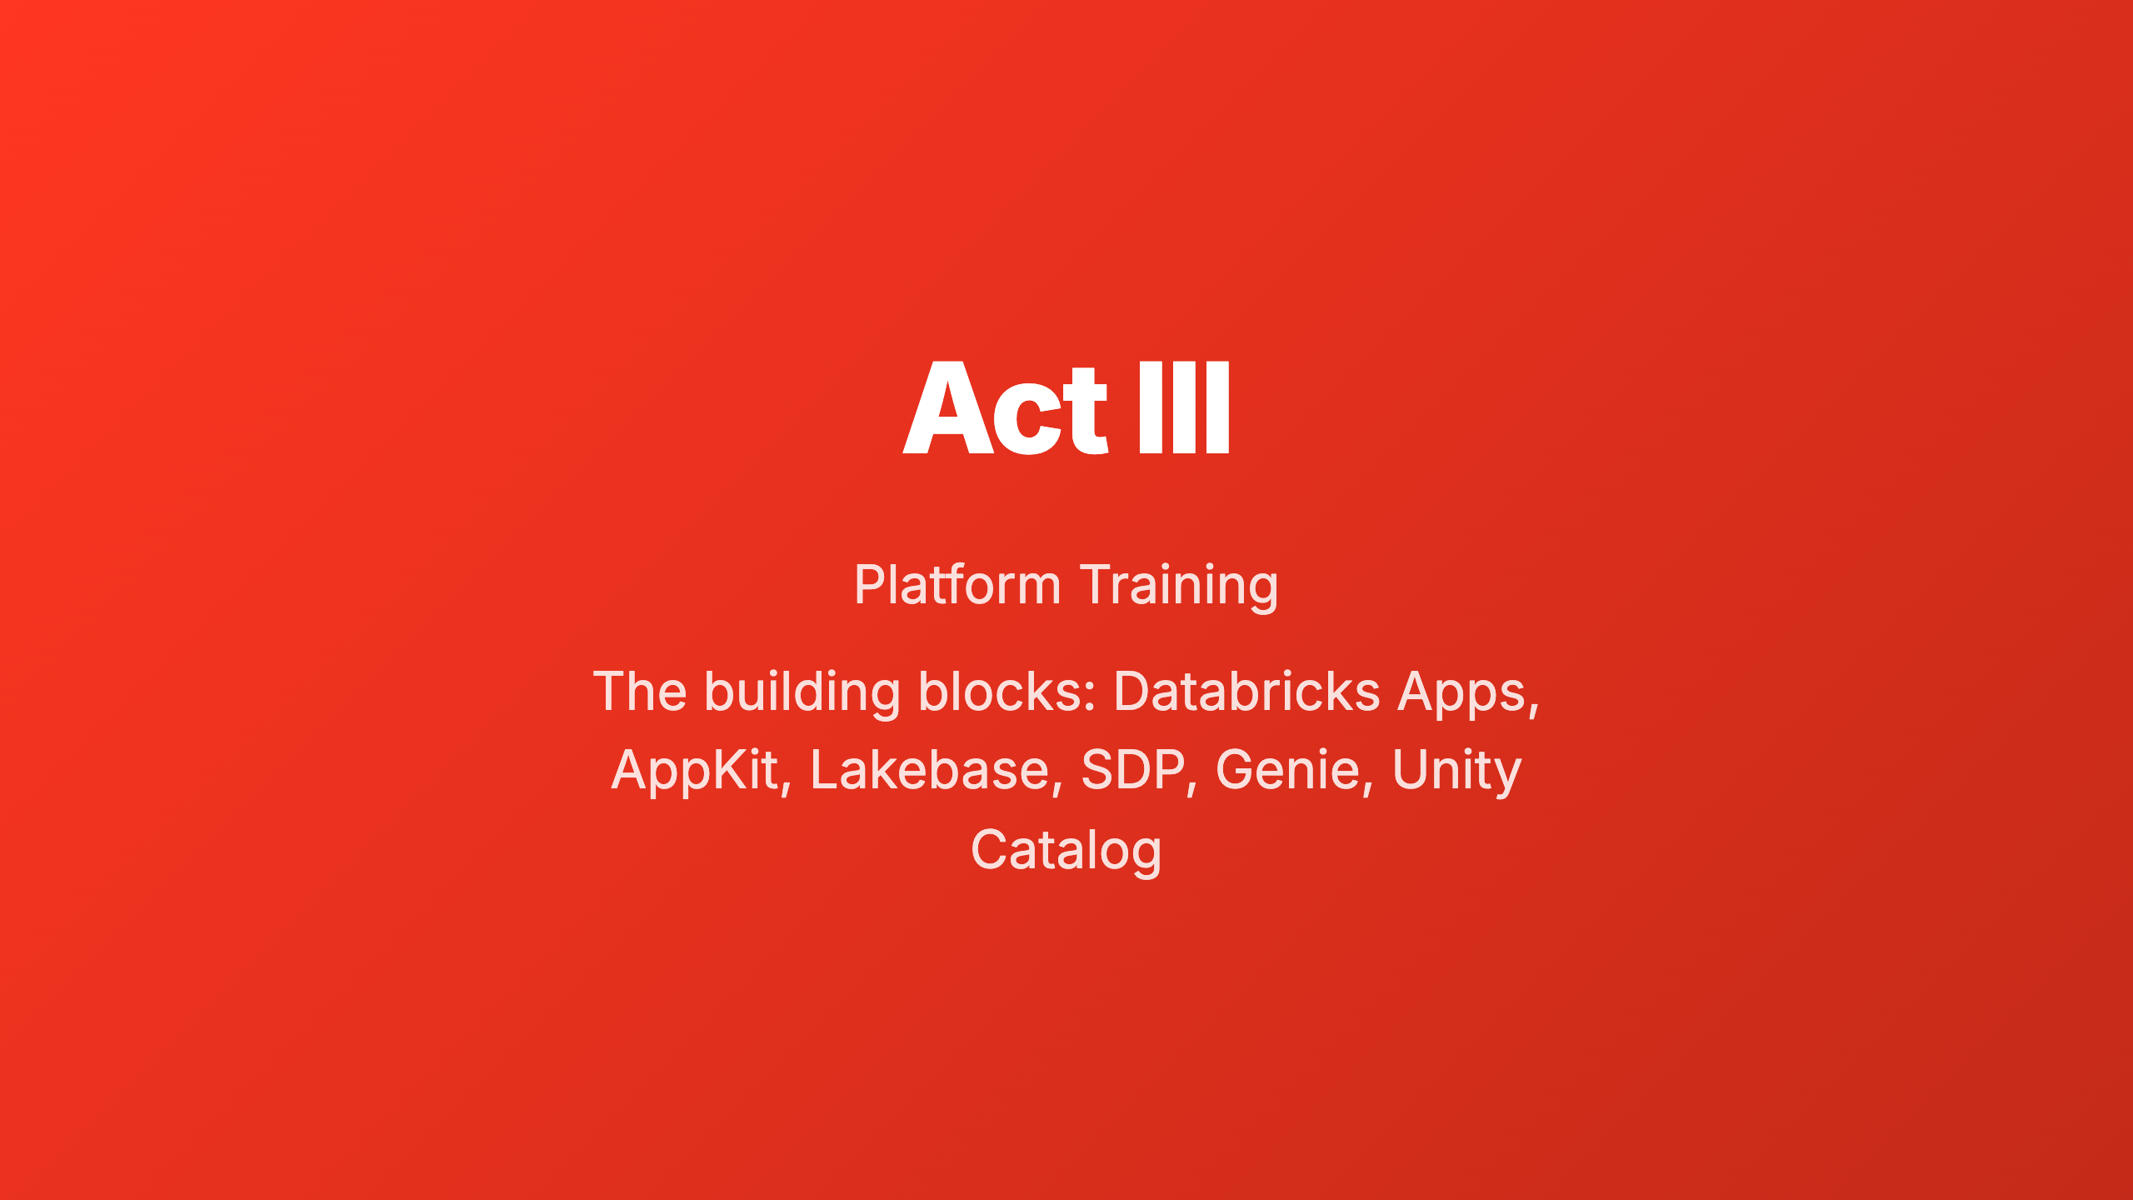
Notes:
_transition: cover Speaker: Before we dive into the hands-on workshop, let's make sure everyone understands the platform components we'll be building on. Six mini-modules, each 2-3 slides, covering the key concepts and architecture patterns. Timing: ~30 sec transition

Slide 27
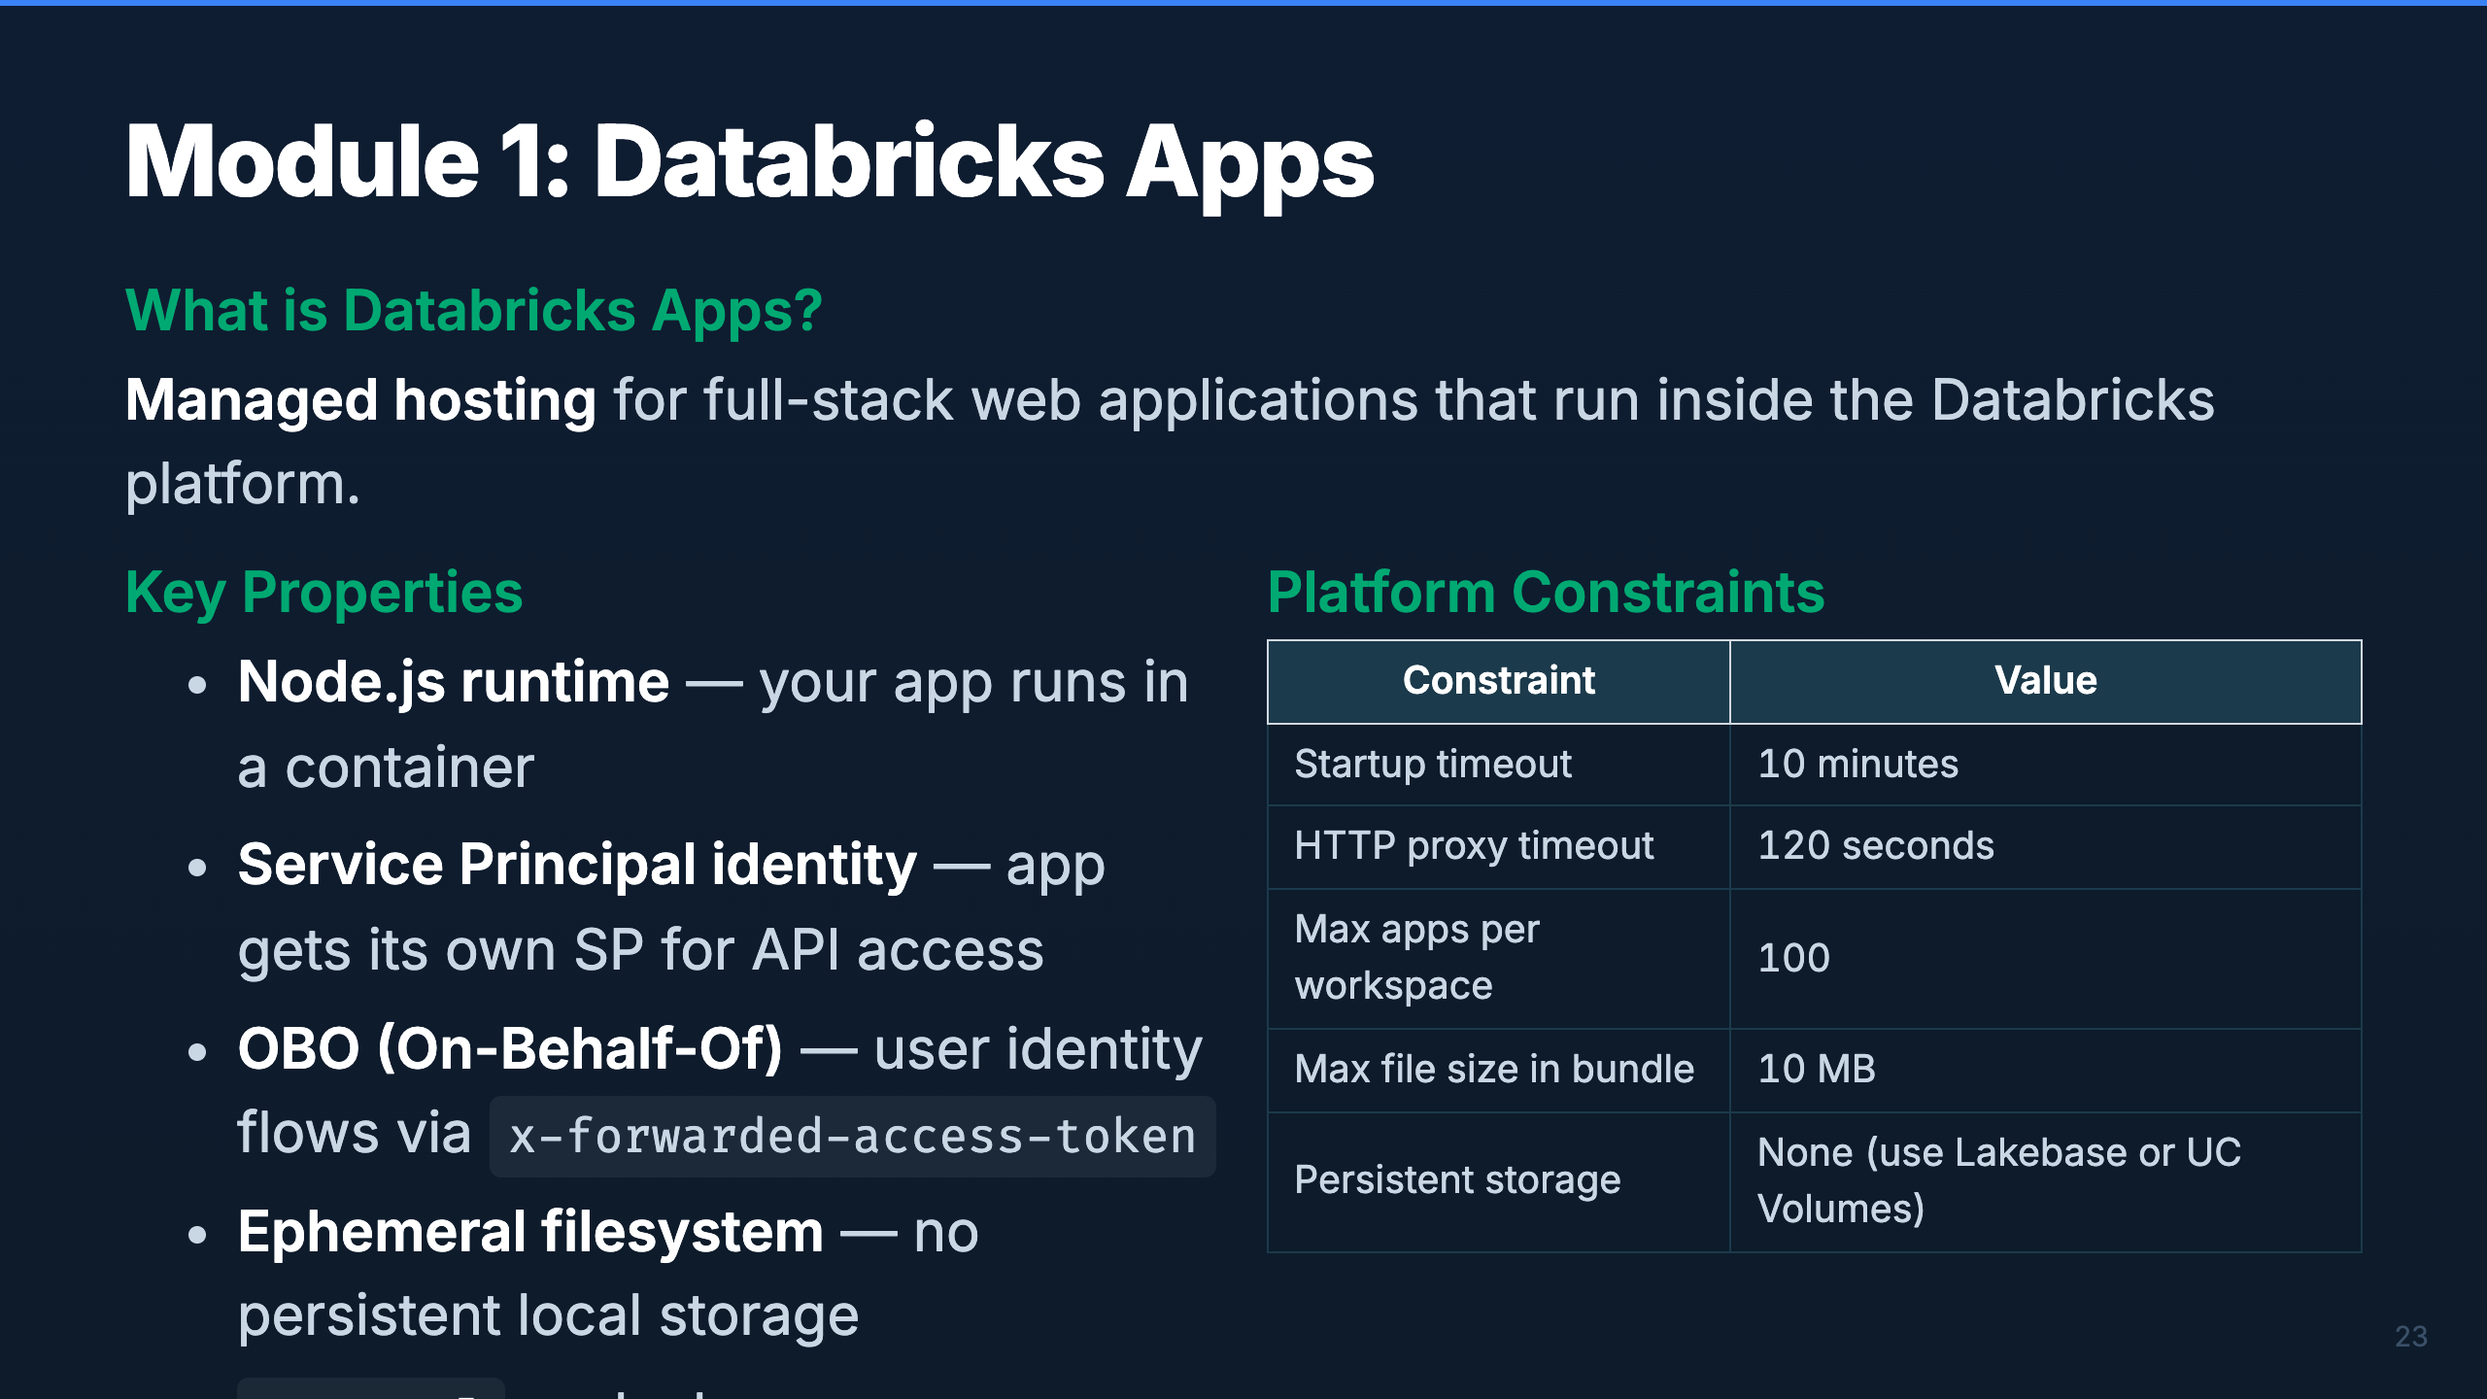
Notes:
Speaker: Databricks Apps is a managed hosting service. Your app gets a container with Node.js, a Service Principal for API calls, and auto-injected environment variables. The key constraint is the ephemeral filesystem — anything your app writes locally is lost on restart. That's why we use Lakebase for persistence and UC Volumes for files. Timing: ~2 min

Slide 28
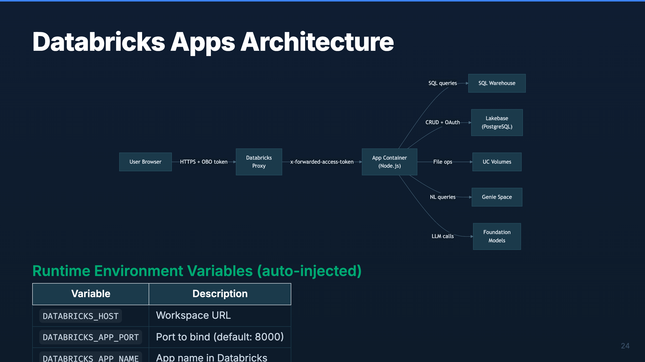
Notes:
Speaker: The architecture is straightforward. Users hit the Databricks proxy, which forwards requests to your app container. The proxy attaches the user's access token so your app can make OBO calls. Your app connects to backend services — SQL Warehouse for analytics, Lakebase for CRUD, UC Volumes for files, Genie for NL queries, and Foundation Models for LLM calls. Timing: ~2 min

Slide 29
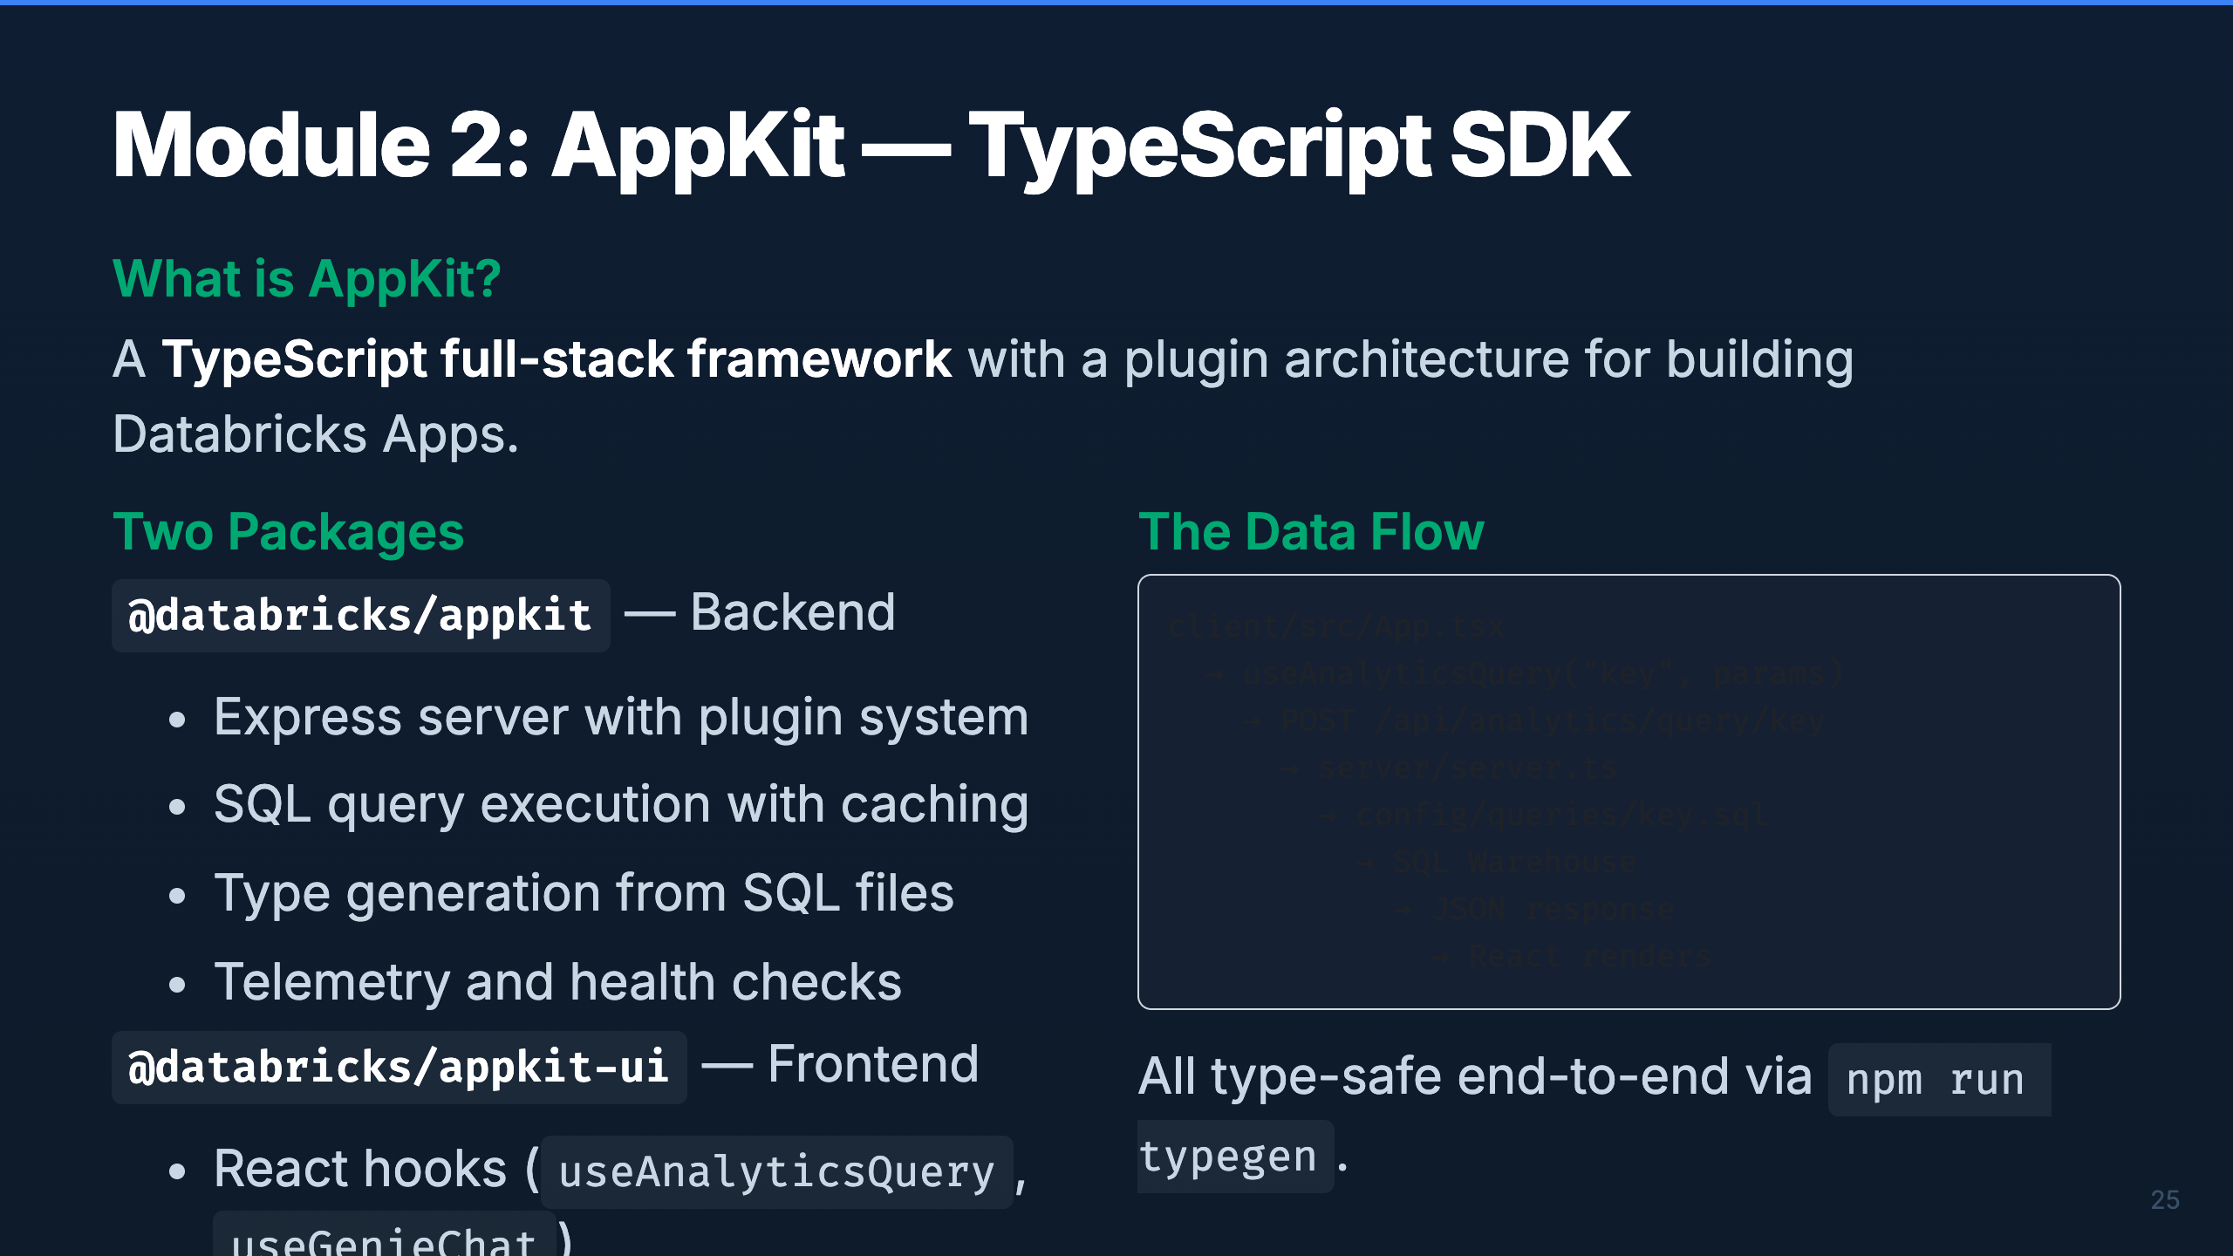
Notes:
Speaker: AppKit gives you a TypeScript backend and a React frontend in one package. The backend handles SQL query execution with caching and retries. The frontend provides type-safe hooks that call those queries. The typegen step bridges them — it reads your SQL files and generates TypeScript types automatically. Timing: ~2 min

Slide 30
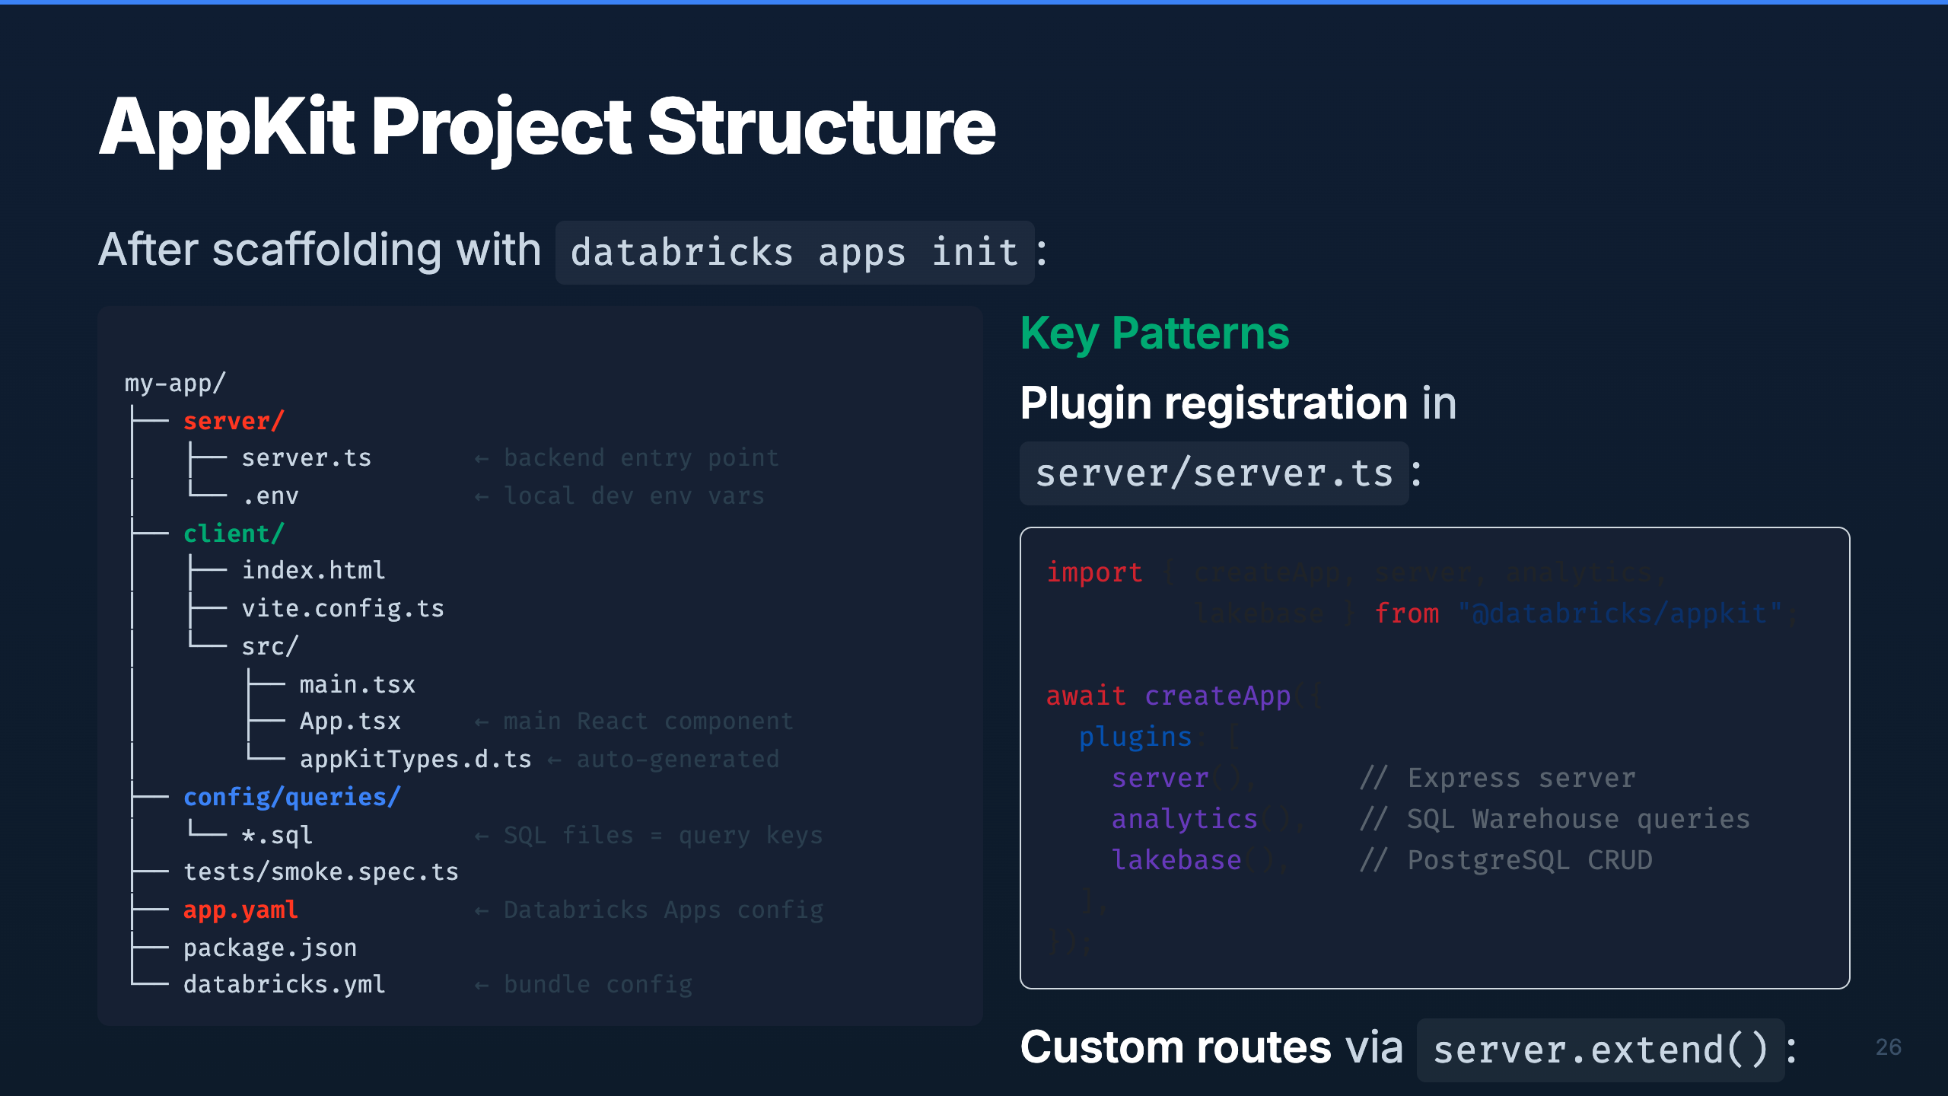
Notes:
Speaker: This is the canonical project layout. Server code in server/, React in client/, SQL queries in config/queries/. The filename of each .sql file becomes the query key. Plugin registration happens in server.ts — you compose plugins freely. For custom API routes beyond what plugins provide, use server.extend(). Timing: ~2 min

Slide 31
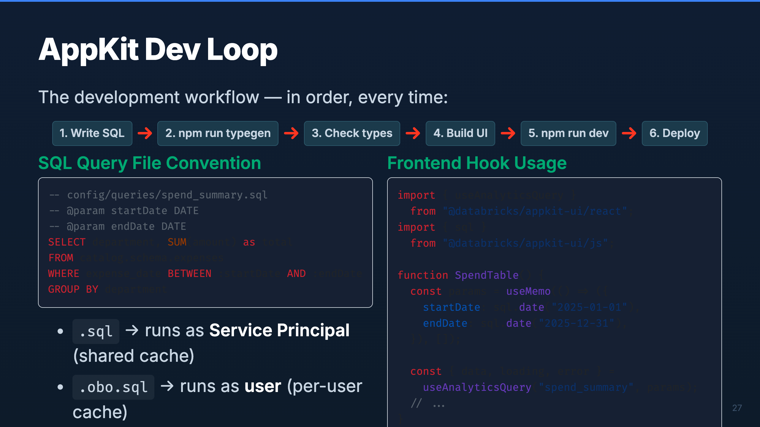
Notes:
Speaker: The dev loop is strict — SQL first, typegen second, UI third. Never write UI code before running typegen or your types won't exist. The SQL file convention is powerful — the filename becomes the API endpoint, and .obo.sql runs as the user for per-user access control. On the frontend, always memoize your params to avoid infinite refetch loops. Timing: ~2 min

Slide 32
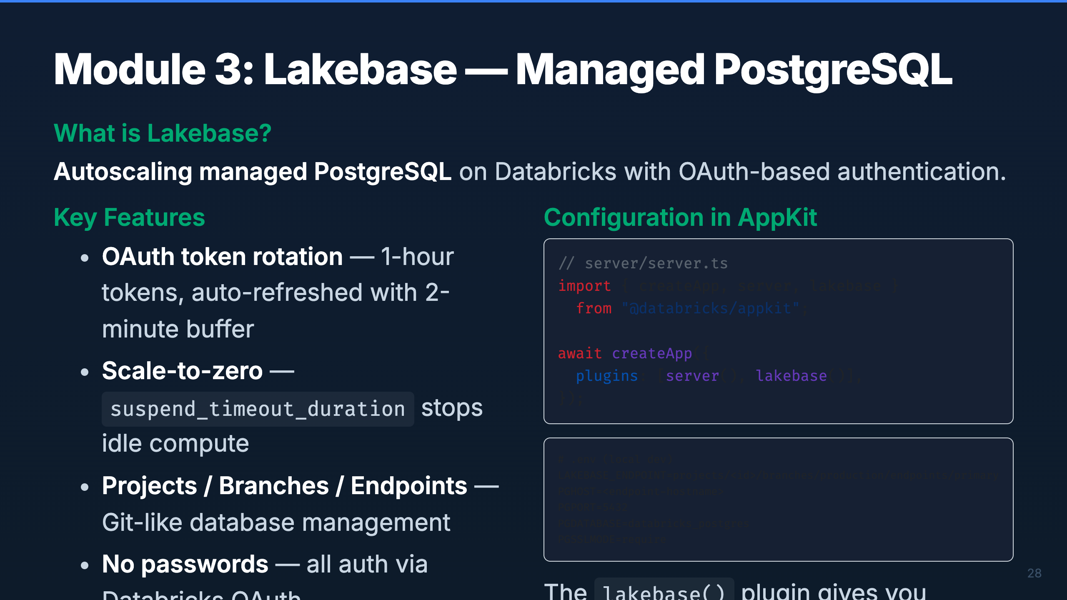
Notes:
Speaker: Lakebase is managed Postgres — but with OAuth instead of passwords. The plugin handles token rotation automatically (tokens expire every hour, refreshed 2 minutes early). The key architectural decision: use Lakebase for CRUD operations (writes, user data, app state) and SQL Warehouse for read-only analytics (dashboards, aggregations). They complement each other. Timing: ~2 min

Slide 33
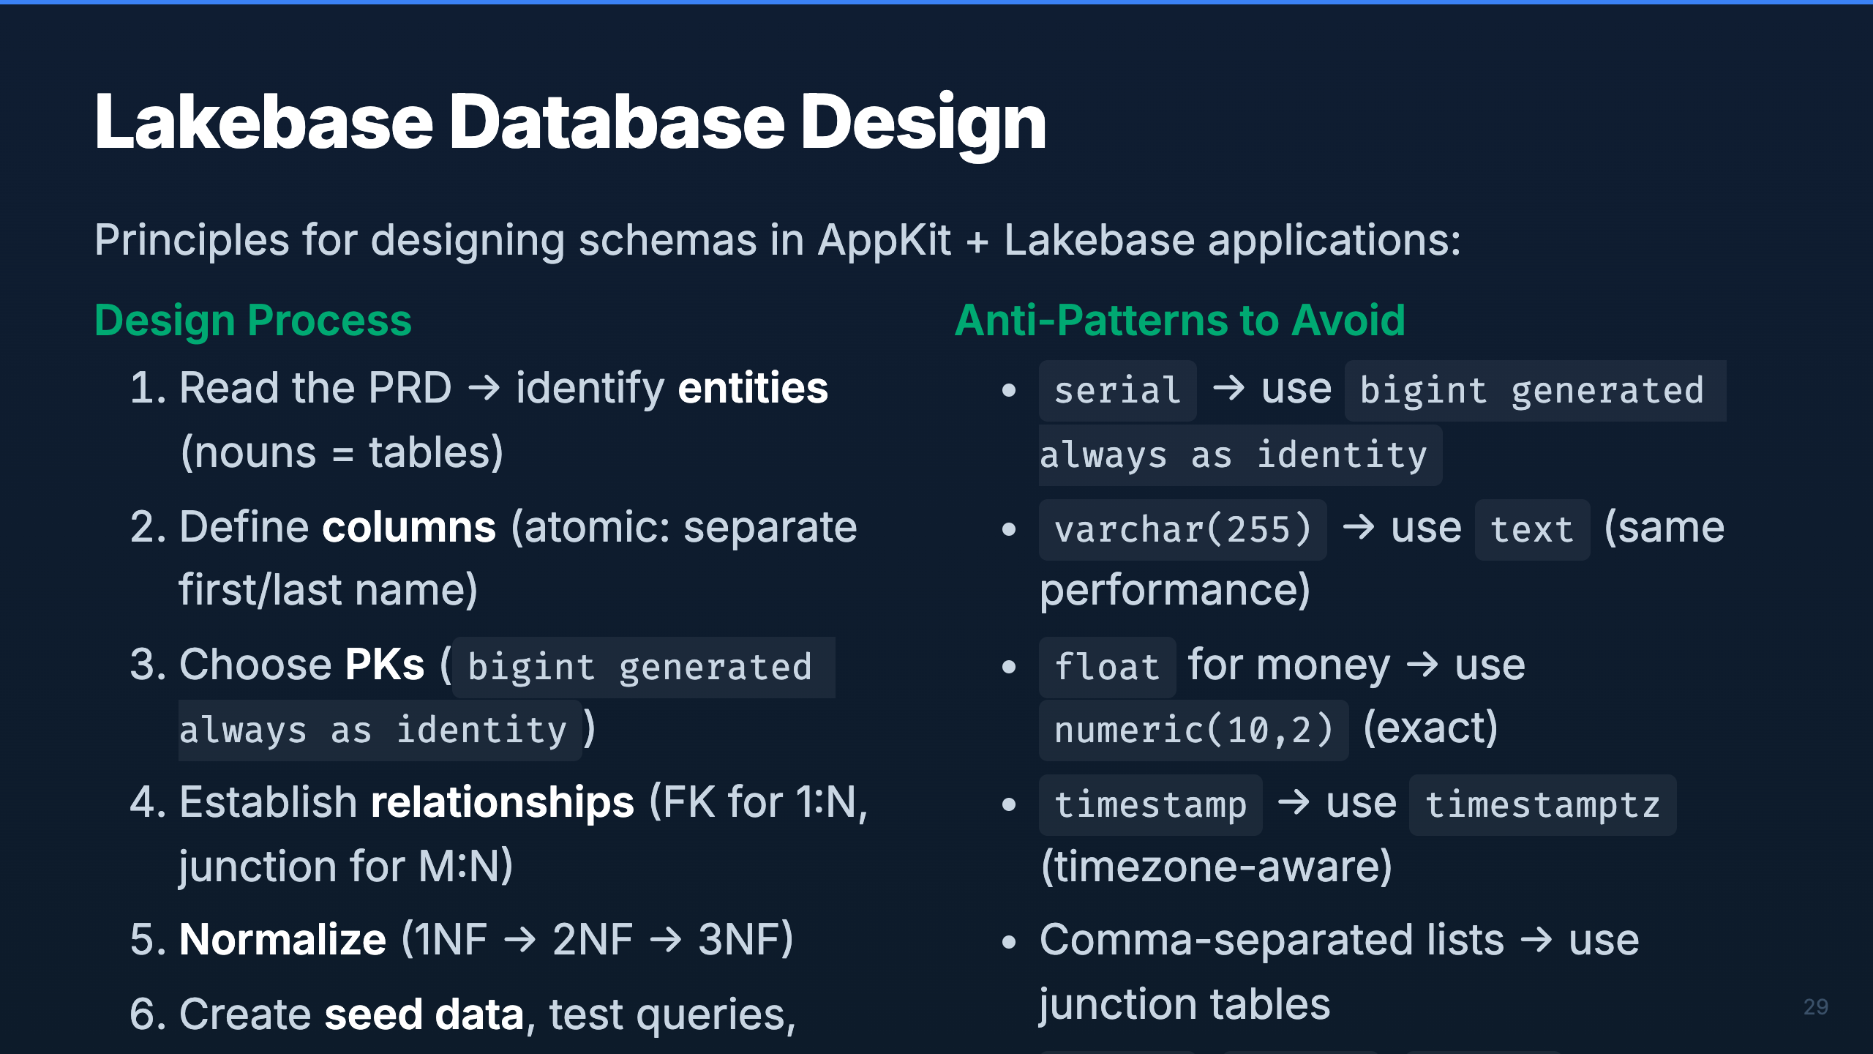
Notes:
Speaker: Database design follows standard relational principles, but with Postgres-specific conventions. Key callouts: use bigint identity (not serial), text (not varchar), numeric for money (not float), and timestamptz (always timezone-aware). Schema isolation via DB_SCHEMA prevents apps from stepping on each other's tables. Timing: ~2 min

Slide 34
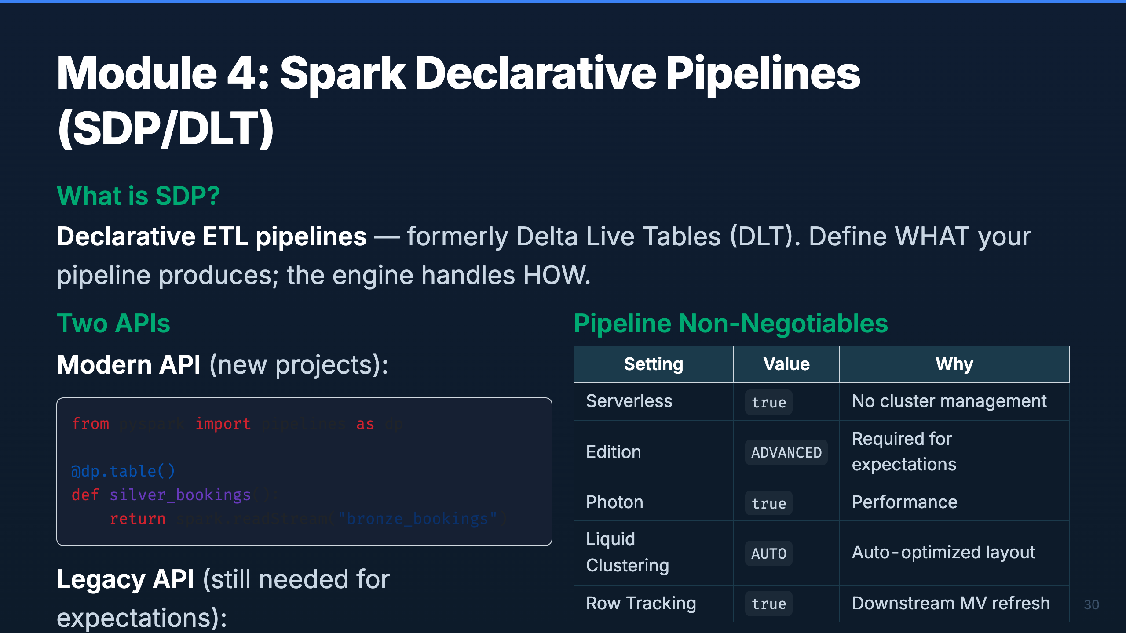
Notes:
Speaker: SDP (formerly DLT) lets you define pipelines declaratively. The engine manages execution, retries, and dependencies. There are two Python APIs — the modern dp API and the legacy dlt API. We still need the legacy API for data quality expectations. Everything runs Serverless with ADVANCED edition for full feature access. Timing: ~2 min

Slide 35
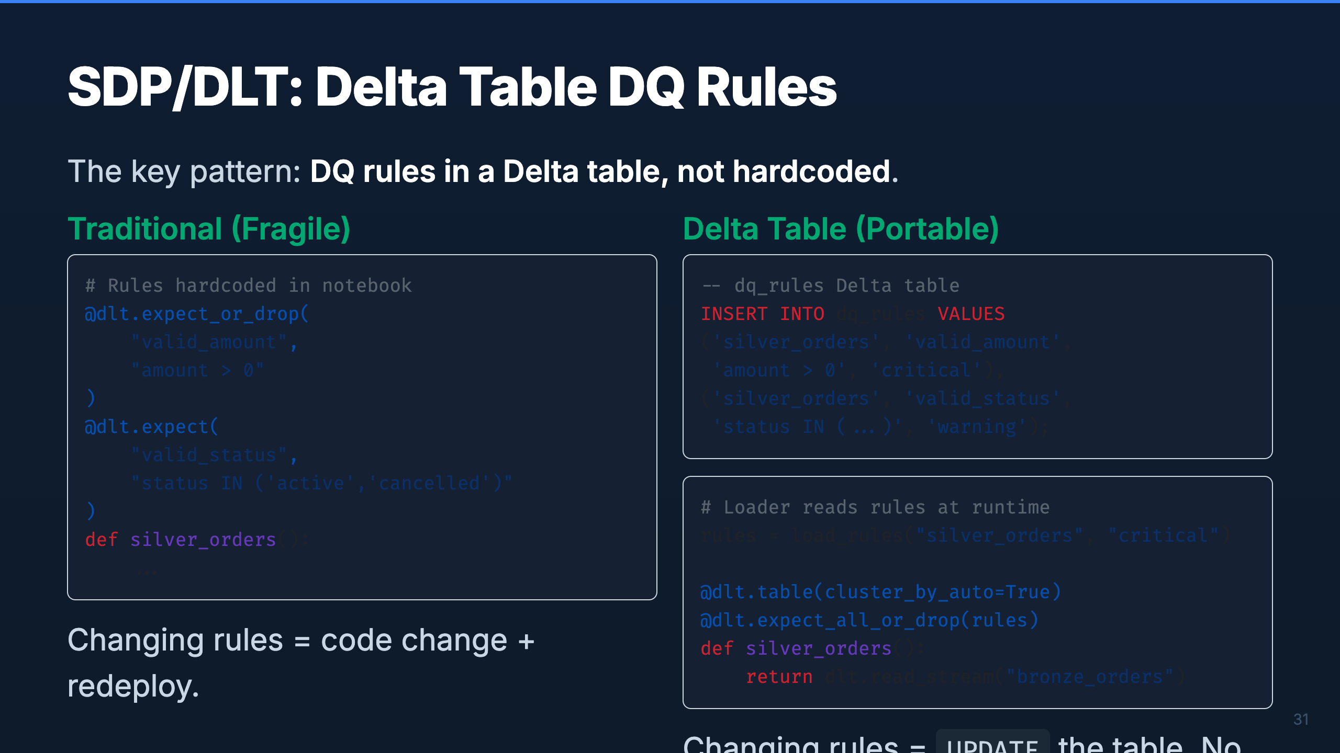
Notes:
Speaker: This is the single most impactful pattern in the Silver layer. By storing DQ rules in a Delta table, you decouple rule management from code deployment. Data stewards can update rules with SQL. The pipeline picks them up on the next run. Critical rules drop bad records; warning rules log them but pass through. Delta time travel gives you a full audit history. Timing: ~2 min

Slide 36
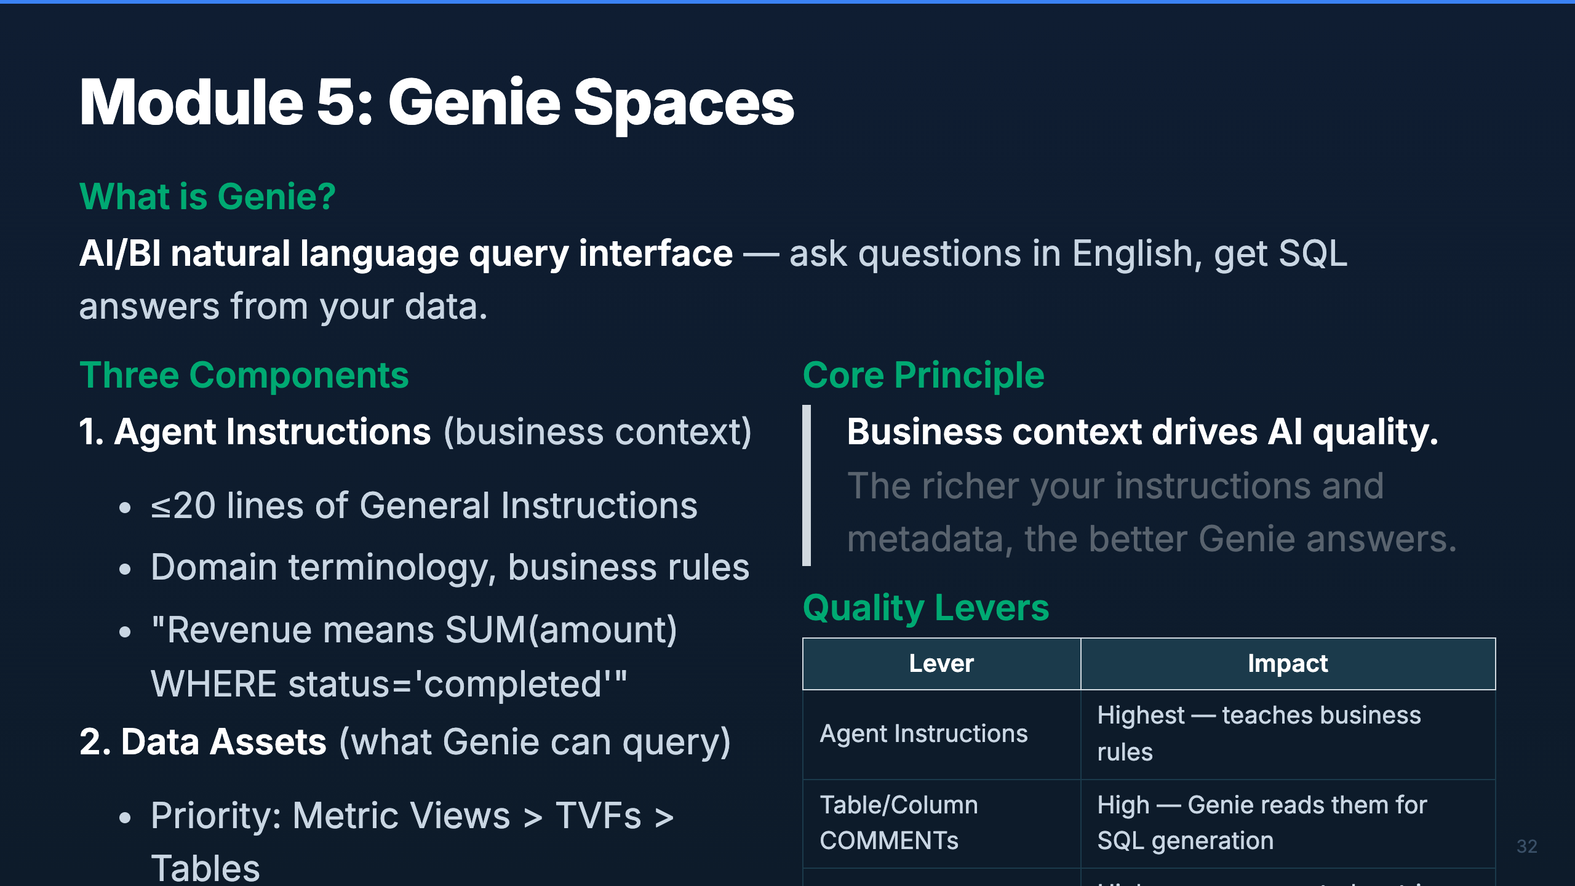
Notes:
Speaker: Genie translates natural language to SQL. The quality of its output depends entirely on the context you provide. Agent instructions are the highest-impact lever — they teach Genie your business rules. Table and column COMMENTs are next — Genie reads them when generating SQL. Metric Views pre-define common aggregations so Genie doesn't have to figure them out. Timing: ~2 min

Slide 37
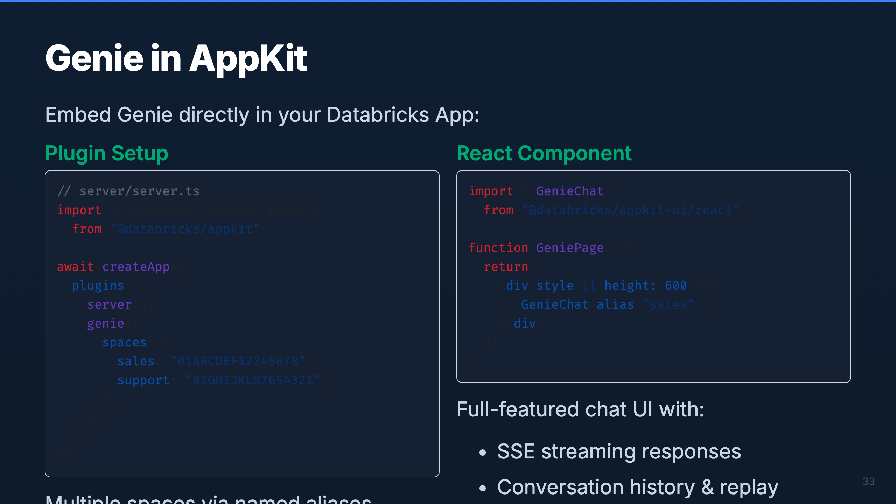
Notes:
Speaker: The Genie plugin makes it trivial to embed natural language analytics in your app. You configure named space aliases in the server, then drop the GenieChat component in your React UI. It handles streaming, history, and reconnection automatically. For custom UIs, the useGenieChat hook gives you lower-level control over messages and status. Timing: ~2 min

Slide 38
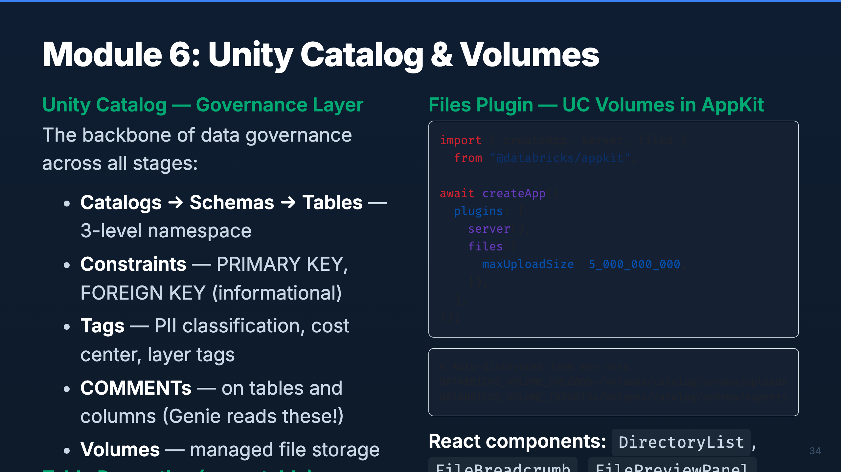
Notes:
Speaker: Unity Catalog is the governance layer that ties everything together. Every table, schema, and volume is governed through UC. The key table properties — Change Data Feed, Row Tracking, Auto-Optimize — are non-negotiable in this framework. The Files plugin connects AppKit to UC Volumes for file upload/download, with env-based auto-discovery of volume paths. Timing: ~2 min

Slide 39

Notes:
_transition: cover Speaker: Now for the hands-on part. We'll walk through the complete AppKit + Lakebase workshop lifecycle — scaffolding a project, building a UI from a PRD, deploying with mock data, wiring a Lakebase backend, and finally deploying with live data and running E2E tests. Timing: ~30 sec transition

Slide 40
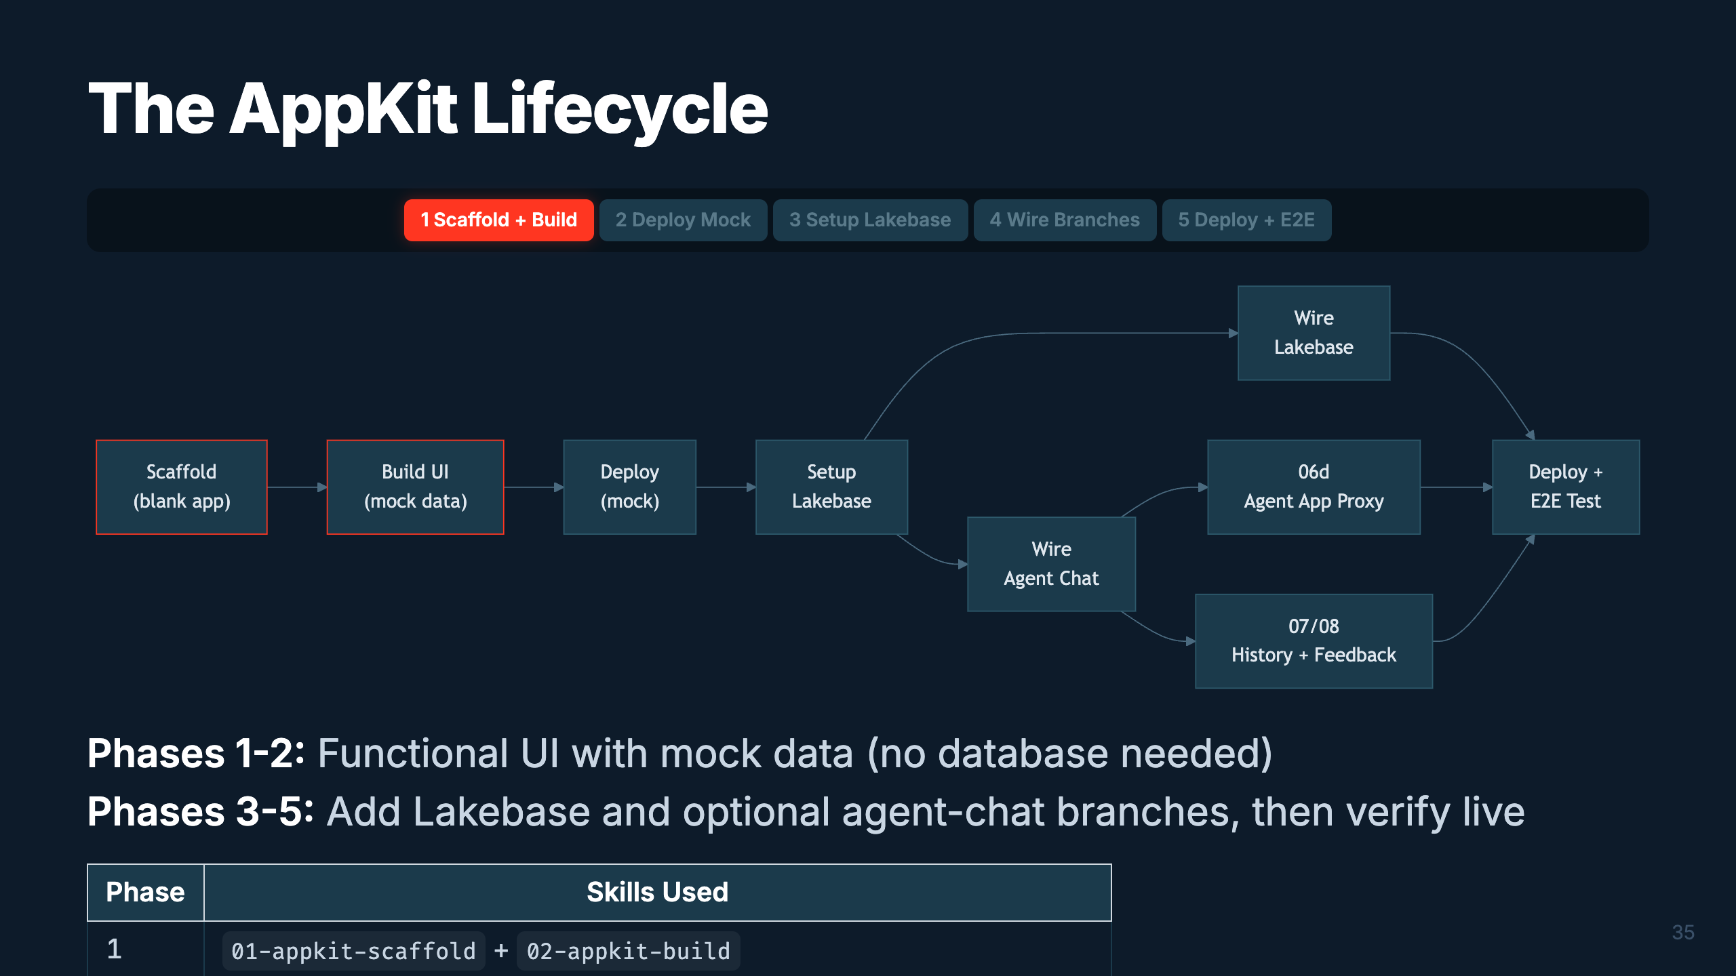
Notes:
Speaker: The AppKit lifecycle still starts simply: scaffold, build, deploy mock. After that, it branches. You can wire Lakebase, wire a Model Serving endpoint, wire a separate Agent App with 06d, then optionally add chat history and feedback before the final E2E deploy. Timing: ~2 min

Slide 41
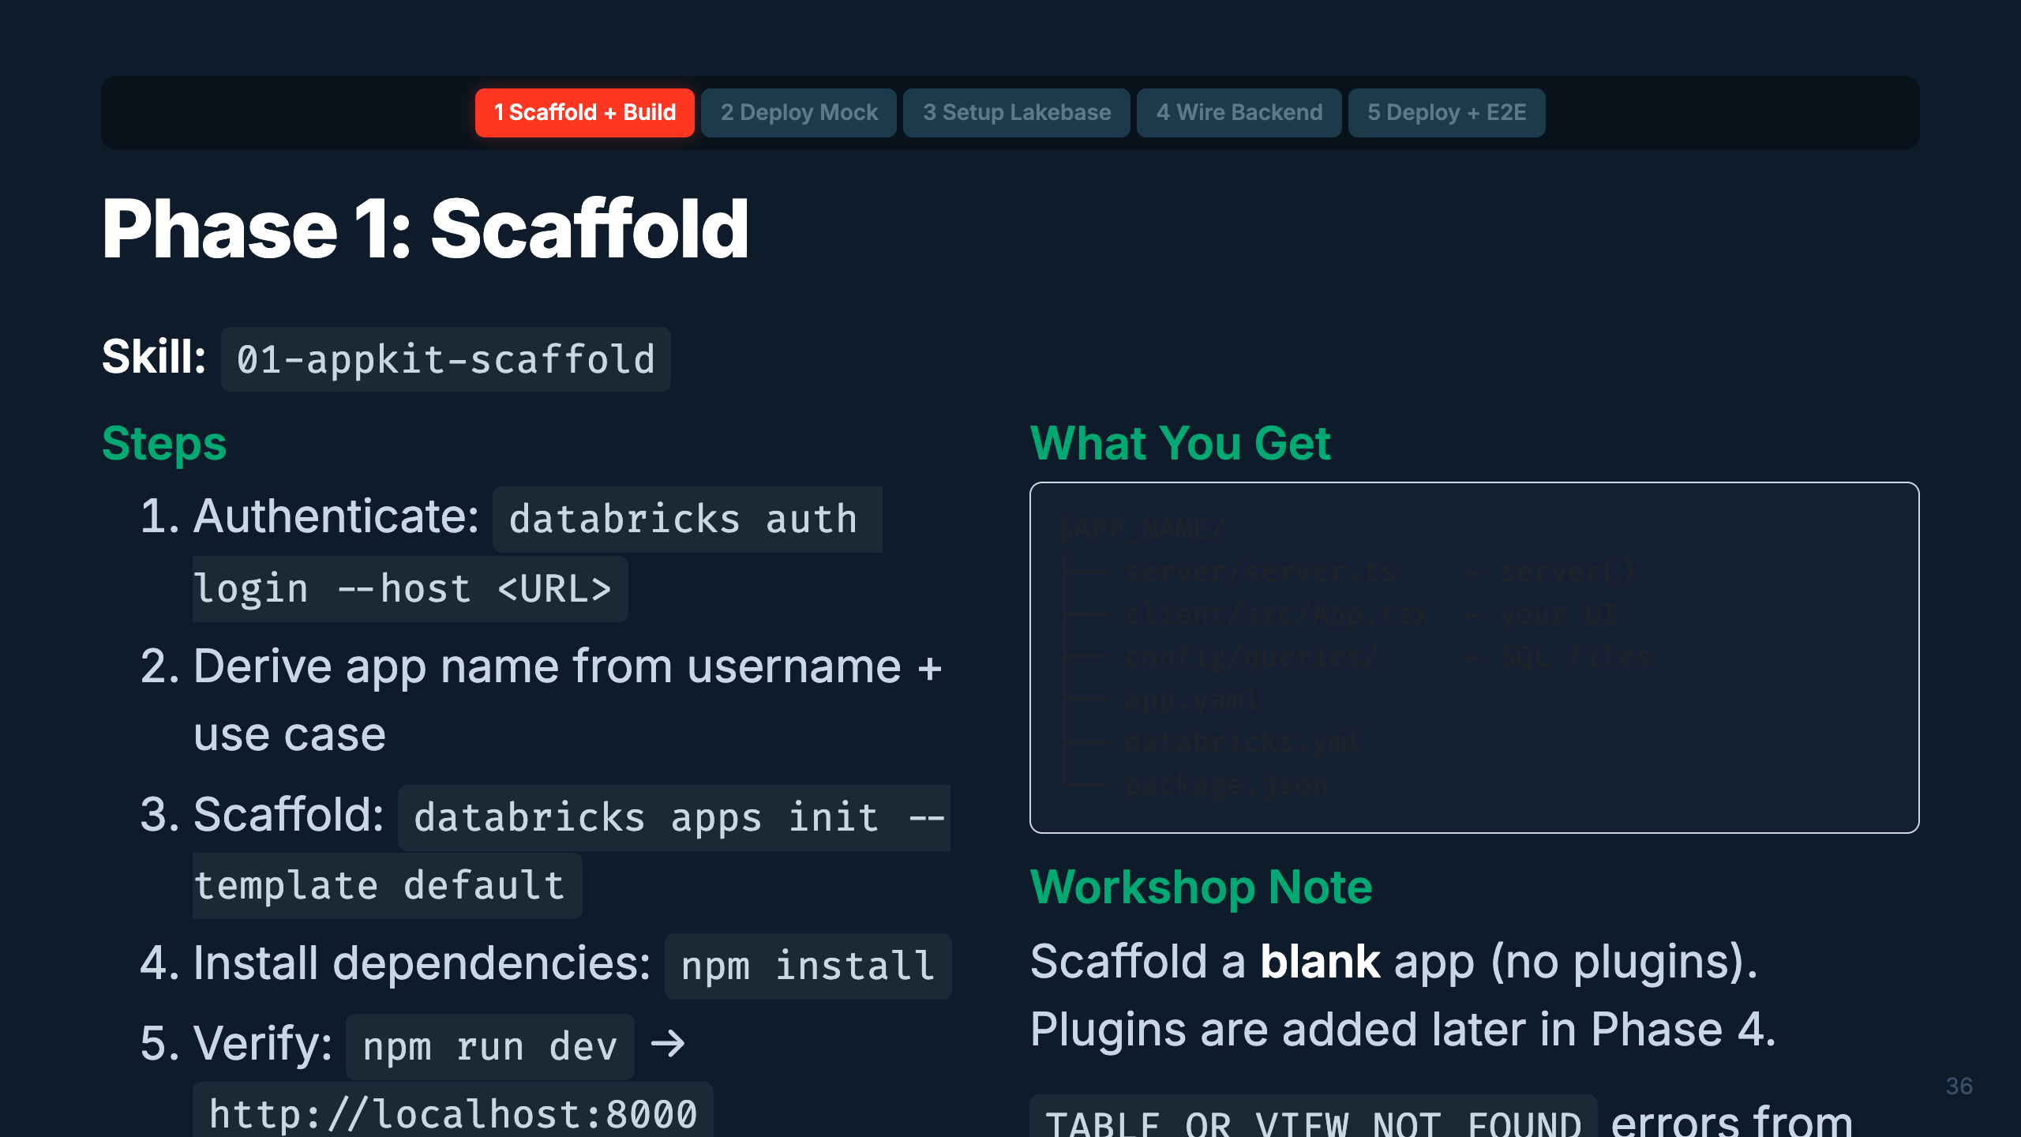
Notes:
Speaker: Phase 1 starts with authentication and scaffolding. The CLI generates the full project structure. We scaffold blank — no plugins yet — because we want to build the UI with mock data first. The typegen errors are normal at this point since we haven't added any SQL files. Timing: ~2 min

Slide 42
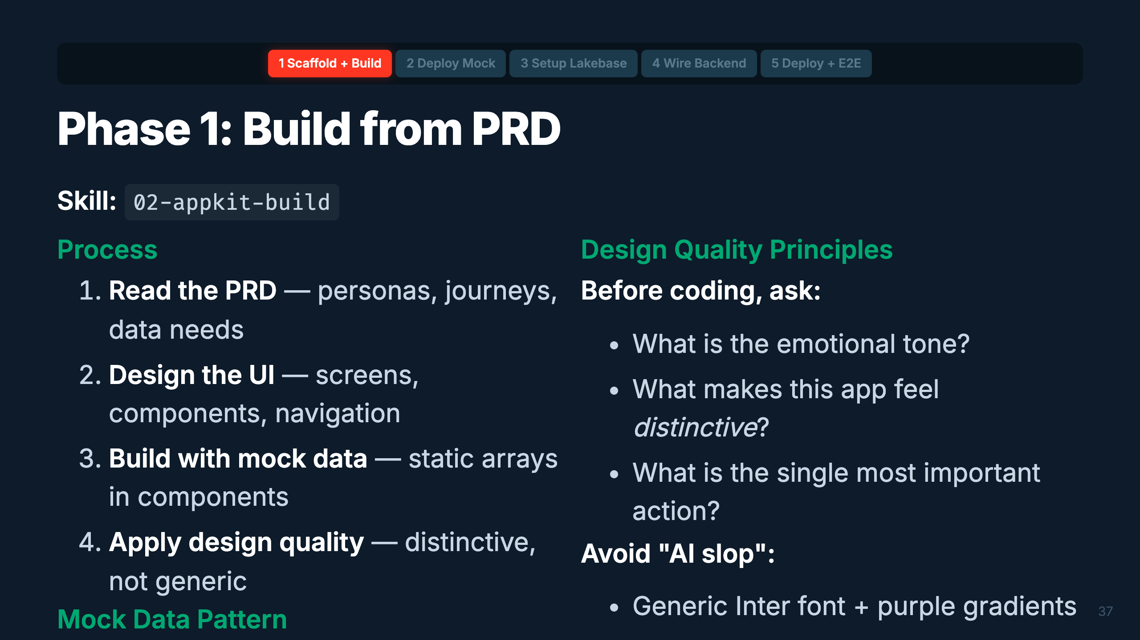
Notes:
Speaker: Building from a PRD is where the app takes shape. The key insight: use mock data arrays first. This lets you validate the entire UI flow without a database. Design quality matters — the skill references the Anthropic frontend-design patterns to avoid generic-looking AI output. Make it distinctive. Timing: ~2 min

Slide 43
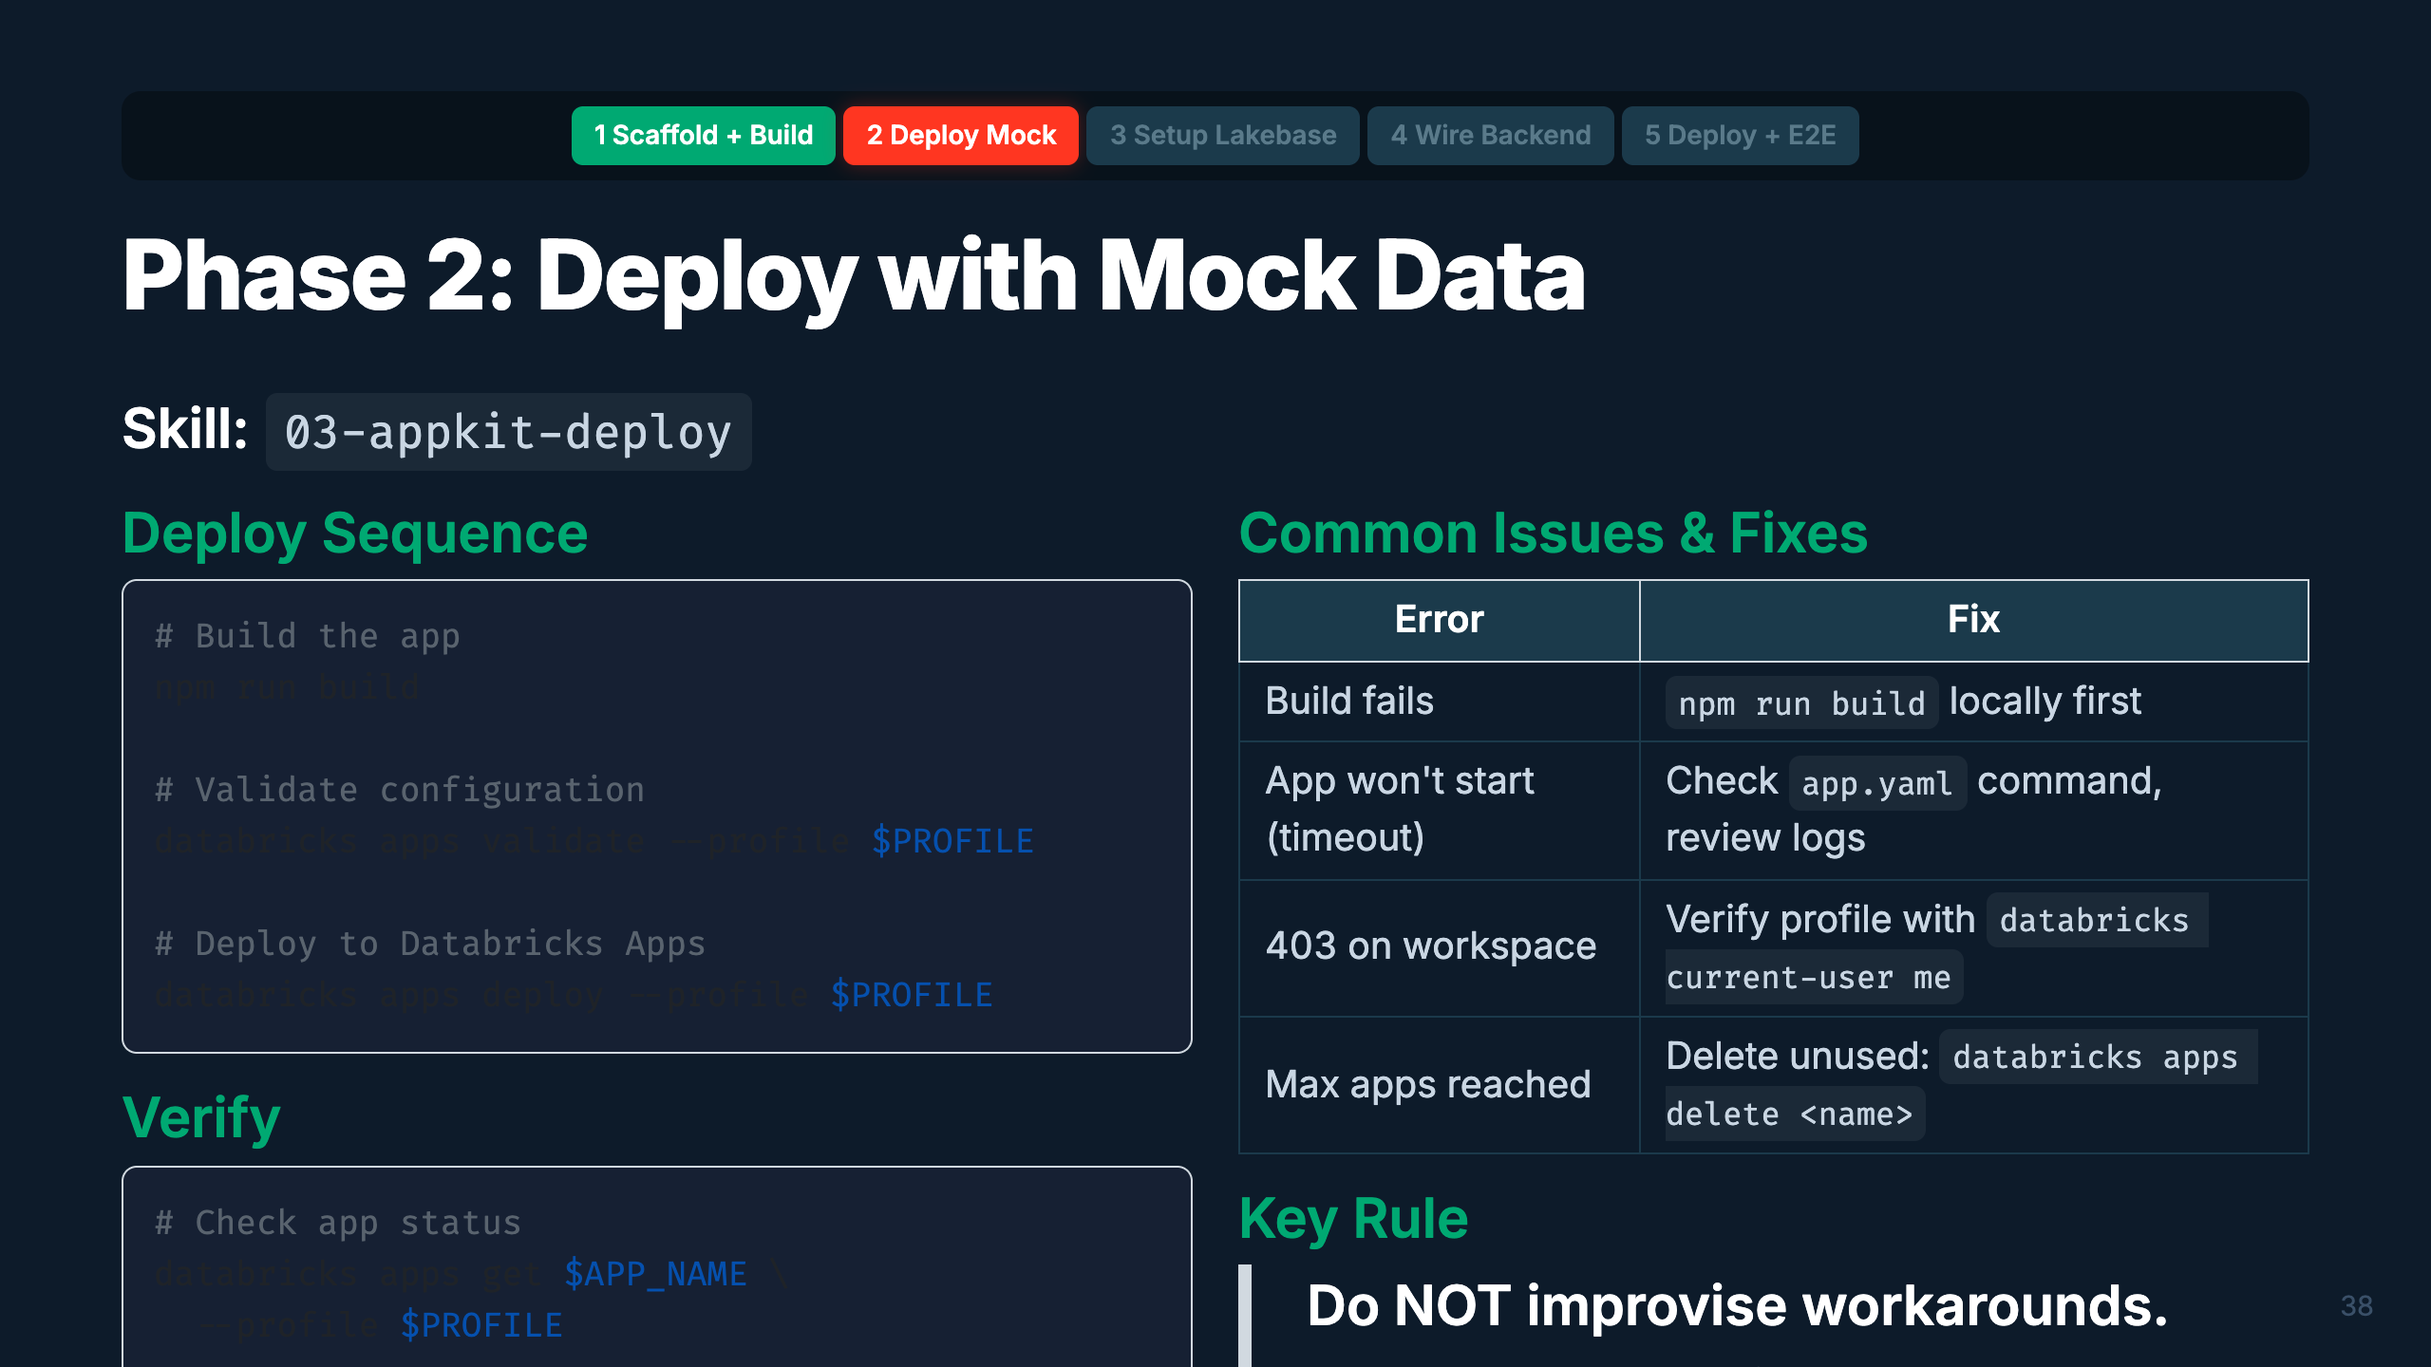
Notes:
Speaker: First deploy! Build locally, validate, deploy. The validate step catches config issues before they hit the platform. If the deploy fails, stream logs and match against known errors. The most important rule: don't improvise workarounds. The skill has a comprehensive error table — use it. Improvised fixes (like adding npm lifecycle hooks) consistently cause cascading failures. Timing: ~2 min

Slide 44
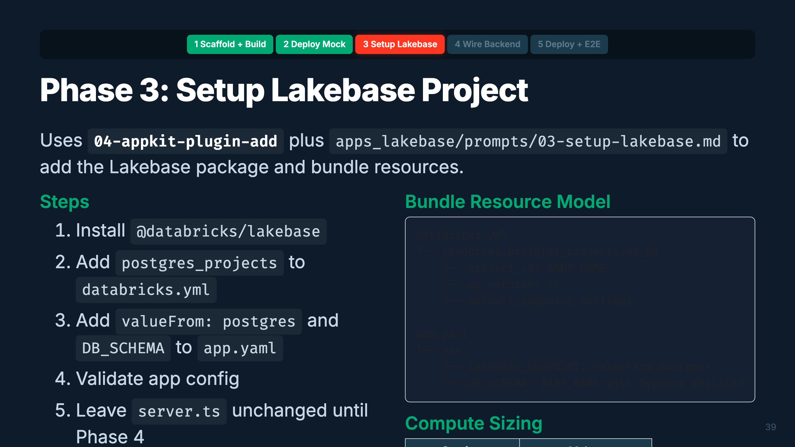
Notes:
Speaker: Phase 3 is config-only. The bundle declares the Lakebase project and app environment variables, but the actual `lakebase()` registration and database code wait until Phase 4. This prevents local runtime crashes before platform-injected Lakebase env vars exist. Timing: ~2 min

Slide 45
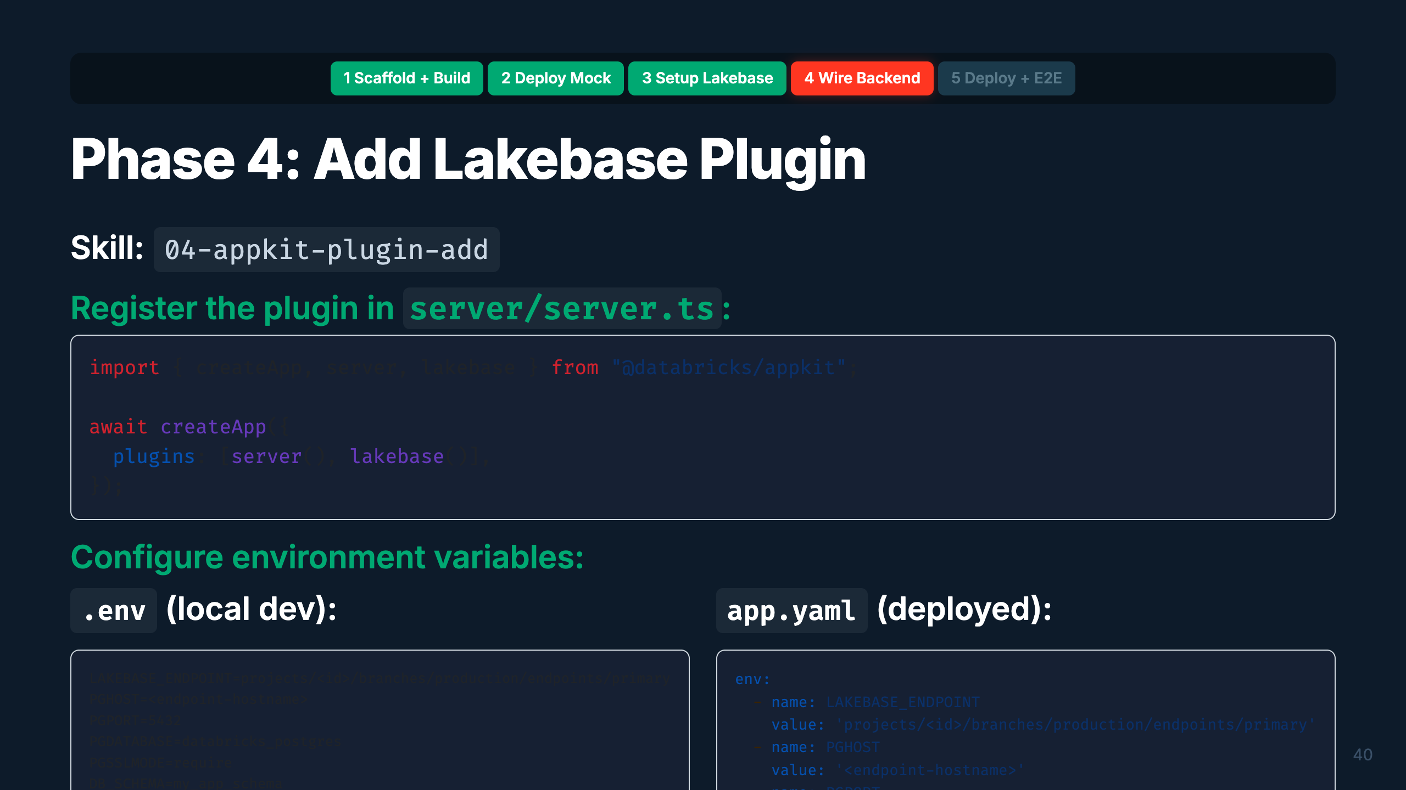
Notes:
Speaker: Now we add the Lakebase plugin. Two steps: register in server.ts and configure env vars. The plugin handles OAuth token rotation automatically — no passwords needed. DB_SCHEMA isolates your app's tables within the shared database. Verify with npm run build to make sure the import compiles. Timing: ~2 min

Slide 46
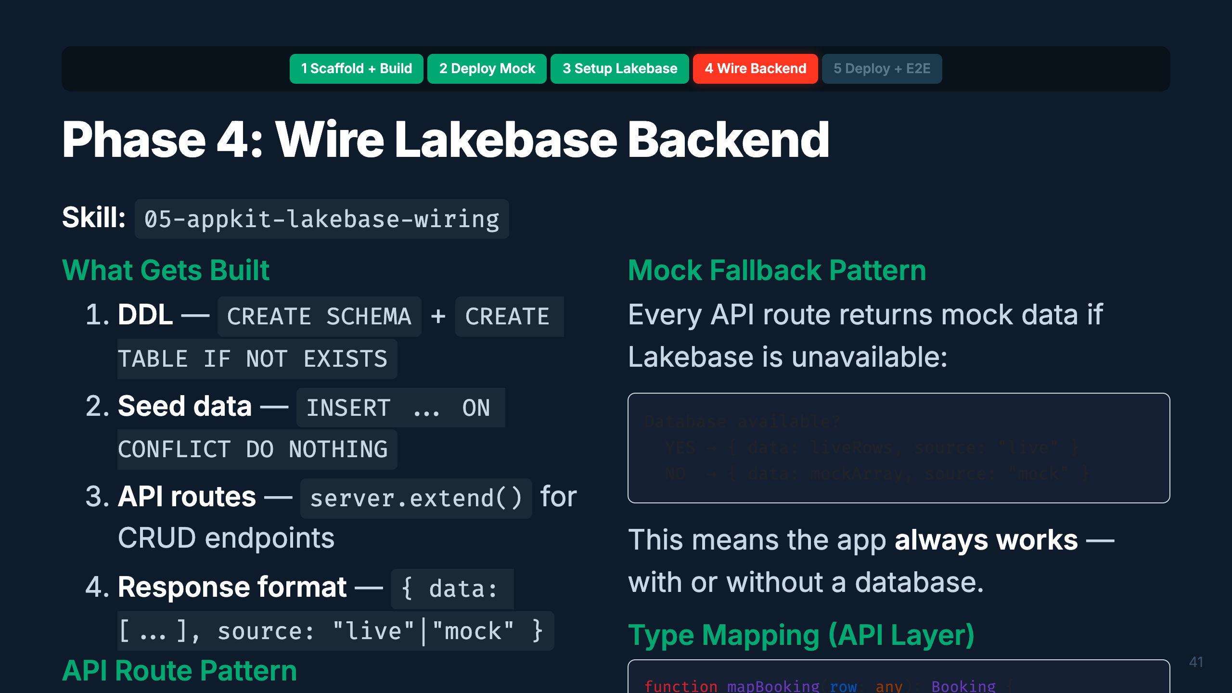
Notes:
Speaker: This is the most substantial phase. You design the schema from the PRD, write DDL, create API routes with server.extend(), and build the mapper layer. The mock fallback pattern is critical — every endpoint returns mock data if the database isn't available. This means the app works locally without Lakebase AND degrades gracefully in production. Timing: ~3 min

Slide 47
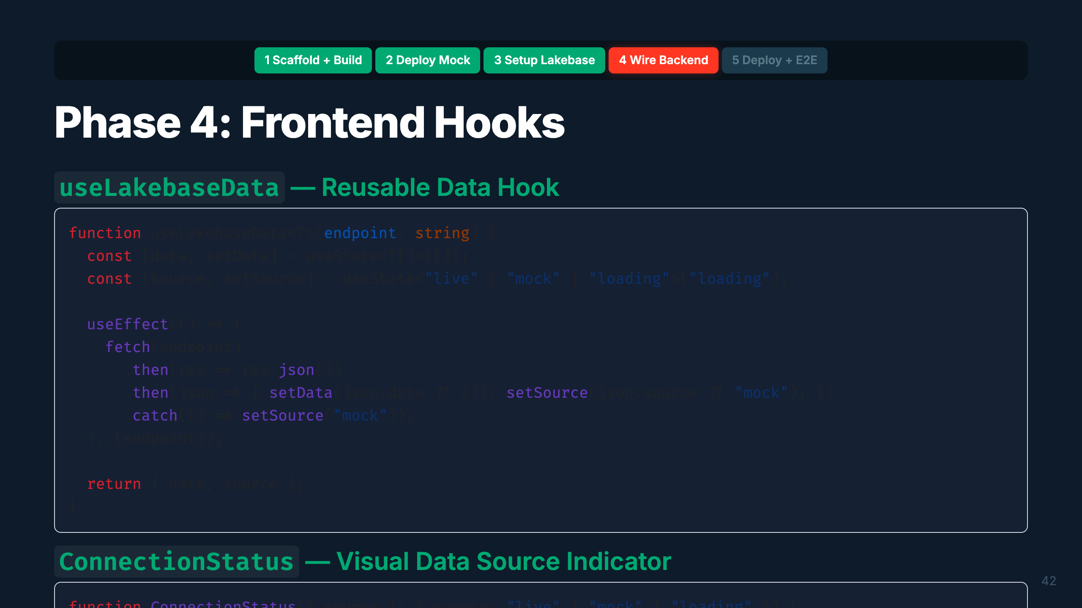
Notes:
Speaker: Two reusable patterns for the frontend. useLakebaseData wraps fetch/useState/useEffect into a single hook — pass an endpoint, get back data and source. ConnectionStatus shows a green or yellow indicator so users always know if they're seeing live or mock data. Put it on every page. Timing: ~1.5 min

Slide 48
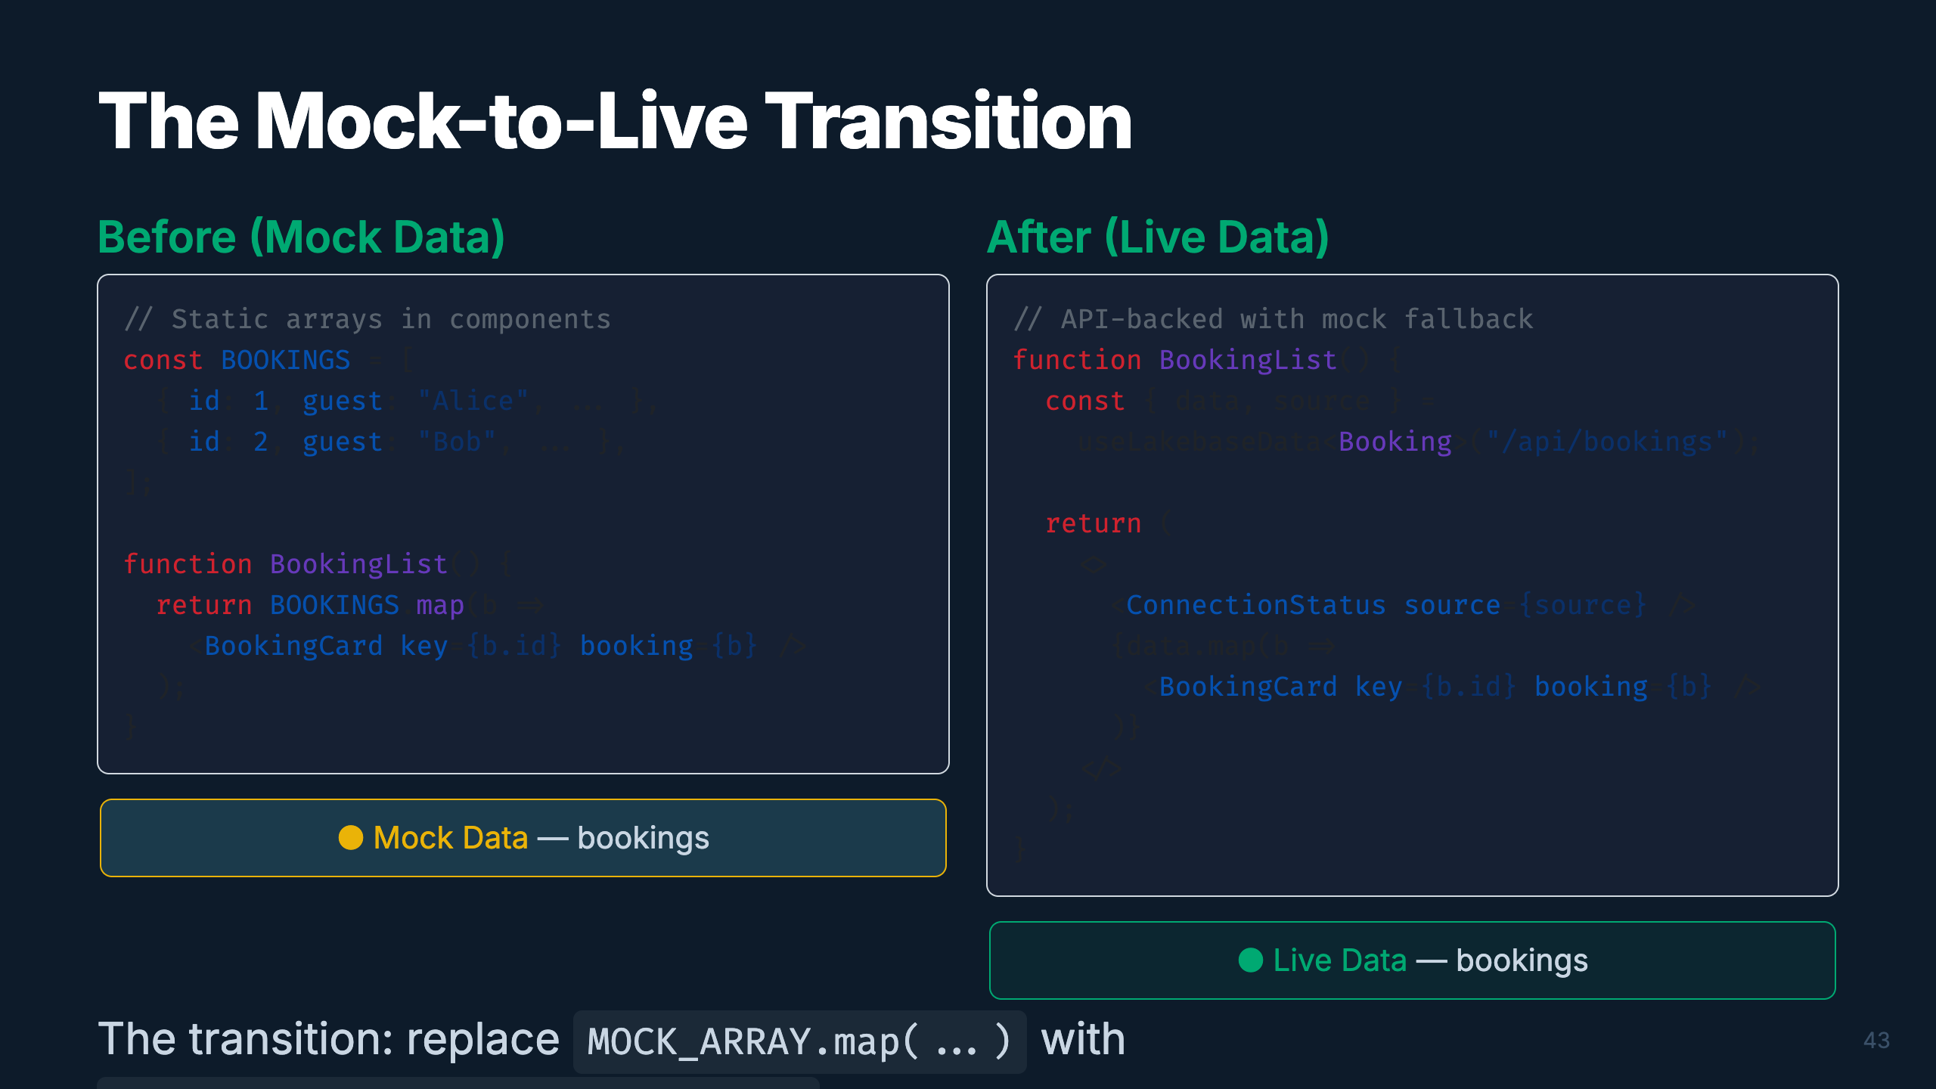
Notes:
Speaker: Here's the before and after. On the left, static mock arrays rendered directly. On the right, the same component but now powered by the useLakebaseData hook. The data comes from the API, which returns live data from Lakebase or falls back to mock. The ConnectionStatus indicator switches from yellow "Mock" to green "Live" when the database connects. Timing: ~2 min

Slide 49
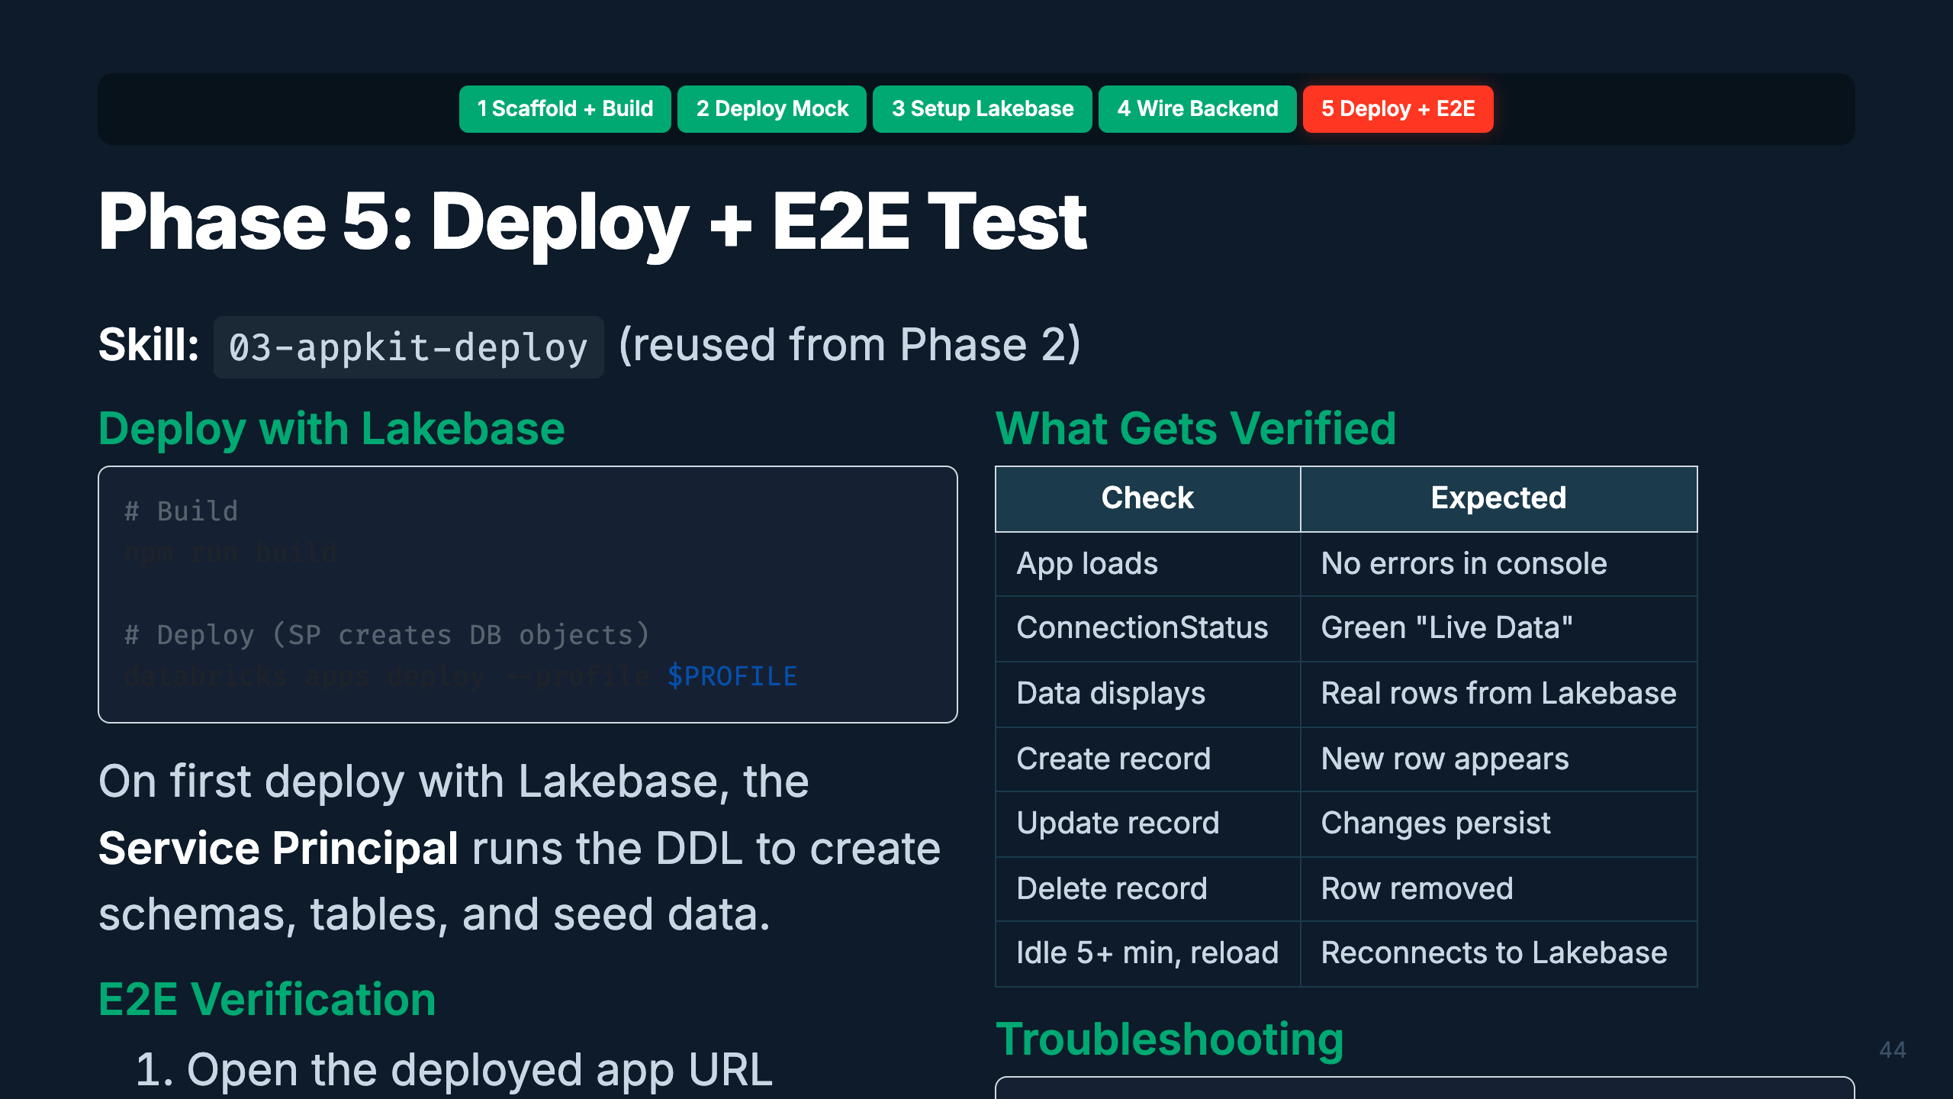
Notes:
Speaker: The final deploy. This time the app has Lakebase wired in, so the Service Principal creates the database objects on first run. E2E testing verifies everything: the app loads, shows live data, CRUD works, and — critically — the app handles Lakebase going idle (scale-to-zero) and reconnecting gracefully. Timing: ~2 min

Slide 50
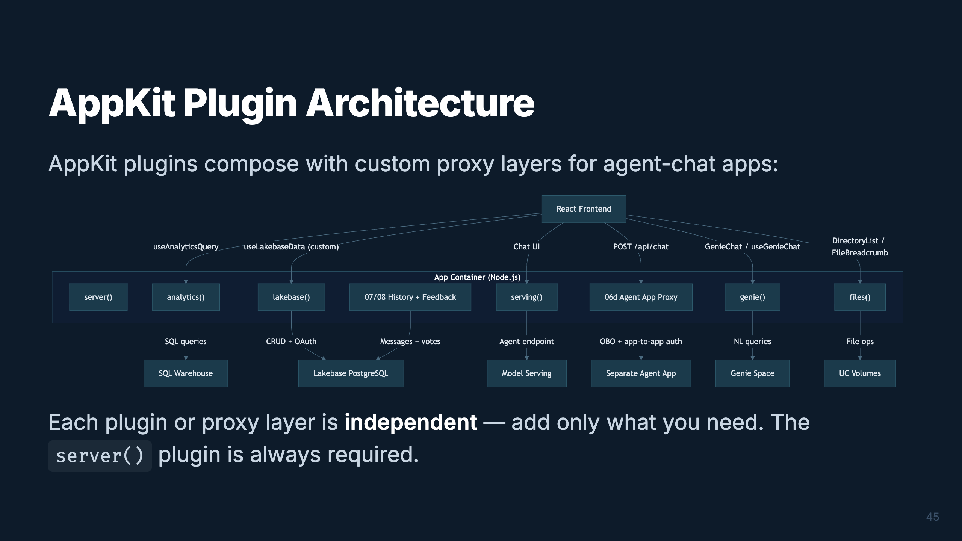
Notes:
Speaker: Here's the plugin and proxy architecture. The built-in plugins connect to Databricks services, and the newer agent-chat path can either use serving() or a separate Agent App proxy with OBO forwarding. Chat history and feedback then persist messages and votes in Lakebase. Timing: ~1.5 min

Slide 51
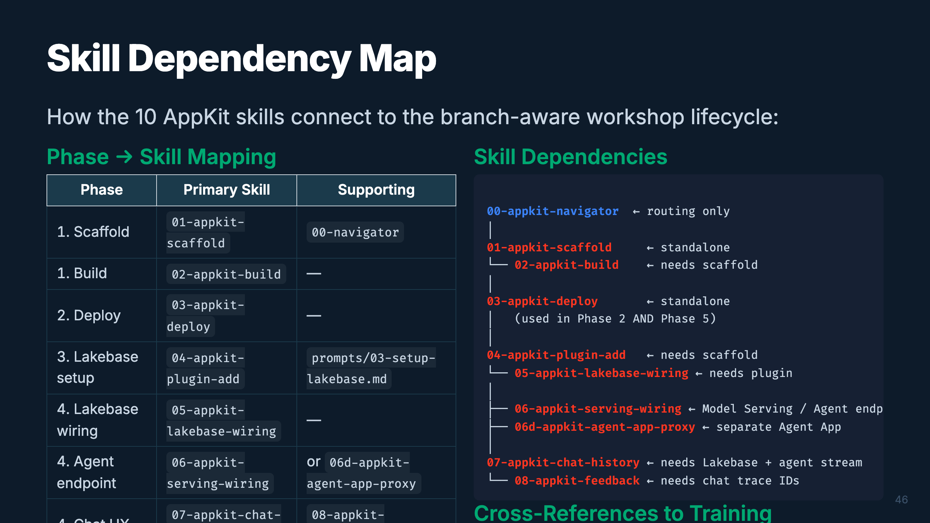
Notes:
Speaker: This map shows the updated AppKit skill graph. The base app path is still scaffold, build, deploy mock. After plugin setup, Lakebase, serving endpoint wiring, and the separate Agent App proxy are branches. Chat history depends on Lakebase plus an agent stream, and feedback depends on the trace IDs captured by chat history. Timing: ~1.5 min

Slide 52

Notes:
_transition: cover Speaker: Let's bring it all together. Both paths — the data pipeline and the app — converge into a complete, production-grade solution. I'll show you how to get started with copy-paste prompts. Timing: ~30 sec transition

Slide 53

Notes:
Speaker: Here's the convergence. Your data pipeline produces Gold tables, a semantic layer, ML models, and GenAI agents. Your Databricks App queries those Gold tables via the analytics plugin, embeds Genie via the genie plugin, stores app state in Lakebase, and can proxy agent responses from Model Serving or a separate Agent App. The two paths aren't separate — they're two halves of the same product. Timing: ~2 min

Slide 54

Notes:
Speaker: Before you start, fill in these parameters. You'll need your workspace URL, a short name for your app, and your CLI profile. The Lakebase values get filled in during Phase 3. Run the pre-flight checks to make sure your environment is ready. Timing: ~1.5 min

Slide 55

Notes:
Speaker: These are your copy-paste prompts. Start a new AI conversation for each phase. The @ syntax references files in your workspace — the AI reads the skill and follows its instructions. Adjust the workspace URL and app name for your setup. Timing: ~2 min

Slide 56

Notes:
Speaker: Path B follows the same pattern — one prompt per stage, one conversation per stage. Start with Gold Design and your schema CSV. Each orchestrator handles the entire workflow for its stage. The QUICKSTART.md file has the complete set of prompts for all 9 stages. Timing: ~2 min

Slide 57

Notes:
Speaker: Bookmark these. The AGENTS.md is your entry point for any AI assistant. The AppKit docs are the source of truth for API details. The Agent Skills repo has the latest Databricks-maintained skills. And the framework docs have visual walkthroughs of how orchestrators work. Timing: ~1 min

Slide 58

Notes:
_transition: cover Speaker: That's the full journey — from a schema CSV or PRD to a production data product with a beautiful Databricks App, all powered by AI-assisted development. The skills are ready. Your AI assistant is ready. All you need is a workspace and a use case. Let's open it up for questions. Timing: Q&A

