Slide 1


Slide 2
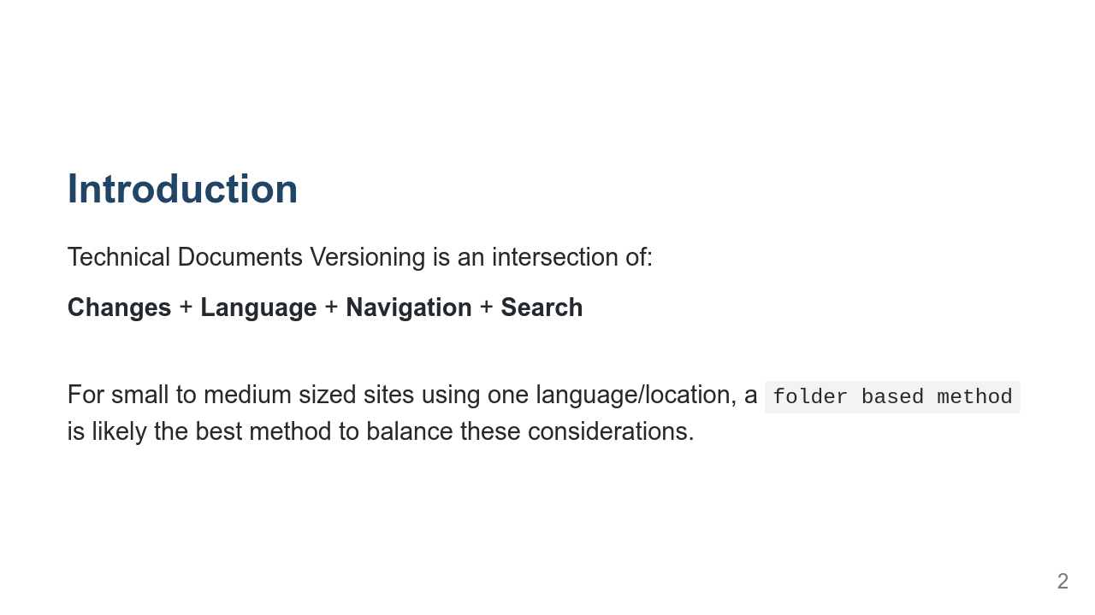
Notes:
Things to consider when thinking about versioning documentation 2 viable schemes available (for Hugo/Netlify) Dropdown menu navigation code examples trade offs

Slide 3
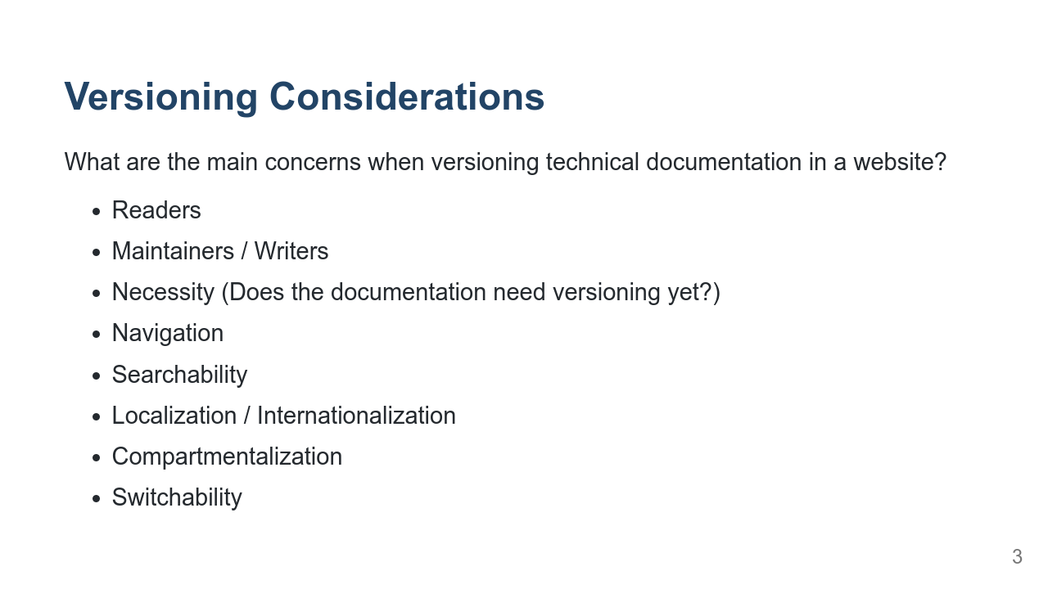
Notes:
Readers: ease of navigation/understanding Maintainer: how hard is it to update when it's time to cut a new version? Necessity: YAGNI - you ain't gonna need it Navigation: Differences between versions (how do you deal with pages that have been added, removed, or moved between releases?) Searchability: Does the duplication of pages affect search results? How do you manage result priority between versions Localization/internationalization: how does the added complexity of language/locale versions affect the version system Compartmentalization: Does all of the site need to be versioned? How do we avoid versioning the entire site if only Documentation versions are the goal? Switchability: How easy is it to change versioning schemes

Slide 4
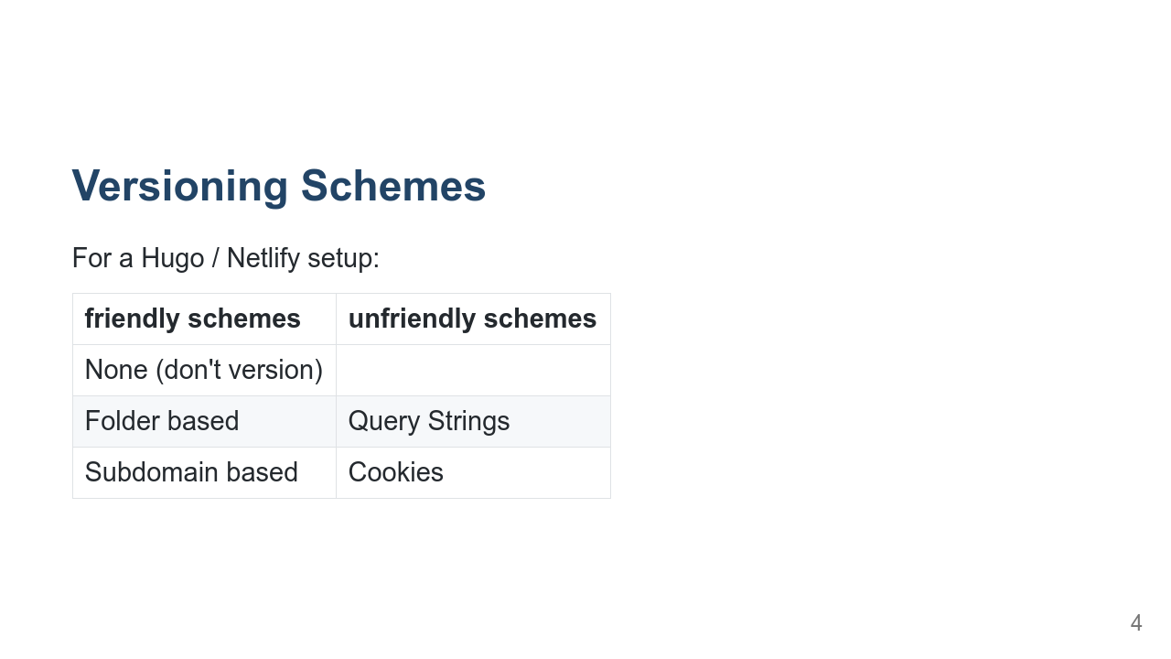
Notes:
Because Hugo is a static site generator, and Netlify abstracts a lot of the server away Query Strings and Cookies don't really work for a Hugo / Netlify site

Slide 5
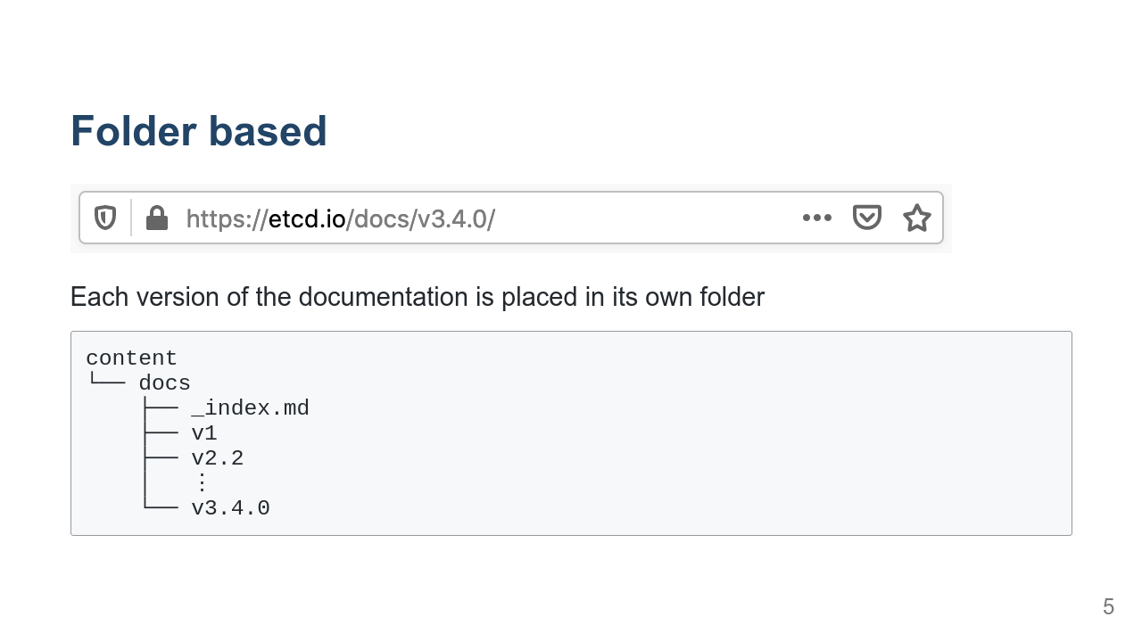
Notes:
Scores high on: - Maintainer ease of updates - Compartmentalization This is probably the easiest way to start versioning. Scores low on: - Localization / Internationalization

Slide 6
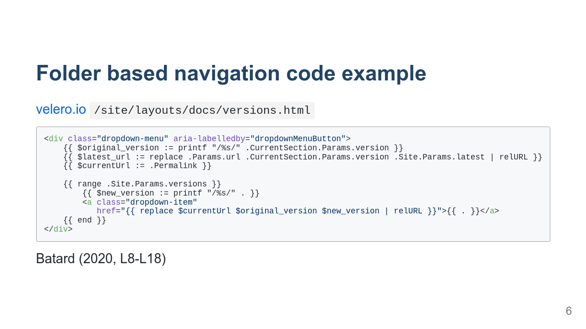
Notes:
Can make code more complex One of the things that make this a good example is how Batard (2020, L8-L18) manages the navigation in the `/site/layouts/docs/versions.html` file, particularly the use of the `replace` function to ensure that when the links in the dropdown menu are built, the versioned links reflect the currently loaded page:

Slide 7
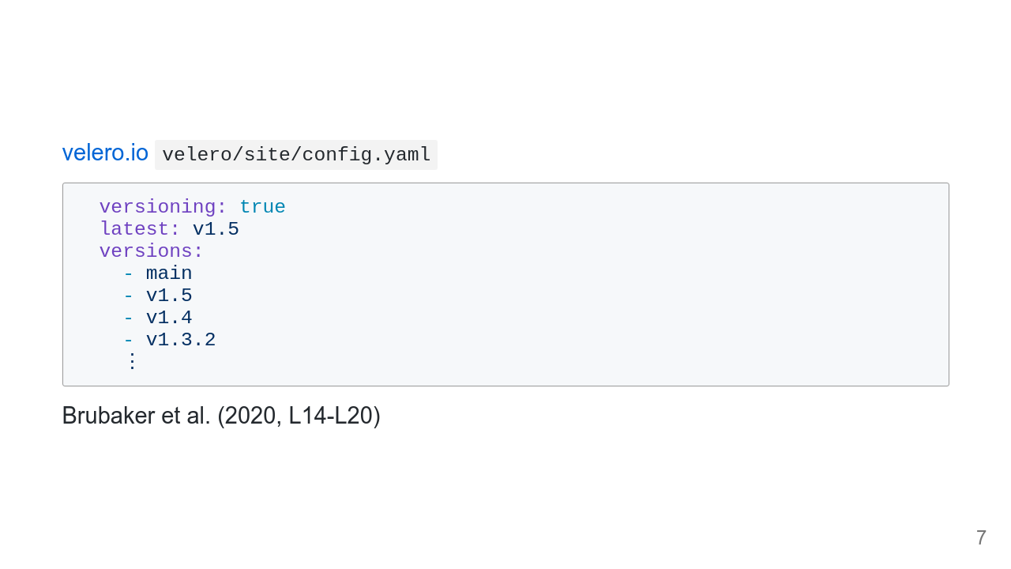
Notes:
Can make configuration less complex

Slide 8
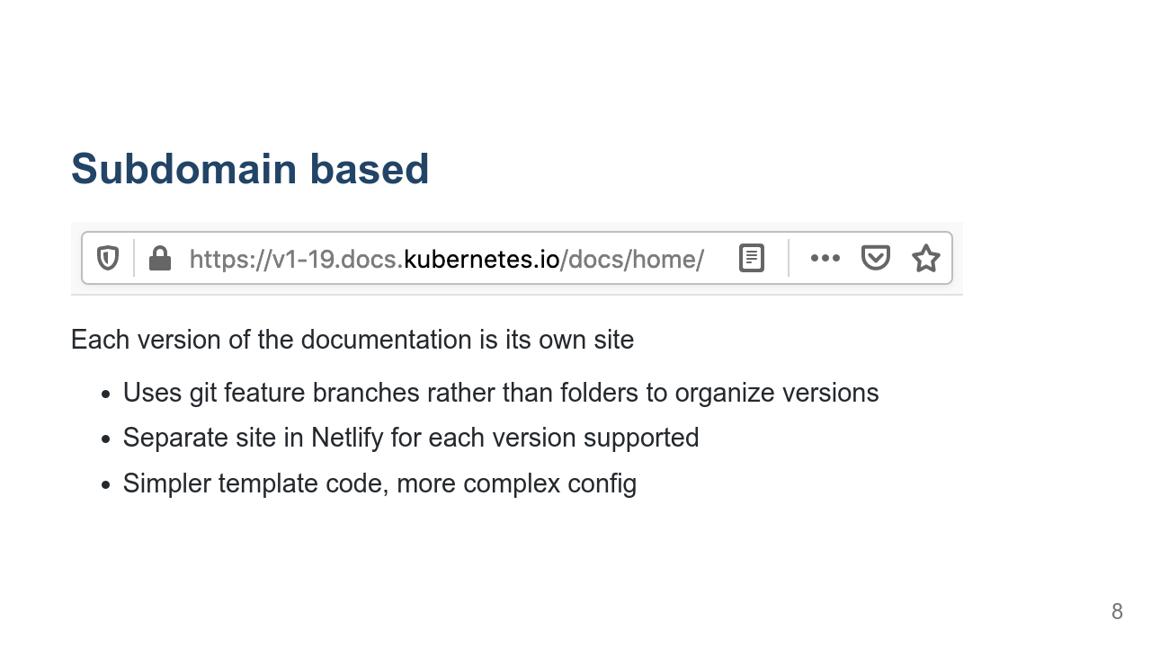
Notes:
Scores high on: - Localization / Internationalization Scores low on: - Compartmentalization Scores low on: - Maintenance, each version is its own site The subdomain scheme uses some simpler template code to generate links, only having to update the `.url`, but the Hugo config file is made more complex.

Slide 9
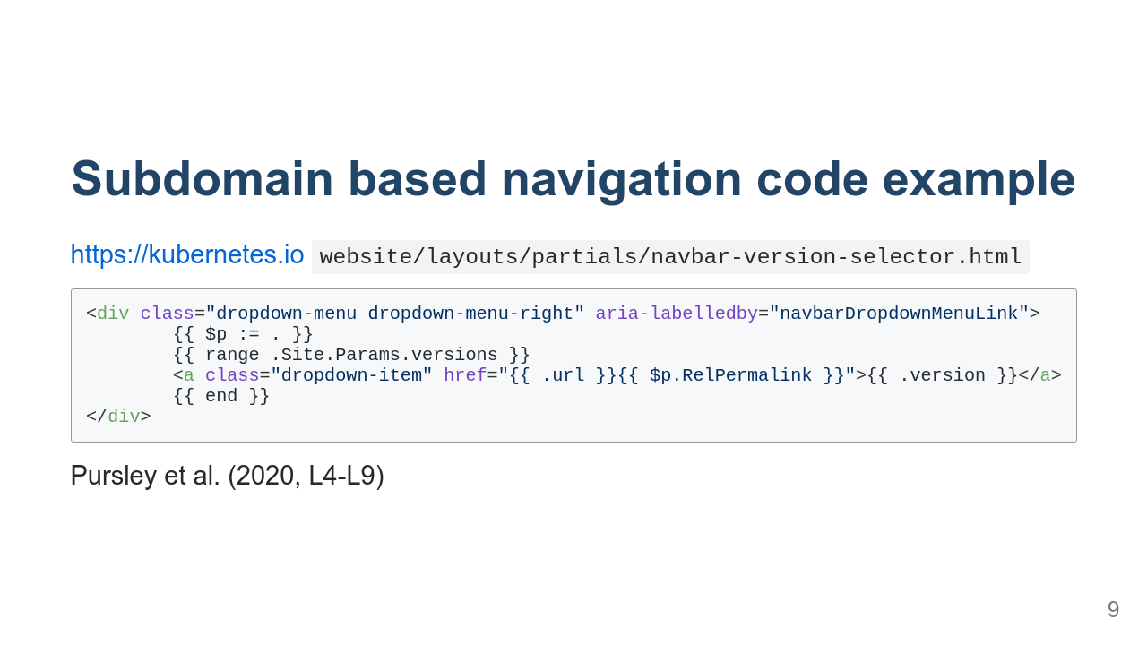
Notes:
same style of dropdown function as before, made simpler

Slide 10
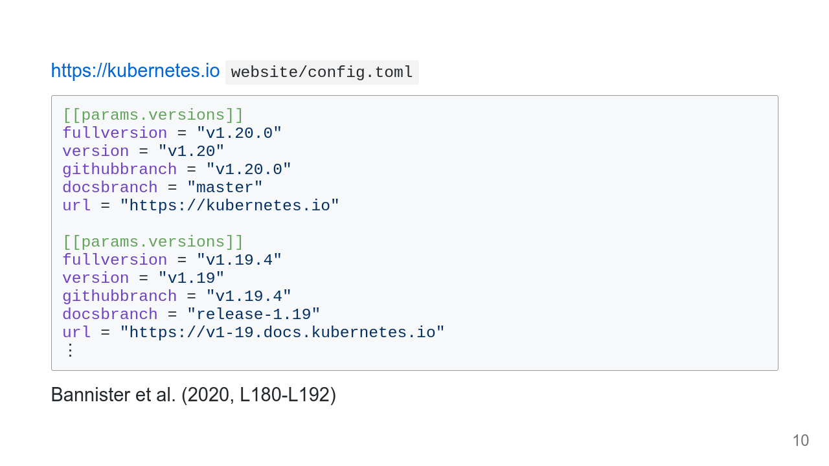
Notes:
dropdown example is made simpler because the config is more complex and because the server setup is more complex

Slide 11
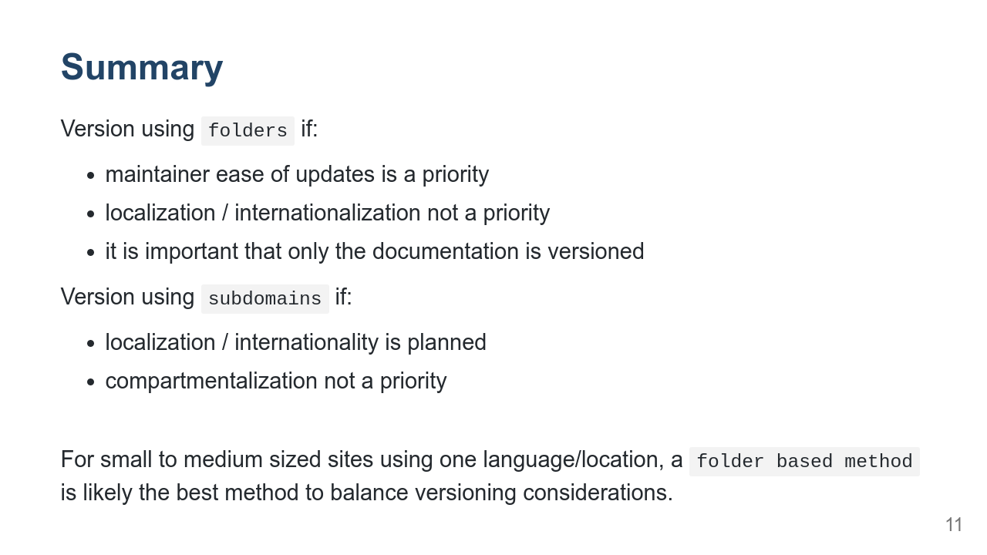
Notes:
and not, for instance, the blog some work is being done on k8s to address compartmentalazion, but it is ongoing

Slide 12


Slide 13
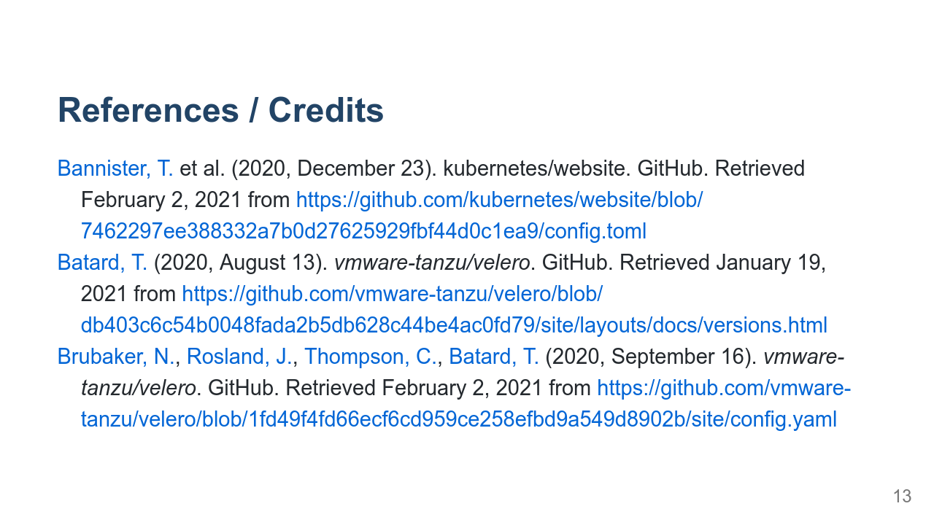

Slide 14
