Slide 1


Slide 2
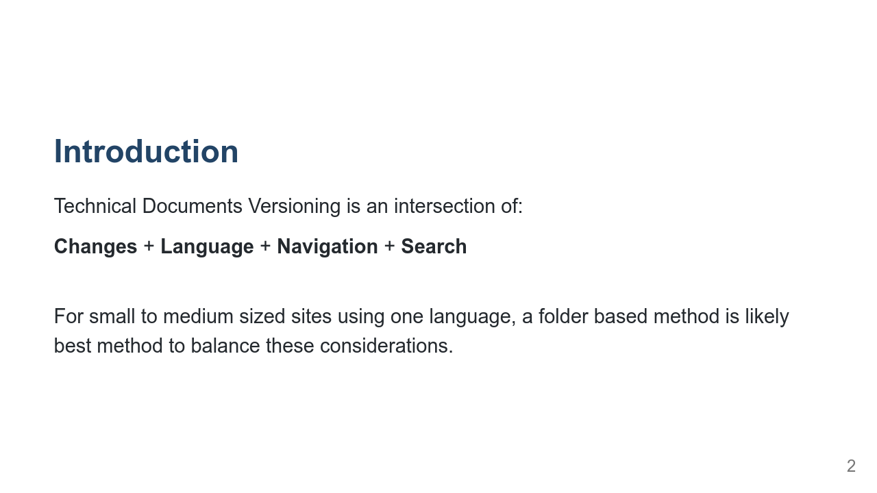
Notes:
Things to consider when thinking about versioning documentation 2 viable schemes available (for Hugo/Netlify) Dropdown menu navigation code examples trade offs

Slide 3
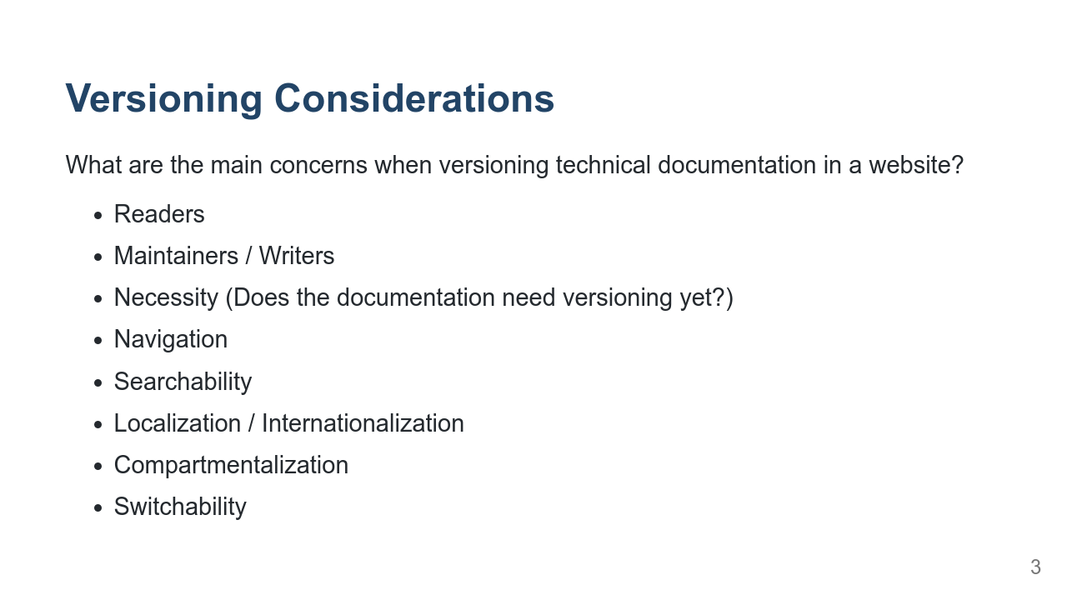
Notes:
Navigation: Differences between versions (how do you deal with pages that have been added, removed, or moved between releases?) Maintainer: how hard is it to update when it's time to cut a new version? Compartmentalization: Does all of the site need to be versioned? How do we avoid versioning the entire site if only Documentation versions are the goal? Switchability: How easy is it to change versioning schemes Searchability: Does the duplication of pages affect search results?

Slide 4
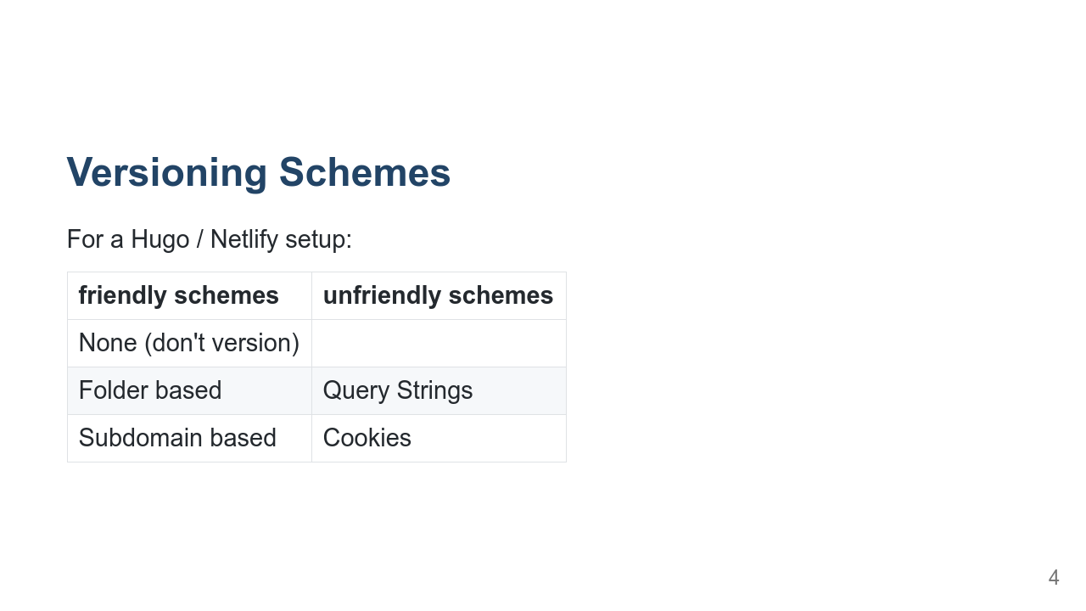
Notes:
Because Hugo is a static site generator, and Netlify abstracts a lot of the server away Query Strings and Cookies don't really work for a Hugo / Netlify site

Slide 5
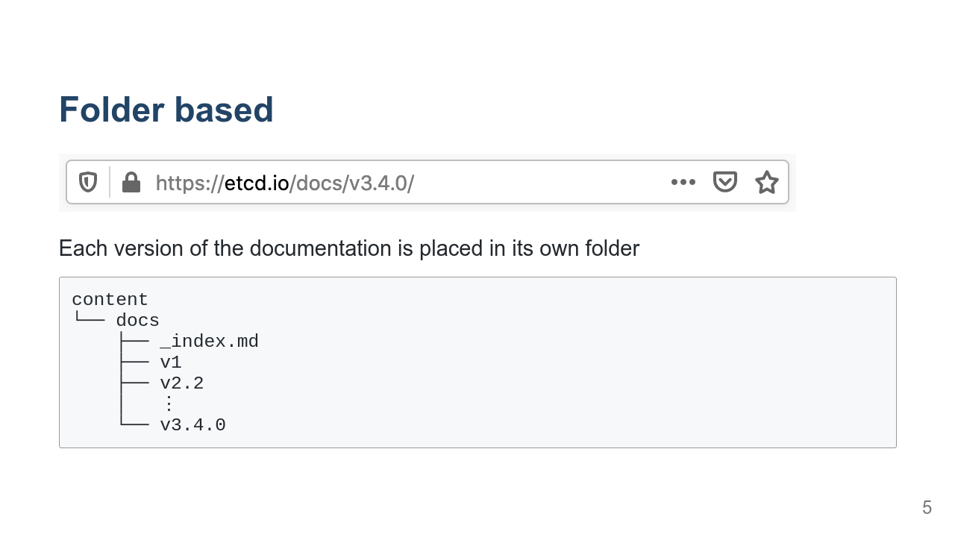
Notes:
Scores high on: - Maintainer ease of updates - Compartmentalization This is probably the easiest way to start versioning. Scores low on: - Localization / Internationalization

Slide 6
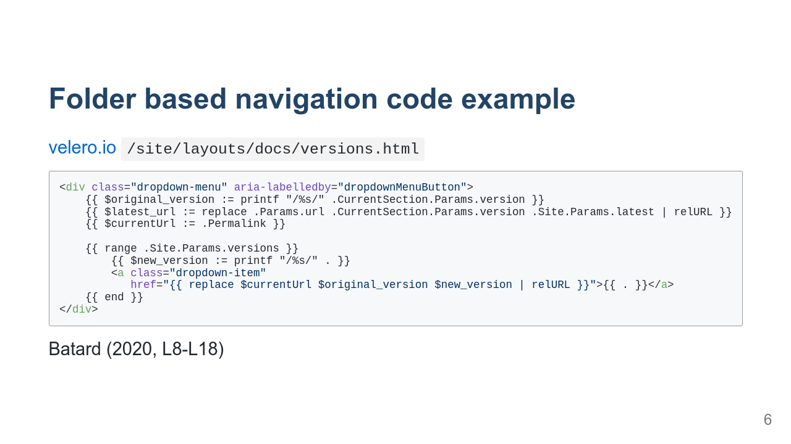
Notes:
One of the things that make this a good example is how Batard (2020, L8-L18) manages the navigation in the `/site/layouts/docs/versions.html` file, particularly the use of the `replace` function to ensure that when the links in the dropdown menu are built, the versioned links reflect the currently loaded page:

Slide 7
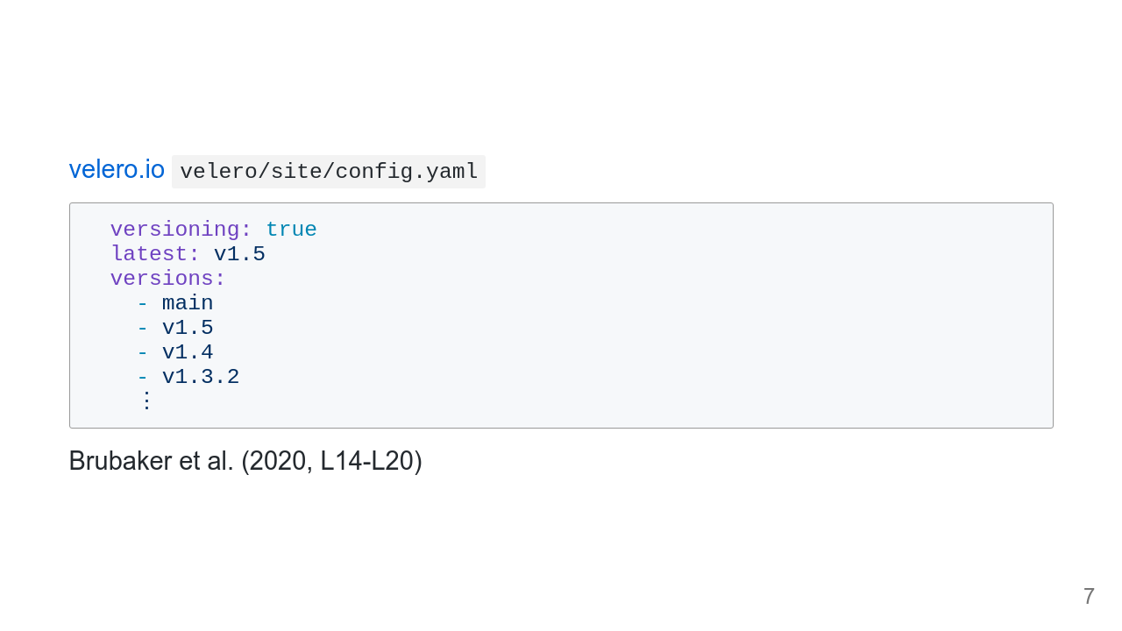

Slide 8
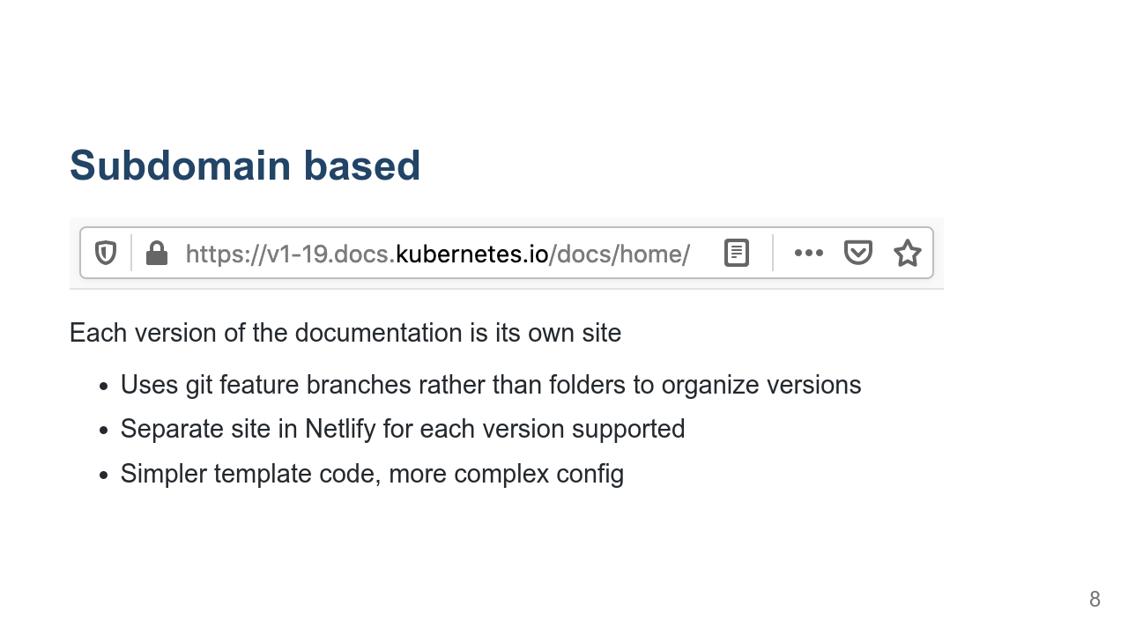
Notes:
Scores high on: - Localization / Internationalization Scores low on: - Compartmentalization The subdomain scheme uses some simpler template code to generate links, only having to update the `.url`, but the Hugo config file is made more complex.

Slide 9
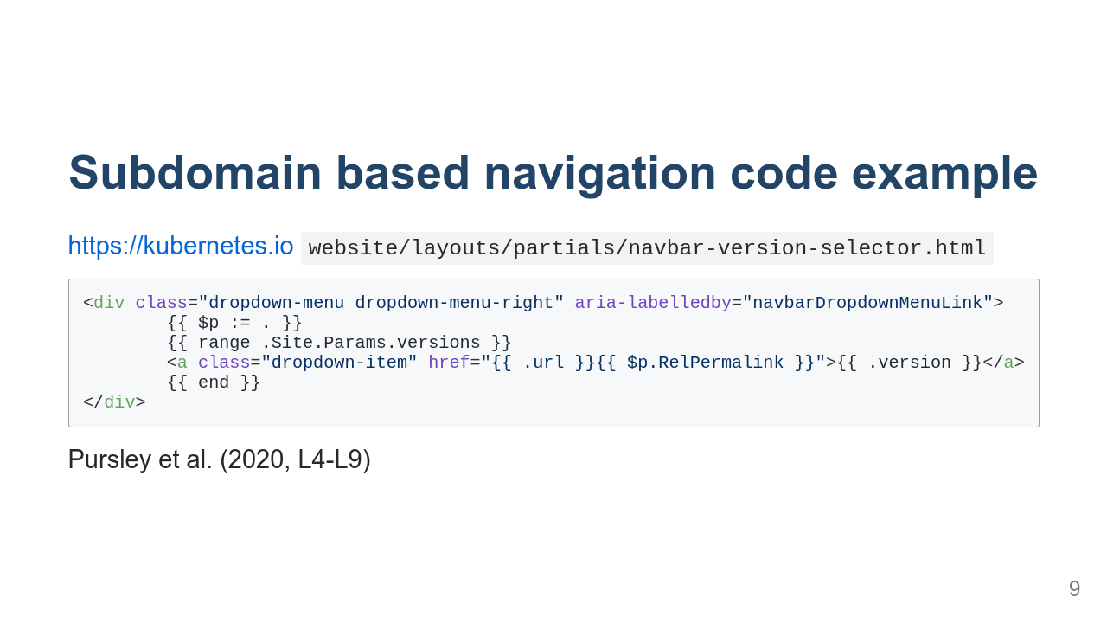

Slide 10
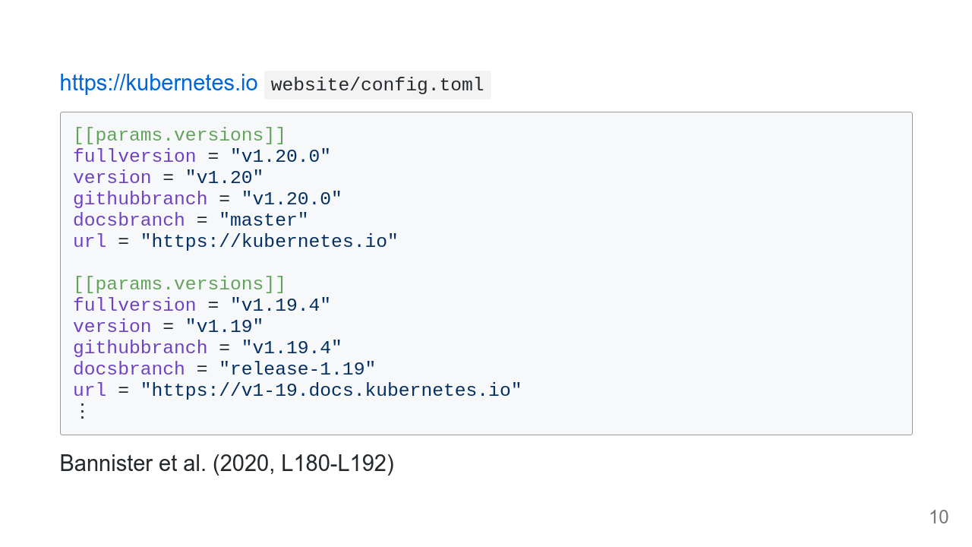

Slide 11
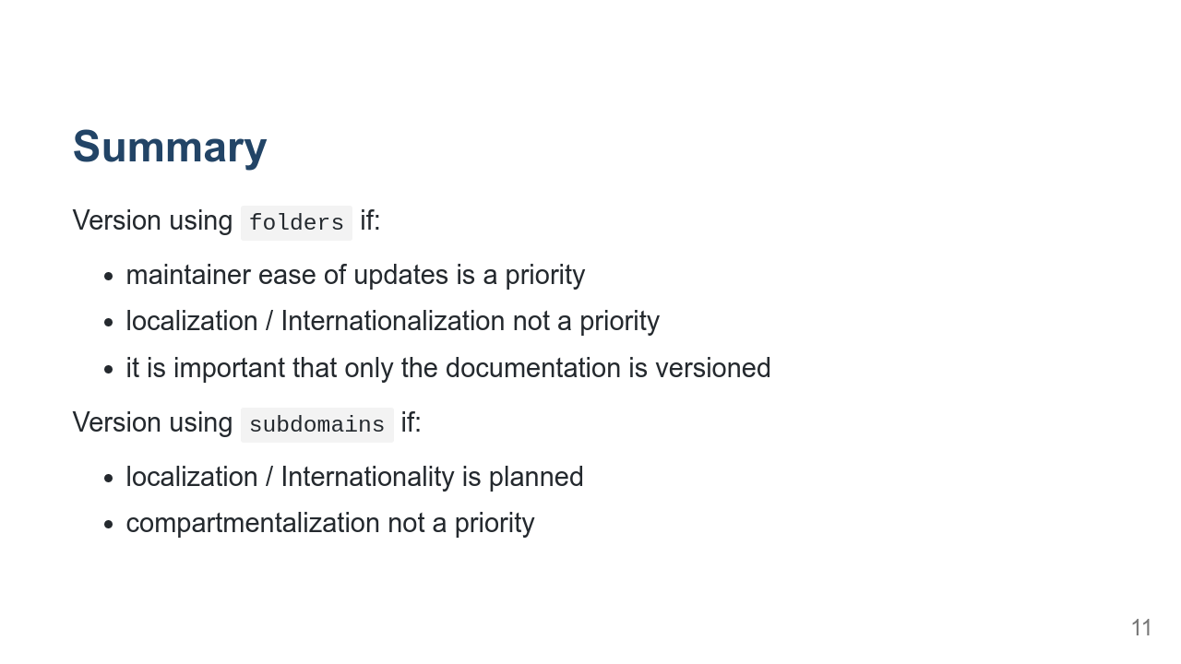
Notes:
and not, for instance, the blog

Slide 12


Slide 13
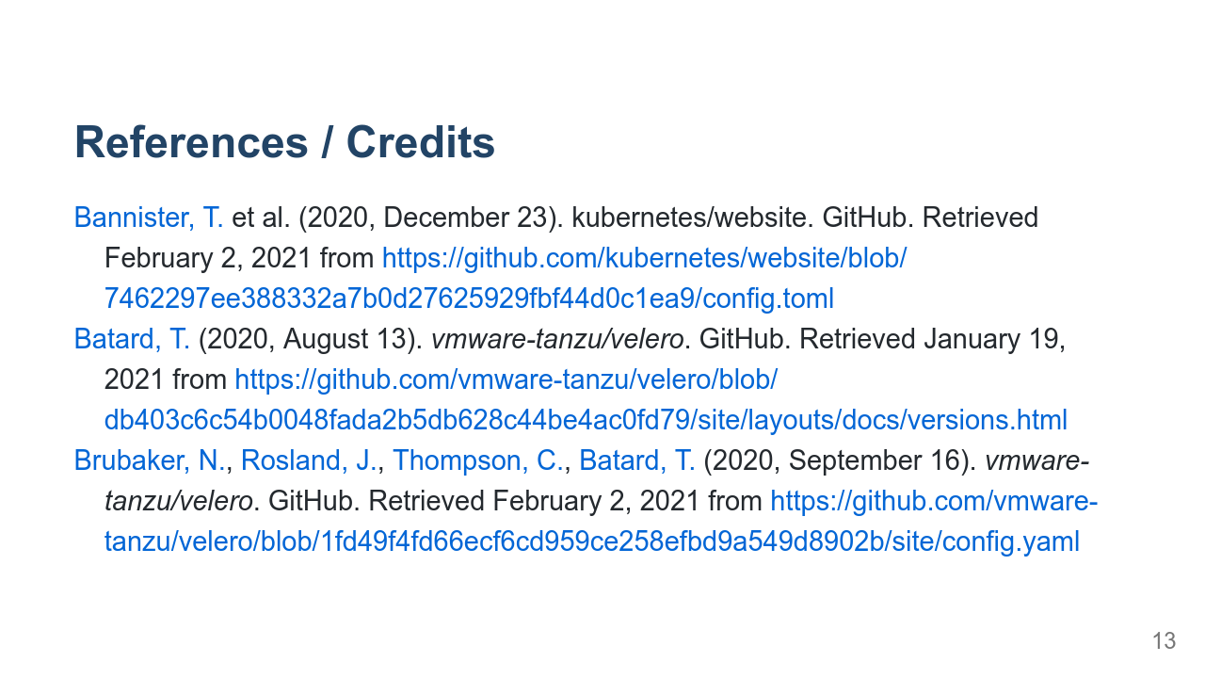

Slide 14
