Slide 1
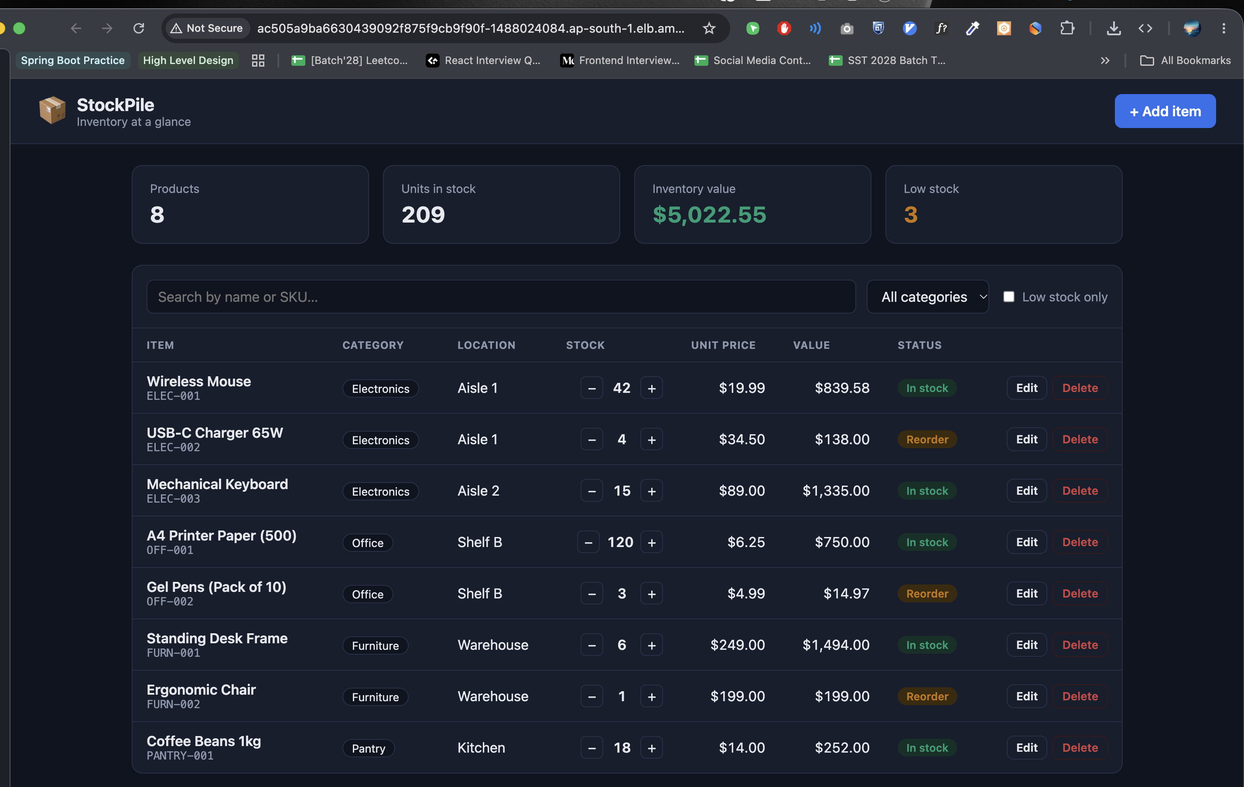
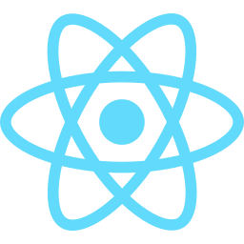
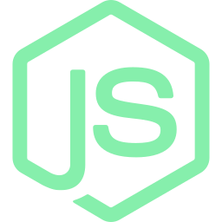
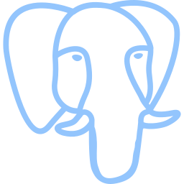
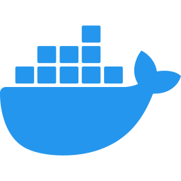
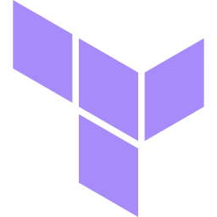
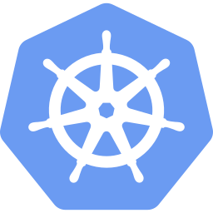

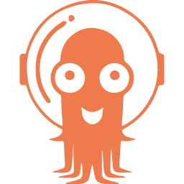


DEVSECOPS FINAL CAPSTONE
StockPile
A cloud-native inventory platform — from git push to a secured, autoscaled and monitored AWS EKS cluster
Suja Rahaman
github.com/Shaikh-Suja-Rahaman/stockpile-DevOps-Project
Live on AWS EKS — served through the ingress-nginx load balancer
Notes:
Introduce StockPile: a simple inventory manager. The app is intentionally small; the focus is the full DevSecOps delivery platform around it.

Slide 2
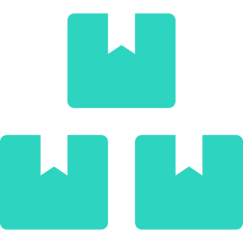



02 · PROJECT OVERVIEW
What I built and why
Inventory management app
Track products, SKUs, stock and prices; adjust stock in one click; see low-stock items instantly.
7
24/24
Full delivery pipeline
Every commit is tested, scanned, packaged and rolled out to Kubernetes automatically.
REST API endpoints
automated tests passing
Security built in, not bolted on
Vulnerability gates, non-root containers, Pod Security and network isolation.
0
62
Observable and self-scaling
Prometheus metrics, a Grafana dashboard and an HPA that scales the API under load.
HIGH / CRITICAL CVEs
AWS resources via Terraform
StockPile · DevSecOps Capstone
2 / 14
Notes:
One-line pitch, then the four headline numbers: 7 APIs, 24 tests, zero high/critical CVEs, 62 AWS resources created and destroyed with Terraform.

Slide 3
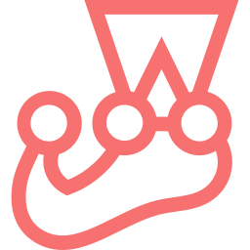

03 · TECH STACK
The tools, layer by layer
Frontend
Backend
Database
Testing
React 19 · Vite 7
nginx (unprivileged)
Node 22 · Express 5
Knex migrations
PostgreSQL 16
StatefulSet + EBS gp3
Jest + Supertest
pg-mem test database
Containers
CI/CD & Security
Infrastructure
Delivery & Ops
Multi-stage builds
Docker Compose
GitHub Actions · Trivy
GHCR registry
Terraform
AWS VPC + EKS 1.34
Helm · ArgoCD · HPA
Prometheus · Grafana
StockPile · DevSecOps Capstone
3 / 14
Notes:
Walk left to right, top to bottom: application layer first, then the delivery and operations layer.

Slide 4
04 · ARCHITECTURE
From commit to cluster
Developer
git push
GitHub repo
main branch
GitHub Actions
Test → Build → Trivy → Push
GHCR
images tagged :commit-sha
ArgoCD watches Git
CI bot commits the new image tag back to Git
AWS ap-south-1 · VPC (2 public + 2 private subnets) · EKS 1.34 — provisioned by Terraform
ArgoCD
auto-sync · self-heal
namespace: stockpile
namespace: monitoring
Frontend
React · ×2
PostgreSQL
gp3 volume
Grafana
StockPile dashboard
/
Ingress
nginx → AWS ELB
Backend API
Express · HPA 2–6
Prometheus
ServiceMonitor
Users
browser
/api
scrape /metrics
StockPile · DevSecOps Capstone
4 / 14
Notes:
Top row is delivery: push, CI, registry. CI never touches the cluster — it commits a new image tag and ArgoCD pulls the change. Inside EKS: Ingress routes / to the frontend and /api to the backend; the backend talks to PostgreSQL; Prometheus scrapes /metrics and Grafana visualises it.

Slide 5
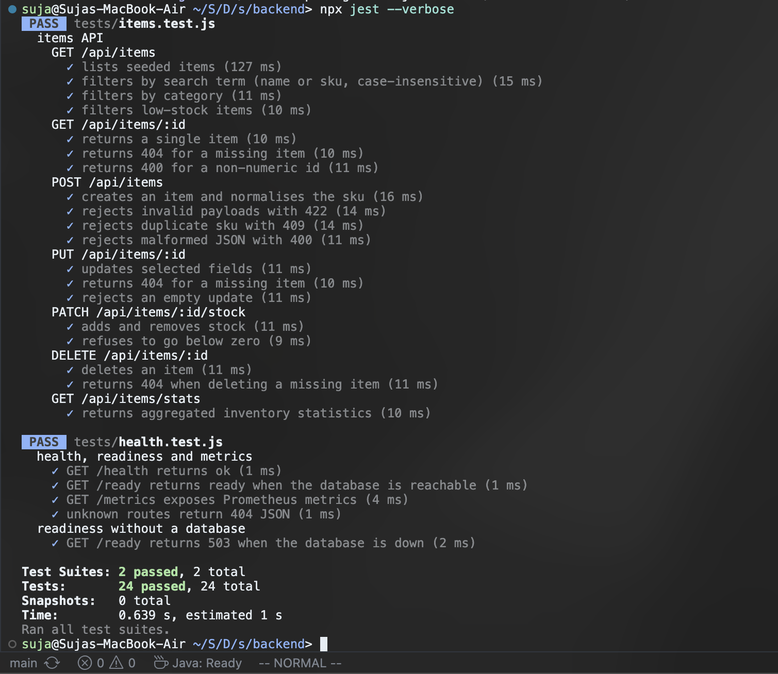
05 · APPLICATION & TESTING
A small API, tested before anything ships
REST API
GET
/api/items
list · search · filter
GET
/api/items/stats
KPIs for the dashboard
POST
/api/items
create (unique SKU)
PUT
/api/items/:id
update
PATCH
/api/items/:id/stock
stock in / out
DELETE
/api/items/:id
remove
GET
/health · /ready · /metrics
probes + Prometheus
Knex migration creates the items table (Alembic equivalent)
Isolated test DB every test gets a fresh in-memory PostgreSQL
Readiness vs liveness /ready = DB check, /health = process
24 / 24 Jest + Supertest tests passing
StockPile · DevSecOps Capstone
5 / 14
Notes:
Seven endpoints plus health, readiness and metrics. Tests use pg-mem, an in-memory PostgreSQL, with the real migrations — so they never touch a real database and run in under a second.

Slide 6
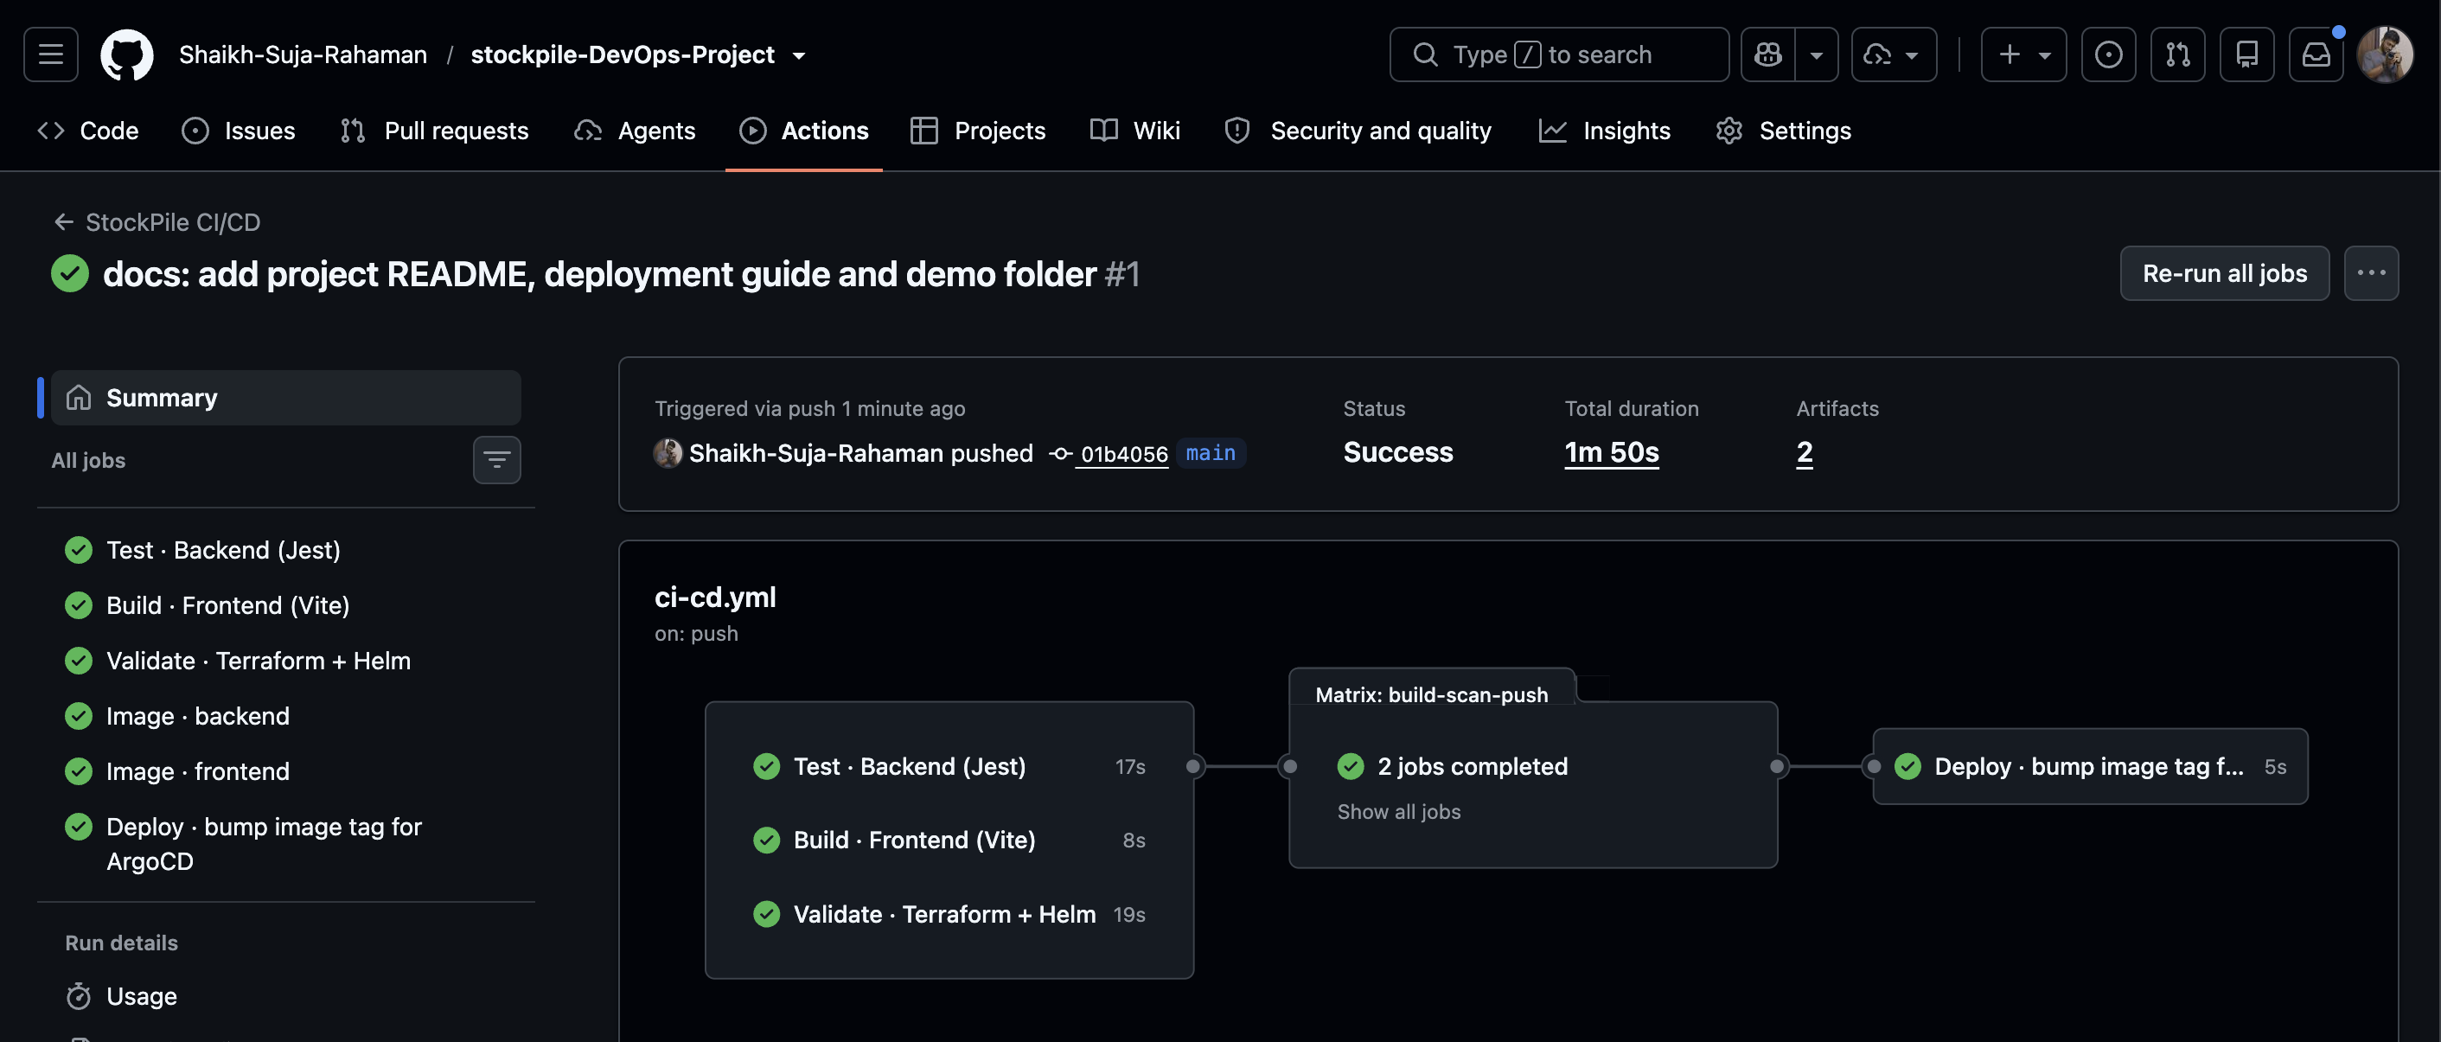
06 · CI/CD PIPELINE
Every push to main runs five gated stages
1
Test
Jest 24/24 · npm audit
2
Build
Vite · Docker multi-stage
3
Scan
Trivy HIGH/CRITICAL gate
4
Push
GHCR :commit-sha
5
GitOps
bump tag → ArgoCD
SHA tags, never "latest"
every pod traces back to the exact commit
PRs build + scan only
nothing unreviewed is pushed
No cluster credentials in CI
ArgoCD pulls; CI only commits a tag
Least-privilege tokens
write scopes only on the jobs that need them
Green pipeline run — all jobs passed in under 2 minutes
StockPile · DevSecOps Capstone
6 / 14
Notes:
Stage 1 runs tests, the frontend build and Terraform/Helm validation in parallel. Images are built, scanned by Trivy, and only then pushed with the commit SHA as tag. The final job writes the tag into values-prod.yaml for ArgoCD.

Slide 7
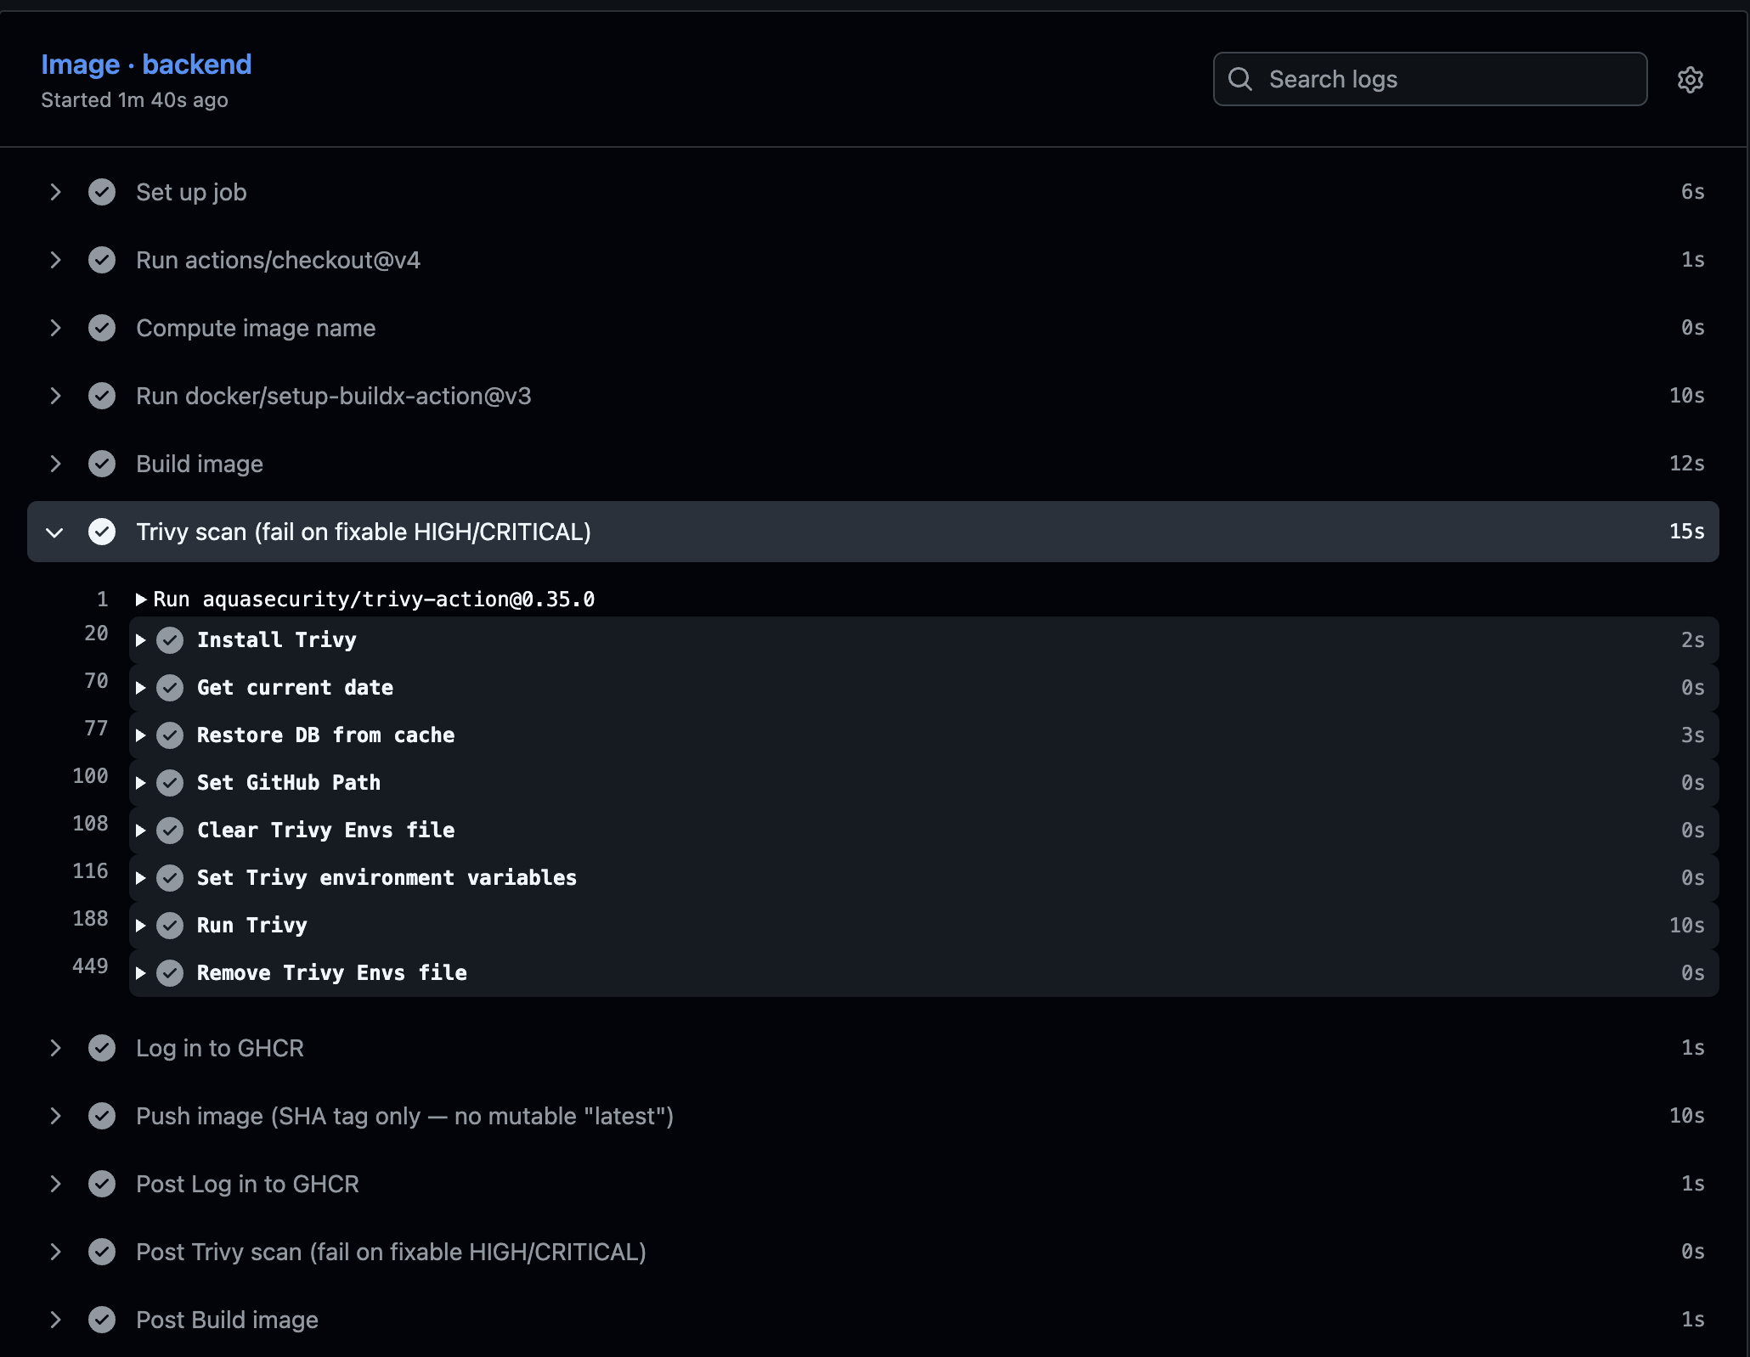



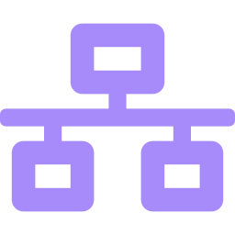

07 · DEVSECOPS
Security gates at every layer
Image scanning gate
Trivy fails the build on fixable HIGH/CRITICAL CVEs
Least-privilege containers
non-root · read-only root FS · all capabilities dropped
Pod Security "restricted"
enforced on the namespace by Kubernetes
NetworkPolicy
only backend pods can reach PostgreSQL
No secrets in Git
short-lived GITHUB_TOKEN; tfvars & state git-ignored
Trivy step in CI: 0 fixable HIGH/CRITICAL findings
The gate caught real CVEs: nginx 1.28 base image → upgraded to 1.30 + apk upgrade → clean. Scanner pinned to trivy-action 0.35.0 after the March 2026 Trivy supply-chain attack.
StockPile · DevSecOps Capstone
7 / 14
Notes:
Explain what Trivy scanned: OS packages and npm libraries in both images. It found real vulnerabilities in the old nginx base; upgrading fixed them. Mention the 2026 Trivy supply-chain incident as why scanner versions are pinned.

Slide 8
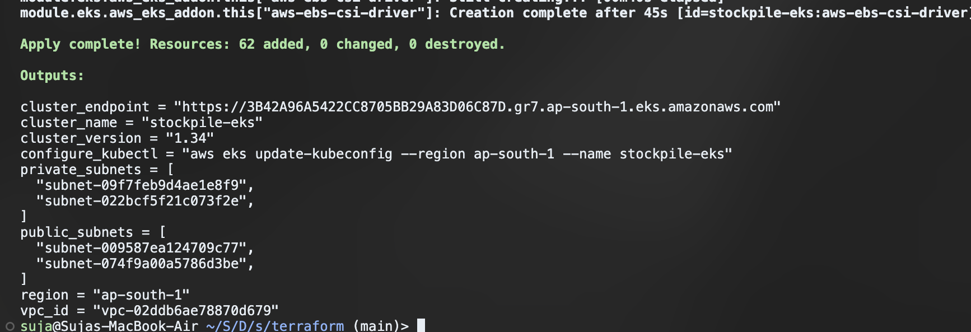
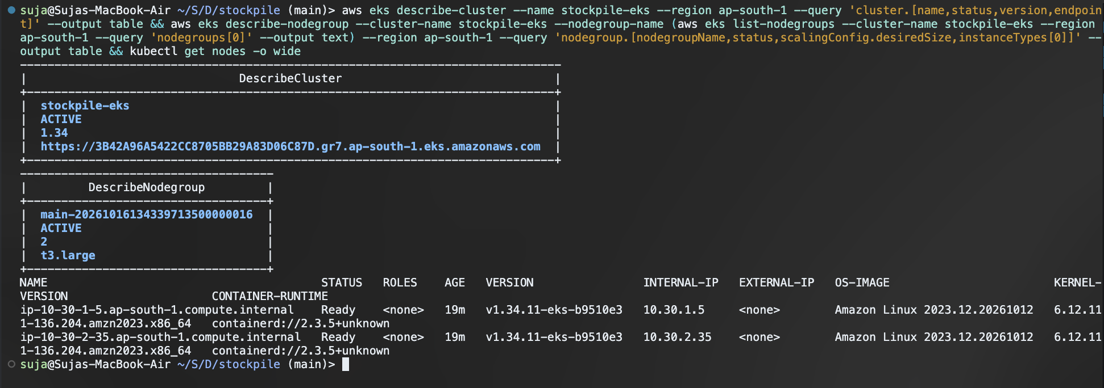
08 · INFRASTRUCTURE AS CODE
Terraform builds the AWS network and EKS cluster
VPC
10.30.0.0/16 · ap-south-1 · 2 AZs
Subnets
2 public (load balancers) + 2 private (nodes) · 1 NAT gateway
EKS 1.34
managed node group · 2 × t3.large · Amazon Linux 2023
terraform apply — Apply complete! 62 added
Add-ons
EBS CSI driver (IRSA) · VPC CNI with NetworkPolicy · CoreDNS
62
resources created by terraform apply — and all 62 removed by terraform destroy
EKS cluster ACTIVE · node group with 2 Ready t3.large nodes
StockPile · DevSecOps Capstone
8 / 14
Notes:
Infrastructure is code, not console clicks. Highlight the EBS CSI driver: without it, the PostgreSQL volume would never bind on EKS. Everything was destroyed after the demo to avoid cost.

Slide 9
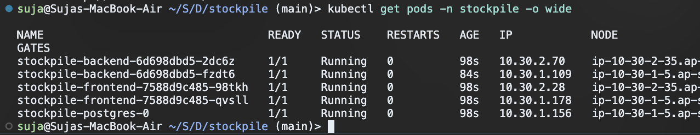
09 · KUBERNETES & HELM
One Helm chart packages the whole app
Deployments
frontend ×2 · backend ×2–6
StatefulSet
PostgreSQL + 2 Gi gp3 volume
Services
ClusterIP for every tier
Ingress
/ → frontend · /api → backend
kubectl get pods — all Running across both nodes
HPA
scales backend on CPU
ServiceMonitor
Prometheus scrape config
helm list — release deployed
NetworkPolicy
DB locked to backend
Probes
liveness /health · readiness /ready
kubectl get ingress — address is the AWS ELB
values-dev.yaml local kind cluster values-prod.yaml EKS: GHCR images, gp3, HPA
StockPile · DevSecOps Capstone
9 / 14
Notes:
The chart has deployments, a Postgres StatefulSet, services, ingress, HPA, ServiceMonitor and NetworkPolicy. The same chart runs locally on kind with values-dev and on EKS with values-prod.

Slide 10
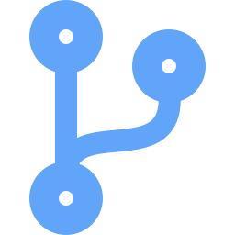
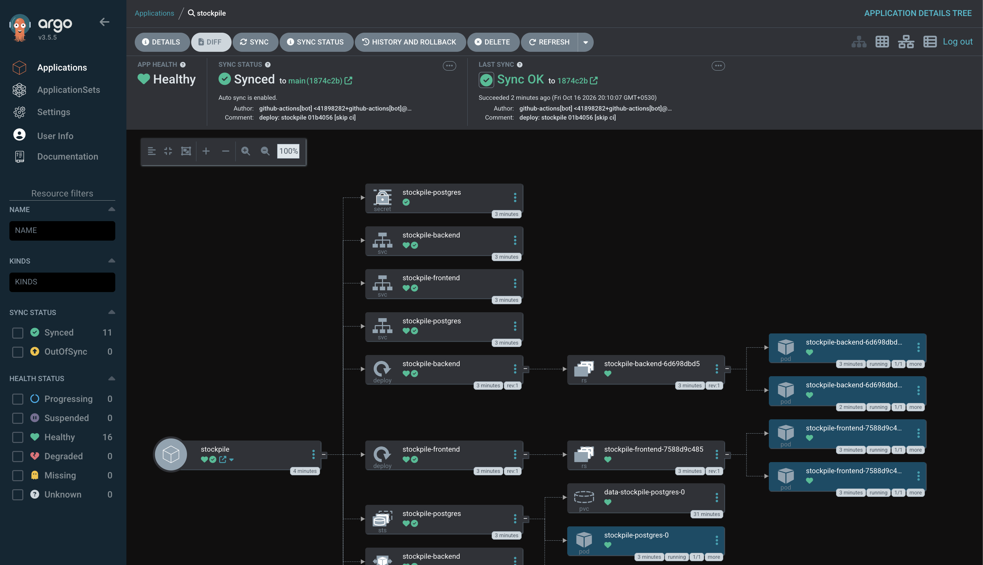



10 · GITOPS WITH ARGOCD
Git is the single source of truth
git push
a code change lands on main
CI tests, scans, pushes
image :sha published to GHCR
Bot commits the new tag
values-prod.yaml updated [skip ci]
ArgoCD auto-syncs
rolling update · prune · self-heal
Self-heal demo: a manual kubectl scale is reverted by ArgoCD back to what Git says.
ArgoCD: stockpile application Synced and Healthy
StockPile · DevSecOps Capstone
10 / 14
Notes:
Deploying is just git push. ArgoCD watches the repo and applies the Helm chart with values-prod.yaml. Show the bot commit and ArgoCD rolling the new pods.

Slide 11
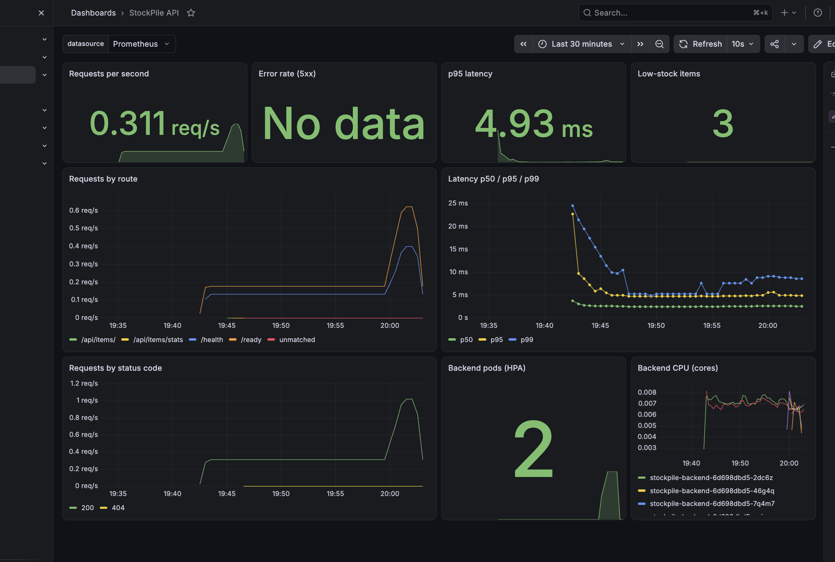
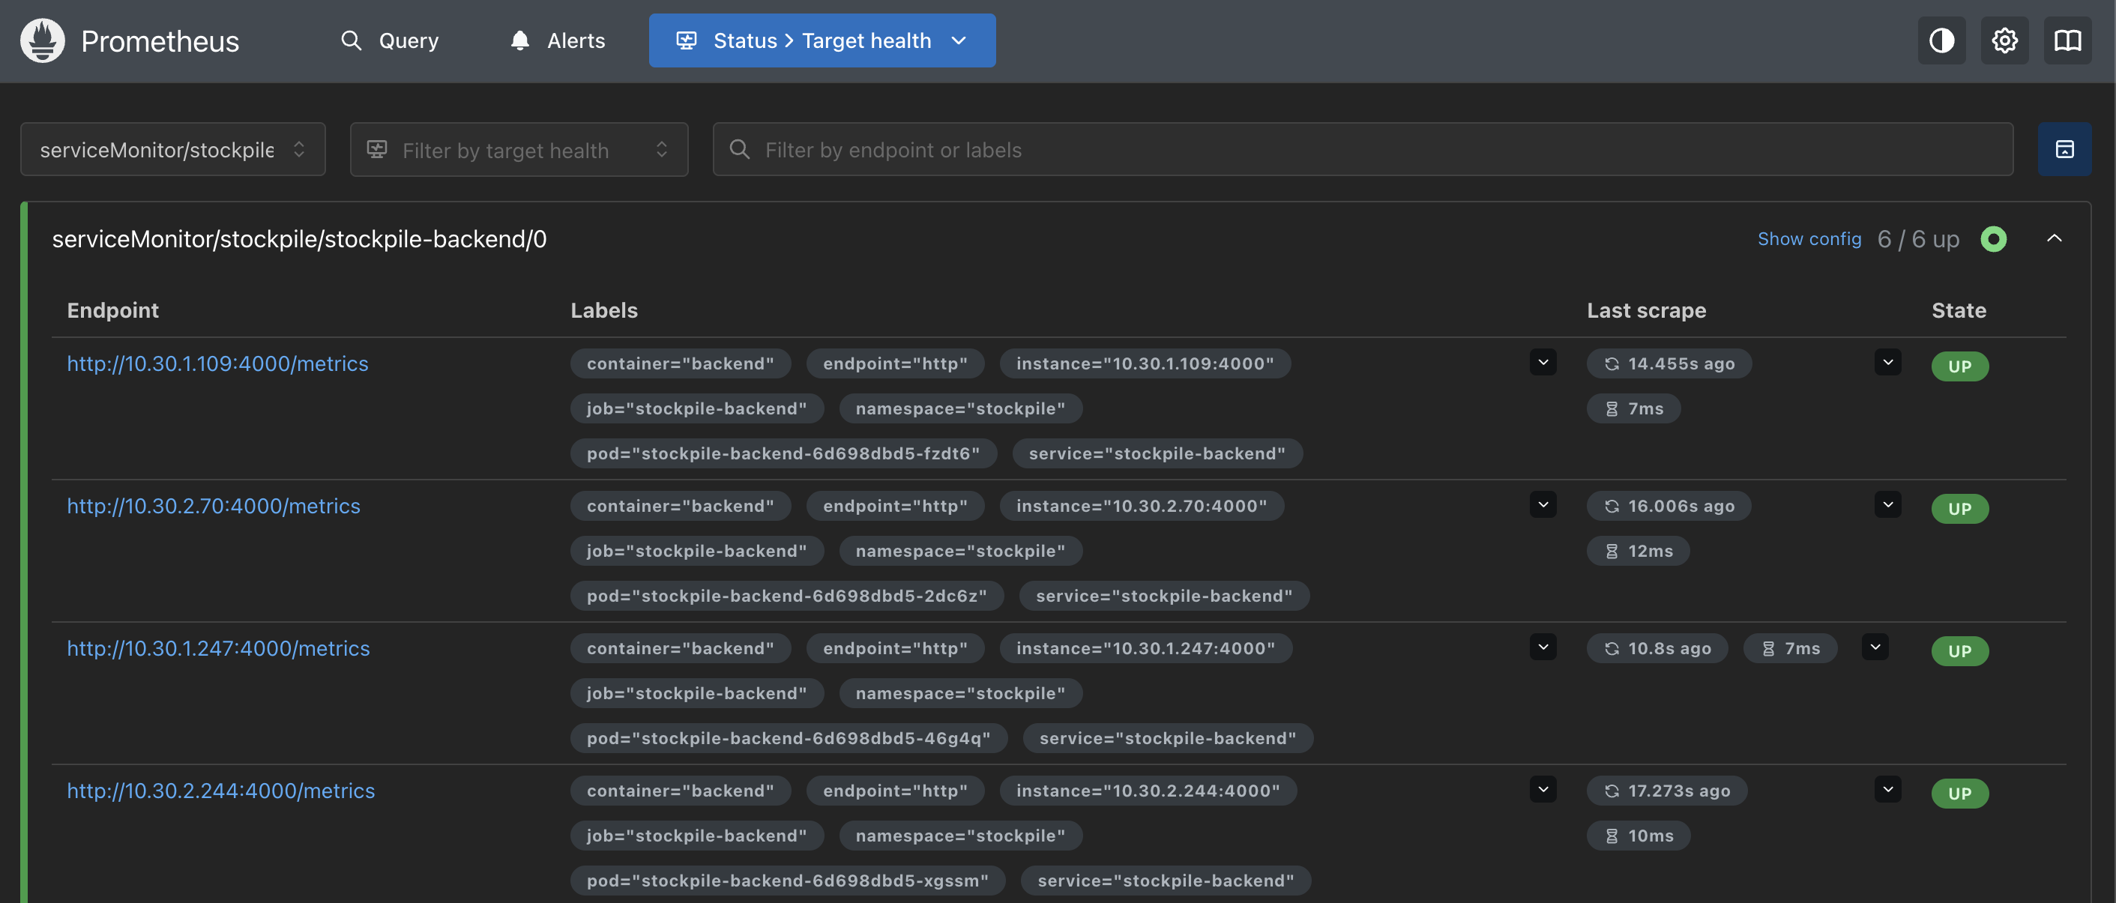
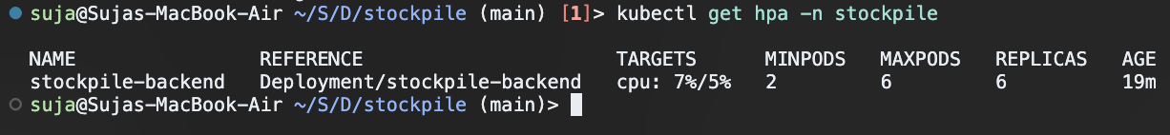
11 · AUTOSCALING & OBSERVABILITY
Measured, watched and scaled automatically
Prometheus: all backend targets UP
HPA scaled the backend from 2 → 6 replicas under load
Custom metrics from /metrics
http_requests_total
request latency histogram
stockpile_low_stock_items
Grafana "StockPile API" dashboard — req/s, latency, routes, pods
Grafana dashboard ships as a ConfigMap — auto-imported, no manual clicks.
StockPile · DevSecOps Capstone
11 / 14
Notes:
Prometheus discovers the backend through a ServiceMonitor and scrapes every pod. The Grafana dashboard is provisioned as code. Under the load-test script, the HPA scaled the backend from 2 to 6 replicas.

Slide 12
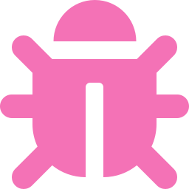


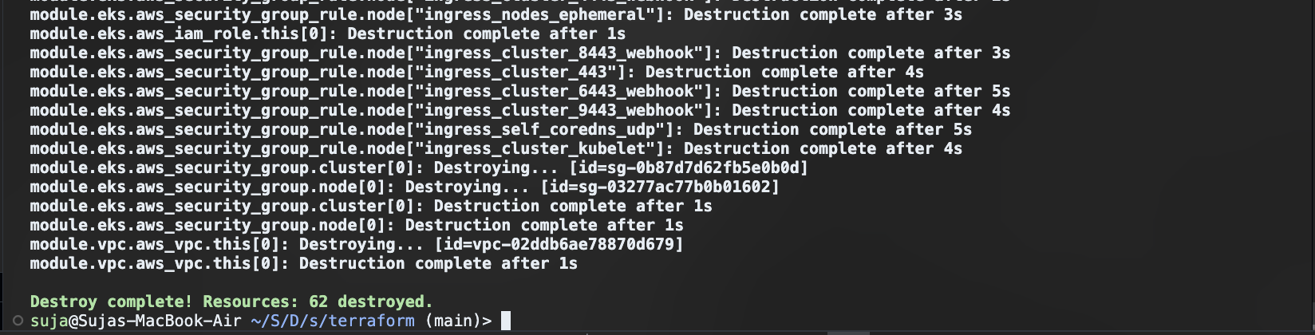
12 · OPERATIONS
Breaking it on purpose, then cleaning up
Broken image tag
Wrong Service selector
Bad readiness probe
Symptom: ImagePullBackOff
Diagnosis: kubectl describe pod → events
Symptom: Service with 0 endpoints
Diagnosis: compare selector vs pod labels
Symptom: Running but 0/1 Ready
Diagnosis: probe path returns 404
Teardown order matters
Delete the ArgoCD app + namespace (EBS volume)
Uninstall ingress-nginx (AWS load balancer)
Then terraform destroy
K8s-created load balancers would otherwise block VPC deletion.
terraform destroy — all 62 resources removed
StockPile · DevSecOps Capstone
12 / 14
Notes:
Three deliberately broken manifests and how to diagnose each with kubectl. Then the teardown order, so nothing keeps billing after the demo.

Slide 13
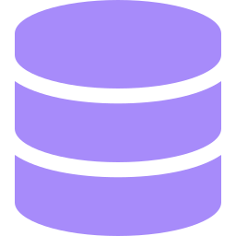
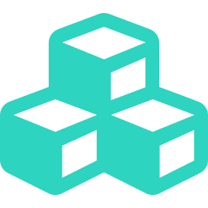
13 · KEY LEARNINGS
What this project taught me
Scanners find real problems
Trivy blocked a vulnerable nginx base image — security gates are only useful when they can fail the build.
The supply chain is an attack surface
Even the scanner was compromised in 2026. Pin tool versions; pin actions to SHAs next.
Readiness ≠ liveness
Separate /health and /ready, plus an init container, made rollouts smooth with zero crash loops.
Storage needs plumbing on EKS
PersistentVolumes need the EBS CSI driver and a StorageClass — EKS 1.30+ ships no default.
Reproducible builds
Lockfiles must match the CI toolchain (Node 22 / npm 10), or npm ci fails in Docker.
GitOps simplifies delivery
CI never needs cluster credentials; Git history becomes the deployment history.
StockPile · DevSecOps Capstone
13 / 14
Notes:
Pick two or three of these to talk about in detail — the Trivy failure and the EBS CSI driver are the strongest stories.

Slide 14
Thank you
Next steps for production
Amazon RDS instead of in-cluster PostgreSQL
TLS with ACM / cert-manager + Route 53 domain
External Secrets / AWS Secrets Manager
Pin GitHub Actions to commit SHAs
Move from ingress-nginx to Gateway API / AWS LB Controller
Remote Terraform state (S3 + locking)
Questions?
Repository
github.com/Shaikh-Suja-Rahaman/stockpile-DevOps-Project
Presented by
Suja Rahaman
Notes:
Close with what would change for real production, then take questions.

