Slide 1

S&P 500
A SECTOR SUMMARY
Sectors
history
services
teams
timeline
about
Team: FINTECH WARRIORS

Slide 2

history
MESSAGE FROM
focus
team
about
report
timeline
FinTech Warriors:
Emiliano Amador, Kowsalya Jeyabalan, Nate Walker, Cody Sifford
This Project presents Exploratory Data Analysis (EDA) of the S&P 500 Stocks in Contrast to the COVID-19 Crisis

Slide 3
Project Description
Review the 11 Sectors of the S&P 500
Sector Performance
Correlation Matrix
Beta Comparison
Deep Dive into each Individual Sector:
Review the Stock Performance
5D
1M
1Yr
5Yr
focus
team
history
report
Plots
project
Stock market index that measures the stock performance of 500 large companies listed on stock exchanges in the United States.

Slide 4



Sectors
Stocks
Report
1
2
3
focus
Performance
Analysis
Dashboard
Agenda
report
team
timeline
about
Charts
Charts
Interactive Charts

Slide 5











S&P 500 Sectors
focus
Energy
Consumer Staples
Health Care
Sectors
report
team
timeline
Industrials
Consumer Discretionary
about
IT
Materials
Financials
Communications
Utilities
Real Estate

Slide 6
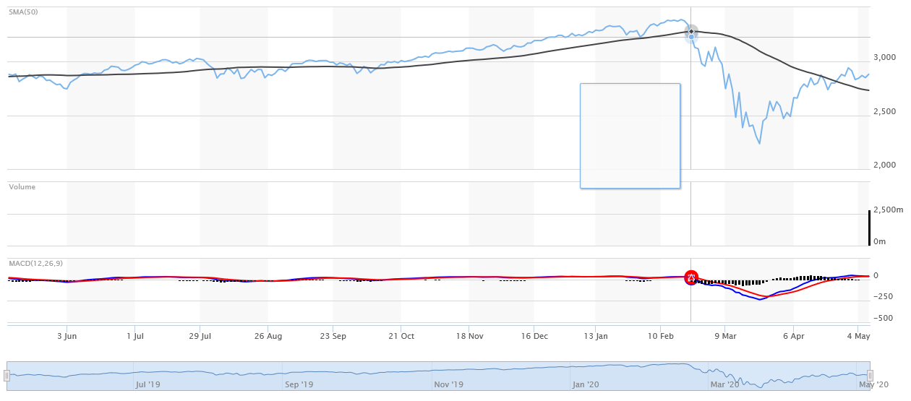
S&P 500 Index
Feb. 2,2020
COVID-19
focus
history
report
S&P 500
timeline
about
We want to know how the 11 Sectors are impacted by the Global Pandemic?

Slide 7
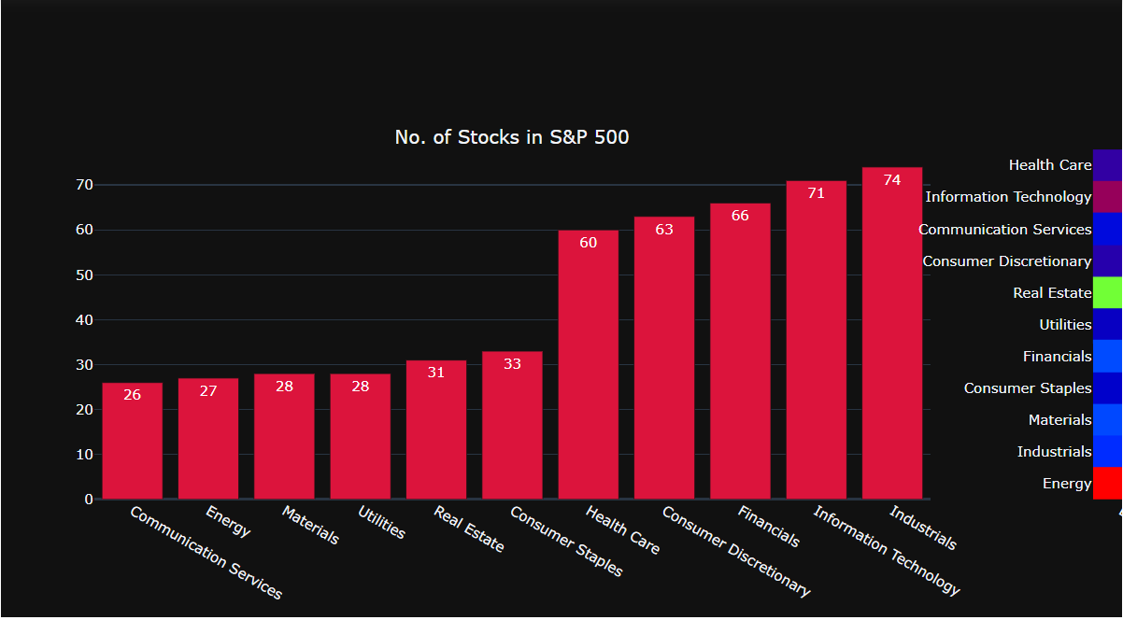
S&P 500: Total Stocks by Sector
report
history
focus
timeline
about
S&P 500
EDA Insight: Sectors w/Least and Most Stocks

Slide 8
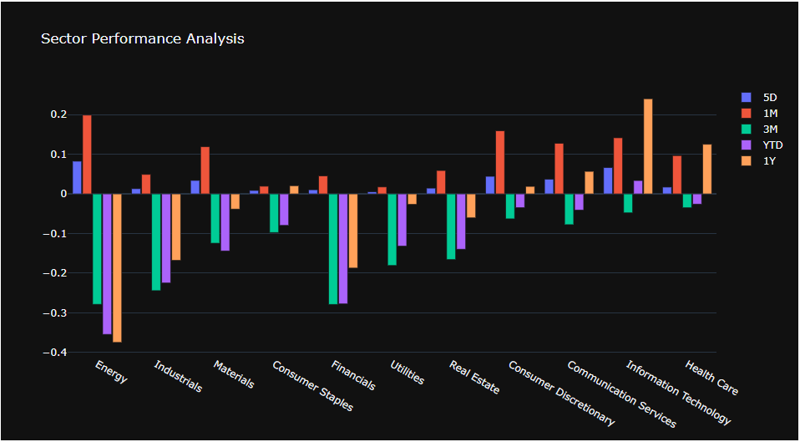
S&P 500: Sector Performance
report
history
focus
timeline
about
S&P 500
EDA Insight: Sectors are Down Overall; 5D & 1M

Slide 9
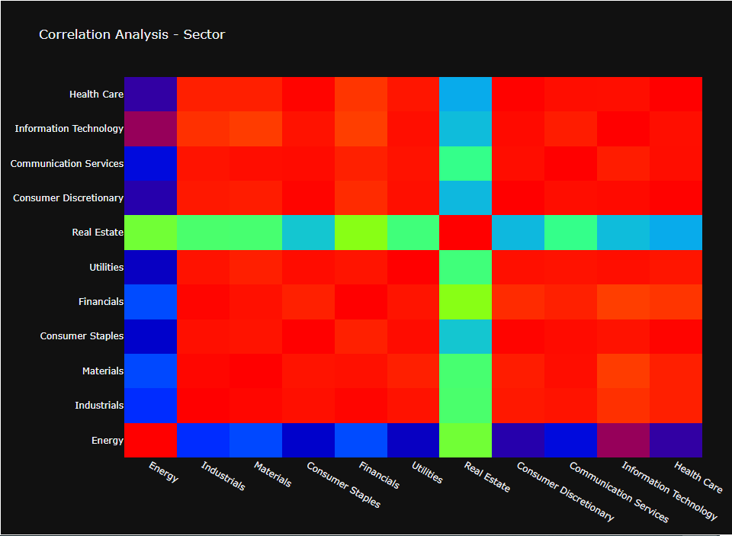
S&P 500: Sector Correlation Heat Map
report
history
focus
timeline
about
S&P 500
EDA Insight: Sectors are Highly Correlated

Slide 10






Bar Plots
Stocks
focus
Correlation
Beta
team
sectors
report
timeline
about
Performance
Dashboard

Slide 11
Dashboard Demo
d
S
p
focus
sectors
report
team
timeline
about
11
500
$
S&P 500 Sectors
Individual Stocks
Portfolio

