Slide 1
Batteries
Phil Baldwin
10/11/19

Slide 2
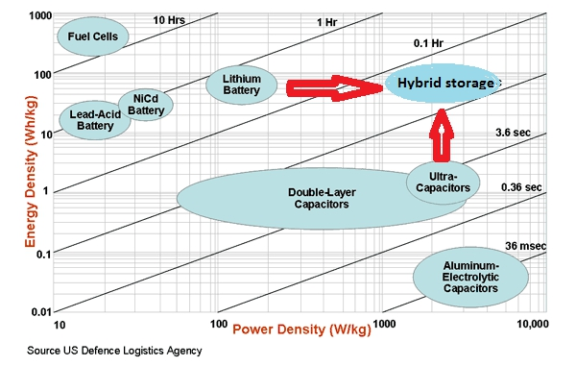
Energy Storage

Slide 3
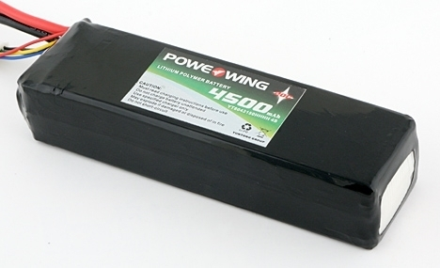
Example Model Airplane Battery
V_{in}=V_{battery}-I*R
4500mAh = 4.5 Ah
Can draw 4.5 Amps for 1.0 hour
OR
Can draw 1.0 Amps for 4.5 hours
OR
Can draw 45 Amps for 6 minutes
4S
4 cells in series
14.8 Volt
3.7 volts/cell nominal
Charges to 4.2 volt/cell
20C
“C” rating
Draw 4.5A * 20 = 90 Amps for 3 minutes
R = internal resistance ~ 3m$Ω$ /cell for a standard LiPo
Battery - Lithium Polymer
4500mAh 4S 14.8V 20C LiPo Battery w/ Deans
Technical Specifications:
Length: 6"
Width: 1-3/4"
Height: 1-1/4"
C Rating: 20C
Weight: 16.5 oz.

Slide 4
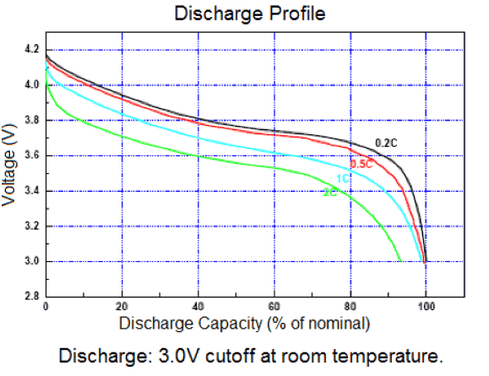
Discharge Profile
Battery use from “full” to “empty” is not linear
On takeoff, your will not see 4.2 V/cell
Recall V_{in}= V_{battery}-I*R
So, if 50 Amps at T/O
V_{in}= V_{battery}-I*R = 16.8 – (50)(0.012) = 16.2V
Reduced RPM → Reduced thrust
At the “bottom of the tank”, voltage drops off quickly
Set software (Pixhawk) alerts

Slide 5

LiPo Safety
Always balance charge your LiPos
Ensures all cells get to 4.2 V
Use a LiPo bag (keeps the flames in)
Never allow below 3.0 V/cell
E.g. for 3S, 9.0 V minimum
Never pierce a LiPo
If you do, keep flammable materials away…

