Slide 1
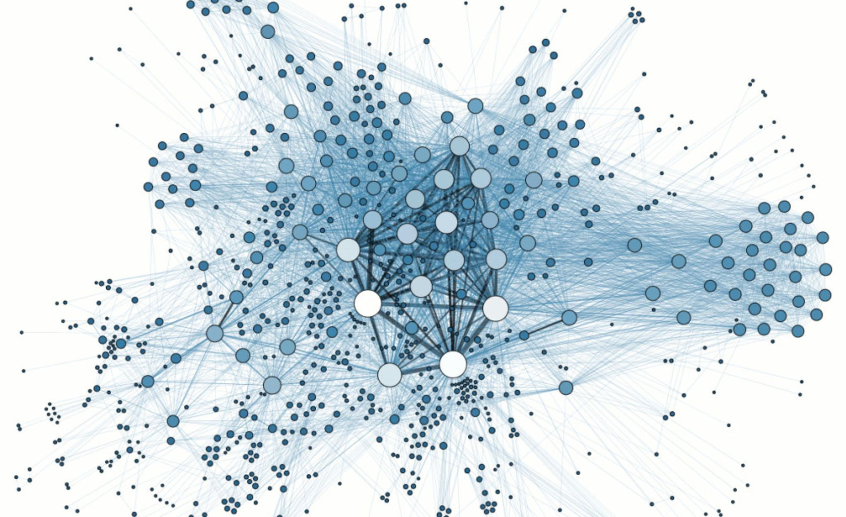
Fair, decentralized exchange networks through a tax based on ordinal distance
Nate Dwyer, Sandro Lera, and Alex ‘Sandy’ Pentland

Slide 2
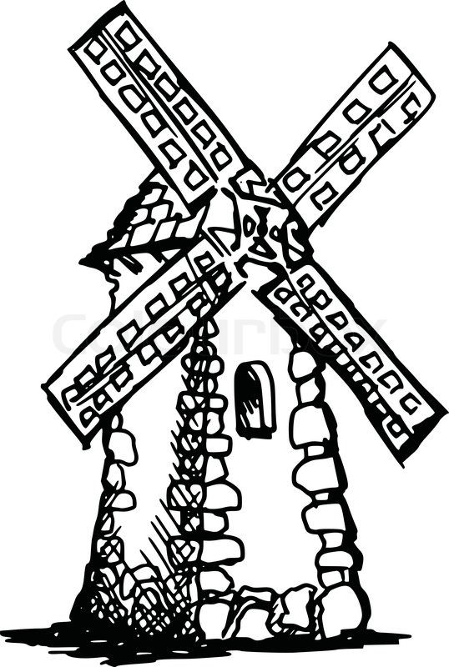

Historical motivation: Villages
High transaction costs cause people to only do business with locals, because the cost to travel is high.
Some consequences of high transaction costs are:
Local small businesses survive, as centralization is prohibitively expensive
Low reward to innovation
Everything is more expensive
Unfairness in cost, as customers that live far from firms have higher costs than closer ones

Slide 3
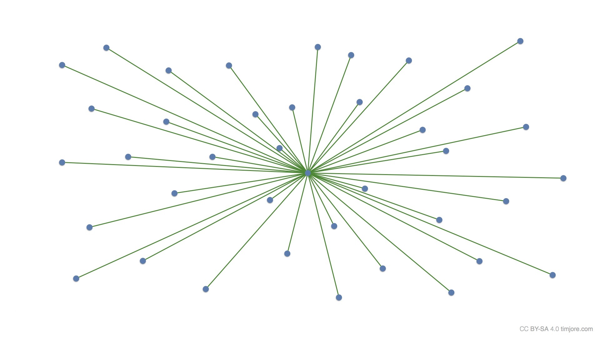

Historical motivation: the rise of Amazon
Invention of new distribution technology, such as cargo containers and internet stores, decreases transaction costs.
Decreased transaction costs are:
Good for the customers who have lower prices and more choice
More fair for customers who live far away from stores
But this causes:
Centralization of firms, especially with network economies
Monopolistic and anti-competitive behavior

Slide 4
A modern decentralized trade-network: motivation
While geographical transaction costs can be unfair and expensive for customers, removal of these constraints can lead to centralization and monopolization, especially with network economies.
Idea: Balance the trade off between decentralization and low costs, while eliminating geographical distance unfairness.
What we want:
Little to no cost increase.
Dampen centralization and monopolization
What we don’t want:
Discourage industry disruption or innovation in general

Slide 5

A modern decentralized trade-network: solution
Tax based on ordinal distance: T ∝ D^{γ}
Customers aren’t punished for geographical distance
Naturally discourages centralization and monopolies without needing to specifically break up firms
D = 3
D = 1
D = 2

Slide 6
A modern decentralized trade-network: model
Place customers and firms randomly on a circle, so that we have a distance and can determine the distance based tax
Have the firms play a game where they compete to make as much profit as they can selling a good. The game has two parts:
First, each firm chooses a quantity to manufacture (capacity)
Second, each firm chooses a price.
Customers then purchase from firm offering the lowest price (including tax), until:
Customer no longer wants more, represented by an individual demand curve
Firm runs out of capacity, so the customer repeats this process
Solved numerically using Python Library Gambit

Slide 7
A modern decentralized trade-network: model
Place customers and firms randomly on a circle, so that we have a distance and can determine the distance based tax
Have the firms play a game where they compete to make as much profit as they can selling a good. The game has two parts:
First, each firm chooses a quantity to manufacture (capacity)
Second, each firm chooses a price.
Customers then purchase from firm offering the lowest price (including tax), until:
Customer no longer wants more, represented by an individual demand curve
Firm runs out of capacity, so the customer repeats this process
Solved numerically using Python Library Gambit

Slide 8
A modern decentralized trade-network: model
Place customers and firms randomly on a circle, so that we have a distance and can determine the distance based tax
Have the firms play a game where they compete to make as much profit as they can selling a good. The game has two parts:
First, each firm chooses a quantity to manufacture (capacity)
Second, each firm chooses a price.
Customers then purchase from firm offering the lowest price (including tax), until:
Customer no longer wants more, represented by an individual demand curve
Firm runs out of capacity, so the customer repeats this process
Solved numerically using Python Library Gambit

Slide 9
A modern decentralized trade-network: model
Place customers and firms randomly on a circle, so that we have a distance and can determine the distance based tax
Have the firms play a game where they compete to make as much profit as they can selling a good. The game has two parts:
First, each firm chooses a quantity to manufacture (capacity)
Second, each firm chooses a price.
Customers then purchase from firm offering the lowest price (including tax), until:
Customer no longer wants more, represented by an individual demand curve
Firm runs out of capacity, so the customer repeats this process
Solved numerically using Python Library Gambit

Slide 10
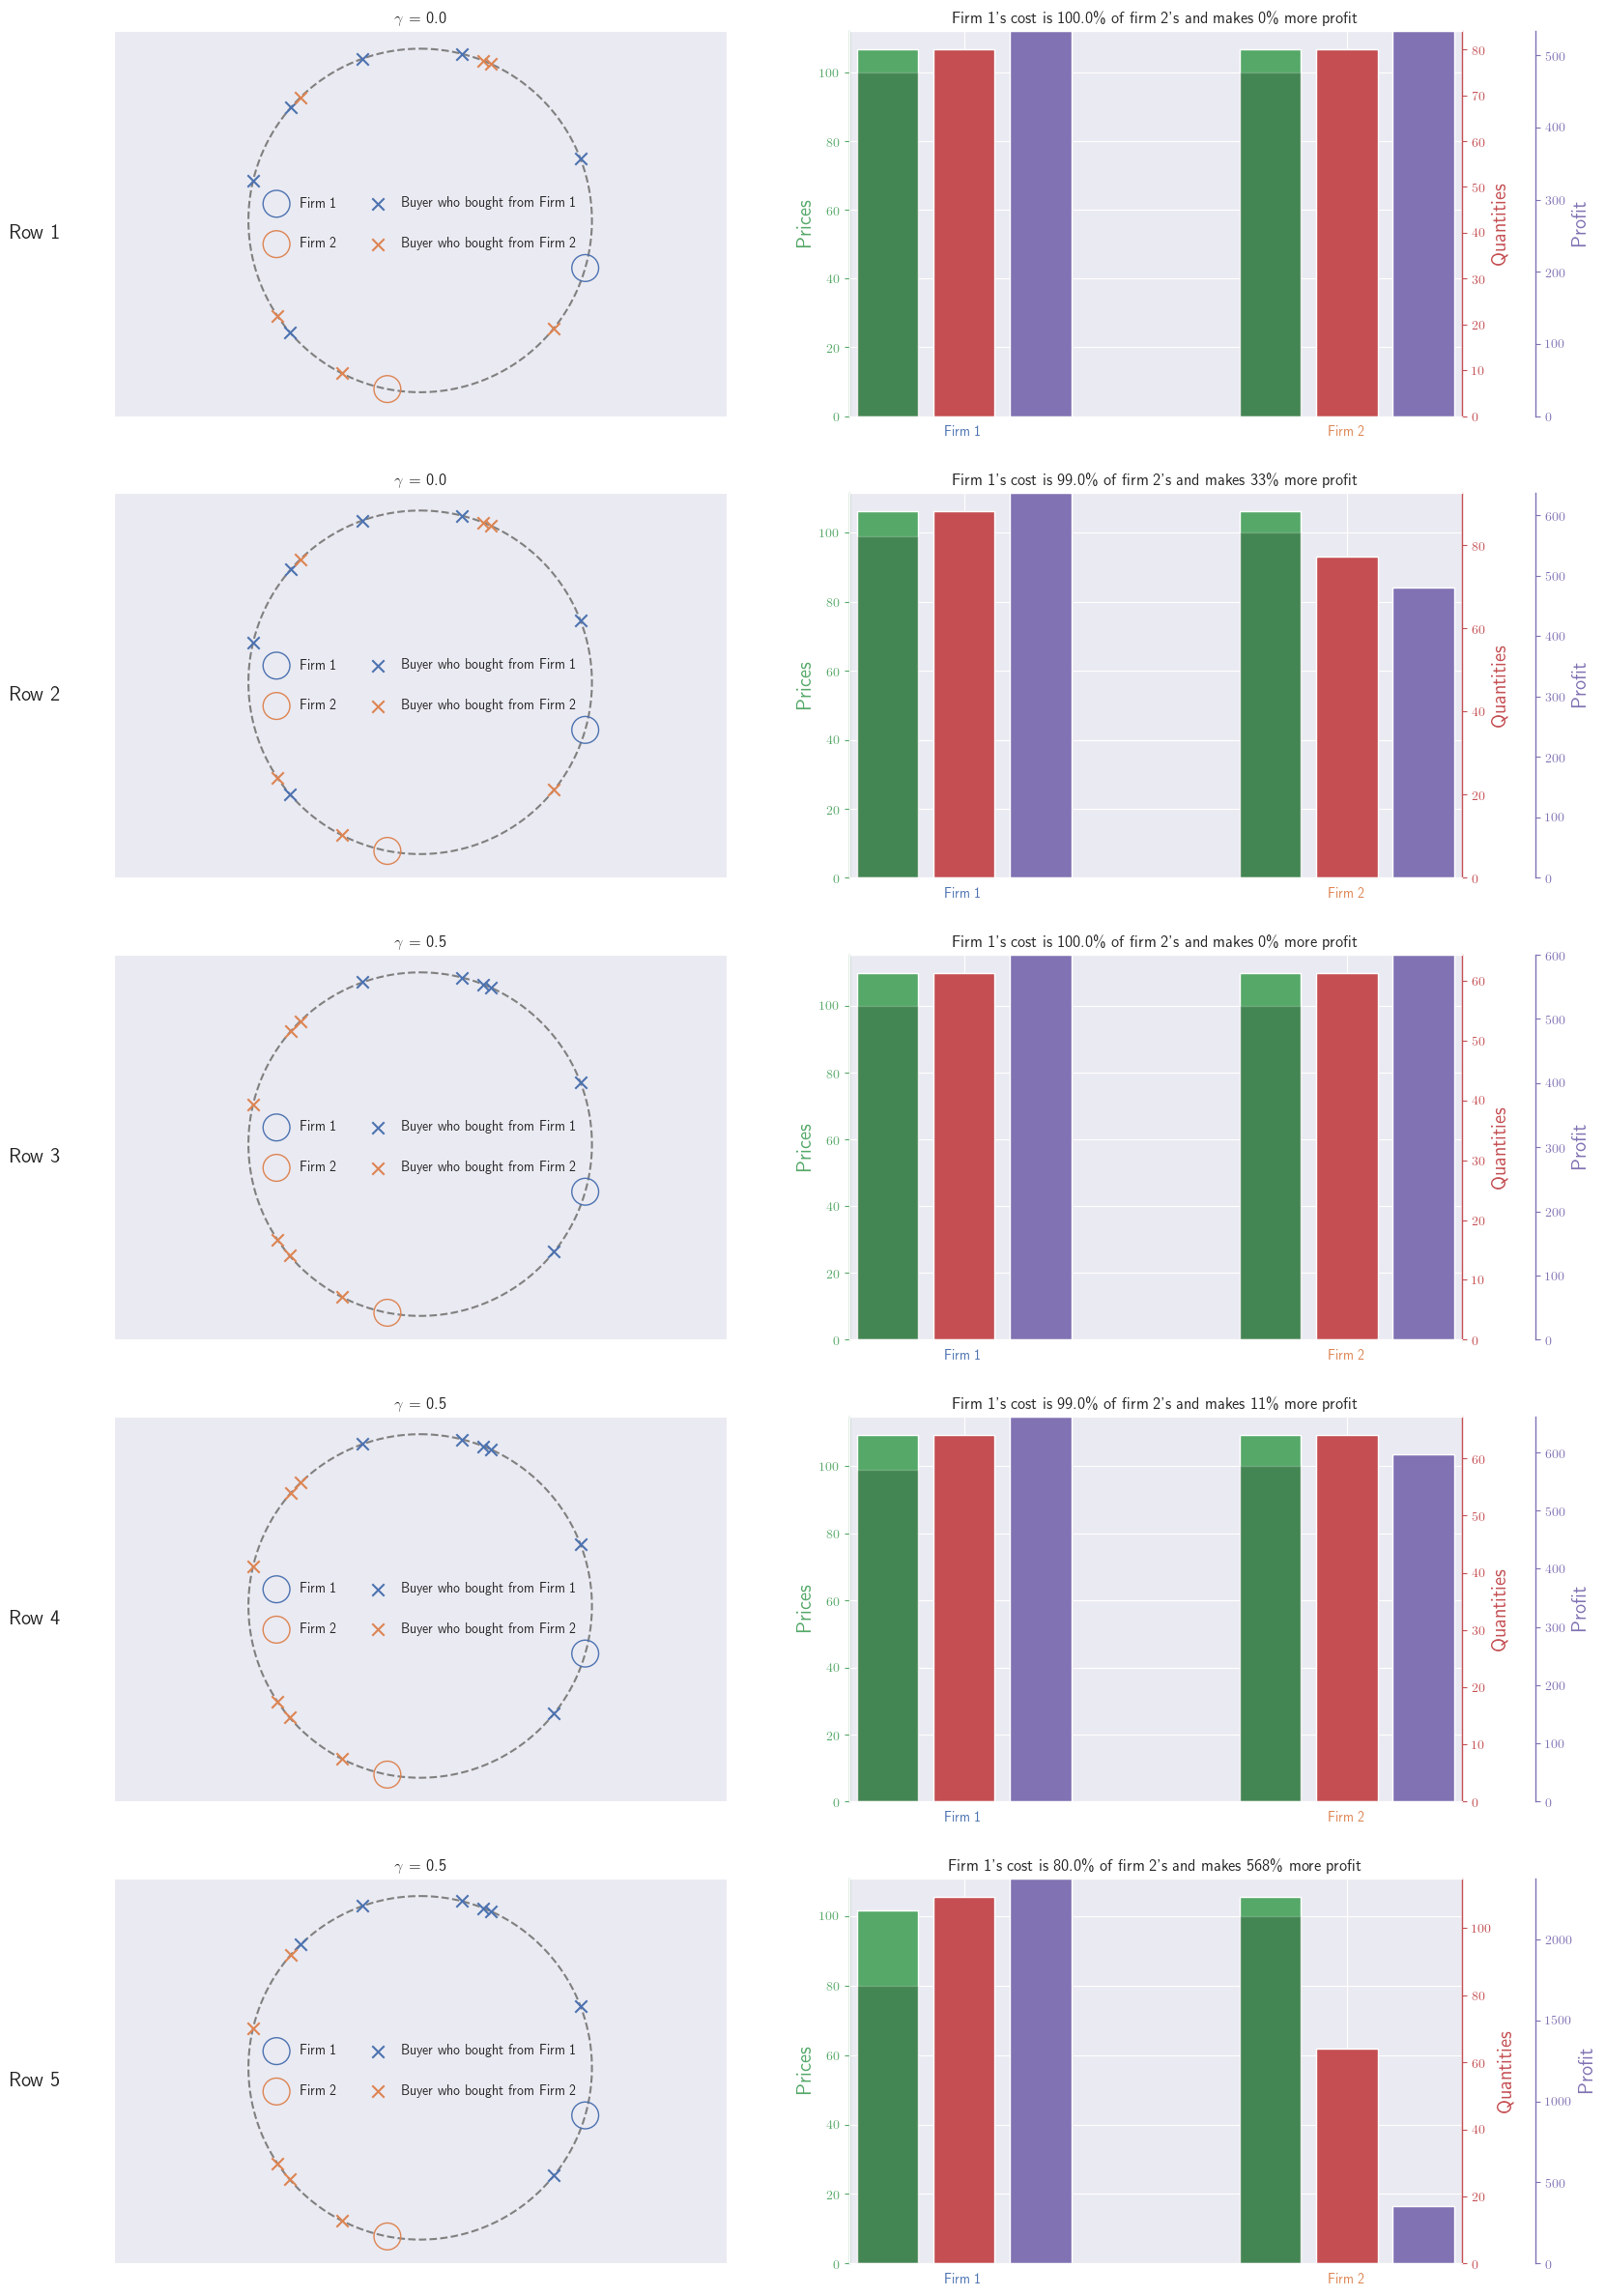
Results: Equal Costs Without Tax
Firm 1’s cost per unit produced is 100% of Firm 2’s
Equal profit for Firm 1 and Firm 2

Slide 11
Results: Slightly Unequal Costs Without Tax
Firm 1’s cost per unit produced is 99% of Firm 2’s
Firm 1 earns 33% more profit than Firm 2

Slide 12
Results: Equal Costs With Tax
Firm 1’s cost per unit produced is 100% of Firm 2’s
Equal profit for Firm 1 and Firm 2

Slide 13
Results: Slightly Unequal Costs With Tax
Firm 1’s cost per unit produced is 99% of Firm 2’s
Firm 1 earns 11% more profit than Firm 2

Slide 14
Results: Very Unequal Costs With Tax
Firm 1’s cost per unit produced is 80% of Firm 2’s
Firm 1 earns 569% more profit than Firm 2

Slide 15
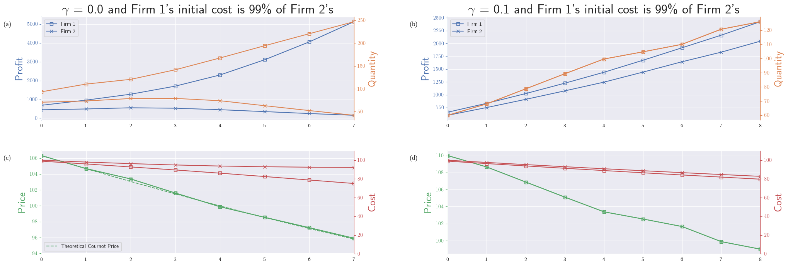
Without tax, Firm 1 snowballs into an effective monopoly.

Slide 16
With tax, Firm 1 and 2 both benefit, and there is no monopoly power.

Slide 17
Further Exploration
How and where to reallocate taxes?
Having 𝛾 change in response to market changing
Combination with reputation systems and bad actors

