Slide 1
Tutorial for programming ESP8266 on windows, using the NodeMCU devkit

Slide 2
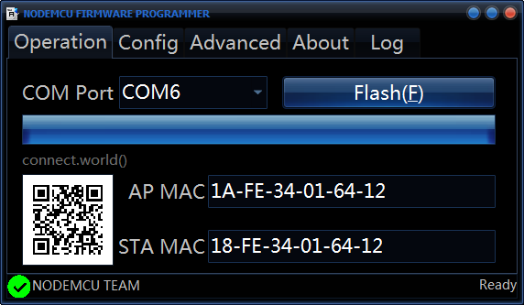
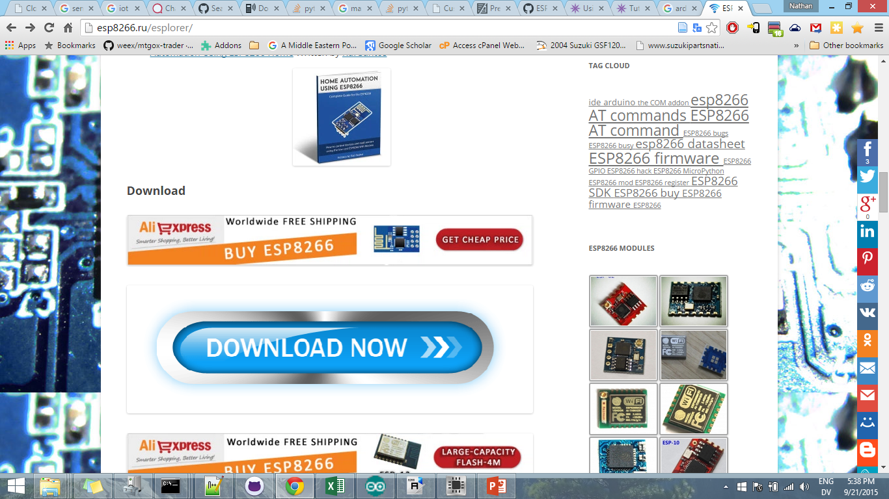
Get the nodemcu flasher from here:
Get ESPlorer from here:
http://esp8266.ru/esplorer/
Or from the github page, though I’ve always used the Russian
Link.
https://github.com/nodemcu/nodemcu-flasher

Slide 3
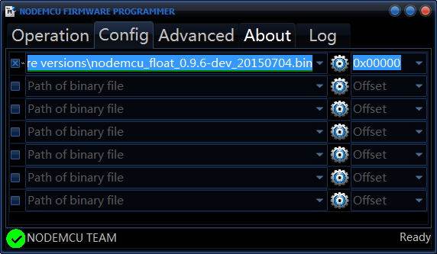
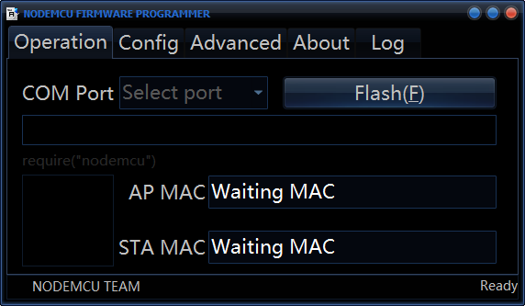
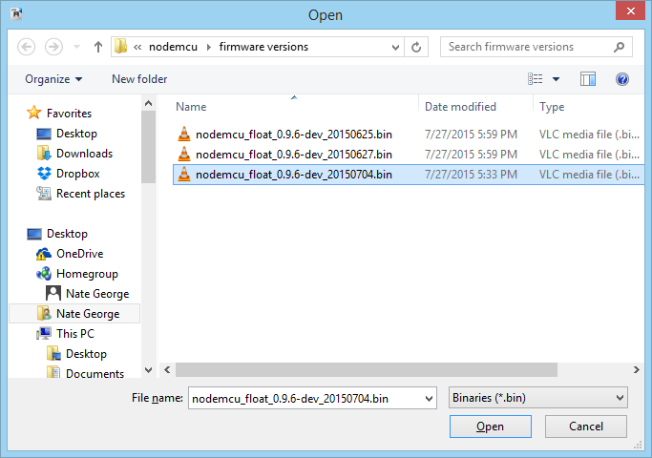
First, click on the gear under config, and choose
your firmware file. Use the latest from
https://github.com/nodemcu/nodemcu-firmware/releases,
which you can find by googling ‘nodemcu releases’
Next, click ‘flash’

Slide 4
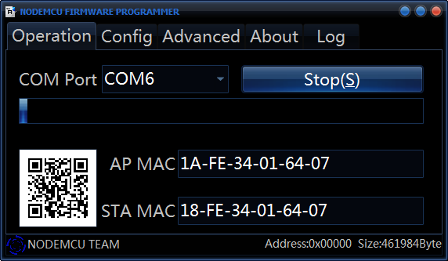

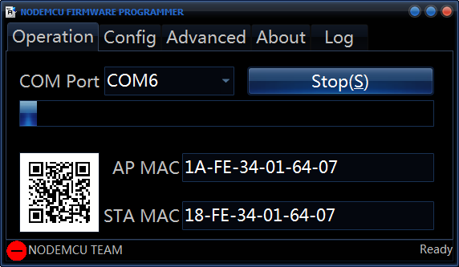
The MACs will be filled in along with the QR code.
If something goes wrong, the red circle will appear
in the bottom left, otherwise, once the status bar
gets to full, and everything went alright, the status
circle will change to green.
You should now reset the module.

Slide 5
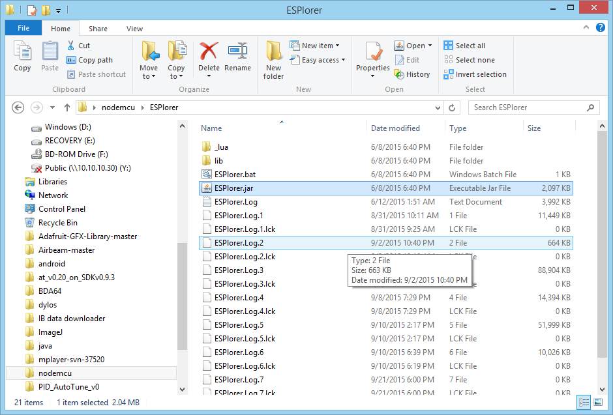
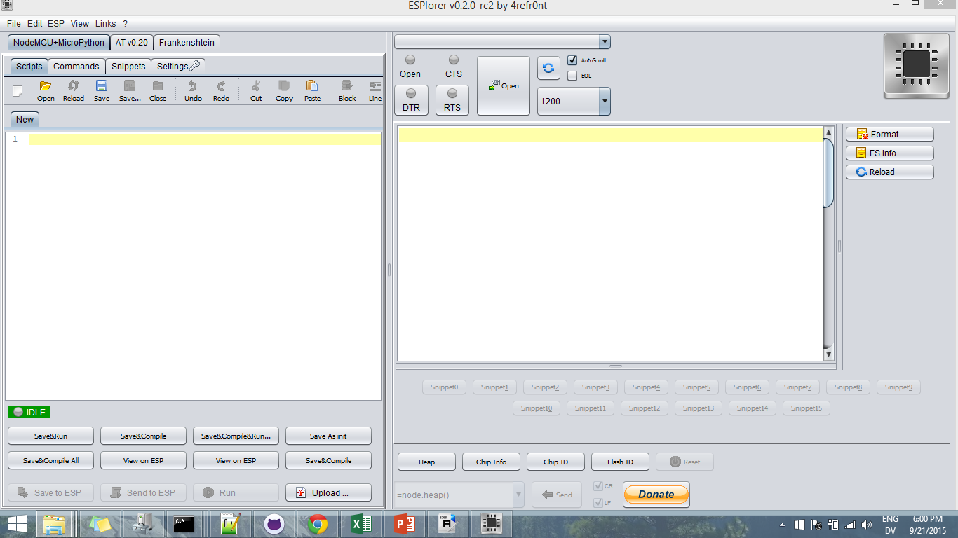
Open ESPlorer.jar

Slide 6
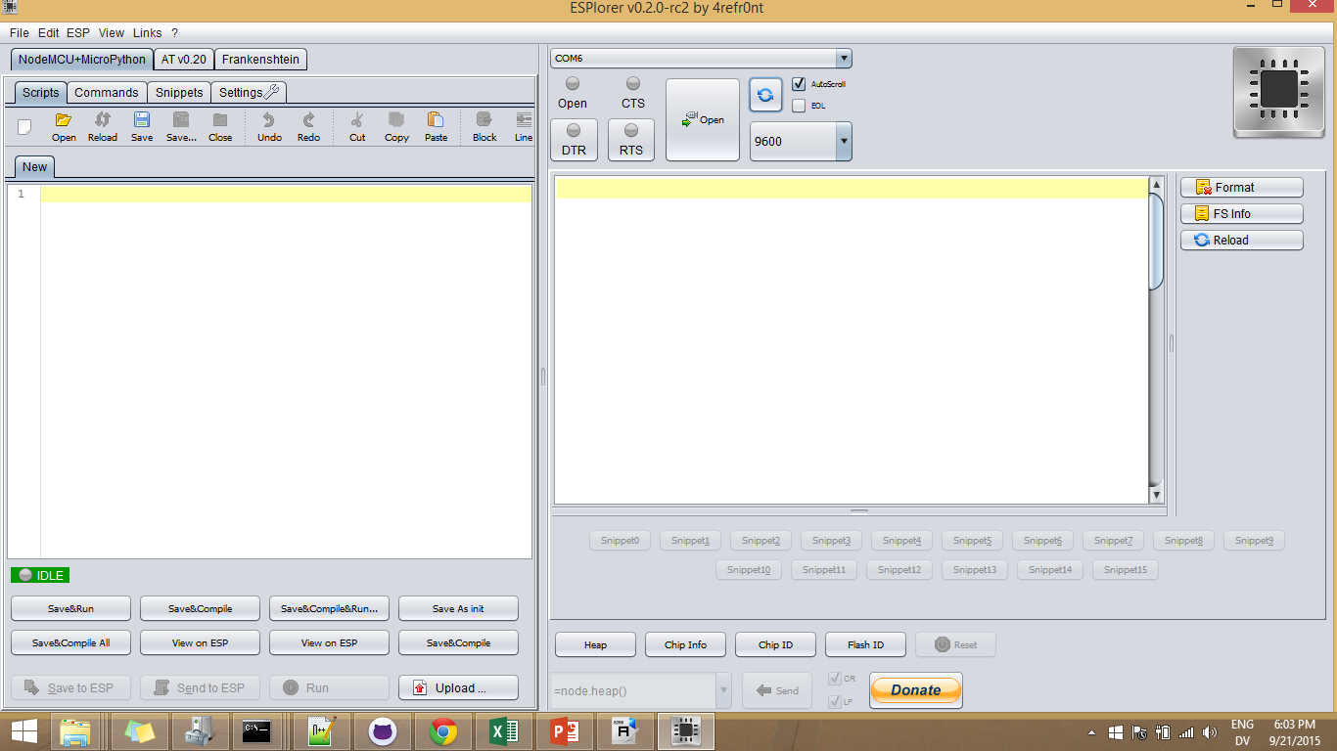
Click the refresh button, and it should detect your
Esp8266 if it was flashed correctly and is plugged in.
You may need to choose the COM port from the
dropdown.

Slide 7
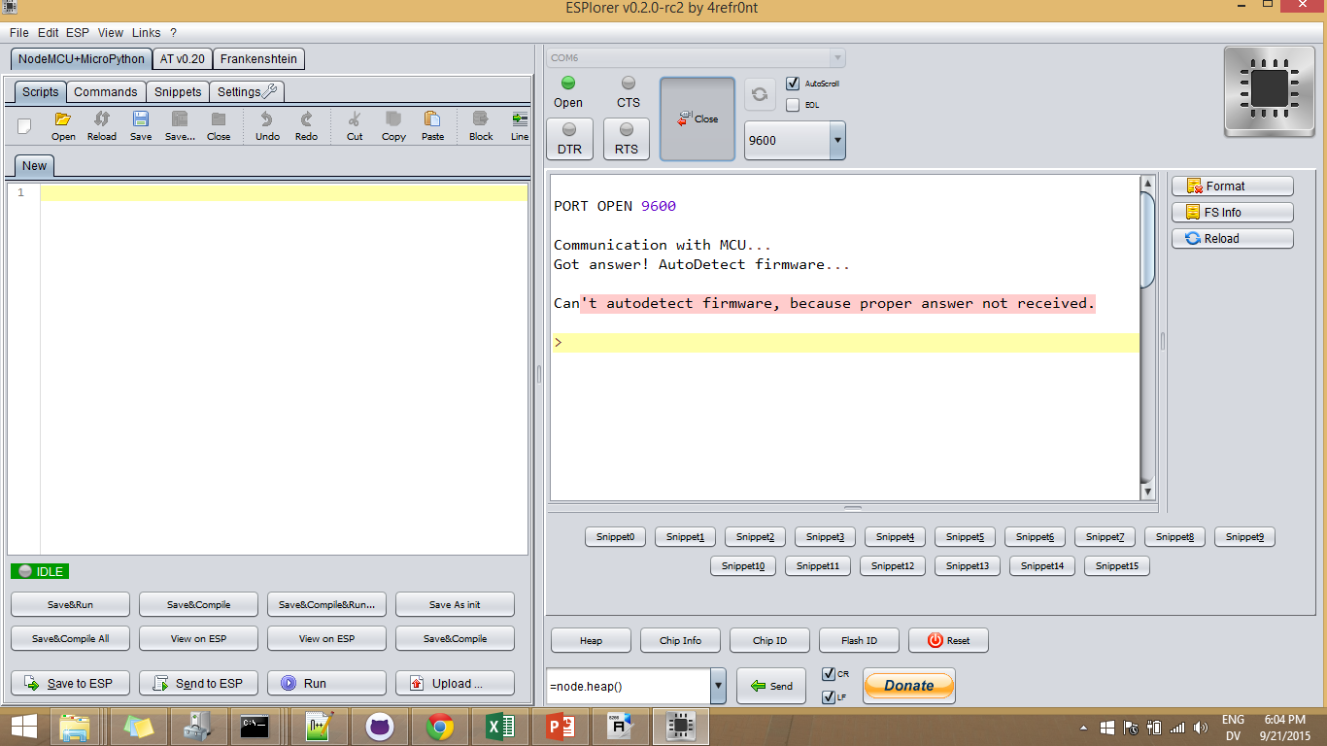
Click ‘open’, the response should look something
like this.

Slide 8
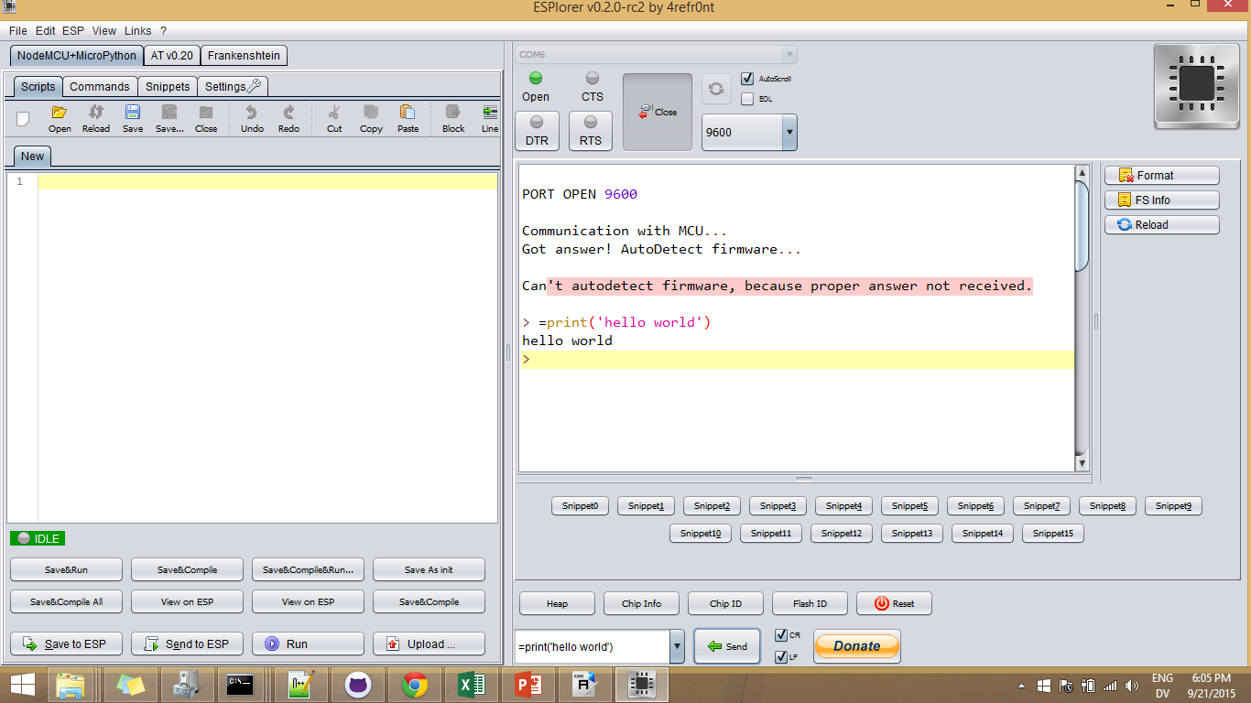
You can enter commands down here, then click ‘send’.
To do the canonical ‘hello world’, type
=print(‘hello world’)
and click ‘send’

Slide 9
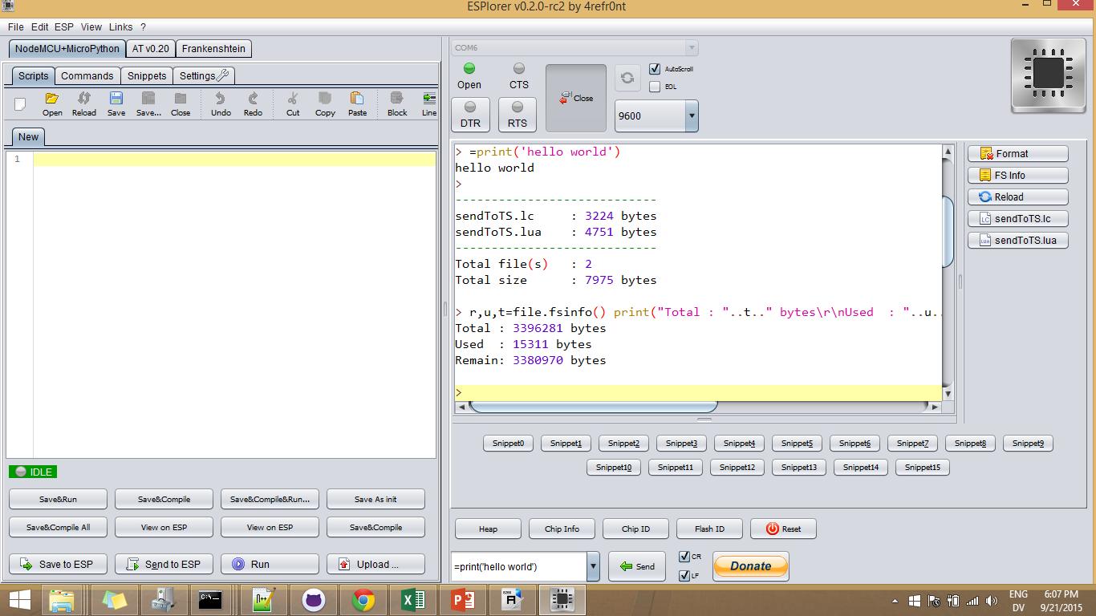
Click ‘reload’ to list the files on the device

Slide 10
Click ‘heap’ or send ‘=node.heap()’ to get the
heap size (free memory).

Slide 11
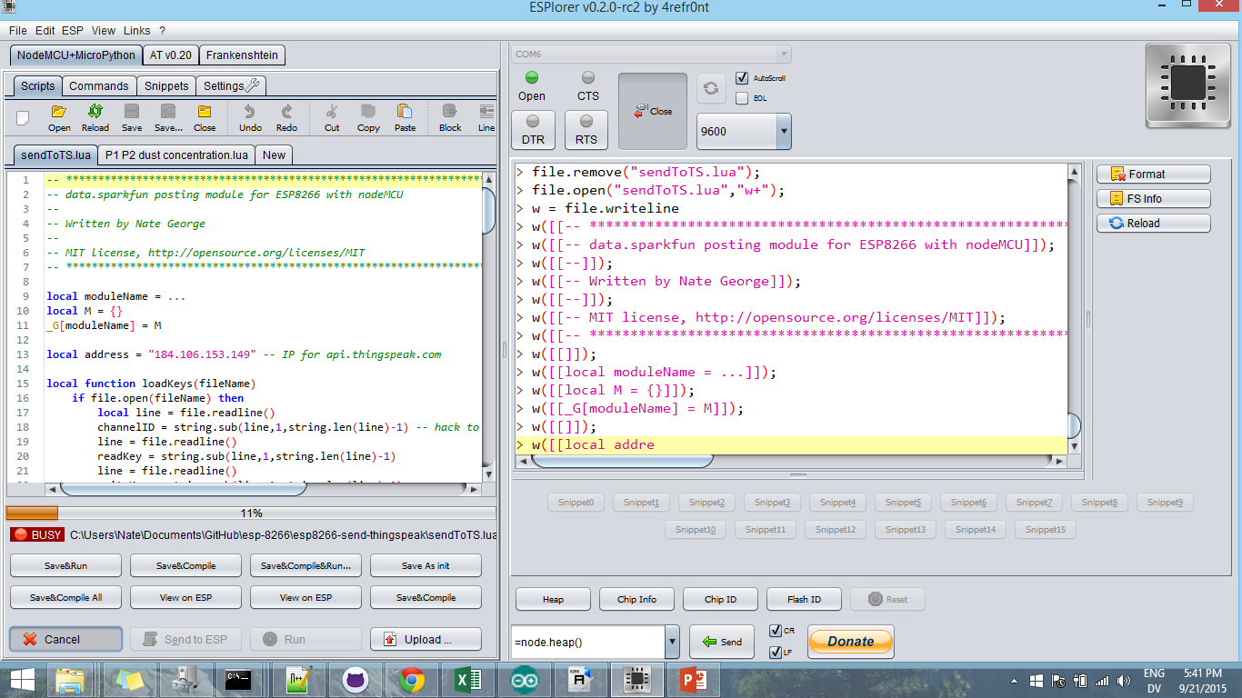
Click ‘save to ESP’ to write your file to the device. Clicking ‘SaveAndCompile’ will compile it, and save a lot of memory at runtime.

Slide 12
The programming is done in the Lua language, which is C-like. I made a few chunks of code for using NodeMCU:
Wifi network chooser:
https://github.com/wordsforthewise/ESP-8266_network-connect
Makes a server at 192.168.4.1 and asks for wifi credentials, then logs into the network.
Send data to sparkfun:
https://github.com/wordsforthewise/esp8266-send-to-sparkfun
Send data to thingspeak:
https://github.com/wordsforthewise/esp8266-send-thingspeak

