Slide 1
High School Sports Participation Analysis
Nate Allen

Slide 2
Primary Objectives
Address the state of youth sports by analyzing high school sports participation data
Find trends in various sports, and attempt to explain these trends

Slide 3
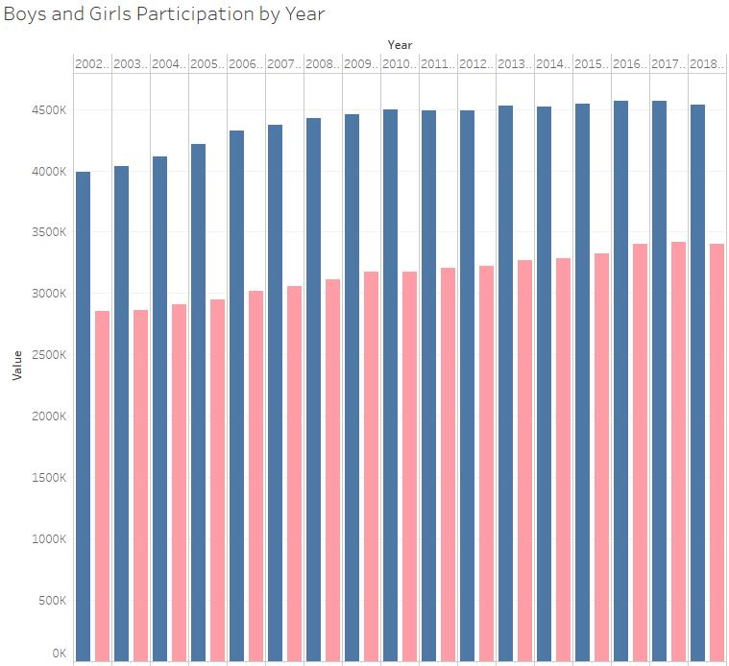


Slide 4
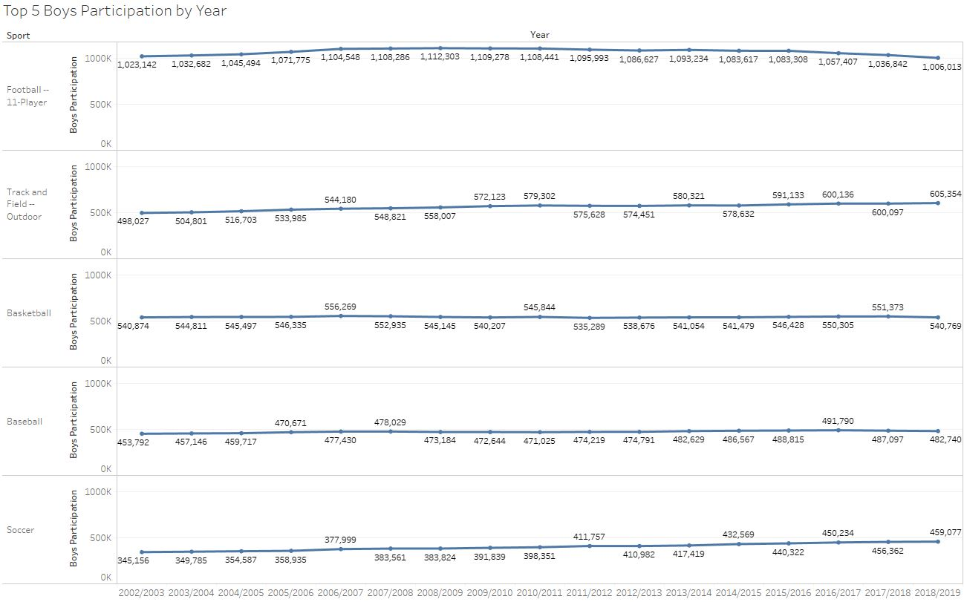

Slide 5
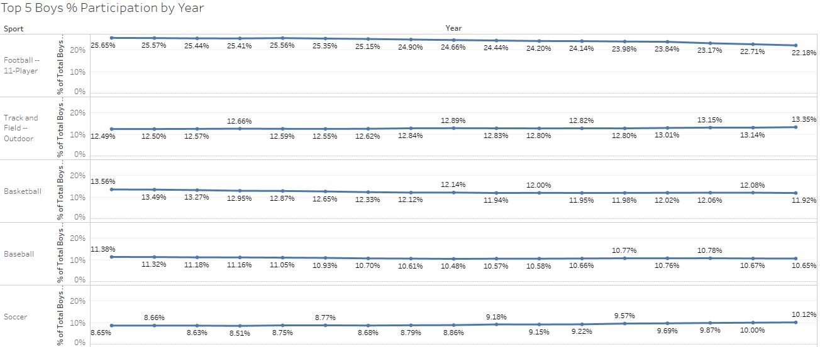

Slide 6
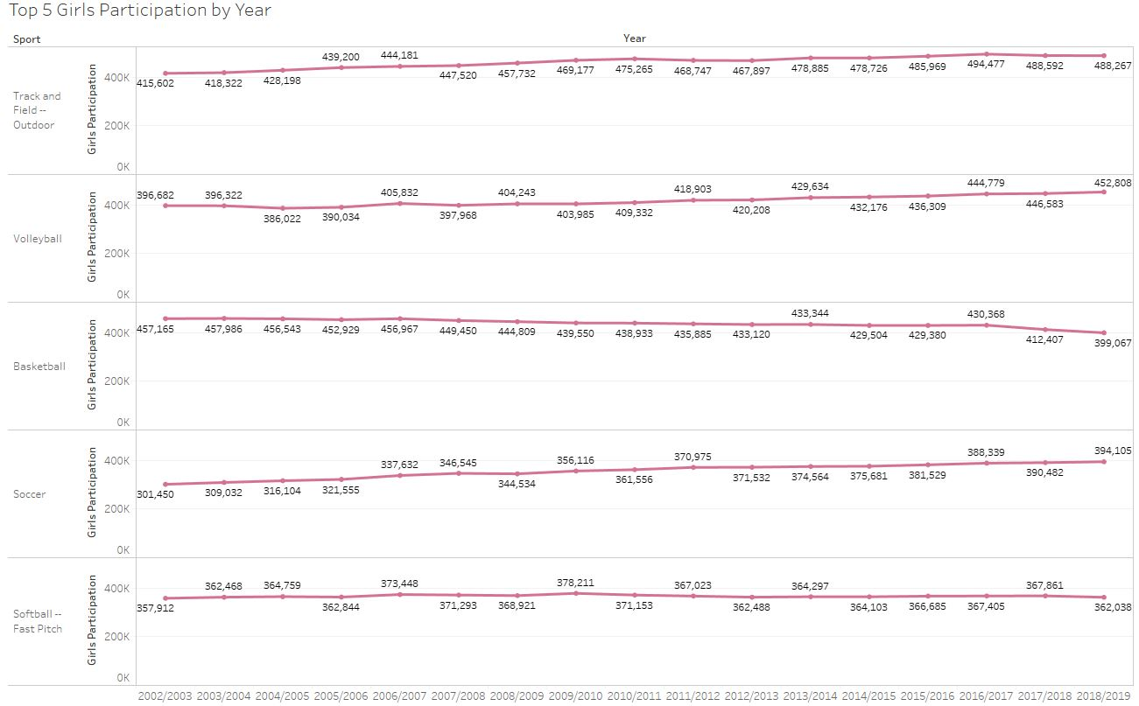

Slide 7
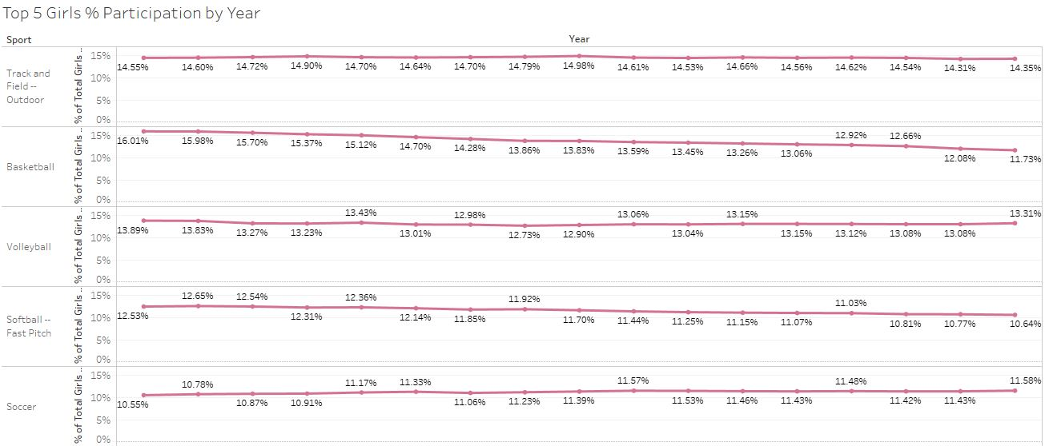

Slide 8
Most Significant Downward Trends
Football participation numbers have been in decline for the last 10 years of the available data, despite overall sports participation increasing for all but the last of those 10 years.
Both boys and girls basketball numbers have shown a decline since 2002. The boys decline is evident when viewing the numbers as a percentage of total participants, and is down to 11.9% from 13.6% back in 2002. The girls decline is drastic in both overall number and as a percent of the total. It is down 58,000 yearly participants since 2002, and down from having 16% to 11.7% of all girls sports participants.

Slide 9
Most Significant Upward Trends
Soccer has shown a steady increase in participation numbers since 2002. There are about 208,000 more annual participants across both genders in 2019 than in 2002. As percentages of all sports participants, boys soccer is up 1.5% over that time, and girls soccer is up 1%.
Boys and Girls track and field numbers have also steadily increased since 2002. They are up by roughly 107,000 and 73,000 respectively.
Volleyball has about 56,000 more annual participants in 2019 than in 2002, and has the same percent share of girls high school athletes.

Slide 10
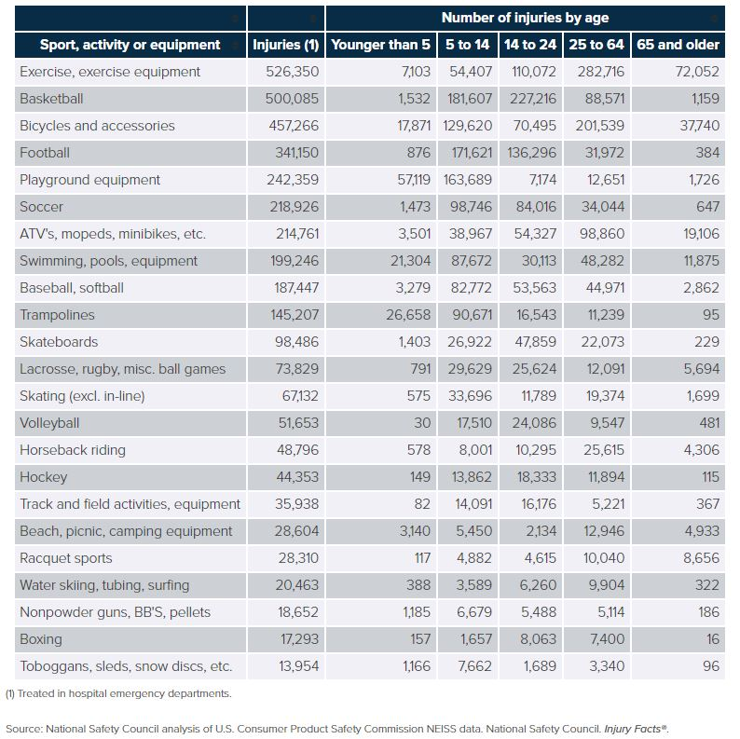
Could it be because of injuries?
Basketball and Football are the 2 most injury prone of the high school sports, and also showed the greatest declines in participation numbers since 2002.
Track and Field injury numbers are very low, and have shown a significant increase in participation numbers since 2002.
Soccer has shown steady increase in participation while having moderate injury rates.
Baseball and Softball have moderate injury rates, and have steadily declined in participation.

