Slide 1
Web Analytics | Spring 2026 | Group 2
Sentiment & Discourse Analysis
of Google's Discontinued Products
Google Stadia · Google Glass · Google+
Fordham University

Slide 2
Problem Definition & Research Goals
Why do users keep talking after a product dies?
When a tech product is discontinued, public discourse does not stop — it shifts. This project uses YouTube comment data to measure how sentiment and topic vocabulary change before and after discontinuation across three Google products.
Research Hypothesis
H1: Mean YouTube comment sentiment polarity decreases significantly (Welch's t-test, α = 0.05) after product discontinuation.
H2: Dominant keywords shift from forward-looking (e.g., 'future', 'innovation') to retrospective terms (e.g., 'remember', 'fail') post-shutdown.
Research Questions
RQ 1
Do YouTube comment polarity scores shift significantly (p < 0.05) after discontinuation, and does the direction vary across products?
RQ 2
Which keywords and co-occurring topics rise or fall in frequency post-discontinuation, as measured by TF-IDF and co-occurrence network analysis?
RQ 3
Which product aspects (quality, market demand, timing) attract the most negative sentiment in post-shutdown discourse, as identified by aspect-based sentiment analysis?

Slide 3
Data Acquisition & Methodology
Data Collection
Analytical Methods
Product | Before Window | n (Before) | After Window | n (After)
Google Stadia | Pre Jan 2023 | 600 | Post Jan 2023 | 620
Google Glass | Pre Jan 2015 | 739 | Post Jan 2015 | 306
Google+ | Pre Apr 2019 | 763 | Post Apr 2019 | 427
Total |  | 2,102 |  | 1,353
Sentiment Analysis (TextBlob)
Quantifies polarity shift; directly tests H1 across all comment groups.
Welch's T-Test
Appropriate for unequal sample sizes and variances; provides significance threshold for H1.
Collection & Cleaning
TF-IDF Keyword Extraction
Source: YouTube Data API v3, queried by video URL for each product's key announcement/eulogy videos.
Cleaning: removed duplicate comment IDs, filtered non-English text, dropped comments under 5 words. Polarity scoring applied via TextBlob on cleaned text.
Identifies discriminating terms per period; tests H2 on vocabulary shift.
Co-occurrence Network (Gephi)
Maps discourse topology; reveals which concepts cluster together in each period.
Limitations
English-only comments may underrepresent global sentiment. Comment volume skews toward videos with high initial engagement. Post-shutdown samples may attract a self-selected nostalgic audience.
ABSA with Gemini LLM
Extracts aspect-level sentiment to answer RQ3 beyond aggregate polarity.

Slide 4
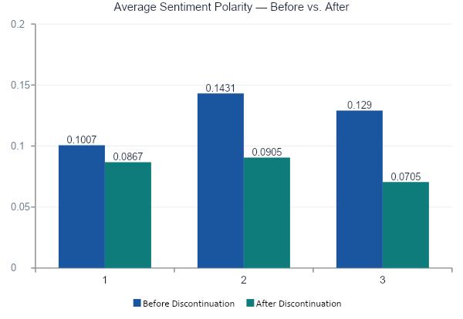
Sentiment Analysis — TextBlob Polarity Scores
Key Findings — answers RQ1
All three products
showed lower mean polarity after discontinuation — consistent with H1.
Google Glass
largest drop (−0.054), statistically significant (p = 0.004).
Google+
significant shift (p = 0.002); nostalgia vocabulary emerges post-shutdown.
Google Stadia
smallest drop (−0.014), not statistically significant (p = 0.41).
Polarity: −1.0 (very negative) to +1.0 (very positive) | Computed via TextBlob on raw YouTube comments

Slide 5
Statistical Testing — Welch's Independent Samples T-Test
Did sentiment shift significantly after discontinuation?
Product | Mean Before | Mean After | Change | t-Statistic | p-Value | Significant
Google Stadia | 0.1007 | 0.0867 | −0.0140 | 0.823 | 0.4105 | No
Google Glass | 0.1431 | 0.0905 | −0.0526 | 2.882 | 0.0041** | Yes
Google+ | 0.1290 | 0.0705 | −0.0585 | 3.151 | 0.0017** | Yes
Interpretation
Google Stadia
Google Glass
Google+
Sentiment decline was not statistically significant, suggesting Stadia never built strong positive sentiment to begin with. The community tone was muted both before and after shutdown.
Significant drop (p < 0.01). Post-shutdown criticism shifted from privacy/novelty debates to direct comparisons with Apple Vision Pro — a sign of unmet long-term expectations.
Strongest statistical significance (p < 0.01). Post-shutdown discourse is dominated by nostalgia terms ('remember', 'miss') and comparisons to Facebook — a grieving community tone.
** p < 0.01 | Welch's t-test used to account for unequal sample sizes and variances between time periods

Slide 6
TF-IDF Keyword Analysis — Discourse Shifts Before vs. After
Google Stadia
Google Glass
Google+
Before
After
Before
After
Before
After
gaming
games
google glass
apple
youtube
remember
internet
game
apple
glasses
facebook
google plus
video
play
vision
video
video
used
play
gaming
glasses
vision
love
youtube
future
remember
ahead
tech
song
social
game
controller
cool
camera
comments
miss
console
service
future
remember
awesome
friends
streaming
fail
need
privacy
thanks
nostalgic
Future-focused gaming enthusiasm shifts to retrospective failure analysis
Innovation curiosity shifts to Apple Vision Pro comparison and privacy critique
Active platform engagement shifts to nostalgia and social network comparison

Slide 7
Keyword Co-occurrence Network — Gephi Graph Analysis
90
427
3
4.7
Total Nodes (Keywords)
Total Edges (Co-occurrences)
Products Analyzed
Avg. Node Degree
Most Frequent Co-occurring Keywords by Product
Google Stadia
Google Glass
Google+
games
153
apple
99
youtube
114
game
109
vision
85
video
103
play
105
glasses
74
facebook
68
gaming
103
video
61
used
51
internet
99
watching
42
friends
50
streaming
60
looks
23
social
49
controller
42
wait
22
comment
42
cloud
38
privacy
20
miss
41
Gaming vocabulary dominated throughout. After shutdown, 'fail', 'service' and 'cloud' grew — criticism focused on the business model rather than game quality.
'Apple' is the top co-occurring node — Glass's legacy is now framed through comparison with Apple Vision Pro. Privacy concerns persist as a recurring theme.
Social platform terms dominate. 'Miss' and 'used' signal post-shutdown nostalgia — a contrast to the 'love' and 'awesome' active engagement terms seen before shutdown.

Slide 8
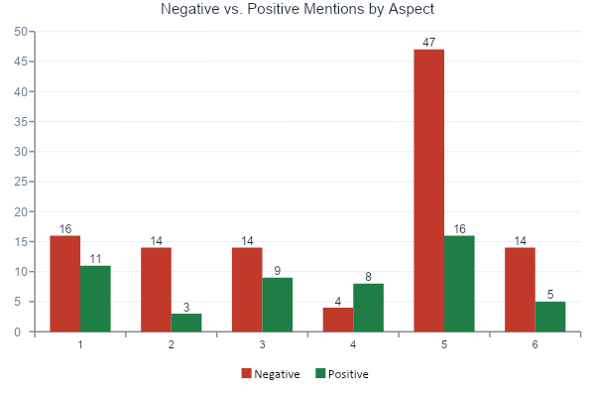
Aspect-Based Sentiment Analysis — Gemini LLM — answers RQ3
Aspect Breakdown
Aspect | Neg | Pos
Stadia
Product Quality | 16 | 11
Market Demand | 14 | 3
Adoption Ability | 11 | 7
Glass
Product Quality | 14 | 9
Market Demand | 10 | 5
Timing/Innovation | 4 | 8
Google+
Product Quality | 47 | 16
Market Demand | 14 | 5
Adoption Ability | 13 | 6
Key Insight:
Google+ had by far the highest volume of Product Quality negativity (47 neg vs. 16 pos), suggesting fundamental platform dissatisfaction. Google Glass's Timing/Innovation aspect skewed positive (4 neg vs. 8 pos) — the concept was appreciated even as execution fell short. Stadia's Market Demand was nearly all negative (14 neg vs. 3 pos), confirming low consumer appetite for cloud gaming at launch.

Slide 9
Findings & Recommendations
Findings
Recommendations
F1
RQ1
All three products showed a decline in mean polarity after shutdown. Glass and Google+ were statistically significant (p < 0.01); Stadia was not.
R1
based on F1+F2
Track sentiment early
Monitor YouTube comment polarity at launch. Persistently muted or declining sentiment (as with Stadia) signals low resilience to shutdown announcements.
F2
RQ1
Stadia's non-significant result reflects pre-existing lukewarm sentiment — the shutdown did not dramatically alter how users felt.
R2
based on F4
Timing readiness matters
F3
RQ2
TF-IDF confirmed a consistent vocabulary shift from future-oriented terms to retrospective ones, validating H2 across all three products.
Glass's positive Timing/Innovation scores show the public appreciated the concept. Time future launches to ecosystem readiness — not just internal readiness.
R3
based on F5
F4
RQ3
ABSA showed Product Quality and Market Demand as universally criticised aspects. Timing/Innovation was uniquely positive for Glass.
Preserve community on exit
Google+'s nostalgia signals a community that valued connection. Products with strong social identity need transition planning, not abrupt shutdowns.
F5
RQ2
Co-occurrence networks show Glass permanently reframed around Apple Vision Pro, while Google+ is remembered through its social community.
R4
based on F3
Shape the post-shutdown story
Vocabulary shifts show organic post-shutdown narratives form quickly. Proactive communication can prevent 'fail' and 'mistake' from dominating the discourse.

Slide 10
Conclusion
What YouTube Comments Reveal
About Product Discontinuation
Sentiment analysis confirmed H1 for two of three products — the shift is real and measurable, not anecdotal.
TF-IDF and network analysis show that product legacies live on through competitive comparisons and community nostalgia, each product developing its own post-shutdown vocabulary.
ABSA with Gemini LLM reveals that Product Quality and Market Demand are the most criticised aspects — issues detectable through web analytics before any shutdown decision.
Group 2 · Web Analytics · Fordham University · Spring 2026

