Slide 1
Consumer Sentiment
Analytics Dashboard
Data-Driven Product Portfolio Decision Support
Sony VAIO • Sony PlayMemories Online • Sony PlayStation Vue
Group 2 | Web Analytics | Fordham University | Spring 2026

Slide 2
PART 1
Project Overview
Objective: Use sentiment analysis to identify the reasoning behind Sony’s decisions to discontinue Sony VAIO, Sony PlayMemories Online, and Sony PlayStation Vue. The results of the project should demonstrate how an integrated analytics system can support strategic product decisions by analyzing consumer feedback into actionable insights.
🔍
🧹
📊
📈
Web Scraping
Data Cleaning
Sentiment Analysis
Dashboard
BeautifulSoup + Playwright scraping across 10+ sources for 3 Sony products
Noise removal, text standardization, structured CSV output
VADER + TextBlob scoring — Positive / Neutral / Negative
Streamlit app with executive KPIs, charts, and word clouds
Products Analyzed:
Sony VAIO
Sony PlayMemories Online
Sony PlayStation Vue
166
67/100
63.3%
10.8%
Total Reviews
Global Sentiment
Positive Reviews
Negative Reviews

Slide 3
PART 2
Data — Product Selection
We analyzed three Sony products that have all already been discontinued — giving us a real-world basis to evaluate what sentiment signals preceded their discontinuation.
Sony VAIO
Sony PlayMemories
Online
Sony PlayStation Vue
PCs & Laptops
Cloud Photo Service
Live TV Streaming
Discontinued: 2014
Discontinued: 2021
Discontinued: Jan 2020
Sony sold VAIO to Japan Industrial Partners. Despite discontinuation, it retained the most positive consumer sentiment in our dataset.
A cloud-based photo storage and sharing platform. Received the lowest sentiment scores — flagged as Critical Remediation Target.
Sony's streaming TV service shut down due to rising content licensing costs. Mixed-to-negative sentiment around the shutdown.
Sources:
Wikipedia • Sony Support • Sony Help Guide • TechRadar • Britannica • DP Review Forum • The Verge • Sony Global History • Sony.com Product Page
Notes:
Honglin

Slide 4
PART 2
Data — Dataset Overview
166
10+
2
4
Total Reviews
Web Sources
NLP Models
Data Columns
Across all 3 products
Per-product multi-source coverage
VADER + TextBlob dual validation
product · source · url · clean_text
Review Volume by Product
Dataset Schema
Sony VAIO
product
str
Sony VAIO / PlayMemories / PS Vue
~60 reviews
source
str
Wikipedia, TechRadar, etc.
Sony PlayStation Vue
url
str
Original source URL
~55 reviews
clean_text
str
Cleaned paragraph-level text
Sony PlayMemories Online
vader_score
float
VADER compound score (−1 to +1)
~51 reviews
sentiment_category
str
Positive / Neutral / Negative
Scraped using Python • BeautifulSoup • Playwright | Cleaned via Data_cleaning_script.ipynb | 166 reviews retained after noise filtering
Notes:
Honglin

Slide 5
PART 3
Data Scraping
🔧
Scraping Statistics
Tools Used
166
Python • requests • BeautifulSoup • Playwright (for JS-heavy pages like DP Review forum)
Total Reviews Collected
📦
3
Products Scraped
Sony Products Analyzed
Sony VAIO • Sony PlayMemories Online • Sony PlayStation Vue
10+
Web Sources Scraped
📄
Output
1,411
updated_sony_raw_data.csv — columns: product, source, url, text (paragraph-level)
DP Review Forum Elements Found
Key Sources: Wikipedia (VAIO) • Sony Support • TechRadar (date-filtered pre-2014) • DP Review Forum • The Verge (PS Vue shutdown)

Slide 6
PART 4
Data Cleaning
🗑️
📋
Noise Removal
Column Schema
Removed HTML tags, short paragraphs (≤50 chars), boilerplate navigation text and duplicates
Standardized columns: product, source, url, clean_text — ready for sentiment pipeline
🔤
✅
Text Standardization
Output File
Lowercased text, removed special characters, Unicode normalization, whitespace cleanup
updated_sony_cleaned_data.csv — used by both sentiment_analysis.ipynb and app.py
Input: updated_sony_raw_data.csv → Output: updated_sony_cleaned_data.csv | 166 reviews retained across 3 products

Slide 7
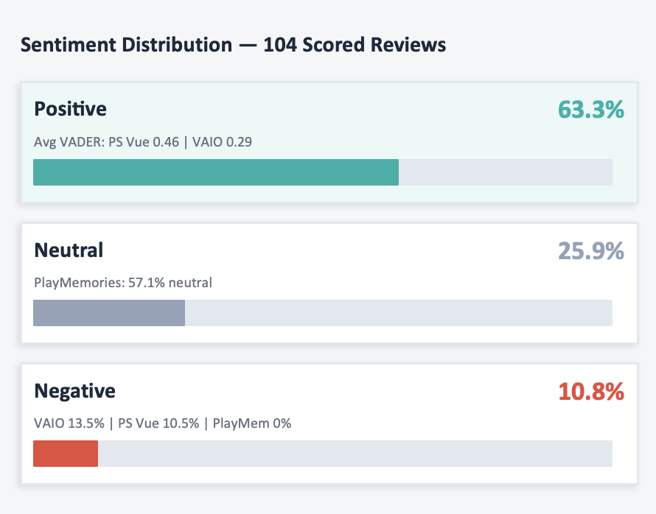
PART 5
Sentiment Analysis
🤖
Sentiment Distribution — 166 Reviews
Models Used
VADER (compound score) + TextBlob (polarity) — dual-model validation for accuracy
Positive
63.3%
Global Sentiment Index: 67/100
🏷️
Classification Rules
Neutral
25.9%
Score ≥ 0.05 → Positive | Score ≤ −0.05 → Negative | Between → Neutral
Global Sentiment Index: 67/100
🔎
Negative
10.8%
Source Comparison
Global Sentiment Index: 67/100
Third-Party avg VADER: ~0.37 | Official Sony avg VADER: ~0.10–0.15
⚠ Key Findings:
Sony PlayMemories Online = lowest sentiment score → Critical Remediation Target
PlayMemories avg VADER 0.21 (lowest) — automated model underestimated negativity; manual inspection confirmed Critical Remediation Target

Slide 8
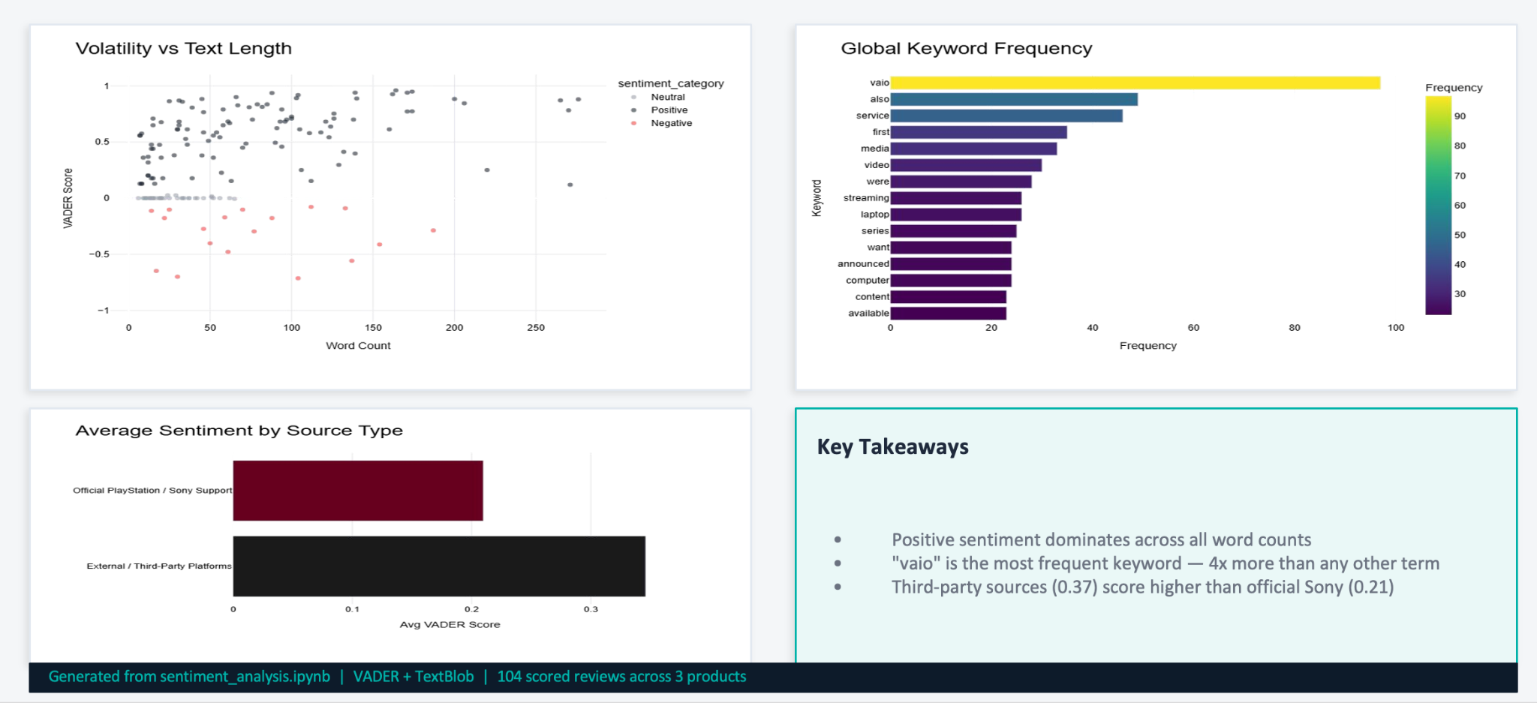
PART 5
Sentiment Analysis - Visualizations
🤖
Sentiment Distribution — 166 Reviews
Models Used
VADER (compound score) + TextBlob (polarity) — dual-model validation for accuracy
Positive
63.3%
Global Sentiment Index: 67/100
🏷️
Classification Rules
Neutral
25.9%
Score ≥ 0.05 → Positive | Score ≤ −0.05 → Negative | Between → Neutral
Global Sentiment Index: 67/100
🔎
Negative
10.8%
Source Comparison
Global Sentiment Index: 67/100
Third-Party avg VADER: ~0.37 | Official Sony avg VADER: ~0.10–0.15
⚠ Key Findings:
Sony PlayMemories Online = lowest sentiment score → Critical Remediation Target
PlayMemories avg VADER 0.21 (lowest) — automated model underestimated negativity; manual inspection confirmed Critical Remediation Target

Slide 9
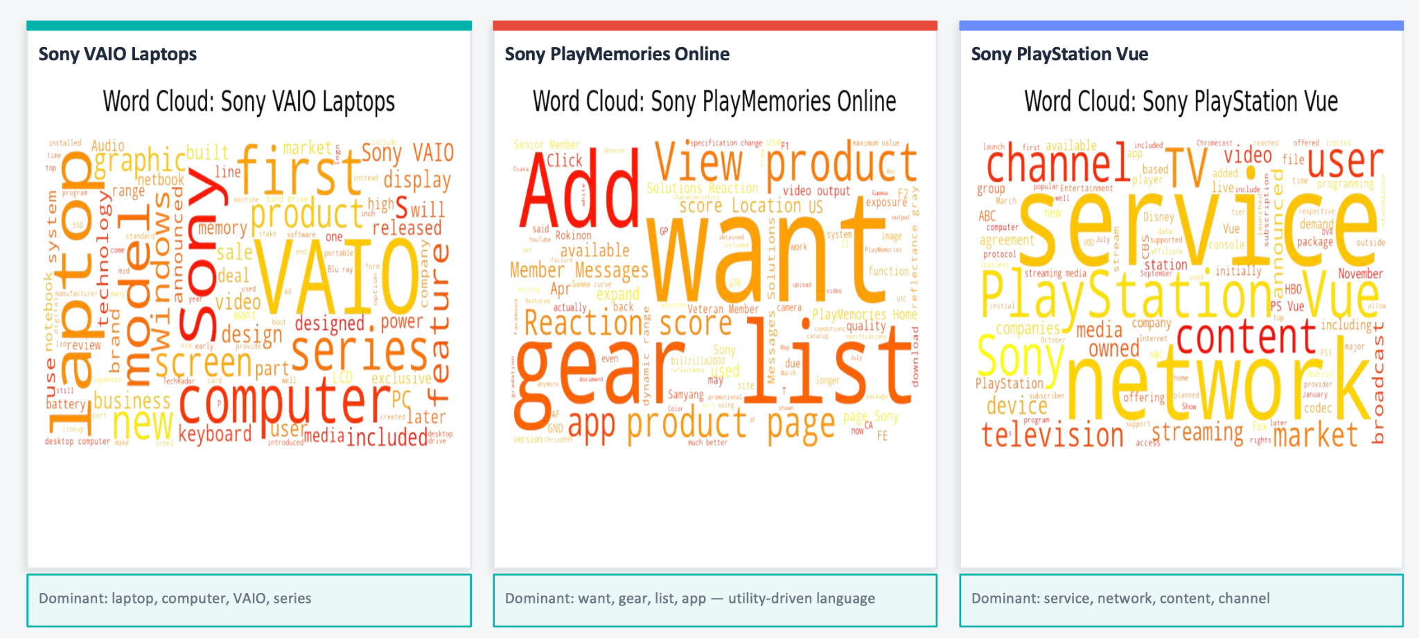
PART 5
Sentiment Analysis - Word Clouds by Product

Slide 10
PART 6
Dashboard & Decision Recommendation - Based on Sentiment Analysis
✅ Recommended: Maintain
✅ Recommended: Maintain
⚠️ Recommended: Sunset
Sony VAIO
PlayStation Vue
PlayMemories
Sentiment Logic:
Highest VADER sentiment scores
Strongest brand loyalty
High hardware reliability
Sentiment Logic:
Highest sentiment score of 73
Premium high-quality service
Strong positive user recognition
Sentiment Logic:
Lowest score in ecosystem
Highest negative reviews
Critical remediation target
Lack of intervention success
Post-Analysis Reflection & Historical Context
Recommendations above are based strictly on sentiment analysis. Note: Despite these sentiment-based findings, Sony has already discontinued all three products (VAIO, PlayMemories, PlayStation Vue) due to market shifts, declining sales, or pricing gaps.

Slide 11

Reflection & Strategic Insights
insights
warning
Consumer Experience
Sentiment analysis provides meaningful insights into the consumer experience of each specific product.
Strategic Limitations
Sentiment analysis alone cannot be the only basis of strategic product decisions.
assessment
search_off
Holistic Decision Making
Sales performance, demand, and competition all factor into strategic decisions like product discontinuation.
Data Nuance Risks
Sentiment analysis can overlook nuances in reviews, causing incorrect sentiment classification. Also can have difficulty distinguishing between user product reviews and general information regarding the product.
Notes:
when reflecting on the results of our sentiment analysis, we learned that sentiment analysis can provide meaningful insights into the consumer experience of specific products, however sentiment analysis can not be the sole basis of strategic product decisions, as in our cases, it does not address additional factors that drive decisions made by businesses like sony. it ignores sales performance, market demand, and how a product matches up to competing products. In the case of VAIO, our analysis results recommend maintaining the product line, but this is due to a lack of consideration of VAIO sales performance, Sony small market share in the PC market, as well as PCs experiencing a decline in demand around the time Sony stopped selling the product. additionally, our results show that sentiment analysis has an inability to identify certain nuances in user reviews, leading to incorrect sentiment identification, that skew results, and also an inability to distinguish between user reviews and general product information

Slide 12
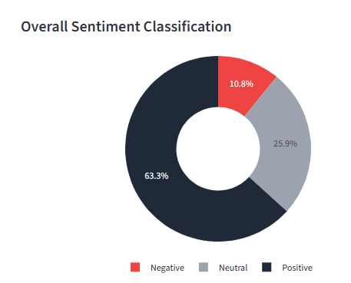
Reflections and Insights continued
search
Sentiment Distribution
Successful Sentiment Analysis Findings
Identified possible reasons for Sony PlayMemories discontinuation:
Poor product quality
Adoption barriers: iOS incompatibility, payment difficulties outside US
visibility_off
Manual Data Inspection Gap
While overall sentiment results indicate mostly positive reviews, manual inspection reveals conflicting insights that automated analysis missed.

Slide 13
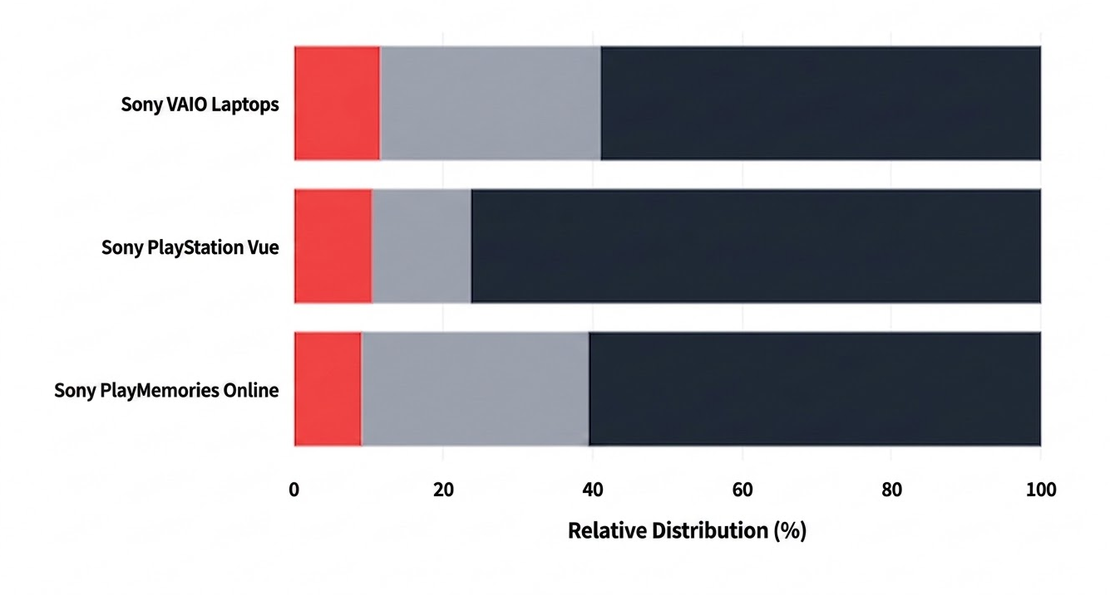
Analysis Gap Case: PlayMemories
analytics
Sentiment Distribution by Segment
Sentiment Analysis Results
PlayMemories had the lowest negative sentiment percentage. This is reflected by the data visualized on the app dashboard.
visibility_off
Manual Data Inspection Gap
Inspection indicates PlayMemories had a higher negative sentiment distribution than the results of the sentiment analysis indicated.

Slide 14

Conclusion of Results
Core Limitation: Sentiment analysis is a component of strategic decision making, but is not suited to act as the sole driver behind strategic decision making.
laptop
live_tv
Case 1: VAIO Discontinuation
Sentiment analysis suggested continuation, but additional data dictated a different strategy:
Unit sales declined from 8.7M (2010) to 5.8M (2013)
Declining market share in a shrinking PC market (1.9% market share in 2013)
Case 2: PlayStation Vue
Highest sentiment score (73), but failed to survive the market:
High quality, but significantly more expensive than competitors
Value Gap: Consumers could not justify a $50 monthly fee

Slide 15
Thank You
Consumer Sentiment Analytics Dashboard
Sony PlayMemories Online — Recommended for Discontinuation
Global Sentiment Index: 67/100 • 166 Reviews • 3 Products Analyzed
Questions & Discussion
Group 2 | Web Analytics | Fordham University | Spring 2026

