Slide 1


Scimitar Functional Programs as Optimization Problems
Nate F. F. Bragg
Jeffrey S. Foster
Philip Zucker

Slide 2
When Only the Best Will Do
Algorithms need optimal values, settle for acceptable
Domains: logistics, control, resource allocation, CAD
Approaches like ad-hoc, greedy, high watermark
Often suboptimal, hard to specify some constraints
Business logic/constraints mixed, less maintainable
Better approach: Optimization solvers
Scimitar = Optimization + Functional programming
Notes:
Slide 1 only the best: 1m
Motivated by the recognition that ...
Read the slide

Slide 3
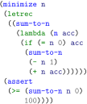
Example: sum-to-n
Goal: minimize the value to sum to
Defines recursive function sum-to-n
Constrains result >= 100
Recursively adds to result until n = 0
Result is 14
Notes:
Slide 2 sum-to-n: 1.5m
Lets consider how this might work with an example, a traditional summing function.
In the middle of this program is the usual recursive definition of a sum-to-n function that takes an accumulator parameter that gradually increases in each recursion as the number n decrements
In our program, we turn the normal execution on its head. Our goal is not to get the sum given some n, but to minimize the value n such that it is constrained to some result.
In this case the result is constrained to be greater than or equal to 100---that is, we want the smallest n such that sum-to-n's result meets or exceeds 100.
In this example, the result is 14, which if we check is indeed the correct, as the sum is 105.

Slide 4
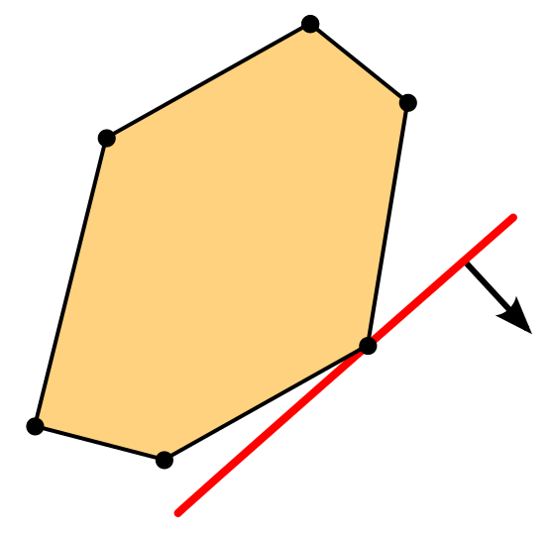
Mathematical Optimization
Get the best value of cost func s.t. constraints: max f(x) s.t. gi(x) = 0 ∀i
LP has linear cost func/constraints
MILP uses real and integer vars
Many efficient off-the-shelf solvers are available
E.g., Gurobi, CPLEX, Coin-OR CBC, etc.
Notes:
Slide 3 mathematical optimization: 1.5m
To be able to approach this problem, we need to discuss two bits of background knowledge.
The first is how to find optimal values. This has been studied extensively, and has spawned the field of mathematical optimization
Mathematical optimization asks “what is the best value of a cost function”
Cost funs so called because we often want to min the cost of something
These problems often include constraints that rule out values
a formal description is … bullet 1
One common kind of optimization is linear programming (LP) ... bullet 2
and its extension mixed integer linear programming (or MILP) ... bullet 3
- MILP is common because it is suitable for many problems, and ... bullet 4-5

Slide 5
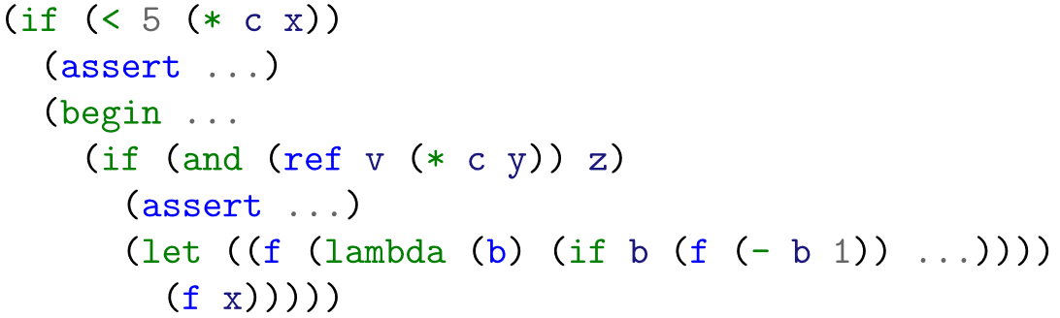
Optimization Expert Encodings
Expert encodings
Expressive
Unmaintainable
(e.g., Bools, *, ITE)
Code changes: easy, MILP constraint changes: hard
* expands to O(log c + log x) constraints
Vector ref expands to O(length(v)) constraints
lambda inlined up to some user defined limit
if-then-else expands asserts to PC, O(assert depth)
Notes:
Slide 4 Expert encodings 2m
However, when problems become more complex we have to rely on ... bullet 1 and subbullets
for example, consider the byzantine code here (don't actually bother trying to understand it, it's gibberish meant to look complicated).
We have (list features), and when this is lowered to constraints, it’s quite complex
if we change one thing, it changes everything. rearrange this inner if-then-else, and the inner asserts must change, which messes up the inlining of the lambda, and could mess up the vector reference and the multiplication.
This code itself is easy to rewrite but the milp constraints are hard
The reason is because the MILP constraint format is hard to change … bullet 2 and subbullets
especially if-then-else, because it relies on path conditions
this makes MILP constraints effectively write only

Slide 6
Solver Aided Languages
Existing langs include SWI-Prolog, Dafny, Rosette
These focus on SMT or similar decision procedures
Target applications are therefore quite different
Often send problems to efficient OTS solvers
They yield satisfying results, not optimal ones
Notes:
Slide 5 solver aided: 1m
The second piece of background knowledge we need to be aware of is the existence of other so-called solver aided languages
read the slide

Slide 7
Scimitar: Functional Optimization
Integrates MILP directly into a scheme-like language
Compiler written in Racket, solver is Gurobi
Expert encodings are performed automatically
Semantic coupling is reduced as compared to MILP
Yields optimal results, not just satisfying
Notes:
Slide 6 Scimitar: 1m
We put these two ideas together in our work Scimitar.
read the slide

Slide 8

Example: Arena Allocate
Allocator, e.g., malloc
Tracks free memory
A common approach on
limited platforms is to use a bucket-based arena
Fast, but tradeoff is must
sometimes be rebalanced
We want the optimal way to rebalance
Notes:
Slide 7 Allocate: 1.5m
For an example of why to use Scimitar, consider ... bullet 1 ... like the Allocate fun in the fig
In systems with manual memory allocation, the runtime needs a way to ... bullet 2.
see the matrix ... bullet 3
This prevents memory fragmentation, and lets you allocate very quickly.
A tradeoff … bullet 4 ... to accommodate anticipated allocations.
Here, the function Update-Arena-Dist is responsible for making that change.
Many implementations are possible, but we... bullet 5.

Slide 9
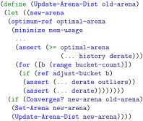
Example: Update-Arena-Dist
Computes new arena
Notes:
Slide 8 update-arena-dist: 0.5m
We give here an implementation of a function to compute a new arena layout Update-Arena-Dist
Just as a note, this is not an industrial strength implementation, which has to incorporate many other factors not considered here.

Slide 10
Example: Update-Arena-Dist
Computes new arena
Call solver via minimize, optimum-ref terms that collect asserts, compile, and solve
Notes:
Slide 9 update-arena-dist: 0.5m
Recall the minimize term from the sum-to-n
The compiler assembles the asserts in the body of the term into an optimization problem which it submits to an off the shelf solver
The solution is accessed via the optimum-ref term.
this is our key contribution

Slide 11
Example: Update-Arena-Dist
Computes new arena
Call solver via minimize, optimum-ref terms that collect asserts, compile, and solve
Mins mem-usage, gets optimal-arena
Notes:
Slide 10 update-arena-dist: 0.5m
In our implementation here, we're minimizing mem-usage, and extracting the optimal-arena
These are determined via constraints, such as this one, over both frozen parameters and symbolic solver variables
the behavior of these asserts depends on the rest of the program
e.g. as I stated earlier asserts inside if-then-else use the path condition to let the solver itself dynamically enable and disable constraints
There are other constraints (...) that we omit here for brevity

Slide 12
Example: Update-Arena-Dist
Computes new arena
Call solver via minimize, optimum-ref terms that collect asserts, compile, and solve
Mins mem-usage, gets optimal-arena
Easily add asserts to ITE
Notes:
Slide 11 update-arena-dist: 1m
bullet 4
These constraints apply only if that branch is active, and the active branch can be selected not only due to the variables in the guard, but also variable use in each branch, that is to say that branches can force the solver to make them active simply by leading to a more optimal result
We can also see at the bottom that Update-Arena-Dist calls itself, recursively converging towards an optimal layout, at which point the system switches to that layout.
This is slower than a simple heuristic, but the intention is to run this very rarely
once the program reaches steady state execution it will no longer need to rebalance.

Slide 13
Host-solver Boundary
Shifts from usual semantics to solver semantics
Host → Solver: concrete variables are frozen
Solver → Host: symbolic variables are frozen
Host Language
Solver
Language
1 | 0 | 0 | -1
0 | 1 | 0 | 0
0 | 1 | -1 | 0
1 | 0 | 1 | 1
minimize
Compiler
Solver
Notes:
Slide 12 host-solver boundary: 1m
Update-Arena-Dist exploits Scimitar’s transition between the host language execution and the optimization solver
We call this transition crossing the ... read slide ...
host language minimize expressions invoke the solver, which compiles to a matrix format that we submit to the solver
its results get returned to the host language
all other terms outside the minimize stay in the host language

Slide 14
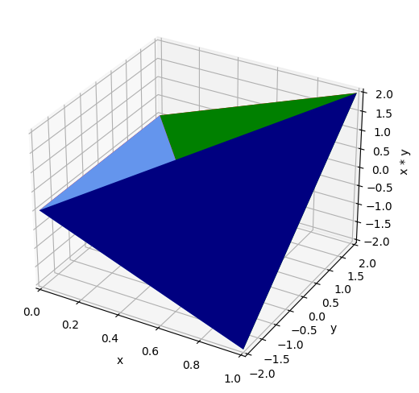

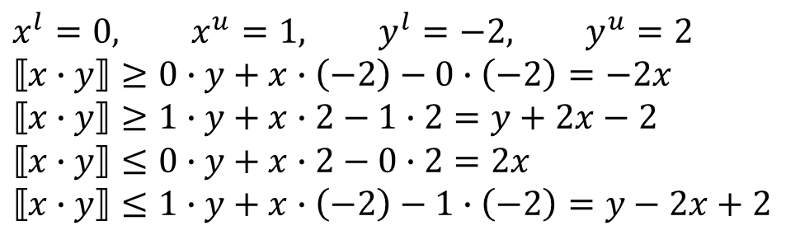
Multiplication: McCormick Envelopes
$$x^{l}=0, x^{u}=1, y^{l}=−2, y^{u}=2$$
$$⟦x∙y⟧≥0∙y+x∙\left(−2\right)−0∙\left(−2\right)=−2x$$
$$⟦x∙y⟧≥1∙y+x∙2−1∙2=y+2x−2$$
$$⟦x∙y⟧≤0∙y+x∙2−0∙2=2x$$
$$⟦x∙y⟧≤1∙y+x∙\left(−2\right)−1∙\left(−2\right)=y−2x+2$$
Notes:
Slide 13 McCormick: 3m
The key contribution of Scimitar is that it automatically encodes program features present in most traditional languages, but that in optimization problems only experts are aware of
There are many, let's focus on variable-variable multiplication, which normally MILP does not permit, as it is a non-linear constraint
Multiplication uses a technique known as McCormick envelopes, which simulates multiplying a variable by another binary variable via creating a convex relaxation using the upper and lower bounds x^l x^u y^l y^u of each variable to bound the possible result
The term convex relaxation refers to a problem that includes all of the feasible results in the original problem, but is a continuous space, and can include values between allowable solutions to the original problem.
In this case it's alright because in practice those values are uninhabitable due to the encoding's construction.
consider the polygon here, which is a relaxation of the Upper and lower bounds we might have for a particular case
the case here is x is from 0 to 1, y from -2 to 2
when we plug and chug, we get the constraining plane equations
each face in the diagram here represents one of these planes in the bottom left. There is also an transparent face on the top that lets us see inside
by inspection we can see that all the vertices are correct
4 out of 6 edges are also correct
the faces and interior are wrong, how to exclude them?
if we restrict x to a Boolean, which MILP allows, the Equations hold. Only two edges are allowed, where x=0 or x=1. We can do this For the others as well
This can be extended to general integer multiplication via bitvectors, but not float*float, a more powerful solver is required for that.
Expert encodings are important, because McCormick envelopes Are actually difficult to find information about if you don't Already know what they are, and the encodings themselves are Hard to find, and all of the explanations I found were hard To understand.

Slide 15
Benchmarks
To demonstrate, we implemented several benchmarks
Classic optimization problems: pipes and logistics
Real world problems: malloc
Minimize data shape and values together: recitation
Others: contradict, bounce, sum-to-n
Notes:
Slide 14 Benchmarks: 1m
a maximum flow problem pipes
a profit, resource, and scheduling problem logistics
the arena allocation problem we looked at previously
recitation attempts to optimally assign students to recitation slots, and is designed to find both the fewest possible number of recitations, but also the shape, that is, complete assignment of each recitation.
This uses dynamic upper bounds and vector shapes, which is a bit of a killer app for Scimitar.
there are others, including some simple microbenchmarks

Slide 16
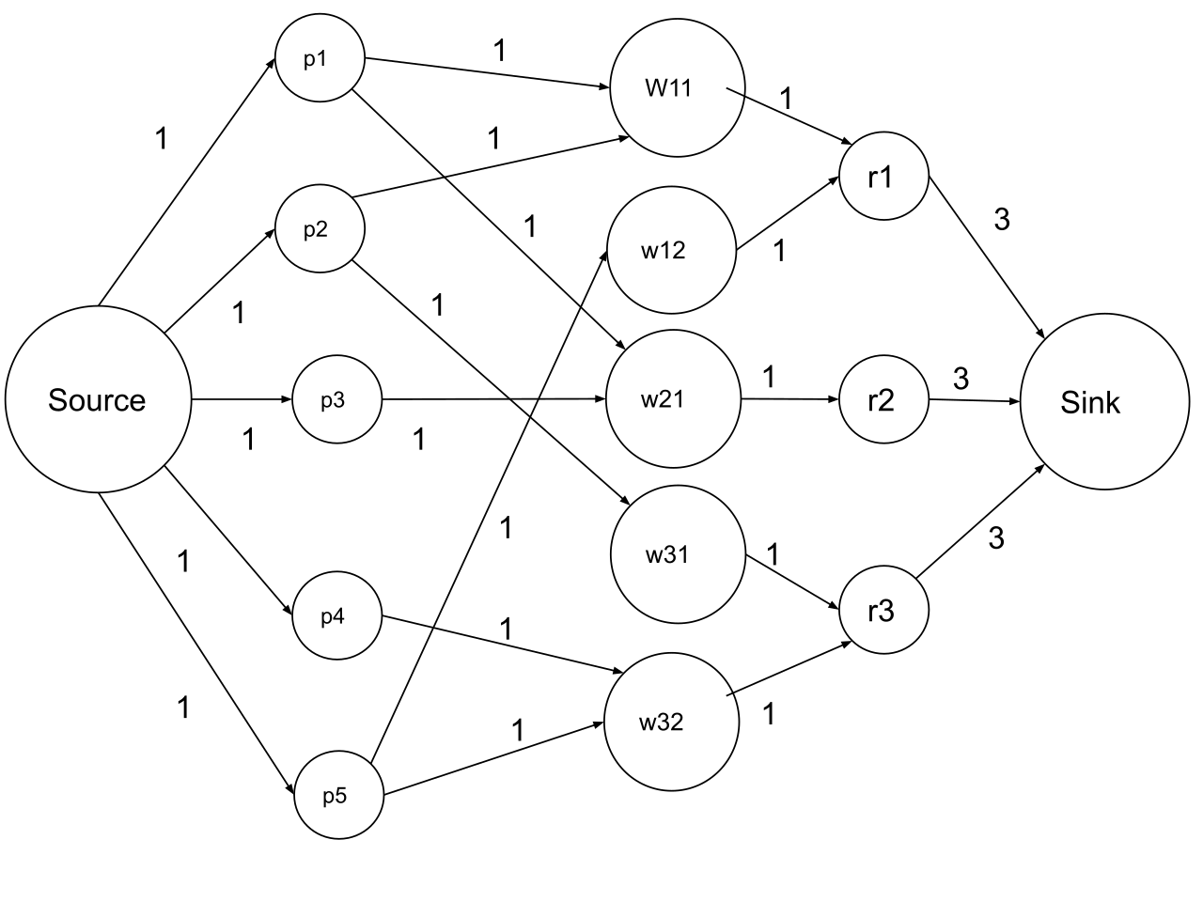
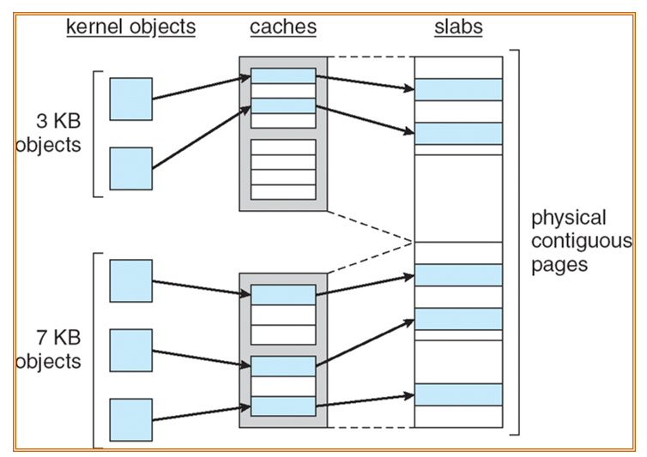
Benchmark Visualization
Flow diagram by George Flonkerton - Own work, CC BY-SA 4.0, https://commons.wikimedia.org/w/index.php?curid=83846144
Notes:
Slide 15 Visualization 1m
to see what this looks like, consider the max flow Visualization on the left, and the memory allocation on the right
These give you an idea of what the solver actually "sees“
the max flow has pipes, source and sink
the allocation shows the relation between block size and location in physical memory

Slide 17
Methods
Our goal: give evidence of MILP solver benefits over more generic approach offered by SMT solvers
Scimitar vs Rosette ≈ Gurobi vs Z3
Overall time is split between avg compile and solve
Differences in performance:
Scimitar encodes at compile time, gives Gurobi a matrix
Rosette compiles to smtlib2, Z3 does encoding
Notes:
Slide 16 Methods: 1m
read the slide
Z3 is not an optimization solver, and so the algorithms it uses fit their application domains rather closely
the expectation is that in general it should not perform as well

Slide 18
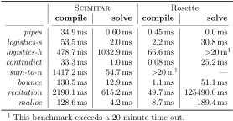
Benchmark Results
Notes:
Slide 17 Results: 1m
We'll analyze these results on the next slide, but quickly …
Compile times are worse 1-2 OOM worse for Scimitar
Solve times are 1-2 OOM better for Scimitar
Two of these did not finish for Rosette

Slide 19
Analysis
Compiler dominates Scimitar, Z3 dominates Rosette
MILP performance is (usually) better
Some exceptions, e.g., pipes
Scales well in target domains, supporting our claim
Problem size corresponds to compile/solve times
Racket impl is slow – a C rewrite would be faster
Notes:
Slide 18 Analysis: 1m
read the slide

Slide 20
Summary
Scimitar: optimization-aided functional programming
Reduced coupling modeling constrained problems
Expert encodings for non-experts
MILP solver outperforms general SMT approach
Targets traditional optimization problems, control, resource allocation, code gen, design optimization
Notes:
Slide 19 Summary: 1m
read the slide

Slide 21
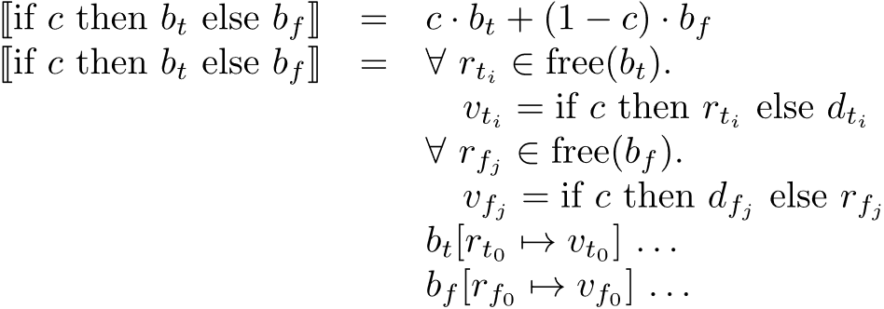

Some More Encodings

