Slide 1


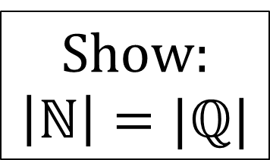
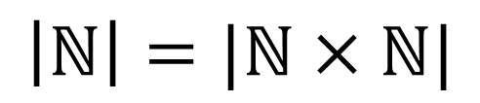
CS3102 Theory of Computation
$$\left|ℕ\right|=|ℕ×ℕ|$$
$$ℕ$$
0 1 2 3 4 5
$$ℕ$$
0
(0,0) (0,1) (0,2) (0,3) (0,4) (0,5)
…
Show:
$$\left|ℕ\right|=|ℚ|$$
1
(1,0) (1,1) (1,2) (1,3) (1,4) (1,5)
…
2
(2,0) (2,1) (2,2) (2,3) (2,4) (2,5)
…
3
(3,0) (3,1) (3,2) (3,3) (3,4) (3,5)
…
4
(4,0) (4,1) (4,2) (4,3) (4,4) (4,5)
…
…
…
…
…
…
…
…
…
…
…
…

Slide 2

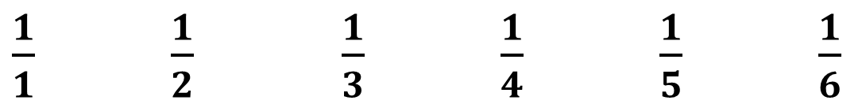

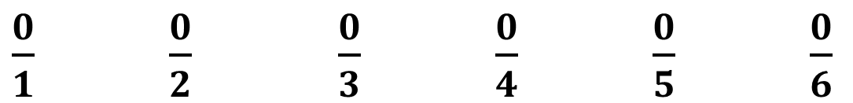
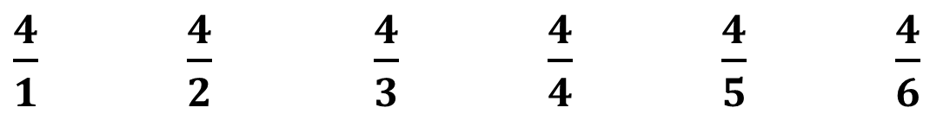
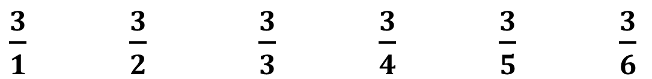
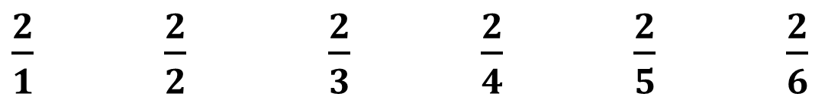

$$\left|ℚ\right|=|ℕ|$$
$$ℤ_{+}$$
Remove Duplicates
1 2 3 4 5 6
$$ℕ$$
0
$\frac{0}{1}$ $\frac{0}{2}$ $\frac{0}{3}$ $\frac{0}{4}$ $\frac{0}{5}$ $\frac{0}{6}$
…
1
$\frac{1}{1}$ $\frac{1}{2}$ $\frac{1}{3}$ $\frac{1}{4}$ $\frac{1}{5}$ $\frac{1}{6}$
…
2
$\frac{2}{1}$ $\frac{2}{2}$ $\frac{2}{3}$ $\frac{2}{4}$ $\frac{2}{5}$ $\frac{2}{6}$
…
3
$\frac{3}{1}$ $\frac{3}{2}$ $\frac{3}{3}$ $\frac{3}{4}$ $\frac{3}{5}$ $\frac{3}{6}$
…
4
$\frac{4}{1}$ $\frac{4}{2}$ $\frac{4}{3}$ $\frac{4}{4}$ $\frac{4}{5}$ $\frac{4}{6}$
…
…
…
…
…
…
…
…
…
…
…
…

Slide 3
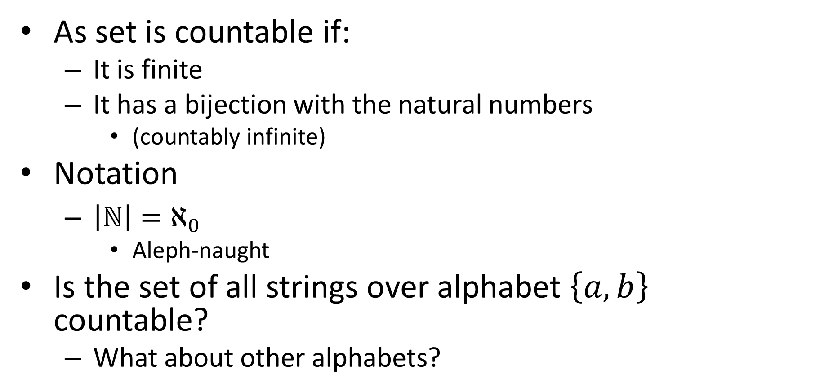
Countability
As set is countable if:
It is finite
It has a bijection with the natural numbers
(countably infinite)
Notation
$\left|ℕ\right|=ℵ_{0}$
Aleph-naught
Is the set of all strings over alphabet $\left\{a,b\right\}$ countable?
What about other alphabets?

Slide 4



The set of all strings is countable
0
Length 0
$$ε$$
1 string
1
2
Length 1
$a$ $b$
2 strings
3
4
5
6
Length 2
$aa$ $ab$ $ba$ $bb$
4 strings
8 strings
7
8
9
10
11
12
13
14
Length 3
$aaa$ $aab$ $aba$ $abb$ $baa$ $bab$ $bba$ $bbb$
16 strings
Length 4
$aaaa$ $aaab$ $aaba$ $aabb$ $abaa$ $abab$ $abba$ $abbb$ …
32 strings
Length 5
$aaaaa$ $aaaab$ $aaaba$ $aaabb$ …
…
…
Important: A countable union of countable sets is countable

Slide 5
Some more countable things
Any language ever!
Number of possible Java Programs
The empty set
The number of words in the English language
Number of possible 410-page novels
Let’s prove them!

Slide 6
All Languages are Countable
Proof:

Slide 7
The set of all possible Java programs is countable
Proof:

Slide 8
The Empty set is Countable
Proof:

Slide 9
The set of all English words is Countable
Proof:

Slide 10
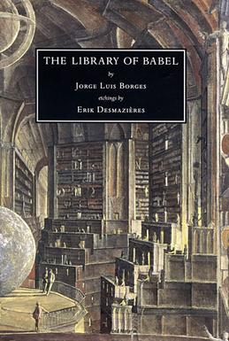
The number of possible 410-page novels is countable
Proof:

Slide 11

Is $ℕ×ℕ×ℕ$ countable?
Proof:

Slide 12


Dovetailing
$$ℕ×ℕ$$
$$f:ℕ↔ℕ$$
$f(0)$ $f(1)$ $f(2)$ $f(3)$ $f(4)$ $f(5)$
$$ℕ$$
0
(0,0) (0,1) (0,2) (0,3) (0,4) (0,5)
…
1
(1,0) (1,1) (1,2) (1,3) (1,4) (1,5)
…
2
(2,0) (2,1) (2,2) (2,3) (2,4) (2,5)
…
3
(3,0) (3,1) (3,2) (3,3) (3,4) (3,5)
…
4
(4,0) (4,1) (4,2) (4,3) (4,4) (4,5)
…
…
…
…
…
…
…
…
…
…
…
…

Slide 13
Take-away Ideas
All finite sets are countable
Anything with a bijection to the naturals is countable
A subset of a countable set is countable
A union of countably many sets is countable
Formal proof of this is homework
To be computable by Java, the set of possibilities must be countable!

Slide 14
Are the Real Numbers Countable?
Things that don’t work:
List out every real number that starts with 1, then 2, then 3, …
List out every real number that has one number after the decimal, then 2, then 3, …
How would we prove it wasn’t?

Slide 15
Diagonalization
Used to prove that a set is not countable
Shows that there cannot be a bijection with the Natural Numbers
Assume toward a contradiction there is a bijection with the natural numbers
Treat this arbitrary bijection as an ordered list containing all items (item 0 is the thing which maps to 0, etc.)
Show that this list must always be missing something

Slide 16
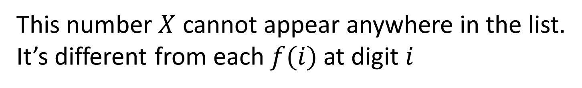
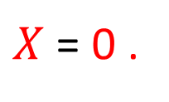
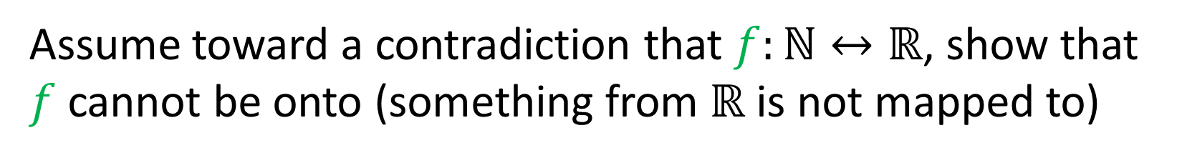
Diagonalization
Assume toward a contradiction that $f:ℕ↔ℝ$, show that $f$ cannot be onto (something from $ℝ$ is not mapped to)
ℕ
ℝ
ƒ(1) = | 3 | . | 1 | 4 | 1 | 5 | 9 | 2 | 6 | 5 | 3 | …
ƒ(2) = | 1 | . | 0 | 0 | 0 | 0 | 0 | 0 | 0 | 0 | 0 | …
ƒ(3) = | 2 | . | 7 | 1 | 8 | 2 | 8 | 1 | 8 | 2 | 8 | …
ƒ(4) = | 1 | . | 4 | 1 | 4 | 2 | 1 | 3 | 5 | 6 | 2 | …
ƒ(5) = | 0 | . | 3 | 3 | 3 | 3 | 3 | 3 | 3 | 3 | 3 | …
. . . | . . .
$X$ = 0 .
2
1
9
3
4
. . . ∈ ℝ
This number $X$ cannot appear anywhere in the list.
It’s different from each $f(i)$ at digit $i$

Slide 17
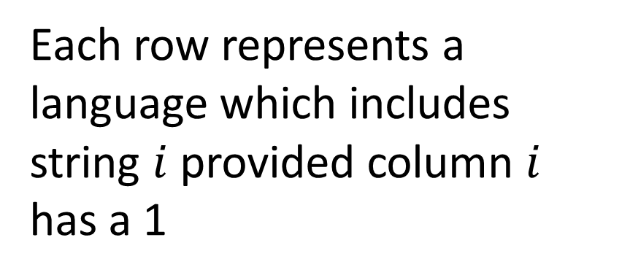
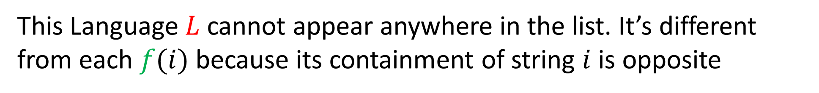
Is the set of all Languages Countable?
$ℕ ε a b aa ab ba bb aaa …$
ƒ(1) = | 1 | 1 | 1 | 1 | 1 | 1 | 1 | 1 | 1 | 1 | 1 | …
ƒ(2) = | 1 | 0 | 1 | 0 | 1 | 0 | 1 | 0 | 1 | 0 | 1 | …
ƒ(3) = | 0 | 1 | 0 | 1 | 0 | 1 | 0 | 1 | 0 | 1 | 0 | …
ƒ(4) = | 1 | 1 | 0 | 1 | 1 | 0 | 1 | 1 | 0 | 1 | 1 | …
ƒ(5) = | 0 | 0 | 0 | 1 | 0 | 0 | 1 | 1 | 1 | 0 | 1 | …
. . . | . . .
L= | 0 | 1 | 1 | 0 | 1 | …
Each row represents a language which includes string $i$ provided column $i$ has a 1
This Language $L$ cannot appear anywhere in the list. It’s different from each $f(i)$ because its containment of string $i$ is opposite

Slide 18
Correlary
Some languages cannot be decided by Java

Slide 19
Another Correlary
Some languages have no finite description!

Slide 20
Yet Another Correlary
Some languages (problems) cannot be described!
Can any of these be decided by Java?

Slide 21
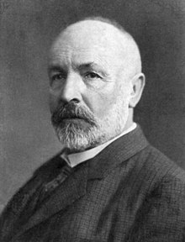
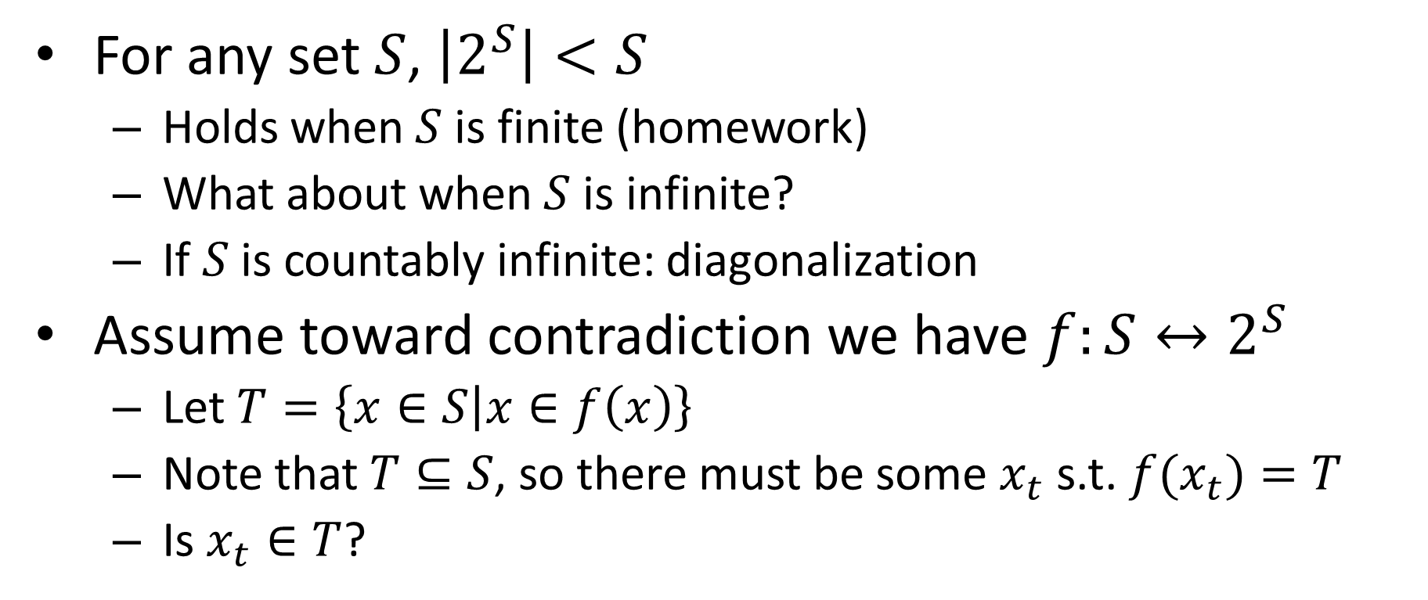
Cantor’s Theorem
For any set $S$, $\left|2^{S}\right|<S$
Holds when $S$ is finite (homework)
What about when $S$ is infinite?
If $S$ is countably infinite: diagonalization
Assume toward contradiction we have $f:S↔2^{S}$
Let $T=\left\{x∈S | x∈f\left(x\right)\right\}$
Note that $T⊆S$, so there must be some $x_{t}$ s.t. ${f(x}_{t})=T$
Is $x_{t}∈T$?

Slide 22
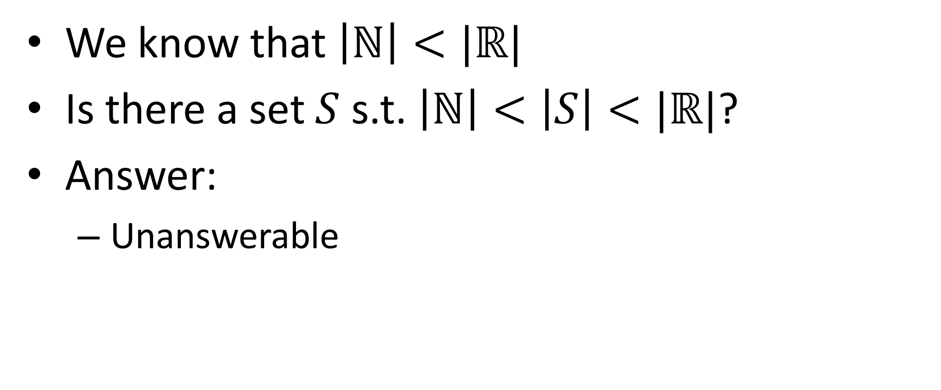
Continuum Hypothesis
We know that $\left|ℕ\right|<|ℝ|$
Is there a set $S$ s.t. $\left|ℕ\right|<\left|S\right|<|ℝ|$?
Answer:
Unanswerable

Slide 23
Godel’s Incompleteness Theorem
Says any axiomatic system is at least one of:
Inconsistent: There are false things that you can prove
Incomplete: There are true things that you cannot prove
Weak: You can’t talk about prime numbers
Proof idea: Show that any system can construct the paradox “This statement cannot be proven”

Slide 24
Incompleteness in CS*
Expectation Maximization Problem
You want to put ads on your website
You don’t know yet who will visit your website
Select ads to maximize the maximum number of potential customers
Answering this problem requires “tools” not yet addressed by set theory!

