Slide 1
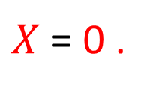
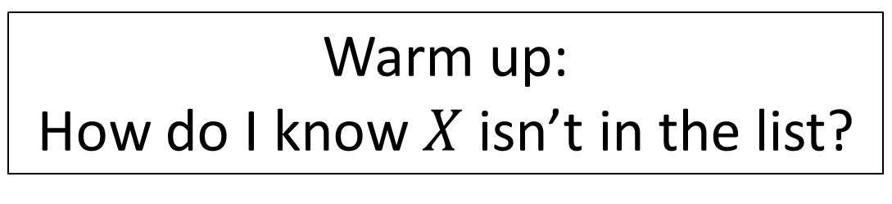
CS3102 Theory of Computation
Warm up:
How do I know $X$ isn’t in the list?
ℕ
ℝ
ƒ(1) = | 3 | . | 1 | 4 | 1 | 5 | 9 | 2 | 6 | 5 | 3 | …
ƒ(2) = | 1 | . | 0 | 0 | 0 | 0 | 0 | 0 | 0 | 0 | 0 | …
ƒ(3) = | 2 | . | 7 | 1 | 8 | 2 | 8 | 1 | 8 | 2 | 8 | …
ƒ(4) = | 1 | . | 4 | 1 | 4 | 2 | 1 | 3 | 5 | 6 | 2 | …
ƒ(5) = | 0 | . | 3 | 3 | 3 | 3 | 3 | 3 | 3 | 3 | 3 | …
. . . | . . .
$X$ = 0 .
2
1
9
3
4
. . . ∈ ℝ

Slide 2
Take-away Ideas
All finite sets are countable
Anything with a bijection to the naturals is countable
A subset of a countable set is countable
A union of countably many sets is countable
Formal proof of this is homework
To be computable by Java, the set of possibilities must be countable!

Slide 3
Are the Real Numbers Countable?
Things that don’t work:
List out every real number that starts with 1, then 2, then 3, …
List out every real number that has one number after the decimal, then 2, then 3, …
How would we prove it wasn’t?

Slide 4
Diagonalization
Used to prove that a set is not countable
Shows that there cannot be a bijection with the Natural Numbers
Assume toward a contradiction there is a bijection with the natural numbers
Treat this arbitrary bijection as an ordered list containing all items (item 0 is the thing which maps to 0, etc.)
Show that this list must always be missing something

Slide 5
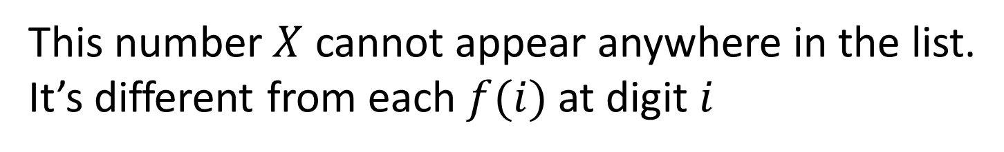

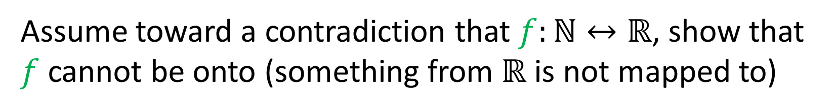
Diagonalization
Assume toward a contradiction that $f:ℕ↔ℝ$, show that $f$ cannot be onto (something from $ℝ$ is not mapped to)
ℕ
ℝ
ƒ(1) = | 3 | . | 1 | 4 | 1 | 5 | 9 | 2 | 6 | 5 | 3 | …
ƒ(2) = | 1 | . | 0 | 0 | 0 | 0 | 0 | 0 | 0 | 0 | 0 | …
ƒ(3) = | 2 | . | 7 | 1 | 8 | 2 | 8 | 1 | 8 | 2 | 8 | …
ƒ(4) = | 1 | . | 4 | 1 | 4 | 2 | 1 | 3 | 5 | 6 | 2 | …
ƒ(5) = | 0 | . | 3 | 3 | 3 | 3 | 3 | 3 | 3 | 3 | 3 | …
. . . | . . .
$X$ = 0 .
2
1
9
3
4
. . . ∈ ℝ
This number $X$ cannot appear anywhere in the list.
It’s different from each $f(i)$ at digit $i$

Slide 6
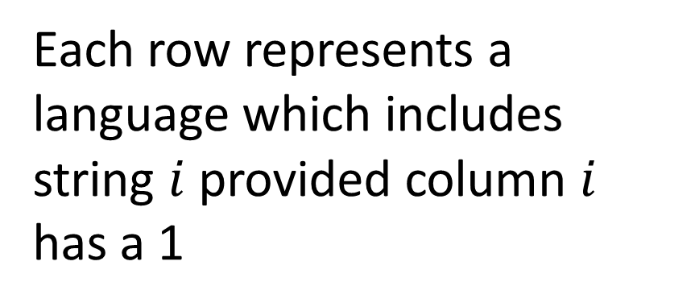
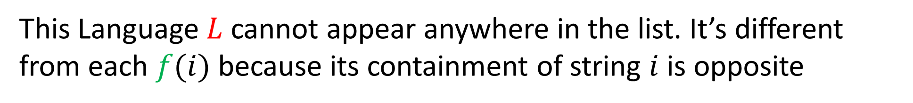
Is the set of all Languages Countable?
$ℕ ε a b aa ab ba bb aaa …$
ƒ(1) = | 1 | 1 | 1 | 1 | 1 | 1 | 1 | 1 | 1 | 1 | 1 | …
ƒ(2) = | 1 | 0 | 1 | 0 | 1 | 0 | 1 | 0 | 1 | 0 | 1 | …
ƒ(3) = | 0 | 1 | 0 | 1 | 0 | 1 | 0 | 1 | 0 | 1 | 0 | …
ƒ(4) = | 1 | 1 | 0 | 1 | 1 | 0 | 1 | 1 | 0 | 1 | 1 | …
ƒ(5) = | 0 | 0 | 0 | 1 | 0 | 0 | 1 | 1 | 1 | 0 | 1 | …
. . . | . . .
L= | 0 | 1 | 1 | 0 | 1 | …
Each row represents a language which includes string $i$ provided column $i$ has a 1
This Language $L$ cannot appear anywhere in the list. It’s different from each $f(i)$ because its containment of string $i$ is opposite

Slide 7
Correlary
Some languages cannot be decided by Java

Slide 8
Another Correlary
Some languages have no finite description!

Slide 9
Yet Another Correlary
Some languages (problems) cannot be described!
Can any of these be decided by Java?

Slide 10
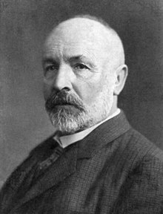
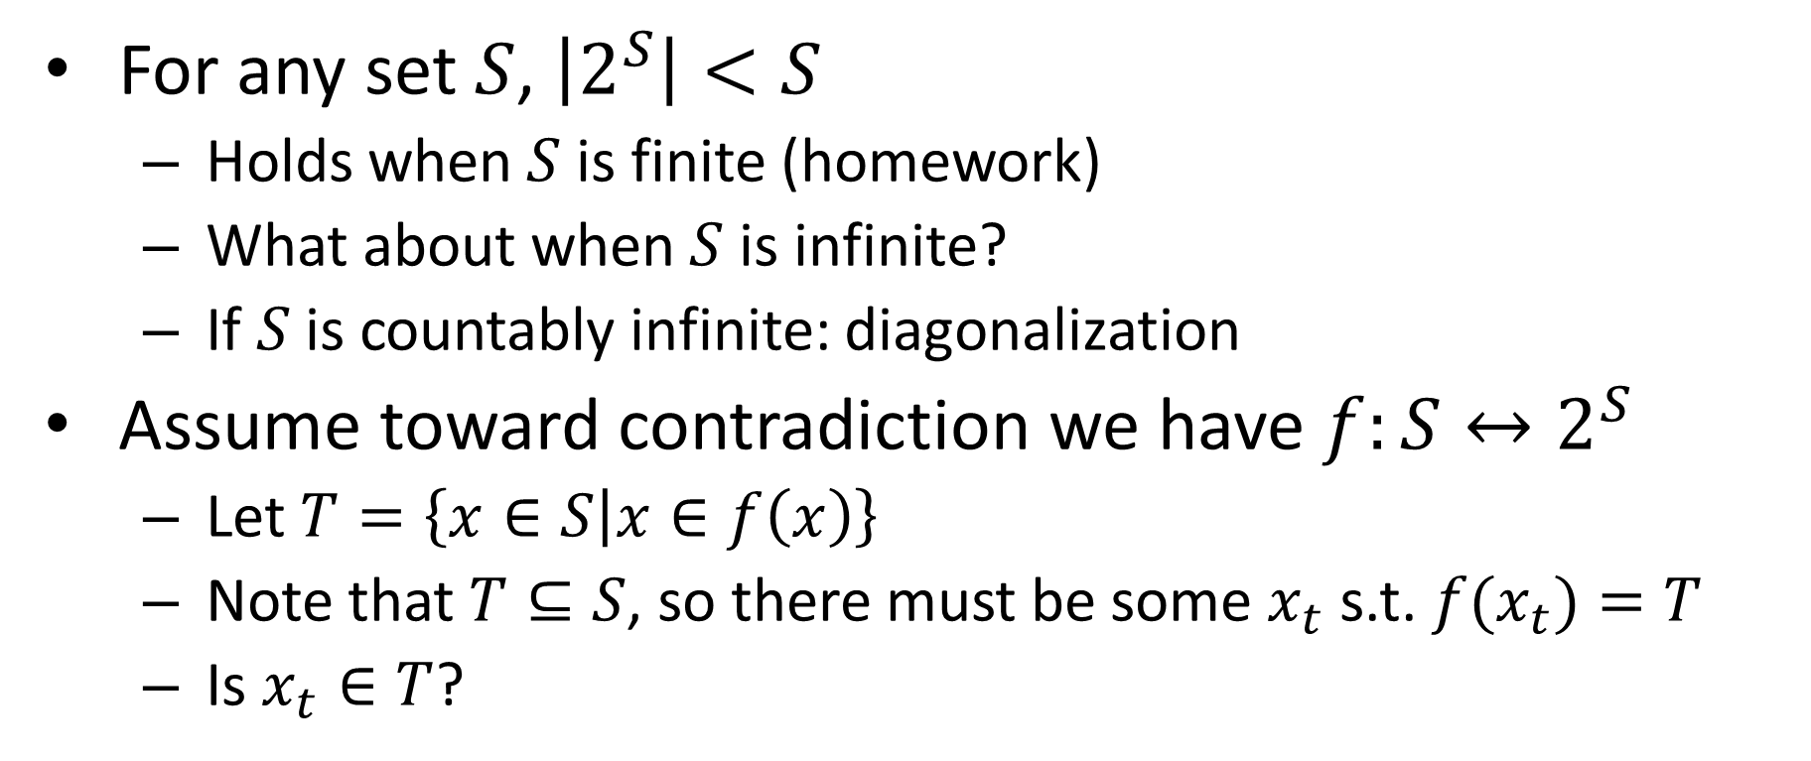
Cantor’s Theorem
For any set $S$, $\left|2^{S}\right|<S$
Holds when $S$ is finite (homework)
What about when $S$ is infinite?
If $S$ is countably infinite: diagonalization
Assume toward contradiction we have $f:S↔2^{S}$
Let $T=\left\{x∈S | x∈f\left(x\right)\right\}$
Note that $T⊆S$, so there must be some $x_{t}$ s.t. ${f(x}_{t})=T$
Is $x_{t}∈T$?

Slide 11
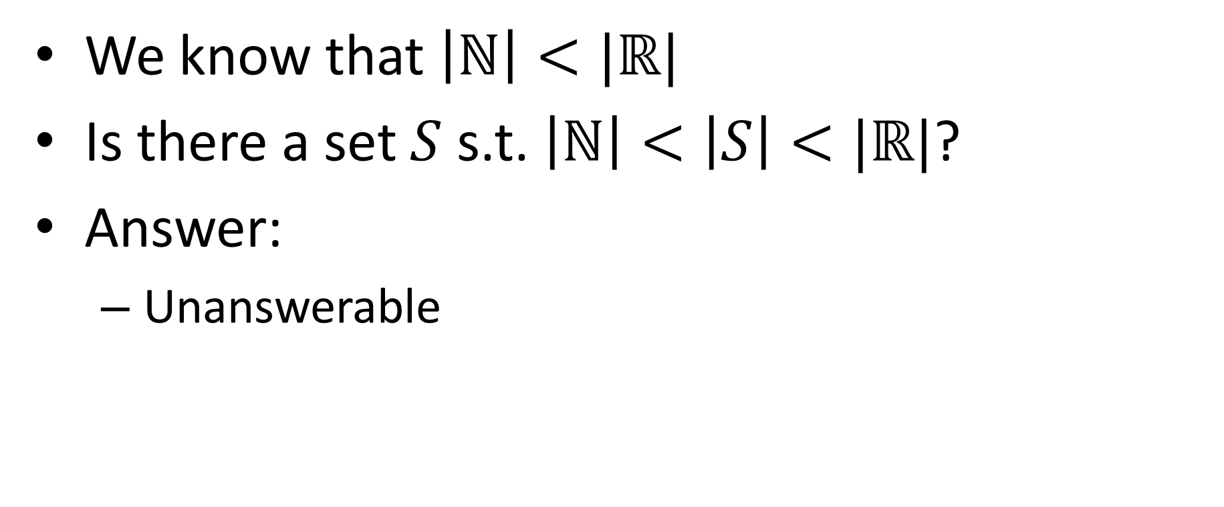
Continuum Hypothesis
We know that $\left|ℕ\right|<|ℝ|$
Is there a set $S$ s.t. $\left|ℕ\right|<\left|S\right|<|ℝ|$?
Answer:
Unanswerable

Slide 12
Godel’s Incompleteness Theorem
Says any axiomatic system is at least one of:
Inconsistent: There are false things that you can prove
Incomplete: There are true things that you cannot prove
Weak: You can’t talk about prime numbers
Proof idea: Show that any system can construct the paradox “This statement cannot be proven”

Slide 13
Incompleteness in CS*
Expectation Maximization Problem
You want to put ads on your website
You don’t know yet who will visit your website
Select ads to maximize the maximum number of potential customers
Answering this problem requires “tools” not yet addressed by set theory!

Slide 14
End of Phase 1
Until now:
Mathematical foundations
Proof strategies
Key ideas/insights
Main takeaway: Some languages (and numbers) cannot be computed by Java (or anything else)
Why? There are more language (numbers) than there are Java programs (or even finite descriptions)

Slide 15
Phase 2
Now we start filling in this box
First option: finite state machine
String
Computing Machine
/ Program / Algorithm
Accept/Reject

Slide 16
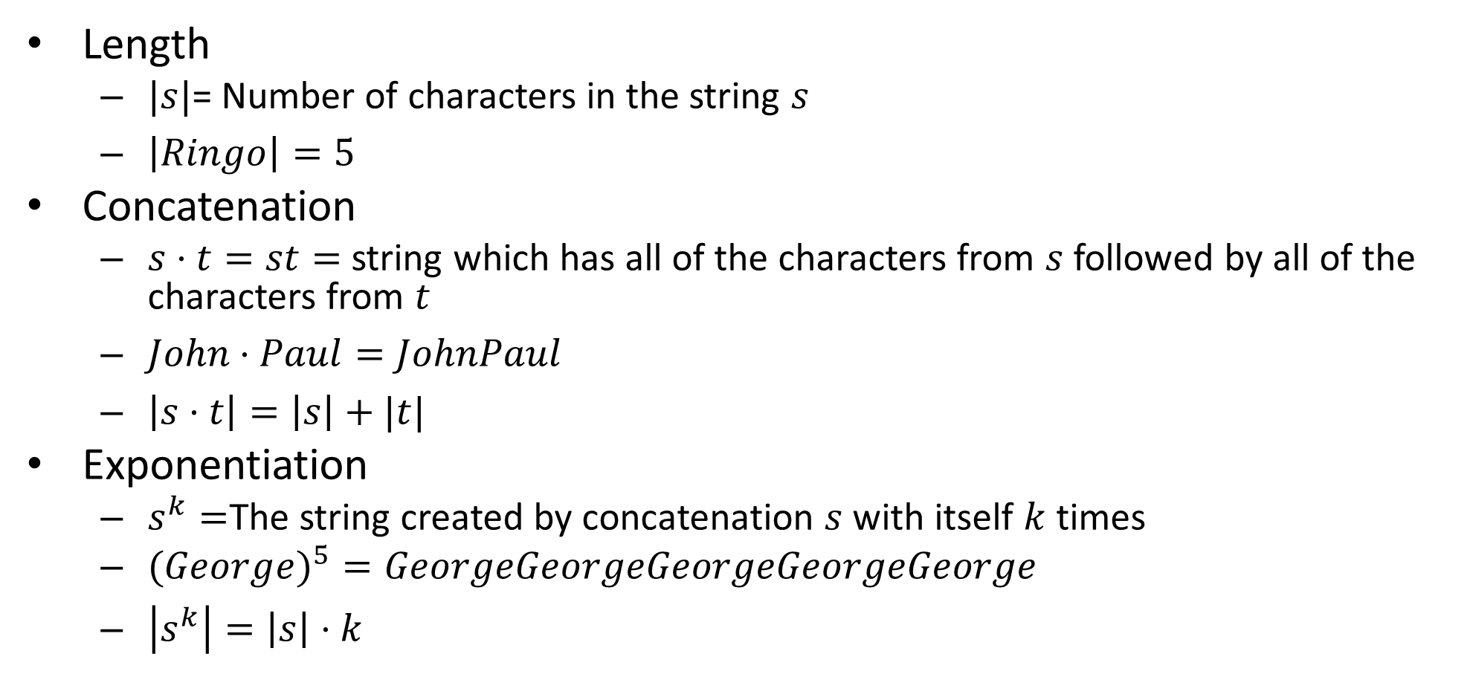
Operations on Strings
Length
$|s|$= Number of characters in the string $s$
$\left|Ringo\right|=5$
Concatenation
$s⋅t=st=$ string which has all of the characters from $s$ followed by all of the characters from $t$
$John⋅Paul=JohnPaul$
$\left|s⋅t\right|=\left|s\right|+|t|$
Exponentiation
$s^{k}=$The string created by concatenation $s$ with itself $k$ times
$(Georg{e)}^{5}=GeorgeGeorgeGeorgeGeorgeGeorge$
$\left|s^{k}\right|=\left|s\right|⋅k$

Slide 17

Empty String (“”)
Notation for this class: $ε$
\varepsilon in Latex
$\left|ε\right|=0$
$s⋅ε=s$
$ε^{k}=ε$
$s^{0}=ε$

Slide 18
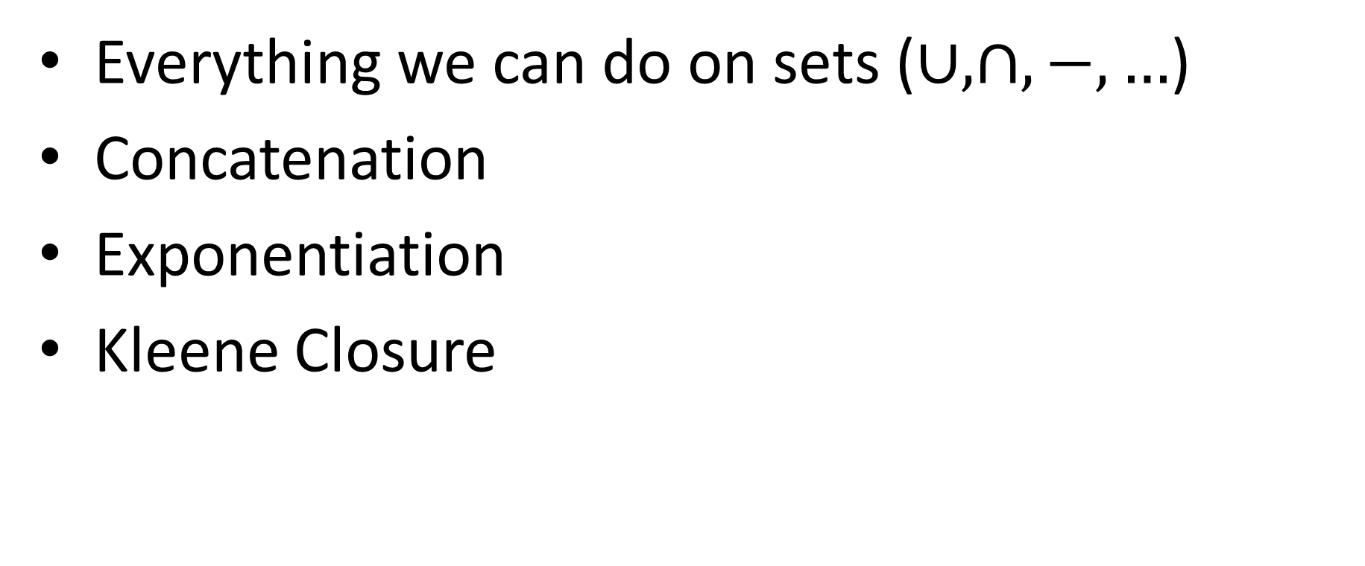
Operations on Languages
Everything we can do on sets ($∪,∩,−,…$)
Concatenation
Exponentiation
Kleene Closure

Slide 19
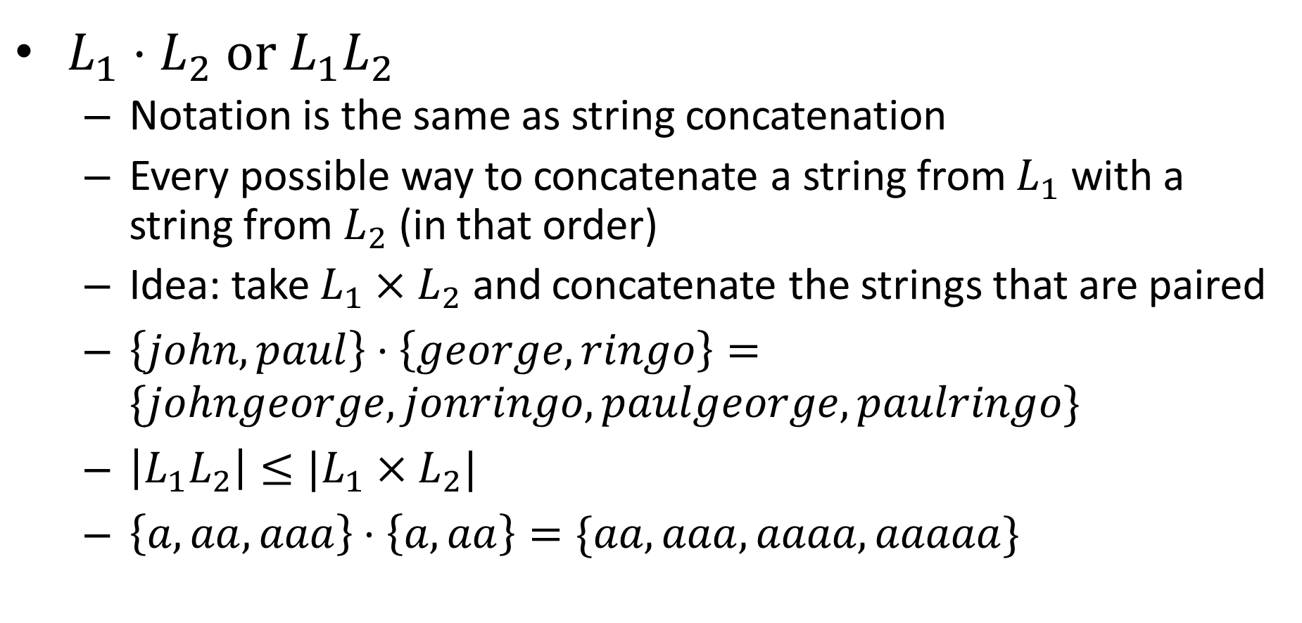
Language Concatenation
$L_{1}⋅L_{2}$ or $L_{1}L_{2}$
Notation is the same as string concatenation
Every possible way to concatenate a string from $L_{1}$ with a string from $L_{2}$ (in that order)
Idea: take $L_{1}×L_{2}$ and concatenate the strings that are paired
$\left\{john,paul\right\}⋅\left\{george,ringo\right\}=\{johngeorge,jonringo,paulgeorge,paulringo\}$
$\left|L_{1}L_{2}\right|≤|L_{1}×L_{2}|$
$\left\{a,aa,aaa\right\}⋅\left\{a,aa\right\}=\{aa,aaa,aaaa,aaaaa\}$

Slide 20
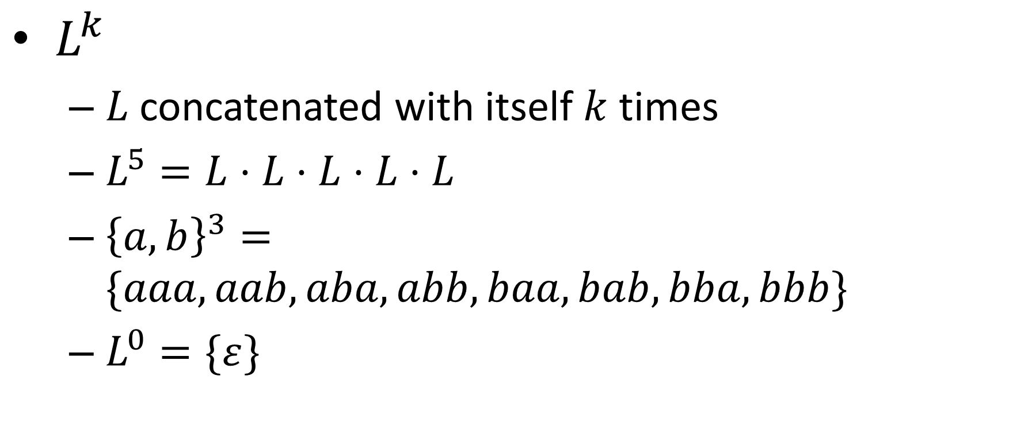
Language Exponentiation
$L^{k}$
$L$ concatenated with itself $k$ times
$L^{5}=L⋅L⋅L⋅L⋅L$
${\left\{a,b\right\}}^{3}=\{aaa,aab,aba,abb,baa,bab,bba,bbb\}$
$L^{0}=\{ε\}$

Slide 21
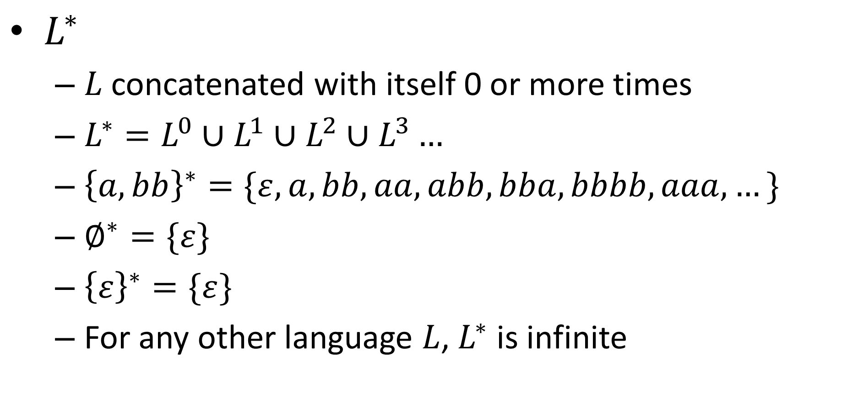
Kleene Closure
$L^{∗}$
$L$ concatenated with itself 0 or more times
$L^{∗}=L^{0}∪L^{1}∪L^{2}∪L^{3}…$
${\left\{a,bb\right\}}^{∗}=\{ε, a,bb,aa,abb,bba,bbbb,aaa,…\}$
$∅^{∗}=\{ε\}$
${\left\{ε\right\}}^{∗}=\{ε\}$
For any other language $L$, $L^{∗}$ is infinite

Slide 22
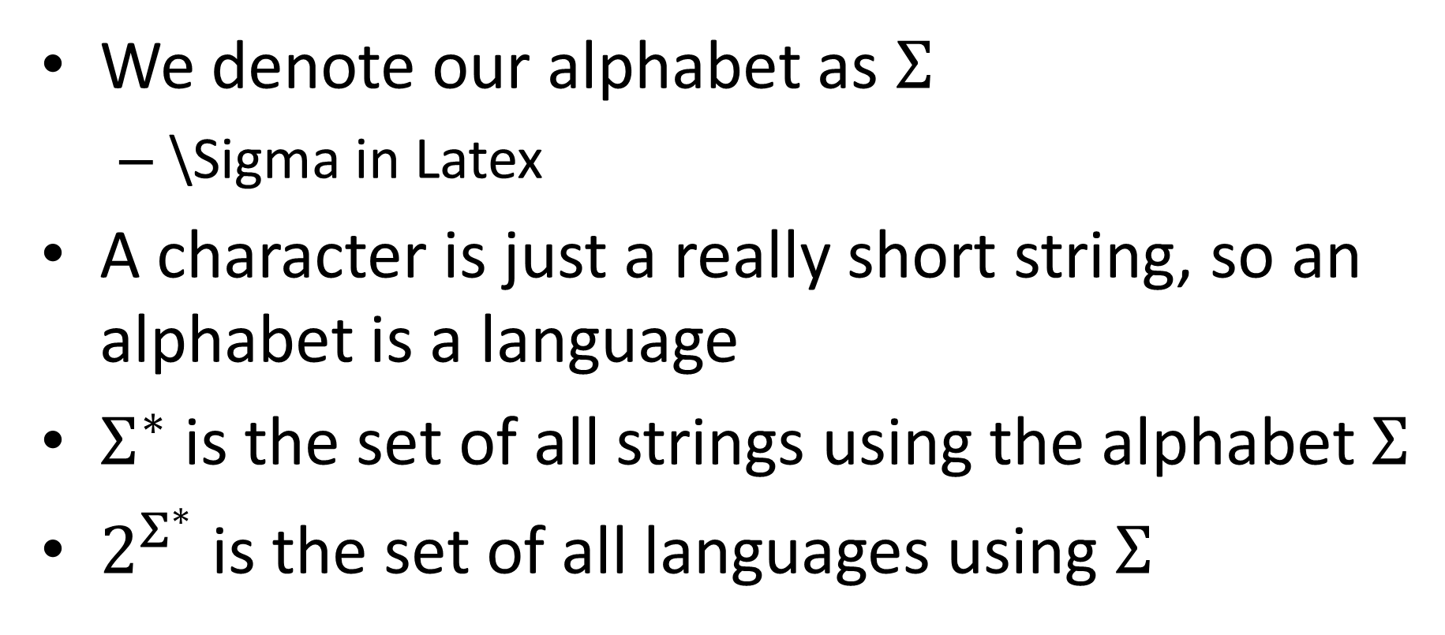
Sigma Star
We denote our alphabet as $Σ$
\Sigma in Latex
A character is just a really short string, so an alphabet is a language
$Σ^{∗}$ is the set of all strings using the alphabet $Σ$
$2^{Σ^{∗}}$ is the set of all languages using $Σ$

Slide 23
What Shall we put in the box?
Goal: start with something easy to prove things about
We’ve talked about Java, but that’s complex
String
Computing Machine
/ Program / Algorithm
Accept/Reject

Slide 24
Finite State Automaton
Simple model of computation
Represents computation without memory
Kind of decider
Our machine reads the input string only once, and one character at a time
After reading each character, enters a new “state”
State transition rules depend only on the current state and the current character (no looking back!)
There are only finitely many states

Slide 25
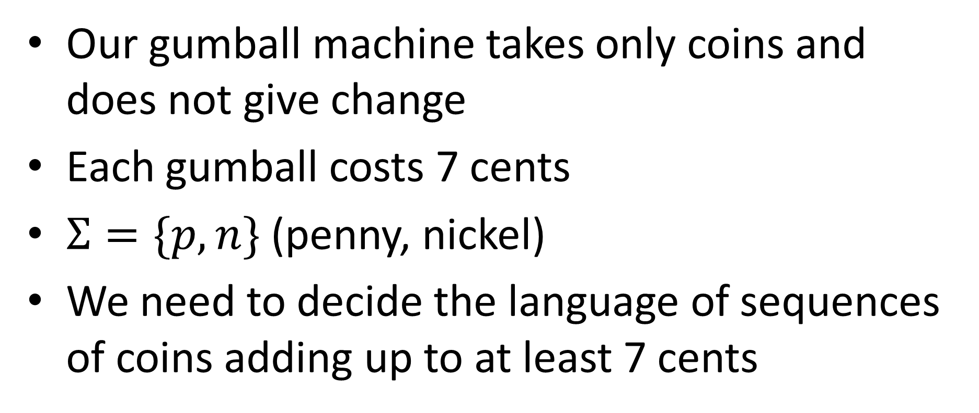
Gumball Machine
Our gumball machine takes only coins and does not give change
Each gumball costs 7 cents
$Σ=\{p,n\}$ (penny, nickel)
We need to decide the language of sequences of coins adding up to at least 7 cents

Slide 26
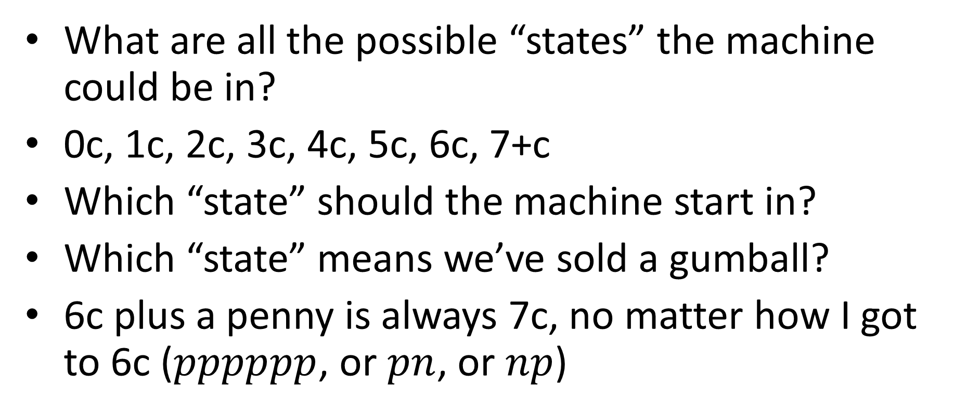
Gumball Machine
What are all the possible “states” the machine could be in?
0c, 1c, 2c, 3c, 4c, 5c, 6c, 7+c
Which “state” should the machine start in?
Which “state” means we’ve sold a gumball?
6c plus a penny is always 7c, no matter how I got to 6c ($pppppp$, or $pn$, or $np$)

Slide 27
Gumball Machine
What are all the possible “states” the machine could be in?
0c, 1c, 2c, 3c, 4c, 5c, 6c, 7+c
Which “state” should the machine start in?
Which “state” means we’ve sold a gumball?
6c plus a penny is always 7c, no matter how I got to 6c ($pppppp$, or $pn$, or $np$)

Slide 28



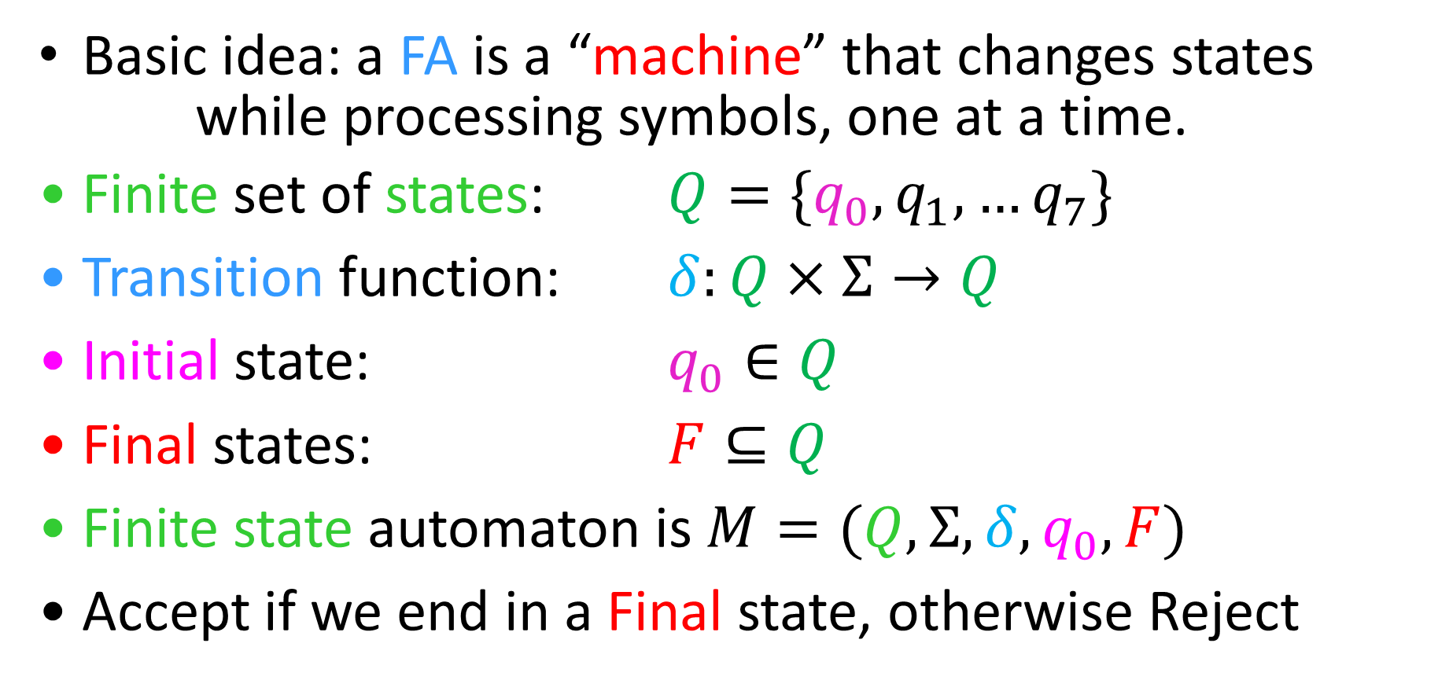



Finite State Automata
Basic idea: a FA is a “machine” that changes states
while processing symbols, one at a time.
Finite set of states: $Q=\{q_{0},q_{1},…q_{7}\}$
Transition function: $δ:Q×Σ→Q$
Initial state: $q_{0}∈Q$
Final states: $F⊆Q$
Finite state automaton is $M=(Q, Σ, δ, q_{0}, F)$
Accept if we end in a Final state, otherwise Reject
$$q_{1}$$
$$q_{1}$$
$$a$$
$$q_{2}$$
$$q_{0}$$
$$q_{k}$$

Slide 29
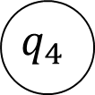


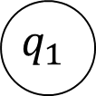

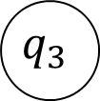


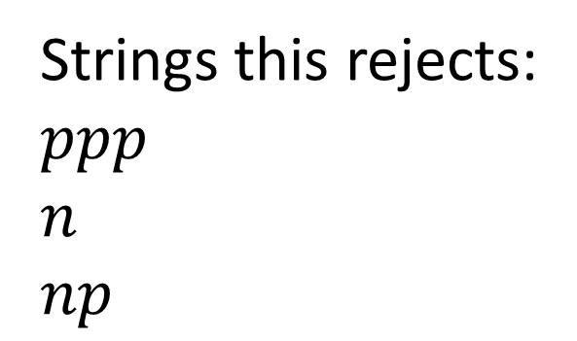





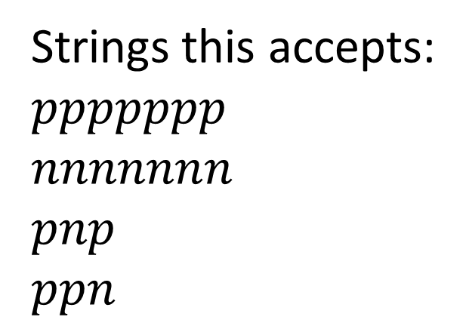
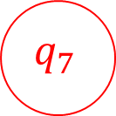


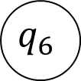

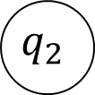
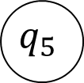


FSA for our Gumball Machine
$$n$$
$$n$$
$$n$$
$$p$$
$$p$$
$$p$$
$$p$$
$$p$$
$$p$$
$$p,n$$
$$q_{7}$$
$$q_{0}$$
$$q_{1}$$
$$q_{2}$$
$$q_{3}$$
$$q_{4}$$
$$q_{5}$$
$$q_{6}$$
$$n$$
$$n$$
$$p,n$$
$$n$$
Strings this accepts:
$ppppppp$
$nnnnnnn$
$pnp$
$ppn$
Strings this rejects:
$ppp$
$n$
$np$

Slide 30
EvenA
In HW1 you were asked to give a decider for EvenA (accepts all strings with an even number of A’s)
How did you do it?

Slide 31
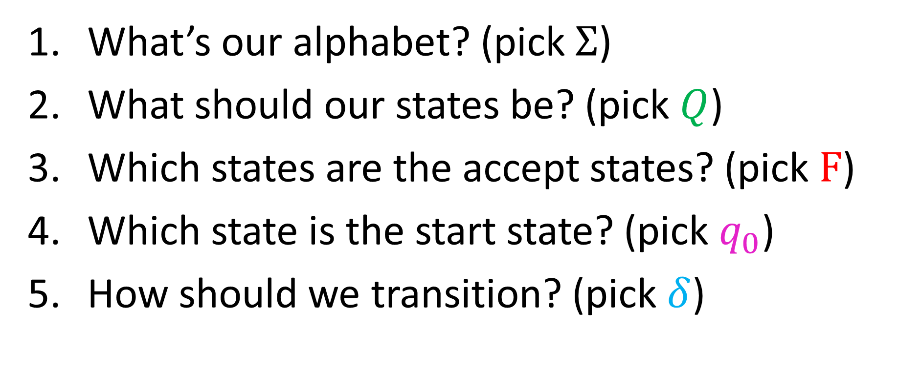
EvenA using FSA
What’s our alphabet? (pick $Σ$)
What should our states be? (pick $Q$)
Which states are the accept states? (pick $F$)
Which state is the start state? (pick $q_{0}$)
How should we transition? (pick $δ$)

Slide 32
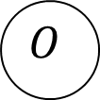





Let’s Draw It!
$$a$$
$$Σ−\{a\}$$
$$Σ−\{a\}$$
$$E$$
$$O$$
$$a$$

Slide 33
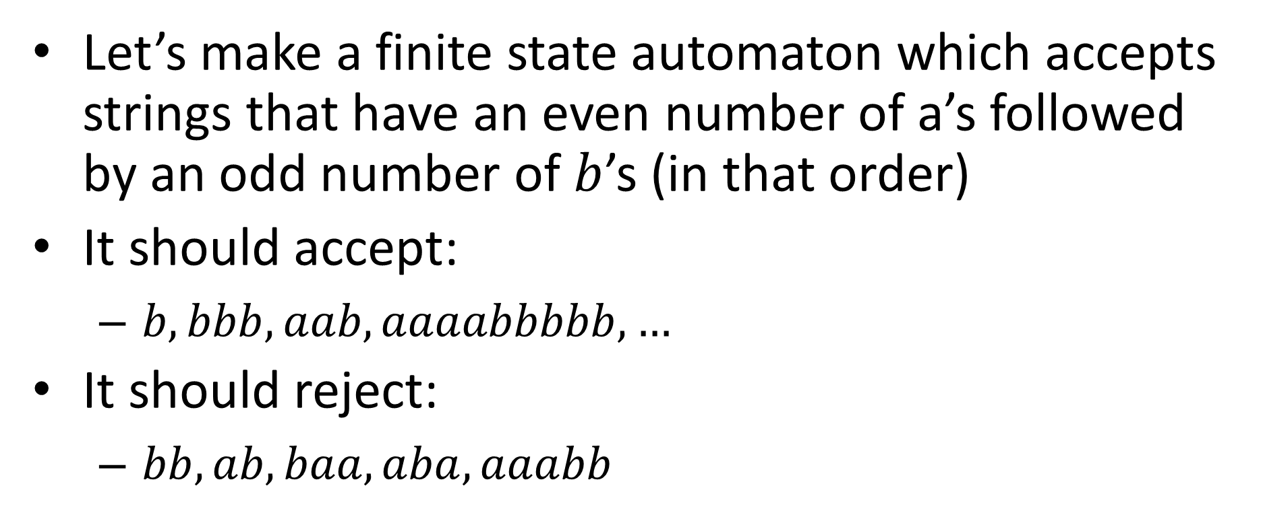
EvenAOddB
Let’s make a finite state automaton which accepts strings that have an even number of a’s followed by an odd number of $b$’s (in that order)
It should accept:
$b, bbb, aab, aaaabbbbb, …$
It should reject:
$bb, ab, baa, aba, aaabb$

Slide 34
EvenAOddB using FSA
What’s our alphabet? (pick $Σ$)
What should our states be? (pick $Q$)
Which states are the accept states? (pick $F$)
Which state is the start state? (pick $q_{0}$)
How should we transition? (pick $δ$)

