Slide 1
CS3102 Theory of Computation

Slide 2



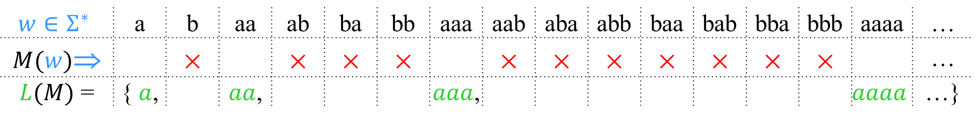
Decidable
Accept
& halt
×
Reject
& halt
Never
runs
forever
$w$→
Input
A language is decidable iff it is exactly the set of strings accepted by some always-halting TM.
$$w∈Σ^{∗}$$ | a | b | aa | ab | ba | bb | aaa | aab | aba | abb | baa | bab | bba | bbb | aaaa | …
$M(w)$⇒ |  | × |  | × | × | × |  | × | × | × | × | × | × | × |  | …
$L(M)$ = | { $a$, |  | $aa$, |  |  |  | $aaa$, |  |  |  |  |  |  |  | $$aaaa$$ | …}
$M$ must always halt on every input.

Slide 3
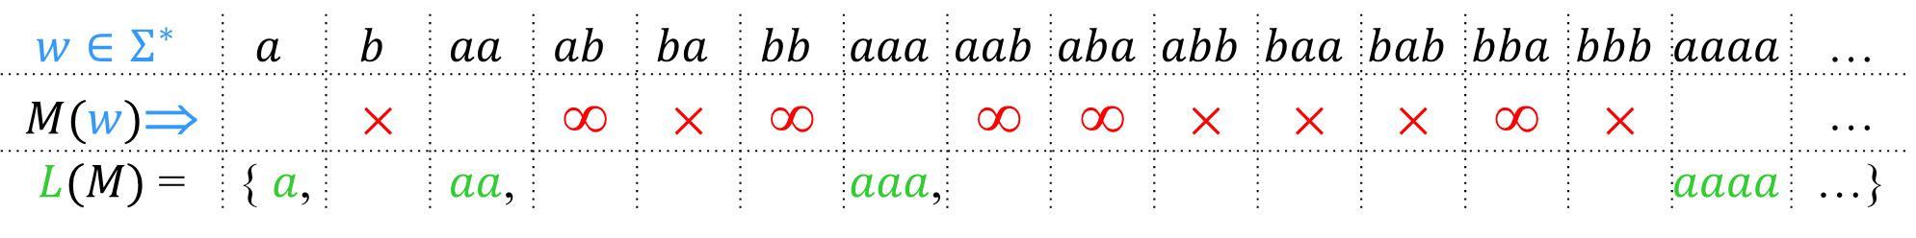
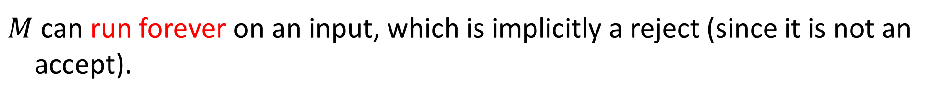
Recognizable
Accept
& halt
×
Reject
& halt
≡
∞
Run
forever
$w$→
Input
A language is Turing-recognizable iff it is exactly the set of strings accepted by some Turing machine.
$$w∈Σ^{∗}$$ | $$a$$ | $$b$$ | $$aa$$ | $$ab$$ | $$ba$$ | $$bb$$ | $$aaa$$ | $$aab$$ | $$aba$$ | $$abb$$ | $$baa$$ | $$bab$$ | $$bba$$ | $$bbb$$ | $$aaaa$$ | …
$M(w)$⇒ |  | × |  | ∞ | × | ∞ |  | ∞ | ∞ | × | × | × | ∞ | × |  | …
$L(M)$ = | { $a$, |  | $aa$, |  |  |  | $aaa$, |  |  |  |  |  |  |  | $$aaaa$$ | …}
$M$ can run forever on an input, which is implicitly a reject (since it is not an accept).

Slide 4
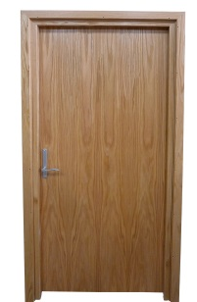

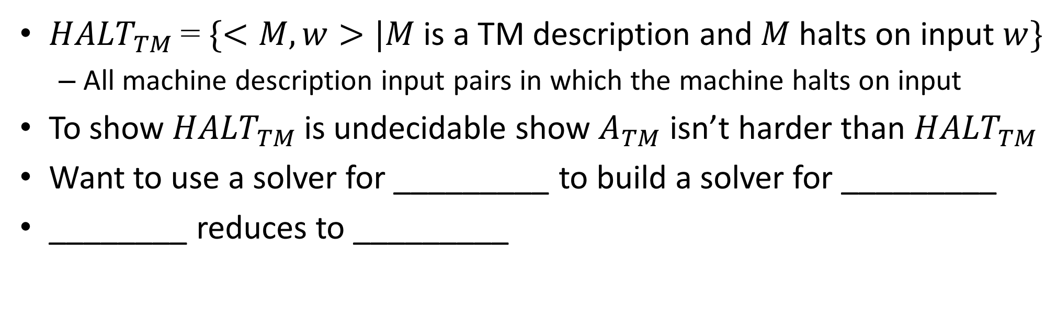







${HALT}_{TM}$ is Undecidable
${HALT}_{TM}$= $\{<M, w>|M$ is a TM description and $M$halts on input $w\}$
All machine description input pairs in which the machine halts on input
To show ${HALT}_{TM}$ is undecidable show $A_{TM}$ isn’t harder than ${HALT}_{TM}$
Want to use a solver for _________ to build a solver for _________
________ reduces to _________
$$HALT_{TM}$$
$$A_{TM}$$
$$A_{TM}$$
$$HALT_{TM}$$
$$A_{TM}$$
$$HALT_{TM}$$

Slide 5




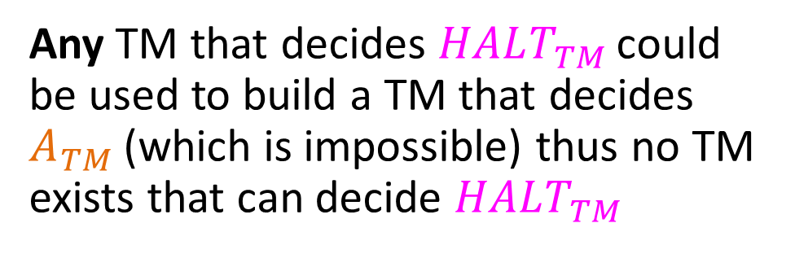
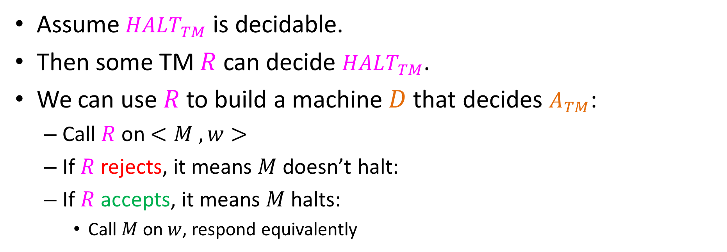

Deciding$A_{TM}$ with ${HALT}_{TM}$
Assume $HALT_{TM}$ is decidable.
Then some TM $R$ can decide $HALT_{TM}$.
We can use $R$ to build a machine $D$that decides $A_{TM}$:
Call $R$on $<M , w>$
If $R$rejects, it means $M$doesn’t halt:
If $R$accepts, it means $M$halts:
Call $M$on $w$, respond equivalently
reject
Machine $D$:
M
$$R$$
no
no
Does
$M(w)$ Halt?
Any TM that decides $HALT_{TM}$ could be used to build a TM that decides $A_{TM}$ (which is impossible) thus no TM exists that can decide $HALT_{TM}$
w
yes
no
$$M(w)$$
yes
yes

Slide 6
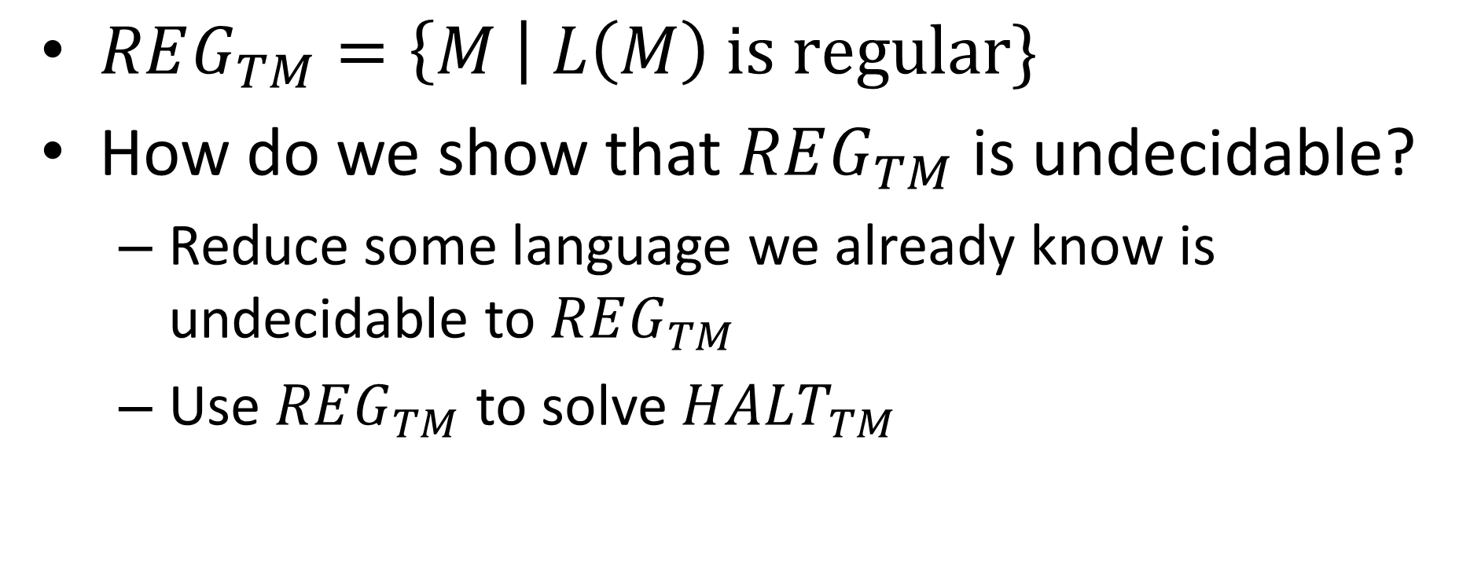

Another example: $REG_{TM}$
$REG_{TM}=\left\{M \right| L\left(M\right) is regular\}$
How do we show that $REG_{TM}$ is undecidable?
Reduce some language we already know is undecidable to $REG_{TM}$
Use $REG_{TM}$ to solve $HALT_{TM}$

Slide 7
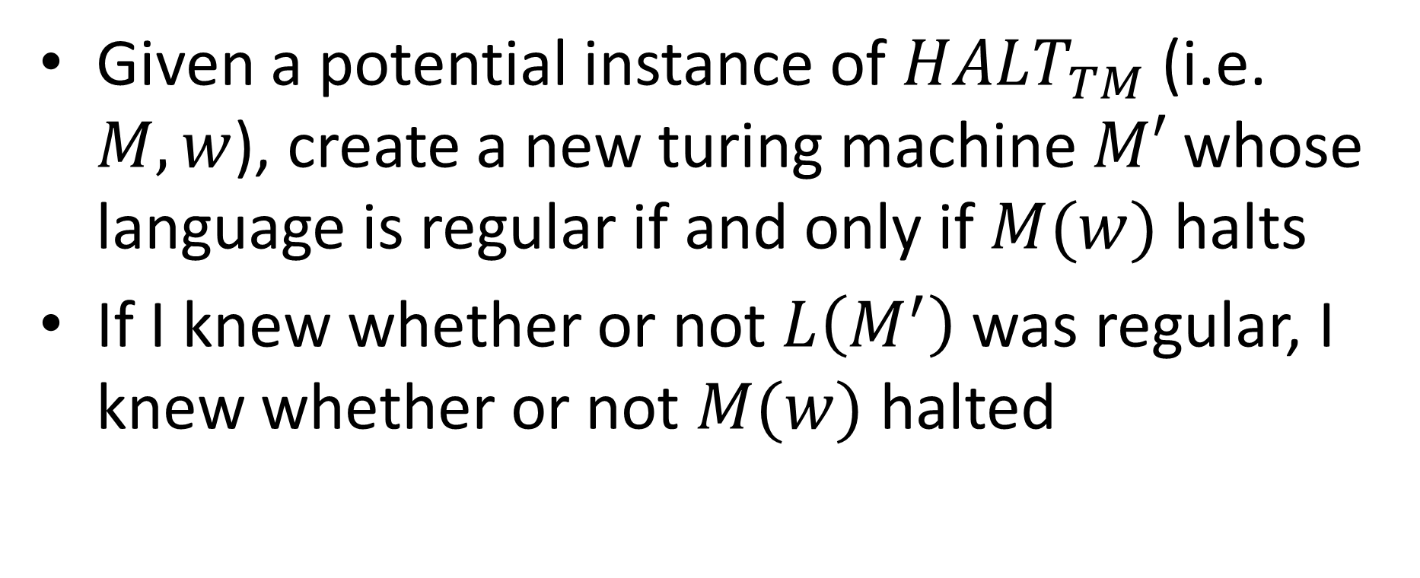

$$REG_{TM}≥HALT_{TM}$$
Given a potential instance of $HALT_{TM}$ (i.e. $M,w$), create a new turing machine $M′$ whose language is regular if and only if $M(w)$ halts
If I knew whether or not $L\left(M^{′}\right)$ was regular, I knew whether or not $M(w)$ halted

Slide 8
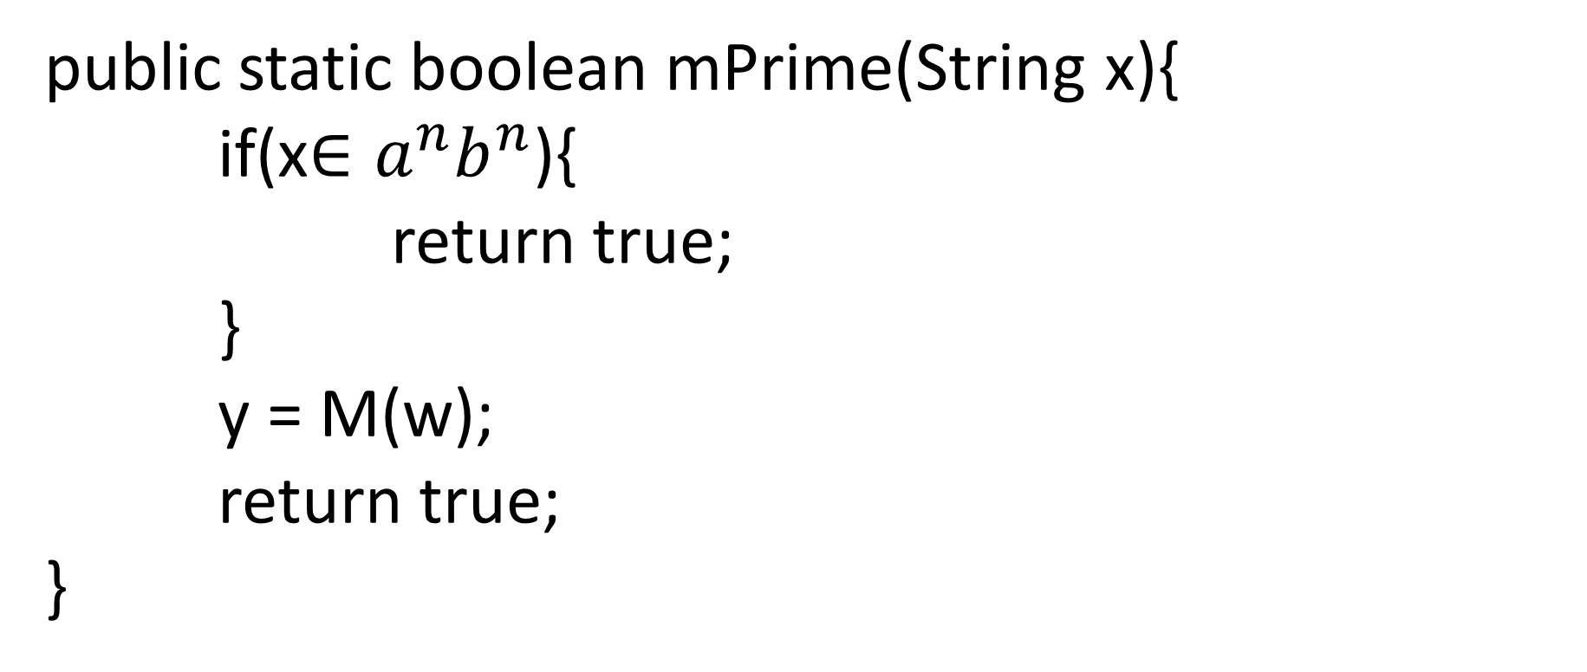

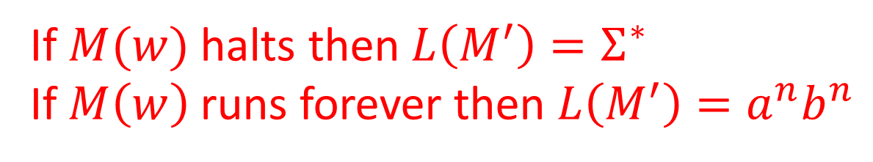
Psuedocode for $M′$
public static boolean mPrime(String x){
if(x$∈a^{n}b^{n}$){
return true;
}
y = M(w);
return true;
}
If this line terminates
We can only get to this line
If $M(w)$ halts then $L\left(M^{′}\right)=Σ^{∗}$
If $M\left(w\right)$ runs forever then $L\left(M^{′}\right)=a^{n}b^{n}$

Slide 9
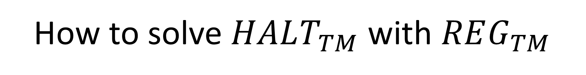
How to solve $HALT_{TM}$ with $REG_{TM}$
public static boolean halt(M,w){
mPrime = make_mPrime(M,w);
return reg(mPrime);
}

Slide 10
Turing Machine “Enhancements”
Multiple heads:
b
b
a
b
a
b
b
a
a
Idea: Mark heads locations on tape and simulate
b
B
B
a
A
A
b
B
B
b
b
a
b
a
b
b
A
b
a
a
Modified δ' processes each “virtual” head independently:
Each move of δ is simulated by a long scan & update
δ' updates & marks all “virtual” head positions

Slide 11
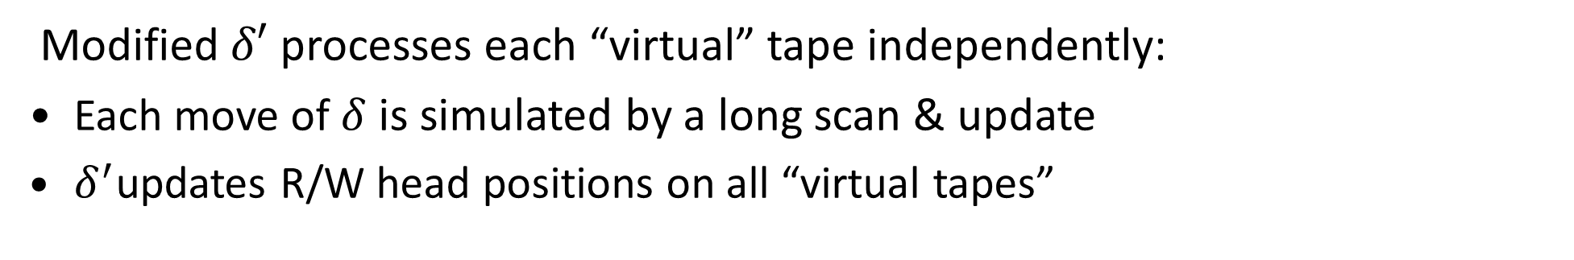
Turing Machine “Enhancements”
Multiple tapes:
1
1
1
1
0
0
1
1
0
0
1
1
0
0
1
1
1
1
0
0
0
0
1
1
1
1
1
1
1
1
0
0
0
0
Idea: Interlace multiple tapes into a single tape
1
0
1
1
1
1
0
1
1
1
0
1
0
0
0
1
0
Modified $δ′$ processes each “virtual” tape independently:
Each move of $δ$ is simulated by a long scan & update
$δ^{′}$updates R/W head positions on all “virtual tapes”

Slide 12
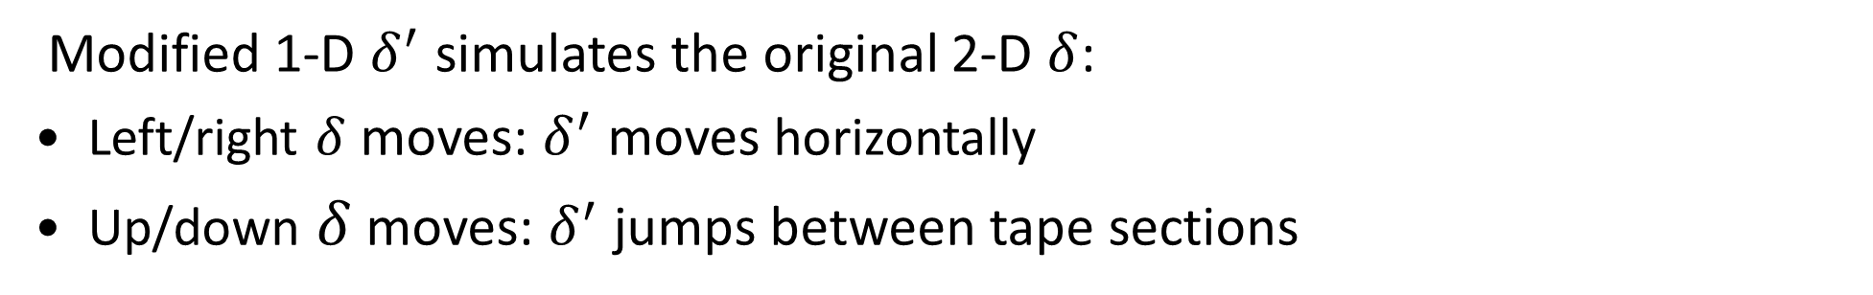
Turing Machine “Enhancements”
Two-dimensional tape:
1
1
1
1
0
0
1
1
0
0
1
1
0
0
1
1
1
1
0
0
1
1
1
1
0
0
1
1
1
1
0
0
0
0
Idea: Flatten 2-D tape into a 1-D tape
1
0
1
1
0
0
$
0
1
1
0
1
$
1
1
0
1
0
1
$
Modified 1-D $δ^{′}$ simulates the original 2-D $δ$:
Left/right $δ$ moves: $δ^{′}$ moves horizontally
Up/down $δ$ moves: $δ^{′}$ jumps between tape sections

Slide 13
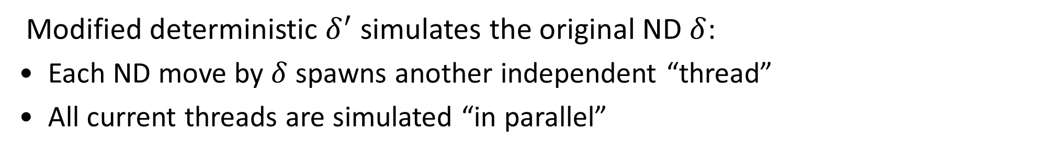
Turing Machine “Enhancements”
Non-determinism:
1
1
1
1
1
0
1
0
1
1
0
1
0
1
1
1
1
0
0
1
1
1
0
0
1
1
1
1
1
1
1
1
1
1
0
0
1
1
Idea: Parallel-simulate non-deterministic threads
1
1
$
1
0
1
0
1
$
1
1
1
1
0
1
$
Modified deterministic $δ^{′}$ simulates the original ND $δ$:
Each ND move by $δ$ spawns another independent “thread”
All current threads are simulated “in parallel”

Slide 14
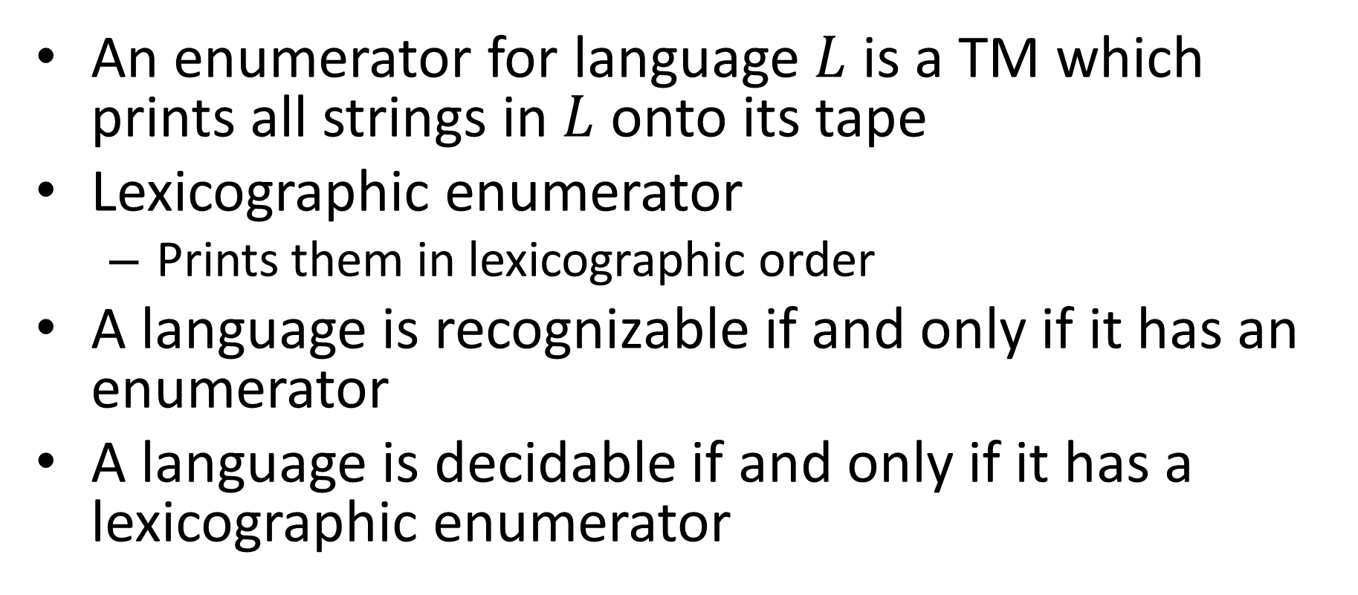
Enumerators
An enumerator for language $L$ is a TM which prints all strings in $L$ onto its tape
Lexicographic enumerator
Prints them in lexicographic order
A language is recognizable if and only if it has an enumerator
A language is decidable if and only if it has a lexicographic enumerator

Slide 15
Enumerable = Recognizable

Slide 16
Lexicographically Enumerable = Decidable

Slide 17
Closure properties of Recognizable
Closed under:
Union
Intersection
Concatenation
Kleene
Not closed under:
Complement

Slide 18



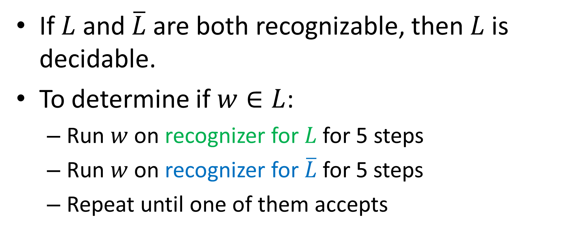



Not closed under Complement
If $L$ and $\overline{L}$ are both recognizable, then $L$ is decidable.
To determine if $w∈L$:
Run $w$ on recognizer for $L$ for 5 steps
Run $w$ on recognizer for $\overline{L}$for 5 steps
Repeat until one of them accepts
Reject!
$$\overline{L}$$
$$\overline{L}$$
$$\overline{L}$$
Time
$$L$$
$$L$$
$$L$$

Slide 19

Some Non-Recognizable Languages
$COHALT=\left\{<M,w>\right|M does not halt on w\}$
$ALL_{TM}=\left\{<M> \right|L\left(M\right){=Σ}^{∗}\}$
Reduce $COHALT$ to $ALL_{TM}$

Slide 20
Some Non-Recognizable Languages
$COHALT=\left\{<M,w>\right|M does not halt on w\}$
$ALL_{TM}=\left\{<M> \right|L\left(M\right){=Σ}^{∗}\}$
Reduce $COHALT$ to $ALL_{TM}$

Slide 21
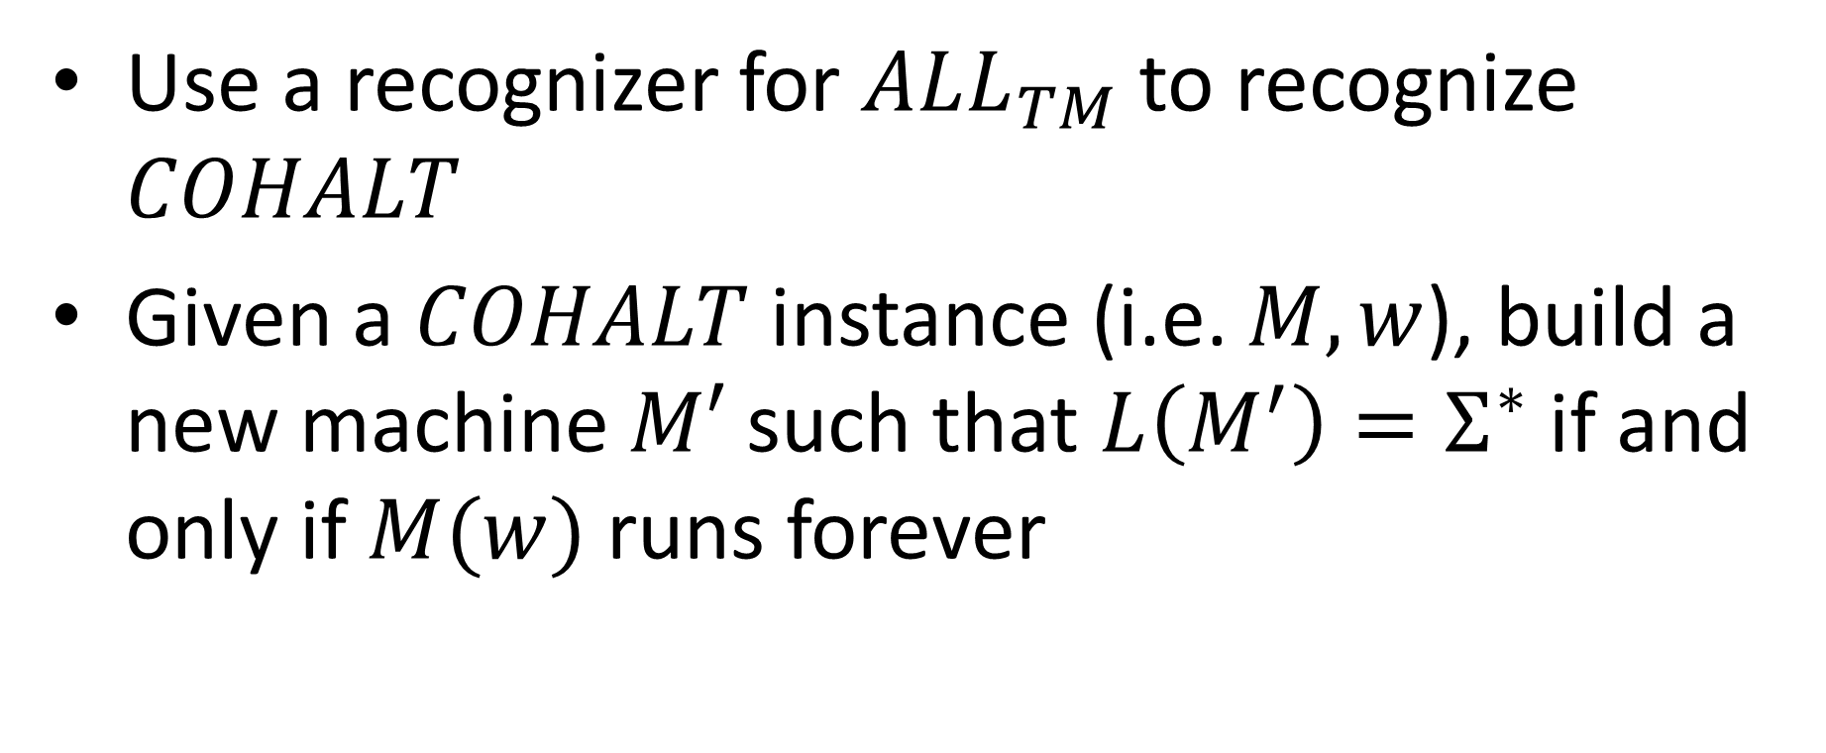

Reduce $COHALT$ to $ALL_{TM}$
Use a recognizer for $ALL_{TM}$ to recognize $COHALT$
Given a $COHALT$ instance (i.e. $M,w$), build a new machine $M′$ such that $L\left(M^{′}\right)=Σ^{∗}$ if and only if $M(w)$ runs forever

Slide 22


Psuedocode for $M′$
public static boolean mPrime(string $x$){
count = 0;
while($M(w)$ hasn’t halted){
if(count > $x$){
return true;
}
run $M(w)$ for 1 step;
}
return false;
}
If $M(w)$ halts, there is a longest string I can accept
The only way to accept all strings is for $M\left(w\right)$ to run forever

Slide 23
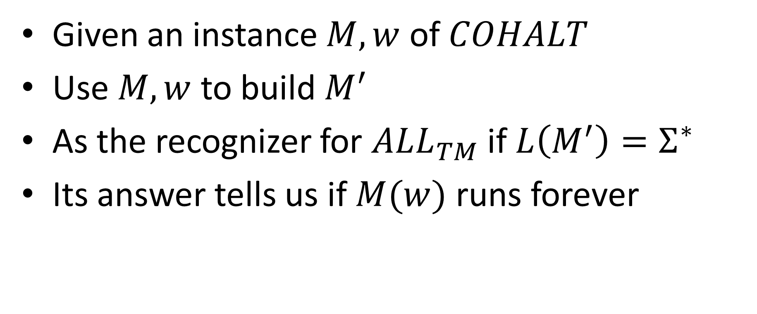
Reduction
Given an instance $M,w$ of $COHALT$
Use $M,w$ to build $M^{′}$
As the recognizer for $ALL_{TM}$ if $L\left(M^{′}\right)=Σ^{∗}$
Its answer tells us if $M(w)$ runs forever

