Slide 1
CS3102 Theory of Computation

Slide 2
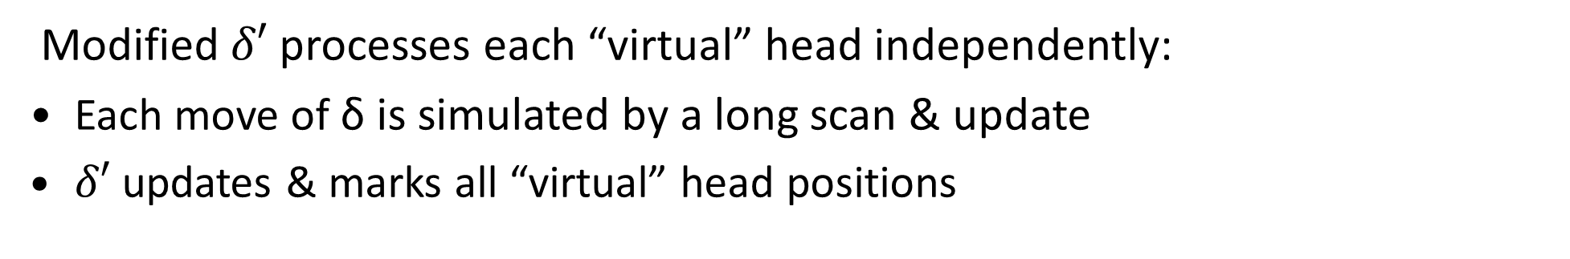
Turing Machine “Enhancements”
Multiple heads:
b
b
a
b
a
b
b
a
a
Idea: Mark heads locations on tape and simulate
b
B
B
a
A
A
b
B
B
b
b
a
b
a
b
b
A
b
a
a
Modified $δ′$processes each “virtual” head independently:
Each move of δ is simulated by a long scan & update
$δ′$ updates & marks all “virtual” head positions

Slide 3
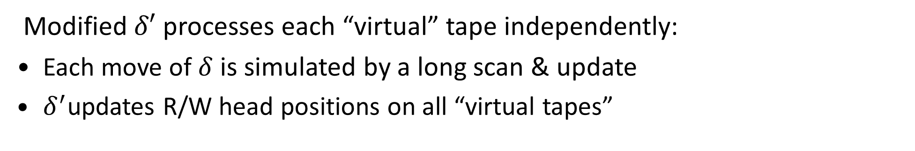
Turing Machine “Enhancements”
Multiple tapes:
1
1
1
1
0
0
1
1
0
0
1
1
0
0
1
1
1
1
0
0
0
0
1
1
1
1
1
1
1
1
0
0
0
0
Idea: Interlace multiple tapes into a single tape
1
0
1
1
1
1
0
1
1
1
0
1
0
0
0
1
0
Modified $δ′$ processes each “virtual” tape independently:
Each move of $δ$ is simulated by a long scan & update
$δ^{′}$updates R/W head positions on all “virtual tapes”

Slide 4
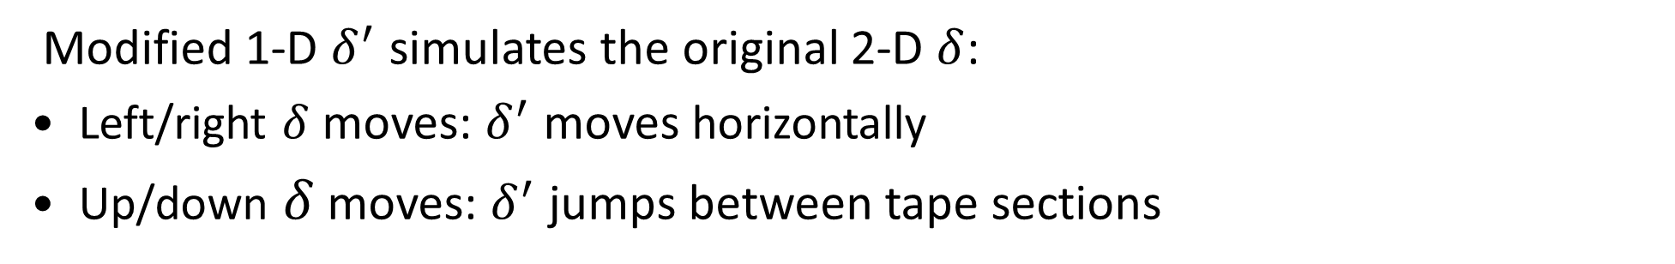
Turing Machine “Enhancements”
Two-dimensional tape:
1
1
1
1
0
0
1
1
0
0
1
1
0
0
1
1
1
1
0
0
1
1
1
1
0
0
1
1
1
1
0
0
0
0
Idea: Flatten 2-D tape into a 1-D tape
1
0
1
1
0
0
$
0
1
1
0
1
$
1
1
0
1
0
1
$
Modified 1-D $δ^{′}$ simulates the original 2-D $δ$:
Left/right $δ$ moves: $δ^{′}$ moves horizontally
Up/down $δ$ moves: $δ^{′}$ jumps between tape sections

Slide 5
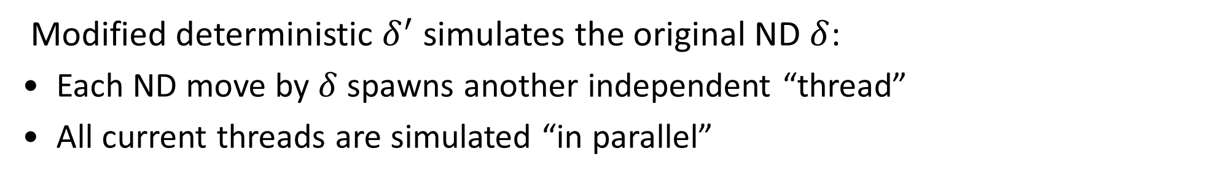
Turing Machine “Enhancements”
Non-determinism:
1
1
1
1
1
0
1
0
1
1
0
1
0
1
1
1
1
0
0
1
1
1
0
0
1
1
1
1
1
1
1
1
1
1
0
0
1
1
Idea: Parallel-simulate non-deterministic threads
1
1
$
1
0
1
0
1
$
1
1
1
1
0
1
$
Modified deterministic $δ^{′}$ simulates the original ND $δ$:
Each ND move by $δ$ spawns another independent “thread”
All current threads are simulated “in parallel”

Slide 6
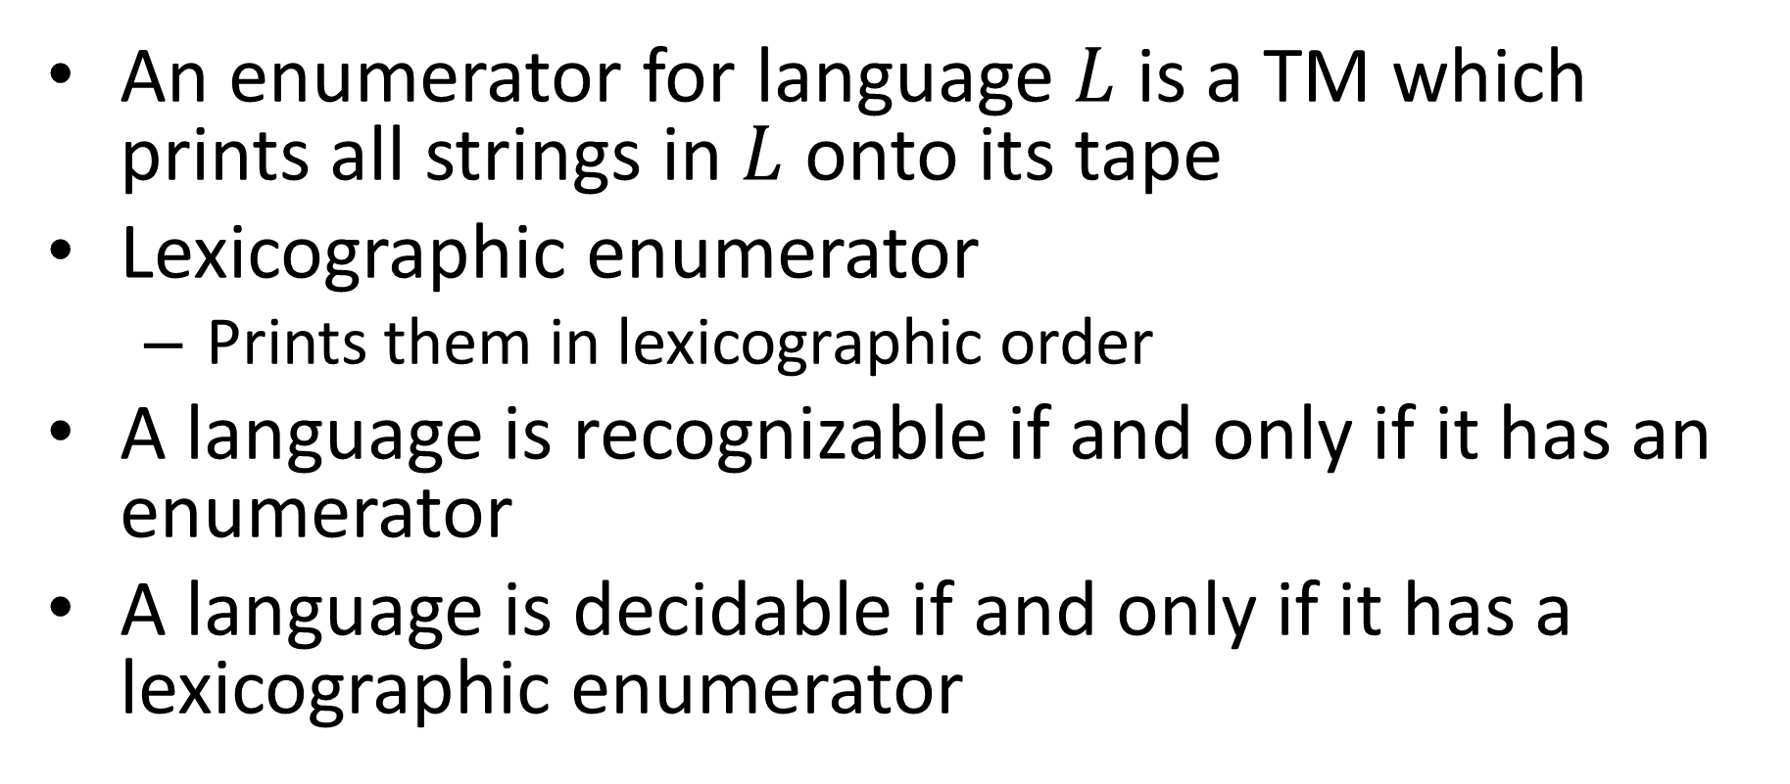
Enumerators
An enumerator for language $L$ is a TM which prints all strings in $L$ onto its tape
Lexicographic enumerator
Prints them in lexicographic order
A language is recognizable if and only if it has an enumerator
A language is decidable if and only if it has a lexicographic enumerator

Slide 7
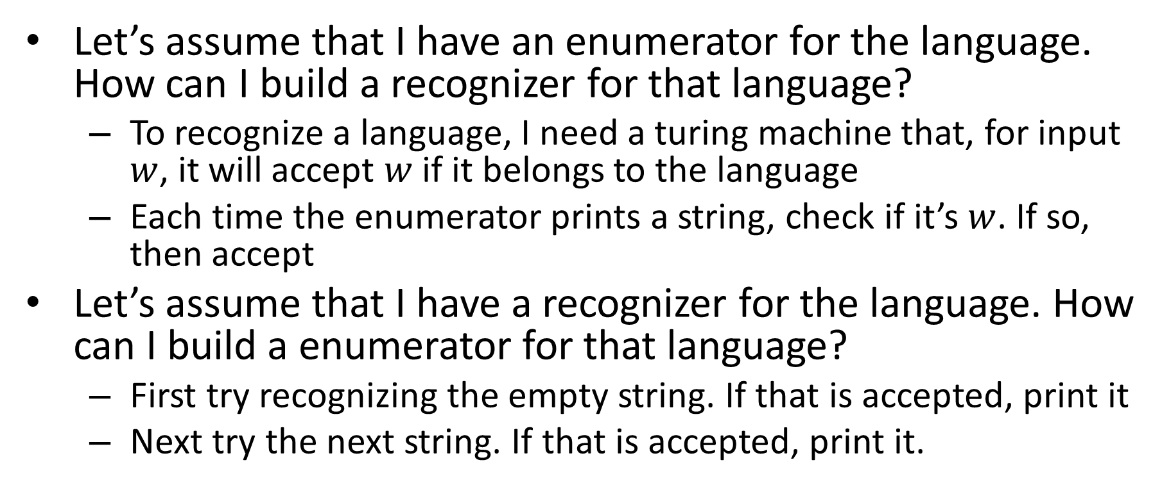
Enumerable = Recognizable
Let’s assume that I have an enumerator for the language. How can I build a recognizer for that language?
To recognize a language, I need a turing machine that, for input $w$, it will accept $w$ if it belongs to the language
Each time the enumerator prints a string, check if it’s $w$. If so, then accept
Let’s assume that I have a recognizer for the language. How can I build a enumerator for that language?
First try recognizing the empty string. If that is accepted, print it
Next try the next string. If that is accepted, print it.

Slide 8
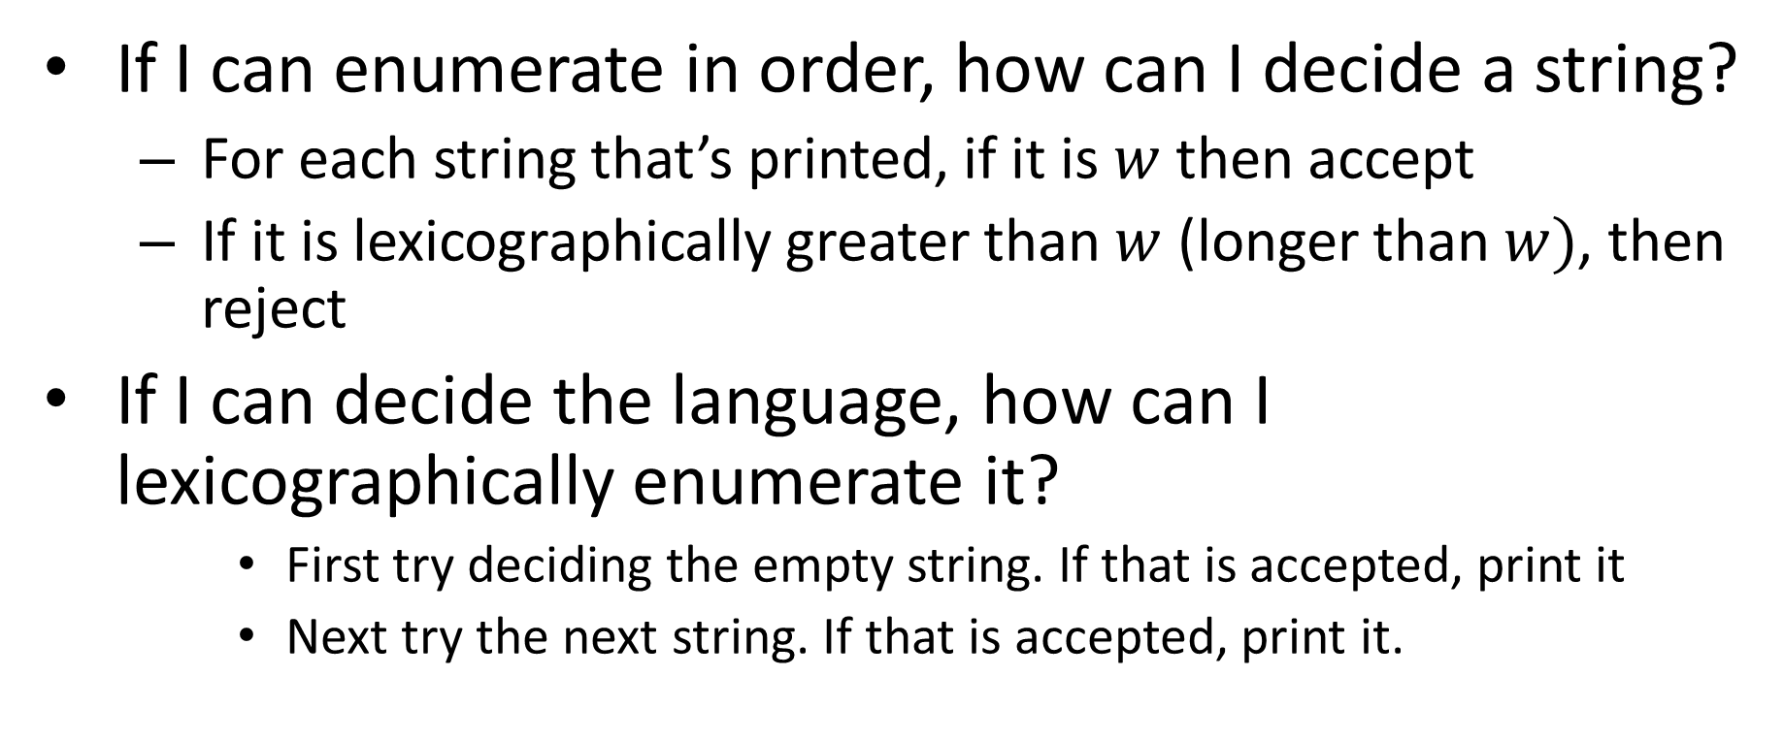
Lexicographically Enumerable = Decidable
If I can enumerate in order, how can I decide a string?
For each string that’s printed, if it is $w$ then accept
If it is lexicographically greater than $w$ (longer than $w)$, then reject
If I can decide the language, how can I lexicographically enumerate it?
First try deciding the empty string. If that is accepted, print it
Next try the next string. If that is accepted, print it.

Slide 9
Closure properties of Recognizable
Closed under:
Union
Intersection
Concatenation
Kleene
Not closed under:
Complement

Slide 10



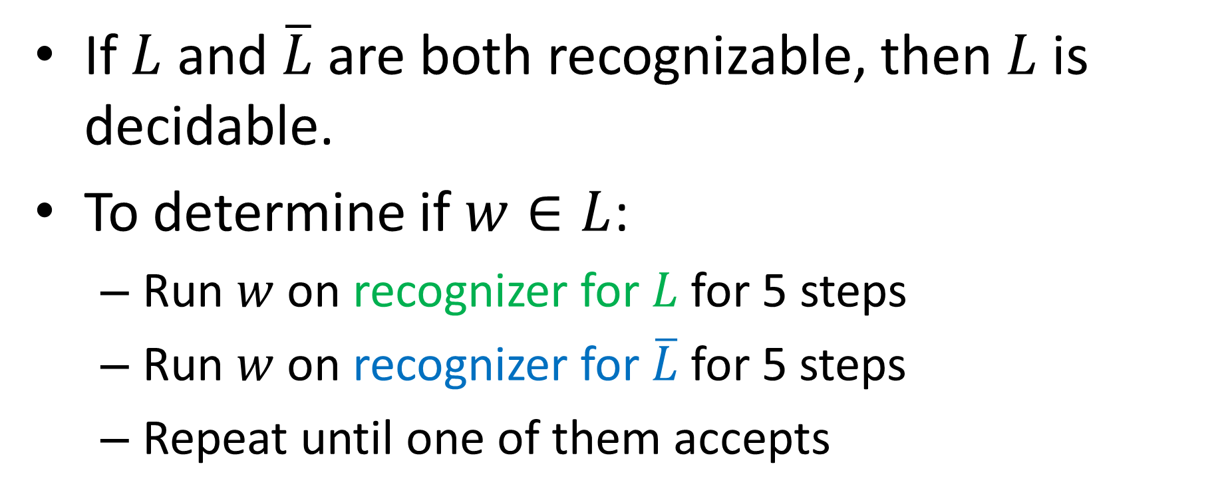



Not closed under Complement
If $L$ and $\overline{L}$ are both recognizable, then $L$ is decidable.
To determine if $w∈L$:
Run $w$ on recognizer for $L$ for 5 steps
Run $w$ on recognizer for $\overline{L}$for 5 steps
Repeat until one of them accepts
Reject!
$$\overline{L}$$
$$\overline{L}$$
$$\overline{L}$$
Time
$$L$$
$$L$$
$$L$$

Slide 11
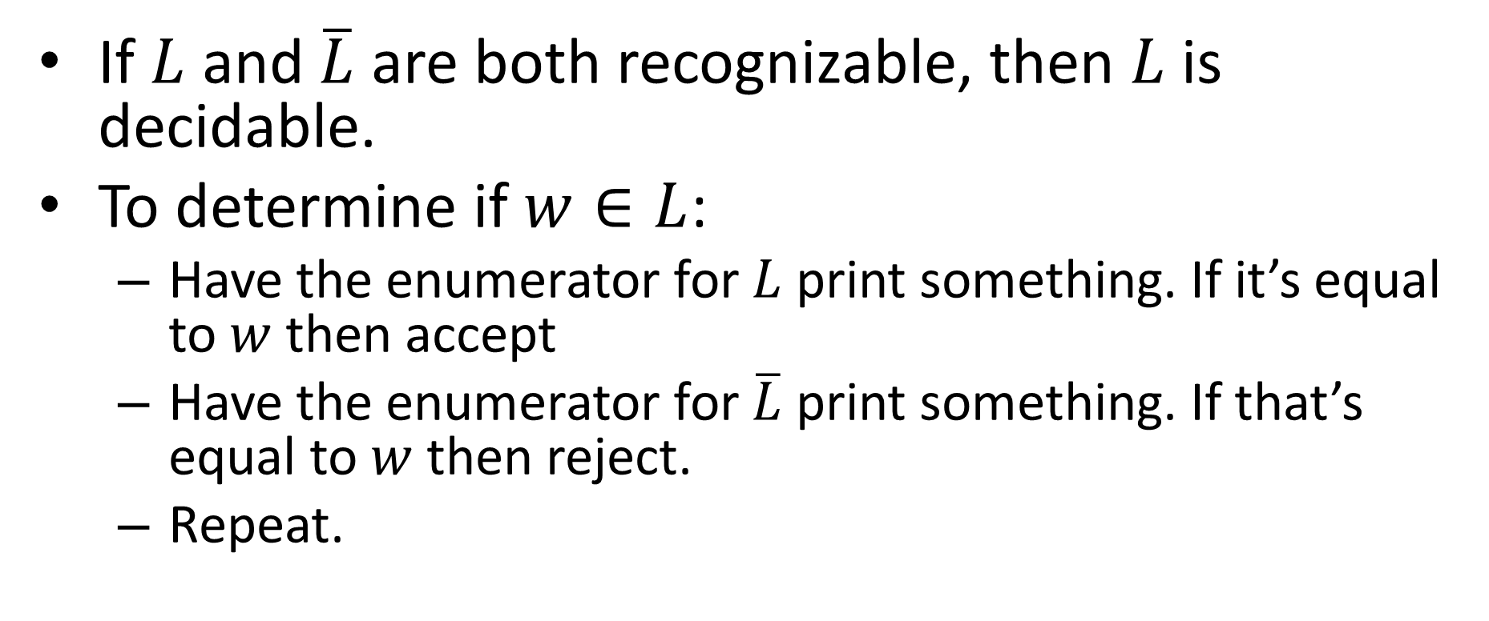
Not closed under Complement
If $L$ and $\overline{L}$ are both recognizable, then $L$ is decidable.
To determine if $w∈L$:
Have the enumerator for $L$ print something. If it’s equal to $w$ then accept
Have the enumerator for $\overline{L}$ print something. If that’s equal to $w$ then reject.
Repeat.

Slide 12

Some Non-Recognizable Languages
$COHALT=\left\{<M,w>\right|M does not halt on w\}$
$ALL_{TM}=\left\{<M> \right|L\left(M\right){=Σ}^{∗}\}$
Reduce $COHALT$ to $ALL_{TM}$

Slide 13
Some Non-Recognizable Languages
$COHALT=\left\{<M,w>\right|M does not halt on w\}$
$ALL_{TM}=\left\{<M> \right|L\left(M\right){=Σ}^{∗}\}$
Reduce $COHALT$ to $ALL_{TM}$

Slide 14
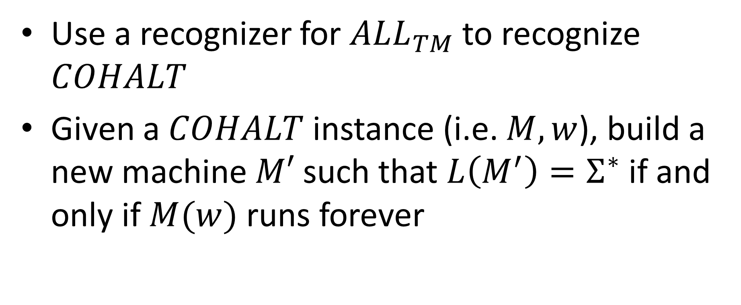

Reduce $COHALT$ to $ALL_{TM}$
Use a recognizer for $ALL_{TM}$ to recognize $COHALT$
Given a $COHALT$ instance (i.e. $M,w$), build a new machine $M′$ such that $L\left(M^{′}\right)=Σ^{∗}$ if and only if $M(w)$ runs forever

Slide 15



Psuedocode for $M′$
public static boolean mPrime(string $x$){
count = 0;
while($M(w)$ hasn’t halted){
if(count > $|x|$){
return true;
}
run $M(w)$ for 1 step;
count++;
}
return false;
}
If $M(w)$ halts, there is a longest string I can accept
The only way to accept all strings is for $M\left(w\right)$ to run forever

Slide 16
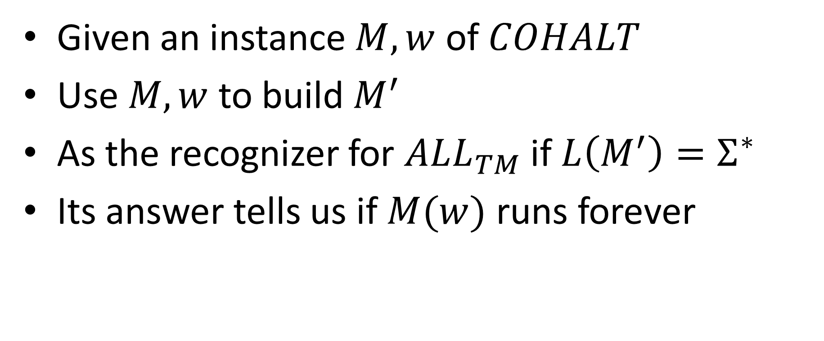
Reduction
Given an instance $M,w$ of $COHALT$
Use $M,w$ to build $M^{′}$
As the recognizer for $ALL_{TM}$ if $L\left(M^{′}\right)=Σ^{∗}$
Its answer tells us if $M(w)$ runs forever

