Slide 1
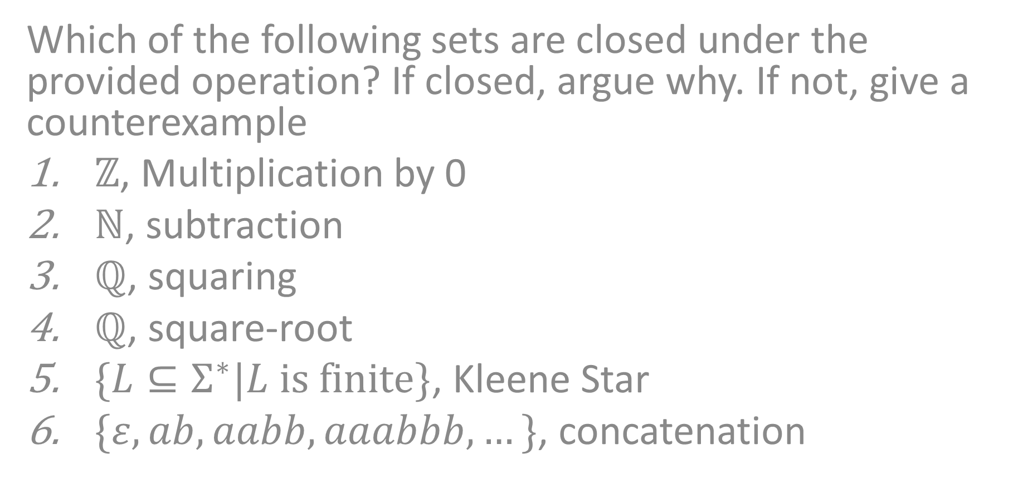
CS3102 Theory of Computation
Closure
Which of the following sets are closed under the provided operation? If closed, argue why. If not, give a counterexample
$ℤ$, Multiplication by 0
$ℕ$, subtraction
$ℚ$, squaring
$ℚ$, square-root
$\{L⊆Σ^{∗}|L is finite\}$, Kleene Star
$\{ε, ab, aabb, aaabbb, …\}$, concatenation

Slide 2



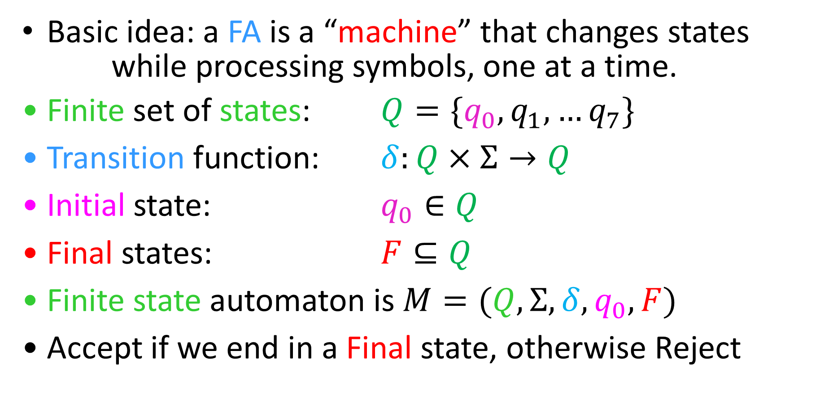



Finite State Automata
Basic idea: a FA is a “machine” that changes states
while processing symbols, one at a time.
Finite set of states: $Q=\{q_{0},q_{1},…q_{7}\}$
Transition function: $δ:Q×Σ→Q$
Initial state: $q_{0}∈Q$
Final states: $F⊆Q$
Finite state automaton is $M=(Q, Σ, δ, q_{0}, F)$
Accept if we end in a Final state, otherwise Reject
$$q_{1}$$
$$q_{1}$$
$$a$$
$$q_{2}$$
$$q_{0}$$
$$q_{k}$$

Slide 3
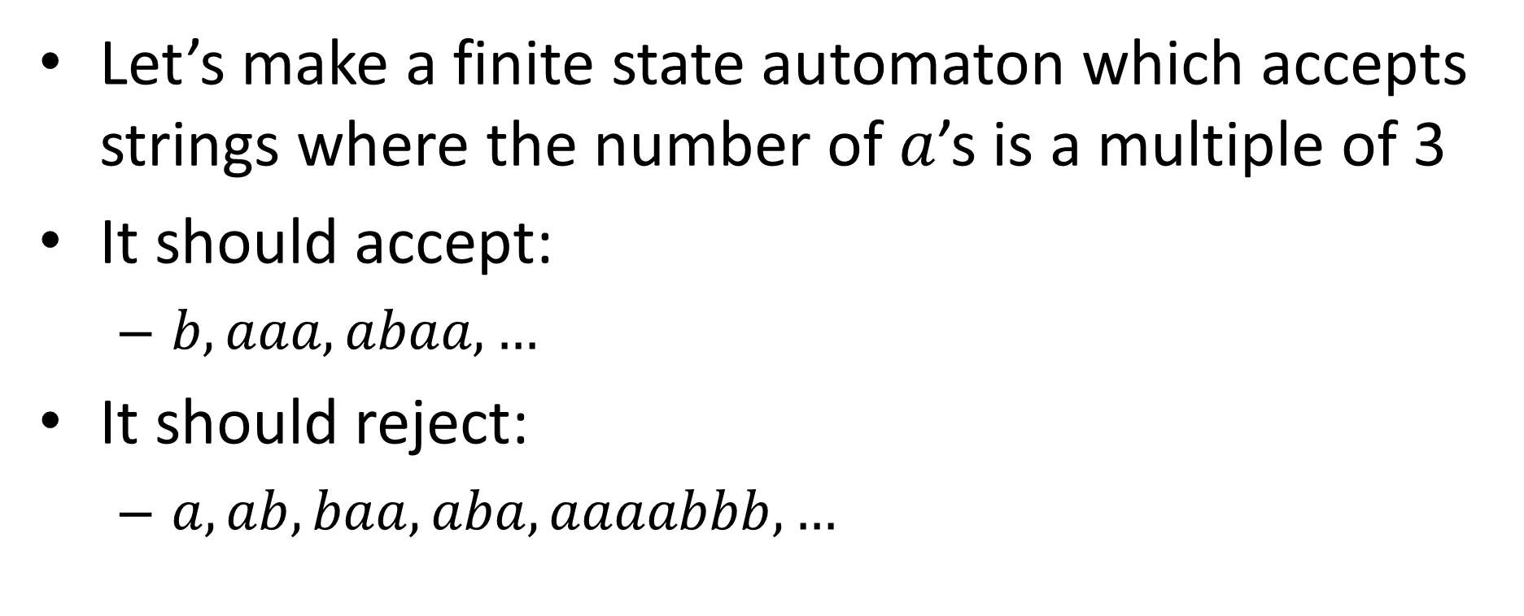
TripleA
Let’s make a finite state automaton which accepts strings where the number of $a$’s is a multiple of 3
It should accept:
$b, aaa, abaa, …$
It should reject:
$a, ab, baa, aba, aaaabbb, …$

Slide 4
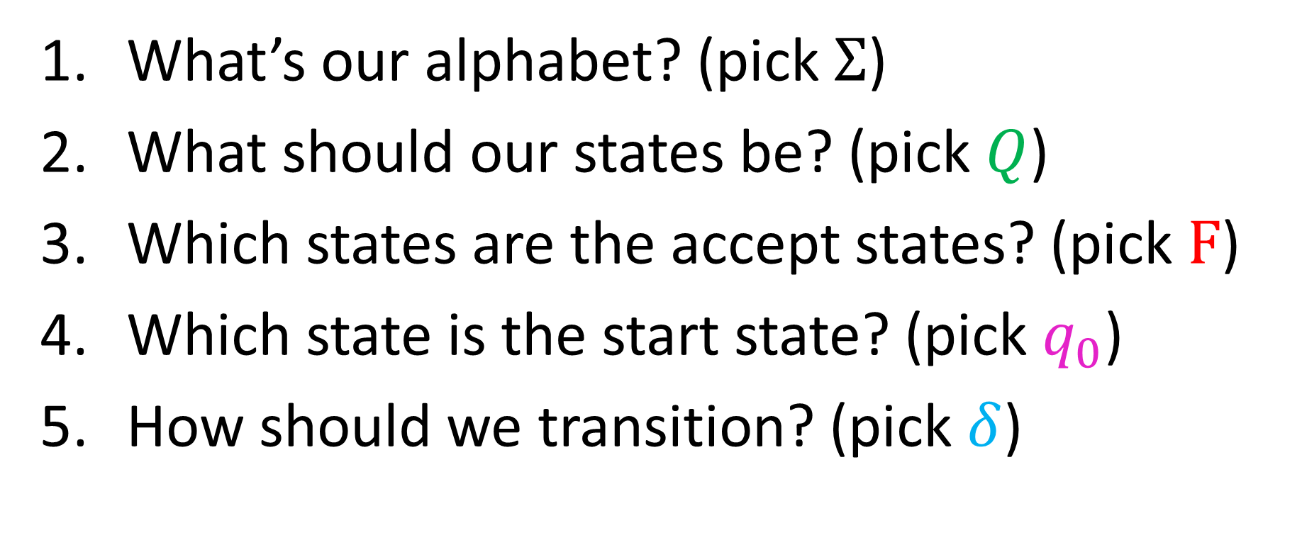
TripleA using FSA
What’s our alphabet? (pick $Σ$)
What should our states be? (pick $Q$)
Which states are the accept states? (pick $F$)
Which state is the start state? (pick $q_{0}$)
How should we transition? (pick $δ$)

Slide 5





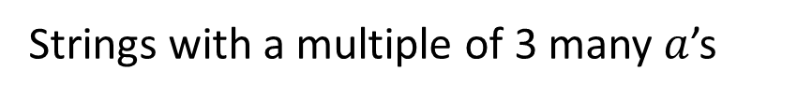

TripleA
Strings with a multiple of 3 many $a$’s
$$a$$
$$a$$
$$b$$
1
2
0
$$b$$
$$b$$
$$a$$

Slide 6
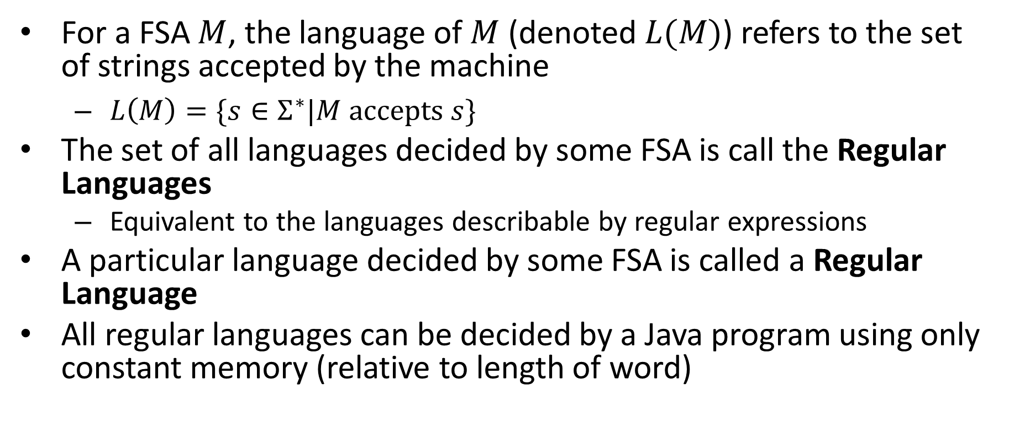
Take-aways
For a FSA $M$, the language of $M$ (denoted $L(M)$) refers to the set of strings accepted by the machine
$L\left(M\right)=\{s∈Σ^{∗}|M accepts s\}$
The set of all languages decided by some FSA is call the Regular Languages
Equivalent to the languages describable by regular expressions
A particular language decided by some FSA is called a Regular Language
All regular languages can be decided by a Java program using only constant memory (relative to length of word)

Slide 7
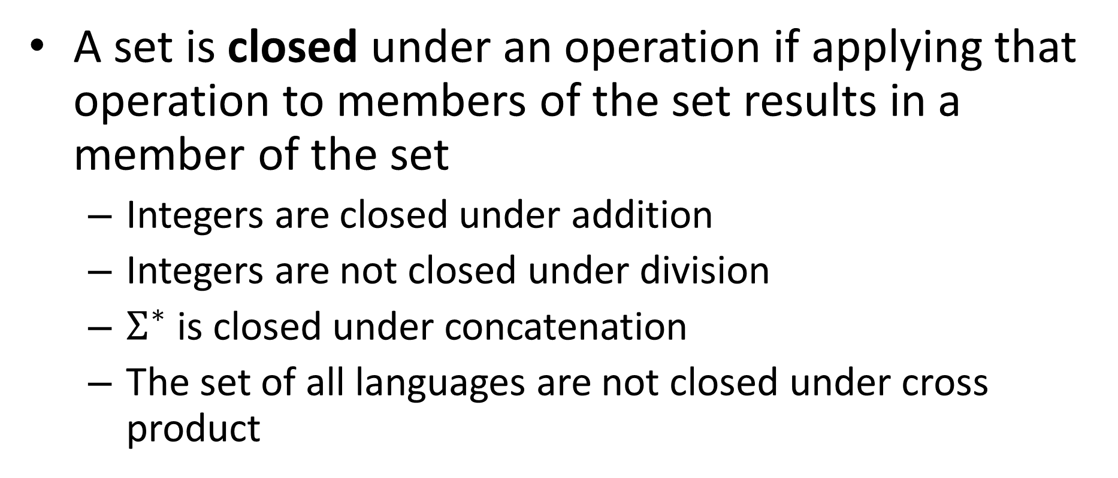
Closure Properties
A set is closed under an operation if applying that operation to members of the set results in a member of the set
Integers are closed under addition
Integers are not closed under division
$Σ^{∗}$ is closed under concatenation
The set of all languages are not closed under cross product

Slide 8
Closure Properties of Regular Languages
Complement
Intersection
Union
Difference
Reversal
Concatenation

Slide 9
Closed under Complement
If a language is regular then its complement is regular
If a language has a FSA, it’s complement does as well
If there is a FSA which accepts exactly the strings in the language, there is a FSA which accepts exactly the strings not in the language

Slide 10
Closed under Complement
Idea: Every string ends in some state. If that was originally an accept state then reject, else accept.
New final states are the old non-final states

Slide 11





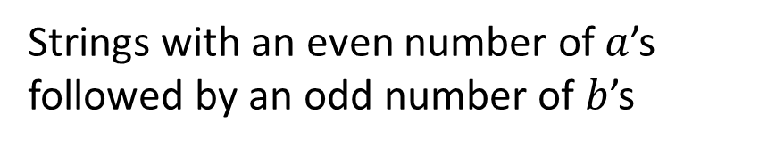




EvenAoddB
Strings with an even number of $a$’s followed by an odd number of $b$’s
$$a$$
Odd a
Even a
$$b$$
$$a,b$$
$$a$$
Trash
$$b$$
$$b$$
$$a$$
Odd b
Even b
$$a$$
$$b$$

Slide 12
Complement of EvenAoddB
Describe it:
$$a$$
Odd a
Even a
$$b$$
$$a,b$$
$$a$$
Trash
$$b$$
$$b$$
$$a$$
Odd b
Even b
$$a$$
$$b$$

Slide 13
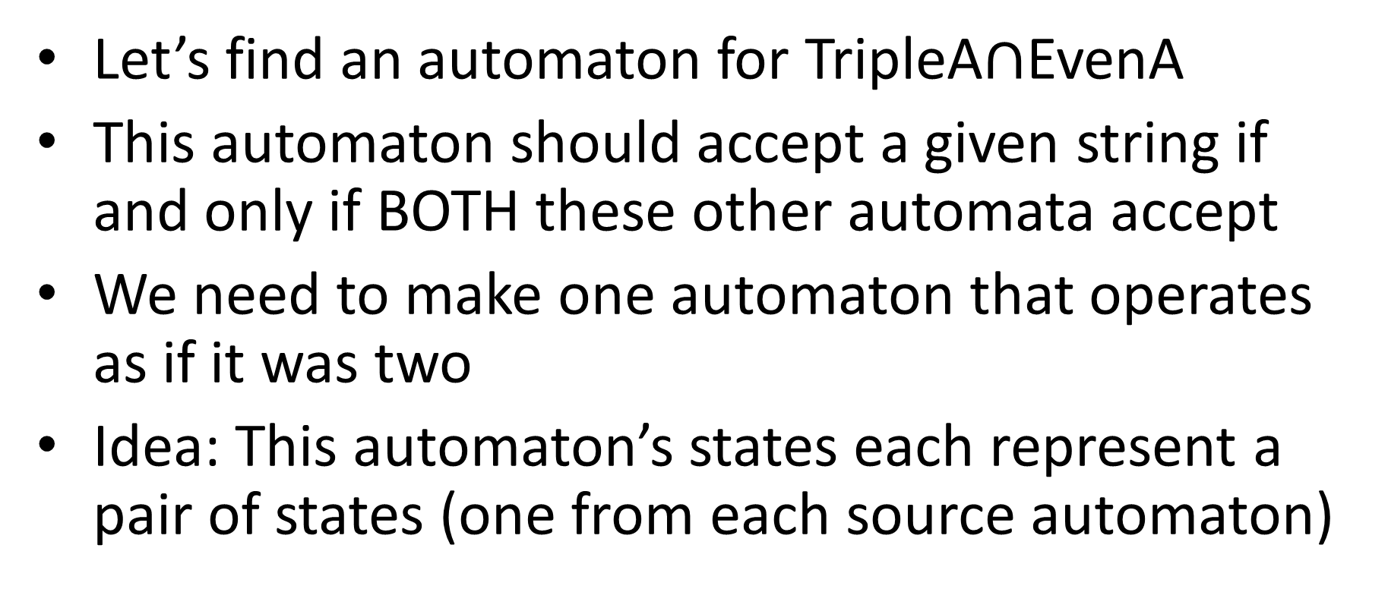
Closed under Intersection
Let’s find an automaton for TripleA$∩$EvenA
This automaton should accept a given string if and only if BOTH these other automata accept
We need to make one automaton that operates as if it was two
Idea: This automaton’s states each represent a pair of states (one from each source automaton)

Slide 14












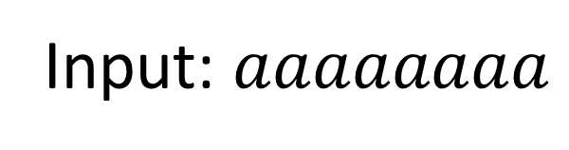
Running Both Machines
$$a$$
Input: $aaaaaaaa$
$$b$$
$$b$$
$$E$$
$$O$$
EvenA
$$a$$
$$a$$
$$a$$
$$b$$
1
2
0
TripleA
$$b$$
$$b$$
$$a$$

Slide 15
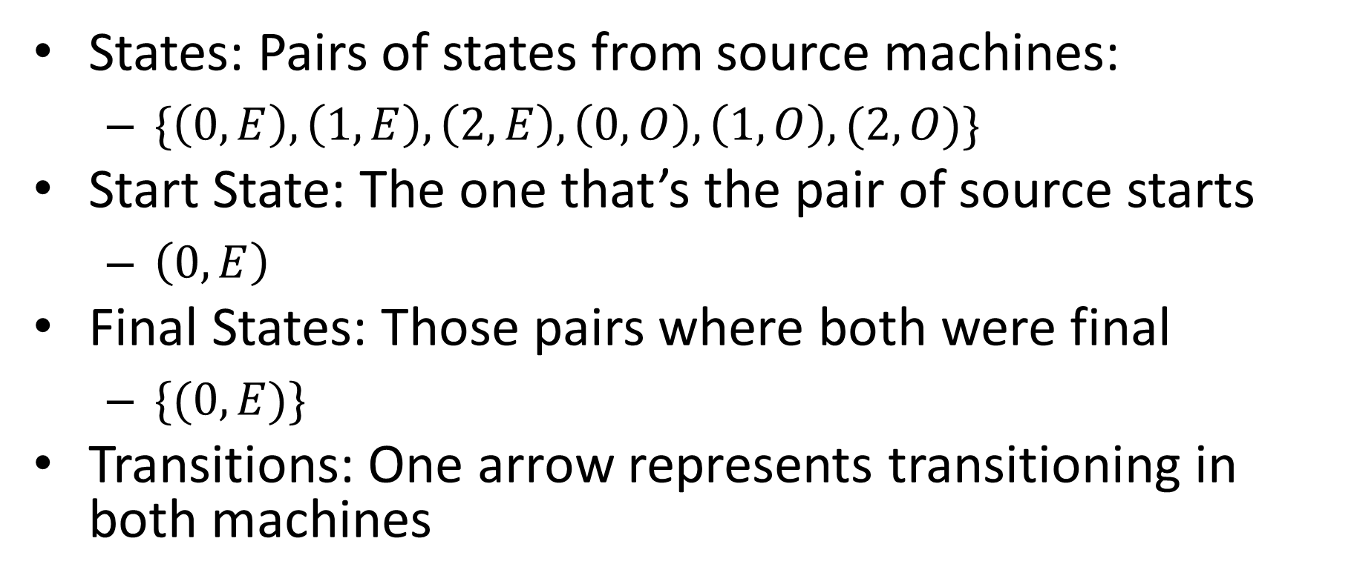
Now at the same time
States: Pairs of states from source machines:
$\{\left(0,E\right),\left(1,E\right),\left(2,E\right),\left(0,O\right),\left(1,O\right),(2,O)\}$
Start State: The one that’s the pair of source starts
$\left(0,E\right)$
Final States: Those pairs where both were final
$\{(0,E)\}$
Transitions: One arrow represents transitioning in both machines

Slide 16



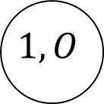



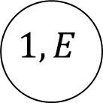

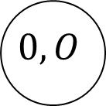

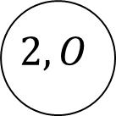


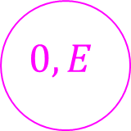
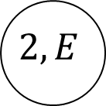


Let’s Draw it!
$$b$$
$$b$$
$$0,E$$
$$0,O$$
$$a$$
$$a$$
$$b$$
$$b$$
$$1,E$$
$$1,O$$
$$a$$
$$a$$
$$a$$
$$a$$
$$2,E$$
$$2,O$$
$$b$$
$$b$$

Slide 17
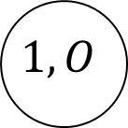
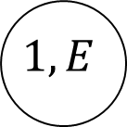
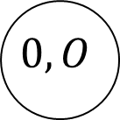
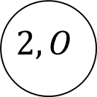
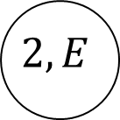
Let’s Draw it!
$$2,E$$
$$1,O$$
$$0,E$$
$$0,O$$
$$1,E$$
$$2,O$$

Slide 18
Let’s Draw it!
$$0,E$$
$$0,O$$
$$1,E$$
$$1,O$$
$$2,E$$
$$2,O$$

Slide 19
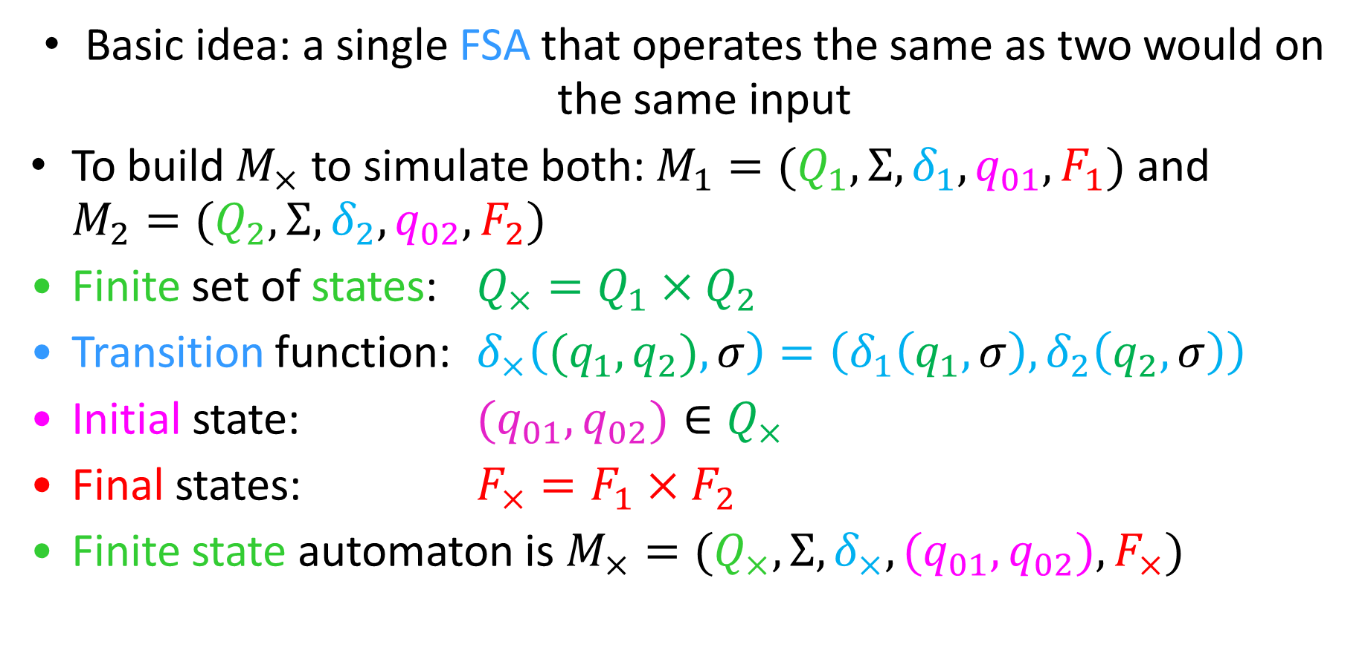
Cross Product Construction (intersection)
Basic idea: a single FSA that operates the same as two would on the same input
To build $M_{×}$ to simulate both: $M_{1}=(Q_{1}, Σ, δ_{1}, q_{01}, F_{1})$ and $M_{2}=(Q_{2}, Σ, δ_{2}, q_{02}, F_{2})$
Finite set of states: $Q_{×}=Q_{1}×Q_{2}$
Transition function: $δ_{×}\left({(q}_{1},q_{2}), σ\right)=\left(δ_{1}\left(q_{1},σ\right), δ_{2}\left(q_{2},σ\right)\right)$
Initial state: ${(q}_{01},q_{02})∈Q_{×}$
Final states: $F_{×}=F_{1}×F_{2}$
Finite state automaton is $M_{×}=(Q_{×}, Σ, δ_{×}, {(q}_{01},q_{02}), F_{×})$

Slide 20








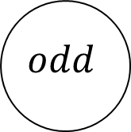



B’s only or even length
$${\left\{b\right\}}^{∗}=\{ε,b,bb,bbb,…\}$$
$$a$$
$$b^{′}s$$
$$trash$$
$$b$$
$$a,b$$
$${\left\{aa,ab,ba,bb\right\}}^{∗}$$
$$a,b$$
$$odd$$
$$even$$
$$a,b$$
$$a$$

Slide 21

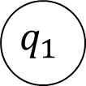






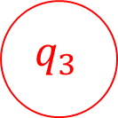

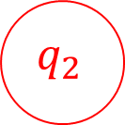
B’s only or even length
$$a$$
$${\left\{b\right\}}^{∗}=\{ε,b,bb,bbb,…\}$$
$$q_{0}$$
$$q_{1}$$
$$a$$
$$b^{′}s$$
$$trash$$
$$a$$
$$b$$
$$b$$
$$a,b$$
$$a,b$$
$${\left\{aa,ab,ba,bb\right\}}^{∗}$$
$$a,b$$
$$odd$$
$$even$$
$$q_{3}$$
$$q_{2}$$
$$a,b$$
$$a$$

Slide 22
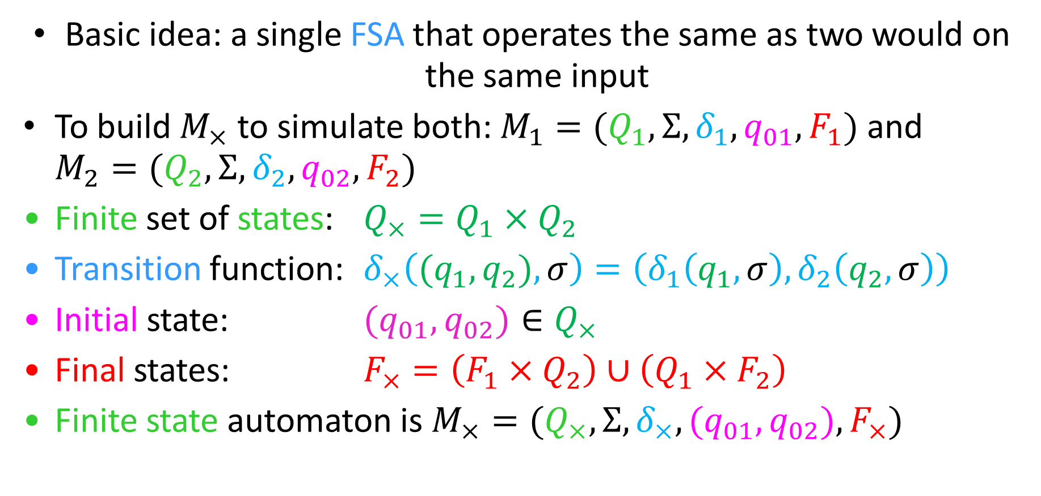
Cross Product Construction (Union)
Basic idea: a single FSA that operates the same as two would on the same input
To build $M_{×}$ to simulate both: $M_{1}=(Q_{1}, Σ, δ_{1}, q_{01}, F_{1})$ and $M_{2}=(Q_{2}, Σ, δ_{2}, q_{02}, F_{2})$
Finite set of states: $Q_{×}=Q_{1}×Q_{2}$
Transition function: $δ_{×}\left({(q}_{1},q_{2}), σ\right)=\left(δ_{1}\left(q_{1},σ\right), δ_{2}\left(q_{2},σ\right)\right)$
Initial state: ${(q}_{01},q_{02})∈Q_{×}$
Final states: $F_{×}=\left(F_{1}×Q_{2}\right)∪\left(Q_{1}×F_{2}\right)$
Finite state automaton is $M_{×}=(Q_{×}, Σ, δ_{×}, {(q}_{01},q_{02}), F_{×})$

Slide 23
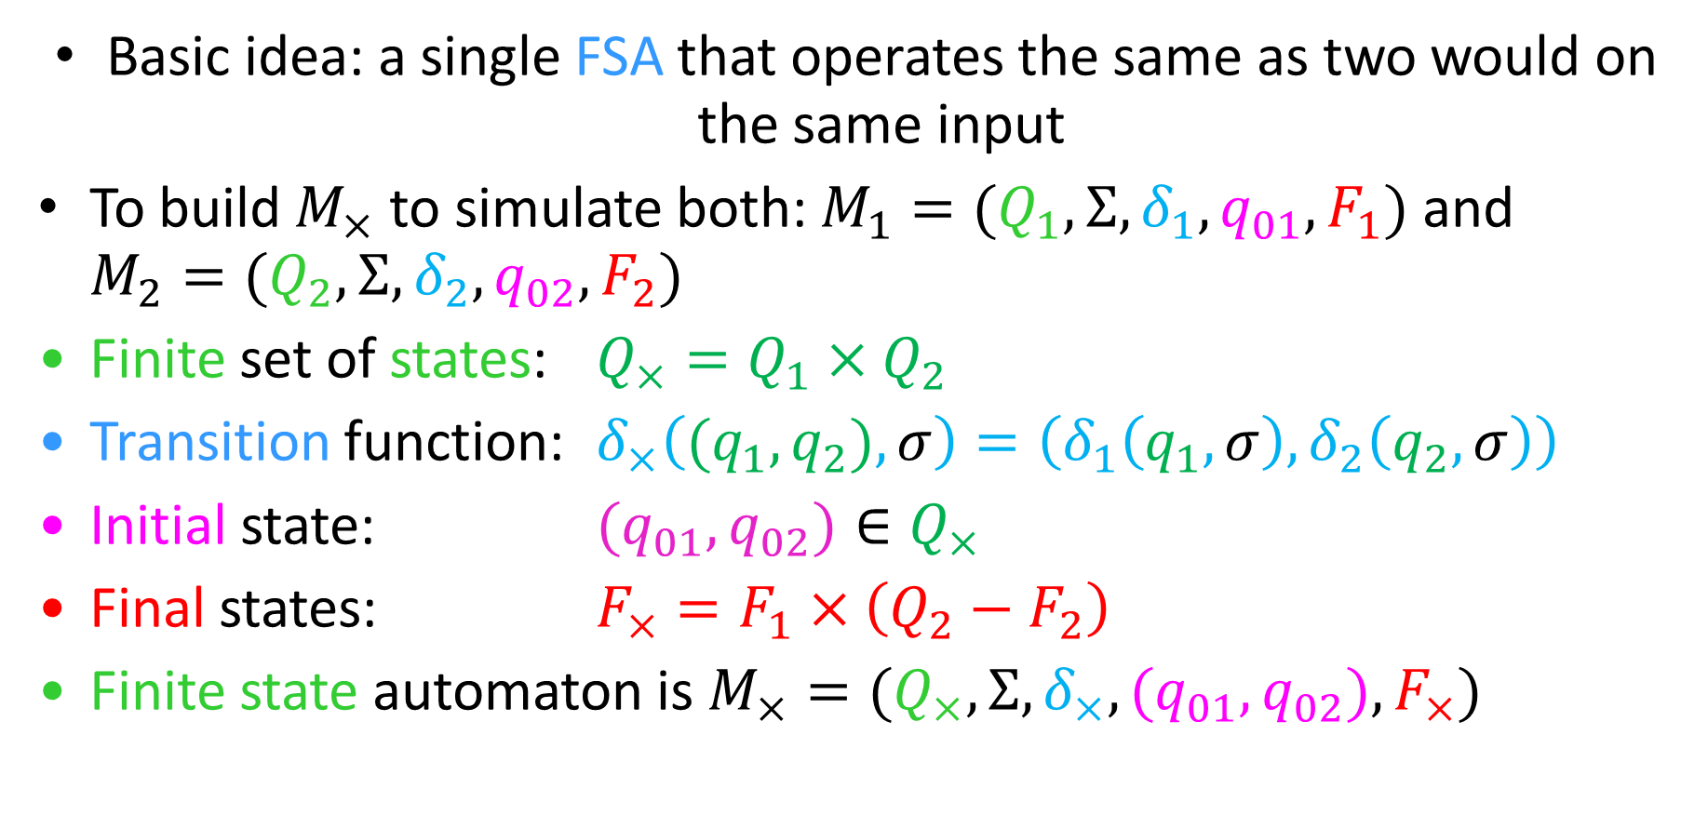
Cross Product Construction (Difference)
Basic idea: a single FSA that operates the same as two would on the same input
To build $M_{×}$ to simulate both: $M_{1}=(Q_{1}, Σ, δ_{1}, q_{01}, F_{1})$ and $M_{2}=(Q_{2}, Σ, δ_{2}, q_{02}, F_{2})$
Finite set of states: $Q_{×}=Q_{1}×Q_{2}$
Transition function: $δ_{×}\left({(q}_{1},q_{2}), σ\right)=\left(δ_{1}\left(q_{1},σ\right), δ_{2}\left(q_{2},σ\right)\right)$
Initial state: ${(q}_{01},q_{02})∈Q_{×}$
Final states: $F_{×}=F_{1}×\left(Q_{2}−F_{2}\right)$
Finite state automaton is $M_{×}=(Q_{×}, Σ, δ_{×}, {(q}_{01},q_{02}), F_{×})$

Slide 24
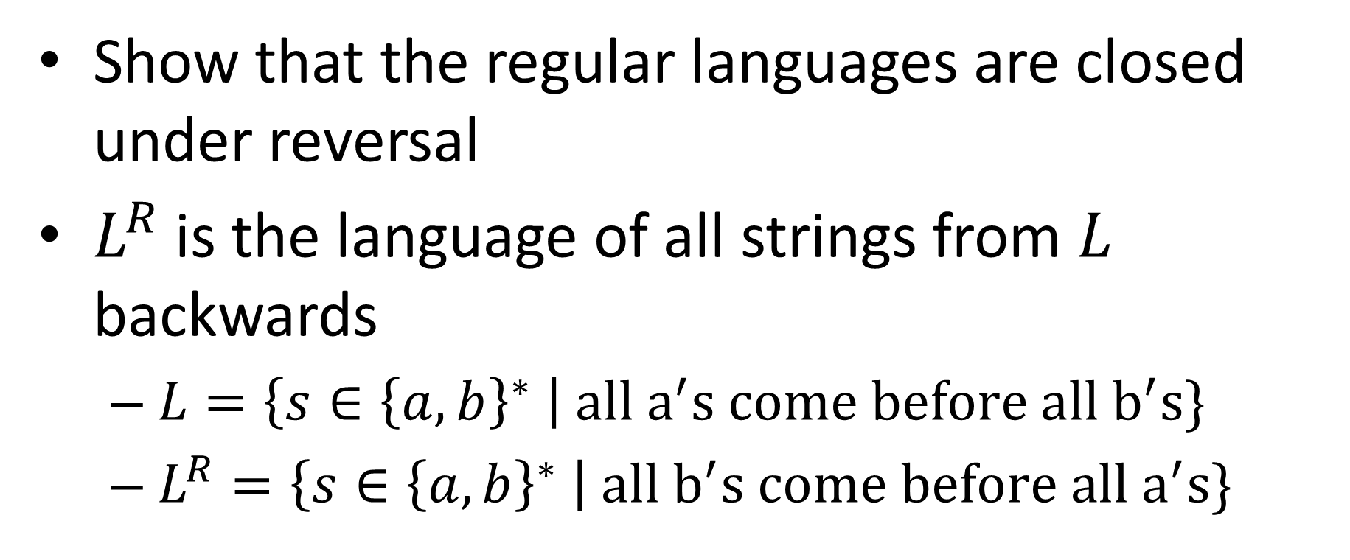
Closed Under reversal
Show that the regular languages are closed under reversal
$L^{R}$ is the language of all strings from $L$ backwards
$L=\left\{s∈{\left\{a,b\right\}}^{∗} \right| all a^{′}s come before all b^{′}s\}$
$L^{R}=\left\{s∈{\left\{a,b\right\}}^{∗} \right| all b^{′}s come before all a^{′}s\}$

Slide 25

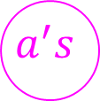






Let’s Draw it!
$$\left\{s∈{\left\{a,b\right\}}^{∗} \right| all a^{′}s come before all b^{′}s\}$$
$$b$$
$$a^{′}s$$
$$b^{′}s$$
$$b$$
$$a$$
$$a$$
$$trash$$
$$a,b$$

Slide 26






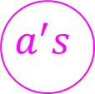









How to do reversal
“reverse” the automaton
Final states become start states
Start state becomes final
Reverse direction of all arrows
Problem(s)?
$$b$$
$$b$$
$$a^{′}s$$
$$b^{′}s$$
$$b$$
$$a^{′}s$$
$$b^{′}s$$
$$b$$
Reversed
$$a$$
$$a$$
$$a$$
$$a$$
$$trash$$
$$trash$$
$$a,b$$
$$a,b$$

Slide 27


Nondeterminism
Driving to a friend’s house
Friend forgets to mention a fork in the directions
Which way do you go?
Why not both?
?

Slide 28
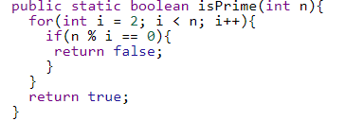
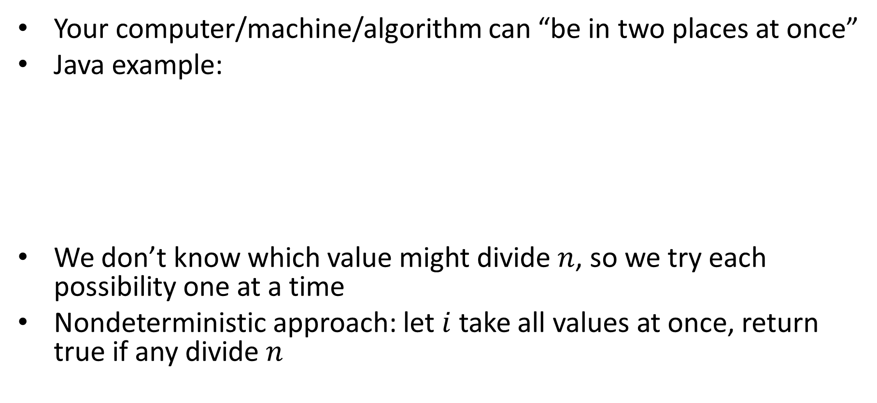
Nondeterminism in computation
Your computer/machine/algorithm can “be in two places at once”
Java example:
We don’t know which value might divide $n$, so we try each possibility one at a time
Nondeterministic approach: let $i$ take all values at once, return true if any divide $n$

Slide 29
Nondeterminism if Automata
Your machine can be in multiple states at once
Accepts if any of the states it ends in are accepting states
Relax restrictions:
Exactly one transition per symbol (can make multiple without consuming a symbol)
There must be exactly one outgoing transition for each symbol for every state (will allow 0 to many of them)
Keep restriction:
One start state

Slide 30




















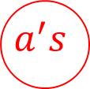





Back to Reversal
$$b$$
$$b$$
$$a^{′}s$$
$$b^{′}s$$
$$b$$
$$a^{′}s$$
$$b^{′}s$$
$$b$$
Reversed
$$a$$
$$a$$
$$a$$
$$a$$
$$trash$$
$$trash$$
$$a,b$$
$$a,b$$
$$b$$
$$a^{′}s$$
$$b^{′}s$$
$$b$$
$$a$$
$$a$$
$$ε$$
$$ε$$
$$trash$$
$$a,b$$
start

Slide 31

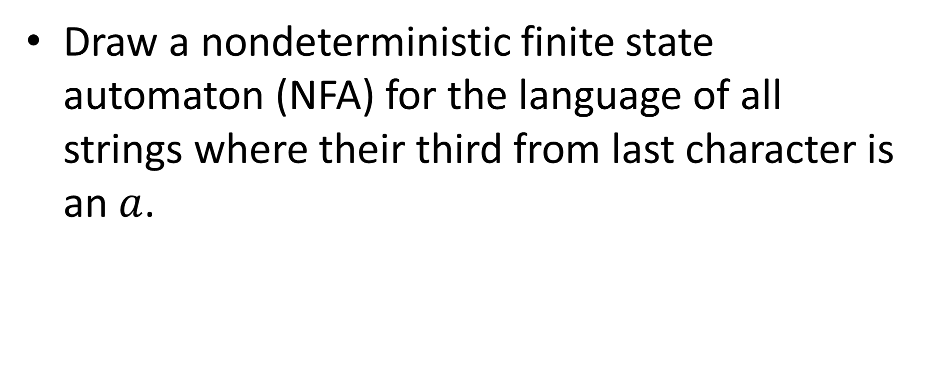







$a$ is Third From Last
Draw a nondeterministic finite state automaton (NFA) for the language of all strings where their third from last character is an $a$.
$$a,b$$
start
$$a$$
$$1$$
$$2$$
$$a$$
$$a,b$$
$$a,b$$

Slide 32


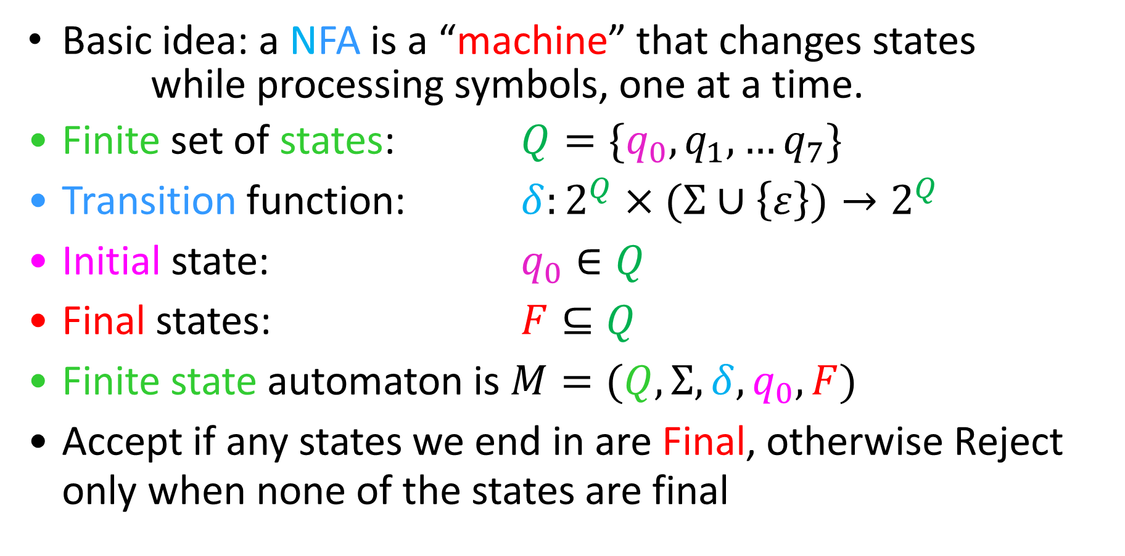
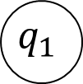

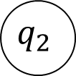
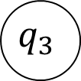
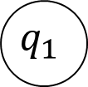
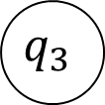
Nondeterministic Finite State Automata
Basic idea: a NFA is a “machine” that changes states
while processing symbols, one at a time.
Finite set of states: $Q=\{q_{0},q_{1},…q_{7}\}$
Transition function: $δ:2^{Q}×(Σ∪\left\{ε\right\})→2^{Q}$
Initial state: $q_{0}∈Q$
Final states: $F⊆Q$
Finite state automaton is $M=(Q, Σ, δ, q_{0}, F)$
Accept if any states we end in are Final, otherwise Reject only when none of the states are final
$$q_{1}$$
$$q_{1}$$
$$a$$
$$q_{2}$$
$$q_{0}$$
$$q_{k}$$
$$a$$
$$q_{3}$$
$$ε$$
$$q_{3}$$

