Slide 1
CS3102 Theory of Computation

Slide 2
Closure Properties of Regular Languages
Complement
Intersection
Union
Difference
Reversal
Concatenation

Slide 3
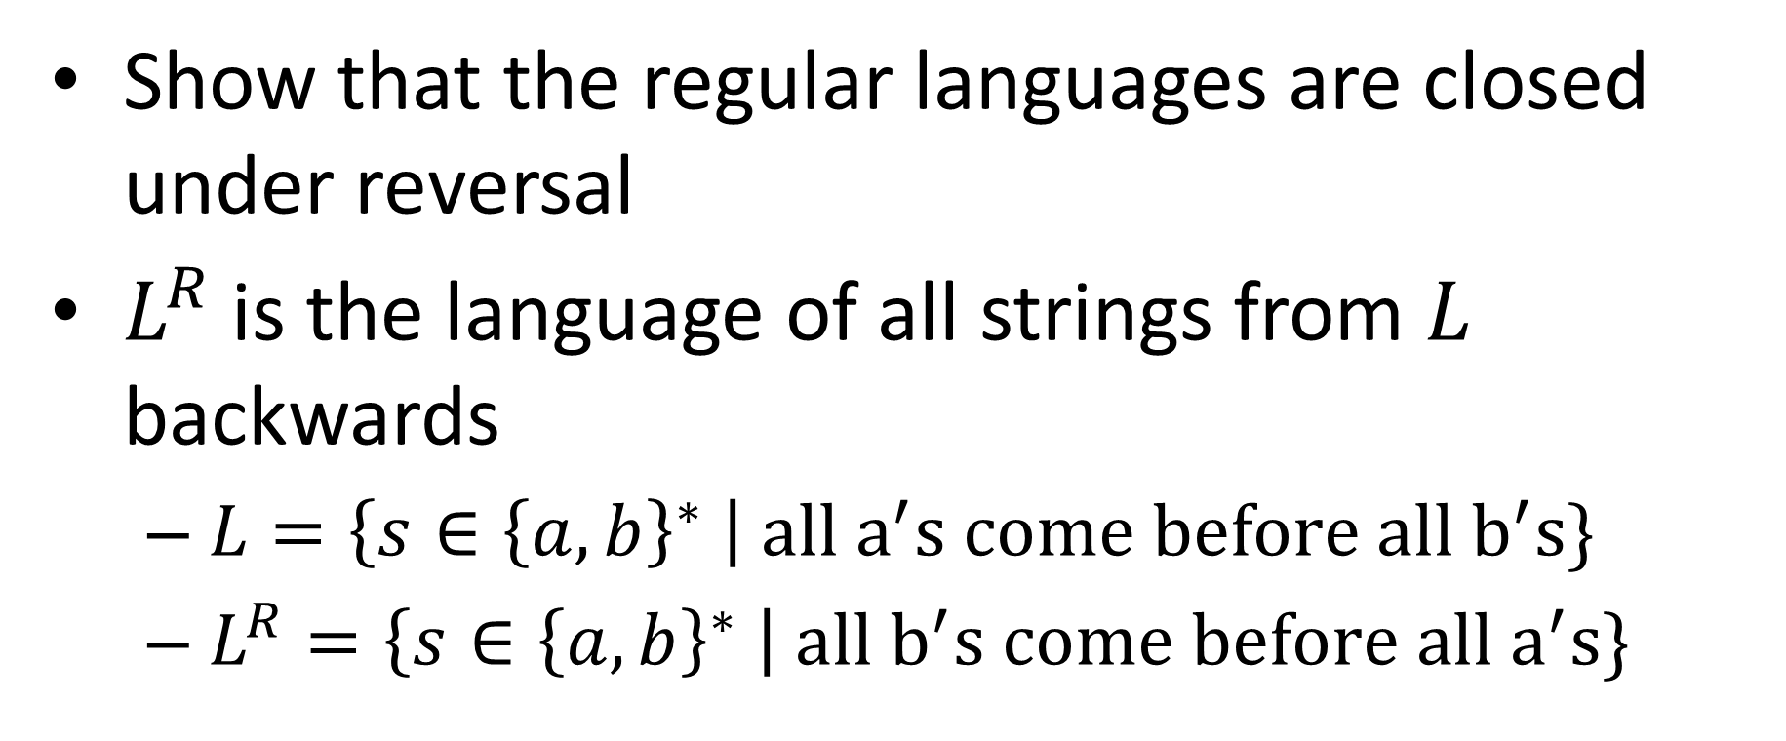
Closed Under reversal
Show that the regular languages are closed under reversal
$L^{R}$ is the language of all strings from $L$ backwards
$L=\left\{s∈{\left\{a,b\right\}}^{∗} \right| all a^{′}s come before all b^{′}s\}$
$L^{R}=\left\{s∈{\left\{a,b\right\}}^{∗} \right| all b^{′}s come before all a^{′}s\}$

Slide 4

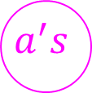






Let’s Draw it!
$$\left\{s∈{\left\{a,b\right\}}^{∗} \right| all a^{′}s come before all b^{′}s\}$$
$$b$$
$$a^{′}s$$
$$b^{′}s$$
$$b$$
$$a$$
$$a$$
$$trash$$
$$a,b$$

Slide 5






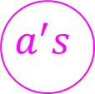








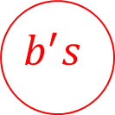
How to do reversal
“reverse” the automaton
Final states become start states
Start state becomes final
Reverse direction of all arrows
Problem(s)?
$$b$$
$$b$$
$$a^{′}s$$
$$b^{′}s$$
$$b$$
$$a^{′}s$$
$$b^{′}s$$
$$b$$
Reversed
$$a$$
$$a$$
$$a$$
$$a$$
$$trash$$
$$trash$$
$$a,b$$
$$a,b$$

Slide 6


Nondeterminism
Driving to a friend’s house
Friend forgets to mention a fork in the directions
Which way do you go?
Why not both?
?

Slide 7
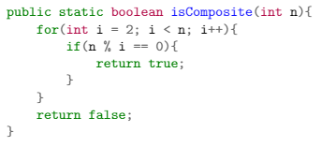
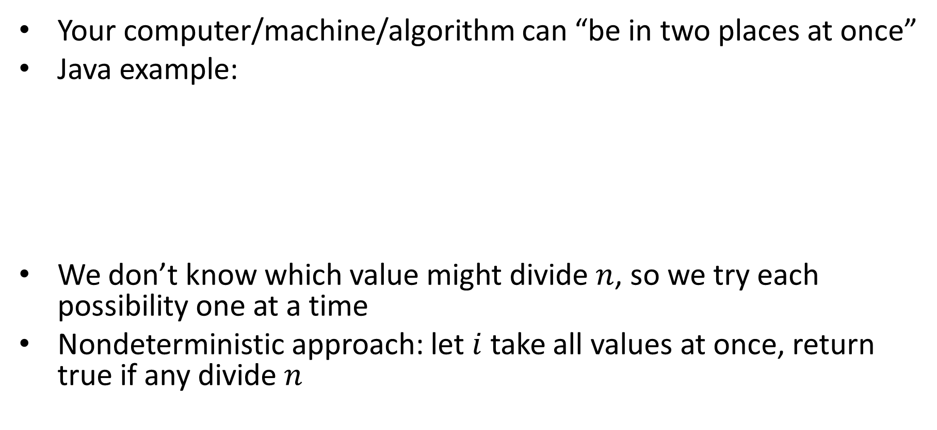
Nondeterminism in computation
Your computer/machine/algorithm can “be in two places at once”
Java example:
We don’t know which value might divide $n$, so we try each possibility one at a time
Nondeterministic approach: let $i$ take all values at once, return true if any divide $n$

Slide 8
Nondeterminism in Automata
Your machine can be in multiple states at once
Accepts if any if the states it ends in are accepting states
Relax restrictions:
Exactly one transition per symbol (can make multiple without consuming a symbol)
There must be exactly one outgoing transition for each symbol for every state (will allow 0 to many of them)
Keep restriction:
One start state

Slide 9




















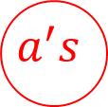





Back to Reversal
$$b$$
$$b$$
$$a^{′}s$$
$$b^{′}s$$
$$b$$
$$a^{′}s$$
$$b^{′}s$$
$$b$$
Reversed
$$a$$
$$a$$
$$a$$
$$a$$
$$trash$$
$$trash$$
$$a,b$$
$$a,b$$
$$b$$
$$a^{′}s$$
$$b^{′}s$$
$$b$$
$$a$$
$$a$$
$$ε$$
$$ε$$
$$trash$$
$$a,b$$
start

Slide 10

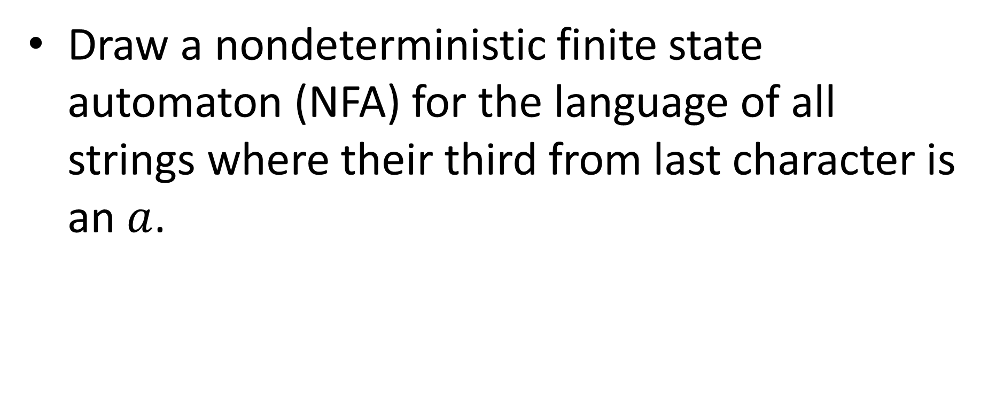







$a$ is Third From Last
Draw a nondeterministic finite state automaton (NFA) for the language of all strings where their third from last character is an $a$.
$$a,b$$
start
$$a$$
$$1$$
$$2$$
$$a$$
$$a,b$$
$$a,b$$

Slide 11


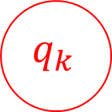

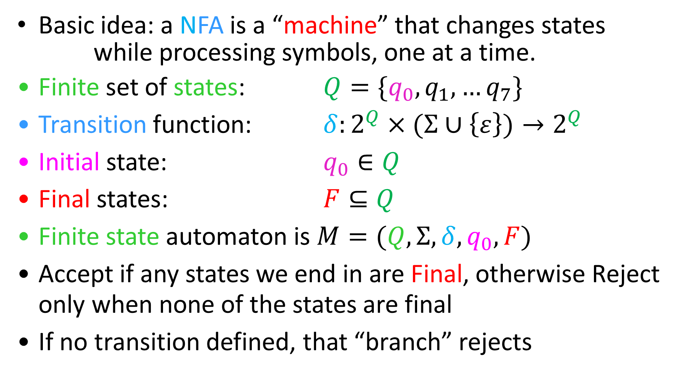
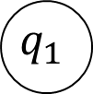

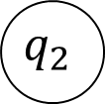
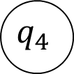
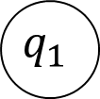
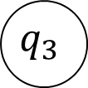
Nondeterministic Finite State Automata
Basic idea: a NFA is a “machine” that changes states
while processing symbols, one at a time.
Finite set of states: $Q=\{q_{0},q_{1},…q_{7}\}$
Transition function: $δ:2^{Q}×(Σ∪\left\{ε\right\})→2^{Q}$
Initial state: $q_{0}∈Q$
Final states: $F⊆Q$
Finite state automaton is $M=(Q, Σ, δ, q_{0}, F)$
Accept if any states we end in are Final, otherwise Reject only when none of the states are final
If no transition defined, that “branch” rejects
$$q_{1}$$
$$q_{1}$$
$$a$$
$$q_{2}$$
$$q_{0}$$
$$q_{k}$$
$$a$$
$$q_{3}$$
$$ε$$
$$q_{4}$$

Slide 12


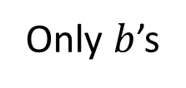






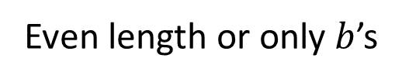




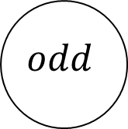





Union using Non-Determinism
$$M_{1}$$
ε
ε
Introduce a new start state, $ε$ transition to original start states.
$$M_{2}$$
$$a,b$$
$$odd$$
$$even$$
$$ε$$
$$a$$
$$∪$$
$$a,b$$
$$trash$$
$$odd$$
start
$$a,b$$
$$b^{′}s$$
$$even$$
$$=$$
$$a$$
$$ε$$
$$b^{′}s$$
$$trash$$
$$b$$
$$a,b$$
$$a,b$$
$$b$$
Only $b$’s
Even length
Even length or only $b$’s
$$a,b$$

Slide 13
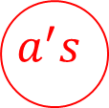


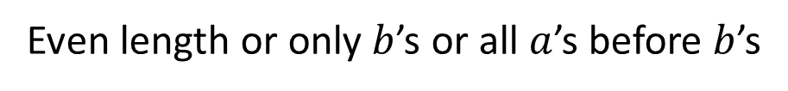





Union using Non-Determinism
Introduce a new start state, $ε$ transition to original start states.
$$a,b$$
$$odd$$
Even length or only $b$’s or all $a$’s before $b$’s
$$even$$
$$ε$$
start2
$$ε$$
start
$$a,b$$
$$a$$
$$ε$$
$$trash$$
$$ε$$
$$b^{′}s$$
$$b$$
$$a^{′}s$$
$$b^{′}s$$
$$b$$
$$b$$
$$a,b$$
$$a$$

Slide 14

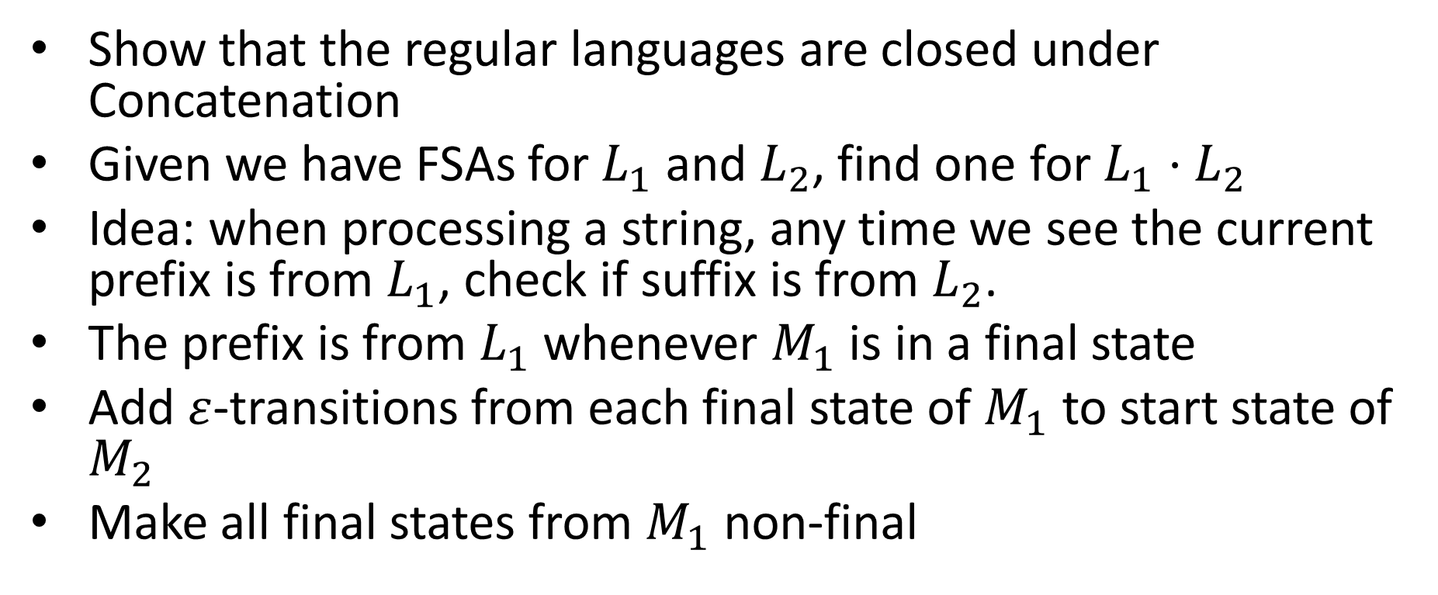

Closed Under Concatenation
ε
$$M_{2}$$
$$M_{1}$$
ε
Show that the regular languages are closed under Concatenation
Given we have FSAs for $L_{1}$ and $L_{2}$, find one for $L_{1}⋅L_{2}$
Idea: when processing a string, any time we see the current prefix is from $L_{1}$, check if suffix is from $L_{2}$.
The prefix is from $L_{1}$ whenever $M_{1}$ is in a final state
Add $ε$-transitions from each final state of $M_{1}$ to start state of $M_{2}$
Make all final states from $M_{1}$ non-final

Slide 15




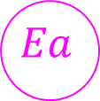






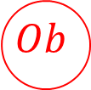





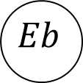



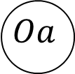
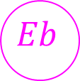

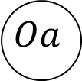

Example: EvenA$⋅$OddB
$$a$$
$$a$$
$$b$$
$$b$$
$$b$$
$$b$$
$$Ea$$
$$Oa$$
$$Ea$$
$$Oa$$
$$a$$
$$a$$
$$ε$$
$$b$$
$$b$$
$$a$$
$$a$$
$$a$$
$$a$$
$$Ob$$
$$Eb$$
$$Eb$$
$$Ob$$
$$b$$
$$b$$

Slide 16

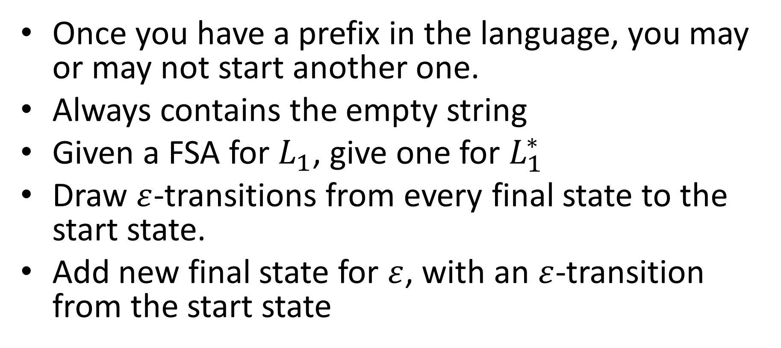
Closed under Kleene Star
ε
$$M_{1}$$
ε
ε
Once you have a prefix in the language, you may or may not start another one.
Always contains the empty string
Given a FSA for $L_{1}$, give one for $L_{1}^{∗}$
Draw $ε$-transitions from every final state to the start state.
Add new final state for $ε$, with an $ε$-transition from the start state

Slide 17




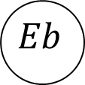






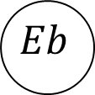







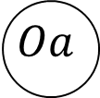

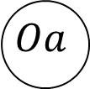







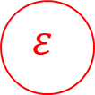
$${EvenAOddB}^{∗}$$
$$a$$
$$a$$
$$b$$
$$b$$
$$b$$
$$b$$
$$Ea$$
$$Oa$$
$$Ea$$
$$Oa$$
$$ε$$
$$a$$
$$a$$
$$ε$$
$$ε$$
$$ε$$
$$ε$$
$$b$$
$$b$$
$$a$$
$$a$$
$$a$$
$$a$$
$$Eb$$
$$Ob$$
$$Eb$$
$$Ob$$
$$b$$
$$b$$

Slide 18
NFAs = DFAs
We can convert any NFA into a DFA
Powerset Construction
Idea: Make a new DFA whose states each represent a subset of states from the original machine.

Slide 19
Nondeterministic Finite State Automata
Basic idea: a NFA is a “machine” that changes states
while processing symbols, one at a time.
Finite set of states: $Q=\{q_{0},q_{1},…q_{7}\}$
Transition function: $δ:2^{Q}×(Σ∪\left\{ε\right\})→2^{Q}$
Initial state: $q_{0}∈Q$
Final states: $F⊆Q$
Finite state automaton is $M=(Q, Σ, δ, q_{0}, F)$
Accept if any states we end in are Final, otherwise Reject only when none of the states are final
If no transition defined, that “branch” rejects
$$q_{1}$$
$$q_{1}$$
$$a$$
$$q_{2}$$
$$q_{0}$$
$$q_{k}$$
$$a$$
$$q_{3}$$
$$ε$$
$$q_{4}$$

Slide 20


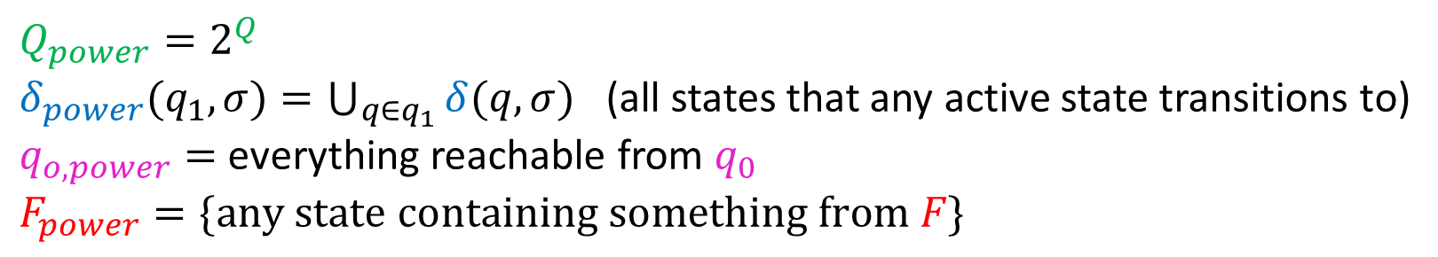
















Powerset Construction
$Q_{power}=2^{Q}$
$δ_{power}(q_{1}, σ)=\bigcup_{q∈q_{1}}{δ(q, σ)}$ (all states that any active state transitions to)
$q_{o,power}=$ everything reachable from $q_{0}$
$F_{power}=\{any state containing something from F\}$
$$∅$$
These states are
unreachable.
$$ε$$
$$b$$
2
$$1$$
$$2$$
$$3$$
1
$$b$$
$$a$$
$$a,b$$
$$1,2$$
$$2,3$$
$$1,3$$
$$b$$
$$a$$
3
$$a$$
$$1,2,3$$
$$a,b$$
$$b$$
Notes:
3 on a goes to 2
1 on a goes to 3
2 on a goes to 1, epsilon to 2
3 on b goes to 3 and 2
2 on b goes to 2
1 on b goes to 1 and 2

Slide 21
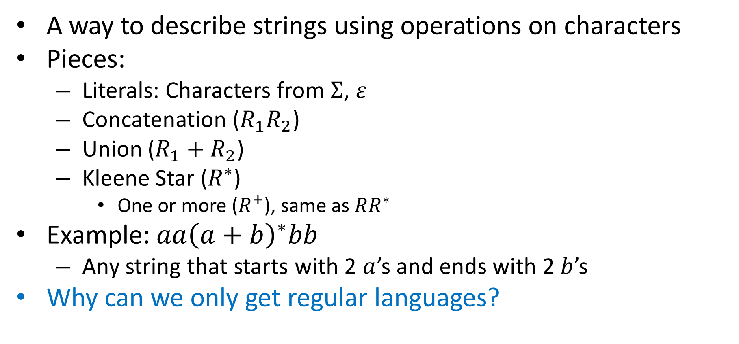
Regular Expressions
A way to describe strings using operations on characters
Pieces:
Literals: Characters from $Σ$, $ε$
Concatenation ($R_{1}R_{2}$)
Union ($R_{1}+R_{2}$)
Kleene Star ($R^{∗}$)
One or more ($R^{+}$), same as $RR^{∗}$
Example: $aa{\left(a+b\right)}^{∗}bb$
Any string that starts with 2 $a$’s and ends with 2 $b$’s
Why can we only get regular languages?
All finite languages are regular!
Preserves Regularity!
Preserves Regularity!
Preserves Regularity!
Preserves Regularity!

Slide 22
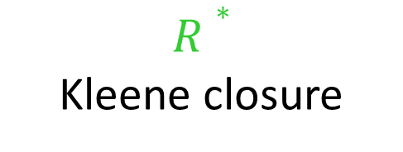

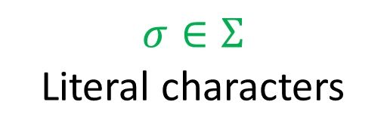
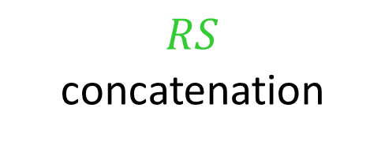

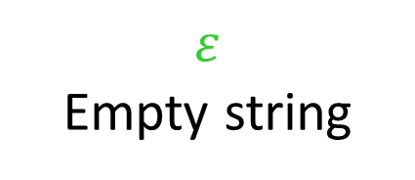
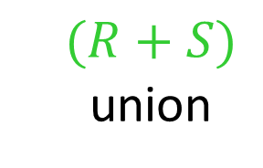




Regex to NFA
All literal regular expressions have an FSA:
$$ε$$
Empty string
$$σ∈Σ$$
Literal characters
q₀
q₀
$$σ$$
q₁
If regular expressions $R$ and $S$ have FSAs, then so do:
$$(R+S)$$
union
$$RS$$
concatenation
$$R∗$$
Kleene closure
$$M_{R}$$
ε
$$M_{S}$$
ε
$$M_{R}$$
ε
$$M_{R}$$
ε
ε
$$M_{S}$$
ε
ε

Slide 23
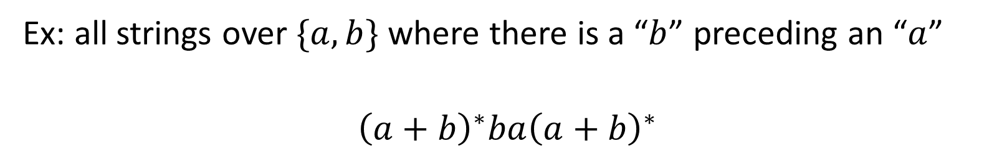
Regex to NFA
Ex: all strings over $\{a,b\}$ where there is a “$b$” preceding an “$a$”
$${\left(a+b\right)}^{∗}ba{\left(a+b\right)}^{∗}$$
ε
ε
ε
ε
a
a
a
a
ε
ε
ε
b
ε
ε
b
ε
a
a
ε
ε
ε
ε
ε
ε
ε
ε
ε
ε
ε
ε
ε
ε
ε
ε
b
b
b
b
ε
ε
ε
ε
ε
a
ε
a
ε
ε
ε
ε
b
ε
a
ε
ε
ε
ε
b
ε
ε
b
ε
Remove previous start/final states
ε

Slide 24
NFA to Regex

