Slide 1
CS3102 Theory of Computation

Slide 2
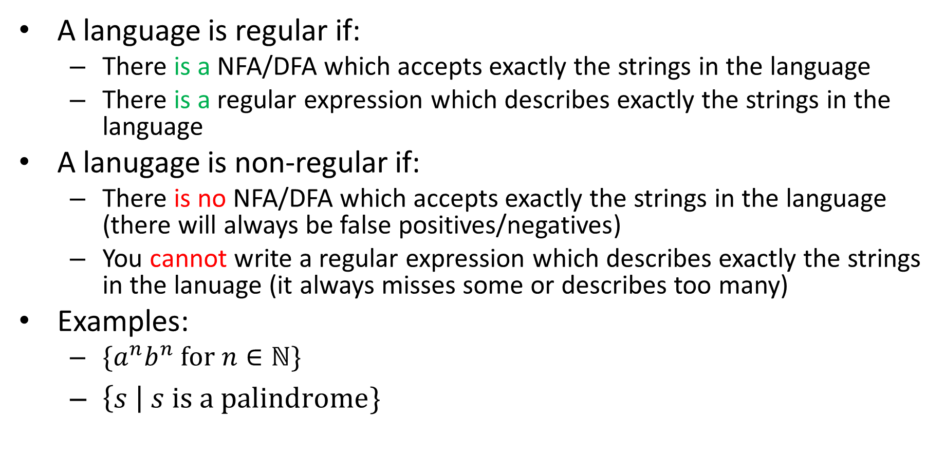
Non-regular Languages
A language is regular if:
There is a NFA/DFA which accepts exactly the strings in the language
There is a regular expression which describes exactly the strings in the language
A lanugage is non-regular if:
There is no NFA/DFA which accepts exactly the strings in the language (there will always be false positives/negatives)
You cannot write a regular expression which describes exactly the strings in the lanuage (it always misses some or describes too many)
Examples:
$\{a^{n}b^{n} for n∈ℕ\}$
$\left\{s \right| s is a palindrome\}$
Non-existence Proof!

Slide 3


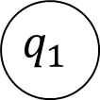
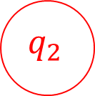
Proving Non-Regularity
For a language to be regular, there must be a DFA for it
That same DFA must work for every string in the language (no matter how long)
If the language is infinite, there must be some string in the language larger than the machine’s size
This long string it must visit at least one state twice on its way to the final state (pigeonhole principle)
Middle part
When “long” string $s$ is accepted
$$q_{0}$$
$$q_{1}$$
$$q_{2}$$
First part
Last part

Slide 4
“Pumping Lemma” Idea
Any infinite regular language has a “long” string
Any “long” string can be broken into 3 parts
A first part that takes you from start to some state
A middle part that takes you back to that same state
A last part that takes you to a final state
Copying the middle part (or skipping) still takes us from start to a final state
If we can’t break up a “long” string into these parts which allows us to “pump” the middle, the language isn’t regular
Middle part
When “long” string $s$ is accepted
$$q_{0}$$
$$q_{1}$$
$$q_{2}$$
First part
Last part

Slide 5
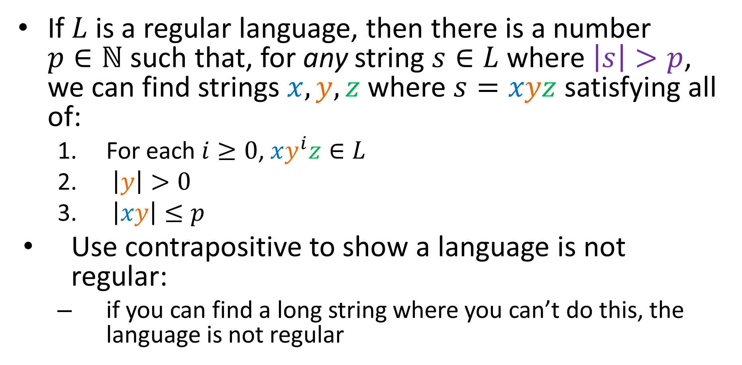
Pumping Lemma
If $L$ is a regular language, then there is a number $p∈ℕ$ such that, for any string $s∈L$ where $\left|s\right|>p$, we can find strings $x, y,z$ where $s=xyz$ satisfying all of:
For each $i≥0$, $xy^{i}z∈L$
$\left|y\right|>0$
$\left|xy\right|≤p$
Use contrapositive to show a language is not regular:
if you can find a long string where you can’t do this, the language is not regular

Slide 6
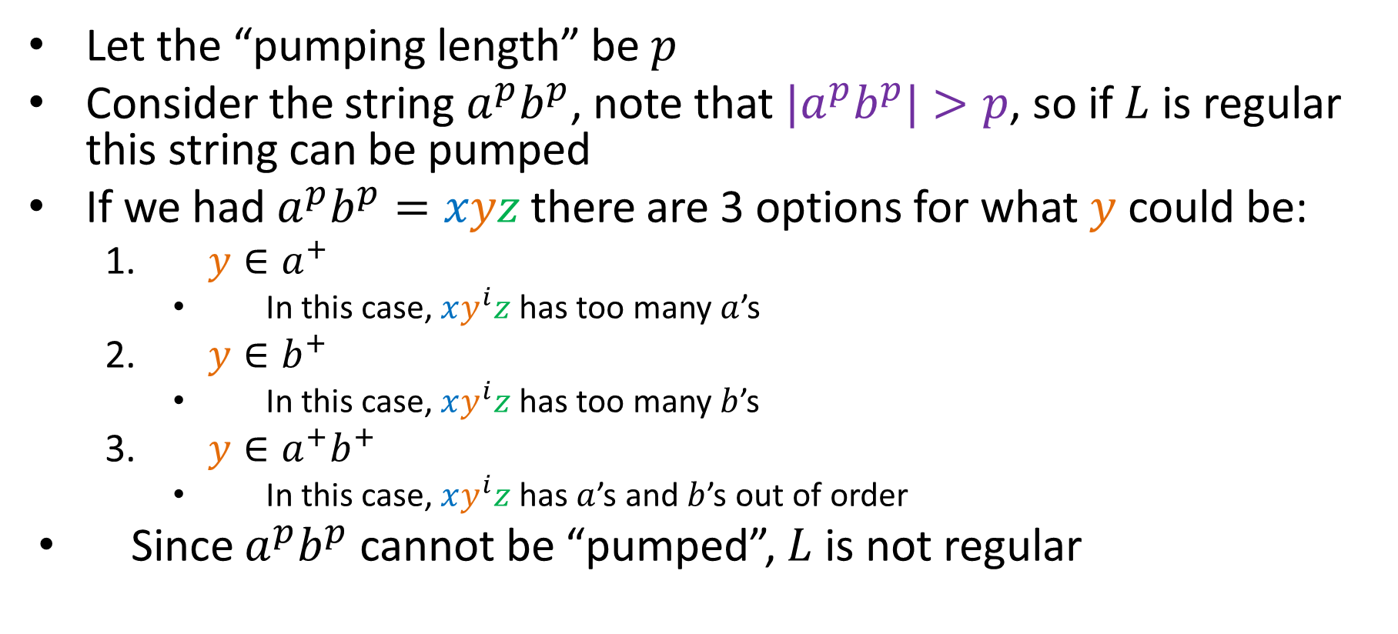

${L=a}^{n}b^{n}$ is not regular
Let the “pumping length” be $p$
Consider the string $a^{p}b^{p}$, note that ${|a}^{p}b^{p}|>p$, so if $L$ is regular this string can be pumped
If we had $a^{p}b^{p}=xyz$ there are 3 options for what $y$ could be:
$y∈a^{+}$
In this case, $xy^{i}z$ has too many $a$’s
$y∈b^{+}$
In this case, $xy^{i}z$ has too many $b$’s
$y∈a^{+}b^{+}$
In this case, $xy^{i}z$ has $a$’s and $b$’s out of order
Since $a^{p}b^{p}$ cannot be “pumped”, $L$ is not regular

Slide 7
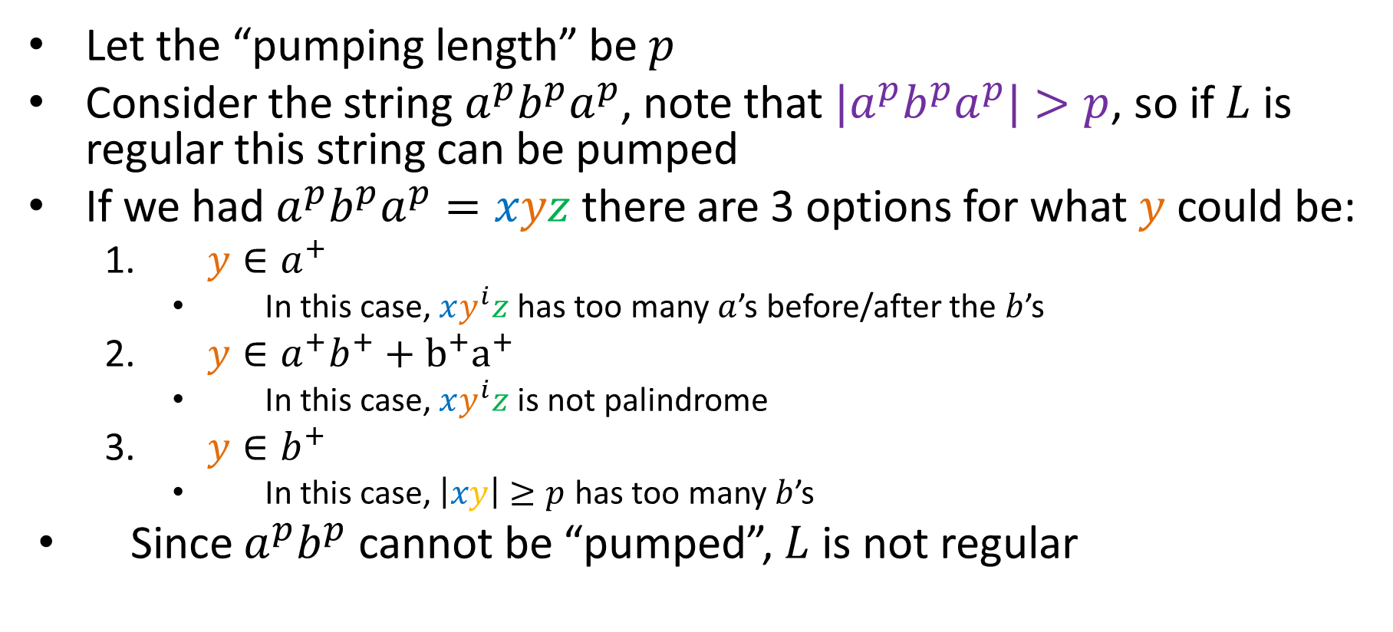
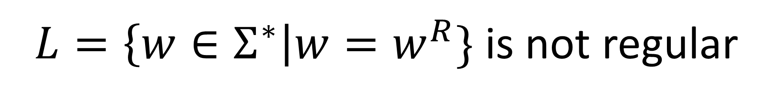
$L=\left\{w∈Σ^{∗}\right|w=w^{R}\}$ is not regular
Let the “pumping length” be $p$
Consider the string $a^{p}b^{p}a^{p}$, note that ${|a}^{p}b^{p}a^{p}|>p$, so if $L$ is regular this string can be pumped
If we had $a^{p}b^{p}a^{p}=xyz$ there are 3 options for what $y$ could be:
$y∈a^{+}$
In this case, $xy^{i}z$ has too many $a$’s before/after the $b$’s
$y∈a^{+}b^{+}+b^{+}a^{+}$
In this case, $xy^{i}z$ is not palindrome
$y∈b^{+}$
In this case, $\left|xy\right|≥p$ has too many $b$’s
Since $a^{p}b^{p}$ cannot be “pumped”, $L$ is not regular

Slide 8
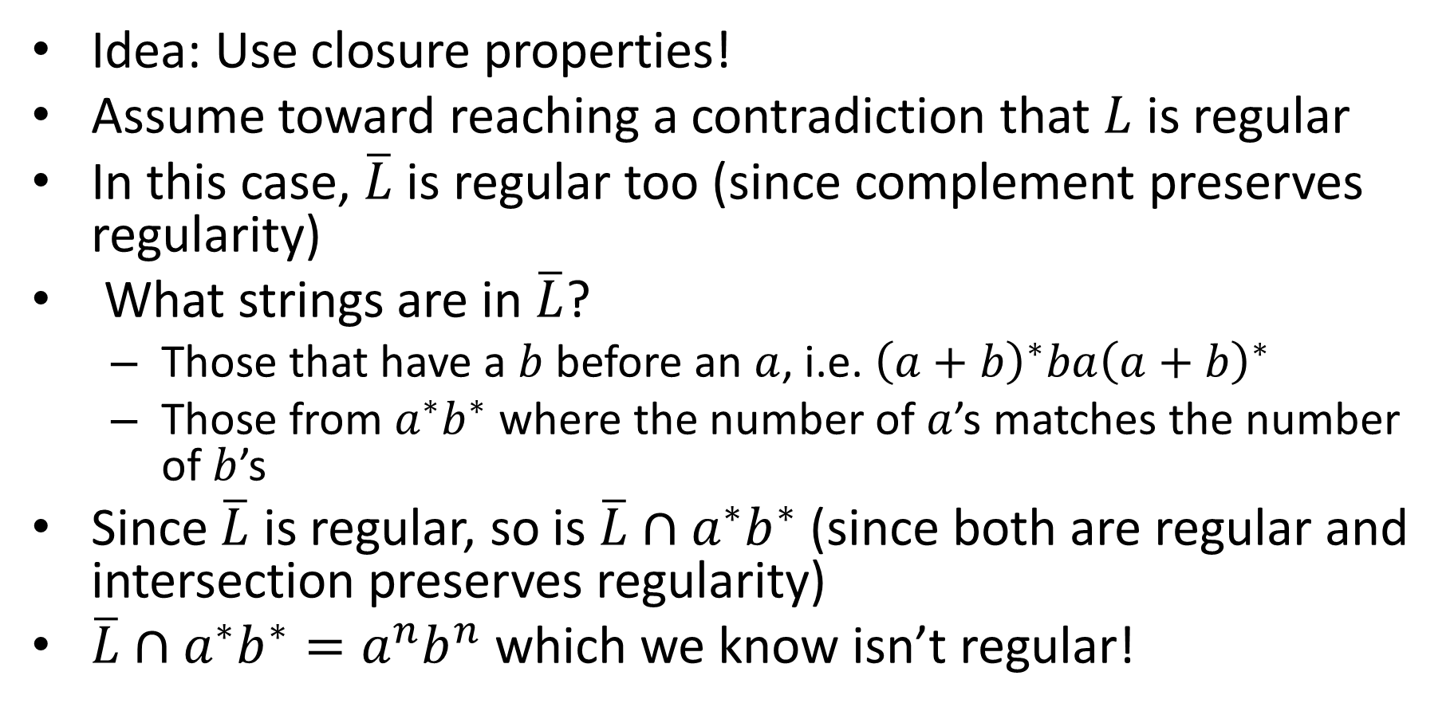
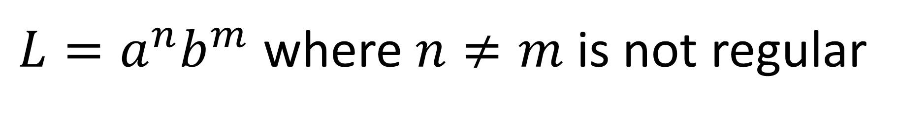
${L=a}^{n}b^{m}$ where $n≠m$ is not regular
Idea: Use closure properties!
Assume toward reaching a contradiction that $L$ is regular
In this case, $\overline{L}$ is regular too (since complement preserves regularity)
What strings are in $\overline{L}$?
Those that have a $b$ before an $a$, i.e. ${\left(a+b\right)}^{∗}ba{\left(a+b\right)}^{∗}$
Those from $a^{∗}b^{∗}$ where the number of $a$’s matches the number of $b$’s
Since $\overline{L}$ is regular, so is $\overline{L}∩a^{∗}b^{∗}$ (since both are regular and intersection preserves regularity)
$\overline{L}∩a^{∗}b^{∗}=a^{n}b^{n}$ which we know isn’t regular!

Slide 9

Pumpable $≠$ Regular
The pumping lemma can only be used to show NON-regularity
If this languages is not pumpable, then it is not regular
The pumping lamma cannot be used to prove a language is regular
Some non-regular languages are pumpable

Slide 10
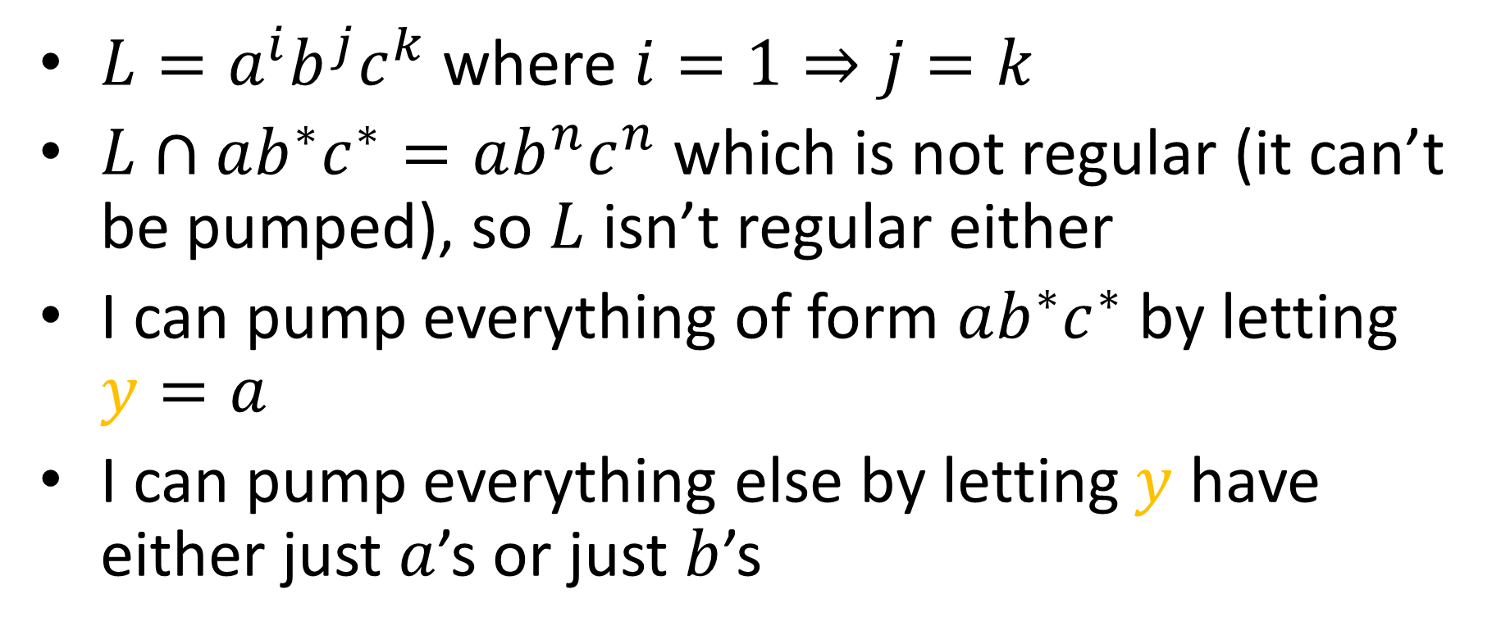
A pumpable non-regular language
$L=a^{i}b^{j}c^{k}$ where $i=1⇒j=k$
$L∩ab^{∗}c^{∗}=ab^{n}c^{n}$ which is not regular (it can’t be pumped), so $L$ isn’t regular either
I can pump everything of form $ab^{∗}c^{∗}$ by letting $y=a$
I can pump everything else by letting $y$ have either just $a$’s or just $b$’s

Slide 11

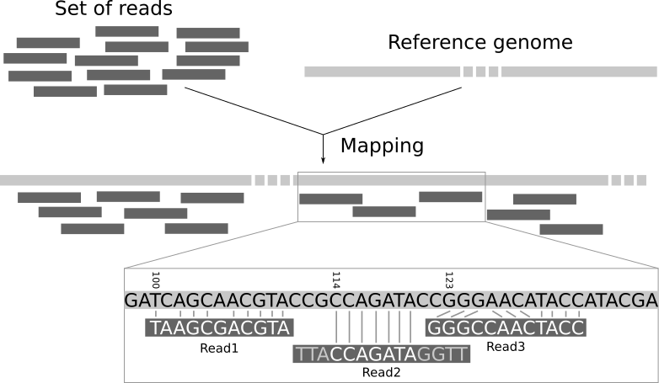

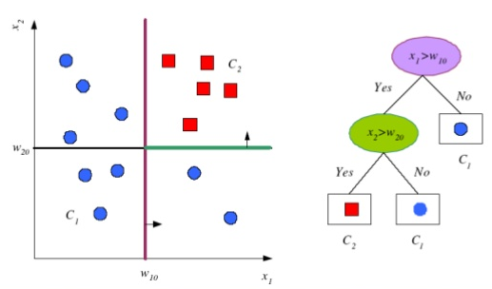

Regexes/NFAs in Applications
Bioinformatics
Read alignment
Virus scanning
ClamAV
Natural Language processing
Part-of-speech tagging
Machine Learning
Decision Tree models
High Energy Physics
Particle collider path tracing

Slide 12
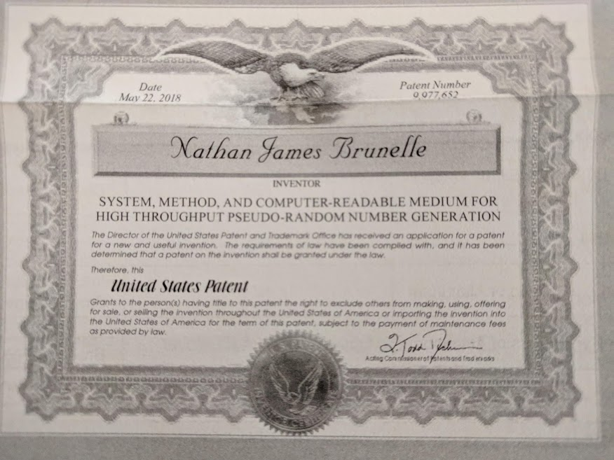

Slide 13
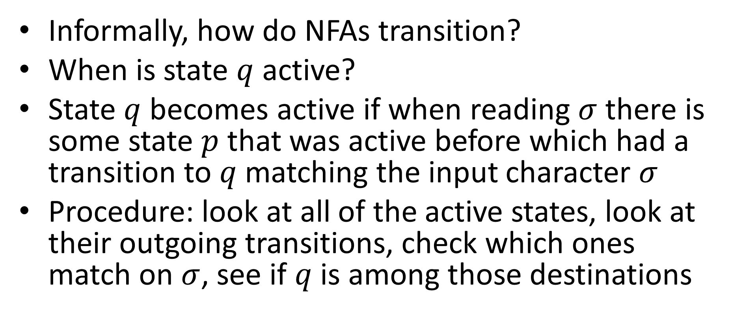
High-performance NFA simulation
Informally, how do NFAs transition?
When is state $q$ active?
State $q$ becomes active if when reading $σ$ there is some state $p$ that was active before which had a transition to $q$ matching the input character $σ$
Procedure: look at all of the active states, look at their outgoing transitions, check which ones match on $σ$, see if $q$ is among those destinations

Slide 14

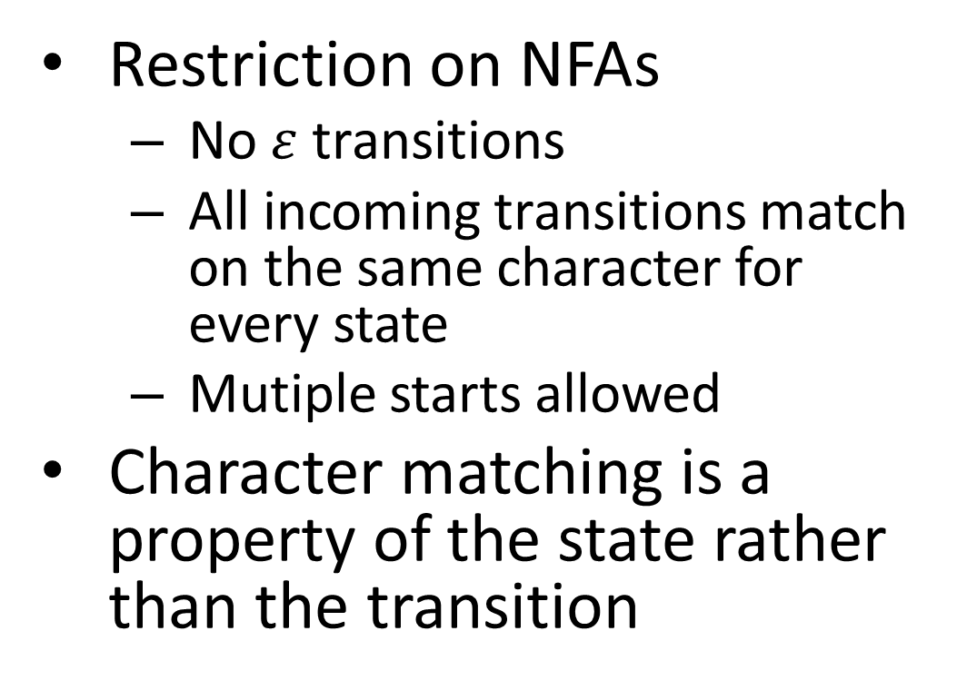
Homogeneous NFAs
Restriction on NFAs
No $ε$ transitions
All incoming transitions match on the same character for every state
Mutiple starts allowed
Character matching is a property of the state rather than the transition
$$ε$$
2
1
1,2
1
a
a
a
a
$$q_{a}$$
a
$$q$$
b
b
b
b
$$q_{b}$$
b

Slide 15

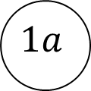


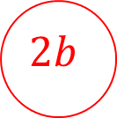

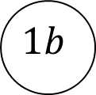

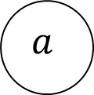



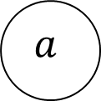

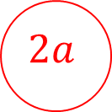
Example: $a$ is third from last
$$a,b$$
start
$$a$$
$$1$$
$$2$$
$$a$$
$$a,b$$
$$a,b$$
start$a$
$$2a$$
$$1a$$
$$a$$
start$b$
$$1b$$
$$2b$$

Slide 16
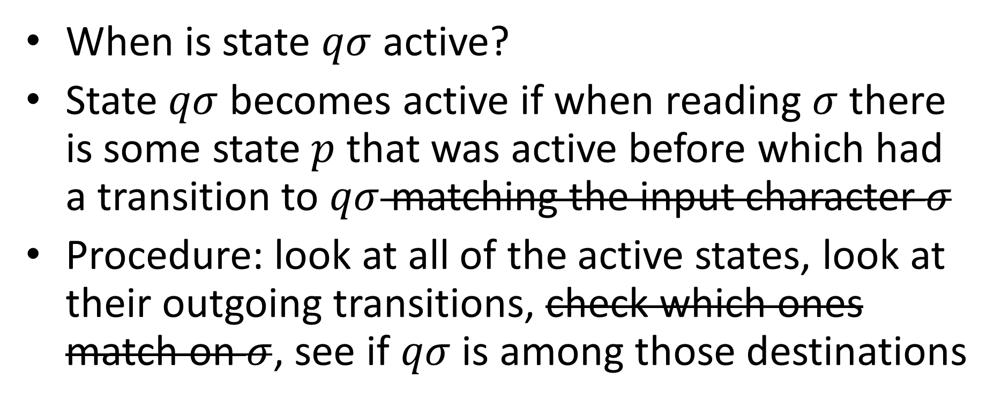
Homgeneous NFA transition
When is state $qσ$ active?
State $qσ$ becomes active if when reading $σ$ there is some state $p$ that was active before which had a transition to $qσ$ matching the input character $σ$
Procedure: look at all of the active states, look at their outgoing transitions, check which ones match on $σ$, see if $qσ$ is among those destinations

Slide 17
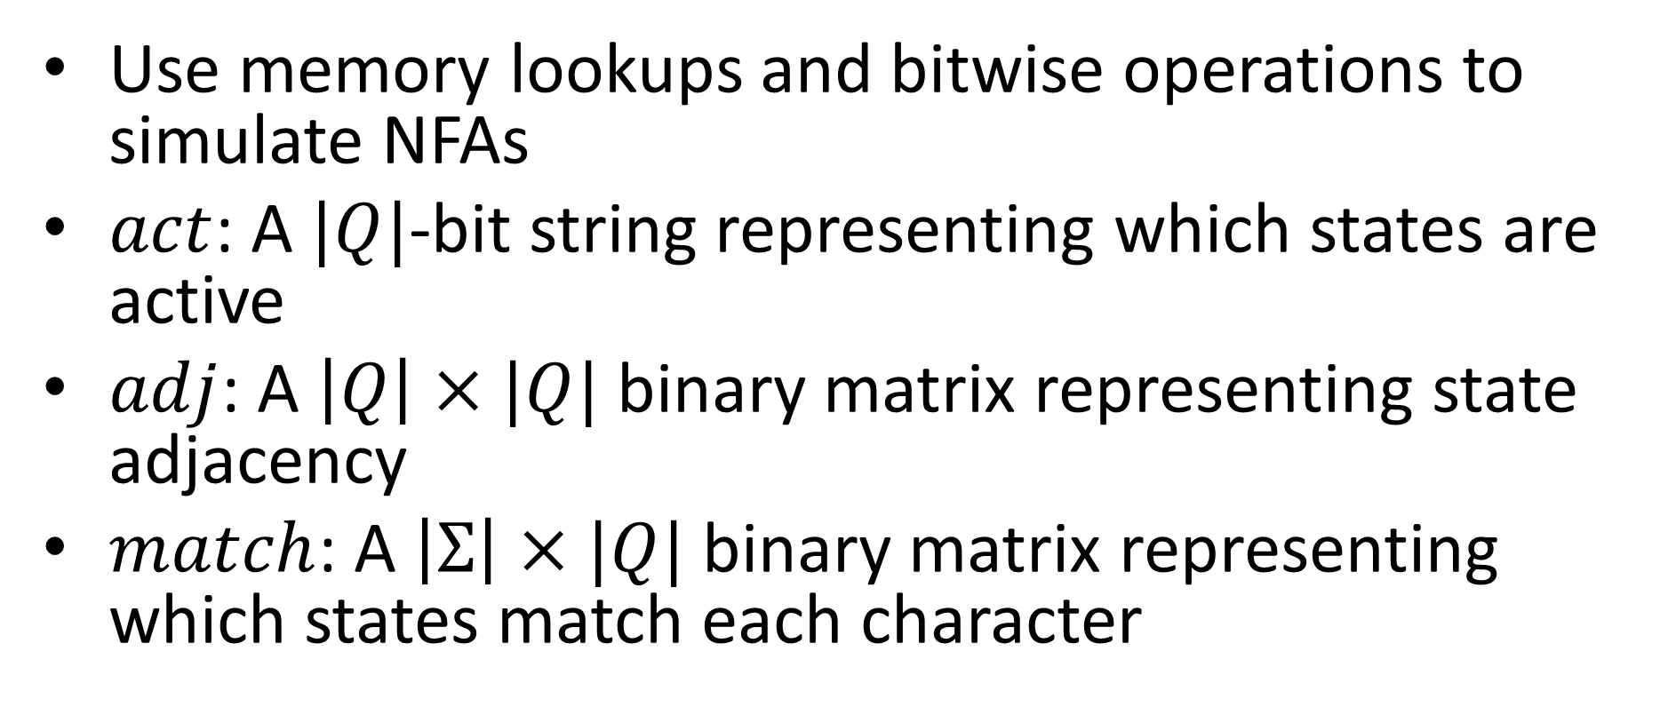
Bit Parallel Execution
Use memory lookups and bitwise operations to simulate NFAs
$act$: A $|Q|$-bit string representing which states are active
$adj$: A $\left|Q\right|×|Q|$ binary matrix representing state adjacency
$match$: A $\left|Σ\right|×|Q|$ binary matrix representing which states match each character

Slide 18
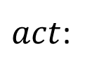
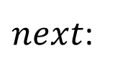


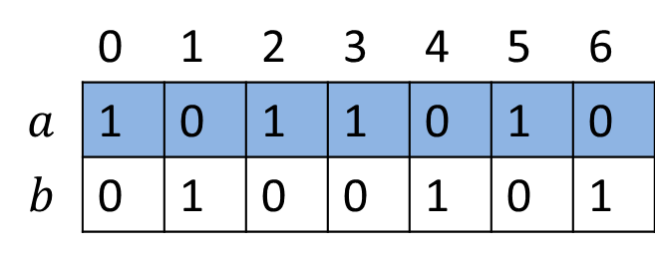



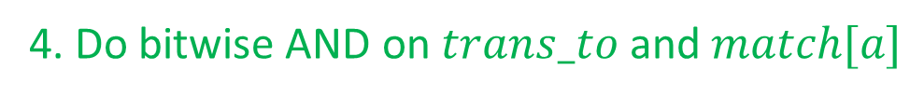



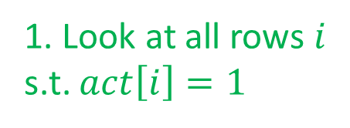
Example: $a$ is third from last
0a
$$5a$$
 | 0 | 1 | 2 | 3 | 4 | 5 | 6
0 | 1 | 1 | 1 | 0 | 0 | 0 | 0
1 | 1 | 1 | 1 | 0 | 0 | 0 | 0
2 | 0 | 0 | 0 | 1 | 1 | 0 | 0
3 | 0 | 0 | 0 | 0 | 0 | 1 | 1
4 | 0 | 0 | 0 | 0 | 0 | 1 | 1
5 | 0 | 0 | 0 | 0 | 0 | 0 | 0
6 | 0 | 0 | 0 | 0 | 0 | 0 | 0
$$3a$$
$$adj:$$
$$2a$$
1. Look at all rows $i$ s.t. $act\left[i\right]=1$
1b
$$4b$$
$$6b$$
0 | 1 | 2 | 3 | 4 | 5 | 6
1 | 1 | 0 | 0 | 0 | 0 | 0
0. Start with which states are active
$act$:
3. Look up states matching current input
 | 0 | 1 | 2 | 3 | 4 | 5 | 6
$$a$$ | 1 | 0 | 1 | 1 | 0 | 1 | 0
$$b$$ | 0 | 1 | 0 | 0 | 1 | 0 | 1
$$match:$$
$$trans_to:$$
1 | 1 | 1 | 0 | 0 | 0 | 0
2. Do bitwise OR on those rows to get adjacent states
0 | 1 | 2 | 3 | 4 | 5 | 6
1 | 0 | 1 | 0 | 0 | 0 | 0
$next$:
4. Do bitwise AND on $trans_to$ and $match[a]$

Slide 19
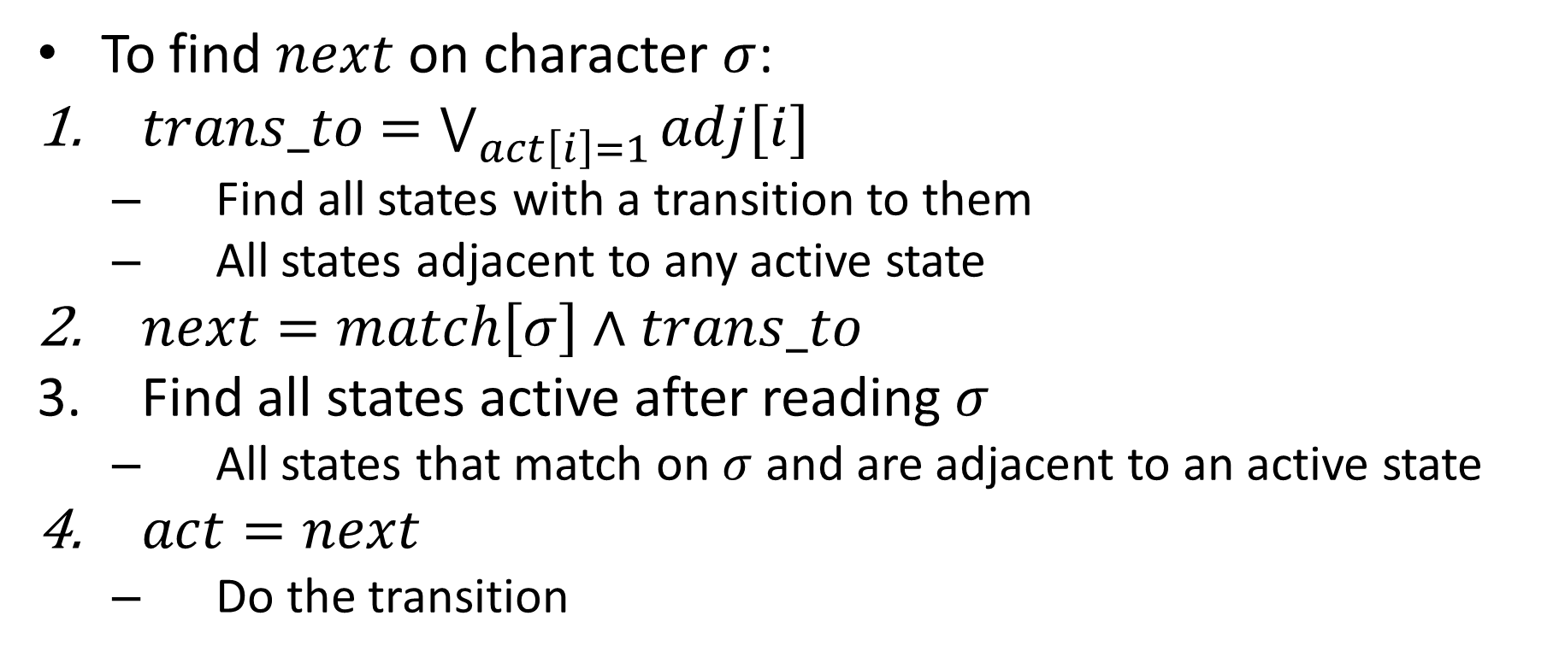
Bit Parallel Algorithm
To find $next$ on character $σ$:
$trans_to$ $=\bigvee_{act\left[i\right]=1}{adj[i]}$
Find all states with a transition to them
All states adjacent to any active state
$next=match\left[σ\right]∧trans_to$
Find all states active after reading $σ$
All states that match on $σ$ and are adjacent to an active state
$act=next$
Do the transition

