Slide 1
CS3102 Theory of Computation
What happens if I try to use the complement construction for DFAs on NFAs?
If I invert the accepting/rejectings states of a NFA, will its language become the complement, why or why not?

Slide 2
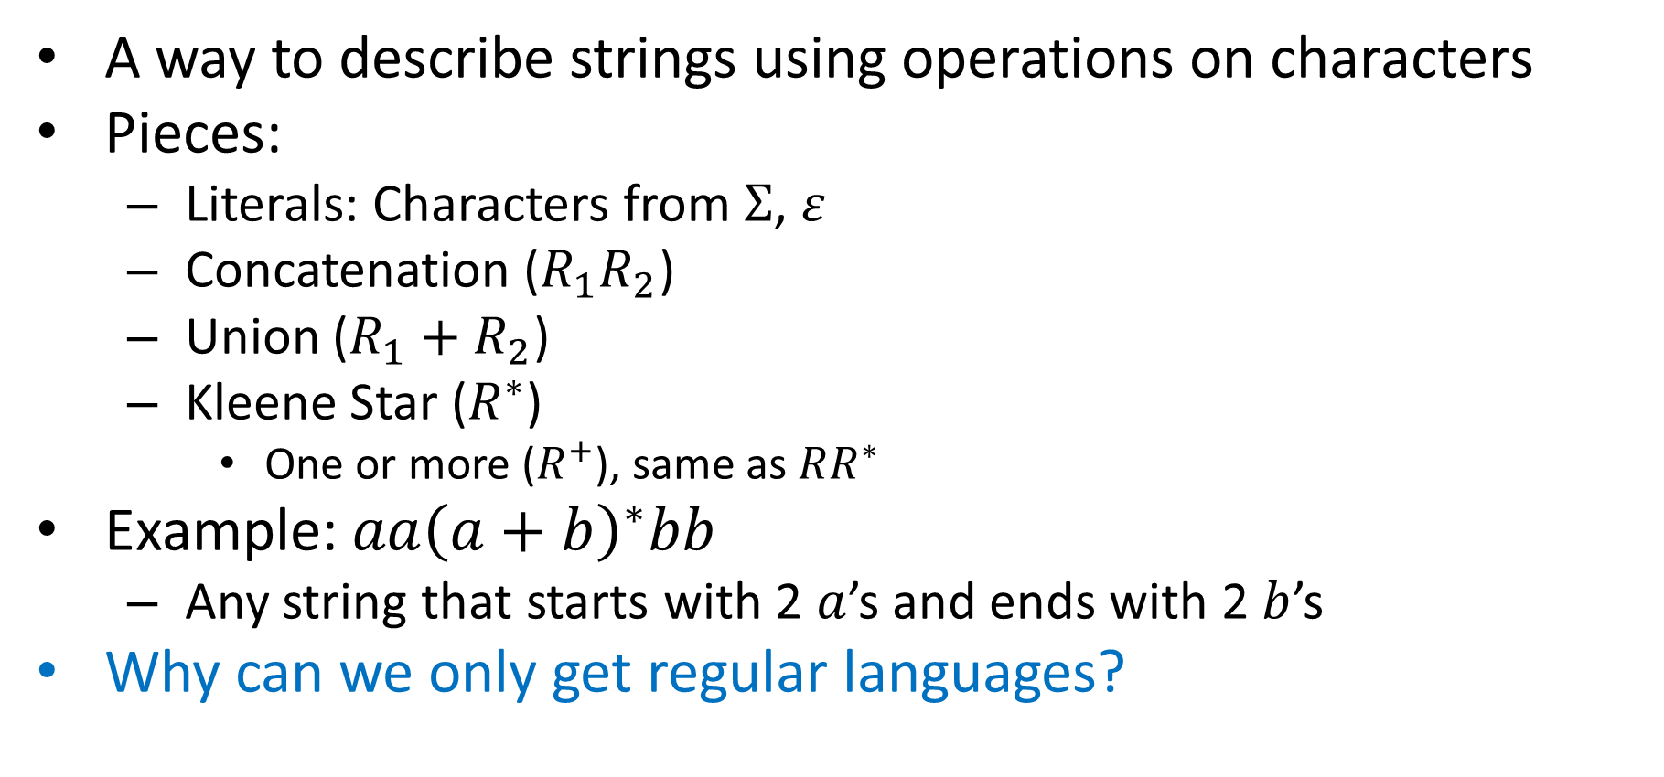
Regular Expressions
A way to describe strings using operations on characters
Pieces:
Literals: Characters from $Σ$, $ε$
Concatenation ($R_{1}R_{2}$)
Union ($R_{1}+R_{2}$)
Kleene Star ($R^{∗}$)
One or more ($R^{+}$), same as $RR^{∗}$
Example: $aa{\left(a+b\right)}^{∗}bb$
Any string that starts with 2 $a$’s and ends with 2 $b$’s
Why can we only get regular languages?
All finite languages are regular!
Preserves Regularity!
Preserves Regularity!
Preserves Regularity!
Preserves Regularity!

Slide 3
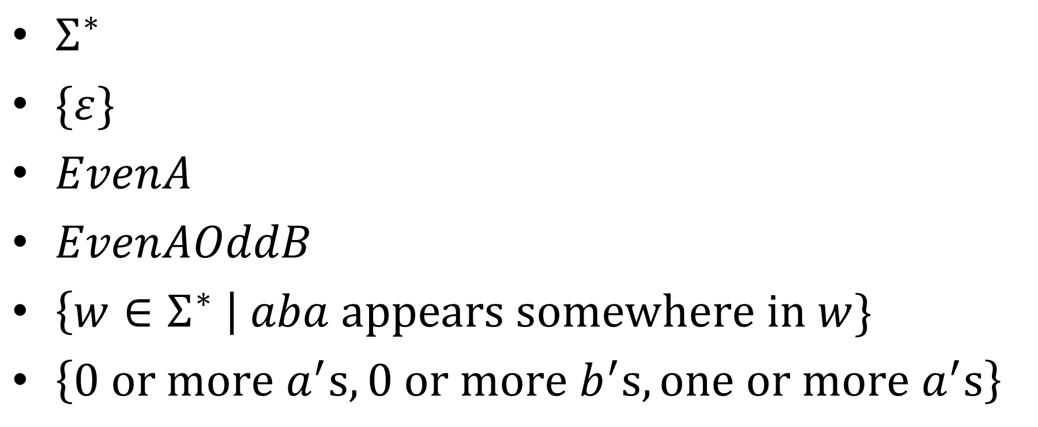
Give Regular Expressions
$Σ^{∗}$
$\{ε\}$
$EvenA$
$EvenAOddB$
$\left\{w∈Σ^{∗} \right| aba appears somewhere in w\}$
$\left\{0 or more a^{′}s, 0 or more b^{′}s, one or more a^{′}s\right\}$

Slide 4
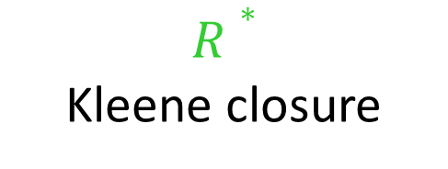

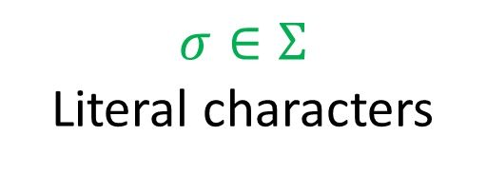
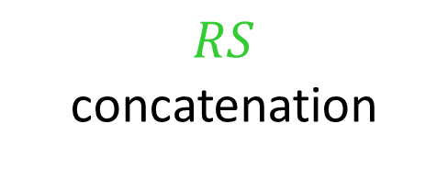

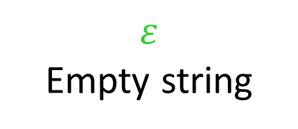
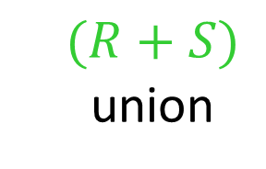




Regex to NFA
All literal regular expressions have an FSA:
$$ε$$
Empty string
$$σ∈Σ$$
Literal characters
q₀
q₀
$$σ$$
q₁
If regular expressions $R$ and $S$ have FSAs, then so do:
$$(R+S)$$
union
$$RS$$
concatenation
$$R∗$$
Kleene closure
$$M_{R}$$
ε
$$M_{S}$$
ε
$$M_{R}$$
ε
$$M_{R}$$
ε
ε
$$M_{S}$$
ε
ε

Slide 5
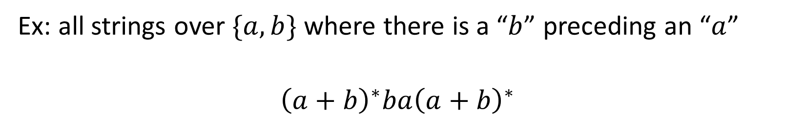
Regex to NFA
Ex: all strings over $\{a,b\}$ where there is a “$b$” preceding an “$a$”
$${\left(a+b\right)}^{∗}ba{\left(a+b\right)}^{∗}$$
ε
ε
ε
ε
a
a
a
a
ε
ε
ε
b
ε
ε
b
ε
a
a
ε
ε
ε
ε
ε
ε
ε
ε
ε
ε
ε
ε
ε
ε
ε
ε
b
b
b
b
ε
ε
ε
ε
ε
a
ε
a
ε
ε
ε
ε
b
ε
a
ε
ε
ε
ε
b
ε
ε
b
ε
Remove previous start/final states
ε

Slide 6
NFA to Regex
Idea: Make transitions match on regular expressions rather than characters, eliminate states until there is just one transition left, the regex that this transition matches will be the regex for that machine
We won’t go over details (less important than the other direction). Book shows this in Lemma 1.60.

Slide 7
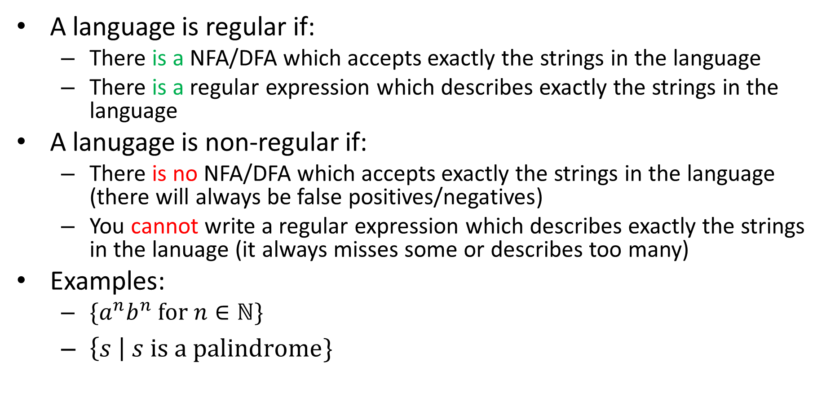
Non-regular Languages
A language is regular if:
There is a NFA/DFA which accepts exactly the strings in the language
There is a regular expression which describes exactly the strings in the language
A lanugage is non-regular if:
There is no NFA/DFA which accepts exactly the strings in the language (there will always be false positives/negatives)
You cannot write a regular expression which describes exactly the strings in the lanuage (it always misses some or describes too many)
Examples:
$\{a^{n}b^{n} for n∈ℕ\}$
$\left\{s \right| s is a palindrome\}$
Non-existence Proof!

Slide 8
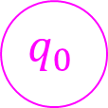
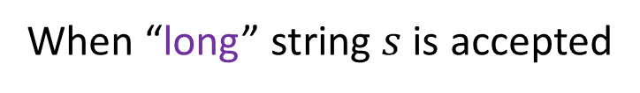
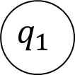
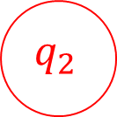
Proving Non-Regularity
For a language to be regular, there must be a DFA for it
That same DFA must work for every string in the language (no matter how long)
If the language is infinite, there must be some string in the language larger than the machine’s size
This long string it must visit at least one state twice on its way to the final state (pigeonhole principle)
Middle part
When “long” string $s$ is accepted
$$q_{0}$$
$$q_{1}$$
$$q_{2}$$
First part
Last part

Slide 9
“Pumping Lemma” Idea
Any infinite regular language has a “long” string
Any “long” string can be broken into 3 parts
A first part that takes you from start to some state
A middle part that takes you back to that same state
A last part that takes you to a final state
Copying the middle part times (or skipping it) still makes a path from start to a final state
If we can’t break up a “long” string into these parts which allows us to “pump” the middle, the language isn’t regular
Middle part
When “long” string $s$ is accepted
$$q_{0}$$
$$q_{1}$$
$$q_{2}$$
First part
Last part

Slide 10
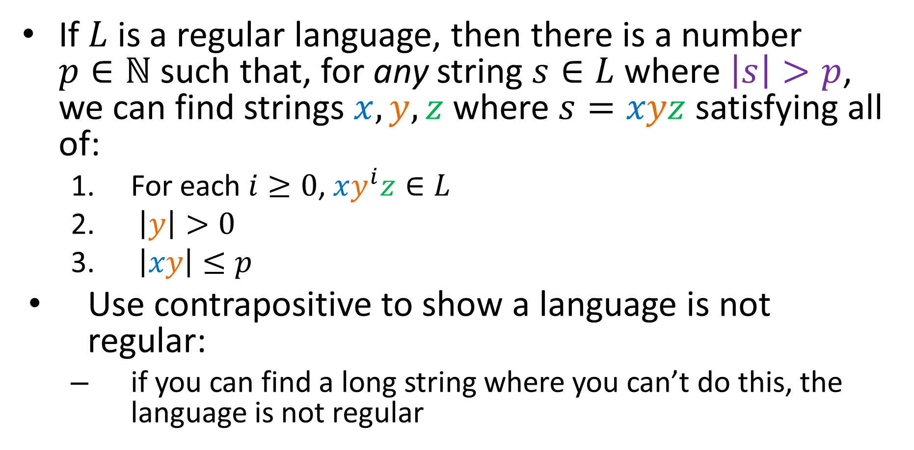
Pumping Lemma
If $L$ is a regular language, then there is a number $p∈ℕ$ such that, for any string $s∈L$ where $\left|s\right|>p$, we can find strings $x, y,z$ where $s=xyz$ satisfying all of:
For each $i≥0$, $xy^{i}z∈L$
$\left|y\right|>0$
$\left|xy\right|≤p$
Use contrapositive to show a language is not regular:
if you can find a long string where you can’t do this, the language is not regular

Slide 11
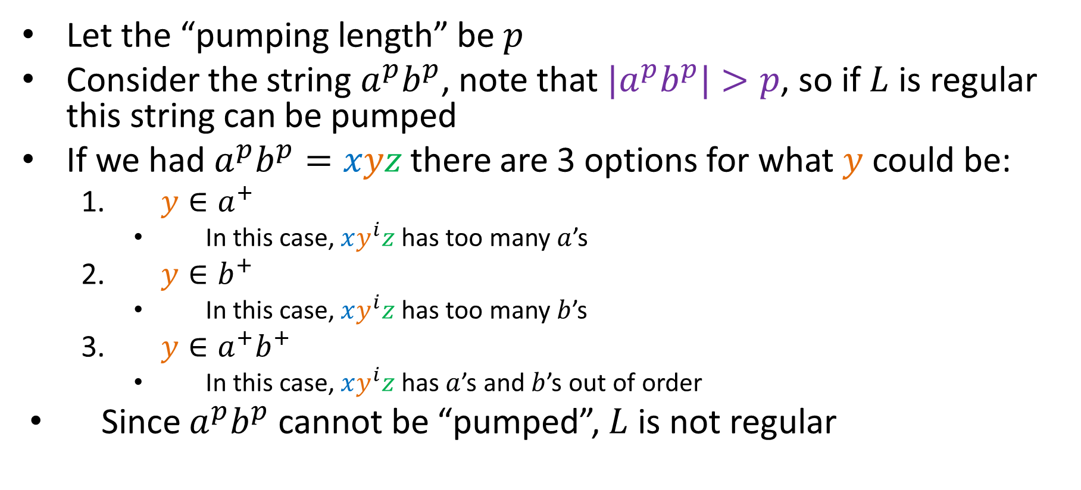

${L=a}^{n}b^{n}$ is not regular
Let the “pumping length” be $p$
Consider the string $a^{p}b^{p}$, note that ${|a}^{p}b^{p}|>p$, so if $L$ is regular this string can be pumped
If we had $a^{p}b^{p}=xyz$ there are 3 options for what $y$ could be:
$y∈a^{+}$
In this case, $xy^{i}z$ has too many $a$’s
$y∈b^{+}$
In this case, $xy^{i}z$ has too many $b$’s
$y∈a^{+}b^{+}$
In this case, $xy^{i}z$ has $a$’s and $b$’s out of order
Since $a^{p}b^{p}$ cannot be “pumped”, $L$ is not regular

Slide 12
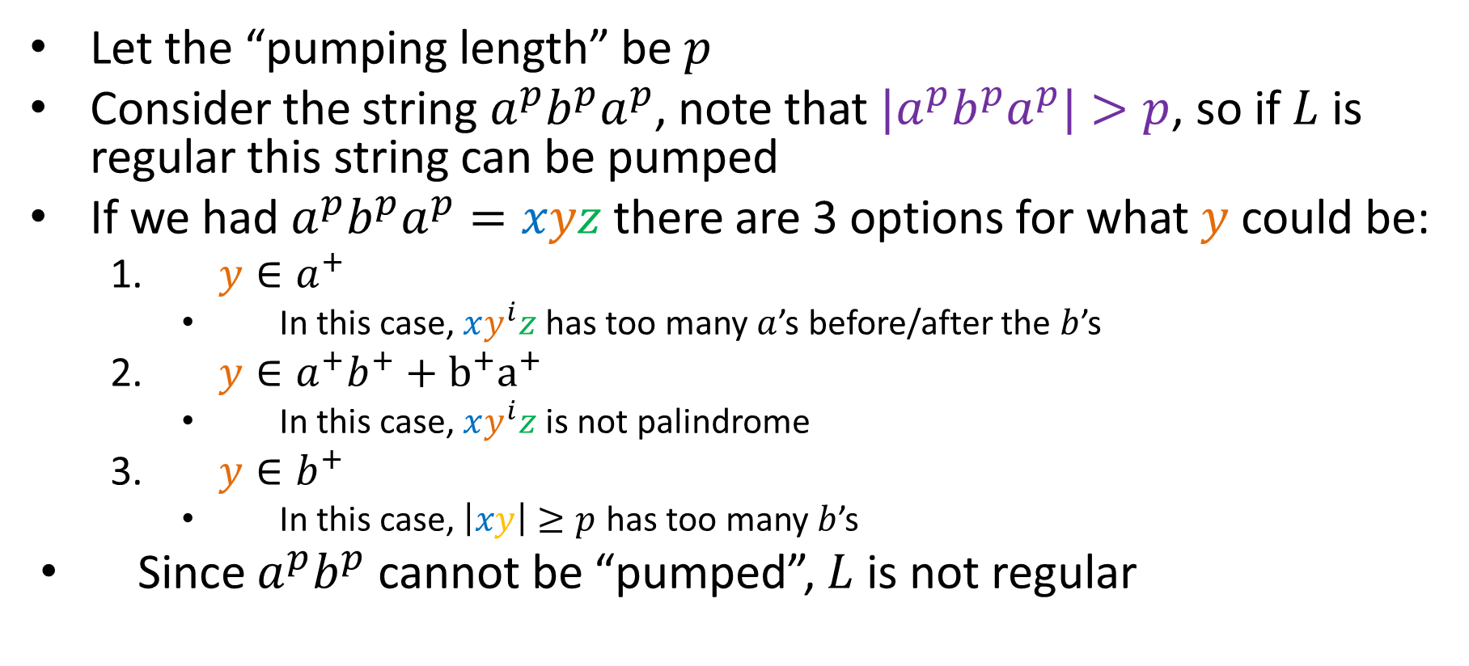
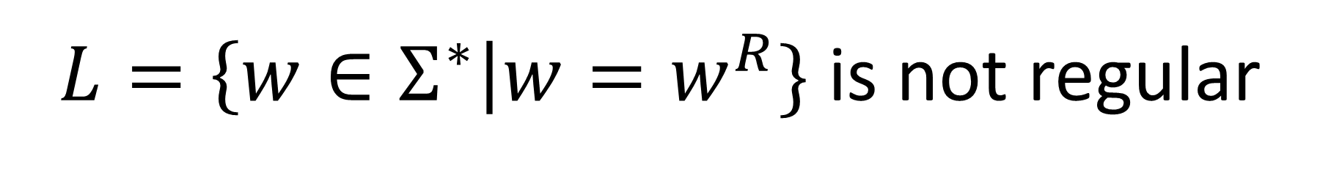
$L=\left\{w∈Σ^{∗}\right|w=w^{R}\}$ is not regular
Let the “pumping length” be $p$
Consider the string $a^{p}b^{p}a^{p}$, note that ${|a}^{p}b^{p}a^{p}|>p$, so if $L$ is regular this string can be pumped
If we had $a^{p}b^{p}a^{p}=xyz$ there are 3 options for what $y$ could be:
$y∈a^{+}$
In this case, $xy^{i}z$ has too many $a$’s before/after the $b$’s
$y∈a^{+}b^{+}+b^{+}a^{+}$
In this case, $xy^{i}z$ is not palindrome
$y∈b^{+}$
In this case, $\left|xy\right|≥p$ has too many $b$’s
Since $a^{p}b^{p}$ cannot be “pumped”, $L$ is not regular

Slide 13
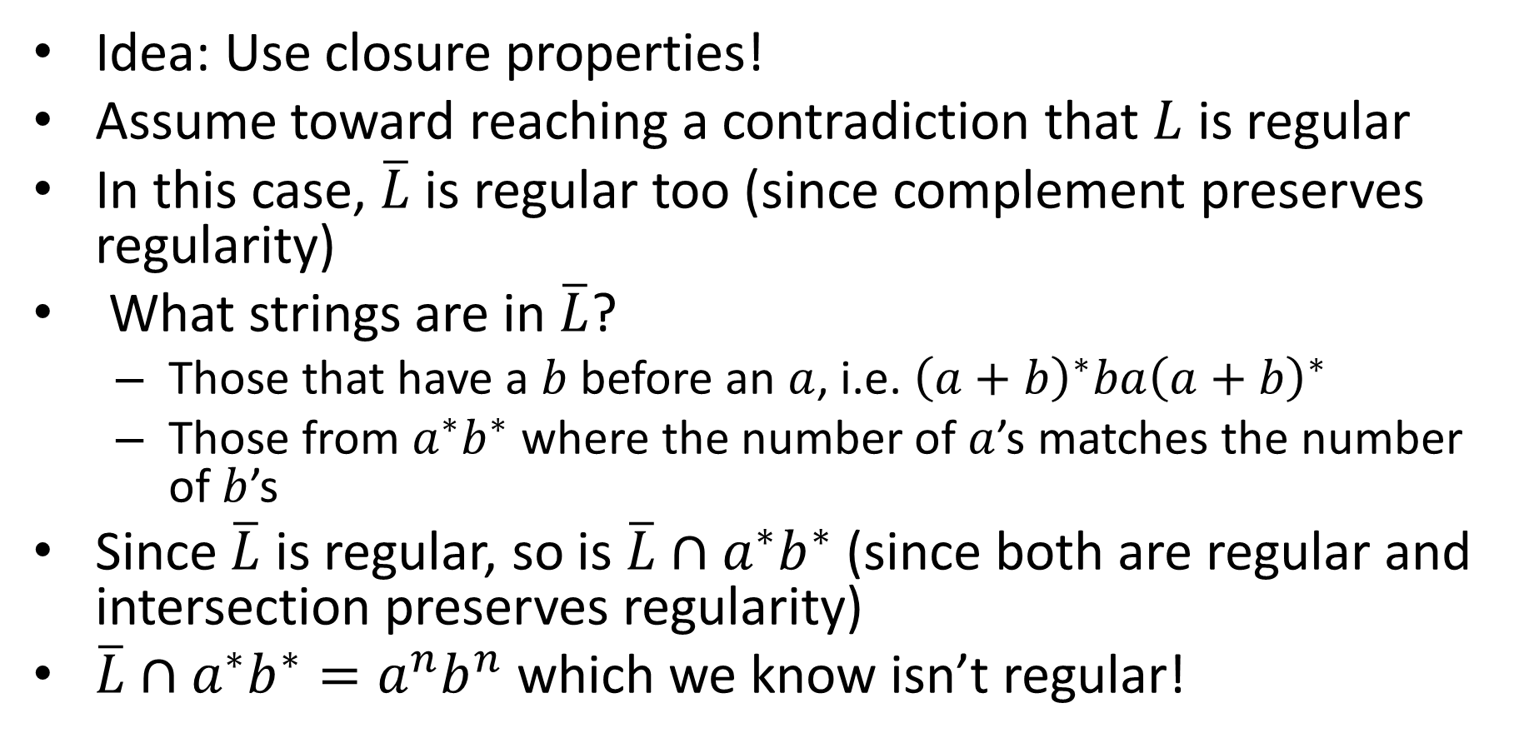
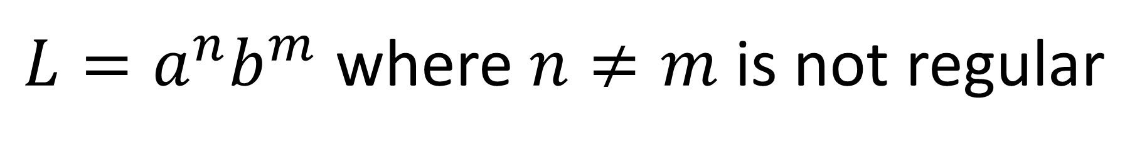
${L=a}^{n}b^{m}$ where $n≠m$ is not regular
Idea: Use closure properties!
Assume toward reaching a contradiction that $L$ is regular
In this case, $\overline{L}$ is regular too (since complement preserves regularity)
What strings are in $\overline{L}$?
Those that have a $b$ before an $a$, i.e. ${\left(a+b\right)}^{∗}ba{\left(a+b\right)}^{∗}$
Those from $a^{∗}b^{∗}$ where the number of $a$’s matches the number of $b$’s
Since $\overline{L}$ is regular, so is $\overline{L}∩a^{∗}b^{∗}$ (since both are regular and intersection preserves regularity)
$\overline{L}∩a^{∗}b^{∗}=a^{n}b^{n}$ which we know isn’t regular!

Slide 14

Pumpable $≠$ Regular
The pumping lemma can only be used to show NON-regularity
If this languages is not pumpable, then it is not regular
The pumping lamma cannot be used to prove a language is regular
Some non-regular languages are pumpable

Slide 15
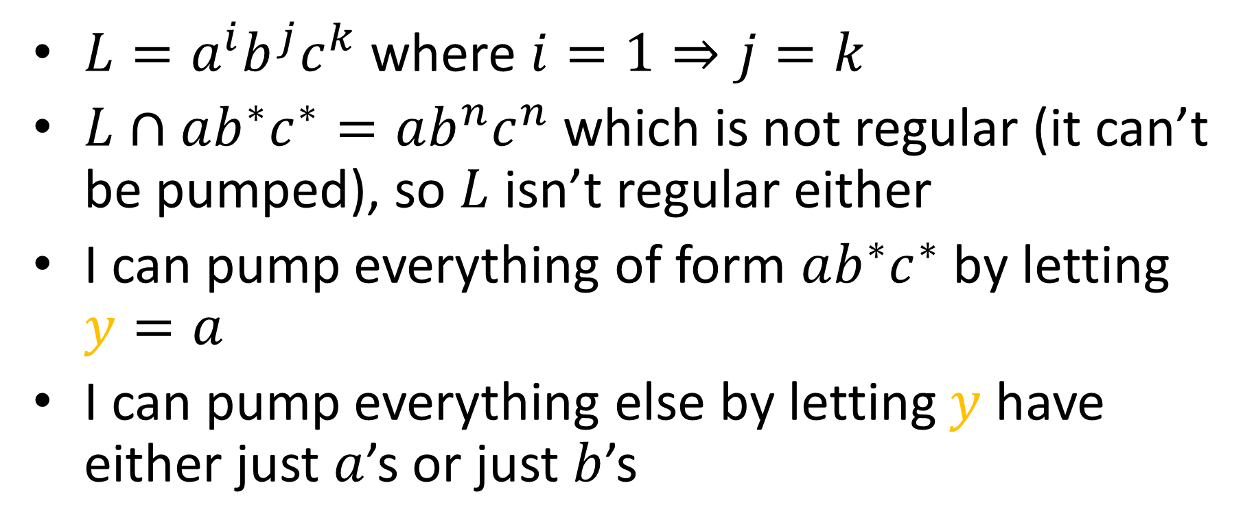
A pumpable non-regular language
$L=a^{i}b^{j}c^{k}$ where $i=1⇒j=k$
$L∩ab^{∗}c^{∗}=ab^{n}c^{n}$ which is not regular (it can’t be pumped), so $L$ isn’t regular either
I can pump everything of form $ab^{∗}c^{∗}$ by letting $y=a$
I can pump everything else by letting $y$ have either just $a$’s or just $b$’s

