Slide 1
CS3102 Theory of Computation

Slide 2
Recap
So far:
Mathematical foundations (sets, functions, etc.)
Finite State automata (NFAs, DFAs)
Regular expressions
This has no “memory”
String
Computing Machine
/ Program / Algorithm
Accept/Reject

Slide 3
Computing with Memory
What do we mean by “memory”?
There are potentially an infinite number of machine “configurations”
What do we mean by “configuration”?
Snapshot/callstack of the computation
In Java: What line are we on in which function, what is in each variable/data structure?
In DFAs/NFAs: Which state(s) are we in?
What gives more computing power?
Longer and longer inputs can result in larger configurations

Slide 4
Adding memory to a FSA
Idea: Allow FSA to read from/write to memory
Reading from memory:
FSA will transition depending on both the input and some location in memory
Writing to memory:
When transition, FSA can change what’s in the memory

Slide 5
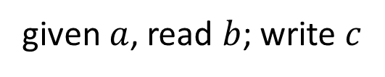
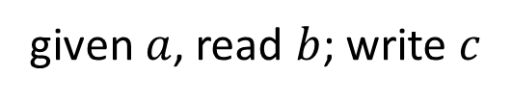
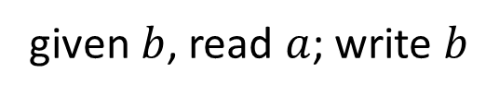
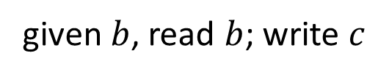
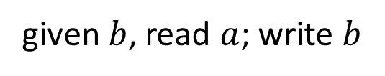
Vague example
given $a$, read $b$; write $c$
given $b$, read $a$; write $b$
given $b$, read $a$; write $b$
given $a$, read $b$; write $c$
given $b$, read $b$; write $c$

Slide 6



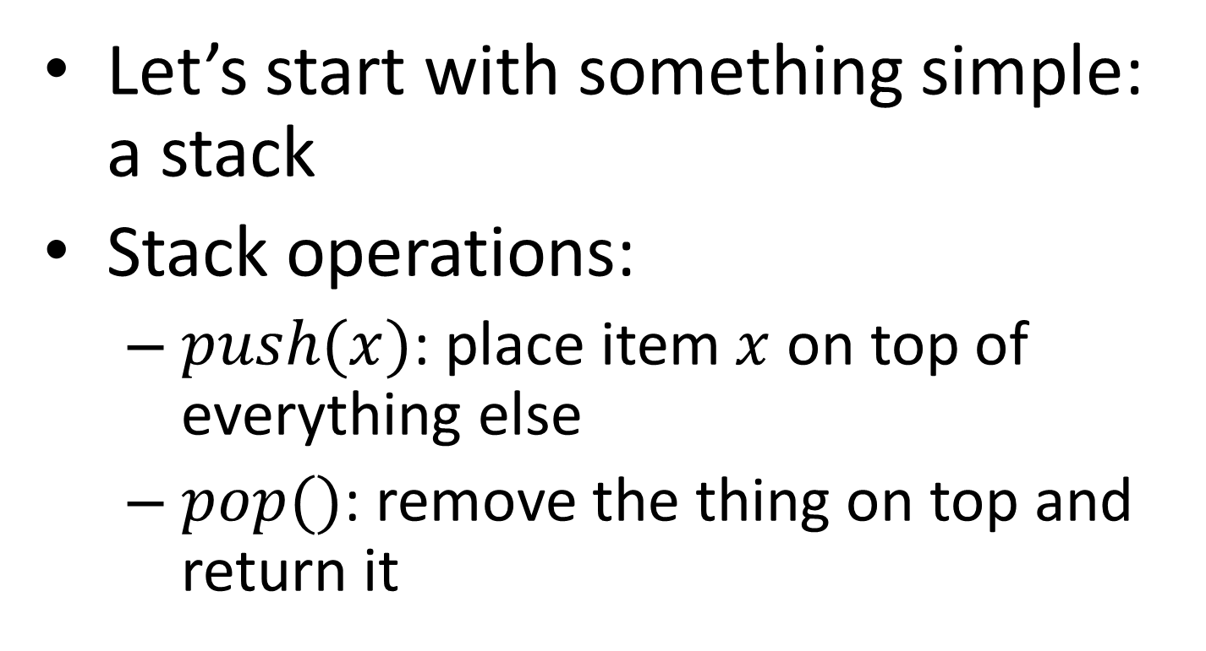




How to use the memory?
Let’s start with something simple: a stack
Stack operations:
$push(x)$: place item $x$ on top of everything else
$pop()$: remove the thing on top and return it
$$b$$
$$a$$
$$b$$
$$a$$
$$a$$
$$a$$
$$b$$
$$a$$
$$a$$
$$push(b)$$
“returned”
$$a$$
$$a$$
$$b$$
$$a$$
$$a$$
$$pop()$$
$$b$$
$$a$$
$$a$$

Slide 7
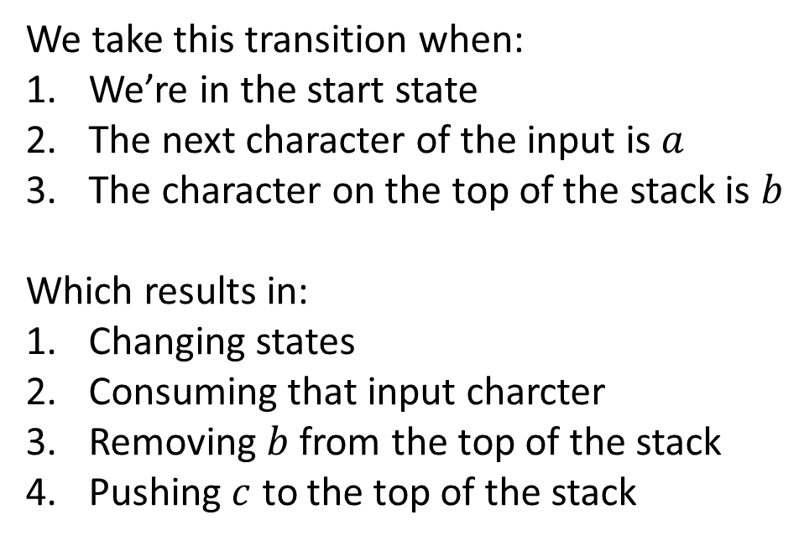

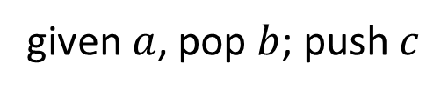



Less Vague example
We take this transition when:
We’re in the start state
The next character of the input is $a$
The character on the top of the stack is $b$
Which results in:
Changing states
Consuming that input charcter
Removing $b$ from the top of the stack
Pushing $c$ to the top of the stack
given $a$, pop $b$; push $c$
$$b$$
$$a$$
$$a$$
$$c$$
$$a$$
$$a$$
before
after
$$b$$ | $$a$$ | $$b$$ | $$b$$
$$b$$ | $$a$$ | $$b$$ | $$b$$

Slide 8

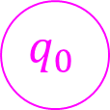
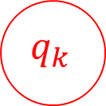
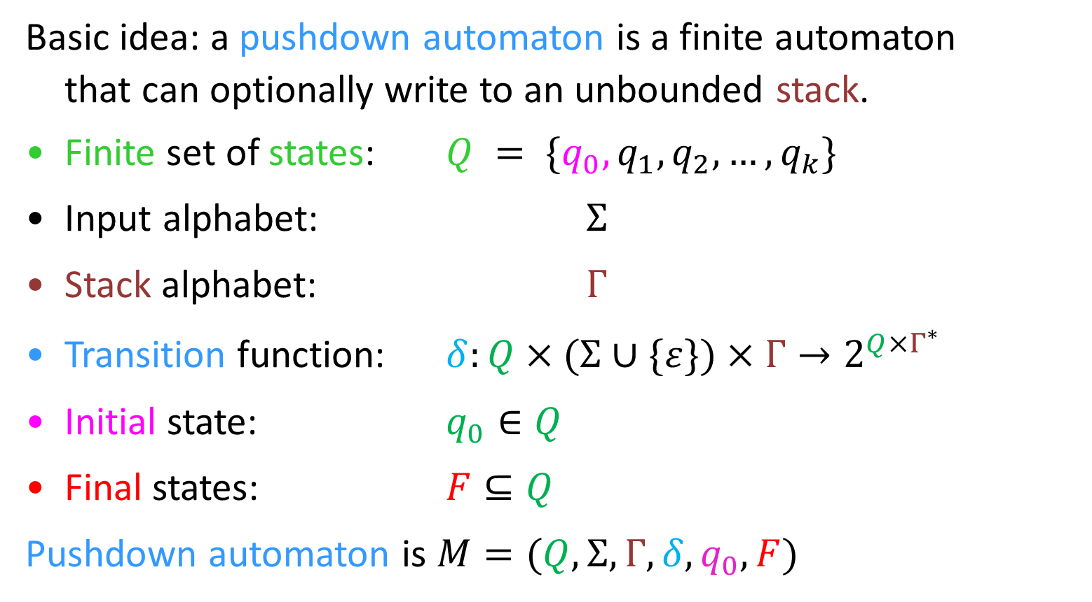
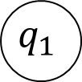
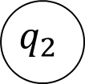
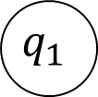
Pushdown Automata
Basic idea: a pushdown automaton is a finite automaton
that can optionally write to an unbounded stack.
Finite set of states: $Q = \{q_{0}, q_{1},q_{2}, …, q_{k}\}$
Input alphabet: $Σ$
Stack alphabet: $Γ$
Transition function: $δ:Q×(Σ∪\{ε\})×Γ→2^{Q×Γ^{∗}}$
Initial state: $q_{0}∈Q$
Final states: $F⊆Q$
Pushdown automaton is $M=(Q,Σ,Γ,δ,q_{0},F)$
$$q_{1}$$
New states
and stack
popped
$$a, b, c$$
Input
$$q_{1}$$
$$q_{2}$$
$$q_{0}$$
Input, popped, push
$$q_{k}$$

Slide 9
Pushdown Automata
Stack alphabet can be different from input alphabet
Typically non-deterministic
Can be in multiple states at once
Can have multiple “parallel” stacks
Non-deterministic “configurations”
Accept when:
The entire input has been read
There is at least one “path” in a final state with an empty stack

Slide 10
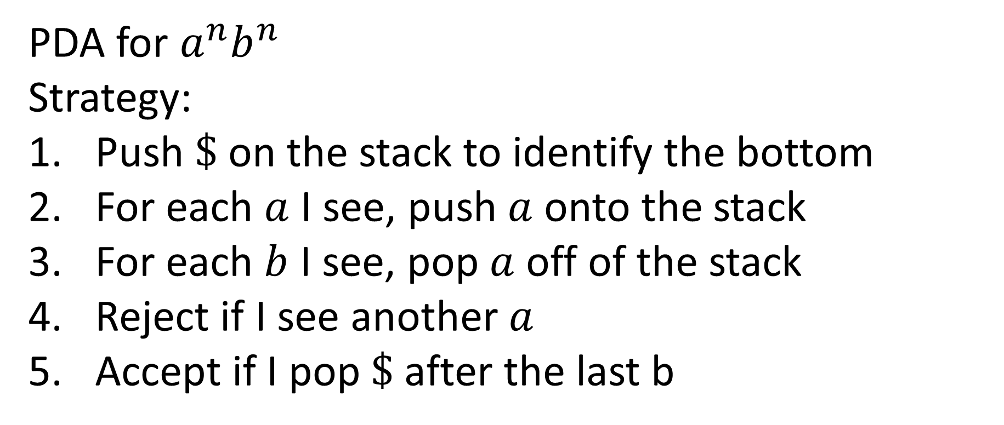
Non-Vague Example
PDA for $a^{n}b^{n}$
Strategy:
Push $\$$ on the stack to identify the bottom
For each $a$ I see, push $a$ onto the stack
For each $b$ I see, pop $a$ off of the stack
Reject if I see another $a$
Accept if I pop $\$$ after the last b

Slide 11

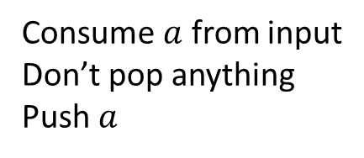

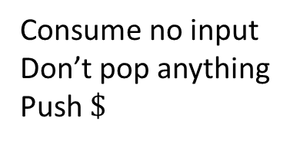

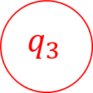

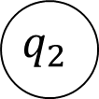
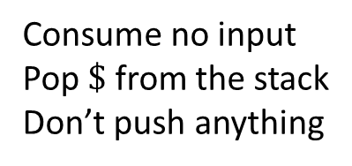

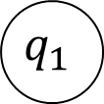

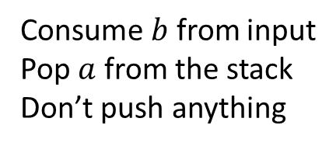
PDA for $a^{n}b^{n}$
Consume $a$ from input
Don’t pop anything
Push $a$
Consume $b$ from input
Pop $a$ from the stack
Don’t push anything
$$a,ε,a$$
$$b,a,ε$$
$$ε,ε,\$$$
$$ε,ε,ε$$
$$ε,\$,ε$$
$$q_{3}$$
$$q_{0}$$
$$q_{1}$$
$$q_{2}$$
Consume no input
Pop $\$$ from the stack
Don’t push anything
Consume no input
Don’t pop anything
Push $\$$
Consume no input
Don’t pop anything
Don’t push anything

Slide 12
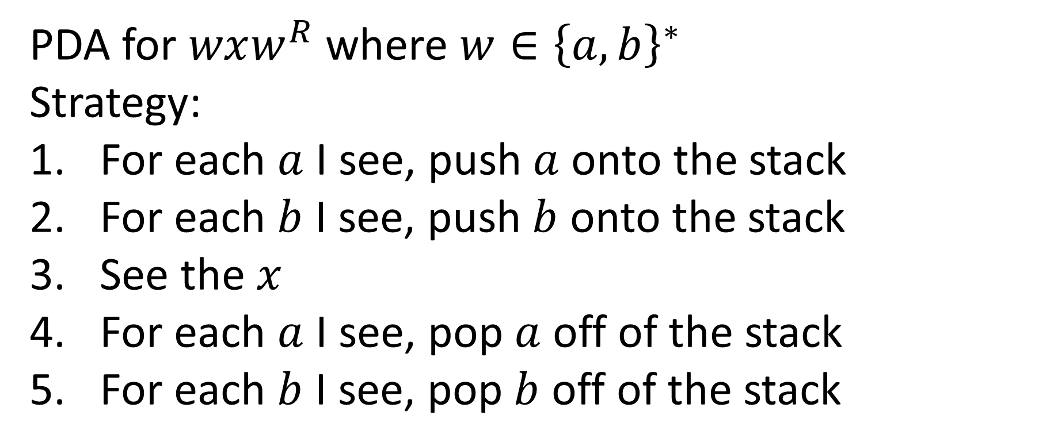
PDA for “Palindromes”
PDA for $wxw^{R}$ where $w∈{\left\{a,b\right\}}^{∗}$
Strategy:
For each $a$ I see, push $a$ onto the stack
For each $b$ I see, push $b$ onto the stack
See the $x$
For each $a$ I see, pop $a$ off of the stack
For each $b$ I see, pop $b$ off of the stack

Slide 13

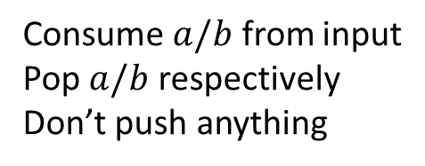


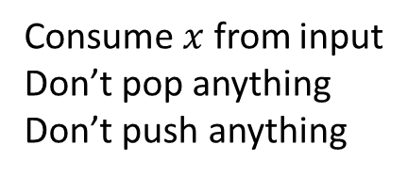


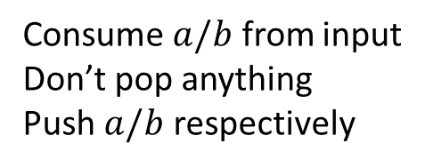
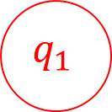

PDA for $wxw^{R}$
Consume $a/b$ from input
Don’t pop anything
Push $a/b$ respectively
Consume $a/b$ from input
Pop $a/b$ respectively
Don’t push anything
$$b,ε,b$$
$$b,b,ε$$
$$a,ε,a$$
$$a,a,ε$$
$$q_{0}$$
$$x,ε,ε$$
$$q_{1}$$
Consume $x$ from input
Don’t pop anything
Don’t push anything

Slide 14
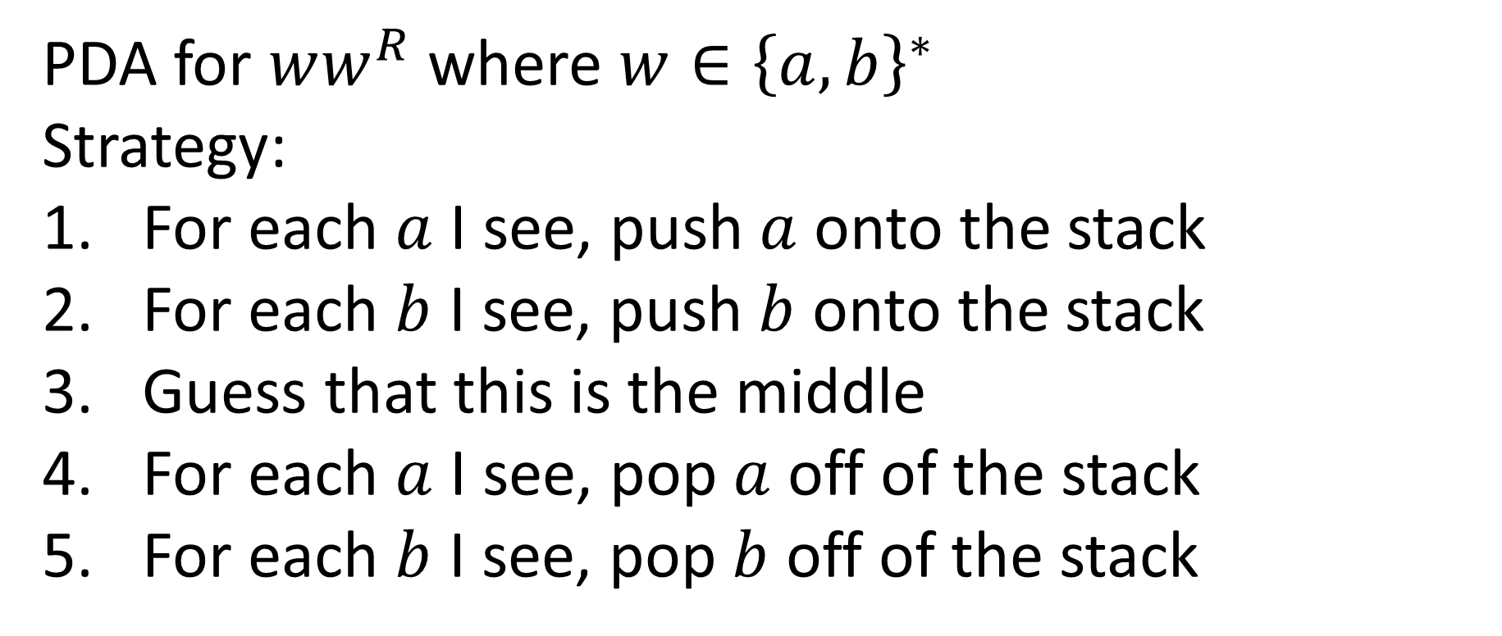
PDA for even-length Palindromes
PDA for $ww^{R}$ where $w∈{\left\{a,b\right\}}^{∗}$
Strategy:
For each $a$ I see, push $a$ onto the stack
For each $b$ I see, push $b$ onto the stack
Guess that this is the middle
For each $a$ I see, pop $a$ off of the stack
For each $b$ I see, pop $b$ off of the stack

Slide 15


PDA for $ww^{R}$
Consume $a/b$ from input
Don’t pop anything
Push $a/b$ respectively
Consume $a/b$ from input
Pop $a/b$ respectively
Don’t push anything
$$b,ε,b$$
$$b,b,ε$$
$$a,ε,a$$
$$a,a,ε$$
$$q_{0}$$
$$ε,ε,ε$$
$$q_{1}$$
Consume no input
Don’t pop anything
Don’t push anything
(going from forward half to backwards half of string)

Slide 16
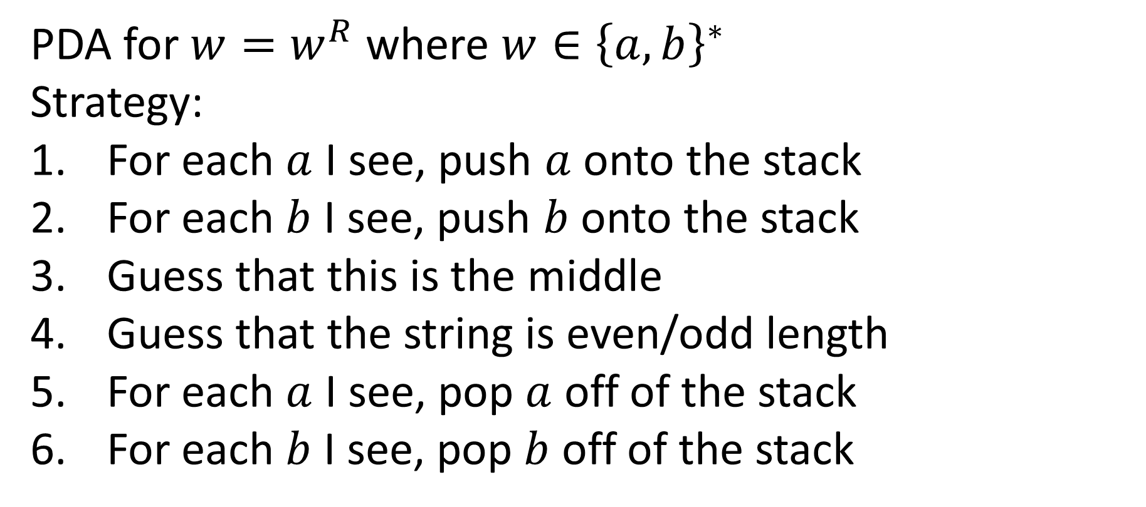
PDA for Palindromes
PDA for $w=w^{R}$ where $w∈{\left\{a,b\right\}}^{∗}$
Strategy:
For each $a$ I see, push $a$ onto the stack
For each $b$ I see, push $b$ onto the stack
Guess that this is the middle
Guess that the string is even/odd length
For each $a$ I see, pop $a$ off of the stack
For each $b$ I see, pop $b$ off of the stack

Slide 17




PDA for $w=w^{R}$
Consume $a/b$ from input
Don’t pop anything
Push $a/b$ respectively
Consume $a/b$ from input
Pop $a/b$ respectively
Don’t push anything
$$b,ε,b$$
$$b,b,ε$$
$$a,ε,a$$
$$a,a,ε$$
$$a,ε,ε$$
$$b,ε,ε$$
$$q_{0}$$
$$ε,ε,ε$$
$$q_{1}$$
Consume $a/b$ or nothing from input
Don’t pop anything
Don’t push anything
(going from forward half to backwards half of string)

