Slide 1
CS3102 Theory of Computation

Slide 2


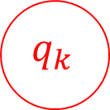
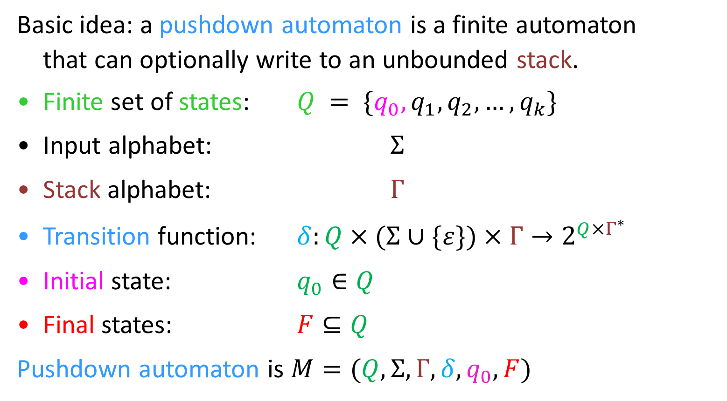
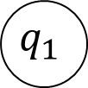
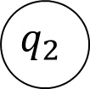
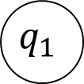
Pushdown Automata
Basic idea: a pushdown automaton is a finite automaton
that can optionally write to an unbounded stack.
Finite set of states: $Q = \{q_{0}, q_{1},q_{2}, …, q_{k}\}$
Input alphabet: $Σ$
Stack alphabet: $Γ$
Transition function: $δ:Q×(Σ∪\{ε\})×Γ→2^{Q×Γ^{∗}}$
Initial state: $q_{0}∈Q$
Final states: $F⊆Q$
Pushdown automaton is $M=(Q,Σ,Γ,δ,q_{0},F)$
$$q_{1}$$
New states
and stack
popped
$$a, b, c$$
Input
$$q_{1}$$
$$q_{2}$$
$$q_{0}$$
Input, popped, push
$$q_{k}$$

Slide 3
Pushdown Automata
Stack alphabet can be different from input alphabet
Typically non-deterministic
Can be in multiple states at once
Can have multiple “parallel” stacks
Non-deterministic “configurations”
Accept when:
The entire input has been read
There is at least one “path” in a final state with an empty stack

Slide 4
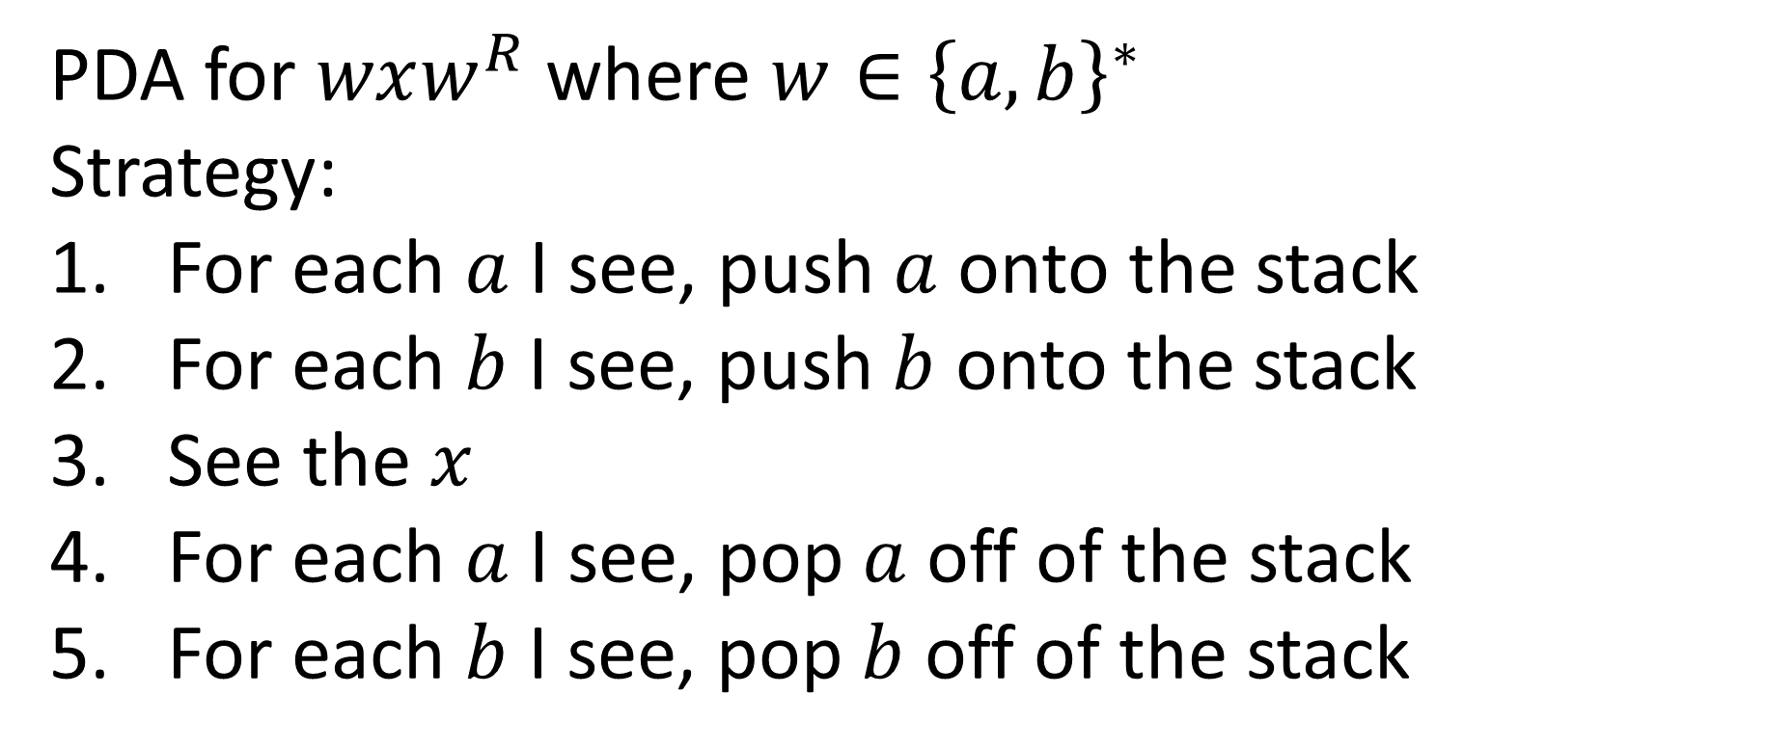
PDA for “Palindromes”
PDA for $wxw^{R}$ where $w∈{\left\{a,b\right\}}^{∗}$
Strategy:
For each $a$ I see, push $a$ onto the stack
For each $b$ I see, push $b$ onto the stack
See the $x$
For each $a$ I see, pop $a$ off of the stack
For each $b$ I see, pop $b$ off of the stack

Slide 5

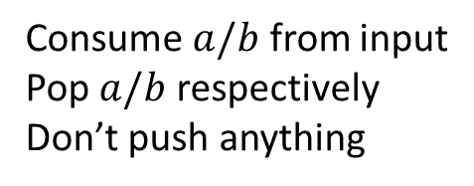


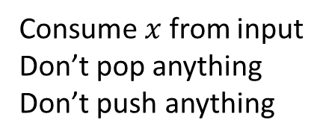


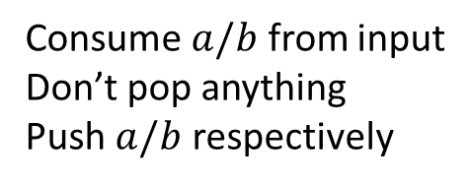
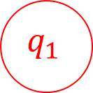

PDA for $wxw^{R}$
Consume $a/b$ from input
Don’t pop anything
Push $a/b$ respectively
Consume $a/b$ from input
Pop $a/b$ respectively
Don’t push anything
$$b,ε,b$$
$$b,b,ε$$
$$a,ε,a$$
$$a,a,ε$$
$$q_{0}$$
$$x,ε,ε$$
$$q_{1}$$
Consume $x$ from input
Don’t pop anything
Don’t push anything

Slide 6
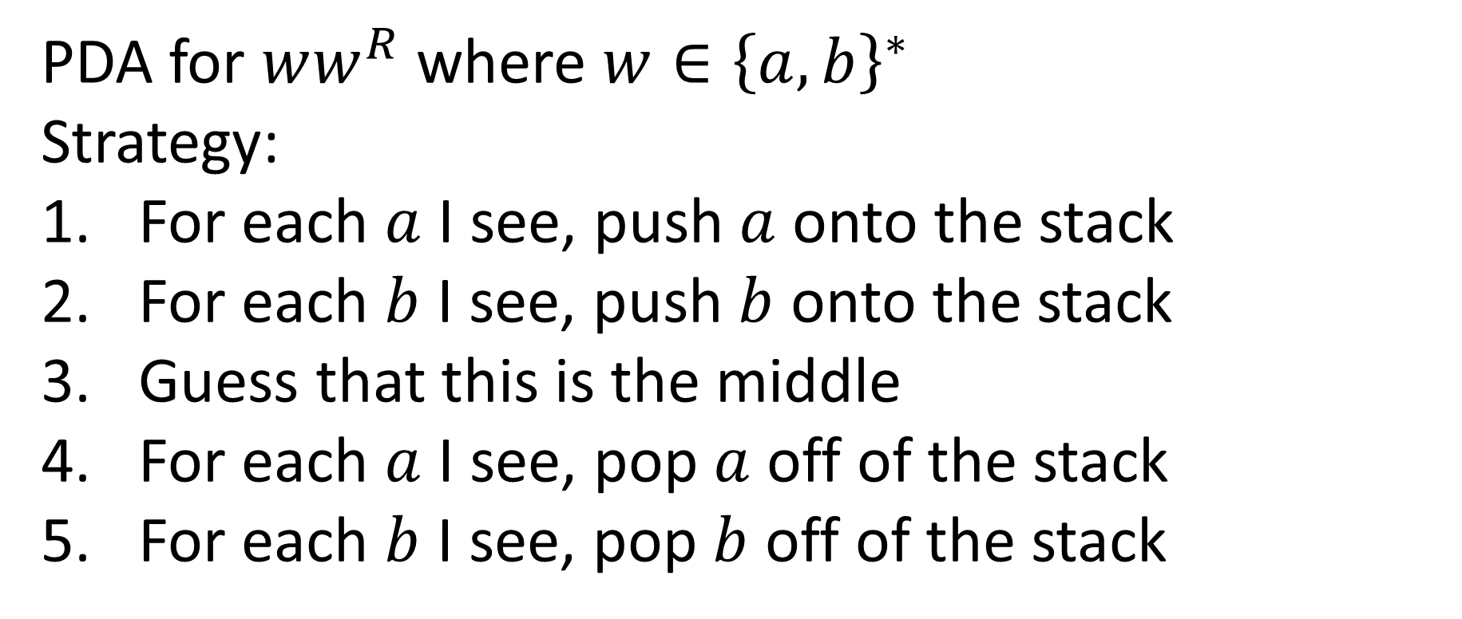
PDA for even-length Palindromes
PDA for $ww^{R}$ where $w∈{\left\{a,b\right\}}^{∗}$
Strategy:
For each $a$ I see, push $a$ onto the stack
For each $b$ I see, push $b$ onto the stack
Guess that this is the middle
For each $a$ I see, pop $a$ off of the stack
For each $b$ I see, pop $b$ off of the stack

Slide 7


PDA for $ww^{R}$
Consume $a/b$ from input
Don’t pop anything
Push $a/b$ respectively
Consume $a/b$ from input
Pop $a/b$ respectively
Don’t push anything
$$b,ε,b$$
$$b,b,ε$$
$$a,ε,a$$
$$a,a,ε$$
$$q_{0}$$
$$ε,ε,ε$$
$$q_{1}$$
Consume no input
Don’t pop anything
Don’t push anything
(going from forward half to backwards half of string)

Slide 8
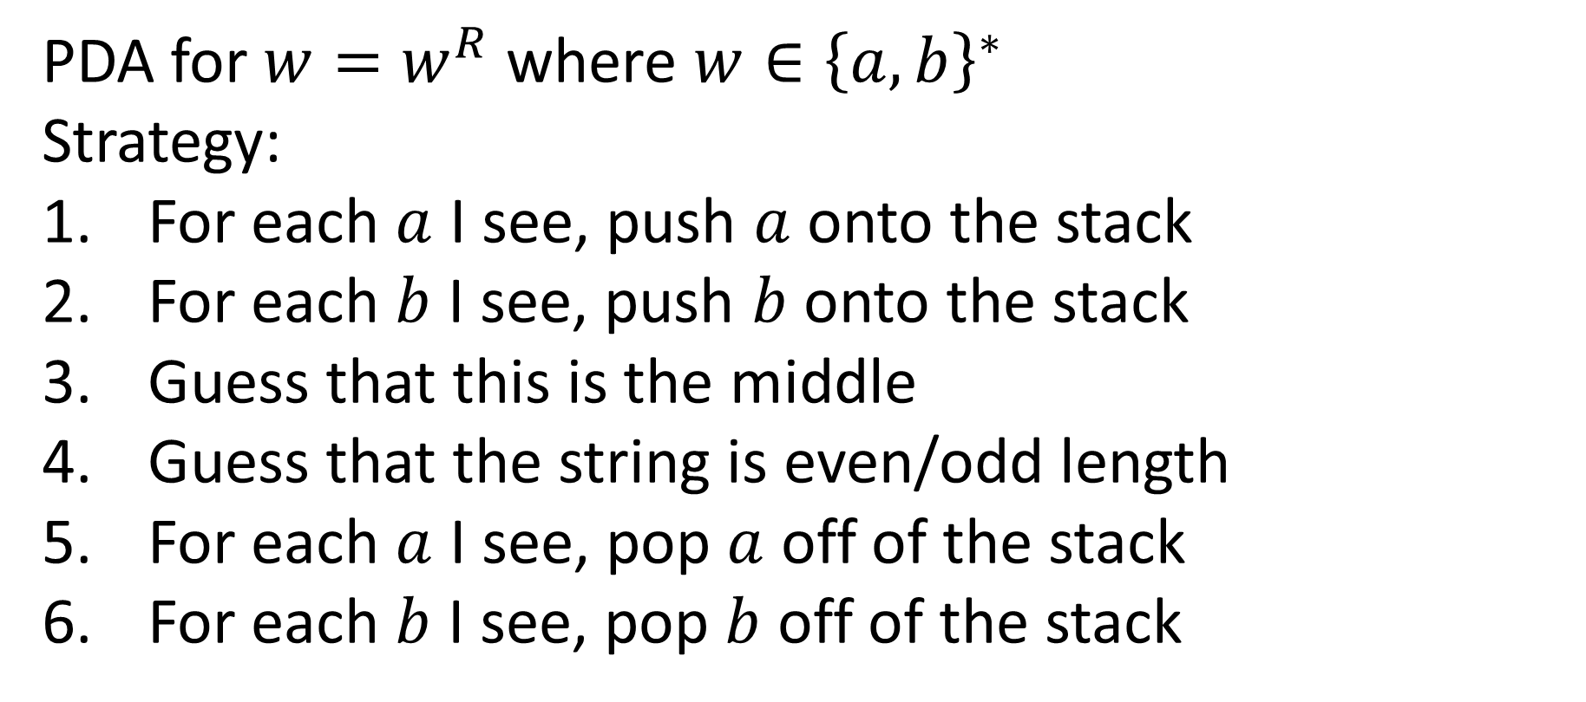
PDA for Palindromes
PDA for $w=w^{R}$ where $w∈{\left\{a,b\right\}}^{∗}$
Strategy:
For each $a$ I see, push $a$ onto the stack
For each $b$ I see, push $b$ onto the stack
Guess that this is the middle
Guess that the string is even/odd length
For each $a$ I see, pop $a$ off of the stack
For each $b$ I see, pop $b$ off of the stack

Slide 9




PDA for $w=w^{R}$
Consume $a/b$ from input
Don’t pop anything
Push $a/b$ respectively
Consume $a/b$ from input
Pop $a/b$ respectively
Don’t push anything
$$b,ε,b$$
$$b,b,ε$$
$$a,ε,a$$
$$a,a,ε$$
$$a,ε,ε$$
$$b,ε,ε$$
$$q_{0}$$
$$ε,ε,ε$$
$$q_{1}$$
Consume $a/b$ or nothing from input
Don’t pop anything
Don’t push anything
(going from forward half to backwards half of string)

Slide 10
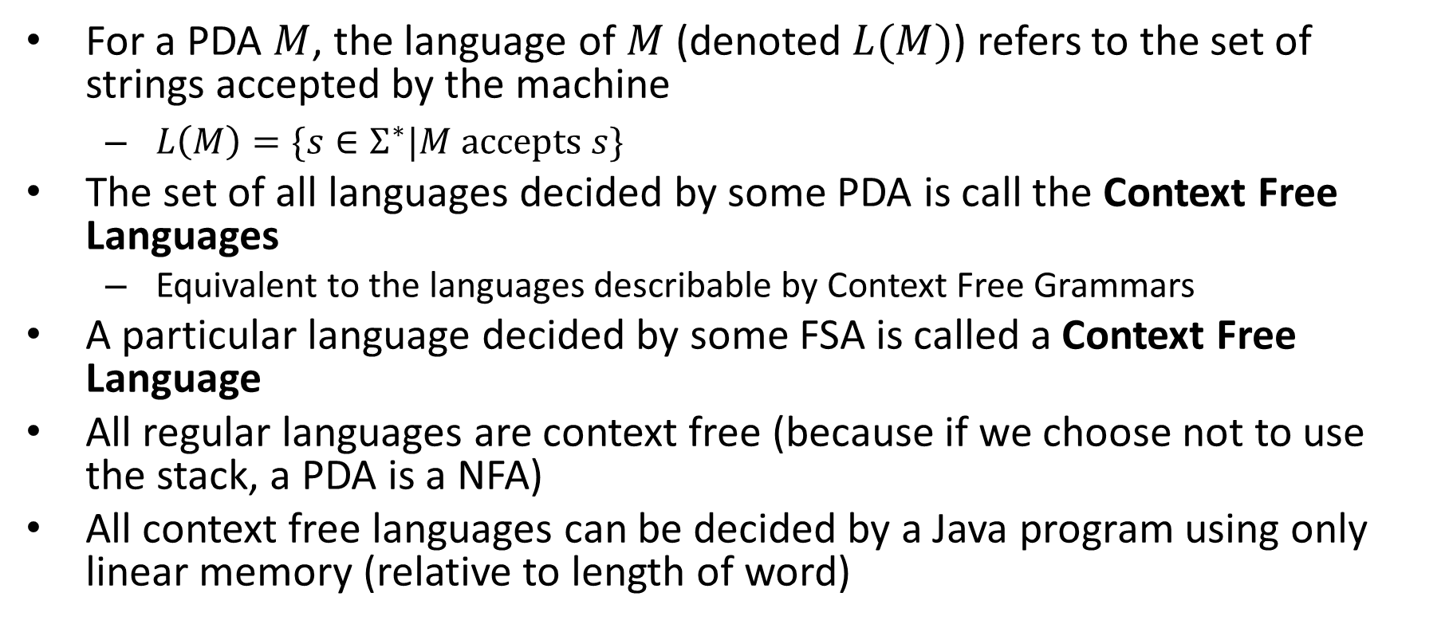
Context Free Languages
For a PDA $M$, the language of $M$ (denoted $L(M)$) refers to the set of strings accepted by the machine
$L\left(M\right)=\{s∈Σ^{∗}|M accepts s\}$
The set of all languages decided by some PDA is call the Context Free Languages
Equivalent to the languages describable by Context Free Grammars
A particular language decided by some FSA is called a Context Free Language
All regular languages are context free (because if we choose not to use the stack, a PDA is a NFA)
All context free languages can be decided by a Java program using only linear memory (relative to length of word)

Slide 11
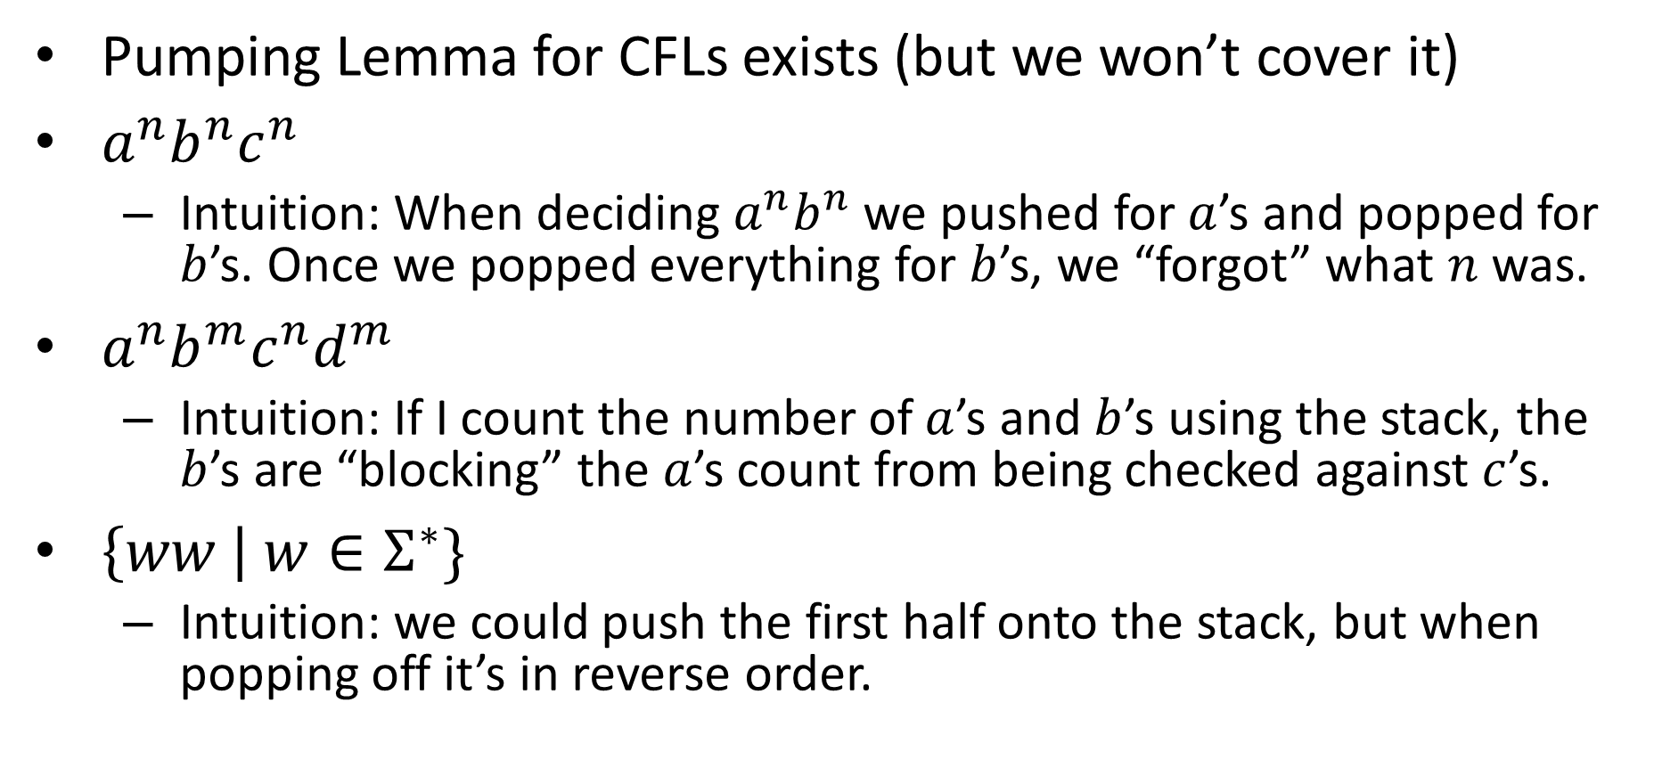
Non-Context-Free Languages
Pumping Lemma for CFLs exists (but we won’t cover it)
$a^{n}b^{n}c^{n}$
Intuition: When deciding $a^{n}b^{n}$ we pushed for $a$’s and popped for $b$’s. Once we popped everything for $b$’s, we “forgot” what $n$ was.
$a^{n}b^{m}c^{n}d^{m}$
Intuition: If I count the number of $a$’s and $b$’s using the stack, the $b$’s are “blocking” the $a$’s count from being checked against $c$’s.
$\left\{ww \right| w∈Σ^{∗}\}$
Intuition: we could push the first half onto the stack, but when popping off it’s in reverse order.

Slide 12
Closure Properties of CFLs
Context Free Languages are closed under:
Union
Concatenation
Kleene Star
Intersection with Regular languages
Context Free Languages are not closed under:
Complementation
Intersection with CFLs

Slide 13
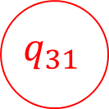

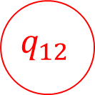



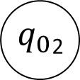










CFLs closed under union
$$M_{R}$$
$$ε,ε,ε$$
$$ε,ε,ε$$
$$M_{S}$$
Add in a new start state, epsilon transition to start states of source machines
Similar to union construction for NFAs
$$a,ε,a$$
$$b,a,ε$$
$$ε,ε,\$$$
$$ε,ε,ε$$
$$ε,\$,ε$$
$$q_{31}$$
$$q_{01}$$
$$q_{11}$$
$$q_{21}$$
$$ε,ε,ε$$
$$q_{0}$$
$$b,b,ε$$
$$b,ε,b$$
$$a,ε,a$$
$$a,a,ε$$
$$a,ε,ε$$
$$b,ε,ε$$
$$ε,ε,ε$$
$$ε,ε,ε$$
$$q_{12}$$
$q_{0}$₂

Slide 14


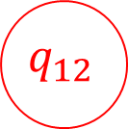





CFLs closed under Concatenation
$$ε,ε,\#$$
$$M_{R}$$
$$ε,\#,ε$$
$$M_{S}$$
$$ε,\#,ε$$
When in an accept state with an empty stack in machine 1, transition into machine 2
$$b,ε,b$$
$$b,b,ε$$
$$a,ε,a$$
$$a,a,ε$$
$$a,ε,ε$$
$$b,ε,ε$$
$$q_{0}$$
$$ε,ε,\#$$
$$ε,ε,ε$$
$$q_{12}$$
$q_{0}$₂
$$ε,\#,ε$$
$$a,ε,a$$
$$b,a,ε$$
$$ε,ε,\$$$
$$ε,ε,ε$$
$$ε,\$,ε$$
$$q_{31}$$
$$q_{01}$$
$$q_{11}$$
$$q_{21}$$

Slide 15






CFLs closed under Kleene Star
$$ε,\#,ε$$
$$ε,ε,\#$$
$$M_{R}$$
$$ε,\#,ε$$
When in an accept state with an empty stack, return to start state
$$ε,\#,ε$$
$$a,ε,a$$
$$b,a,ε$$
$$ε,ε,\#$$
$$ε,ε,\$$$
$$ε,ε,ε$$
$$ε,\$,ε$$
$$q_{31}$$
$$q_{0}$$
$$q_{01}$$
$$q_{11}$$
$$q_{21}$$

Slide 16











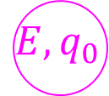

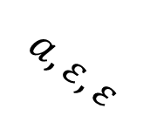





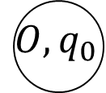



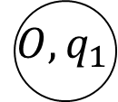





CFLs closed under Intersection with Regular Languages
Cross product construction
$$b,ε,b$$
$$b,b,ε$$
$$b,ε,b$$
$$b,b,ε$$
$$ε,ε,ε$$
$$a,ε,a$$
$$a,a,ε$$
$${E,q}_{0}$$
$$b,ε,ε$$
$${E,q}_{1}$$
$$a,ε,ε$$
$$b,ε,ε$$
$$ε,ε,ε$$
$$q_{1}$$
$$a,ε,ε$$
$$q_{0}$$
$$a,ε,a$$
$$a,a,ε$$
$$a,ε,a$$
$$a,a,ε$$
$$a,ε,ε$$
$$b$$
$$a$$
$$b$$
$$O,q_{0}$$
$$b,ε,ε$$
$$O,q_{1}$$
$$O$$
$$ε,ε,ε$$
$$E$$
$$b,ε,b$$
$$b,b,ε$$
$$a$$

Slide 17
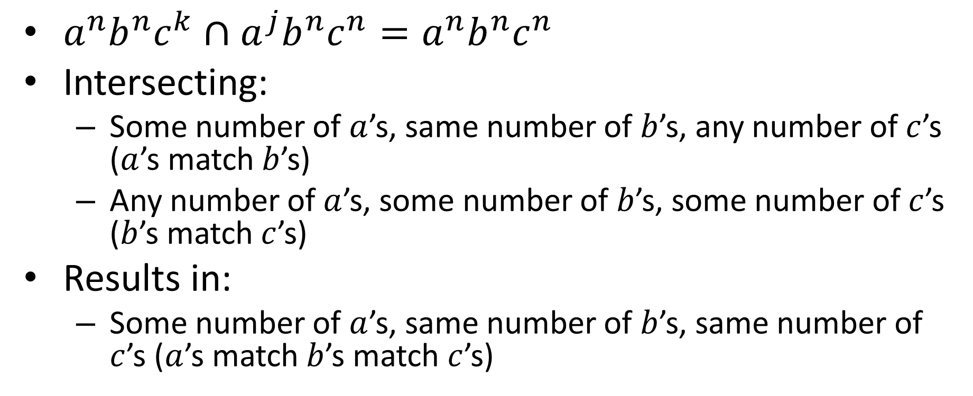
CFLs not closed under Intersection
$a^{n}b^{n}c^{k}∩a^{j}b^{n}c^{n}=a^{n}b^{n}c^{n}$
Intersecting:
Some number of $a$’s, same number of $b$’s, any number of $c$’s ($a$’s match $b$’s)
Any number of $a$’s, some number of $b$’s, some number of $c$’s ($b$’s match $c$’s)
Results in:
Some number of $a$’s, same number of $b$’s, same number of $c$’s ($a$’s match $b$’s match $c$’s)

Slide 18
CFLs not closed under Complement

