Slide 1
CS3102 Theory of Computation

Slide 2
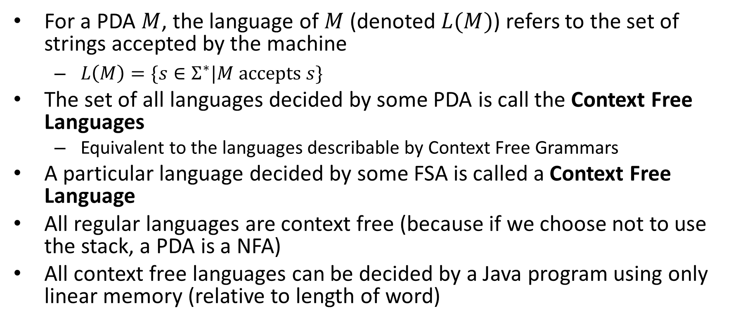
Context Free Languages
For a PDA $M$, the language of $M$ (denoted $L(M)$) refers to the set of strings accepted by the machine
$L\left(M\right)=\{s∈Σ^{∗}|M accepts s\}$
The set of all languages decided by some PDA is call the Context Free Languages
Equivalent to the languages describable by Context Free Grammars
A particular language decided by some FSA is called a Context Free Language
All regular languages are context free (because if we choose not to use the stack, a PDA is a NFA)
All context free languages can be decided by a Java program using only linear memory (relative to length of word)

Slide 3
Closure Properties of CFLs
Context Free Languages are closed under:
Union
Concatenation
Kleene Star
Intersection with Regular languages
Context Free Languages are not closed under:
Complementation
Intersection with CFLs

Slide 4
















CFLs closed under:
$$M_{R}$$
Union
Concatenation
Kleene Star
Intersection with regular languages
$$ε,ε,ε$$
$$ε,ε,ε$$
$$M_{S}$$
$$ε,ε,\#$$
$$M_{R}$$
$$ε,\#,ε$$
$$M_{S}$$
$$ε,\#,ε$$
$$ε,\#,ε$$
$$ε,ε,\#$$
$$M_{R}$$
$$ε,\#,ε$$
$$PDA$$
$$×$$
$$FSA$$

Slide 5
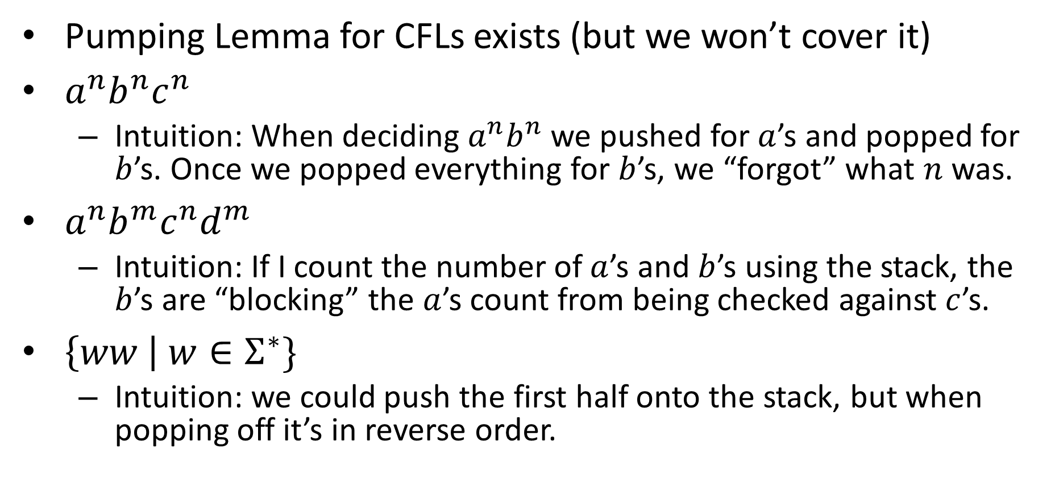
Non-Context-Free Languages
Pumping Lemma for CFLs exists (but we won’t cover it)
$a^{n}b^{n}c^{n}$
Intuition: When deciding $a^{n}b^{n}$ we pushed for $a$’s and popped for $b$’s. Once we popped everything for $b$’s, we “forgot” what $n$ was.
$a^{n}b^{m}c^{n}d^{m}$
Intuition: If I count the number of $a$’s and $b$’s using the stack, the $b$’s are “blocking” the $a$’s count from being checked against $c$’s.
$\left\{ww \right| w∈Σ^{∗}\}$
Intuition: we could push the first half onto the stack, but when popping off it’s in reverse order.

Slide 6
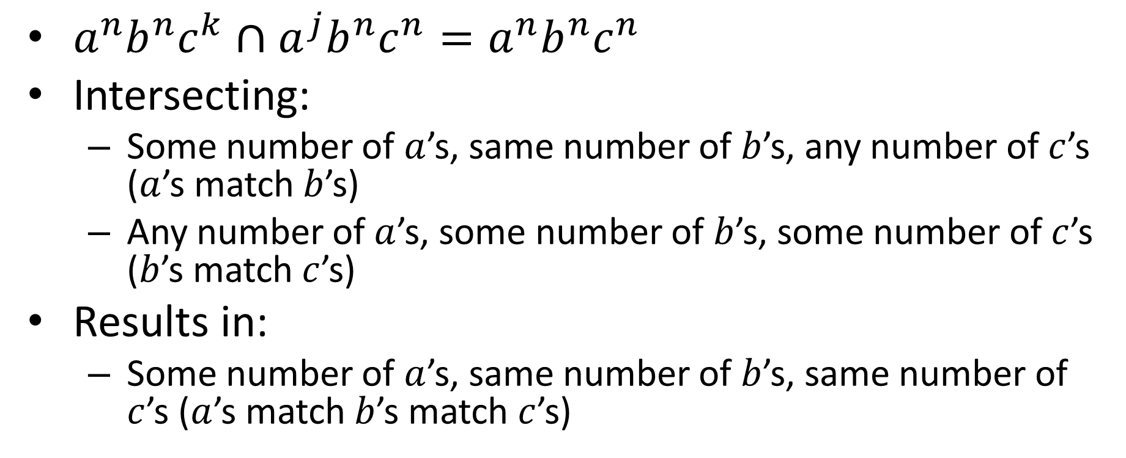
CFLs not closed under Intersection
$a^{n}b^{n}c^{k}∩a^{j}b^{n}c^{n}=a^{n}b^{n}c^{n}$
Intersecting:
Some number of $a$’s, same number of $b$’s, any number of $c$’s ($a$’s match $b$’s)
Any number of $a$’s, some number of $b$’s, some number of $c$’s ($b$’s match $c$’s)
Results in:
Some number of $a$’s, same number of $b$’s, same number of $c$’s ($a$’s match $b$’s match $c$’s)

Slide 7
CFLs not closed under Complement
Prove this with the people around you

Slide 8
Context Free Grammars
A way of describing context free languages
Gives a list of subtitution rules you can apply to generate strings
Any string that can be generated by some sequence of these substitutions is in the language of that grammar
A language is generated by some CFG if and only if it is decided by some PDA

Slide 9
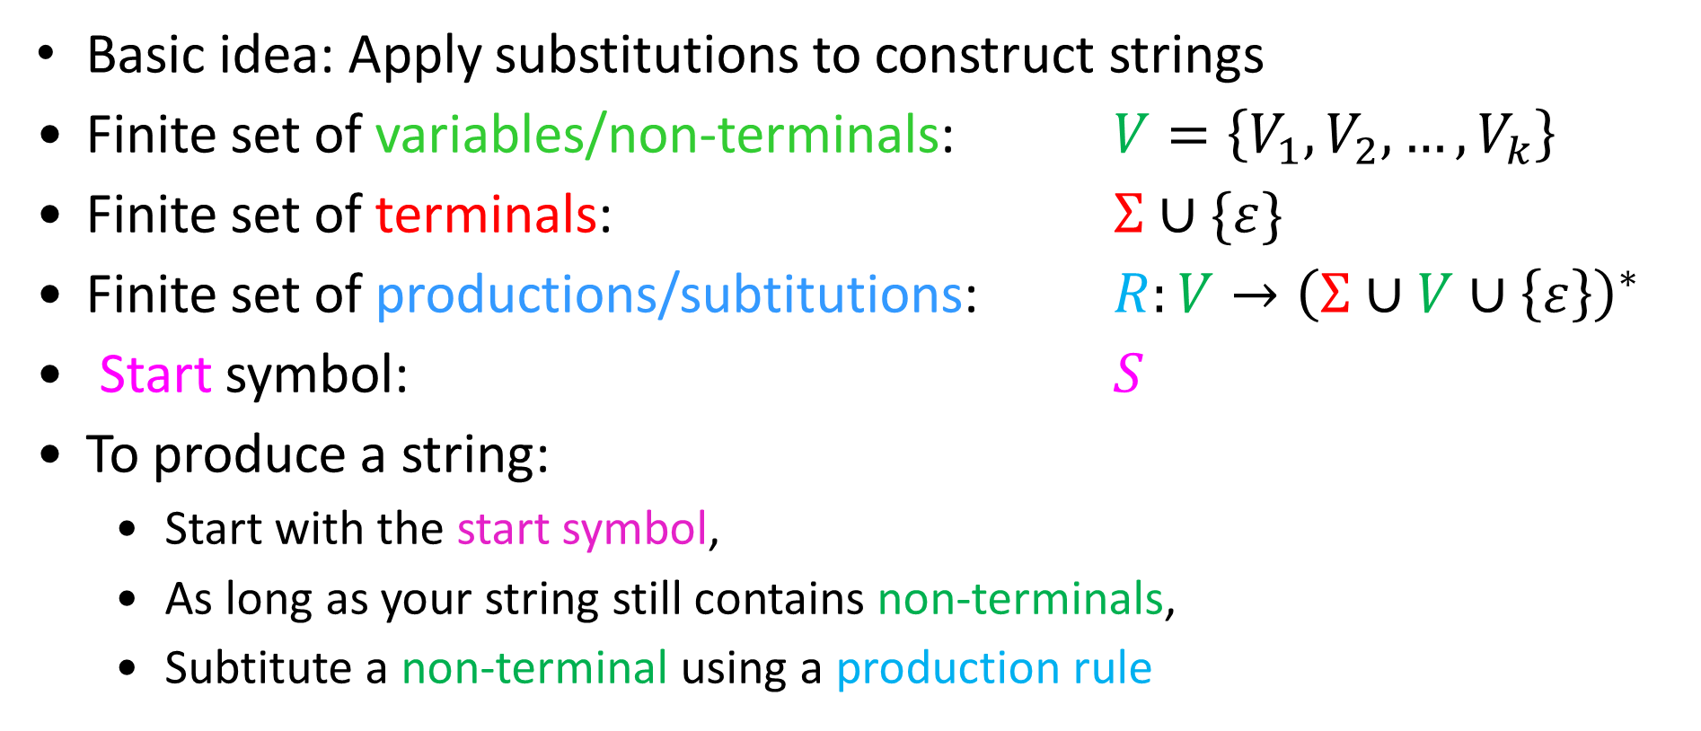
Context Free Grammar
Basic idea: Apply substitutions to construct strings
Finite set of variables/non-terminals: $V=\left\{V_{1},V_{2},…,V_{k}\right\}$
Finite set of terminals: $Σ∪\{ε\}$
Finite set of productions/subtitutions: $R:V→{\left(Σ∪V∪\left\{ε\right\}\right)}^{∗}$
Start symbol: $S$
To produce a string:
Start with the start symbol,
As long as your string still contains non-terminals,
Subtitute a non-terminal using a production rule

Slide 10










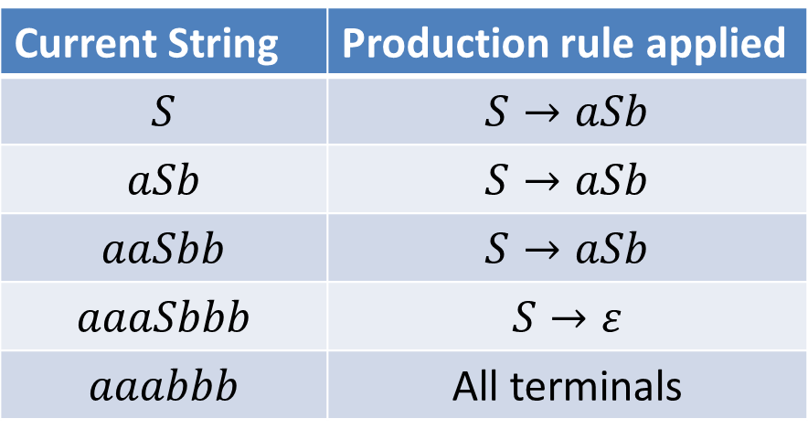

CFG Example: $a^{n}b^{n}$
$$S→aSb | ε$$
To produce $aaabbb$
Parse Tree
$$S$$
Current String | Production rule applied
$$S$$ | $$S→aSb$$
$$aSb$$ | $$S→aSb$$
$$aaSbb$$ | $$S→aSb$$
$$aaaSbbb$$ | $$S→ε$$
$$aaabbb$$ | All terminals
$$S$$
$$S$$
$$S$$
$$a$$
$$a$$
$$a$$
$$b$$
$$b$$
$$b$$

Slide 11



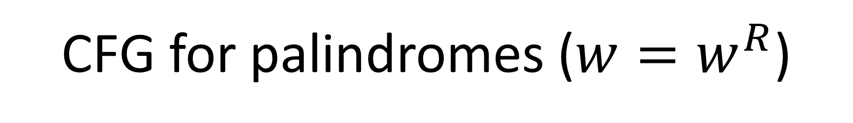




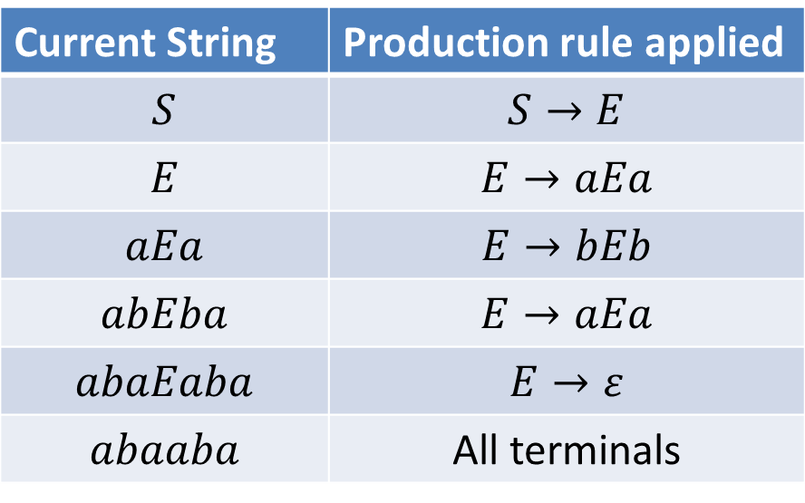


CFG for palindromes ($w{=w}^{R}$)
$$S→E|O$$
$$E→aEa \left| bEb \right| ε$$
$$O→aOa \left| bOb \right| a | b$$
To produce: abaaba
Parse Tree
$$S$$
$$E$$
Current String | Production rule applied
$$S$$ | $$S→E$$
$$E$$ | $$E→aEa$$
$$aEa$$ | $$E→bEb$$
$$abEba$$ | $$E→aEa$$
$$abaEaba$$ | $$E→ε$$
$$abaaba$$ | All terminals
$$E$$
$$E$$
$$E$$
$$a$$
$$b$$
$$a$$
$$a$$
$$b$$
$$a$$

Slide 12


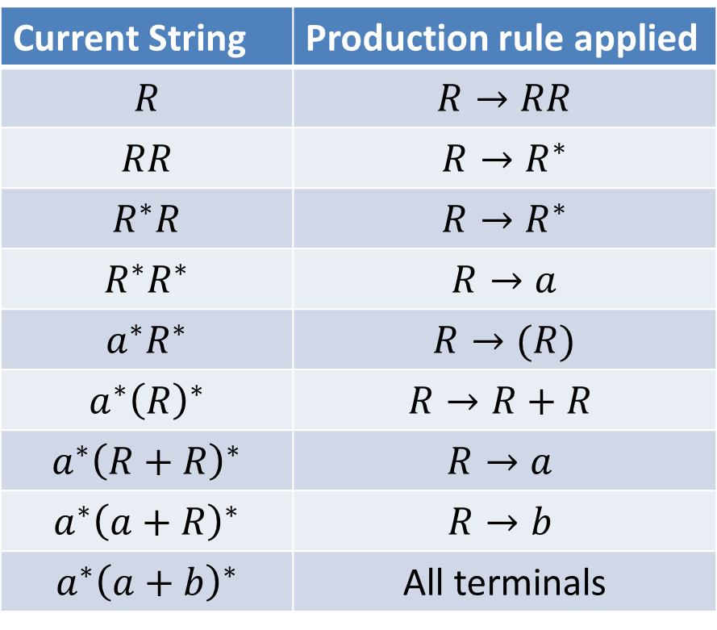













CFG for Regular Expressions
$$R→a \left| b \right| ε \left| R+R \right| RR \left| R^{∗} \right| (R)$$
To produce: $a^{∗}{\left(a+b\right)}^{∗}$
Parse Tree
$$R$$
Current String | Production rule applied
$$R$$ | $$R→RR$$
$$RR$$ | $$R→R^{∗}$$
$$R^{∗}R$$ | $$R→R^{∗}$$
$$R^{∗}R^{∗}$$ | $$R→a$$
$$a^{∗}R^{∗}$$ | $$R→(R)$$
$$a^{∗}{\left(R\right)}^{∗}$$ | $$R→R+R$$
$$a^{∗}{\left(R+R\right)}^{∗}$$ | $$R→a$$
$$a^{∗}{\left(a+R\right)}^{∗}$$ | $$R→b$$
$$a^{∗}{\left(a+b\right)}^{∗}$$ | All terminals
$$R$$
$$R$$
$$R$$
$$R$$
$$R$$
$$R$$
$$R$$
$$a$$
$$∗$$
$$($$
$$a$$
$$+$$
$$b$$
$$)$$
$$∗$$

Slide 13
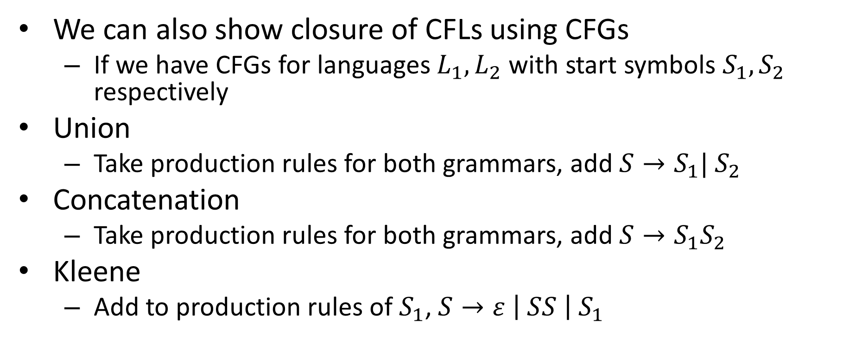
CFL Closure Redux
We can also show closure of CFLs using CFGs
If we have CFGs for languages $L_{1},L_{2}$ with start symbols $S_{1},S_{2}$ respectively
Union
Take production rules for both grammars, add $S→S_{1}| S_{2}$
Concatenation
Take production rules for both grammars, add $S→S_{1}S_{2}$
Kleene
Add to production rules of $S_{1}$, $S→ε \left| SS \right| S_{1}$

Slide 14
Usefulness of Parse Tree
Typically with CFGs, each production rule as some “meaning” associated
E.g. in Regex, each rule was an operation
From the parse tree, we know which operations to apply to which languages in what order to get the describe language

Slide 15





























Regex parse tree to NFA
Parse Tree
$$R$$
$$ε$$
concat
$$ε$$
$$a$$
$$R$$
$$R$$
kleene
$$a$$
kleene
$$ε$$
$$ε$$
$$R$$
$$ε$$
$$R$$
$$ε$$
$$ε$$
$$R$$
$$ε$$
$$b$$
$$a$$
union
$$R$$
$$R$$
$$ε$$
$$a$$
$$b$$
$$a$$
$$∗$$
$$($$
$$a$$
$$+$$
$$b$$
$$)$$
$$∗$$

Slide 16



























CFGs and Smug People on Social Media
Consider this CFG for arithemetic expressions:
$$S→S+S \left| S×S \right| \left(S\right) | 2$$
How could we get $2+2×2$?
$$6$$
$$8$$
$$S$$
$$S$$
$$2+4$$
$$4×2$$
$$S$$
$$S$$
$$S$$
$$S$$
$$2×2$$
$$2+2$$
$$S$$
$$S$$
$$S$$
$$S$$
$$2$$
$$+$$
$$2$$
$$×$$
$$2$$
$$2$$
$$+$$
$$2$$
$$×$$
$$2$$

Slide 17
Ambiguous Grammars
A CFG is ambiguous if there is at least 1 string that can be generated by at least 2 different parse trees
Generally less desirable (harder to assign meaning to each production rule)
Some languages have no non-ambiguous CFGs
Determining whether a CFG is ambiguous is not computable

