Slide 1
CS3102 Theory of Computation

Slide 2
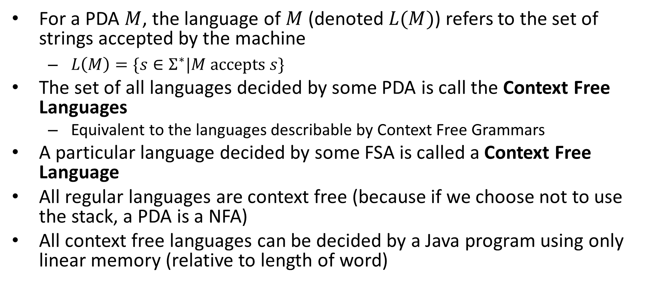
Context Free Languages
For a PDA $M$, the language of $M$ (denoted $L(M)$) refers to the set of strings accepted by the machine
$L\left(M\right)=\{s∈Σ^{∗}|M accepts s\}$
The set of all languages decided by some PDA is call the Context Free Languages
Equivalent to the languages describable by Context Free Grammars
A particular language decided by some FSA is called a Context Free Language
All regular languages are context free (because if we choose not to use the stack, a PDA is a NFA)
All context free languages can be decided by a Java program using only linear memory (relative to length of word)

Slide 3
Closure Properties of CFLs
Context Free Languages are closed under:
Union
Concatenation
Kleene Star
Intersection with Regular languages
Context Free Languages are not closed under:
Complementation
Intersection with CFLs

Slide 4
















CFLs closed under:
$$M_{R}$$
Union
Concatenation
Kleene Star
Intersection with regular languages
$$ε,ε,ε$$
$$ε,ε,ε$$
$$M_{S}$$
$$ε,ε,\#$$
$$M_{R}$$
$$ε,\#,ε$$
$$M_{S}$$
$$ε,\#,ε$$
$$ε,\#,ε$$
$$ε,ε,\#$$
$$M_{R}$$
$$ε,\#,ε$$
$$PDA$$
$$×$$
$$FSA$$

Slide 5
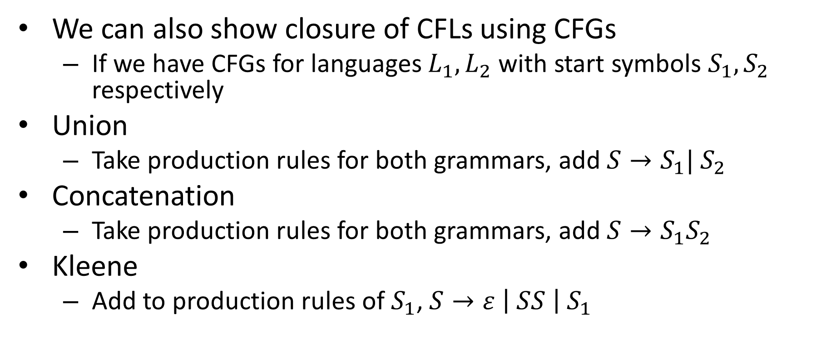
CFL Closure Redux
We can also show closure of CFLs using CFGs
If we have CFGs for languages $L_{1},L_{2}$ with start symbols $S_{1},S_{2}$ respectively
Union
Take production rules for both grammars, add $S→S_{1}| S_{2}$
Concatenation
Take production rules for both grammars, add $S→S_{1}S_{2}$
Kleene
Add to production rules of $S_{1}$, $S→ε \left| SS \right| S_{1}$

Slide 6


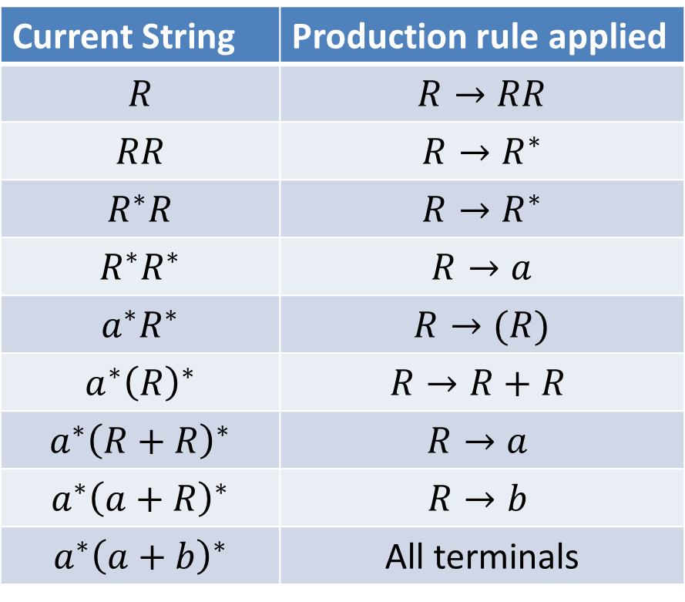













CFG for Regular Expressions
$$R→a \left| b \right| ε \left| R+R \right| RR \left| R^{∗} \right| (R)$$
To produce: $a^{∗}{\left(a+b\right)}^{∗}$
Parse Tree
$$R$$
Current String | Production rule applied
$$R$$ | $$R→RR$$
$$RR$$ | $$R→R^{∗}$$
$$R^{∗}R$$ | $$R→R^{∗}$$
$$R^{∗}R^{∗}$$ | $$R→a$$
$$a^{∗}R^{∗}$$ | $$R→(R)$$
$$a^{∗}{\left(R\right)}^{∗}$$ | $$R→R+R$$
$$a^{∗}{\left(R+R\right)}^{∗}$$ | $$R→a$$
$$a^{∗}{\left(a+R\right)}^{∗}$$ | $$R→b$$
$$a^{∗}{\left(a+b\right)}^{∗}$$ | All terminals
$$R$$
$$R$$
$$R$$
$$R$$
$$R$$
$$R$$
$$R$$
$$a$$
$$∗$$
$$($$
$$a$$
$$+$$
$$b$$
$$)$$
$$∗$$

Slide 7
Usefulness of Parse Tree
Typically with CFGs, each production rule has some “meaning” associated
E.g. in Regex, each rule was an operation
From the parse tree, we know which operations to apply to which languages in what order to get the describe language

Slide 8





























Regex parse tree to NFA
Parse Tree
$$R$$
$$ε$$
concat
$$ε$$
$$a$$
$$R$$
$$R$$
kleene
$$a$$
kleene
$$ε$$
$$ε$$
$$R$$
$$ε$$
$$R$$
$$ε$$
$$ε$$
$$R$$
$$ε$$
$$b$$
$$a$$
union
$$R$$
$$R$$
$$ε$$
$$a$$
$$b$$
$$a$$
$$∗$$
$$($$
$$a$$
$$+$$
$$b$$
$$)$$
$$∗$$

Slide 9



























CFGs and Smug People on Social Media
Consider this CFG for arithemetic expressions:
$$S→S+S \left| S×S \right| \left(S\right) | 2$$
How could we get $2+2×2$?
$$6$$
$$8$$
$$S$$
$$S$$
$$2+4$$
$$4×2$$
$$S$$
$$S$$
$$S$$
$$S$$
$$2×2$$
$$2+2$$
$$S$$
$$S$$
$$S$$
$$S$$
$$2$$
$$+$$
$$2$$
$$×$$
$$2$$
$$2$$
$$+$$
$$2$$
$$×$$
$$2$$

Slide 10
Ambiguous Grammars
A CFG is ambiguous if there is at least 1 string that can be generated by at least 2 different parse trees
Generally less desirable (harder to assign meaning to each production rule)
Some languages have no non-ambiguous CFGs
Determining whether a CFG is ambiguous is not computable

Slide 11






Hierarchy
Violates Pumping Lemma
For CFLs
$$a^{n}b^{n}c^{n}$$
$$ww$$
$$a^{n}b^{n}$$
Languages Decidable by ANY machine
$$b^{∗}$$
Violates Pumping Lemma
$$abba$$
$$ww^{R}$$
Languages computable by humans?
finite Languages
Described by DFA, NFA, RegExp,
Described by CFG, NDPDA
Regular Languages
Context-Free Languages
Decideable Languages

Slide 12
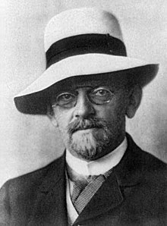
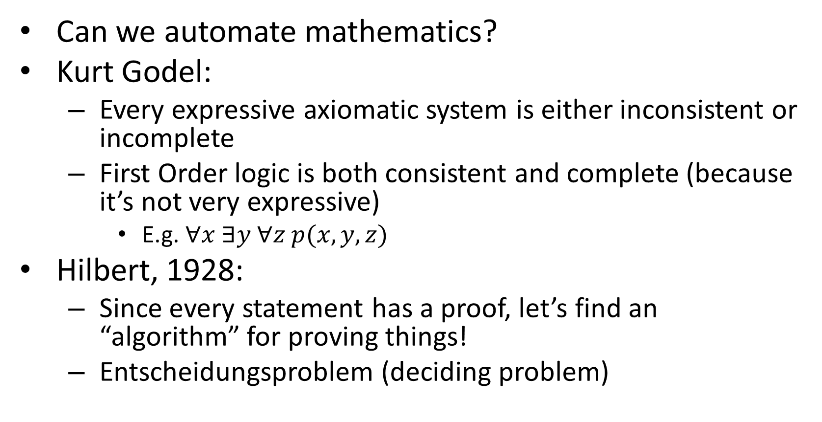
Historical Aside: David Hilbert
Can we automate mathematics?
Kurt Godel:
Every expressive axiomatic system is either inconsistent or incomplete
First Order logic is both consistent and complete (because it’s not very expressive)
E.g. $∀x ∃y ∀z p(x,y,z)$
Hilbert, 1928:
Since every statement has a proof, let’s find an “algorithm” for proving things!
Entscheidungsproblem (deciding problem)

Slide 13
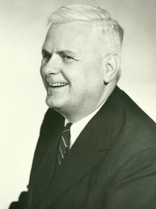
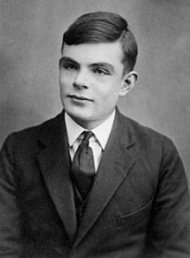
Alonzo Church, Alan Turing
What is an algorithm, anyway?
Church:
Lambda Calculus
Algorithms consist of variables and functions
Turing:
(Turing) Machine
Algorithms consist of memory that’s manipulated by a finite “controller”

Slide 14
On Computable Numbers, With an Application to the Entscheidungsproblem
Alan Turing’s seminal work
Contributions
Turing Machines
Proof that some “numbers” (equivalently functions) are expressible, but not computable by them
Proof that the Entscheidungsproblem cannot be solved by them
Proof that they are of equivalent power to the lambda calculus
Demonstration that they are “universal”
There is one Turing Machine that can simulate all others
A philosophical argument that they are equivalent to humans

Slide 15
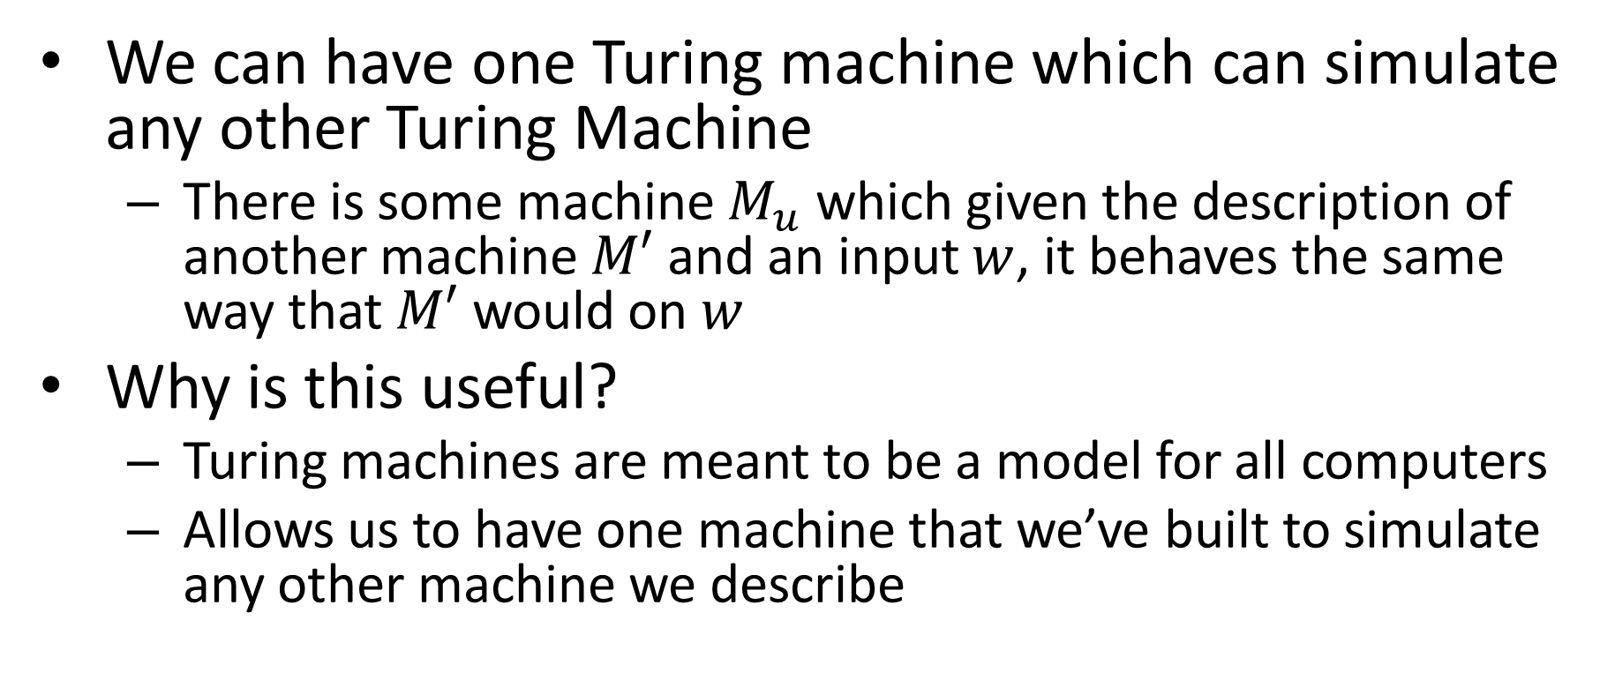
Universal Machine
We can have one Turing machine which can simulate any other Turing Machine
There is some machine $M_{u}$ which given the description of another machine $M′$ and an input $w$, it behaves the same way that $M′$ would on $w$
Why is this useful?
Turing machines are meant to be a model for all computers
Allows us to have one machine that we’ve built to simulate any other machine we describe

Slide 16
How do we describe a computer?

Slide 17
Lambda Calculus = Turing Machines
Lambda Calculus:
Computes using variables and functions to manipulate them
Precursor to modern programming languages
Turing Machines:
Precursor to modern CPUs
Their equivalence means:
Anything we can do in hardware, we can also do in software (and the reverse)

Slide 18
How do we compute?
We start with a universal Turing machine that we’ve built (a CPU)
We use the lambda calculus (programming languages) to write algorithms
Since the lambda calculus is equivalent to Turing machines, and our machine was universal, we can perform the operation described

Slide 19
What is Computer Science?
Computer Science studies all layers of abstractions of computing machines
Less Abstract More Abstract
Programming
Software
Algorithm
C, C++, Java, Python, …
Programming Languages
Lambda Calculus
Transistors, CPUs, Caches, …
Hardware
Turing Machine
Tools / Manifestations
“Layers” of Computation
Formal Models

Slide 20
Turing Machines
NFA/DFA:
Finite number of states,
read-once input,
transition using input character and state
PDA:
Finite number of states,
read-once input,
stack (memory)
Transition using input character, state, and stack
Can push to the stack on transition
Turing Machine:
Finite number of states,
Read-once input,
Semi-infinite tape (memory)
Transition using input character, state, and “current symbol” on tape
Can overwrite current symbol, move left/right on tape

Slide 21




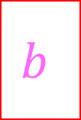
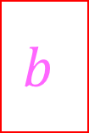
Turing Machine
States, transitions, etc.
FSM
Tape Contents
(initially contains input string followed by blanks)
…
$$a$$
$$a$$
$$b$$
$$b$$
$$c$$
$$c$$
_
_
_
Semi-infinite tape (memory)
Operation: transitions outgoing from each state match on current character on the tape, when transitioning you can overwrite that character and move which cell you’re reading

Slide 22
Can We do better?
Church-Turing Thesis:
No!
Turing Machines can compute anything a human can compute
Why is this reasonable?

