Slide 1
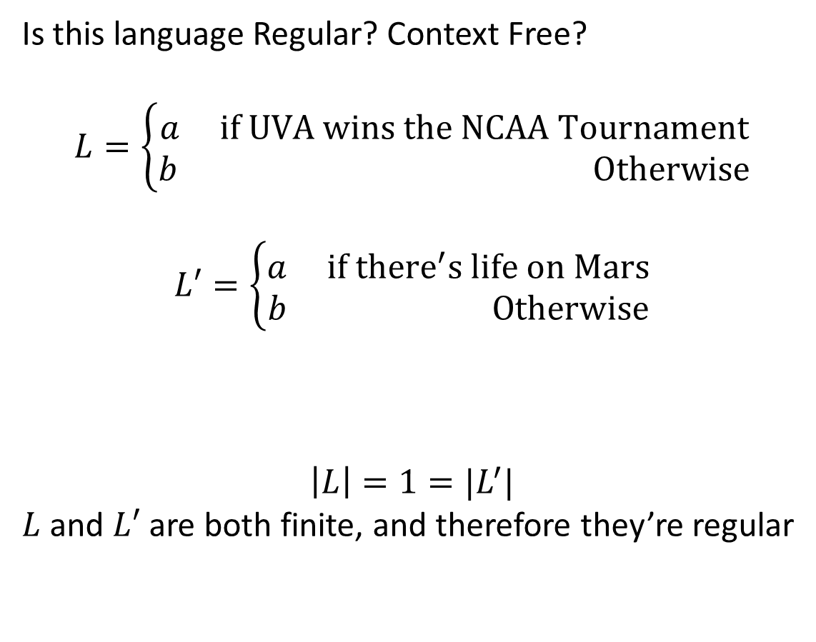
CS3102 Theory of Computation
Is this language Regular? Context Free?
$$L=\left\{\begin{aligned}a if UVA wins the NCAA Tournament \\ b Otherwise\end{aligned}\right.$$
$$L′=\left\{\begin{aligned}a if {there}^{′}s life on Mars \\ b Otherwise\end{aligned}\right.$$
$$\left|L\right|=1=|L^{′}|$$
$L$ and $L′$ are both finite, and therefore they’re regular

Slide 2
On Computable Numbers, With an Application to the Entscheidungsproblem
Alan Turing’s seminal work
Contributions
Turing Machines
Proof that some “numbers” (equivalently functions) are expressible, but not computable by them
Proof that the Entscheidungsproblem cannot be solved by them
Proof that they are of equivalent power to the lambda calculus
Demonstration that they are “universal”
There is one Turing Machine that can simulate all others
A philosophical argument that they are equivalent to humans

Slide 3
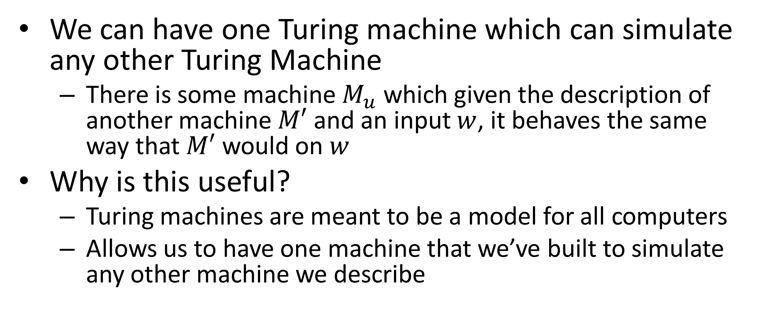
Universal Machine
We can have one Turing machine which can simulate any other Turing Machine
There is some machine $M_{u}$ which given the description of another machine $M′$ and an input $w$, it behaves the same way that $M′$ would on $w$
Why is this useful?
Turing machines are meant to be a model for all computers
Allows us to have one machine that we’ve built to simulate any other machine we describe

Slide 4
How do we compute?
We start with a universal Turing machine that we’ve built (a CPU)
We use the lambda calculus (programming languages) to write algorithms
Since the lambda calculus is equivalent to Turing machines, and our machine was universal, we can perform the operation described

Slide 5
What is Computer Science?
Computer Science studies all layers of abstractions of computing machines
Less Abstract More Abstract
Programming
Software
Algorithm
C, C++, Java, Python, …
Programming Languages
Lambda Calculus
Transistors, CPUs, Caches, …
Hardware
Turing Machine
Tools / Manifestations
“Layers” of Computation
Formal Models

Slide 6
Can We do better?
Church-Turing Thesis:
No!
Turing Machines can compute anything a human can compute
Why is this reasonable?
How do humans calculate?
Brains = finite state machine
Using scratchwork = tape

Slide 7
Turing Machines
NFA/DFA:
Finite number of states,
read-once input,
transition using input character and state
PDA:
Finite number of states,
read-once input,
stack (memory)
Transition using input character, state, and stack
Can push to the stack on transition
Turing Machine:
Finite number of states,
Read-once input,
Semi-infinite tape (memory)
Transition using input character, state, and “current symbol” on tape
Can overwrite current symbol, move left/right on tape

Slide 8

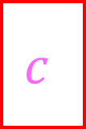


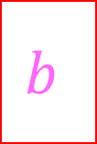
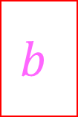
Turing Machine
States, transitions, etc.
FSM
Tape Contents
(initially contains input string followed by blanks)
…
$$a$$
$$a$$
$$b$$
$$b$$
$$c$$
$$c$$
_
_
_
Semi-infinite tape (memory)
Operation: transitions outgoing from each state match on current character on the tape, when transitioning you can overwrite that character and move which cell you’re reading

Slide 9



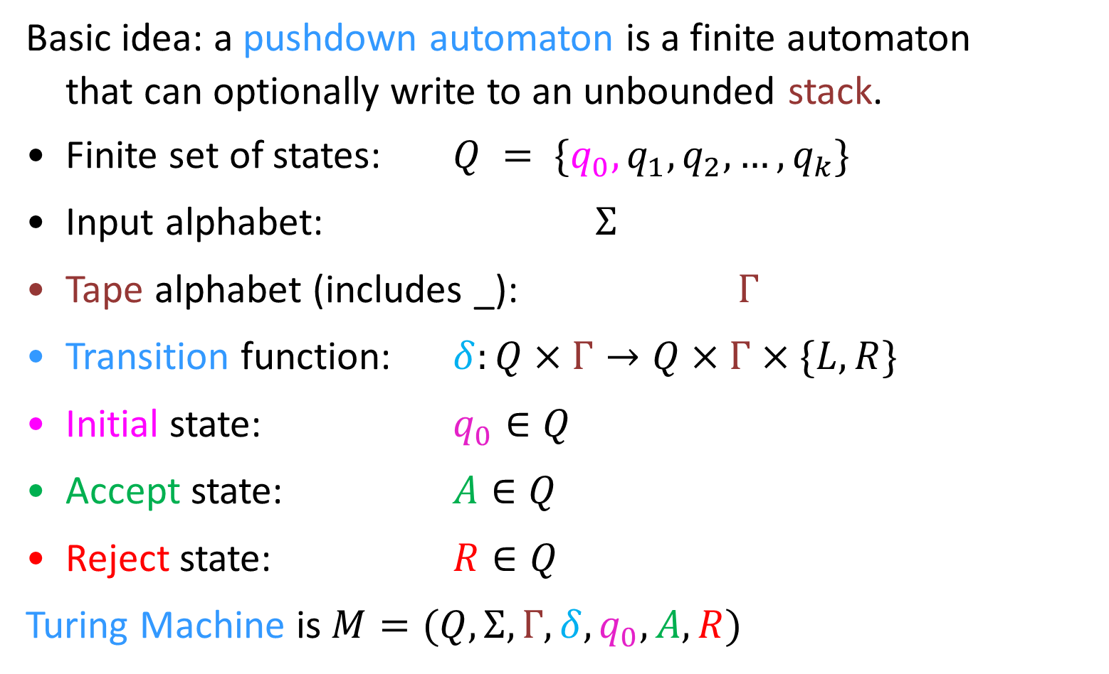
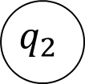
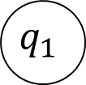

Turing Machine
Basic idea: a pushdown automaton is a finite automaton
that can optionally write to an unbounded stack.
Finite set of states: $Q = \{q_{0}, q_{1},q_{2}, …, q_{k}\}$
Input alphabet: $Σ$
Tape alphabet (includes _): $Γ$
Transition function: $δ:Q×Γ→Q×Γ×\{L,R\}$
Initial state: $q_{0}∈Q$
Accept state: $A∈Q$
Reject state: $R∈Q$
Turing Machine is $M=(Q,Σ,Γ,δ,q_{0},A,R)$
$$q_{1}$$
Read
Move
$$a, b, L$$
Write
$$q_{1}$$
$$q_{2}$$
$$q_{0}$$
read, write, move
$$A$$
$$R$$

Slide 10
Configurations
DFA:
Which state is currently active
At start: Start state is active
PDA:
Which state is currently active
What’s in the stack
At start: start state is active, stack is empty
Turing Machine
Which state is currently active
What’s on the tape
Where the read head is on the tape
At start: start state is active, input is is on the tape (with blanks after), read head is at the first cell

Slide 11
Transition behavior
DFA:
Input: State and input symbol
Result: state
PDA:
Input: State, input symbol, symbol popped from the stack
Result: state, symbol pushed to the stack
Turing Machine:
Input: State, symbol at current location in the tape
Result: State, symbol writtent to current location in the tape, current location moved 1 to the left/right

Slide 12
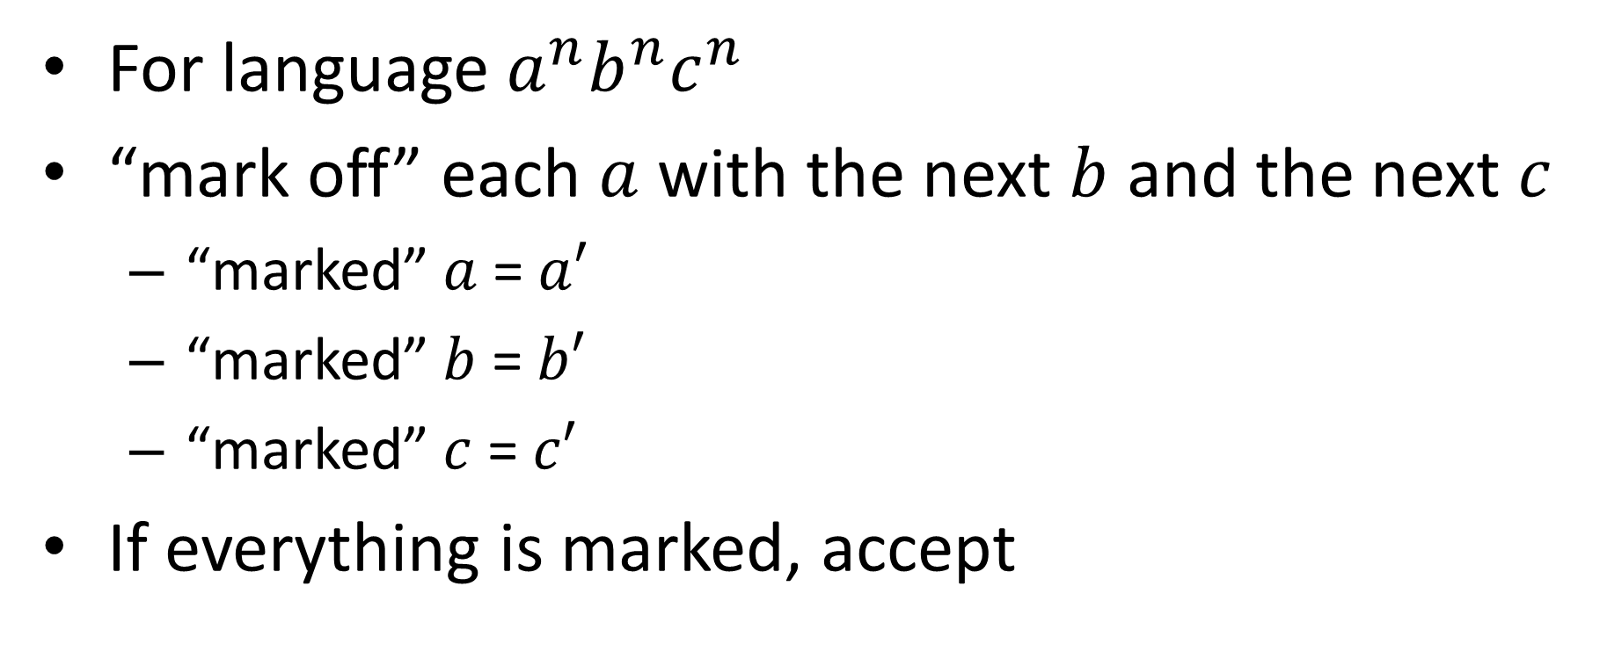
Example Turing Machine
For language $a^{n}b^{n}c^{n}$
“mark off” each $a$ with the next $b$ and the next $c$
“marked” $a$ = $a′$
“marked” $b$ = $b′$
“marked” $c$ = $c′$
If everything is marked, accept

Slide 13

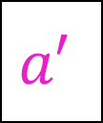


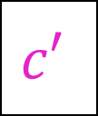


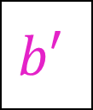

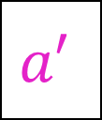

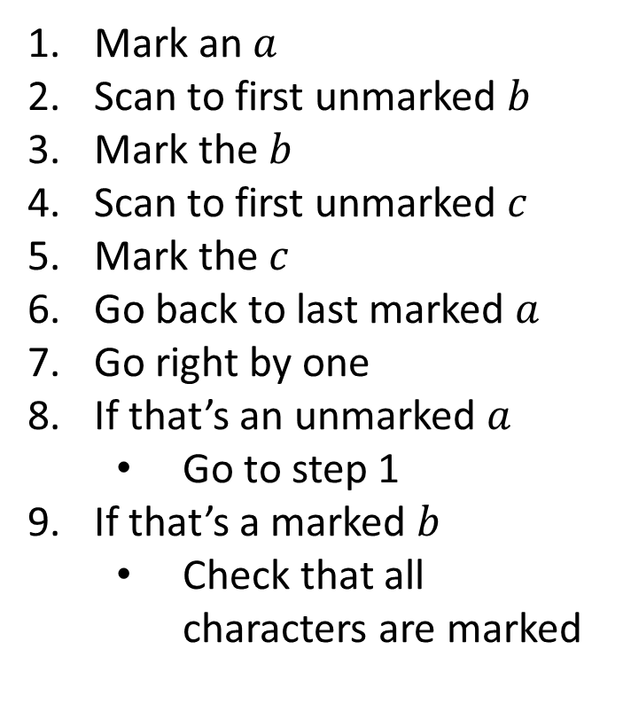
$$a^{n}b^{n}c^{n}$$
Mark an $a$
Scan to first unmarked $b$
Mark the $b$
Scan to first unmarked $c$
Mark the $c$
Go back to last marked $a$
Go right by one
If that’s an unmarked $a$
Go to step 1
If that’s a marked $b$
Check that all characters are marked
$$a′$$
$$a′$$
$$b′$$
$$a$$
$$a$$
$$b$$
$$b$$
$$c$$
$$c$$
_
_
_
$$c′$$
input

Slide 14
What does the machine look like?

Slide 15
Acceptance Condition
DFA
Input has all been read
We’re in a final/accepting state
PDA
Input has all been read
We’re in a final/accepting state
The stack is empty
TM
We’re in the accepting state

Slide 16
Rejection Condition
DFA
Input has all been read
We’re not in a final/accepting state
PDA
Input has all been read
We’re not in a final/accepting state
The stack isn’t empty
TM
We’re in the rejecting state

Slide 17
Some Turing Machines never accept/reject
while(true){
twiddle(thumbs);
}
In this case they run forever
3 “reporting” behaviors
Accept and halt
Reject and halt
Run forever (implicit reject)
This is necessary for computation
while(x != 1){
if(x%2 == 0){
x = x / 2;
}
else{
x = 3x+1;
}
}

Slide 18
Running forever
Is it a bad thing?

Slide 19

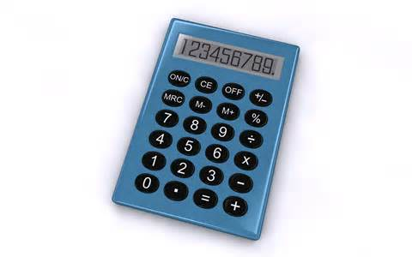
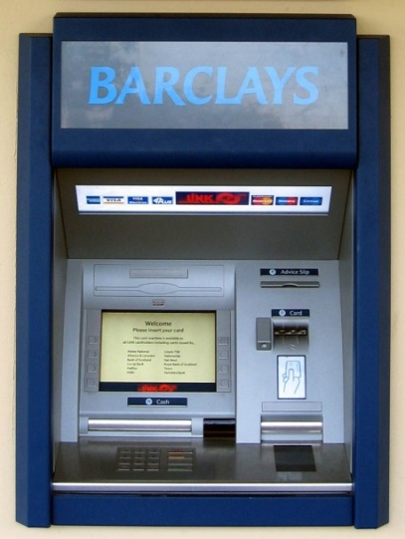



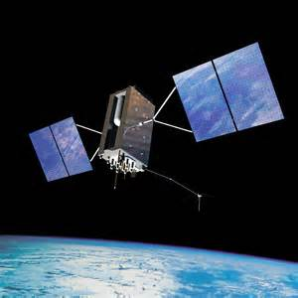
Programs we want to halt:
Programs we want to run forever:
Your 2150 Homework

Slide 20
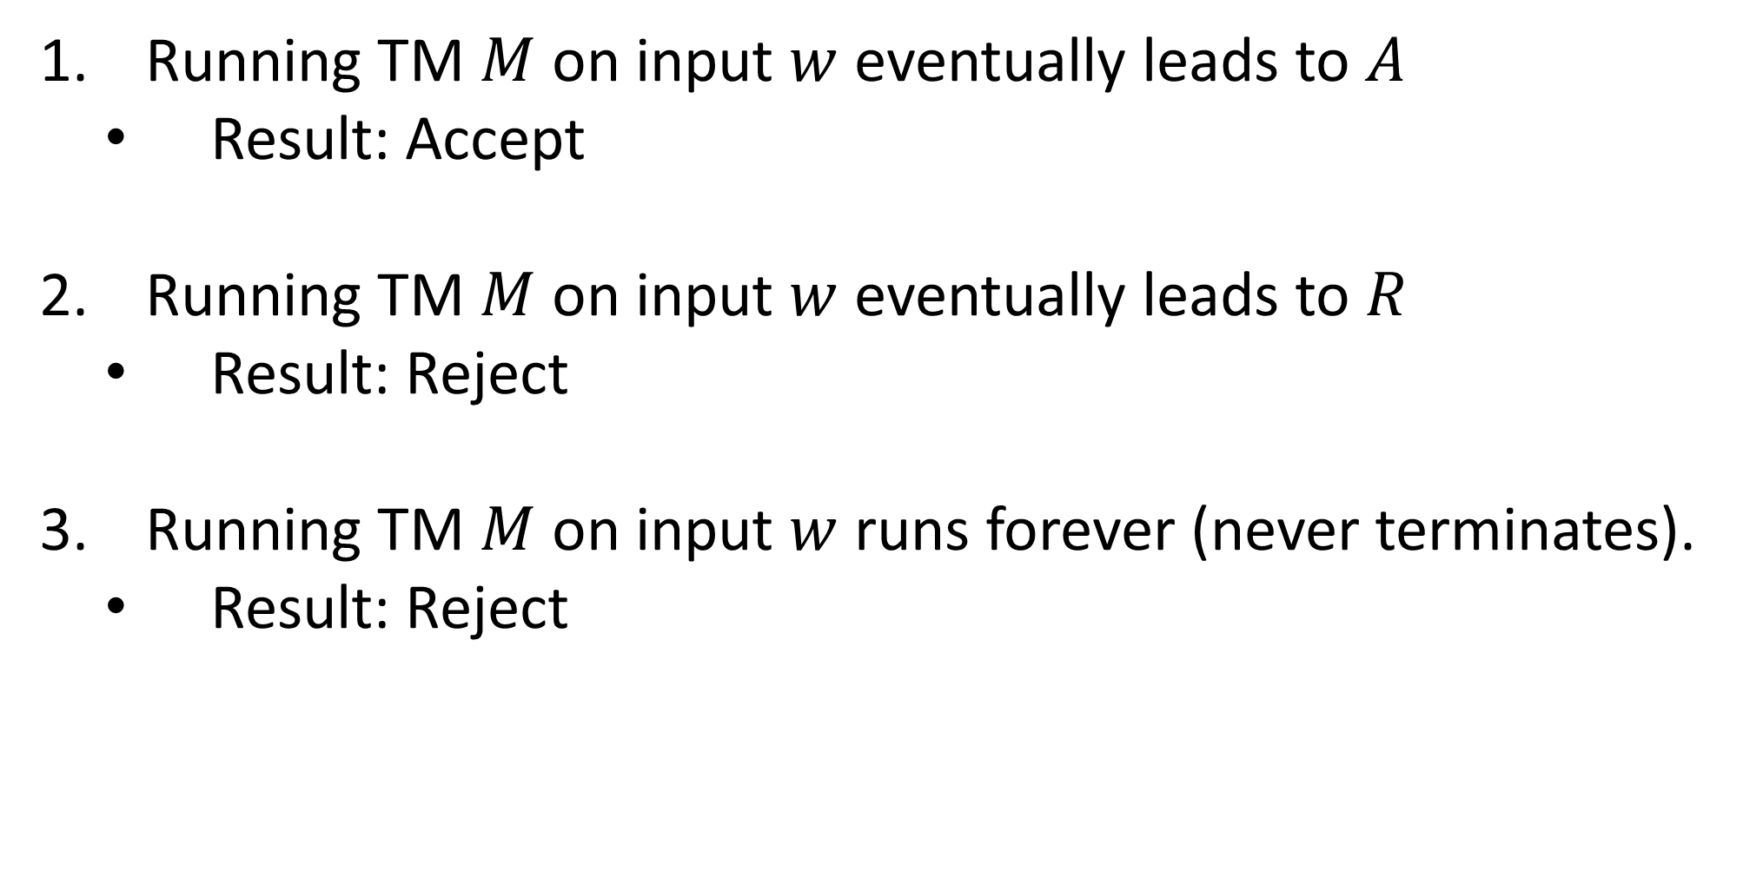
Turing Machine Outcomes
Running TM $M$ on input $w$ eventually leads to $A$
Result: Accept
Running TM $M$ on input $w$ eventually leads to $R$
Result: Reject
Running TM $M$ on input $w$ runs forever (never terminates).
Result: Reject

Slide 21
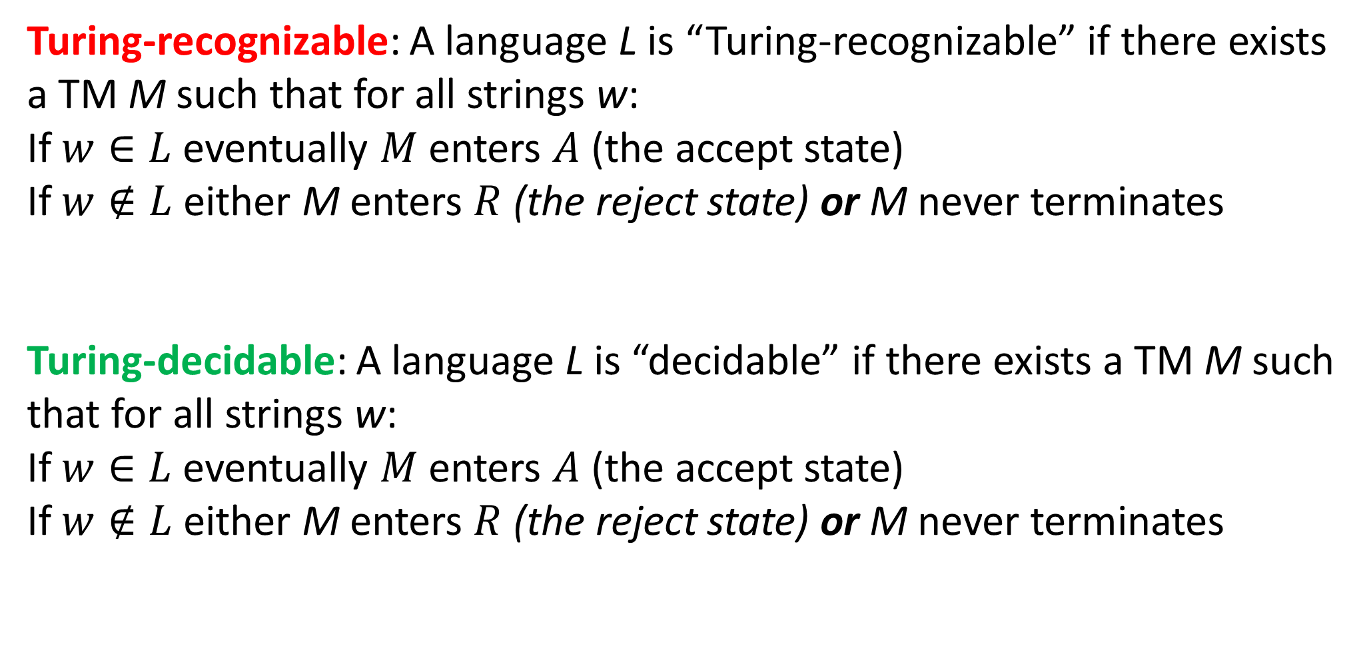
Recognizing vs. Deciding
Turing-recognizable: A language L is “Turing-recognizable” if there exists a TM M such that for all strings w:
If $w∈L$ eventually $M$ enters $A$ (the accept state)
If $w∉L$ either M enters $R$ (the reject state) or M never terminates
Turing-decidable: A language L is “decidable” if there exists a TM M such that for all strings w:
If $w∈L$ eventually $M$ enters $A$ (the accept state)
If $w∉L$ either M enters $R$ (the reject state) or M never terminates

Slide 22



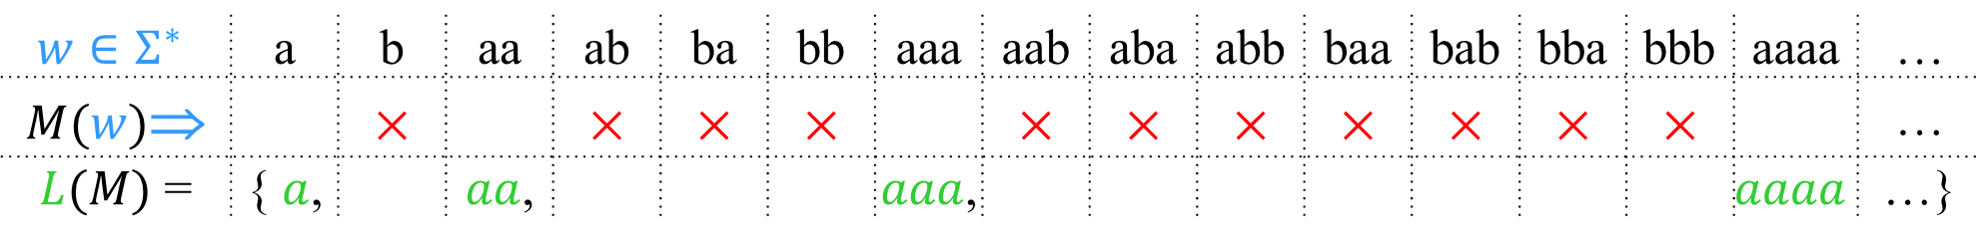
Turing -Recognizable vs. -Decidable
Accept
& halt
×
Reject
& halt
Never
runs
forever
$w$→
Input
A language is Turing-decidable iff it is exactly the set of strings accepted by some always-halting TM.
$$w∈Σ^{∗}$$ | a | b | aa | ab | ba | bb | aaa | aab | aba | abb | baa | bab | bba | bbb | aaaa | …
$M(w)$⇒ |  | × |  | × | × | × |  | × | × | × | × | × | × | × |  | …
$L(M)$ = | { $a$, |  | $aa$, |  |  |  | $aaa$, |  |  |  |  |  |  |  | $$aaaa$$ | …}
$M$ must always halt on every input.

Slide 23
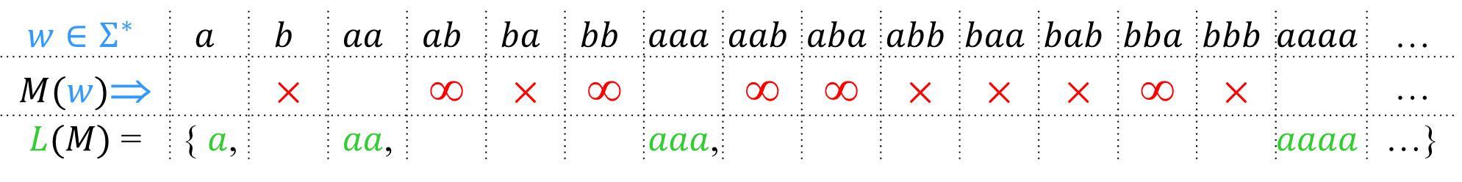
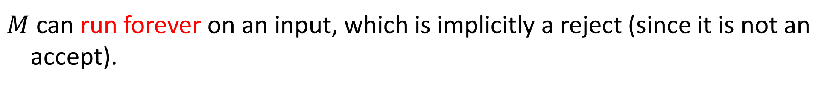
Turing -Recognizable vs. -Decidable
Accept
& halt
×
Reject
& halt
≡
∞
Run
forever
$w$→
Input
A language is Turing-recognizable iff it is exactly the set of strings accepted by some Turing machine.
$$w∈Σ^{∗}$$ | $$a$$ | $$b$$ | $$aa$$ | $$ab$$ | $$ba$$ | $$bb$$ | $$aaa$$ | $$aab$$ | $$aba$$ | $$abb$$ | $$baa$$ | $$bab$$ | $$bba$$ | $$bbb$$ | $$aaaa$$ | …
$M(w)$⇒ |  | × |  | ∞ | × | ∞ |  | ∞ | ∞ | × | × | × | ∞ | × |  | …
$L(M)$ = | { $a$, |  | $aa$, |  |  |  | $aaa$, |  |  |  |  |  |  |  | $$aaaa$$ | …}
$M$ can run forever on an input, which is implicitly a reject (since it is not an accept).

