Slide 1
CS3102 Theory of Computation

Slide 2




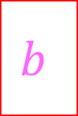
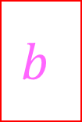
Turing Machine
States, transitions, etc.
FSM
Tape Contents
(initially contains input string followed by blanks)
…
$$a$$
$$a$$
$$b$$
$$b$$
$$c$$
$$c$$
_
_
_
Semi-infinite tape (memory)
Operation: transitions outgoing from each state match on current character on the tape, when transitioning you can overwrite that character and move which cell you’re reading

Slide 3
Turing Machines
NFA/DFA:
Finite number of states,
read-once input,
transition using input character and state
PDA:
Finite number of states,
read-once input,
stack (memory)
Transition using input character, state, and stack
Can push to the stack on transition
Turing Machine:
Finite number of states,
Semi-infinite tape (memory)
Transition using state, and “current symbol” on tape
Can overwrite current symbol, move left/right on tape

Slide 4
Configurations
DFA:
Which state is currently active
At start: Start state is active
PDA:
Which state is currently active
What’s in the stack
At start: start state is active, stack is empty
Turing Machine
Which state is currently active
What’s on the tape
Where the read head is on the tape
At start: start state is active, input is is on the tape (with blanks after), read head is at the first cell

Slide 5
Transition behavior
DFA:
Input: State and input symbol
Result: state
PDA:
Input: State, input symbol, symbol popped from the stack
Result: state, symbol pushed to the stack
Turing Machine:
Input: State, symbol at current location in the tape
Result: State, symbol writtent to current location in the tape, current location moved 1 to the left/right

Slide 6
Acceptance Condition
DFA
Input has all been read
We’re in a final/accepting state
PDA
Input has all been read
We’re in a final/accepting state
The stack is empty
TM
We’re in the accepting state

Slide 7
Rejection Condition
DFA
Input has all been read
We’re not in a final/accepting state
PDA
Input has all been read
We’re not in a final/accepting state
The stack isn’t empty
TM
We’re in the rejecting state

Slide 8
Some Turing Machines never accept/reject
while(true){
twiddle(thumbs);
}
In this case they run forever
3 “reporting” behaviors
Accept and halt
Reject and halt
Run forever (implicit reject)
This is necessary for computation
while(x != 1){
if(x%2 == 0){
x = x / 2;
}
else{
x = 3x+1;
}
}
Return true;

Slide 9
Running forever
Is it a bad thing?

Slide 10

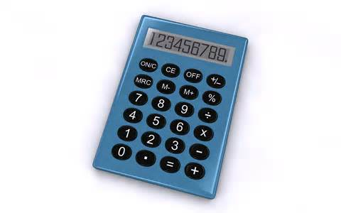
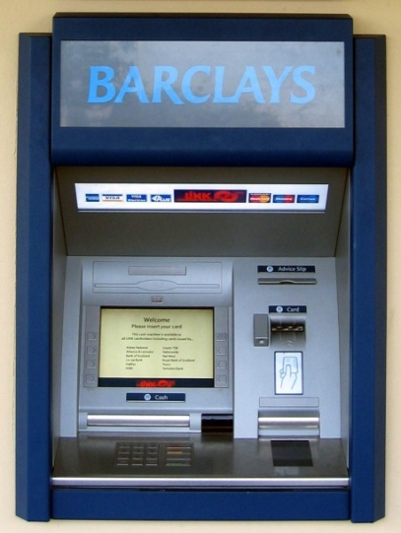




Programs we want to halt:
Programs we want to run forever:
Your 2150 Homework

Slide 11
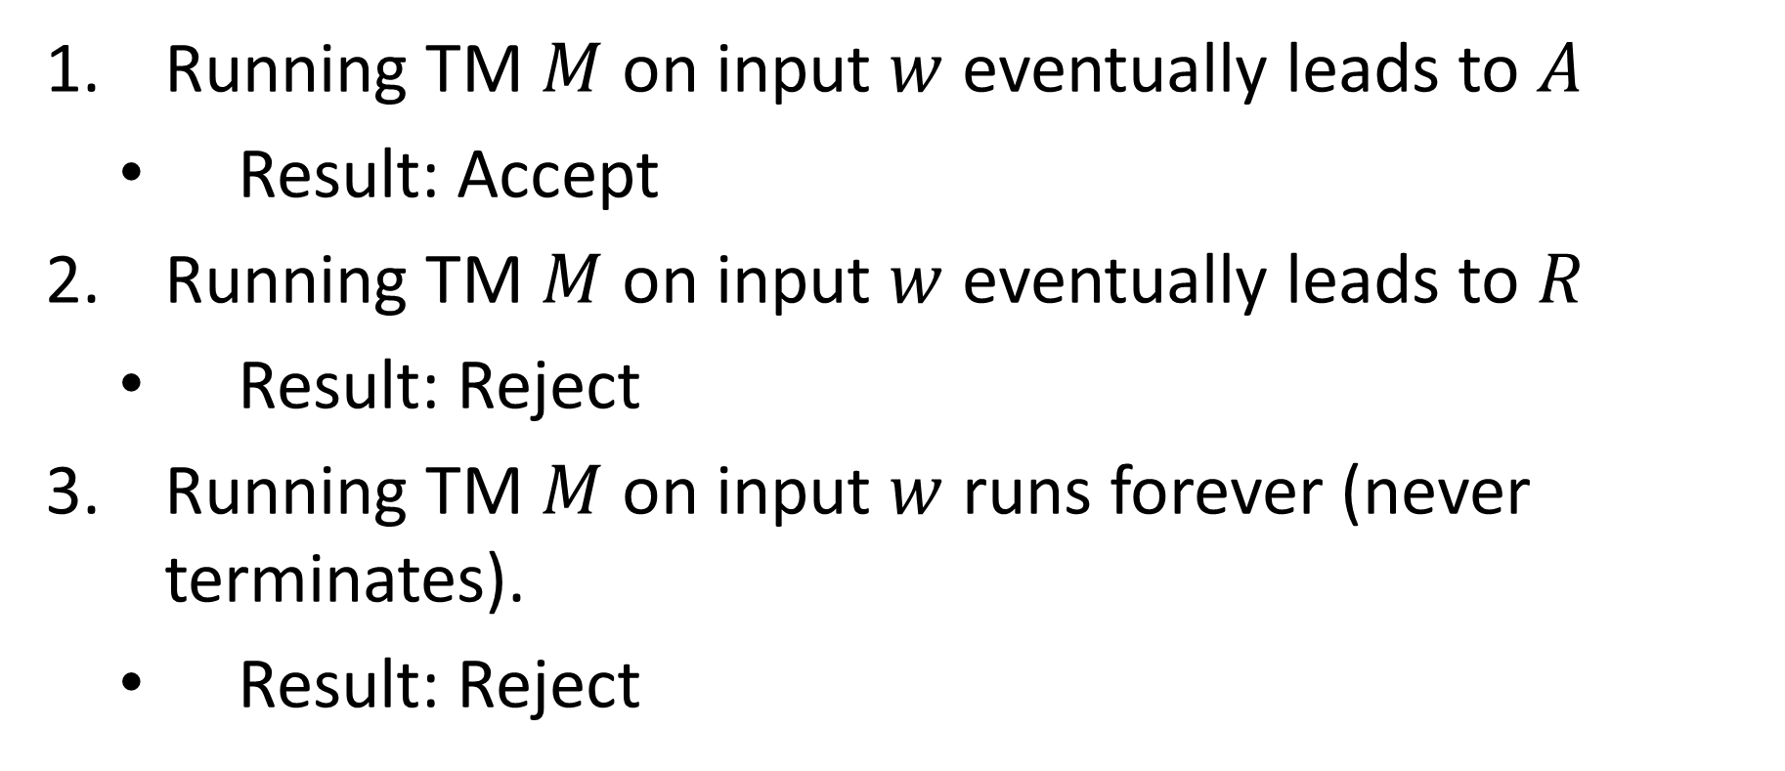
Turing Machine Outcomes
Running TM $M$ on input $w$ eventually leads to $A$
Result: Accept
Running TM $M$ on input $w$ eventually leads to $R$
Result: Reject
Running TM $M$ on input $w$ runs forever (never terminates).
Result: Reject

Slide 12
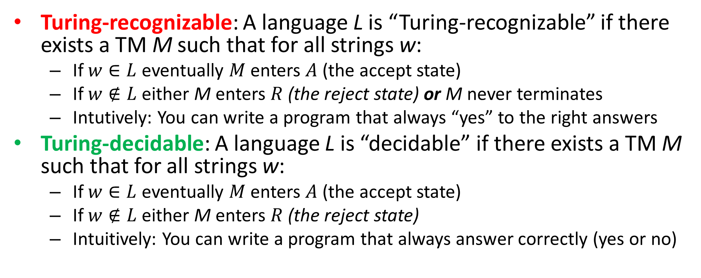
Recognizing Vs. Deciding
Turing-recognizable: A language L is “Turing-recognizable” if there exists a TM M such that for all strings w:
If $w∈L$ eventually $M$ enters $A$ (the accept state)
If $w∉L$ either M enters $R$ (the reject state) or M never terminates
Intutively: You can write a program that always “yes” to the right answers
Turing-decidable: A language L is “decidable” if there exists a TM M such that for all strings w:
If $w∈L$ eventually $M$ enters $A$ (the accept state)
If $w∉L$ either M enters $R$ (the reject state)
Intuitively: You can write a program that always answer correctly (yes or no)

Slide 13


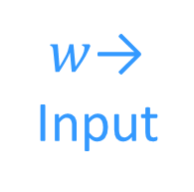
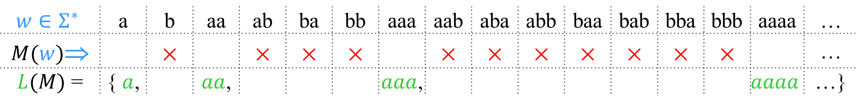
Decidable
Accept
& halt
×
Reject
& halt
Never
runs
forever
$w$→
Input
A language is decidable iff it is exactly the set of strings accepted by some always-halting TM.
$$w∈Σ^{∗}$$ | a | b | aa | ab | ba | bb | aaa | aab | aba | abb | baa | bab | bba | bbb | aaaa | …
$M(w)$⇒ |  | × |  | × | × | × |  | × | × | × | × | × | × | × |  | …
$L(M)$ = | { $a$, |  | $aa$, |  |  |  | $aaa$, |  |  |  |  |  |  |  | $$aaaa$$ | …}
$M$ must always halt on every input.

Slide 14
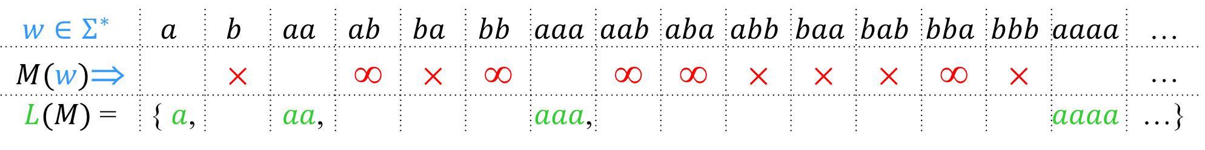
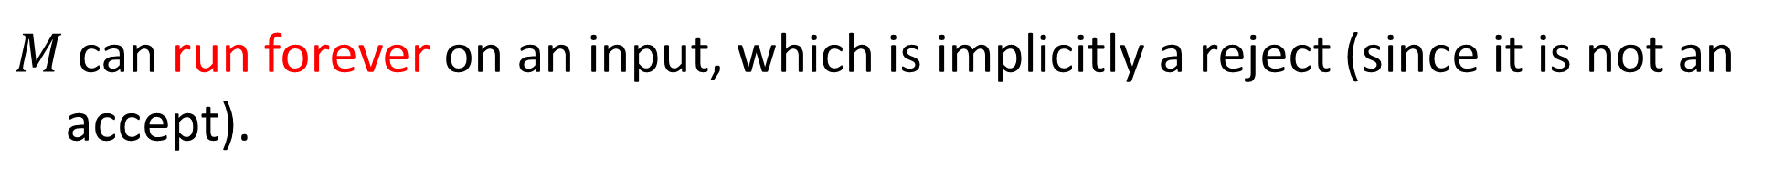
Recognizable
Accept
& halt
×
Reject
& halt
≡
∞
Run
forever
$w$→
Input
A language is Turing-recognizable iff it is exactly the set of strings accepted by some Turing machine.
$$w∈Σ^{∗}$$ | $$a$$ | $$b$$ | $$aa$$ | $$ab$$ | $$ba$$ | $$bb$$ | $$aaa$$ | $$aab$$ | $$aba$$ | $$abb$$ | $$baa$$ | $$bab$$ | $$bba$$ | $$bbb$$ | $$aaaa$$ | …
$M(w)$⇒ |  | × |  | ∞ | × | ∞ |  | ∞ | ∞ | × | × | × | ∞ | × |  | …
$L(M)$ = | { $a$, |  | $aa$, |  |  |  | $aaa$, |  |  |  |  |  |  |  | $$aaaa$$ | …}
$M$ can run forever on an input, which is implicitly a reject (since it is not an accept).

Slide 15
Computability
Generally: Computable = Decideable

Slide 16
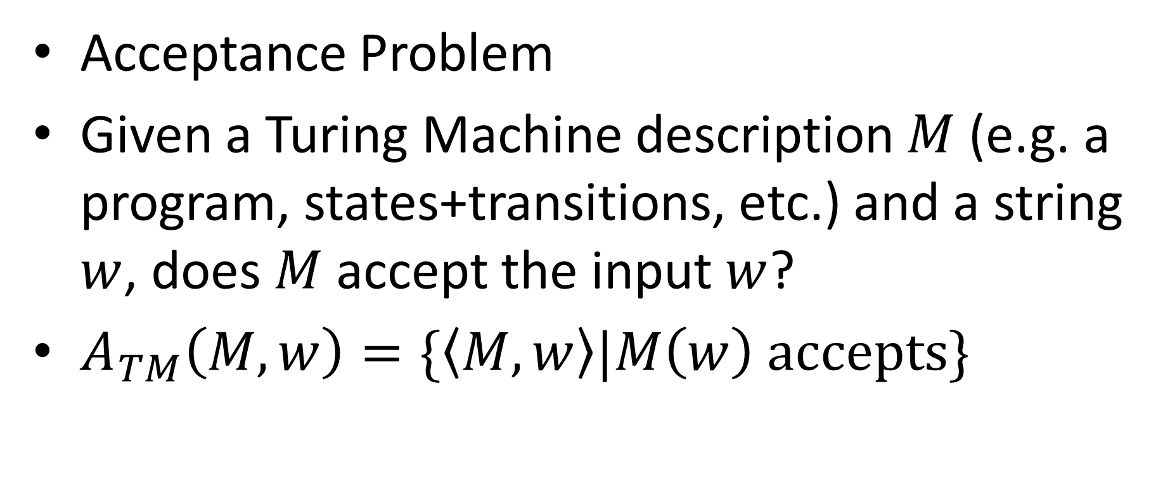
An Undecidable Problem/Language
Acceptance Problem
Given a Turing Machine description $M$ (e.g. a program, states+transitions, etc.) and a string $w$, does $M$ accept the input $w$?
$A_{TM}\left(M,w\right)=\{\left\langle M,w\right\rangle |M\left(w\right) accepts\}$

Slide 17
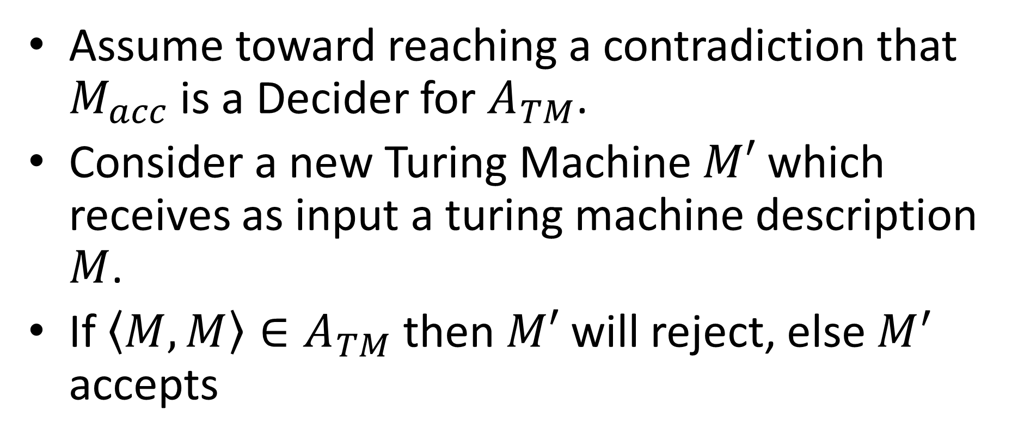
Acceptance problem is undecidable
Assume toward reaching a contradiction that $M_{acc}$ is a Decider for $A_{TM}$.
Consider a new Turing Machine $M′$ which receives as input a turing machine description $M$.
If $\left\langle M,M\right\rangle ∈A_{TM}$ then $M′$ will reject, else $M^{′}$ accepts

Slide 18

Pseudocode for $M′$
public static boolean mPrime(String m){
return !accept(m,m);
}
What does mPrime(source(mPrime)) return?

Slide 19
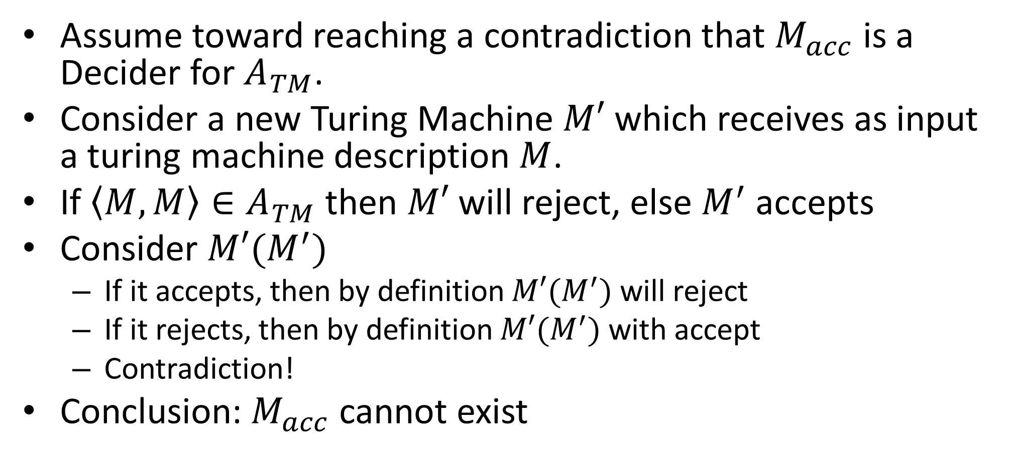
Acceptance problem is undecidable
Assume toward reaching a contradiction that $M_{acc}$ is a Decider for $A_{TM}$.
Consider a new Turing Machine $M′$ which receives as input a turing machine description $M$.
If $\left\langle M,M\right\rangle ∈A_{TM}$ then $M′$ will reject, else $M^{′}$ accepts
Consider $M′(M^{′})$
If it accepts, then by definition $M′(M^{′})$ will reject
If it rejects, then by definition $M′(M^{′})$ with accept
Contradiction!
Conclusion: $M_{acc}$ cannot exist

Slide 20

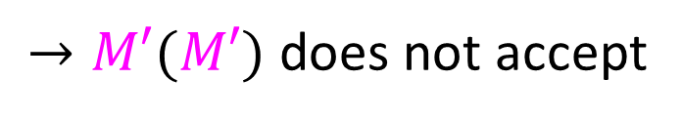




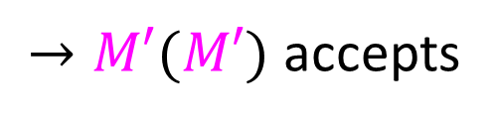
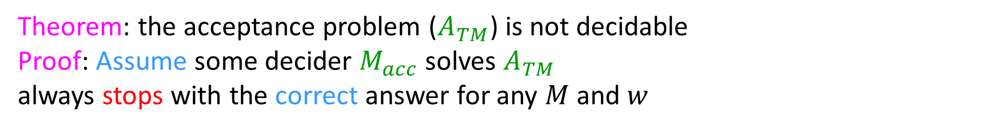



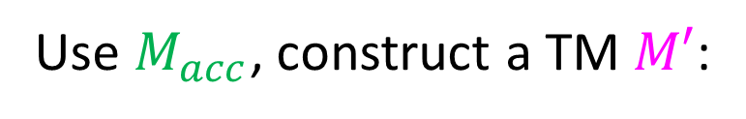




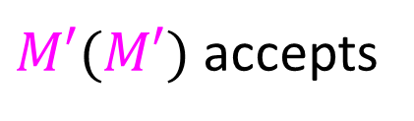
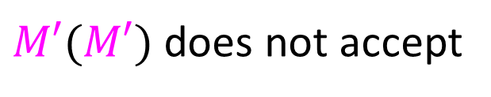



Theorem: the acceptance problem ($A_{TM}$) is not decidable
Proof: Assume some decider $M_{acc}$solves $A_{TM}$
always stops with the correct answer for any $M$ and $w$
$$M_{acc}$$
$$D$$
yes
Does
$M(w)$ accept?
yes
$$M$$
Does
$M(w)$ accept?
$$M$$
$$w$$
$$w$$
no
no
Use $M_{acc}$, construct a TM $M′$:
$$M′$$
$$M_{acc}$$
$$M$$
$$M′$$
Does
$M(w)$ accept?
yes
no
$$x$$
$$M^{′}$$
$$w$$
$$M′$$
no
yes
$M′(M′)$ accepts
$→M′(M′)$ does not accept
Contradiction!
$M′(M′)$ does not accept
$→M′(M′)$ accepts
$→$ $M_{acc}$ cannot exist! (at least as an algorithm / program / TM)

Slide 21


Proof by Reduction
Shows how two different problems relate to each other
MOVIE TIME!

Slide 22
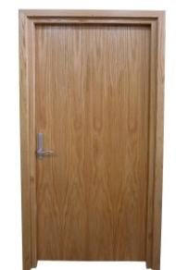


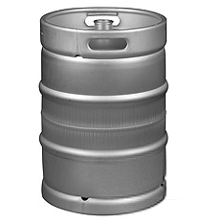

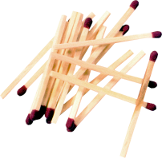




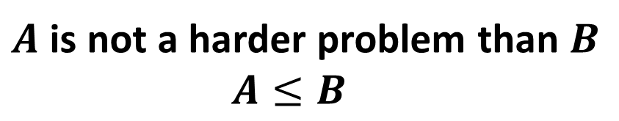

Reduction Proofs
Opening a door
Lighting a fire
$$A$$
reduces to
$$B$$
Alcohol, wood, matches
$$X$$
Keg cannon battering ram
$$Y$$
can be used to make
that can solve B
that can solve A
$A$ is not a harder problem than $B$
$A≤B$
The name “reduces” is confusing: it is in the opposite direction of the making

Slide 23
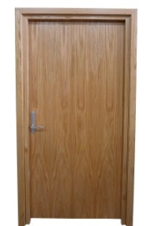
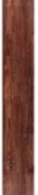







Proof of Impossibility by Reduction
$$X$$
1. X isn’t possible
(e.g., X = some way to open the door)
$$Y$$
2. Assume Y is possible
(Y = some way to light a fire)
$$X$$
$$Y$$
3. Show how to use Y to perform X.
4. X isn’t possible, but Y could be used to perform X
conclusion: Y must not be possible either

Slide 24
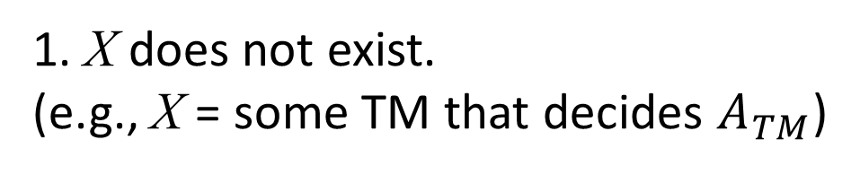
Proof of Impossibility by Reduction
$$X$$
1. X does not exist.
(e.g., X = some TM that decides $A_{TM}$)
$$Y$$
2. Assume Y exists.
(Y = some TM that decides B)
$$X$$
$$Y$$
3. Show how to use Y to perform X.
4. X doesn’t exist, but Y could be used to make X
conclusion: Y must not exist either

Slide 25

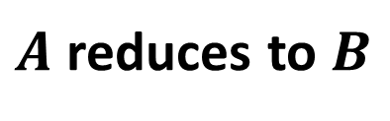

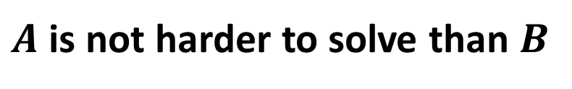

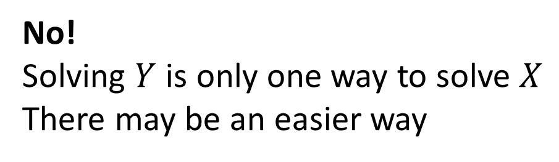

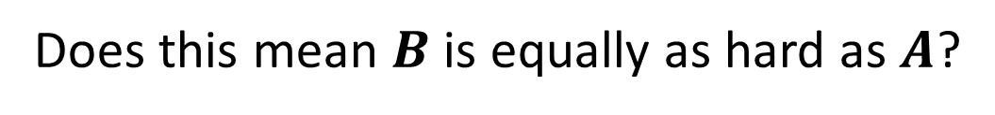

Converse?
$A$ reduces to $B$
$$X$$
$$Y$$
can be used to make
that can solve B
(Lighting a fire)
$A$ is not harder to solve than $B$
that can solve A
(opening a door)
$$A≤B$$
Does this mean $B$ is equally as hard as $A$?
$$A=B$$
No!
Solving $Y$ is only one way to solve $X$
There may be an easier way

Slide 26


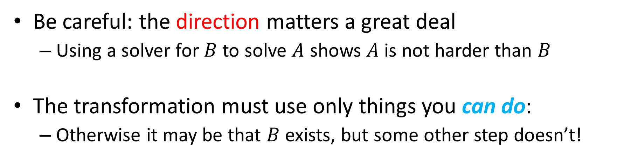

Common Reduction Traps
Be careful: the direction matters a great deal
Using a solver for $B$ to solve $A$ shows $A$ is not harder than $B$
The transformation must use only things you can do:
Otherwise it may be that $B$ exists, but some other step doesn’t!
$$A$$
$$B$$
___ Reduces to ___
What does can do mean?

Slide 27
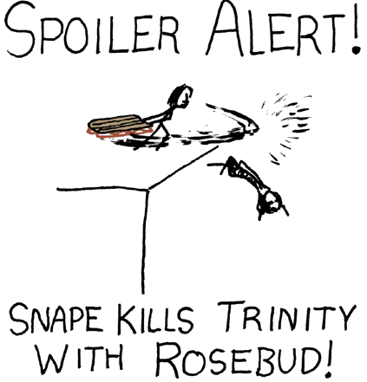
What “Can Do” Means
Tools used in a reduction are limited by what you are proving
Undecidability:
You are proving something about all TMs:
The transformation “can do” things a terminating TM “can do”
Spoiler alert!
Complexity:
You are proving something about time required:
The time it takes to do the transformation is limited
Combinatorics:
You are proving something about the number of things
The transformation must be bijective

Slide 28
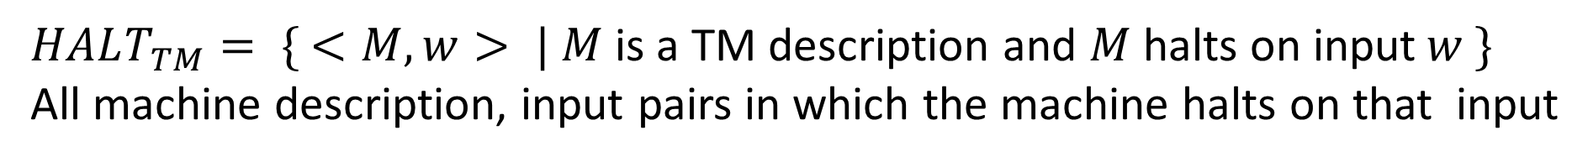
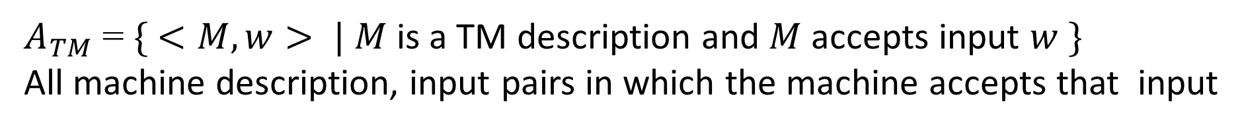
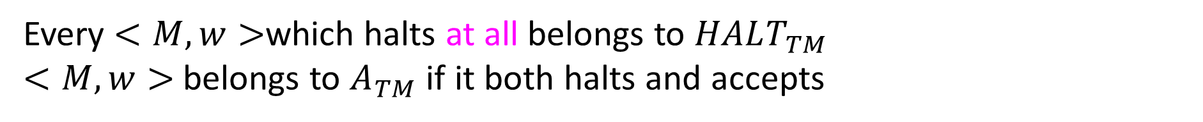
The Halting Language
$A_{TM}$= $\{ <M, w> | M$ is a TM description and $M$accepts input $w \}$
All machine description, input pairs in which the machine accepts that input
$HALT_{TM}= \{ <M, w> | M$is a TM description and $M$halts on input$w \}$
All machine description, input pairs in which the machine halts on that input
Every $<M,w>$which halts at all belongs to $HALT_{TM}$
$<M,w>$ belongs to $A_{TM}$ if it both halts and accepts

Slide 29

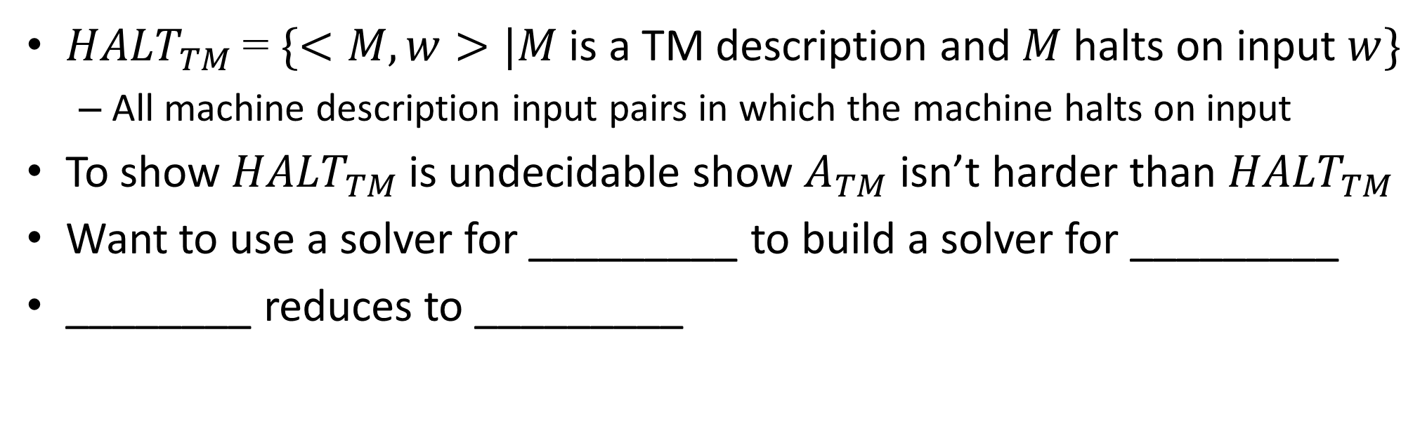







${HALT}_{TM}$ is Undecidable
${HALT}_{TM}$= $\{<M, w>|M$ is a TM description and $M$halts on input $w\}$
All machine description input pairs in which the machine halts on input
To show ${HALT}_{TM}$ is undecidable show $A_{TM}$ isn’t harder than ${HALT}_{TM}$
Want to use a solver for _________ to build a solver for _________
________ reduces to _________
$$HALT_{TM}$$
$$A_{TM}$$
$$A_{TM}$$
$$HALT_{TM}$$
$$A_{TM}$$
$$HALT_{TM}$$

Slide 30




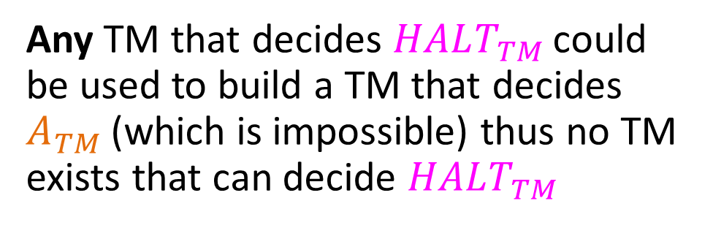
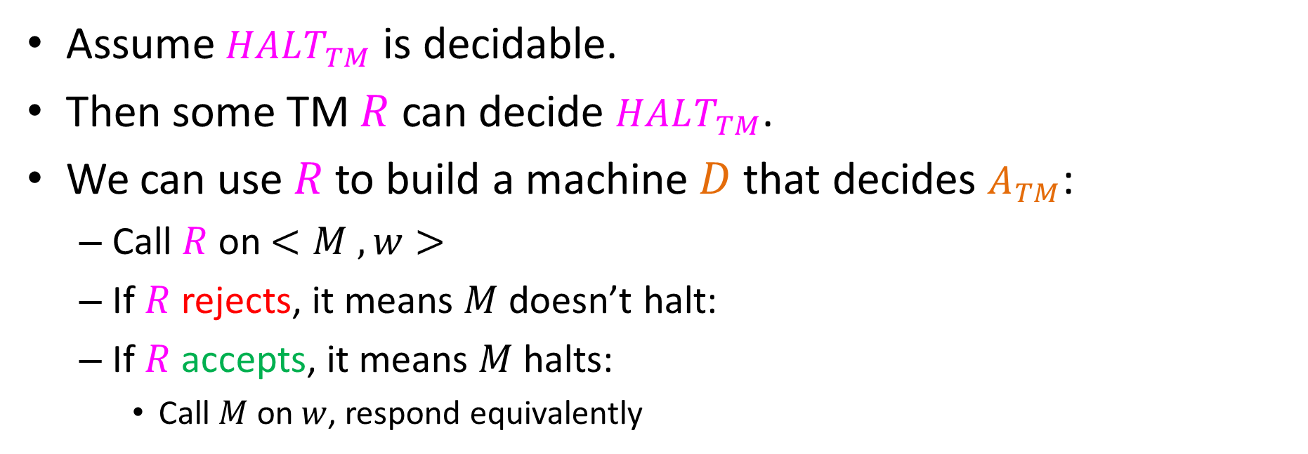

Deciding$A_{TM}$ with ${HALT}_{TM}$
Assume $HALT_{TM}$ is decidable.
Then some TM $R$ can decide $HALT_{TM}$.
We can use $R$ to build a machine $D$that decides $A_{TM}$:
Call $R$on $<M , w>$
If $R$rejects, it means $M$doesn’t halt:
If $R$accepts, it means $M$halts:
Call $M$on $w$, respond equivalently
reject
Machine $D$:
M
$$R$$
no
no
Does
$M(w)$ Halt?
Any TM that decides $HALT_{TM}$ could be used to build a TM that decides $A_{TM}$ (which is impossible) thus no TM exists that can decide $HALT_{TM}$
w
yes
no
$$M(w)$$
yes
yes

