Slide 1
CS3102 Theory of Computation

Slide 2



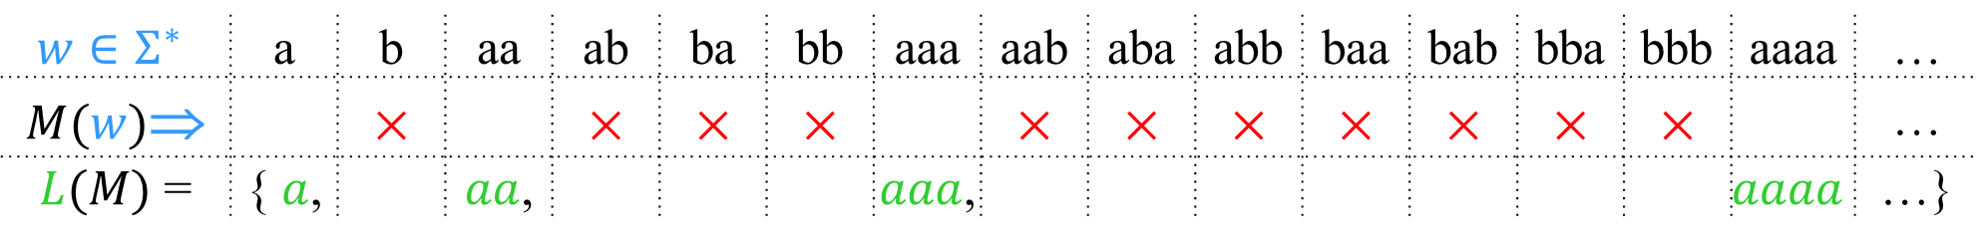
Decidable
Accept
& halt
×
Reject
& halt
Never
runs
forever
$w$→
Input
A language is decidable iff it is exactly the set of strings accepted by some always-halting TM.
$$w∈Σ^{∗}$$ | a | b | aa | ab | ba | bb | aaa | aab | aba | abb | baa | bab | bba | bbb | aaaa | …
$M(w)$⇒ |  | × |  | × | × | × |  | × | × | × | × | × | × | × |  | …
$L(M)$ = | { $a$, |  | $aa$, |  |  |  | $aaa$, |  |  |  |  |  |  |  | $$aaaa$$ | …}
$M$ must always halt on every input.

Slide 3
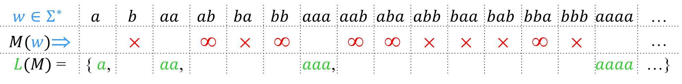
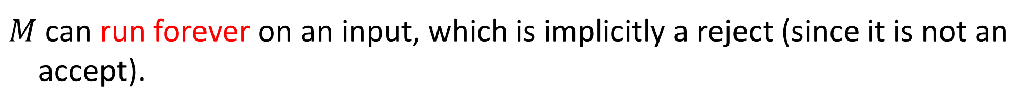
Recognizable
Accept
& halt
×
Reject
& halt
≡
∞
Run
forever
$w$→
Input
A language is Turing-recognizable iff it is exactly the set of strings accepted by some Turing machine.
$$w∈Σ^{∗}$$ | $$a$$ | $$b$$ | $$aa$$ | $$ab$$ | $$ba$$ | $$bb$$ | $$aaa$$ | $$aab$$ | $$aba$$ | $$abb$$ | $$baa$$ | $$bab$$ | $$bba$$ | $$bbb$$ | $$aaaa$$ | …
$M(w)$⇒ |  | × |  | ∞ | × | ∞ |  | ∞ | ∞ | × | × | × | ∞ | × |  | …
$L(M)$ = | { $a$, |  | $aa$, |  |  |  | $aaa$, |  |  |  |  |  |  |  | $$aaaa$$ | …}
$M$ can run forever on an input, which is implicitly a reject (since it is not an accept).

Slide 4
Computability
Generally: Computable = Decideable

Slide 5
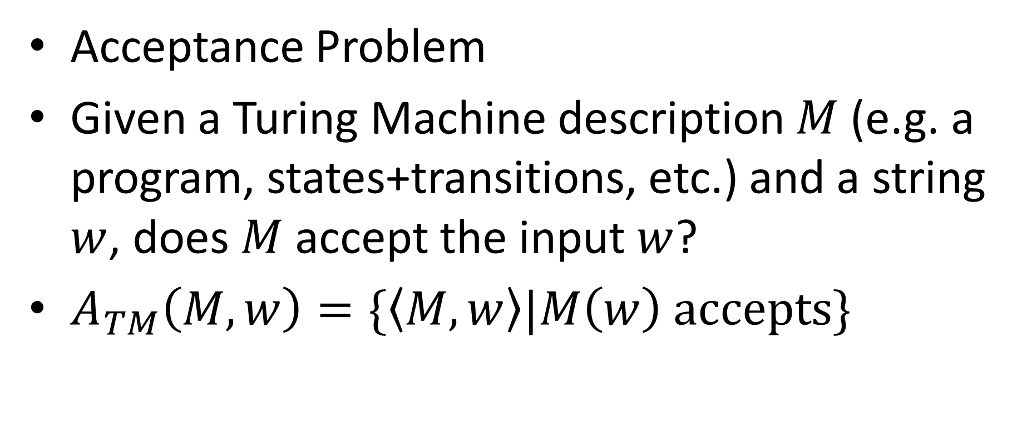
An Undecidable Problem/Language
Acceptance Problem
Given a Turing Machine description $M$ (e.g. a program, states+transitions, etc.) and a string $w$, does $M$ accept the input $w$?
$A_{TM}\left(M,w\right)=\{\left\langle M,w\right\rangle |M\left(w\right) accepts\}$

Slide 6
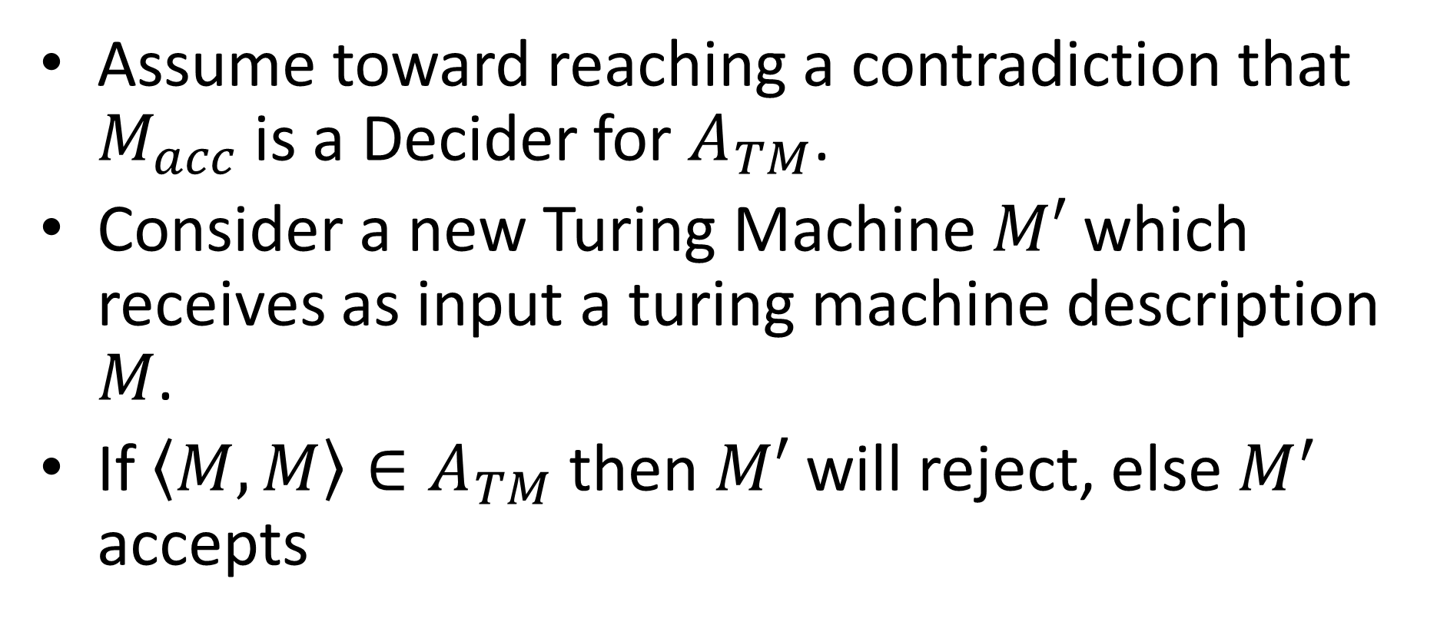
Acceptance problem is undecidable
Assume toward reaching a contradiction that $M_{acc}$ is a Decider for $A_{TM}$.
Consider a new Turing Machine $M′$ which receives as input a turing machine description $M$.
If $\left\langle M,M\right\rangle ∈A_{TM}$ then $M′$ will reject, else $M^{′}$ accepts

Slide 7

Pseudocode for $M′$
public static boolean mPrime(String m){
return !accept(m,m);
}
What does mPrime(source(mPrime)) return?

Slide 8
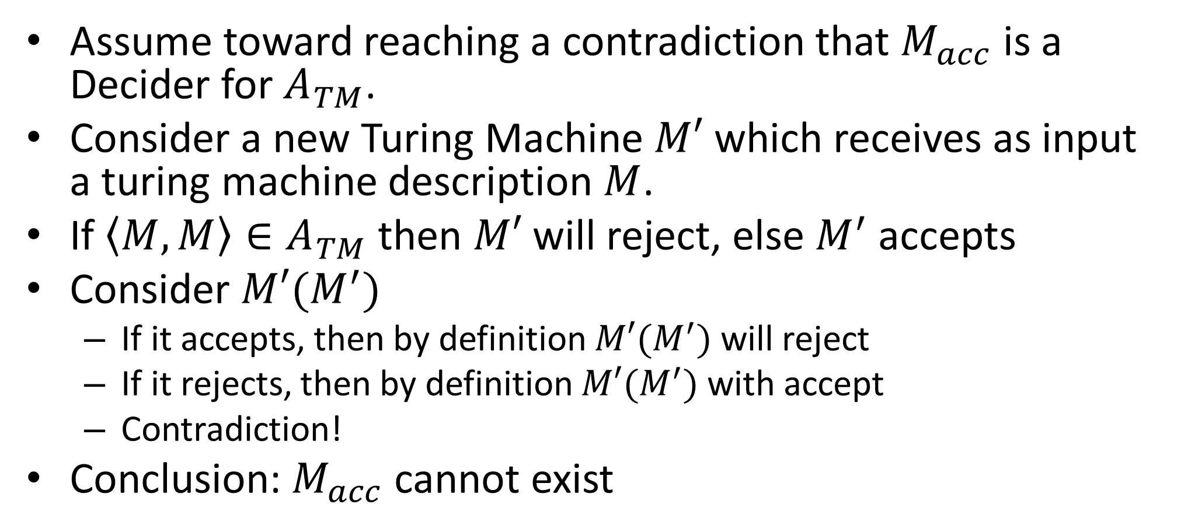
Acceptance problem is undecidable
Assume toward reaching a contradiction that $M_{acc}$ is a Decider for $A_{TM}$.
Consider a new Turing Machine $M′$ which receives as input a turing machine description $M$.
If $\left\langle M,M\right\rangle ∈A_{TM}$ then $M′$ will reject, else $M^{′}$ accepts
Consider $M′(M^{′})$
If it accepts, then by definition $M′(M^{′})$ will reject
If it rejects, then by definition $M′(M^{′})$ with accept
Contradiction!
Conclusion: $M_{acc}$ cannot exist

Slide 9

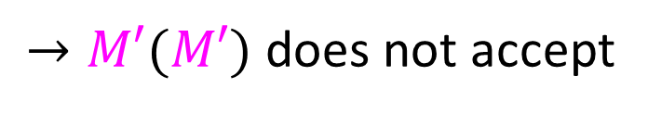




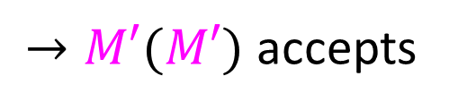
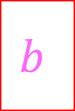
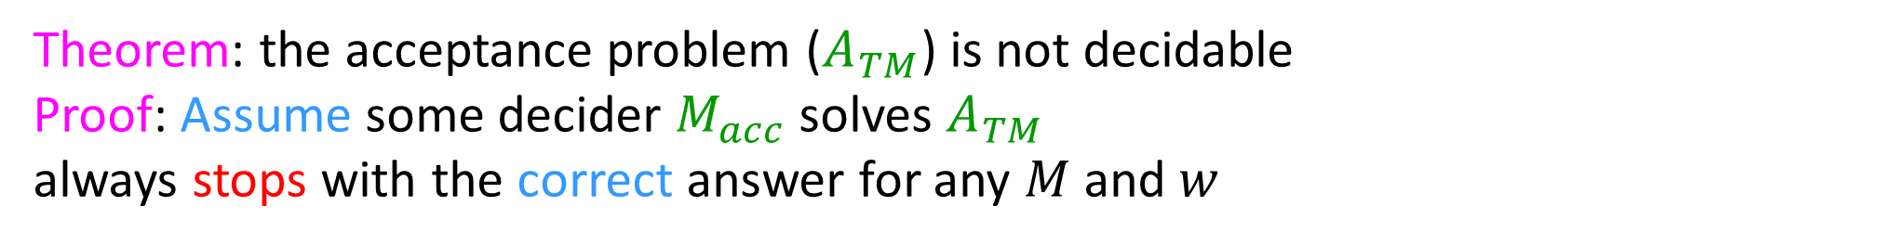



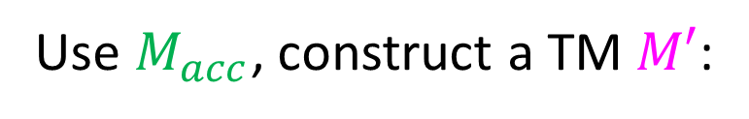
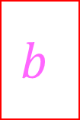




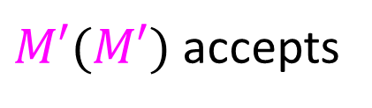
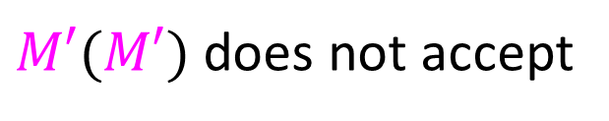



Theorem: the acceptance problem ($A_{TM}$) is not decidable
Proof: Assume some decider $M_{acc}$solves $A_{TM}$
always stops with the correct answer for any $M$ and $w$
$$M_{acc}$$
$$D$$
yes
Does
$M(w)$ accept?
yes
$$M$$
Does
$M(w)$ accept?
$$M$$
$$w$$
$$w$$
no
no
Use $M_{acc}$, construct a TM $M′$:
$$M′$$
$$M_{acc}$$
$$M$$
$$M′$$
Does
$M(w)$ accept?
yes
no
$$x$$
$$M^{′}$$
$$w$$
$$M′$$
no
yes
$M′(M′)$ accepts
$→M′(M′)$ does not accept
Contradiction!
$M′(M′)$ does not accept
$→M′(M′)$ accepts
$→$ $M_{acc}$ cannot exist! (at least as an algorithm / program / TM)

Slide 10
Proving Other language Undecidable
Option 1: Closure properties
Decidable languages are closed under:
Union
Intersection
Complement
Reversal
Pretty much everything
Option 2: Reduction
Convert some problem into a known undecidable one to show it’s undecidable.

Slide 11


Proof by Reduction
Shows how two different problems relate to each other
MOVIE TIME!

Slide 12
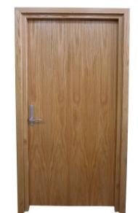

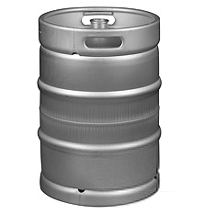







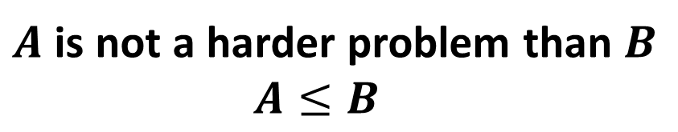

Reduction Proofs
Opening a door
Lighting a fire
$$A$$
reduces to
$$B$$
Alcohol, wood, matches
$$X$$
Keg cannon battering ram
$$Y$$
can be used to make
that can solve B
that can solve A
$A$ is not a harder problem than $B$
$A≤B$
The name “reduces” is confusing: it is in the opposite direction of the making

Slide 13
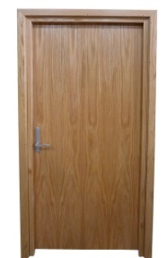
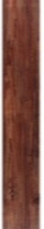







Proof of Impossibility by Reduction
$$X$$
1. X isn’t possible
(e.g., X = some way to open the door)
$$Y$$
2. Assume Y is possible
(Y = some way to light a fire)
$$X$$
$$Y$$
3. Show how to use Y to perform X.
4. X isn’t possible, but Y could be used to perform X
conclusion: Y must not be possible either

Slide 14
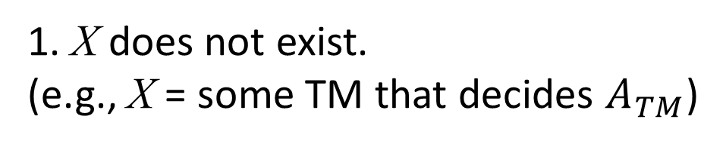
Proof of Impossibility by Reduction
$$X$$
1. X does not exist.
(e.g., X = some TM that decides $A_{TM}$)
$$Y$$
2. Assume Y exists.
(Y = some TM that decides B)
$$X$$
$$Y$$
3. Show how to use Y to perform X.
4. X doesn’t exist, but Y could be used to make X
conclusion: Y must not exist either

Slide 15

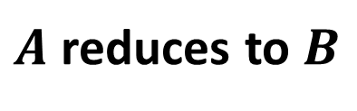

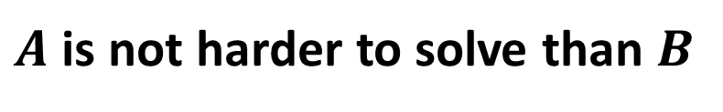

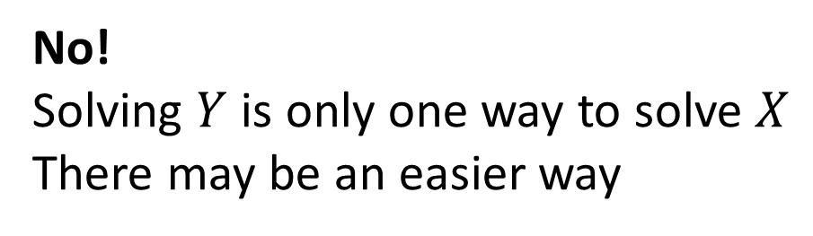

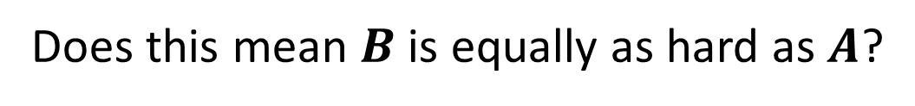

Converse?
$A$ reduces to $B$
$$X$$
$$Y$$
can be used to make
that can solve B
(Lighting a fire)
$A$ is not harder to solve than $B$
that can solve A
(opening a door)
$$A≤B$$
Does this mean $B$ is equally as hard as $A$?
$$A=B$$
No!
Solving $Y$ is only one way to solve $X$
There may be an easier way

Slide 16

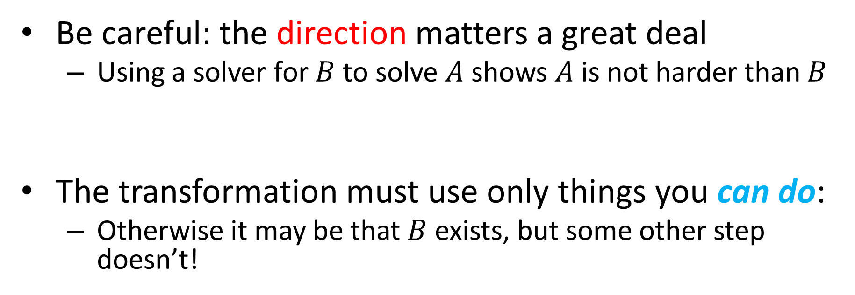

Common Reduction Traps
Be careful: the direction matters a great deal
Using a solver for $B$ to solve $A$ shows $A$ is not harder than $B$
The transformation must use only things you can do:
Otherwise it may be that $B$ exists, but some other step doesn’t!
$$A$$
$$B$$
___ Reduces to ___

Slide 17
What “Can Do” Means
Tools used in a reduction are limited by what you are proving
Undecidability:
You are proving something about all TMs:
The transformation “can do” things a terminating TM “can do”
Spoiler alert!
Complexity:
You are proving something about time required:
The time it takes to do the transformation is limited

Slide 18
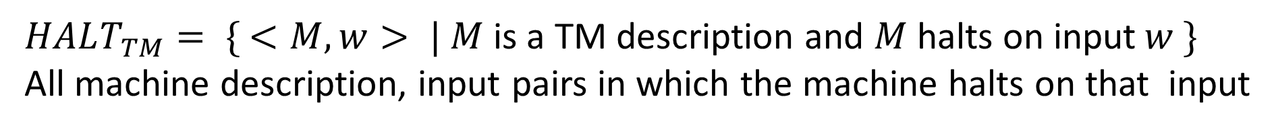
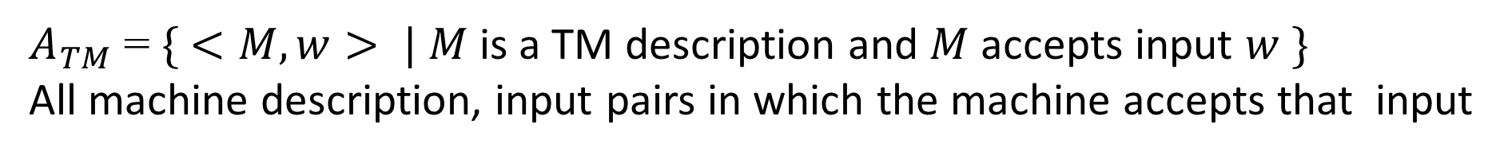
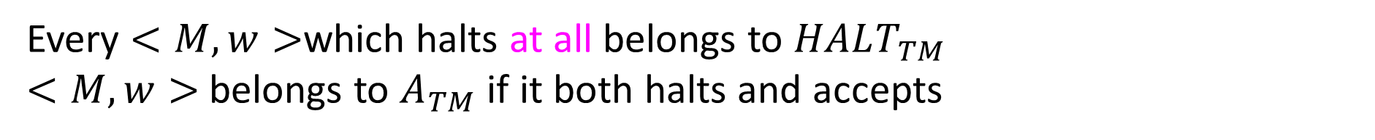
The Halting Language
$A_{TM}$= $\{ <M, w> | M$ is a TM description and $M$accepts input $w \}$
All machine description, input pairs in which the machine accepts that input
$HALT_{TM}= \{ <M, w> | M$is a TM description and $M$halts on input$w \}$
All machine description, input pairs in which the machine halts on that input
Every $<M,w>$which halts at all belongs to $HALT_{TM}$
$<M,w>$ belongs to $A_{TM}$ if it both halts and accepts

Slide 19

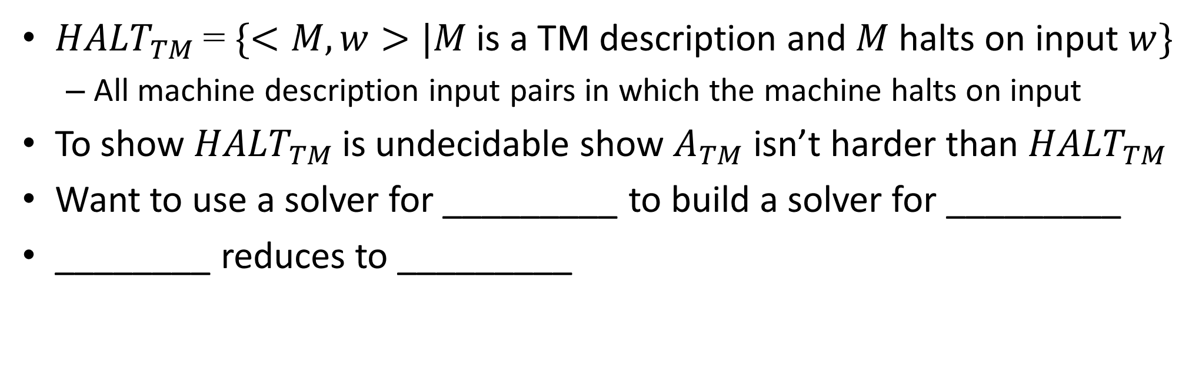







${HALT}_{TM}$ is Undecidable
${HALT}_{TM}$= $\{<M, w>|M$ is a TM description and $M$halts on input $w\}$
All machine description input pairs in which the machine halts on input
To show ${HALT}_{TM}$ is undecidable show $A_{TM}$ isn’t harder than ${HALT}_{TM}$
Want to use a solver for _________ to build a solver for _________
________ reduces to _________
$$HALT_{TM}$$
$$A_{TM}$$
$$A_{TM}$$
$$HALT_{TM}$$
$$A_{TM}$$
$$HALT_{TM}$$

Slide 20




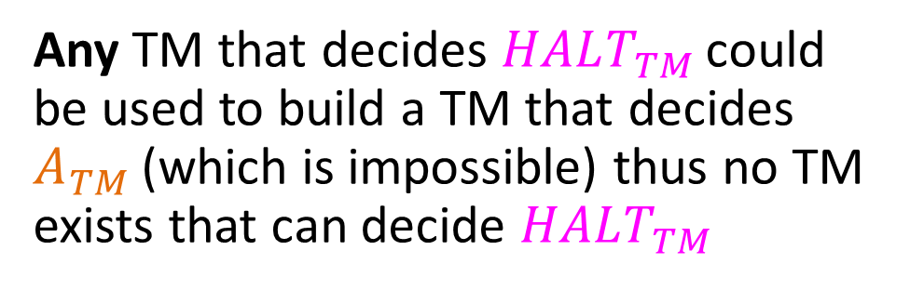
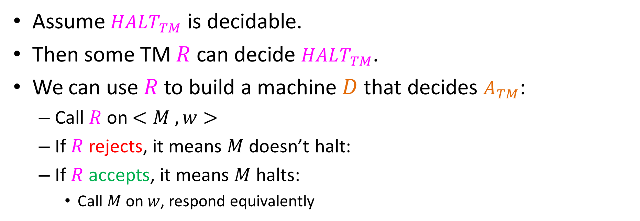

Deciding$A_{TM}$ with ${HALT}_{TM}$
Assume $HALT_{TM}$ is decidable.
Then some TM $R$ can decide $HALT_{TM}$.
We can use $R$ to build a machine $D$that decides $A_{TM}$:
Call $R$on $<M , w>$
If $R$rejects, it means $M$doesn’t halt:
If $R$accepts, it means $M$halts:
Call $M$on $w$, respond equivalently
reject
Machine $D$:
M
$$R$$
no
no
Does
$M(w)$ Halt?
Any TM that decides $HALT_{TM}$ could be used to build a TM that decides $A_{TM}$ (which is impossible) thus no TM exists that can decide $HALT_{TM}$
w
yes
no
$$M(w)$$
yes
yes

Slide 21
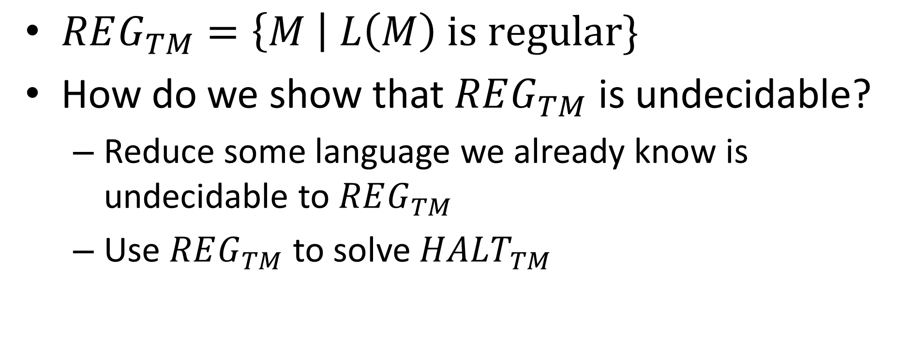

Another example: $REG_{TM}$
$REG_{TM}=\left\{M \right| L\left(M\right) is regular\}$
How do we show that $REG_{TM}$ is undecidable?
Reduce some language we already know is undecidable to $REG_{TM}$
Use $REG_{TM}$ to solve $HALT_{TM}$

Slide 22
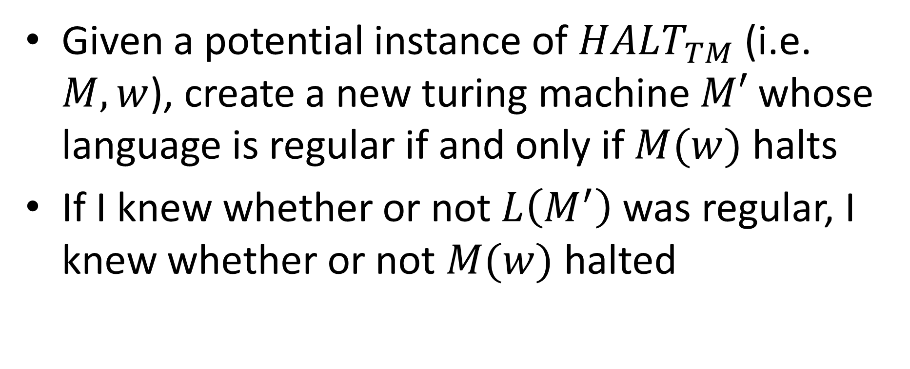

$$REG_{TM}≥HALT_{TM}$$
Given a potential instance of $HALT_{TM}$ (i.e. $M,w$), create a new turing machine $M′$ whose language is regular if and only if $M(w)$ halts
If I knew whether or not $L\left(M^{′}\right)$ was regular, I knew whether or not $M(w)$ halted

Slide 23
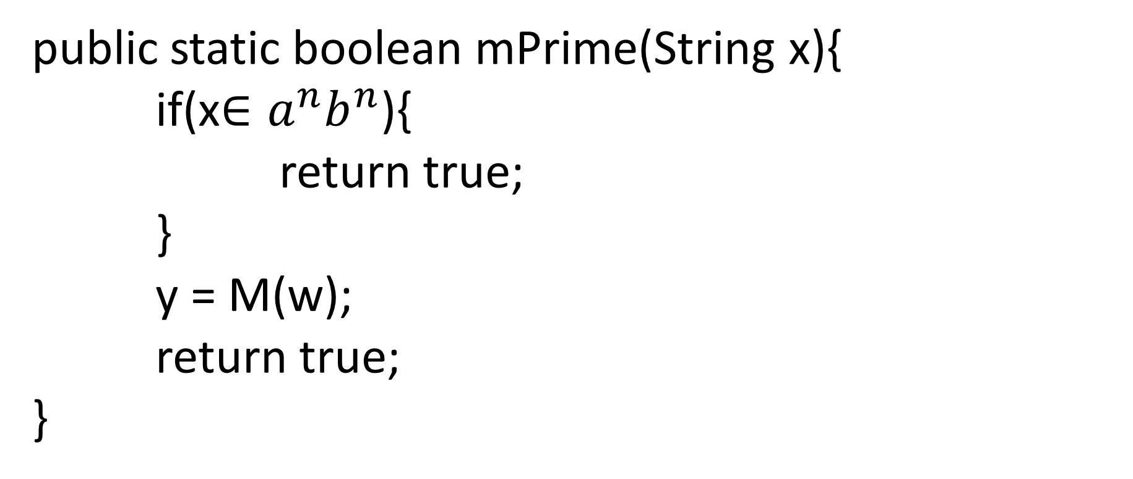

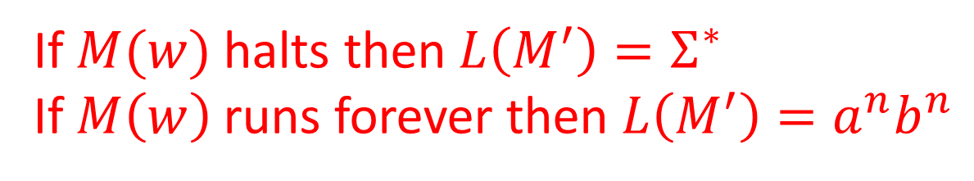
Psuedocode for $M′$
public static boolean mPrime(String x){
if(x$∈a^{n}b^{n}$){
return true;
}
y = M(w);
return true;
}
If this line terminates
We can only get to this line
If $M(w)$ halts then $L\left(M^{′}\right)=Σ^{∗}$
If $M\left(w\right)$ runs forever then $L\left(M^{′}\right)=a^{n}b^{n}$

Slide 24

How to solve $HALT_{TM}$ with $REG_{TM}$
public static boolean halt(M,w){
mPrime = make_mPrime(M,w);
return reg(mPrime);
}

