Slide 1

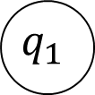




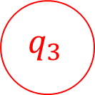

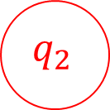

CS3102 Theory of Computation
$$a$$
$$q_{0}$$
$$q_{1}$$
Some strings it accepts:
Some strings it rejects:
Describe the language:
$$b$$
$$b$$
$$a,b$$
$$a,b$$
$$q_{3}$$
$$q_{2}$$
$$a$$

Slide 2
Finite State Automaton
Simple model of computation
Represents computation without memory
Kind of decider
We call the set of strings it accepts the “language” of the machine
Our machine reads the input string only once, and one character at a time
After reading each character, enters a new “state”
State transition rules depend only on the current state and the current character (no looking back!)
There are only finitely many states

Slide 3
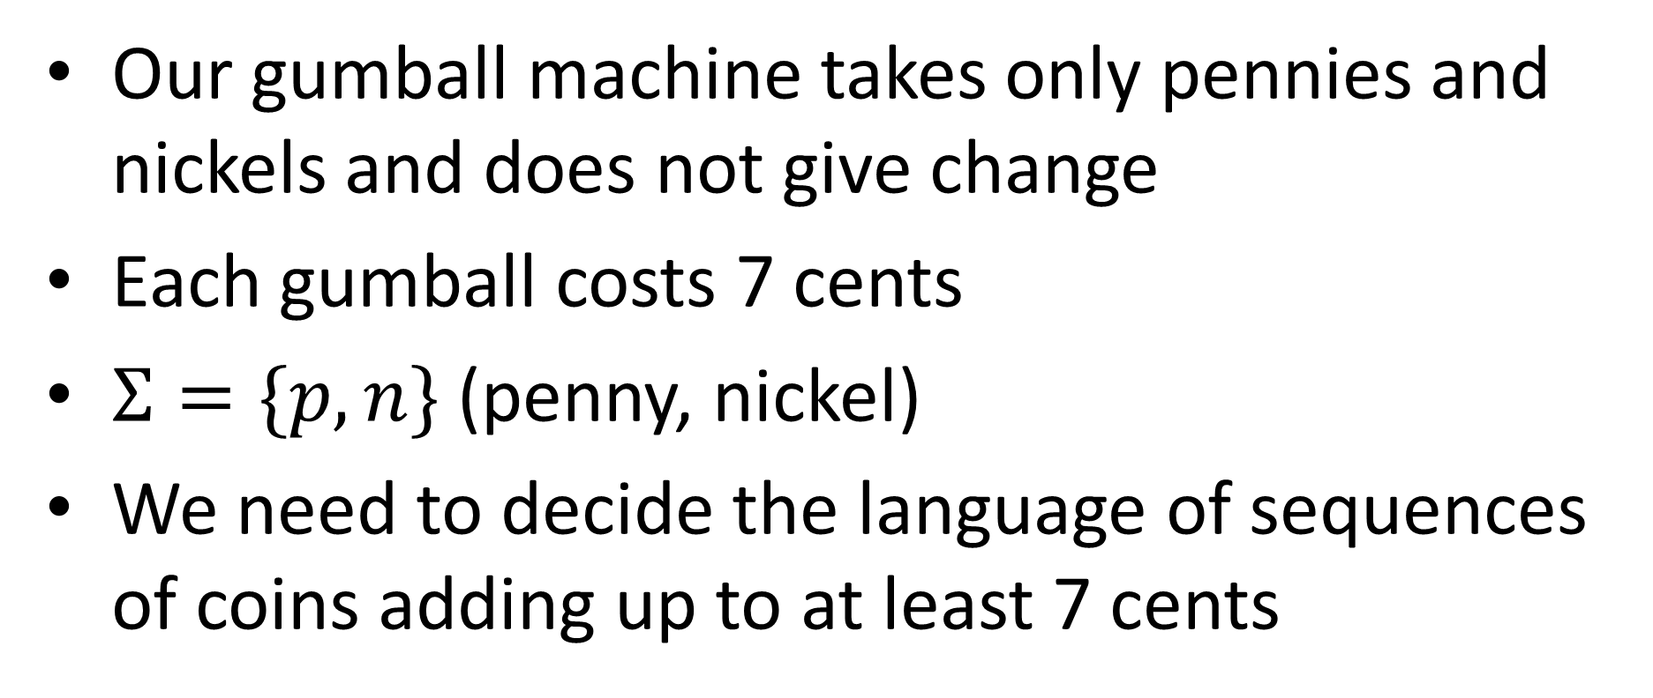
Gumball Machine
Our gumball machine takes only pennies and nickels and does not give change
Each gumball costs 7 cents
$Σ=\{p,n\}$ (penny, nickel)
We need to decide the language of sequences of coins adding up to at least 7 cents

Slide 4
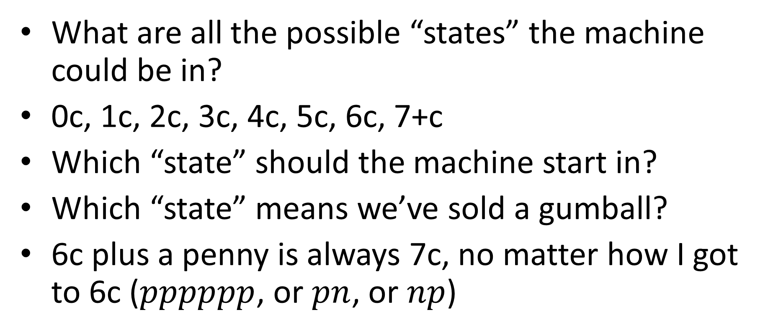
Gumball Machine
What are all the possible “states” the machine could be in?
0c, 1c, 2c, 3c, 4c, 5c, 6c, 7+c
Which “state” should the machine start in?
Which “state” means we’ve sold a gumball?
6c plus a penny is always 7c, no matter how I got to 6c ($pppppp$, or $pn$, or $np$)

Slide 5



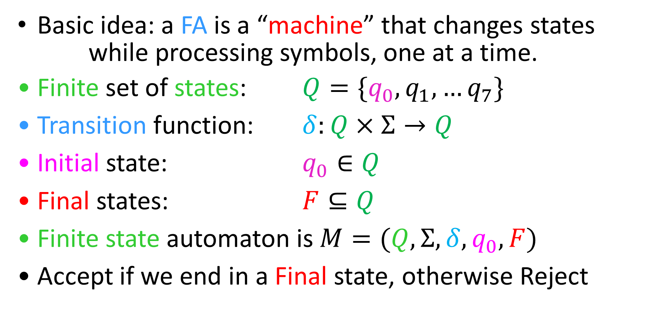



Finite State Automata
Basic idea: a FA is a “machine” that changes states
while processing symbols, one at a time.
Finite set of states: $Q=\{q_{0},q_{1},…q_{7}\}$
Transition function: $δ:Q×Σ→Q$
Initial state: $q_{0}∈Q$
Final states: $F⊆Q$
Finite state automaton is $M=(Q, Σ, δ, q_{0}, F)$
Accept if we end in a Final state, otherwise Reject
$$q_{1}$$
$$q_{1}$$
$$a$$
$$q_{2}$$
$$q_{0}$$
$$q_{k}$$

Slide 6
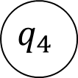


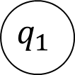

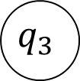


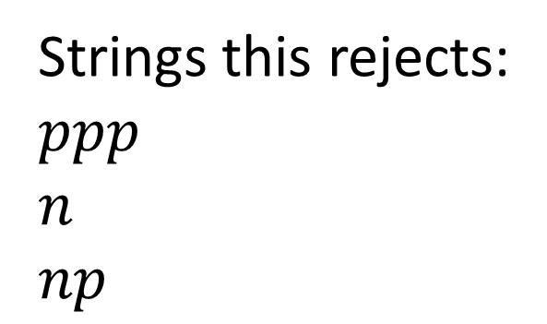





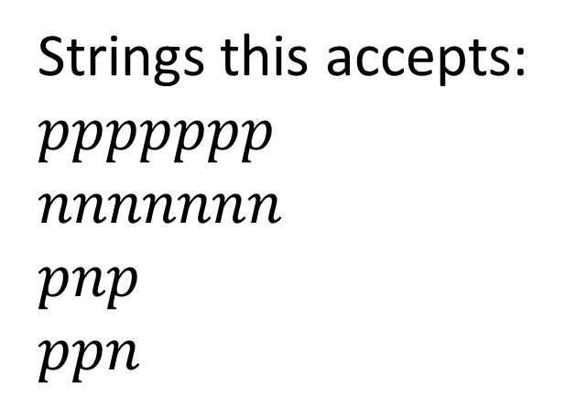
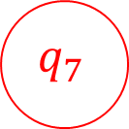


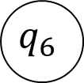

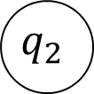
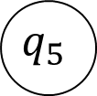


FSA for our Gumball Machine
$$n$$
$$n$$
$$n$$
$$p$$
$$p$$
$$p$$
$$p$$
$$p$$
$$p$$
$$p,n$$
$$q_{7}$$
$$q_{0}$$
$$q_{1}$$
$$q_{2}$$
$$q_{3}$$
$$q_{4}$$
$$q_{5}$$
$$q_{6}$$
$$n$$
$$n$$
$$p,n$$
$$n$$
Strings this accepts:
$ppppppp$
$nnnnnnn$
$pnp$
$ppn$
Strings this rejects:
$ppp$
$n$
$np$

Slide 7
EvenA
In HW1 you were asked to give a decider for EvenA (accepts all strings with an even number of A’s)
How did you do it?

Slide 8
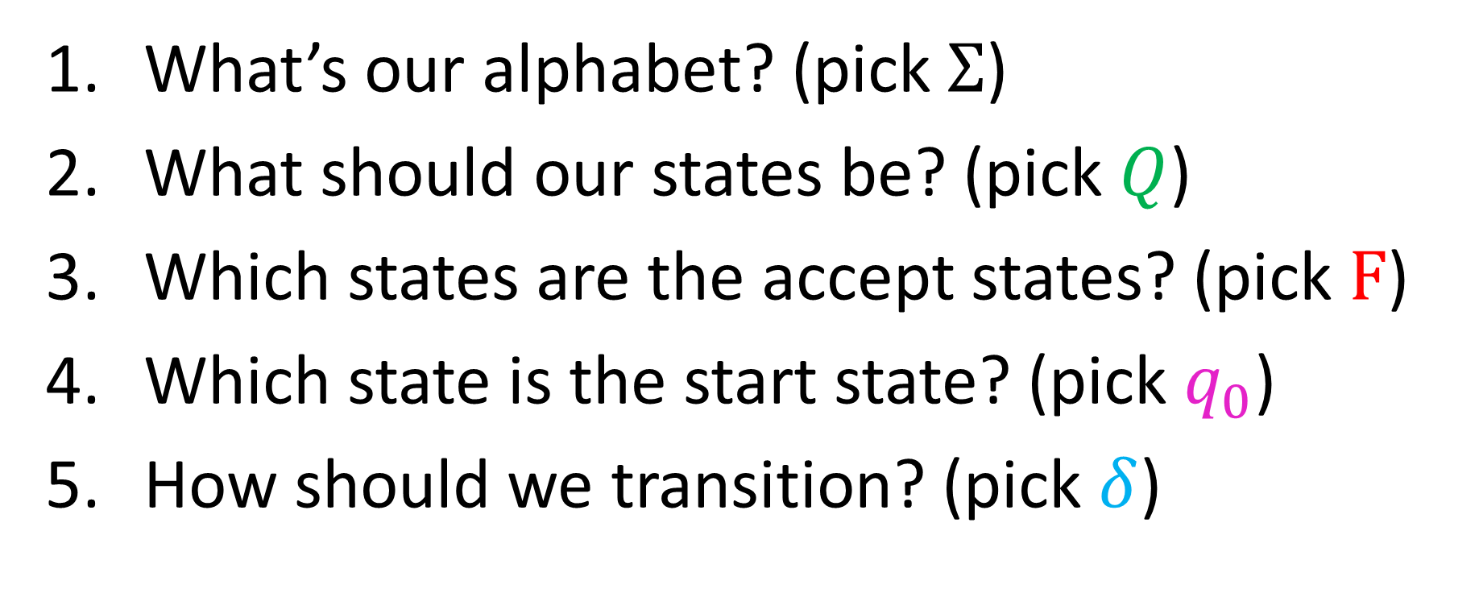
EvenA using FSA
What’s our alphabet? (pick $Σ$)
What should our states be? (pick $Q$)
Which states are the accept states? (pick $F$)
Which state is the start state? (pick $q_{0}$)
How should we transition? (pick $δ$)

Slide 9
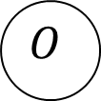





Let’s Draw It!
$$a$$
$$Σ−\{a\}$$
$$Σ−\{a\}$$
$$E$$
$$O$$
$$a$$

Slide 10
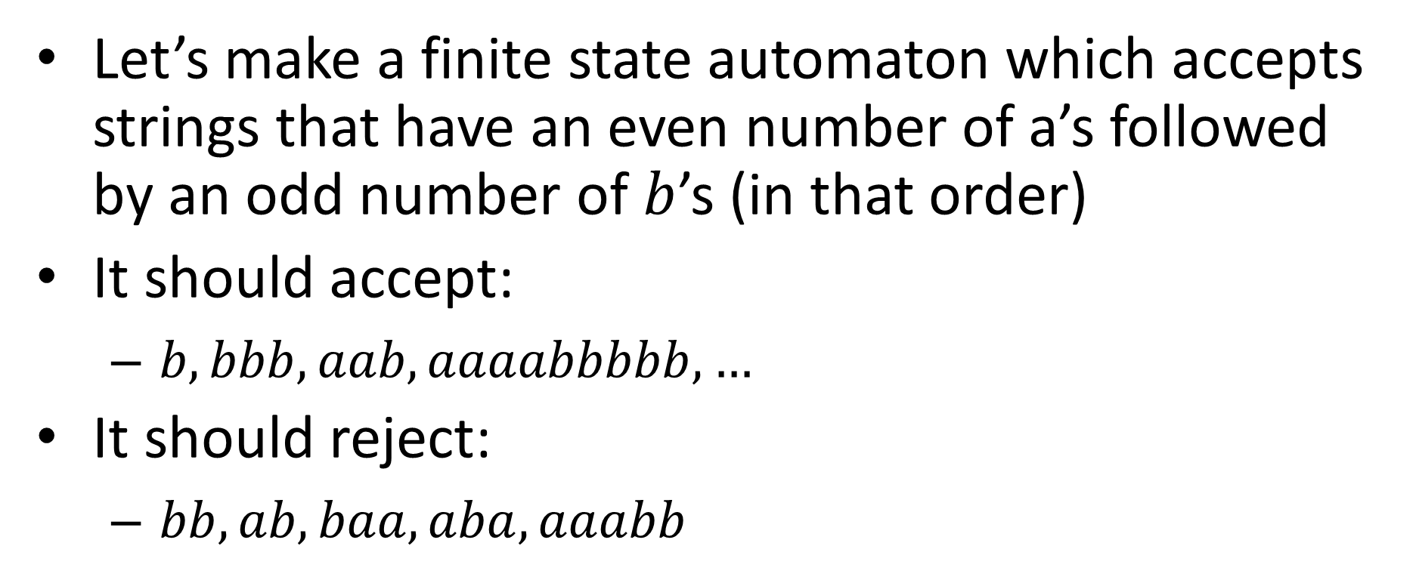
EvenAOddB
Let’s make a finite state automaton which accepts strings that have an even number of a’s followed by an odd number of $b$’s (in that order)
It should accept:
$b, bbb, aab, aaaabbbbb, …$
It should reject:
$bb, ab, baa, aba, aaabb$

Slide 11





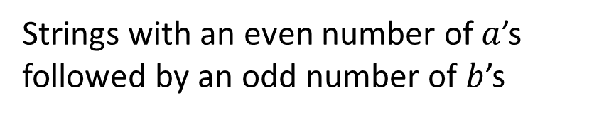




EvenAoddB
Strings with an even number of $a$’s followed by an odd number of $b$’s
$$a$$
Odd a
Even a
$$b$$
$$a,b$$
$$a$$
Trash
$$b$$
$$b$$
$$a$$
Odd b
Even b
$$a$$
$$b$$

Slide 12
EvenAOddB using FSA
What’s our alphabet? (pick $Σ$)
What should our states be? (pick $Q$)
Which states are the accept states? (pick $F$)
Which state is the start state? (pick $q_{0}$)
How should we transition? (pick $δ$)

Slide 13
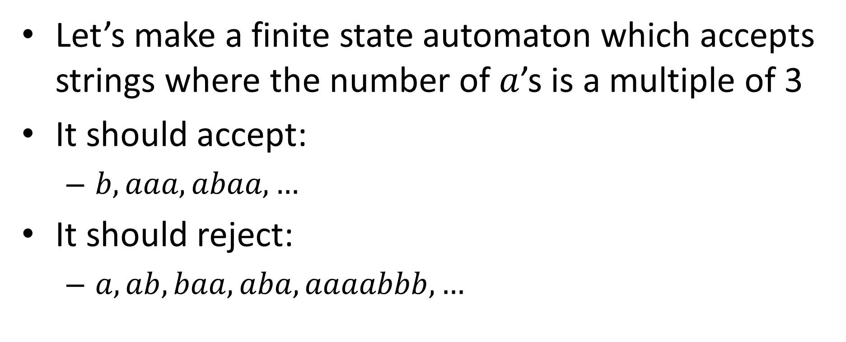
TripleA
Let’s make a finite state automaton which accepts strings where the number of $a$’s is a multiple of 3
It should accept:
$b, aaa, abaa, …$
It should reject:
$a, ab, baa, aba, aaaabbb, …$

Slide 14
TripleA using FSA
What’s our alphabet? (pick $Σ$)
What should our states be? (pick $Q$)
Which states are the accept states? (pick $F$)
Which state is the start state? (pick $q_{0}$)
How should we transition? (pick $δ$)

Slide 15





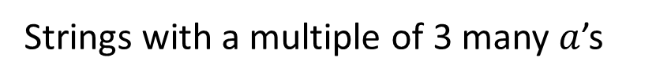

EvenAoddB
Strings with a multiple of 3 many $a$’s
$$a$$
$$a$$
$$b$$
1
2
0
$$b$$
$$b$$
$$a$$

Slide 16
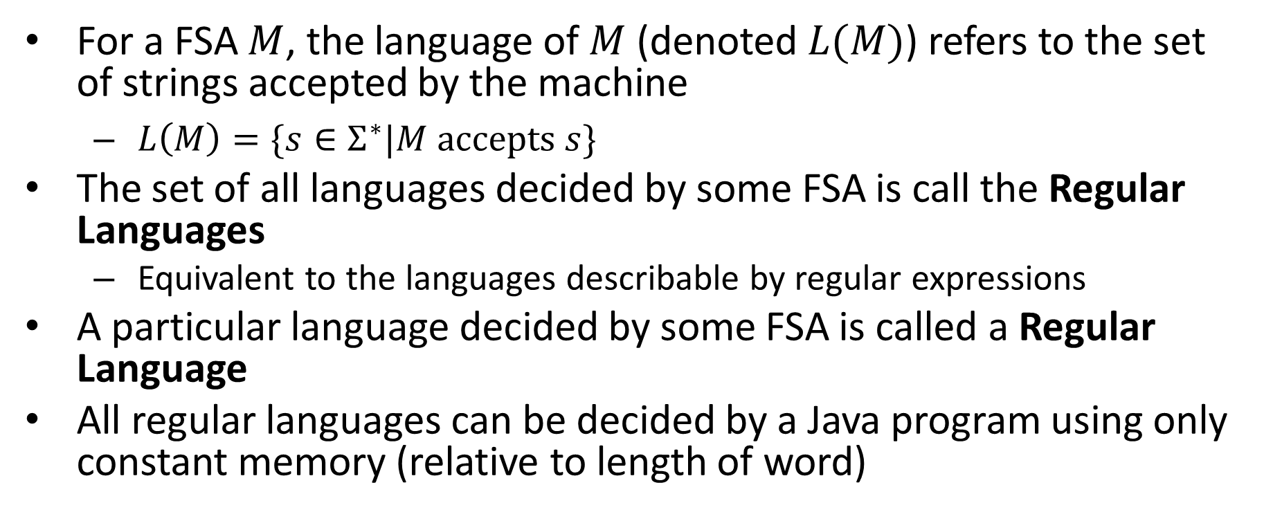
Take-aways
For a FSA $M$, the language of $M$ (denoted $L(M)$) refers to the set of strings accepted by the machine
$L\left(M\right)=\{s∈Σ^{∗}|M accepts s\}$
The set of all languages decided by some FSA is call the Regular Languages
Equivalent to the languages describable by regular expressions
A particular language decided by some FSA is called a Regular Language
All regular languages can be decided by a Java program using only constant memory (relative to length of word)

Slide 17
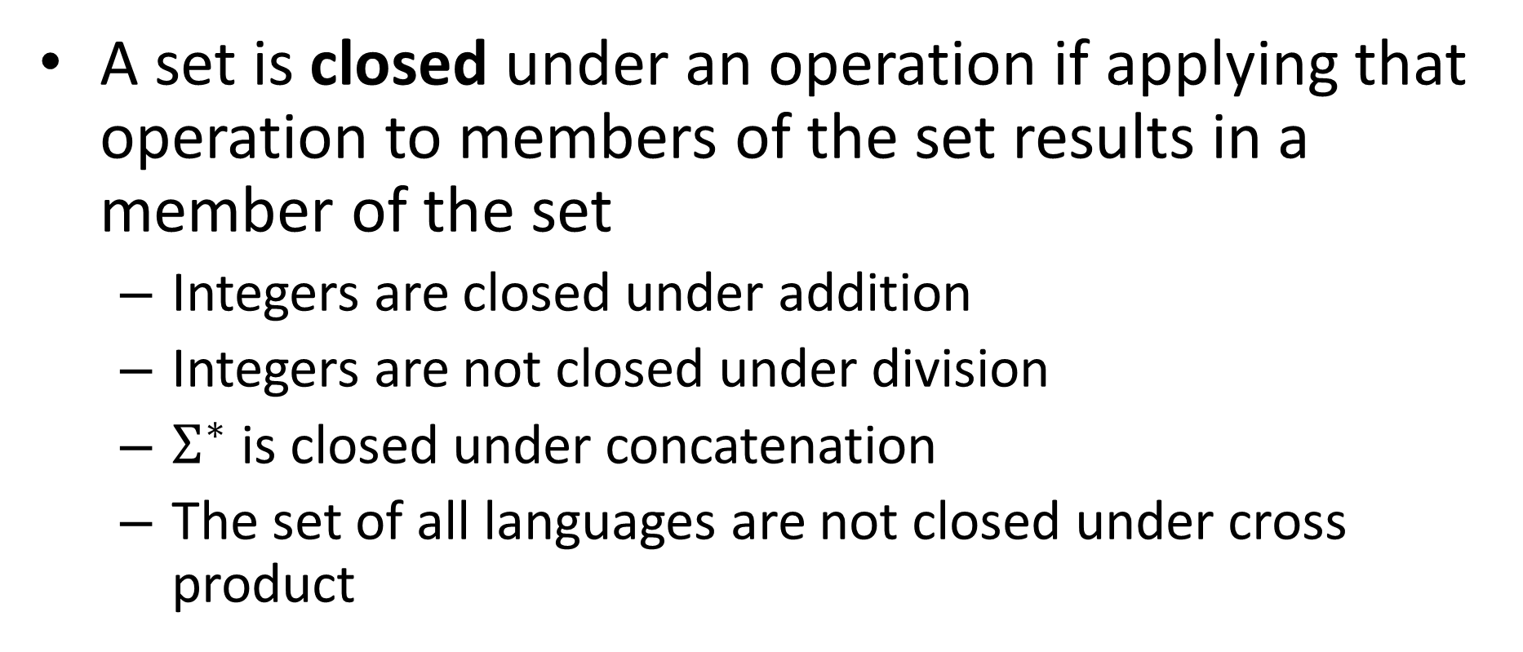
Closure Properties
A set is closed under an operation if applying that operation to members of the set results in a member of the set
Integers are closed under addition
Integers are not closed under division
$Σ^{∗}$ is closed under concatenation
The set of all languages are not closed under cross product

Slide 18
Closure Properties of Regular Languages
Complement
Intersection
Union
Difference
Concatenation

Slide 19
Closed under Complement
If a language is regular then its complement is regular
If a language has a FSA, it’s complement does as well
If there is a FSA which accepts exactly the strings in the language, there is a FSA which accepts exactly the strings not in the language

Slide 20
Closed under Complement
Idea: Every string ends in some state. If that was originally an accept state then reject, else accept.
New final states are the old non-final states

Slide 21
EvenAoddB
Strings with an even number of $a$’s followed by an odd number of $b$’s
$$a$$
Odd a
Even a
$$b$$
$$a,b$$
$$a$$
Trash
$$b$$
$$b$$
$$a$$
Odd b
Even b
$$a$$
$$b$$

Slide 22
Complement of EvenAoddB
Describe it:
$$a$$
Odd a
Even a
$$b$$
$$a,b$$
$$a$$
Trash
$$b$$
$$b$$
$$a$$
Odd b
Even b
$$a$$
$$b$$

Slide 23
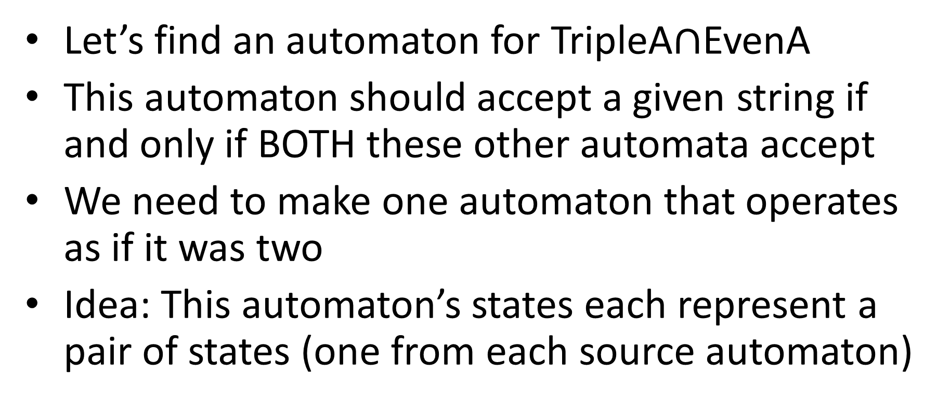
Closed under Intersection
Let’s find an automaton for TripleA$∩$EvenA
This automaton should accept a given string if and only if BOTH these other automata accept
We need to make one automaton that operates as if it was two
Idea: This automaton’s states each represent a pair of states (one from each source automaton)

Slide 24











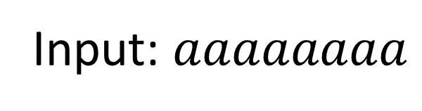
Running Both Machines
$$a$$
Input: $aaaaaaaa$
$$b$$
$$b$$
$$E$$
$$O$$
EvenA
$$a$$
$$a$$
$$a$$
$$b$$
1
2
0
TripleA
$$b$$
$$b$$
$$a$$

Slide 25
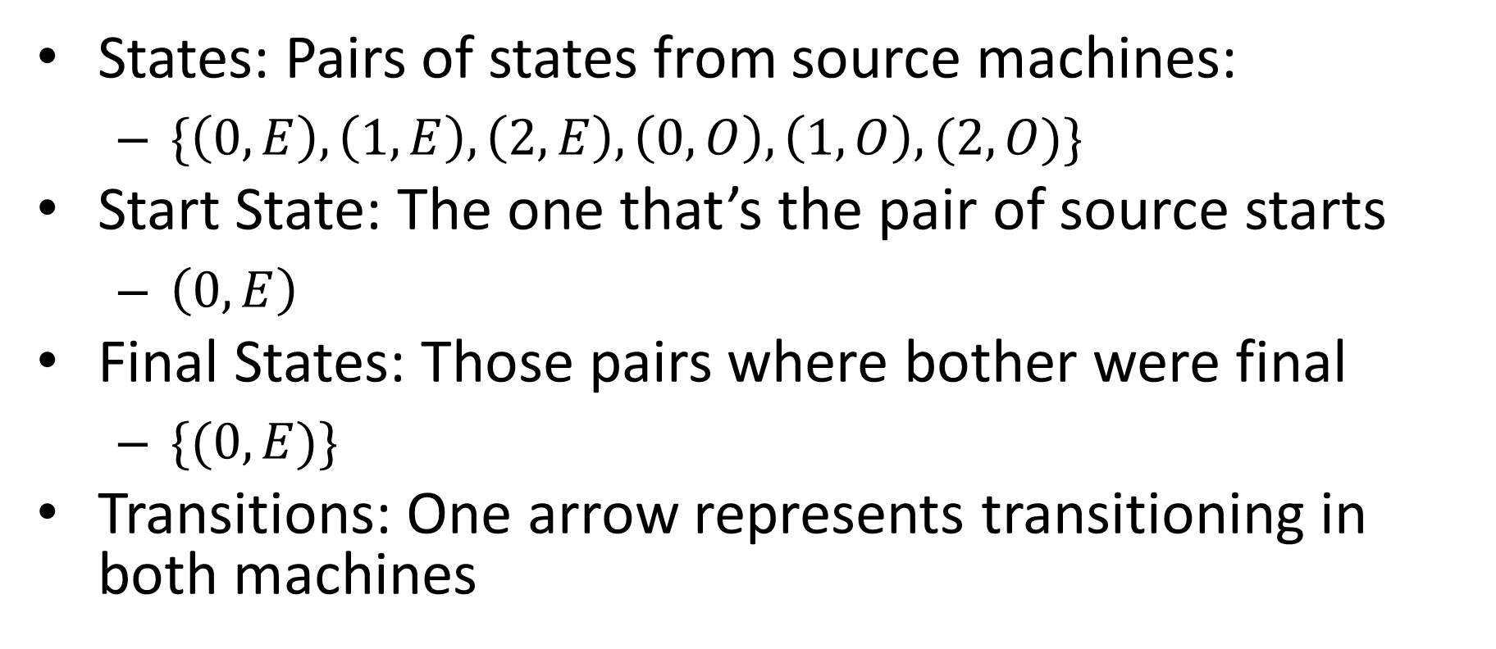
Now at the same time
States: Pairs of states from source machines:
$\{\left(0,E\right),\left(1,E\right),\left(2,E\right),\left(0,O\right),\left(1,O\right),(2,O)\}$
Start State: The one that’s the pair of source starts
$\left(0,E\right)$
Final States: Those pairs where bother were final
$\{(0,E)\}$
Transitions: One arrow represents transitioning in both machines

Slide 26



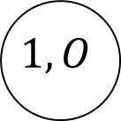



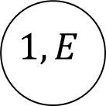

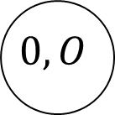

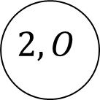


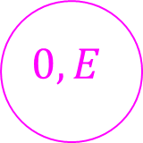
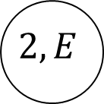


Let’s Draw it!
$$b$$
$$b$$
$$0,E$$
$$0,O$$
$$a$$
$$a$$
$$b$$
$$b$$
$$1,E$$
$$1,O$$
$$a$$
$$a$$
$$a$$
$$a$$
$$2,E$$
$$2,O$$
$$b$$
$$b$$

Slide 27
Let’s Draw it!
$$0,E$$
$$0,O$$
$$1,E$$
$$1,O$$
$$2,E$$
$$2,O$$

Slide 28
Let’s Draw it!
$$0,E$$
$$0,O$$
$$1,E$$
$$1,O$$
$$2,E$$
$$2,O$$

Slide 29
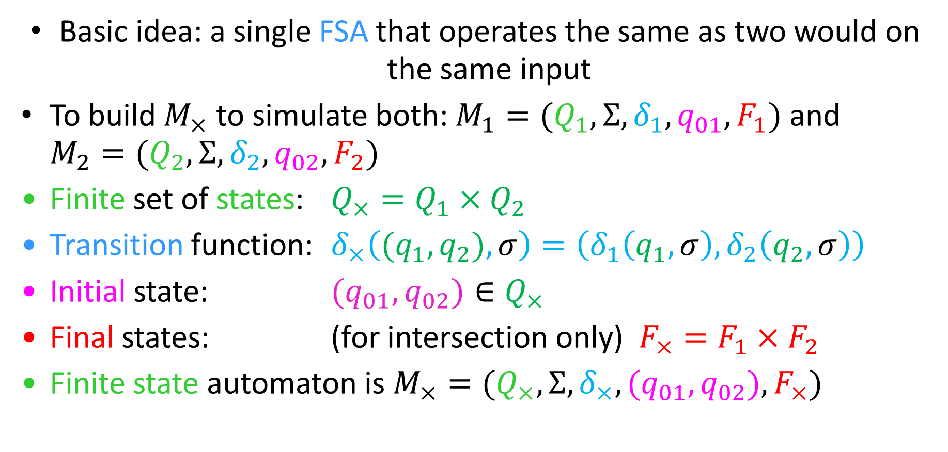
Cross Product Construction
Basic idea: a single FSA that operates the same as two would on the same input
To build $M_{×}$ to simulate both: $M_{1}=(Q_{1}, Σ, δ_{1}, q_{01}, F_{1})$ and $M_{2}=(Q_{2}, Σ, δ_{2}, q_{02}, F_{2})$
Finite set of states: $Q_{×}=Q_{1}×Q_{2}$
Transition function: $δ_{×}\left({(q}_{1},q_{2}), σ\right)=\left(δ_{1}\left(q_{1},σ\right), δ_{2}\left(q_{2},σ\right)\right)$
Initial state: ${(q}_{01},q_{02})∈Q_{×}$
Final states: (for intersection only) $F_{×}=F_{1}×F_{2}$
Finite state automaton is $M_{×}=(Q_{×}, Σ, δ_{×}, {(q}_{01},q_{02}), F_{×})$

