Slide 1
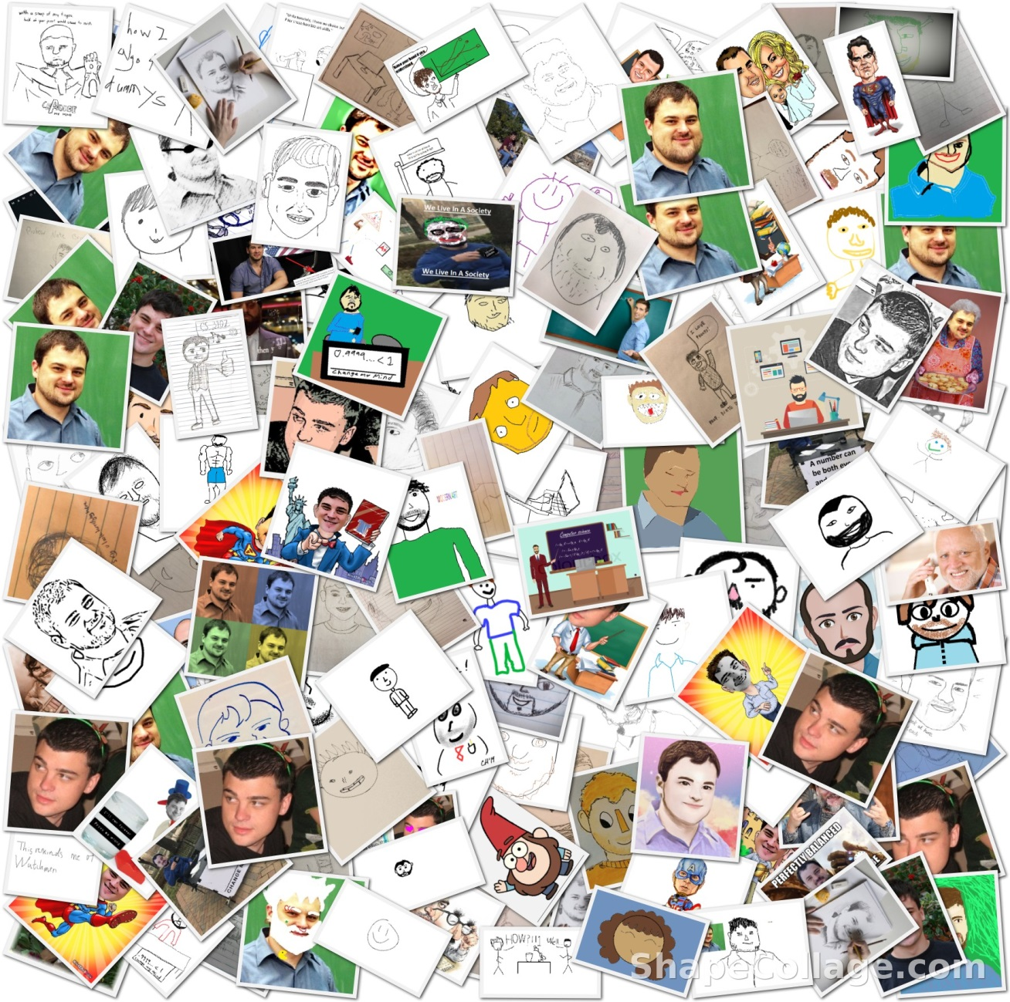

CS3102 Theory of Computation

Slide 2
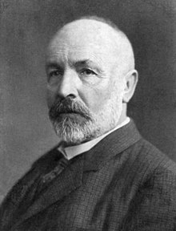
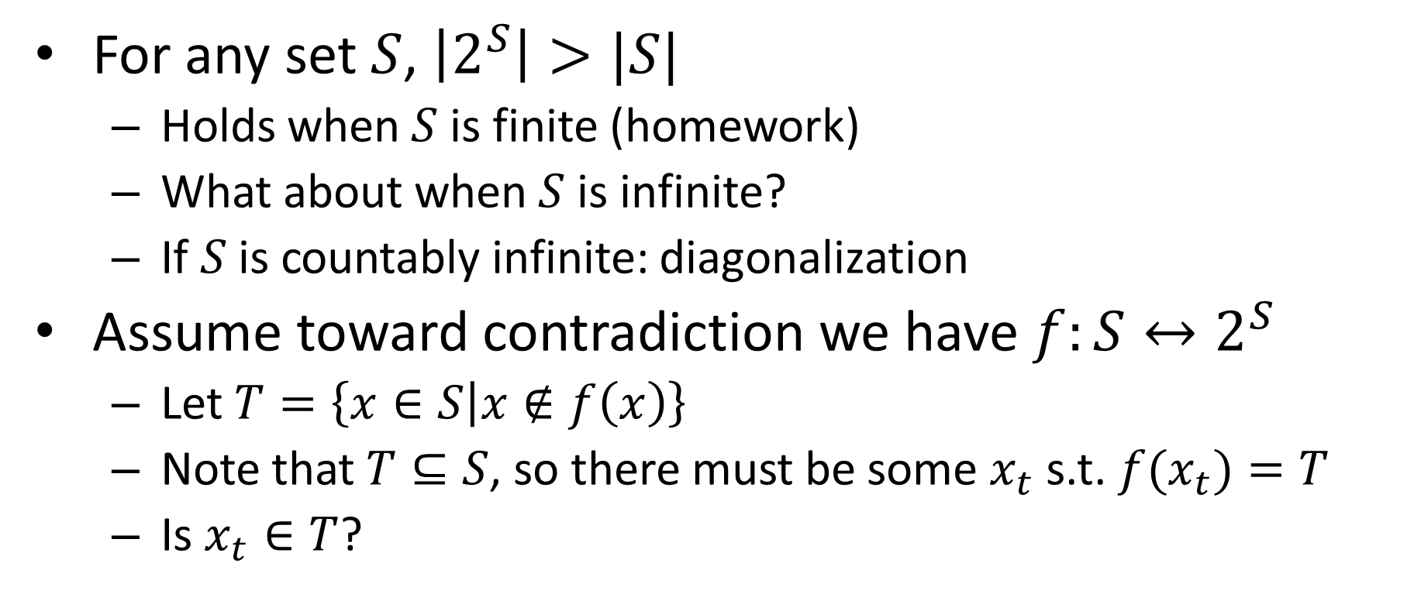
Cantor’s Theorem
For any set $S$, $\left|2^{S}\right|>|S|$
Holds when $S$ is finite (homework)
What about when $S$ is infinite?
If $S$ is countably infinite: diagonalization
Assume toward contradiction we have $f:S↔2^{S}$
Let $T=\left\{x∈S | x∉f\left(x\right)\right\}$
Note that $T⊆S$, so there must be some $x_{t}$ s.t. ${f(x}_{t})=T$
Is $x_{t}∈T$?

Slide 3
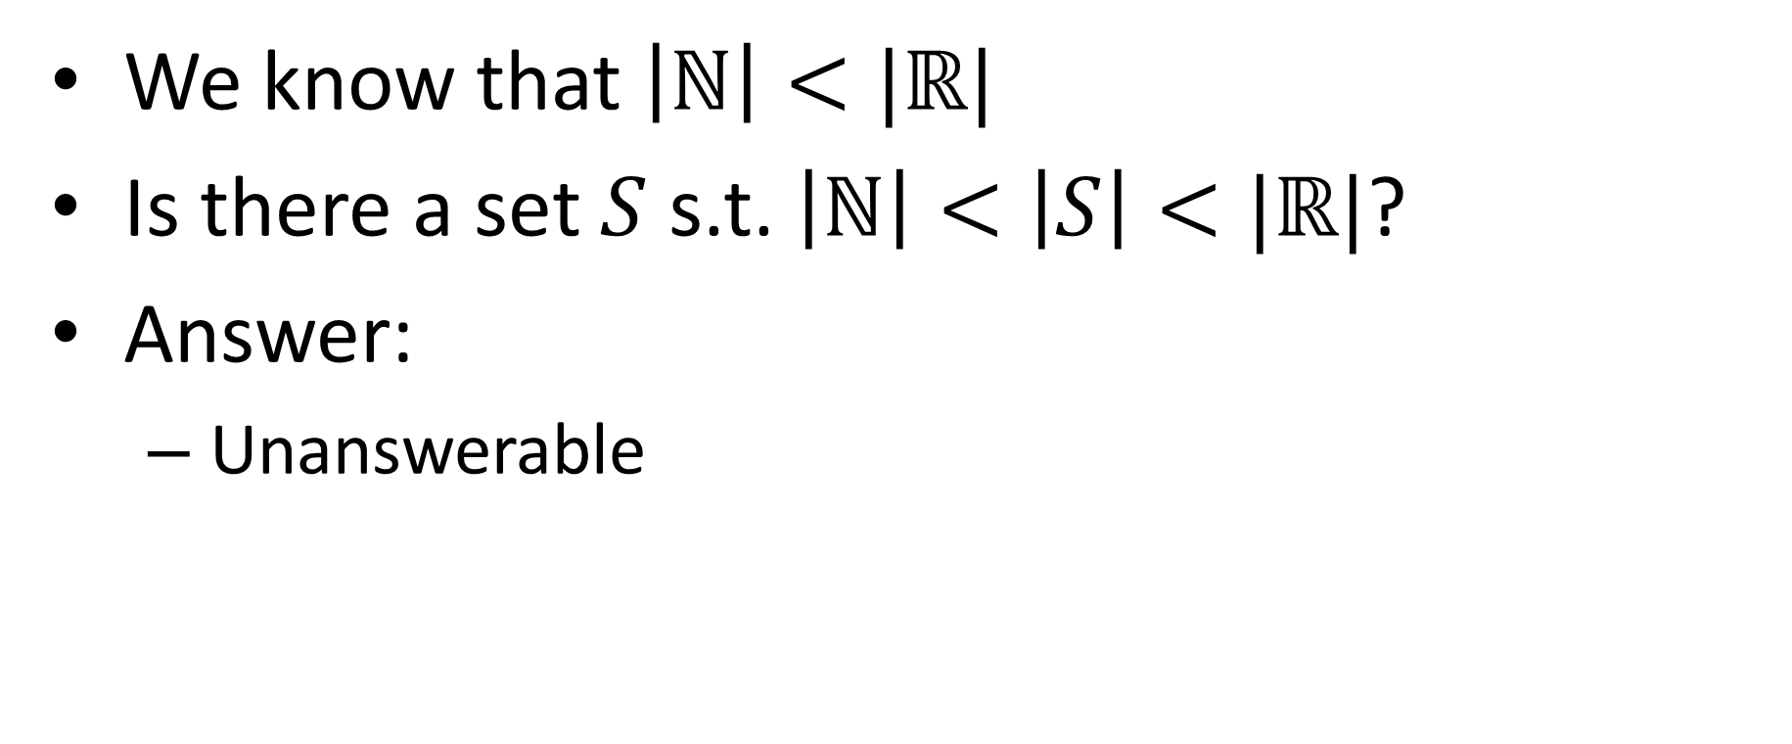
Continuum Hypothesis
We know that $\left|ℕ\right|<|ℝ|$
Is there a set $S$ s.t. $\left|ℕ\right|<\left|S\right|<|ℝ|$?
Answer:
Unanswerable

Slide 4
Godel’s Incompleteness Theorem
Says any axiomatic system is at least one of:
Inconsistent: There are false things that you can prove
Incomplete: There are true things that you cannot prove
Weak: You can’t talk about prime numbers
Proof idea: Show that any system can construct the paradox “This statement cannot be proven”

Slide 5
Incompleteness in CS*
Expectation Maximization Problem
You want to put ads on your website
You don’t know yet who will visit your website
Select ads to maximize the maximum number of potential customers
Answering this problem requires “tools” not yet addressed by set theory!

Slide 6
End of Phase 1
Until now:
Mathematical foundations
Proof strategies
Key ideas/insights
Main takeaway: Some languages (and numbers) cannot be computed by Java (or anything else)
Why? There are more language (numbers) than there are Java programs (or even finite descriptions)

Slide 7
Phase 2
Now we start filling in this box
First option: finite state machine
String
Computing Machine
/ Program / Algorithm
Accept/Reject

Slide 8
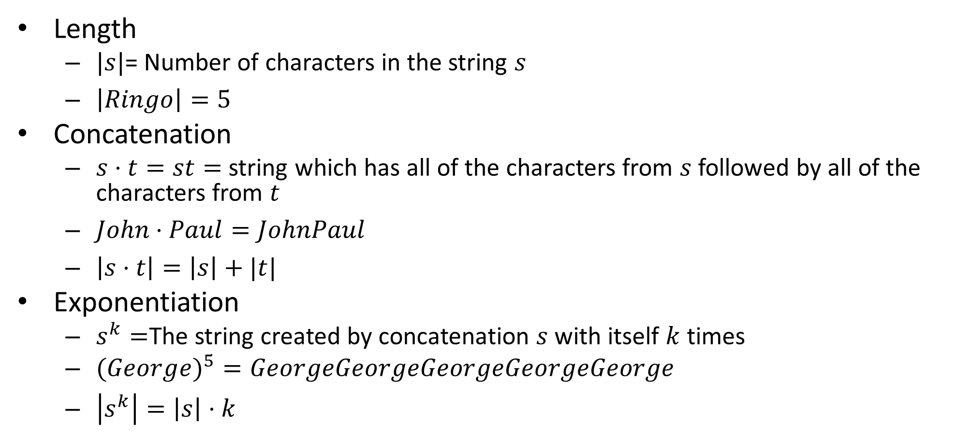
Operations on Strings
Length
$|s|$= Number of characters in the string $s$
$\left|Ringo\right|=5$
Concatenation
$s⋅t=st=$ string which has all of the characters from $s$ followed by all of the characters from $t$
$John⋅Paul=JohnPaul$
$\left|s⋅t\right|=\left|s\right|+|t|$
Exponentiation
$s^{k}=$The string created by concatenation $s$ with itself $k$ times
$(Georg{e)}^{5}=GeorgeGeorgeGeorgeGeorgeGeorge$
$\left|s^{k}\right|=\left|s\right|⋅k$

Slide 9

Empty String (“”)
Notation for this class: $ε$
\varepsilon in Latex
$\left|ε\right|=0$
$s⋅ε=s$
$ε^{k}=ε$
$s^{0}=ε$

Slide 10
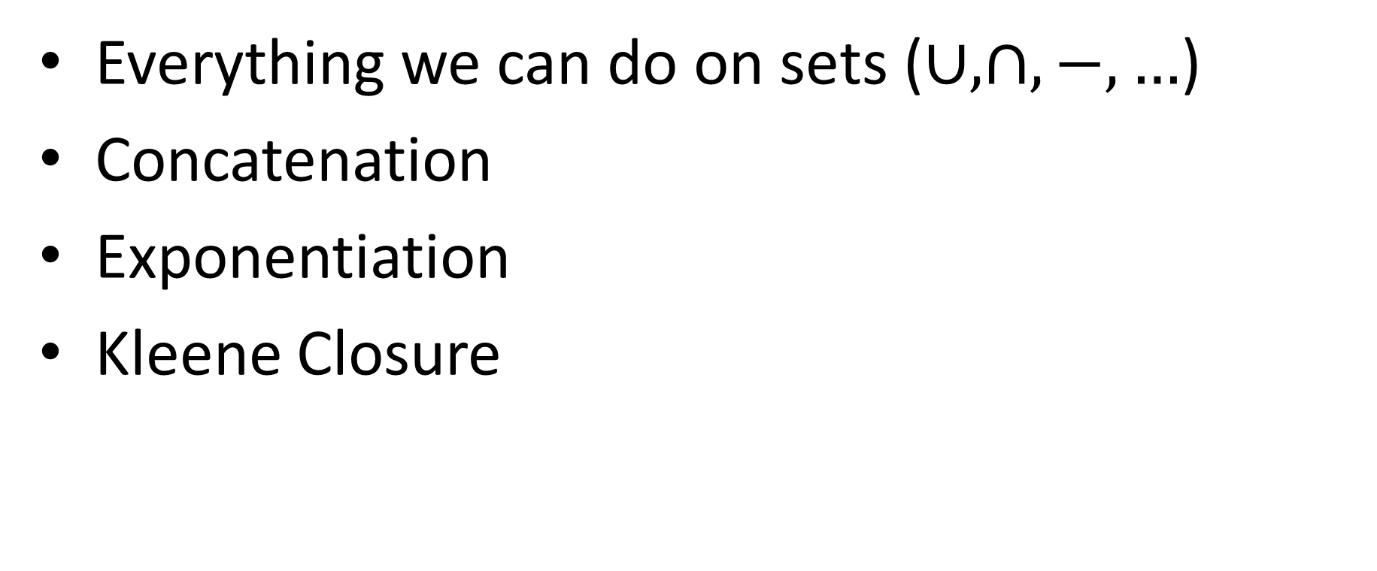
Operations on Languages
Everything we can do on sets ($∪,∩,−,…$)
Concatenation
Exponentiation
Kleene Closure

Slide 11
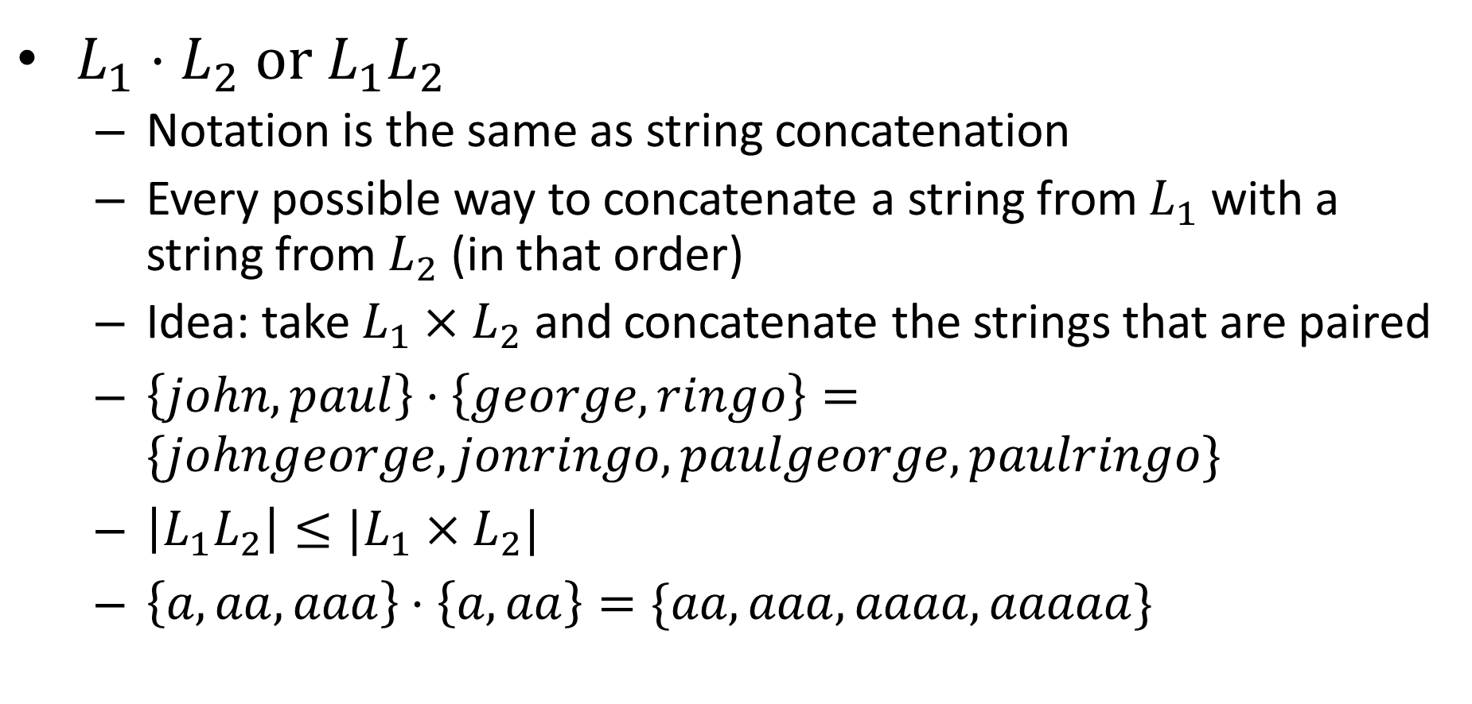
Language Concatenation
$L_{1}⋅L_{2}$ or $L_{1}L_{2}$
Notation is the same as string concatenation
Every possible way to concatenate a string from $L_{1}$ with a string from $L_{2}$ (in that order)
Idea: take $L_{1}×L_{2}$ and concatenate the strings that are paired
$\left\{john,paul\right\}⋅\left\{george,ringo\right\}=\{johngeorge,jonringo,paulgeorge,paulringo\}$
$\left|L_{1}L_{2}\right|≤|L_{1}×L_{2}|$
$\left\{a,aa,aaa\right\}⋅\left\{a,aa\right\}=\{aa,aaa,aaaa,aaaaa\}$

Slide 12
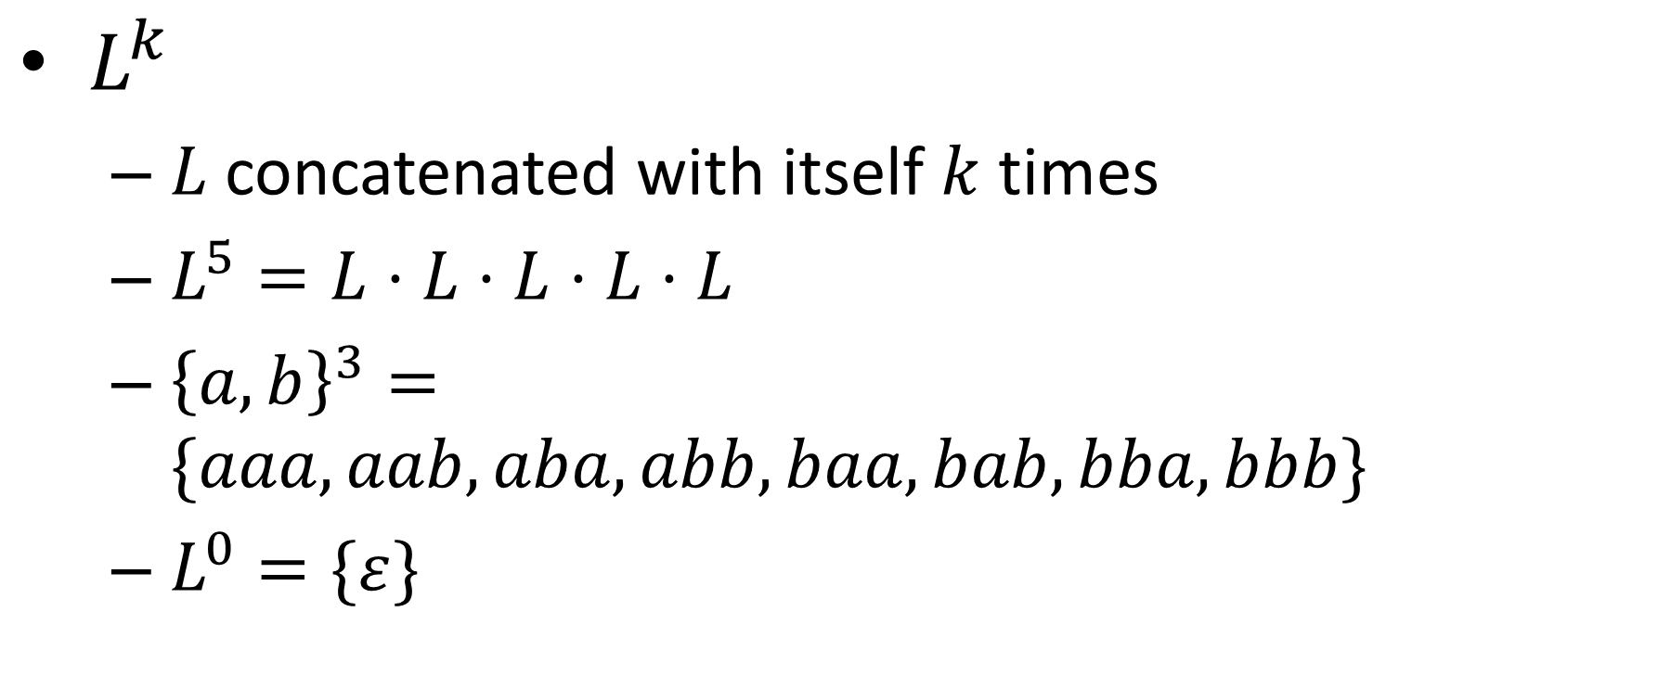
Language Exponentiation
$L^{k}$
$L$ concatenated with itself $k$ times
$L^{5}=L⋅L⋅L⋅L⋅L$
${\left\{a,b\right\}}^{3}=\{aaa,aab,aba,abb,baa,bab,bba,bbb\}$
$L^{0}=\{ε\}$

Slide 13
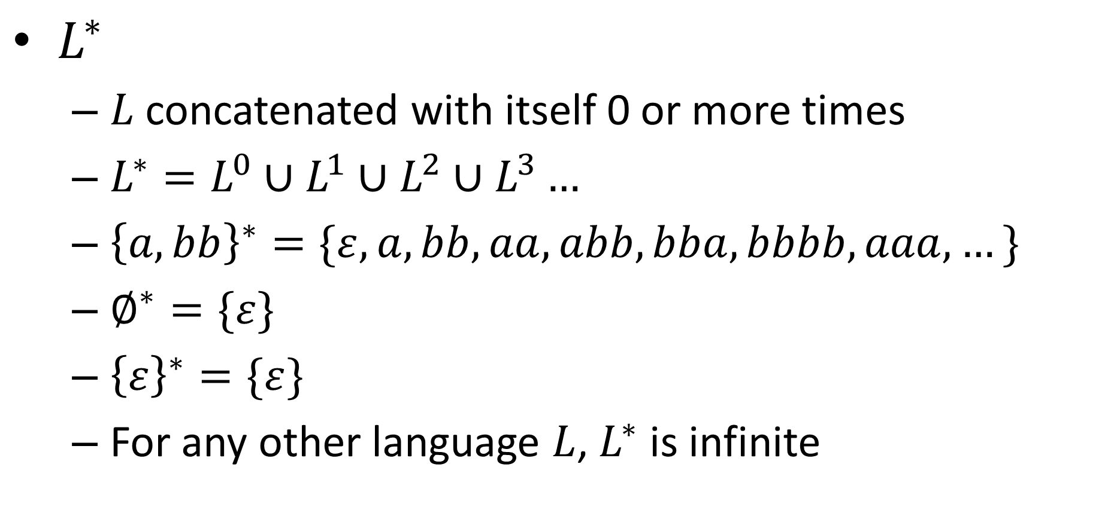
Kleene Closure
$L^{∗}$
$L$ concatenated with itself 0 or more times
$L^{∗}=L^{0}∪L^{1}∪L^{2}∪L^{3}…$
${\left\{a,bb\right\}}^{∗}=\{ε, a,bb,aa,abb,bba,bbbb,aaa,…\}$
$∅^{∗}=\{ε\}$
${\left\{ε\right\}}^{∗}=\{ε\}$
For any other language $L$, $L^{∗}$ is infinite

Slide 14
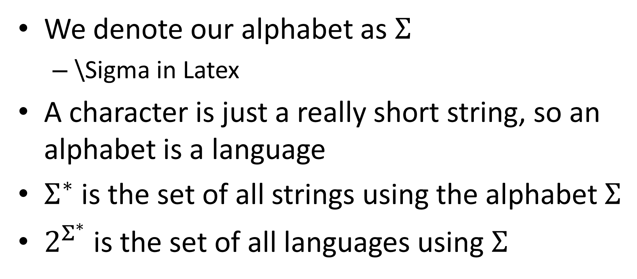
Sigma Star
We denote our alphabet as $Σ$
\Sigma in Latex
A character is just a really short string, so an alphabet is a language
$Σ^{∗}$ is the set of all strings using the alphabet $Σ$
$2^{Σ^{∗}}$ is the set of all languages using $Σ$

Slide 15
What Shall we put in the box?
Goal: start with something easy to prove things about
We’ve talked about Java, but that’s complex
String
Computing Machine
/ Program / Algorithm
Accept/Reject

Slide 16
Finite State Automaton
Simple model of computation
Represents computation without memory
Kind of decider
We call the set of strings it accepts the “language” of the machine
Our machine reads the input string only once, and one character at a time
After reading each character, enters a new “state”
State transition rules depend only on the current state and the current character (no looking back!)
There are only finitely many states

Slide 17
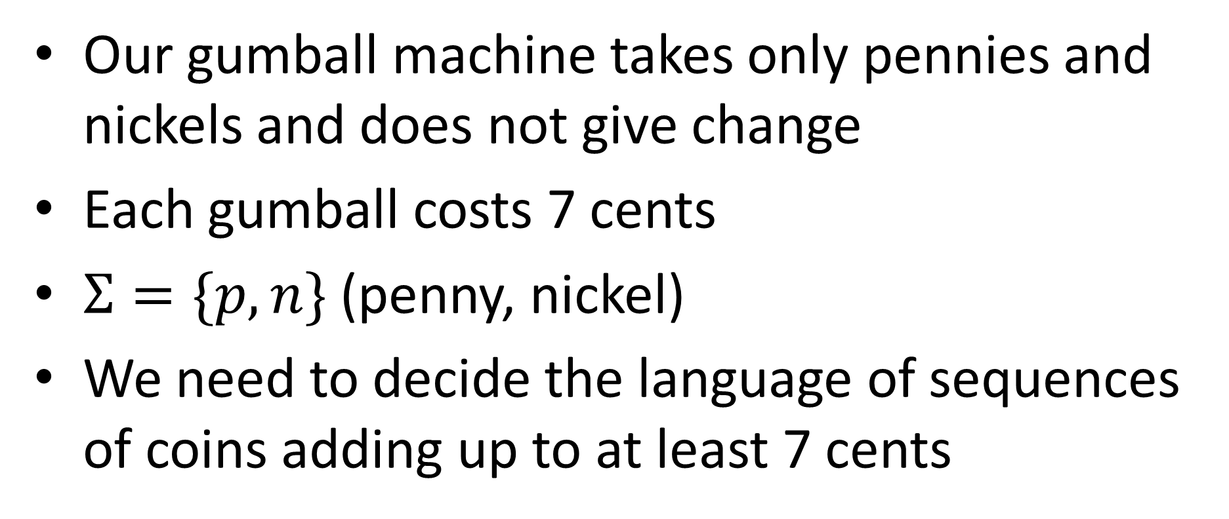
Gumball Machine
Our gumball machine takes only pennies and nickels and does not give change
Each gumball costs 7 cents
$Σ=\{p,n\}$ (penny, nickel)
We need to decide the language of sequences of coins adding up to at least 7 cents

Slide 18
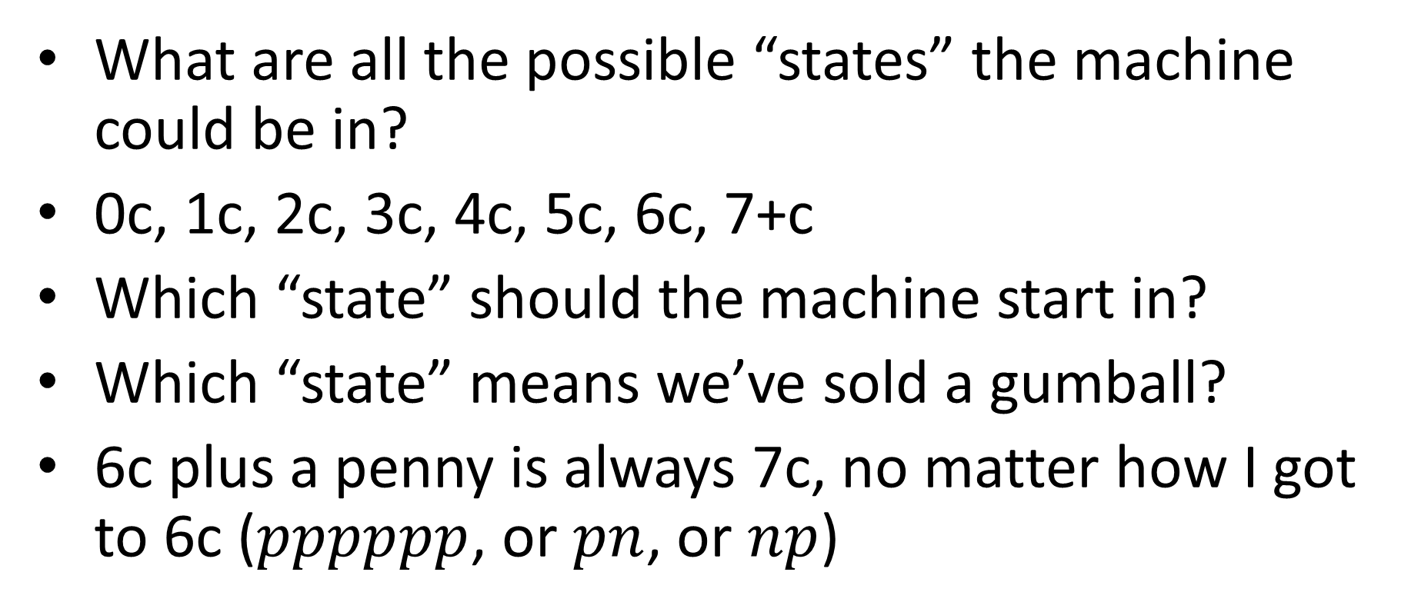
Gumball Machine
What are all the possible “states” the machine could be in?
0c, 1c, 2c, 3c, 4c, 5c, 6c, 7+c
Which “state” should the machine start in?
Which “state” means we’ve sold a gumball?
6c plus a penny is always 7c, no matter how I got to 6c ($pppppp$, or $pn$, or $np$)

Slide 19



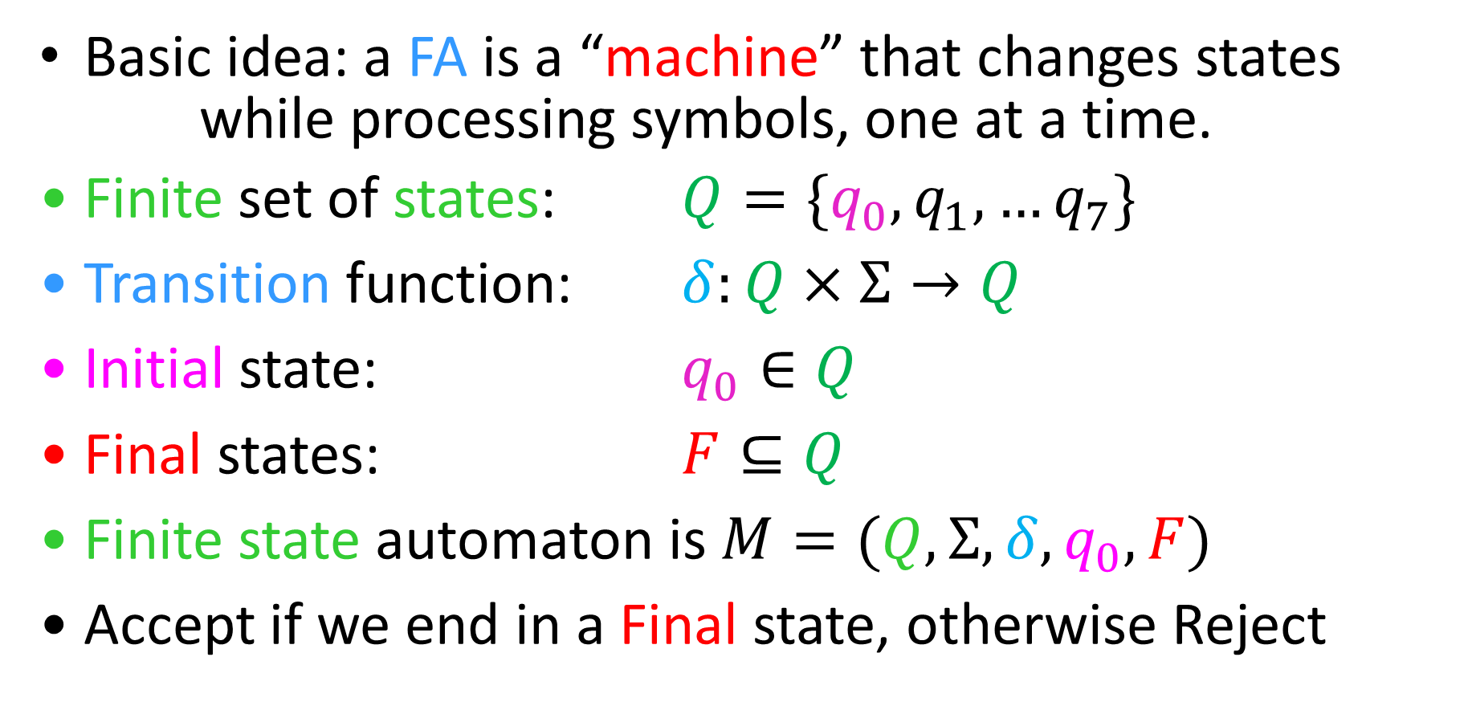



Finite State Automata
Basic idea: a FA is a “machine” that changes states
while processing symbols, one at a time.
Finite set of states: $Q=\{q_{0},q_{1},…q_{7}\}$
Transition function: $δ:Q×Σ→Q$
Initial state: $q_{0}∈Q$
Final states: $F⊆Q$
Finite state automaton is $M=(Q, Σ, δ, q_{0}, F)$
Accept if we end in a Final state, otherwise Reject
$$q_{1}$$
$$q_{1}$$
$$a$$
$$q_{2}$$
$$q_{0}$$
$$q_{k}$$

Slide 20
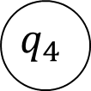


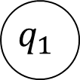

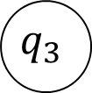


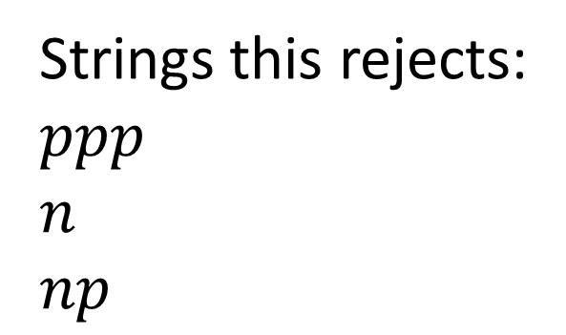





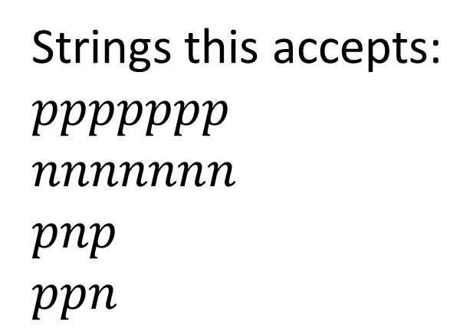
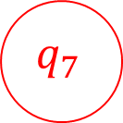


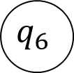

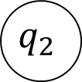
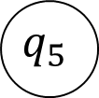


FSA for our Gumball Machine
$$n$$
$$n$$
$$n$$
$$p$$
$$p$$
$$p$$
$$p$$
$$p$$
$$p$$
$$p,n$$
$$q_{7}$$
$$q_{0}$$
$$q_{1}$$
$$q_{2}$$
$$q_{3}$$
$$q_{4}$$
$$q_{5}$$
$$q_{6}$$
$$n$$
$$n$$
$$p,n$$
$$n$$
Strings this accepts:
$ppppppp$
$nnnnnnn$
$pnp$
$ppn$
Strings this rejects:
$ppp$
$n$
$np$

Slide 21
EvenA
In HW1 you were asked to give a decider for EvenA (accepts all strings with an even number of A’s)
How did you do it?

Slide 22
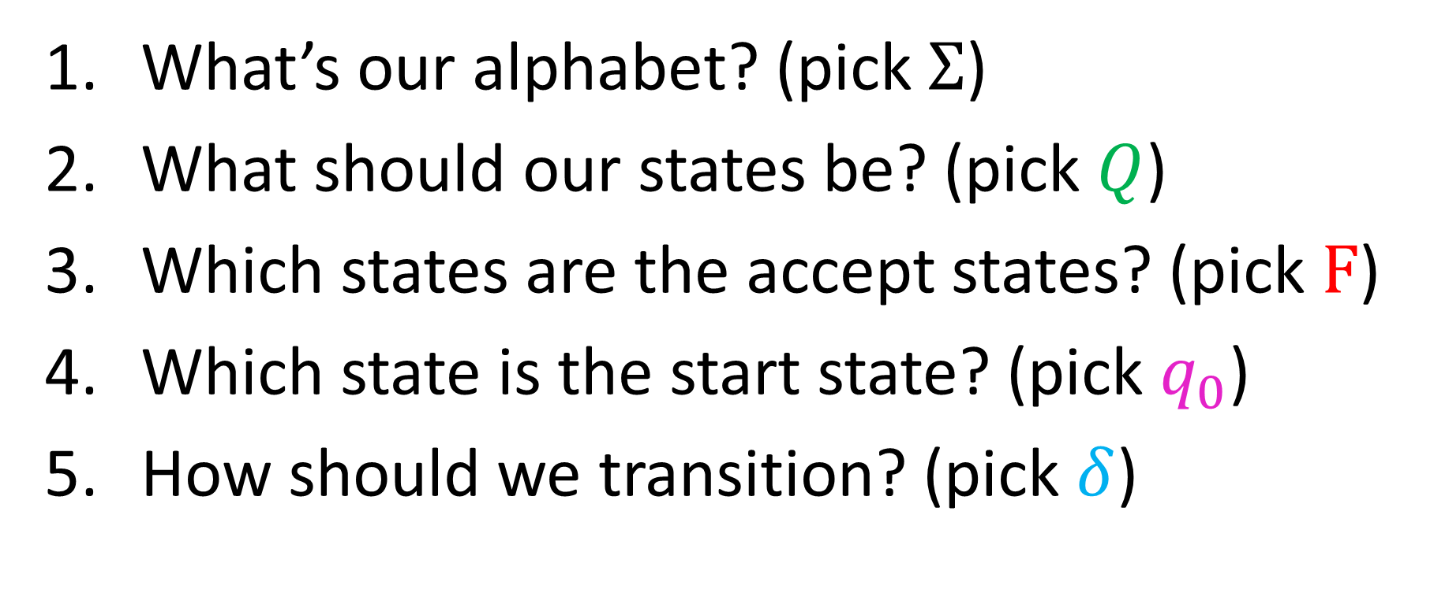
EvenA using FSA
What’s our alphabet? (pick $Σ$)
What should our states be? (pick $Q$)
Which states are the accept states? (pick $F$)
Which state is the start state? (pick $q_{0}$)
How should we transition? (pick $δ$)

Slide 23
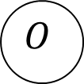





Let’s Draw It!
$$a$$
$$Σ−\{a\}$$
$$Σ−\{a\}$$
$$E$$
$$O$$
$$a$$

Slide 24
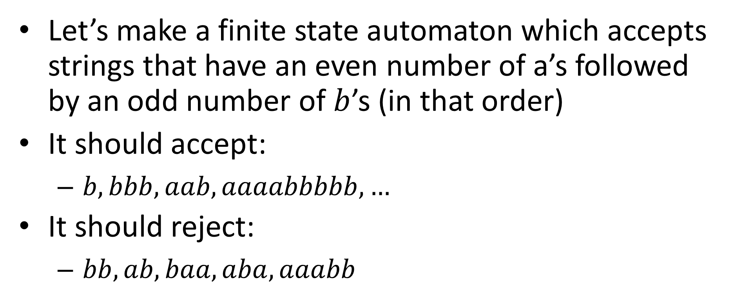
EvenAOddB
Let’s make a finite state automaton which accepts strings that have an even number of a’s followed by an odd number of $b$’s (in that order)
It should accept:
$b, bbb, aab, aaaabbbbb, …$
It should reject:
$bb, ab, baa, aba, aaabb$

Slide 25





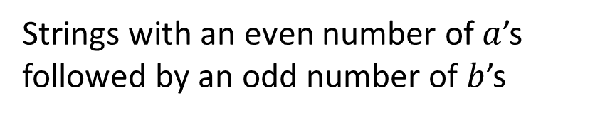




EvenAoddB
Strings with an even number of $a$’s followed by an odd number of $b$’s
$$a$$
Odd a
Even a
$$b$$
$$a,b$$
$$a$$
Trash
$$b$$
$$b$$
$$a$$
Odd b
Even b
$$a$$
$$b$$

Slide 26
EvenAOddB using FSA
What’s our alphabet? (pick $Σ$)
What should our states be? (pick $Q$)
Which states are the accept states? (pick $F$)
Which state is the start state? (pick $q_{0}$)
How should we transition? (pick $δ$)

Slide 27
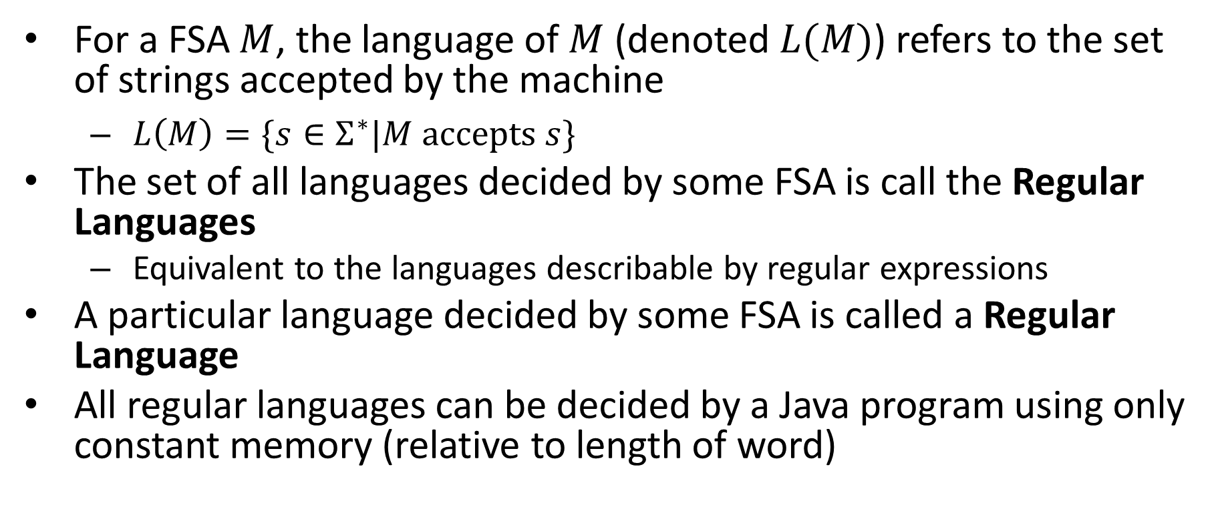
Take-aways
For a FSA $M$, the language of $M$ (denoted $L(M)$) refers to the set of strings accepted by the machine
$L\left(M\right)=\{s∈Σ^{∗}|M accepts s\}$
The set of all languages decided by some FSA is call the Regular Languages
Equivalent to the languages describable by regular expressions
A particular language decided by some FSA is called a Regular Language
All regular languages can be decided by a Java program using only constant memory (relative to length of word)

Slide 28
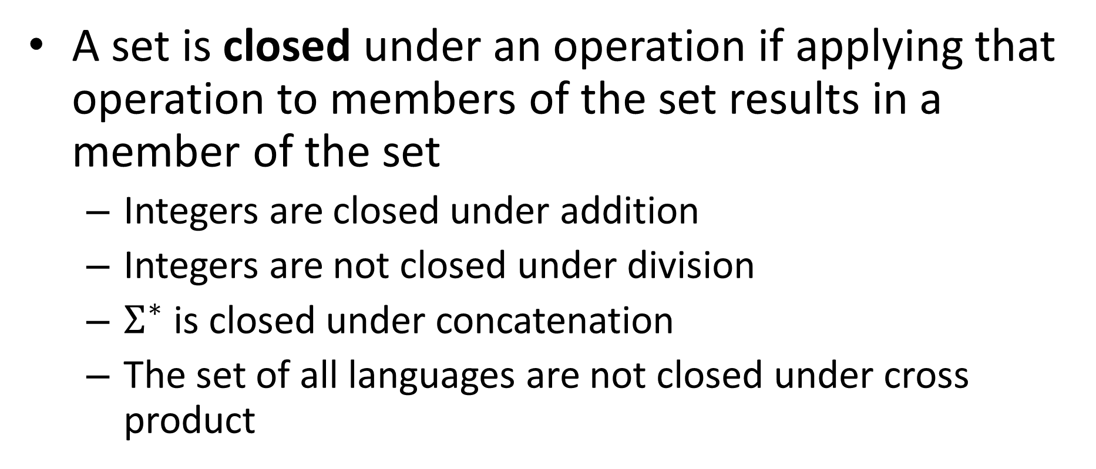
Closure Properties
A set is closed under an operation if applying that operation to members of the set results in a member of the set
Integers are closed under addition
Integers are not closed under division
$Σ^{∗}$ is closed under concatenation
The set of all languages are not closed under cross product

Slide 29
Closure Properties of Regular Languages
Complement
Intersection
Union
Difference
Concatenation

Slide 30
Closed under Complement
If a language is regular then its complement is regular
If a language has a FSA, it’s complement does as well
If there is a FSA which accepts exactly the strings in the language, there is a FSA which accepts exactly the strings not in the language

Slide 31
Closed under complement
Idea: Every string ends in some state. If that was originally an accept state then reject, else accept.
New final states are the old non-final states

Slide 32
EvenAoddB
Strings with an even number of $a$’s followed by an odd number of $b$’s
$$a$$
Odd a
Even a
$$b$$
$$a,b$$
$$a$$
Trash
$$b$$
$$b$$
$$a$$
Odd b
Even b
$$a$$
$$b$$

Slide 33
Complement of EvenAoddB
$$a$$
Odd a
Even a
$$b$$
$$a,b$$
$$a$$
Trash
$$b$$
$$b$$
$$a$$
Odd b
Even b
$$a$$
$$b$$

