Slide 1
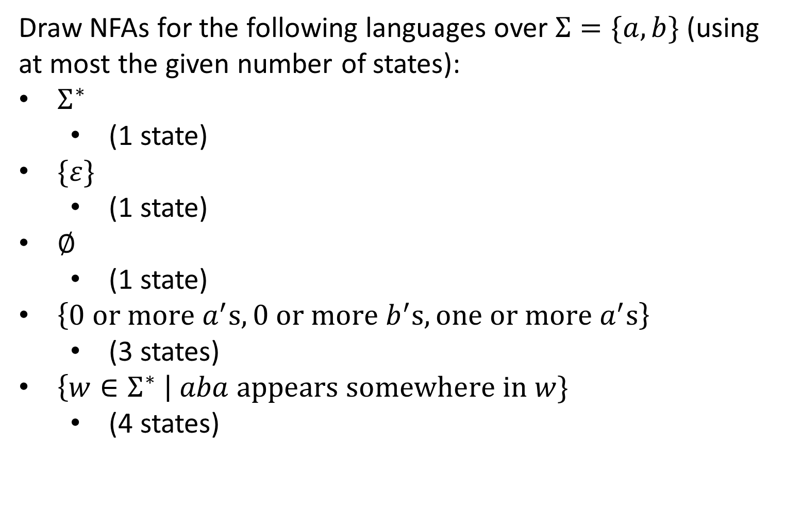
CS3102 Theory of Computation
Draw NFAs for the following languages over $Σ=\{a,b\}$ (using at most the given number of states):
$Σ^{∗}$
(1 state)
$\{ε\}$
(1 state)
$∅$
(1 state)
$\left\{0 or more a^{′}s, 0 or more b^{′}s, one or more a^{′}s\right\}$
(3 states)
$\left\{w∈Σ^{∗} \right| aba appears somewhere in w\}$
(4 states)

Slide 2
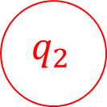




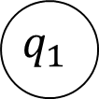

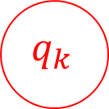

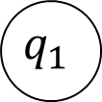




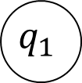





NFAs
$$a,b$$
$$q_{0}$$
$$q_{0}$$
$$q_{0}$$
$$\{ε\}$$
$$∅$$
$$Σ^{∗}$$
$$a,b$$
$$a,b$$
$$q_{0}$$
$$q_{1}$$
$$q_{1}$$
$$q_{k}$$
$$a$$
$$b$$
$$a$$
$$a$$
$\left\{w∈Σ^{∗} \right| aba appears somewhere in w\}$
$$a$$
$$b$$
$$q_{0}$$
$$q_{1}$$
$$q_{2}$$
$$ε$$
$$a$$
$$\left\{0 or more a^{′}s, 0 or more b^{′}s, one or more a^{′}s\right\}$$

Slide 3


Nondeterminism
Driving to a friend’s house
Friend forgets to mention a fork in the directions
Which way do you go?
Why not both?
?

Slide 4
Nondeterminism in Automata
Your machine can be in multiple states at once
Accepts if any if the states it ends in are accepting states
Relax restrictions:
Exactly one transition per symbol (can make multiple without consuming a symbol)
There must be exactly one outgoing transition for each symbol for every state (will allow 0 to many of them)
Keep restriction:
One start state

Slide 5
NFAs = DFAs
We can convert any NFA into a DFA
Powerset Construction
Idea: Make a new DFA whose states each represent a subset of states from the original machine.

Slide 6


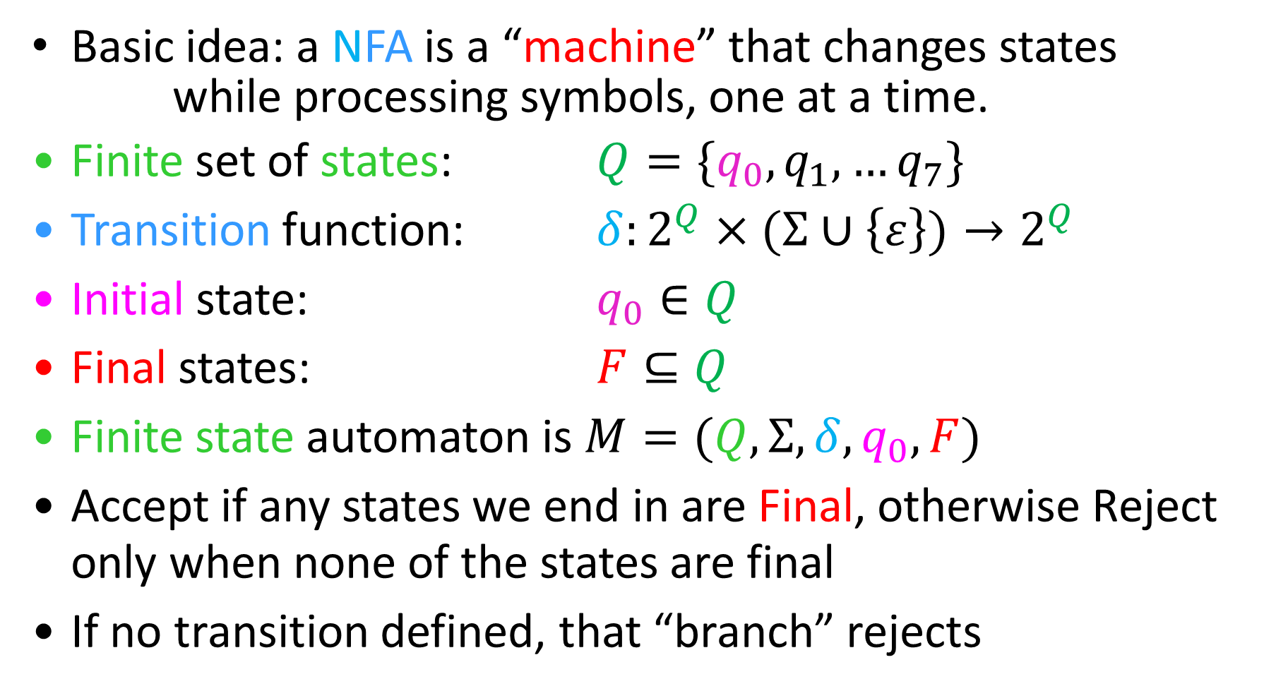
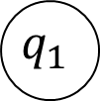

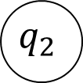
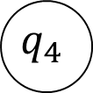
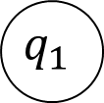
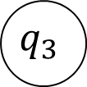
Nondeterministic Finite State Automata
Basic idea: a NFA is a “machine” that changes states
while processing symbols, one at a time.
Finite set of states: $Q=\{q_{0},q_{1},…q_{7}\}$
Transition function: $δ:2^{Q}×(Σ∪\left\{ε\right\})→2^{Q}$
Initial state: $q_{0}∈Q$
Final states: $F⊆Q$
Finite state automaton is $M=(Q, Σ, δ, q_{0}, F)$
Accept if any states we end in are Final, otherwise Reject only when none of the states are final
If no transition defined, that “branch” rejects
$$q_{1}$$
$$q_{1}$$
$$a$$
$$q_{2}$$
$$q_{0}$$
$$q_{k}$$
$$a$$
$$q_{3}$$
$$ε$$
$$q_{4}$$

Slide 7


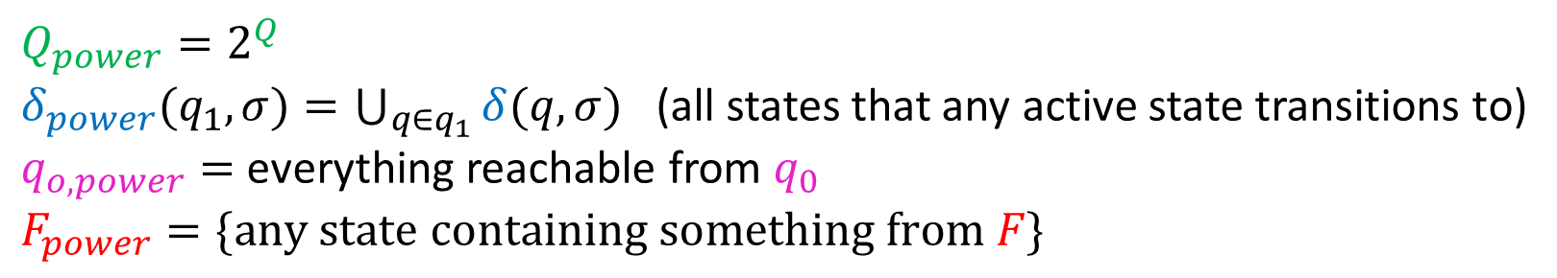
















Powerset Construction
$Q_{power}=2^{Q}$
$δ_{power}(q_{1}, σ)=\bigcup_{q∈q_{1}}{δ(q, σ)}$ (all states that any active state transitions to)
$q_{o,power}=$ everything reachable from $q_{0}$
$F_{power}=\{any state containing something from F\}$
$$∅$$
These states are
unreachable.
$$ε$$
$$b$$
2
$$1$$
$$2$$
$$3$$
1
$$b$$
$$a$$
$$a,b$$
$$1,2$$
$$2,3$$
$$1,3$$
$$b$$
$$a$$
3
$$a$$
$$1,2,3$$
$$a,b$$
$$b$$
Notes:
3 on a goes to 2
1 on a goes to 3
2 on a goes to 1, epsilon to 2
3 on b goes to 3 and 2
2 on b goes to 2
1 on b goes to 1 and 2

Slide 8
Do Powerset Construction on these
$$a,b$$
$$q_{0}$$
$$q_{0}$$
$$q_{0}$$
$$\{ε\}$$
$$∅$$
$$Σ^{∗}$$
$$a$$
$$b$$
$$a$$
$$q_{0}$$
$$q_{1}$$
$$q_{2}$$
$$ε$$
$$a$$
$$\left\{0 or more a^{′}s, 0 or more b^{′}s, one or more a^{′}s\right\}$$

Slide 9






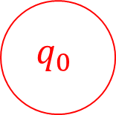

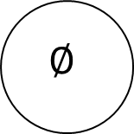
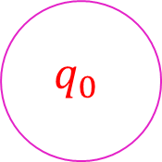
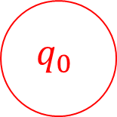

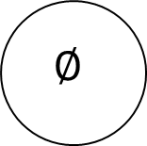
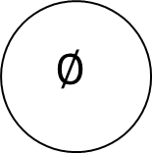
Powerset Construction
$$q_{0}$$
$$a,b$$
$$q_{0}$$
$$q_{0}$$
$$a,b$$
$$q_{0}$$
$$a,b$$
$$∅$$
$$a,b$$
$$∅$$
$$∅$$
$$Σ^{∗}$$
$$q_{0}$$
$$q_{0}$$
$$a,b$$
$$a,b$$
$$\{ε\}$$
$$∅$$

Slide 10

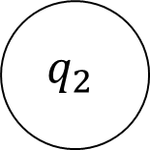
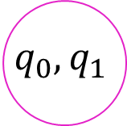



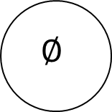
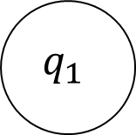

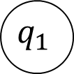
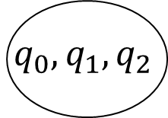


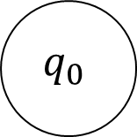


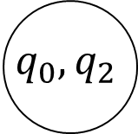




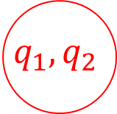


Powerset Construction
$$a,b$$
$$∅$$
$$b$$
$$b$$
$$a$$
$$a$$
$$b$$
$$a$$
$$q_{0}$$
$$q_{1}$$
$$q_{2}$$
$$q_{0}$$
$$q_{1}$$
$$q_{2}$$
$$a$$
$$a$$
$$ε$$
$$b$$
$$\left\{0 or more a^{′}s, 0 or more b^{′}s, one or more a^{′}s\right\}$$
$$q_{0},q_{1}$$
$$q_{1},q_{2}$$
$$q_{0},q_{2}$$
$$a$$
$$q_{0},q_{1},q_{2}$$
$$b$$
$$a$$

Slide 11
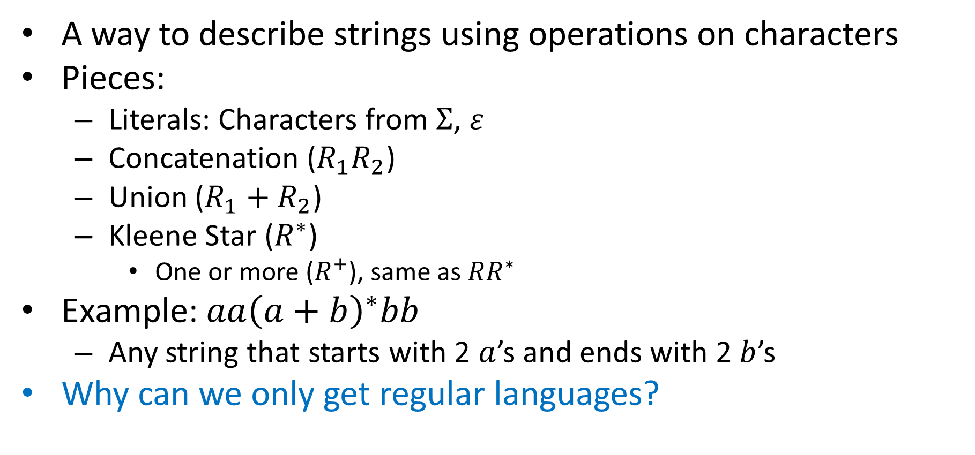
Regular Expressions
A way to describe strings using operations on characters
Pieces:
Literals: Characters from $Σ$, $ε$
Concatenation ($R_{1}R_{2}$)
Union ($R_{1}+R_{2}$)
Kleene Star ($R^{∗}$)
One or more ($R^{+}$), same as $RR^{∗}$
Example: $aa{\left(a+b\right)}^{∗}bb$
Any string that starts with 2 $a$’s and ends with 2 $b$’s
Why can we only get regular languages?
All finite languages are regular!
Preserves Regularity!
Preserves Regularity!
Preserves Regularity!
Preserves Regularity!

Slide 12
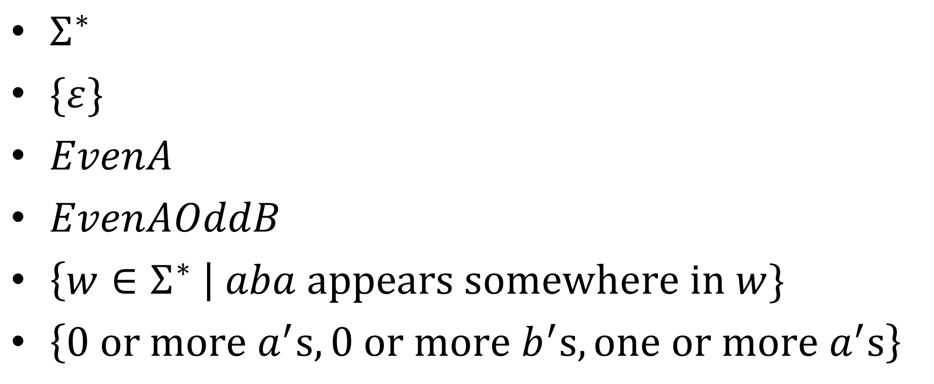
Give Regular Expressions
$Σ^{∗}$
$\{ε\}$
$EvenA$
$EvenAOddB$
$\left\{w∈Σ^{∗} \right| aba appears somewhere in w\}$
$\left\{0 or more a^{′}s, 0 or more b^{′}s, one or more a^{′}s\right\}$

Slide 13
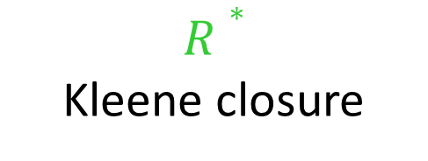

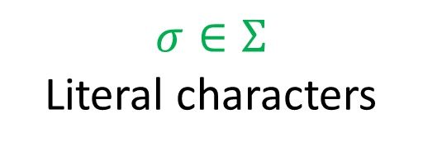
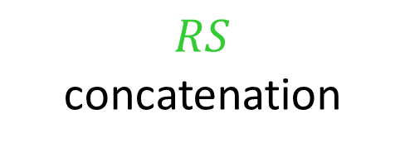

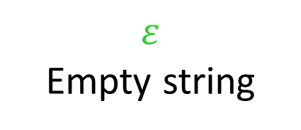
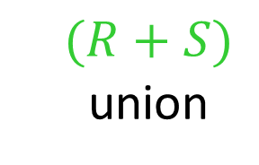




Regex to NFA
All literal regular expressions have an FSA:
$$ε$$
Empty string
$$σ∈Σ$$
Literal characters
q₀
q₀
$$σ$$
q₁
If regular expressions $R$ and $S$ have FSAs, then so do:
$$(R+S)$$
union
$$RS$$
concatenation
$$R∗$$
Kleene closure
$$M_{R}$$
ε
$$M_{S}$$
ε
$$M_{R}$$
ε
$$M_{R}$$
ε
ε
$$M_{S}$$
ε
ε

Slide 14
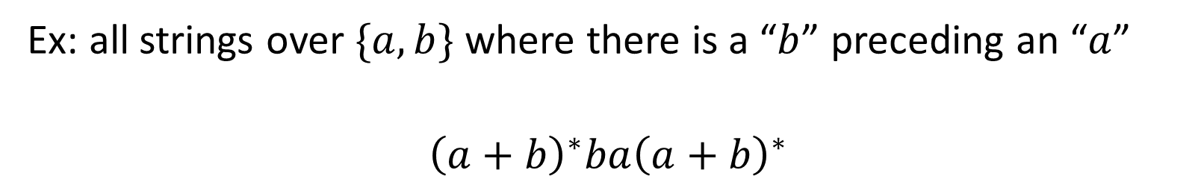
Regex to NFA
Ex: all strings over $\{a,b\}$ where there is a “$b$” preceding an “$a$”
$${\left(a+b\right)}^{∗}ba{\left(a+b\right)}^{∗}$$
ε
ε
ε
ε
a
a
a
a
ε
ε
ε
b
ε
ε
b
ε
a
a
ε
ε
ε
ε
ε
ε
ε
ε
ε
ε
ε
ε
ε
ε
ε
ε
b
b
b
b
ε
ε
ε
ε
ε
a
ε
a
ε
ε
ε
ε
b
ε
a
ε
ε
ε
ε
b
ε
ε
b
ε
Remove previous start/final states
ε

Slide 15
NFA to Regex
Idea: Make transitions match on regular expressions rather than characters, eliminate states until there is just one transition left, the regex that this transition matches will be the regex for that machine
We won’t go over details (less important than the other direction). Book shows this in Lemma 1.60.

Slide 16
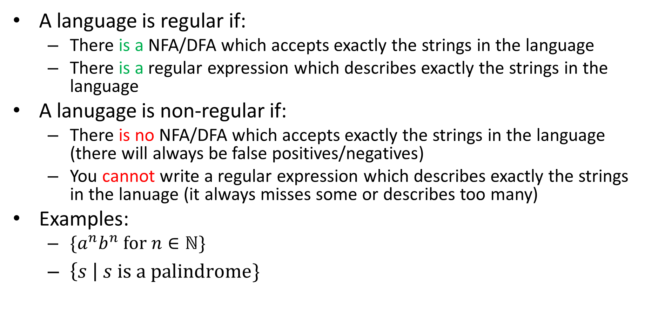
Non-regular Languages
A language is regular if:
There is a NFA/DFA which accepts exactly the strings in the language
There is a regular expression which describes exactly the strings in the language
A lanugage is non-regular if:
There is no NFA/DFA which accepts exactly the strings in the language (there will always be false positives/negatives)
You cannot write a regular expression which describes exactly the strings in the lanuage (it always misses some or describes too many)
Examples:
$\{a^{n}b^{n} for n∈ℕ\}$
$\left\{s \right| s is a palindrome\}$
Non-existence Proof!

Slide 17
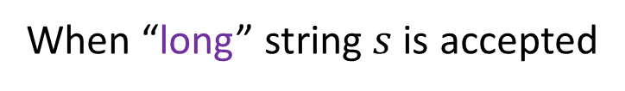
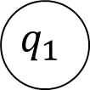
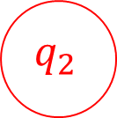
Proving Non-Regularity
For a language to be regular, there must be a DFA for it
That same DFA must work for every string in the language (no matter how long)
If the language is infinite, there must be some string in the language larger than the machine’s size
This long string it must visit at least one state twice on its way to the final state (pigeonhole principle)
Middle part
When “long” string $s$ is accepted
$$q_{0}$$
$$q_{1}$$
$$q_{2}$$
First part
Last part

Slide 18
“Pumping Lemma” Idea
Any infinite regular language has a “long” string
Any “long” string can be broken into 3 parts
A first part that takes you from start to some state
A middle part that takes you back to that same state
A last part that takes you to a final state
Copying the middle part times (or skipping it) still makes a path from start to a final state
If we can’t break up a “long” string into these parts which allows us to “pump” the middle, the language isn’t regular
Middle part
When “long” string $s$ is accepted
$$q_{0}$$
$$q_{1}$$
$$q_{2}$$
First part
Last part

Slide 19
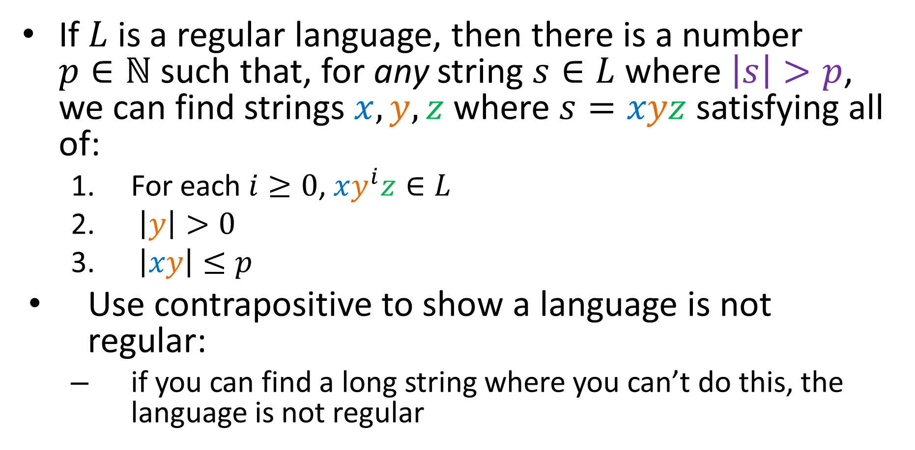
Pumping Lemma
If $L$ is a regular language, then there is a number $p∈ℕ$ such that, for any string $s∈L$ where $\left|s\right|>p$, we can find strings $x, y,z$ where $s=xyz$ satisfying all of:
For each $i≥0$, $xy^{i}z∈L$
$\left|y\right|>0$
$\left|xy\right|≤p$
Use contrapositive to show a language is not regular:
if you can find a long string where you can’t do this, the language is not regular

Slide 20
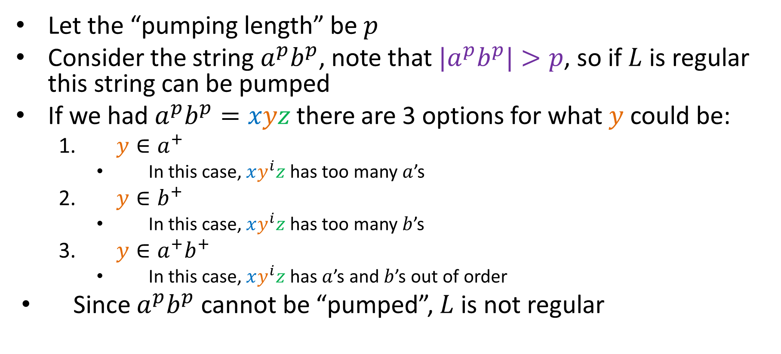

${L=a}^{n}b^{n}$ is not regular
Let the “pumping length” be $p$
Consider the string $a^{p}b^{p}$, note that ${|a}^{p}b^{p}|>p$, so if $L$ is regular this string can be pumped
If we had $a^{p}b^{p}=xyz$ there are 3 options for what $y$ could be:
$y∈a^{+}$
In this case, $xy^{i}z$ has too many $a$’s
$y∈b^{+}$
In this case, $xy^{i}z$ has too many $b$’s
$y∈a^{+}b^{+}$
In this case, $xy^{i}z$ has $a$’s and $b$’s out of order
Since $a^{p}b^{p}$ cannot be “pumped”, $L$ is not regular

