Slide 1
CS3102 Theory of Computation

Slide 2

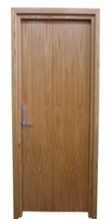
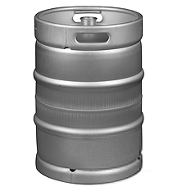





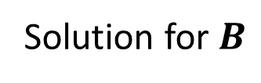
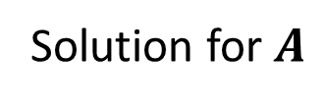

MacGyver’s Reduction
Problem known to be “hard”
Problem of uknown “hardness”
Lighting a fire
Opening a door
Aim duct at door, insert keg
$$B$$
$$A$$
How?
Solution for $A$
Solution for $B$
Keg cannon battering ram
Alcohol, wood, matches
Put fire under the Keg
Reduction

Slide 3
Theme: Categorizing Languages
Recognizable
So far:
Finite
Regular
Context Free
Decidable
Recognizable
Decidable
Context Free
Regular
Finite

Slide 4
Why Categorize Languages?
Indicates limits on resources needed to compute by Turing Machines relative to input size
Space = number of cells required on the tape (beyond input)
Time = number of transitions required by the machine
Regular:
Constant space
Linear time
Context Free:
Linear space

Slide 5
Categorizing Languages by Complexity
So far: Categorize by kind of machine needed to express
Going forward: Categorize by amount of resources a Turing Machine needs (asymptotic, relative to input size)

Slide 6
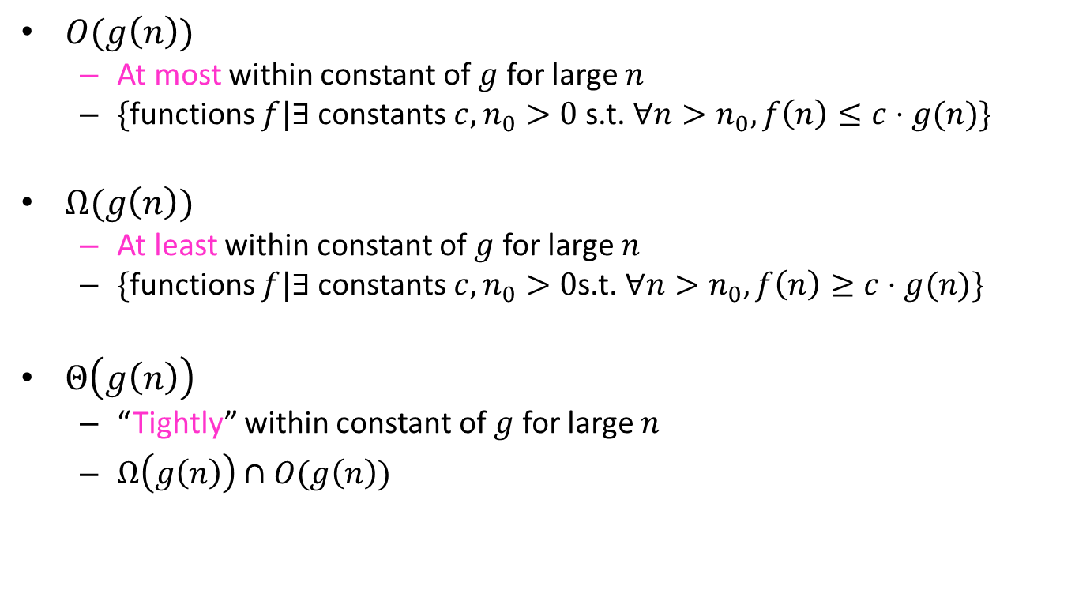
Asymptotic Notation
$O(g\left(n\right))$
At most within constant of $g$ for large $n$
$\{$functions $f|∃$constants $c, n_{0}>0$ s.t. $∀n>n_{0}, f\left(n\right)≤c⋅g(n)\}$
$Ω(g\left(n\right))$
At least within constant of $g$ for large $n$
$\{$functions $f|∃$constants $c, n_{0}>0$s.t. $∀n>n_{0}, f\left(n\right)≥c⋅g(n)\}$
$Θ\left(g\left(n\right)\right)$
“Tightly” within constant of $g$ for large $n$
$Ω\left(g\left(n\right)\right)∩O(g\left(n\right))$

Slide 7
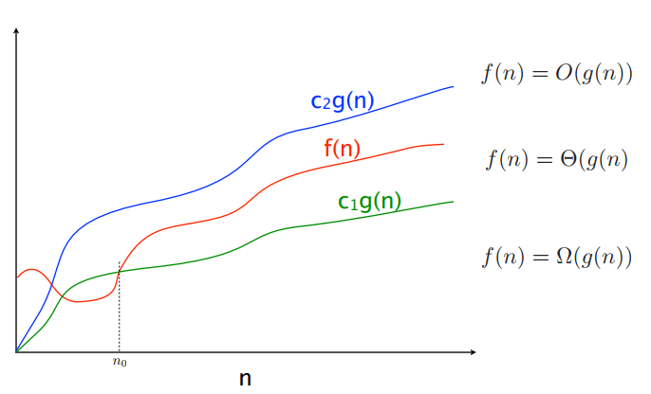



$$f(n)=O(g\left(n\right))$$
$$f(n)=Θ(g\left(n\right))$$
$$f(n)=Ω(g\left(n\right))$$

Slide 8
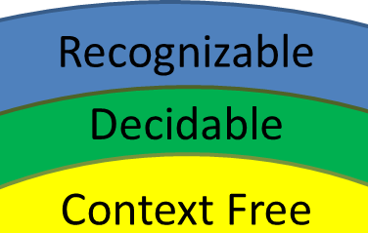
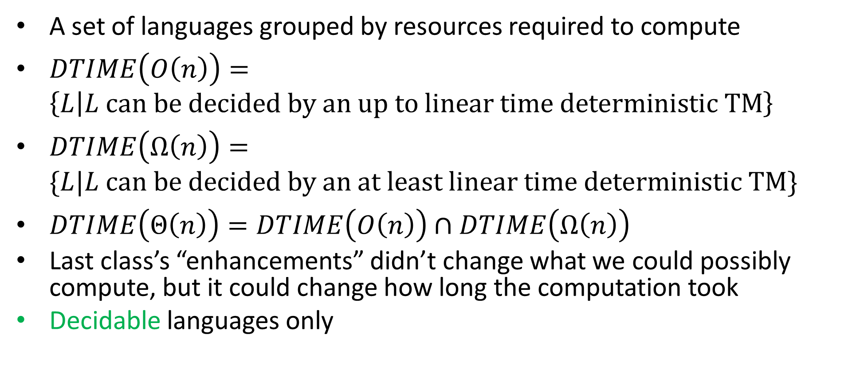



Complexity Classes
A set of languages grouped by resources required to compute
$DTIME\left(O\left(n\right)\right)=\left\{L | L can be decided by an up to linear time deterministic TM\right\}$
$DTIME\left(Ω\left(n\right)\right)=\{L|L can be decided by an at least linear time deterministic TM\}$
$DTIME\left(Θ\left(n\right)\right)=DTIME\left(O\left(n\right)\right)∩DTIME\left(Ω\left(n\right)\right)$
Last class’s “enhancements” didn’t change what we could possibly compute, but it could change how long the computation took
Decidable languages only
$$DTIME\left(O\left(n\right)\right)$$
$$DTIME\left(Ω\left(n\right)\right)$$
$$DTIME\left(Θ\left(n\right)\right)$$

Slide 9
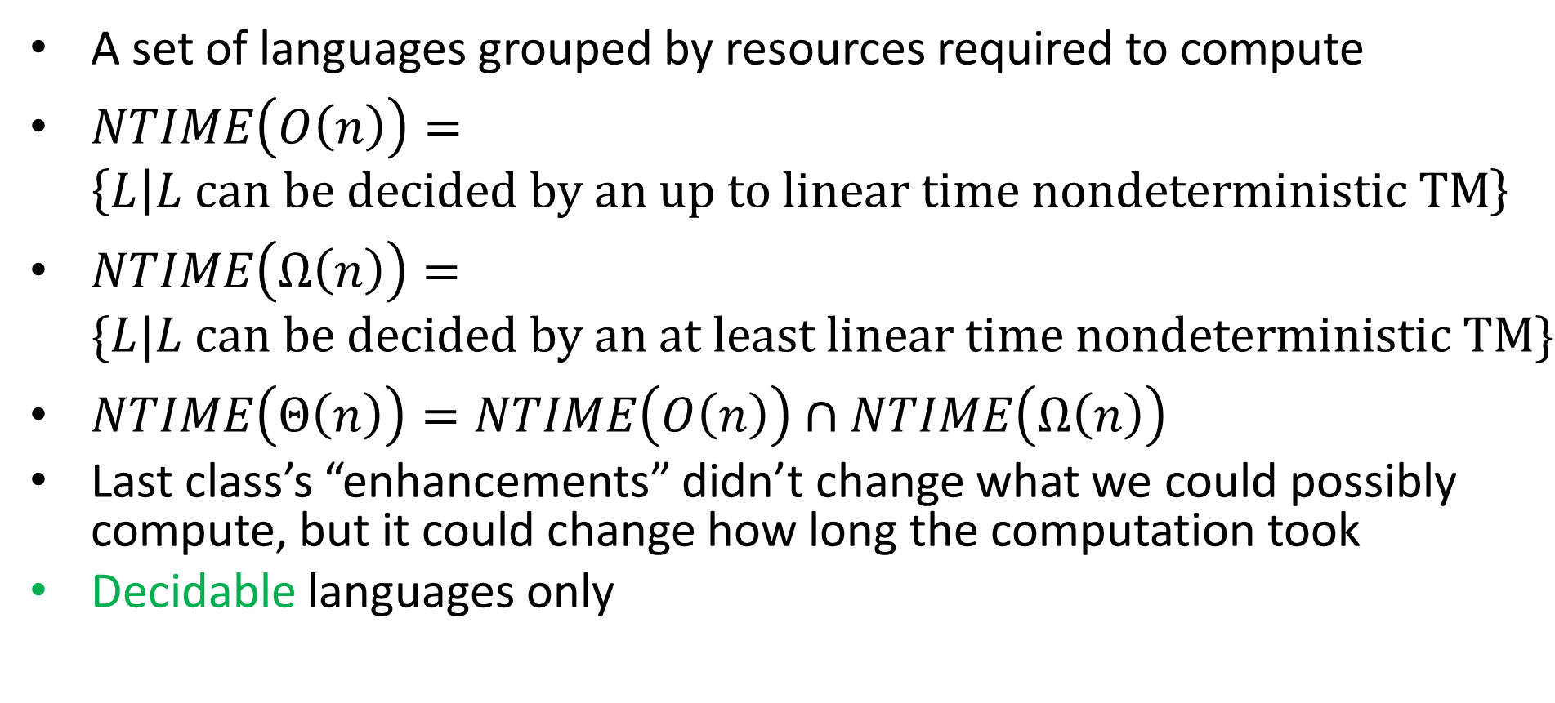



Non-Determinisitic Complexity Classes
A set of languages grouped by resources required to compute
$NTIME\left(O\left(n\right)\right)=\left\{L | L can be decided by an up to linear time nondeterministic TM\right\}$
$NTIME\left(Ω\left(n\right)\right)=\{L|L can be decided by an at least linear time nondeterministic TM\}$
$NTIME\left(Θ\left(n\right)\right)=NTIME\left(O\left(n\right)\right)∩NTIME\left(Ω\left(n\right)\right)$
Last class’s “enhancements” didn’t change what we could possibly compute, but it could change how long the computation took
Decidable languages only
$$NTIME\left(O\left(n\right)\right)$$
$$NTIME\left(Ω\left(n\right)\right)$$
$$NTIME\left(Θ\left(n\right)\right)$$

Slide 10
Deterministic vs Non-deterministic
Last time:
We can convert any deterministic Turing machine into a non-deterministic Turing machine
This conversion was very inefficient
Open problem:
Can we make this efficient?

Slide 11
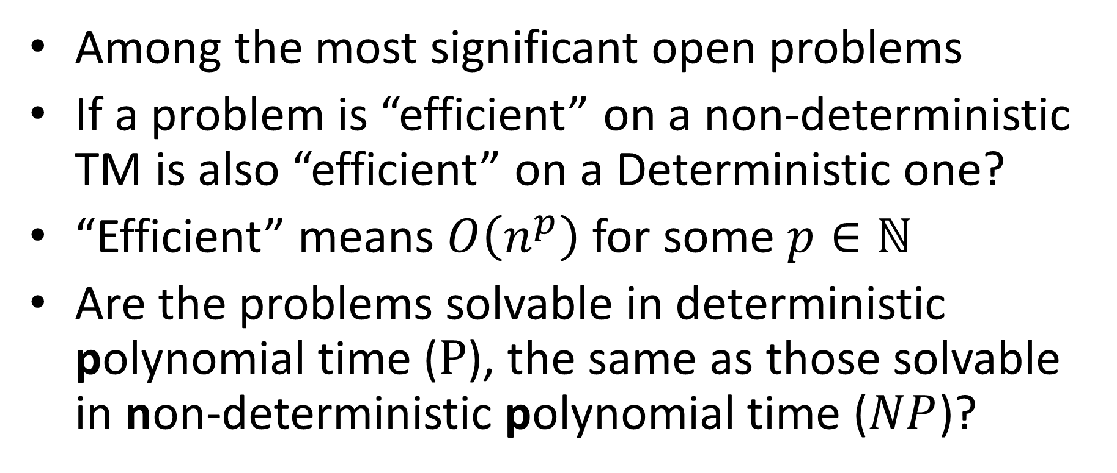
P vs NP Problem
Among the most significant open problems
If a problem is “efficient” on a non-deterministic TM is also “efficient” on a Deterministic one?
“Efficient” means $O\left(n^{p}\right)$ for some $p∈ℕ$
Are the problems solvable in deterministic polynomial time ($P$), the same as those solvable in non-deterministic polynomial time ($NP$)?

Slide 12

$$P⊆NP$$
Why?
Non-determinism is a “super power”
Any deterministic Turing machine is already a non-deterministic Turing machine

Slide 13
Why do we care?
P
Problems we can solve efficiently
NP
Problems we can verify efficiently
Verify: Given a potential solution, check if it’s correct
Equivalent statement
If we can verify solutions efficiently, can we find them efficiently as well?

Slide 14
Problem Types
Decision Problems:
Is there a solution?
Output is True/False
Can all these boxes fit in the trunk of my car?
Search Problems:
Find a solution
Output is complex
Show me how to make these boxes fit in the trunk of my car.
Verification Problems:
Given a potential solution, is it valid?
Output is True/False
Will the boxes fit in the trunk of your care if you load them like this?

Slide 15
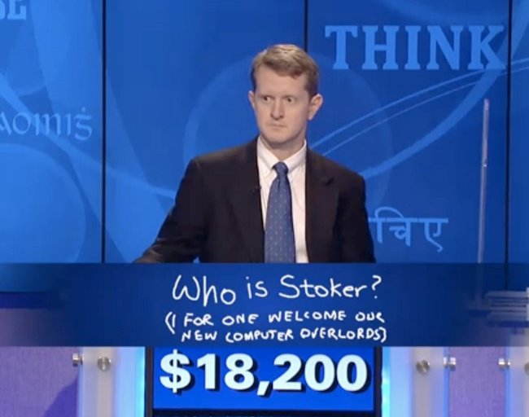
What if P=NP?
Any problem we can verify efficiently, we can solve efficiently
Good things:
Optimize packing boxes
Predict how proteins will fold
Optimally layout computer hardware
Bad (?) things:
No cryptography
Stronger AI?

Slide 16
Non-determinism and Verification
Non-deterministic TM to Verifier:
To accept: Some polynomial-length path in the TM accepts
What might we verify: When there is a non-deterministic split, which “fork” to take
Verifier to Non-determinstic TM:
Non-deterministically guess a solution for the verifier
Accept if the solution was valid

Slide 17
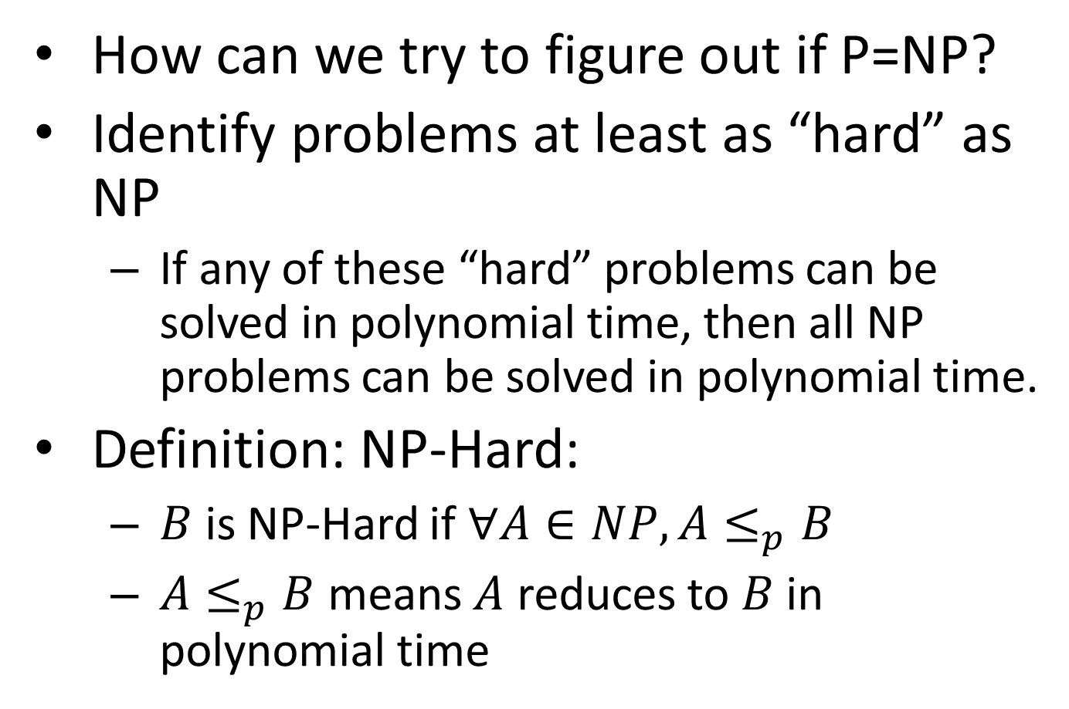
NP-Hard
How can we try to figure out if P=NP?
Identify problems at least as “hard” as NP
If any of these “hard” problems can be solved in polynomial time, then all NP problems can be solved in polynomial time.
Definition: NP-Hard:
$B$ is NP-Hard if $∀A∈NP, A≤_{p}B$
$A≤_{p}B$ means $A$ reduces to $B$ in polynomial time
NP-H
At least as “hard” as NP
NP
P

Slide 18




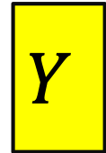


NP-Hardness Reduction
Any NP-Hard Problem
$$O(n^{p})$$
Problem to show is NP-Hard
$$A$$
$$B$$
If This could be done in Polynomial time
Then this could be done in polynomial time
Solution for $A$
Solution for $B$
$$X$$
$$Y$$
Reduction

Slide 19
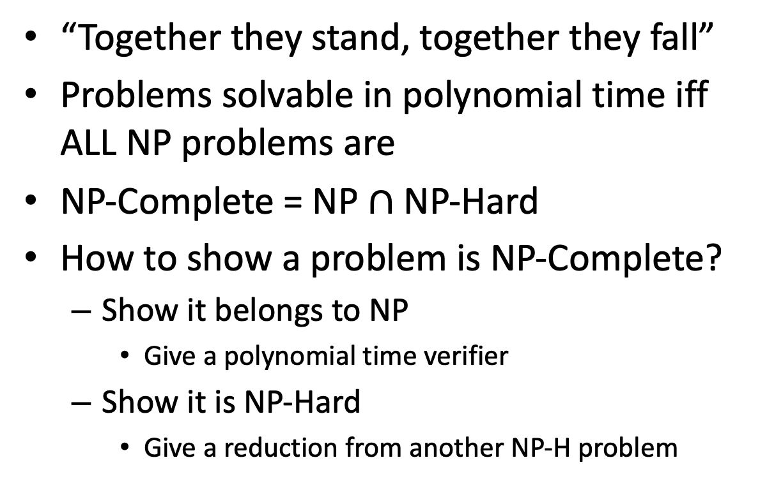
NP-Complete
“Together they stand, together they fall”
Problems solvable in polynomial time iff ALL NP problems are
NP-Complete = NP $∩$ NP-Hard
How to show a problem is NP-Complete?
Show it belongs to NP
Give a polynomial time verifier
Show it is NP-Hard
Give a reduction from another NP-H problem
NP-H
NP-C
NP
P
We now just need a FIRST NP-Hard problem

Slide 20



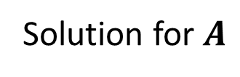
NP-Completeness
Any NP-Complete Problem
$$O(n^{p})$$
Any other NP-Complete Problem
$$A$$
$$B$$
If This could be done in Polynomial time
Then this could be done in polynomial time
Solution for $A$
Solution for $B$
$$X$$
$$Y$$
Reduction

Slide 21
NP-Completeness
Any NP-Complete Problem
$$O(n^{p})$$
Any other NP-Complete Problem
$$A$$
$$B$$
If this cannot be done in polynomial time
Then this cannot be done in polynomial time
Solution for $A$
Solution for $B$
$$X$$
$$Y$$
Reduction

Slide 22
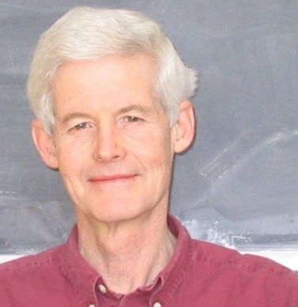
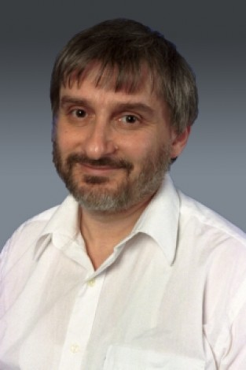
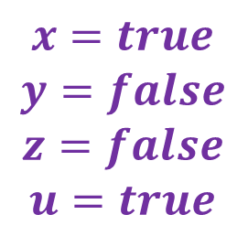
3-SAT
Stephen Cook
Leonid Levin
Shown to be NP-Hard by Cook and Levin (independently)
Given a 3-CNF formula (logical AND of clauses, each an OR of 3 variables), Is there an assignment of true/false to each variable to make the formula true?
$$\left(x∨y∨z\right)∧\left(x∨\overline{y}∨y\right)∧\left(u∨y∨\overline{z}\right)∧\left(z∨\overline{x}∨u\right)∧(\overline{x}∨\overline{y}∨\overline{z})$$
Clause
$$x=true$$
$$y=false$$
$$z=false$$
$$u=true$$
Variables

