Slide 1
CS3102 Theory of Computation

Slide 2
Problem Types
Decision Problems:
Is there a solution?
Output is True/False
Can all these boxes fit in the trunk of my car?
Search Problems:
Find a solution
Output is complex
Show me how to make these boxes fit in the trunk of my car.
Verification Problems:
Given a potential solution, is it valid?
Output is True/False
Will the boxes fit in the trunk of your care if you load them like this?

Slide 3
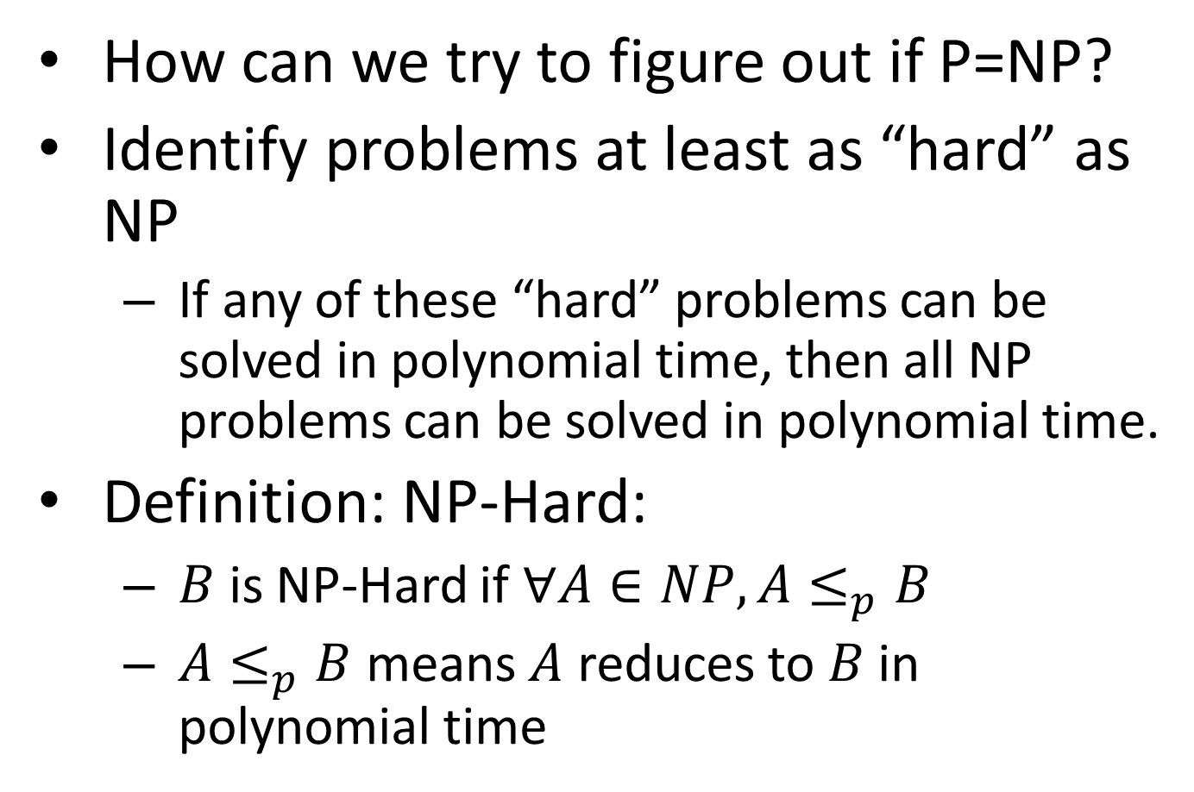
NP-Hard
How can we try to figure out if P=NP?
Identify problems at least as “hard” as NP
If any of these “hard” problems can be solved in polynomial time, then all NP problems can be solved in polynomial time.
Definition: NP-Hard:
$B$ is NP-Hard if $∀A∈NP, A≤_{p}B$
$A≤_{p}B$ means $A$ reduces to $B$ in polynomial time
NP-H
At least as “hard” as NP
NP
P

Slide 4

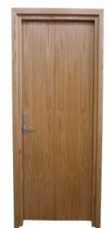
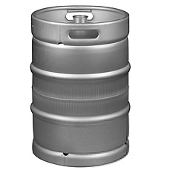

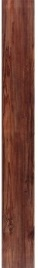

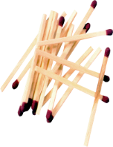

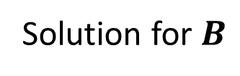
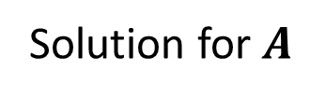

MacGyver’s Reduction
Problem known to be “hard”
Problem of uknown “hardness”
Lighting a fire
Opening a door
Aim duct at door, insert keg
$$B$$
$$A$$
How?
Solution for $A$
Solution for $B$
Keg cannon battering ram
Alcohol, wood, matches
Put fire under the Keg
Reduction

Slide 5




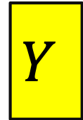


NP-Hardness Reduction
Any NP-Hard Problem
$$O(n^{p})$$
Problem to show is NP-Hard
$$A$$
$$B$$
If This could be done in Polynomial time
Then this could be done in polynomial time
Solution for $A$
Solution for $B$
$$X$$
$$Y$$
Reduction

Slide 6
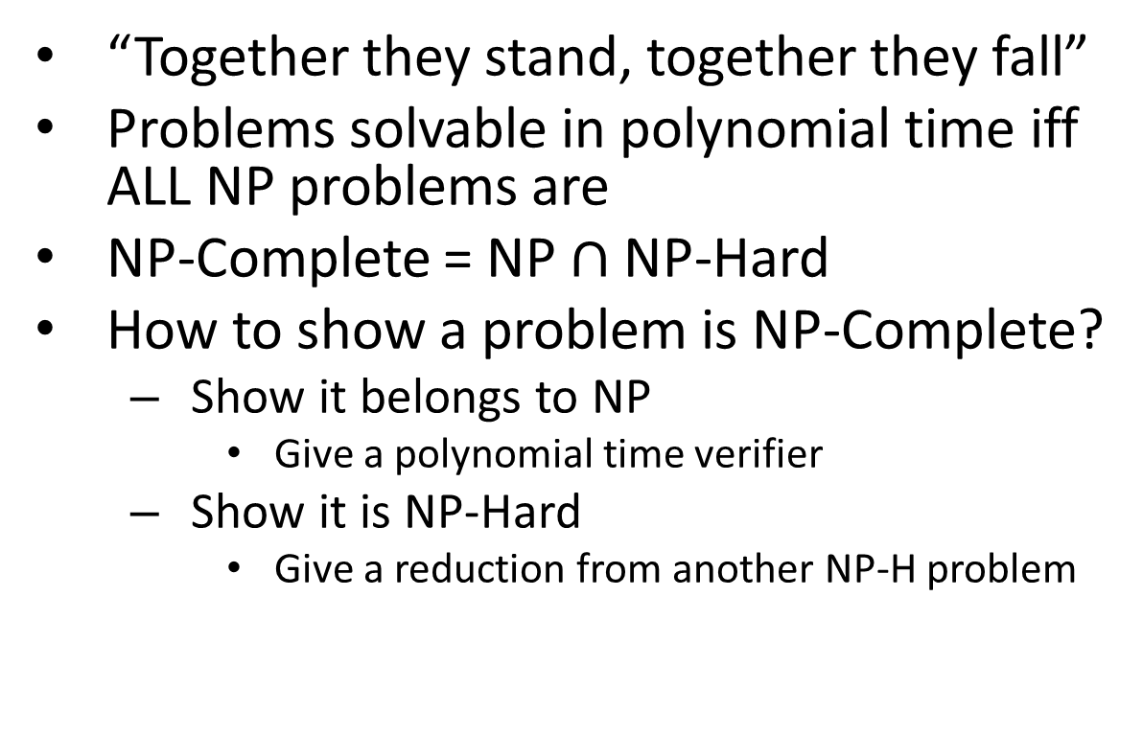
NP-Complete
“Together they stand, together they fall”
Problems solvable in polynomial time iff ALL NP problems are
NP-Complete = NP $∩$ NP-Hard
How to show a problem is NP-Complete?
Show it belongs to NP
Give a polynomial time verifier
Show it is NP-Hard
Give a reduction from another NP-H problem
NP-H
NP-C
NP
P
We now just need a FIRST NP-Hard problem

Slide 7



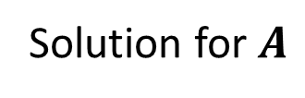
NP-Completeness
Any NP-Complete Problem
$$O(n^{p})$$
Any other NP-Complete Problem
$$A$$
$$B$$
If This could be done in Polynomial time
Then this could be done in polynomial time
Solution for $A$
Solution for $B$
$$X$$
$$Y$$
Reduction

Slide 8
NP-Completeness
Any NP-Complete Problem
$$O(n^{p})$$
Any other NP-Complete Problem
$$A$$
$$B$$
If this cannot be done in polynomial time
Then this cannot be done in polynomial time
Solution for $A$
Solution for $B$
$$X$$
$$Y$$
Reduction

Slide 9
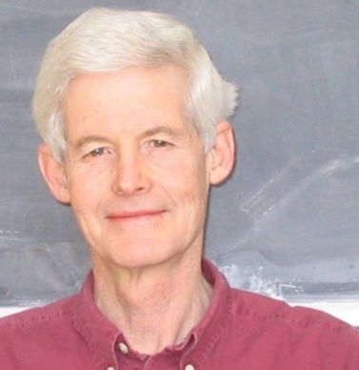

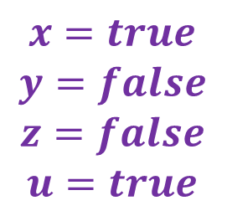
3-SAT
Stephen Cook
Leonid Levin
Shown to be NP-Hard by Cook and Levin (independently)
Given a 3-CNF formula (logical AND of clauses, each an OR of 3 variables), Is there an assignment of true/false to each variable to make the formula true?
$$\left(x∨y∨z\right)∧\left(x∨\overline{y}∨y\right)∧\left(u∨y∨\overline{z}\right)∧\left(z∨\overline{x}∨u\right)∧(\overline{x}∨\overline{y}∨\overline{z})$$
Clause
$$x=true$$
$$y=false$$
$$z=false$$
$$u=true$$
Variables

Slide 10
Proof idea
For a given non-determinstic polynomial time TM and an input string:
Create variables representing configurations of the TM
Create Clauses to represent valid transitions among configurations
Formula will be satisfiable if and only if the machine accepts the input
Conclusion: If we can decide 3SAT in polynomial time, we can simulate any non-deterministic polynomial time TM in polynomial time

Slide 11
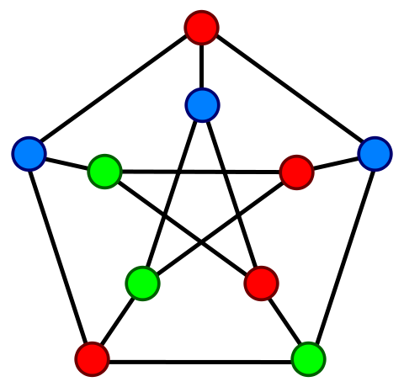
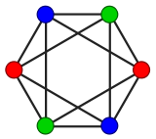
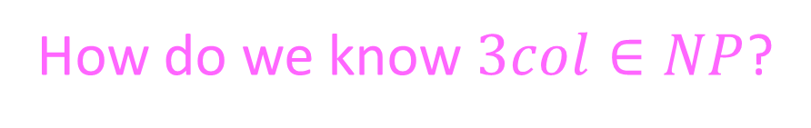
Another NP-Complete Problem
Graph 3-coloring: given a graph, is it
3-colorable? (adjacent nodes get different colors)
These are 3-colorable:
This is not 3-colorable:
How do we know $3col∈NP$?

Slide 12


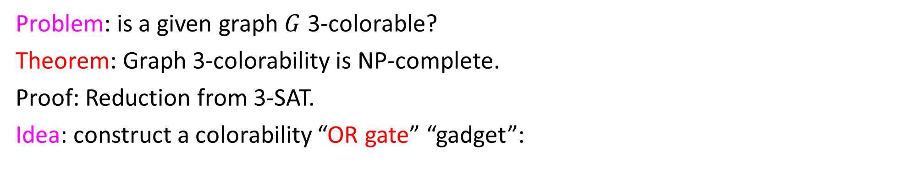


Graph Colorability
Problem: is a given graph $G$ 3-colorable?
Theorem: Graph 3-colorability is NP-complete.
Proof: Reduction from 3-SAT.
Idea: construct a colorability “OR gate” “gadget”:
⇒
$$x$$
$$(x∨y∨z)$$
$$y$$
T
$$z$$
Property: gadget is 3-colorable iff $(x+y+z)$ is true

Slide 13

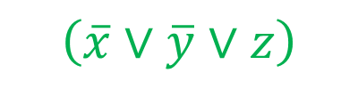











Example: $\left(x∨y∨z\right)∧\left(\overline{x}∨\overline{y}∨z\right)∧(\overline{x}∨y∨\overline{z})$
“Or Gate”:
$$x$$
$$\left(x∨y∨z\right)$$
x
y
T
$$y$$
z
Makes T/F different colors:
$$z$$
T
$$\left(\overline{x}∨\overline{y}∨z\right)$$
$$\overline{x}$$
F
$$\overline{y}$$
F
T
F
Makes $x$, $\overline{x}$ different colors:
$$x$$
$$∀x$$
$$(\overline{x}∨y∨\overline{z})$$
$$\overline{x}$$
Make an “or gate” for each clause
Add a node for False and 3rd color
Connect T,F,3rd into a triangle
Connect each node to its complement and 3rd color
$$\overline{z}$$

Slide 14
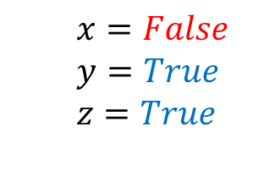
NP-Completeness
3-SAT
$$O(n^{p})$$
3-Colorability
$$A$$
$$B$$
x
y
T
z
$$\left(x∨y∨z\right)∧\left(\overline{x}∨\overline{y}∨z\right)∧(\overline{x}∨y∨\overline{z})$$
If This could be done in Polynomial time
Then this could be done in polynomial time
Solution for $A$
x
Solution for $B$
$$X$$
$$Y$$
$x=False$
$$y=True$$
$$z=True$$
y
T
z
Reduction

Slide 15
NP-Completeness
3-SAT
$$O(n^{p})$$
3-Colorability
$$A$$
$$B$$
x
y
T
z
$$\left(x∨y∨z\right)∧\left(\overline{x}∨\overline{y}∨z\right)∧(\overline{x}∨y∨\overline{z})$$
If this cannot be done in polynomial time
Then this cannot be done in polynomial time
Solution for $A$
x
Solution for $B$
$$X$$
$$Y$$
$x=False$
$$y=True$$
$$z=True$$
y
T
z
Reduction

Slide 16
What about Search Problems
If we can solve a decision version in polynomial time, we can solve the search version as well.
Idea: use the decider to build a solution “guess and check” one piece at a time

Slide 17
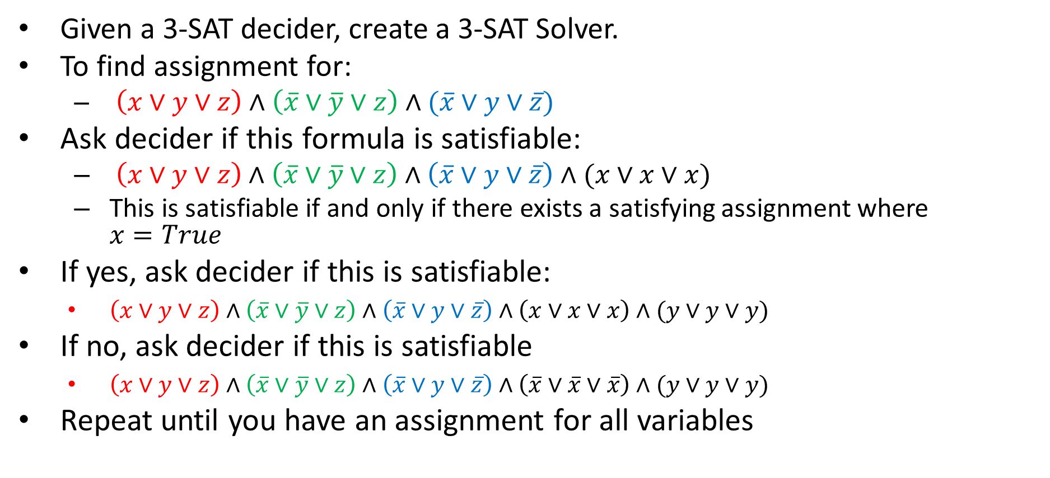
Search-Decision Reduction
Given a 3-SAT decider, create a 3-SAT Solver.
To find assignment for:
$\left(x∨y∨z\right)∧\left(\overline{x}∨\overline{y}∨z\right)∧(\overline{x}∨y∨\overline{z})$
Ask decider if this formula is satisfiable:
$\left(x∨y∨z\right)∧\left(\overline{x}∨\overline{y}∨z\right)∧\left(\overline{x}∨y∨\overline{z}\right)∧(x∨x∨x)$
This is satisfiable if and only if there exists a satisfying assignment where $x=True$
If yes, ask decider if this is satisfiable:
$\left(x∨y∨z\right)∧\left(\overline{x}∨\overline{y}∨z\right)∧\left(\overline{x}∨y∨\overline{z}\right)∧\left(x∨x∨x\right)∧(y∨y∨y)$
If no, ask decider if this is satisfiable
$\left(x∨y∨z\right)∧\left(\overline{x}∨\overline{y}∨z\right)∧\left(\overline{x}∨y∨\overline{z}\right)∧\left(\overline{x}∨\overline{x}∨\overline{x}\right)∧(y∨y∨y)$
Repeat until you have an assignment for all variables

Slide 18
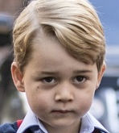


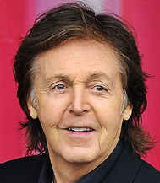
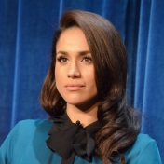
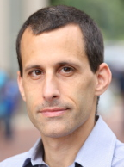
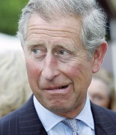
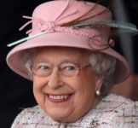


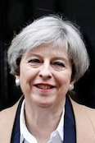
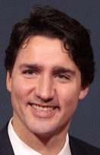

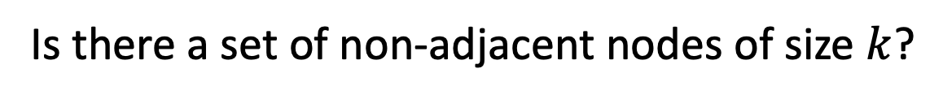
$k$ Independent Set
Is there a set of non-adjacent nodes of size $k$?

Slide 19
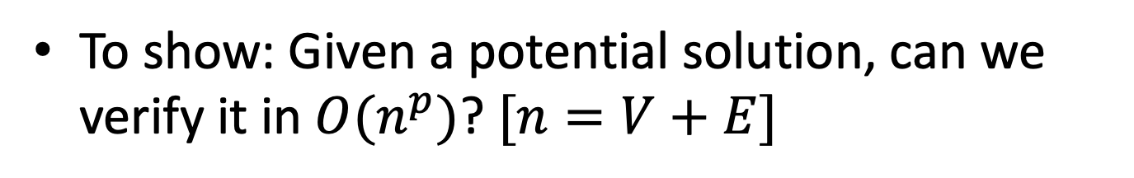

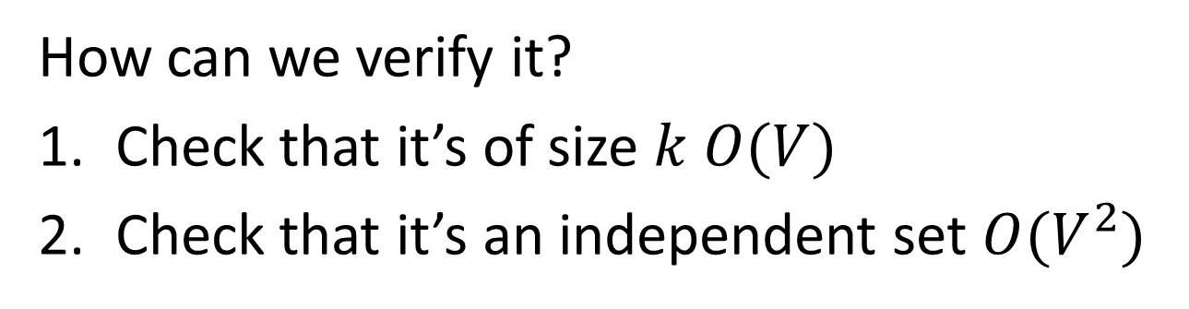
$k$-Independent Set is NP
To show: Given a potential solution, can we verify it in $O(n^{p})$? $[n=V+E]$
How can we verify it?
Check that it’s of size $k$ $O(V)$
Check that it’s an independent set $O(V^{2})$

Slide 20



$$3SAT≤_{p}kIndSet$$
3SAT
$$O(n^{p})$$
$k$-Ind Set
$$A$$
$$B$$
Solution for 3SAT
Solution for $k$-Ind Set
$$X$$
$$Y$$
Reduction

Slide 21














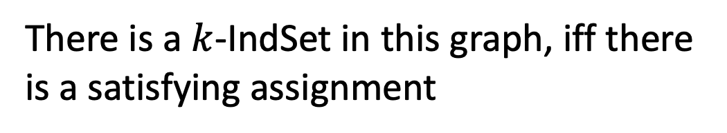



Instance of 3SAT to Instance of $k$IndSet
$$\left(x∨y∨z\right)∧\left(x∨\overline{y}∨y\right)∧\left(u∨y∨\overline{z}\right)∧\left(z∨\overline{x}∨u\right)∧(\overline{x}∨\overline{y}∨\overline{z})$$
$$x$$
$$u$$
$$z$$
$$\overline{x}$$
$$x$$
$$y$$
$$\overline{y}$$
$$\overline{z}$$
$$y$$
$$u$$
$$\overline{x}$$
$$\overline{z}$$
$$\overline{y}$$
$$z$$
$$y$$
For each clause, produce a triangle graph with its three variables as nodes
Connect each node to all of its opposites
Let $k=$ number of clauses
There is a $k$-IndSet in this graph, iff there is a satisfying assignment

Slide 22







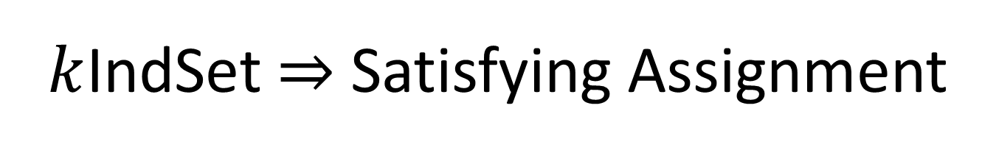

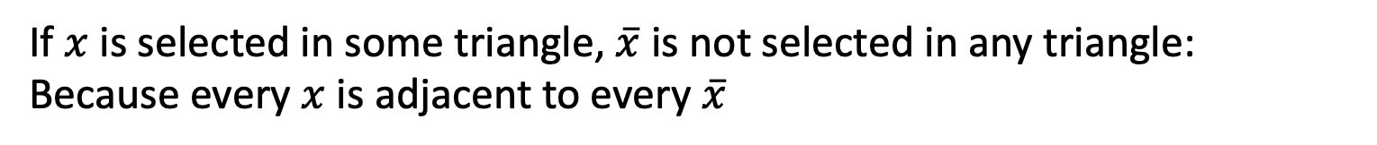






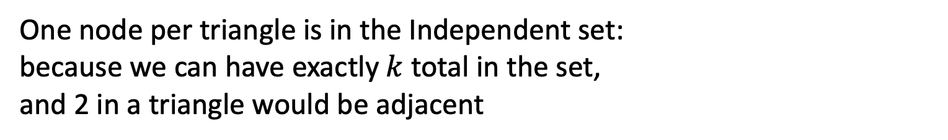


$k$IndSet $⇒$ Satisfying Assignment
$$\left(x∨y∨z\right)∧\left(x∨\overline{y}∨y\right)∧\left(u∨y∨\overline{z}\right)∧\left(z∨\overline{x}∨u\right)∧(\overline{x}∨\overline{y}∨\overline{z})$$
$$x$$
$$u$$
$$z$$
$$\overline{x}$$
$$x$$
$$y$$
$$\overline{y}$$
$$\overline{z}$$
$$y$$
$$u$$
$$\overline{x}$$
$$\overline{z}$$
$$\overline{y}$$
$$z$$
$$y$$
$$x=true$$
$$y=false$$
$$z=false$$
$$u=true$$
One node per triangle is in the Independent set:
because we can have exactly $k$ total in the set,
and 2 in a triangle would be adjacent
If $x$ is selected in some triangle, $\overline{x}$ is not selected in any triangle:
Because every $x$ is adjacent to every $\overline{x}$
Set the variable which each included node represents to “true”

Slide 23
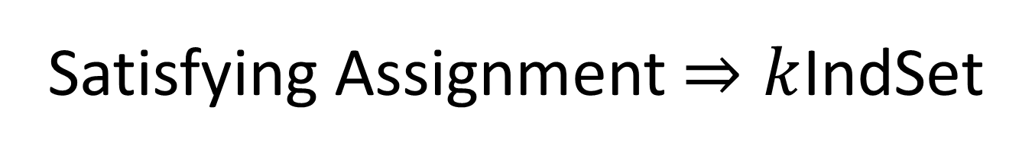
Satisfying Assignment $⇒k$IndSet
$$\left(x∨y∨z\right)∧\left(x∨\overline{y}∨y\right)∧\left(u∨y∨\overline{z}\right)∧\left(z∨\overline{x}∨u\right)∧(\overline{x}∨\overline{y}∨\overline{z})$$
$$x$$
$$u$$
$$z$$
$$\overline{x}$$
$$x$$
$$y$$
$$\overline{y}$$
$$\overline{z}$$
$$y$$
$$u$$
$$\overline{x}$$
$$\overline{z}$$
$$\overline{y}$$
$$z$$
$$y$$
$$x=true$$
$$y=false$$
$$z=false$$
$$u=true$$
Use one true variable from the assignment for each triangle
The independent set has $k$ nodes, because there are $k$ clauses
If any variable $x$ is true then $\overline{x}$ cannot be true

Slide 24
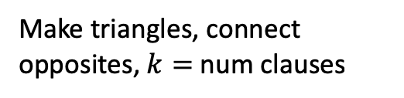
$$3SAT≤_{p}kIndSet$$
3SAT
$$O(n^{p})$$
$k$-Ind Set
$$A$$
$$B$$
Make triangles, connect opposites, $k=$ num clauses
If This could be done in Polynomial time
Then This could be done in polynomial time
Solution for 3SAT
Assign true to variables from selected nodes
Solution for $k$-Ind Set
$$X$$
$$Y$$
Reduction

