Slide 1


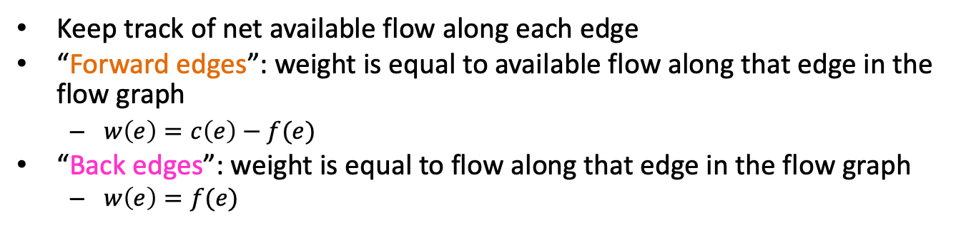




CS4102 Algorithms
Fall 2018
Warm up:
Remember Residual Graphs
Keep track of net available flow along each edge
“Forward edges”: weight is equal to available flow along that edge in the flow graph
$w\left(e\right)=c\left(e\right)−f(e)$
“Back edges”: weight is equal to flow along that edge in the flow graph
$w\left(e\right)=f(e)$
Residual Graph $G_{f}$
Flow Graph $G$
1
2
1/3
2/2
0
2
2/3
2
$$s$$
1/3
1/1
$$s$$
1
1
1/2
$$t$$
1
2/2
2/3
2
0
3
$$t$$
0
2
3
1
1
0/1
1/2
1
2/3
1
2

Slide 2
Today’s Keywords
Reductions
Bipartite Matching
Vertex Cover
Independent Set

Slide 3
CLRS Readings
Chapter 34

Slide 4
Homeworks
HW8 due Friday 11/30 at 11pm
Written (use LaTeX)
Graphs

Slide 5
Divide and Conquer*
When is this a good strategy?
Divide:
Break the problem into multiple subproblems, each smaller instances of the original
Conquer:
If the suproblems are “large”:
Solve each subproblem recursively
If the subproblems are “small”:
Solve them directly (base case)
Combine:
Merge together solutions to subproblems
*CLRS Chapter 4

Slide 6
Dynamic Programming
Requires Optimal Substructure
Solution to larger problem contains the solutions to smaller ones
Idea:
Identify recursive structure of the problem
Select a good order for solving subproblems
Usually smallest problem first

Slide 7
Greedy Algorithms
Require Optimal Substructure
Solution to larger problem contains the solution to a smaller one
Only one subproblem to consider!
Idea:
Identify a greedy choice property
How to make a choice guaranteed to be included in some optimal solution
Repeatedly apply the choice property until no subproblems remain

Slide 8
So far
Divide and Conquer, Dynamic Programming, Greedy
Take an instance of Problem A, relate it to smaller instances of Problem A
Next:
Take an instance of Problem A, relate it to an instance of Problem B

Slide 9

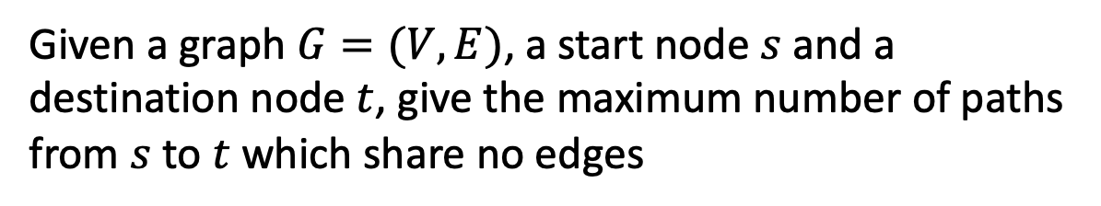

Edge-Disjoint Paths
Given a graph $G=(V,E)$, a start node $s$ and a destination node $t$, give the maximum number of paths from $s$ to $t$ which share no edges
$$s$$
g
Set of edge-disjoint paths of size 3
h
f
$$t$$
e
b
c
a

Slide 10


Edge-Disjoint Paths
Given a graph $G=(V,E)$, a start node $s$ and a destination node $t$, give the maximum number of paths from $s$ to $t$ which share no edges
$$s$$
g
Set of edge-disjoint paths of size 4
h
f
$$t$$
e
b
c
a

Slide 11
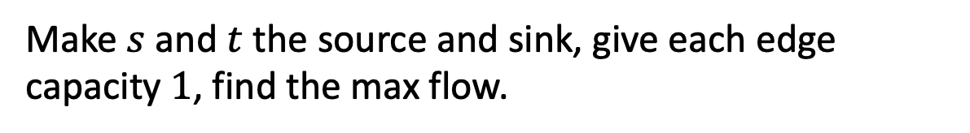
Edge-Disjoint Paths Algorithm
Make $s$ and $t$ the source and sink, give each edge capacity $1$, find the max flow.
$$s$$
g
Set of edge-disjoint paths of size 4
h
f
$$t$$
e
b
c
a

Slide 12
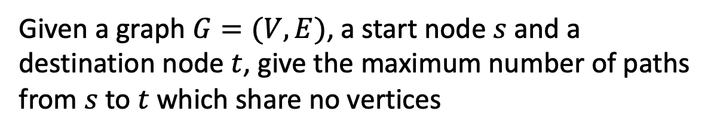
Vertex-Disjoint Paths
Given a graph $G=(V,E)$, a start node $s$ and a destination node $t$, give the maximum number of paths from $s$ to $t$ which share no vertices
$$s$$
g
Not a vertex-disjoint path!
h
f
$$t$$
e
b
c
a

Slide 13

Vertex-Disjoint Paths Algorithm
Idea: Convert an instance of the vertex-disjoint paths problem into an instance of edge-disjoint paths
Make two copies of each node, one connected to incoming edges, the other to outgoing edges
Compute Edge-Disjoint paths on new graph
$$s$$
g
Restricts to 1 edge
g in
g out
h
f
$$t$$
e
b
c
a

Slide 14
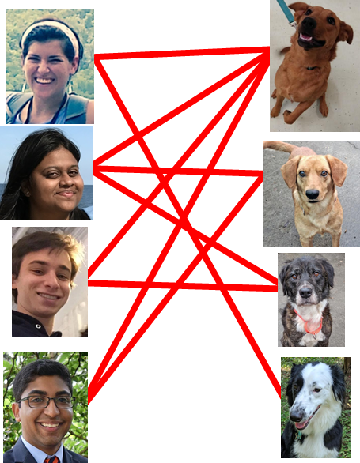
Maximum Bipartite Matching
Dog Lovers
Dogs

Slide 15
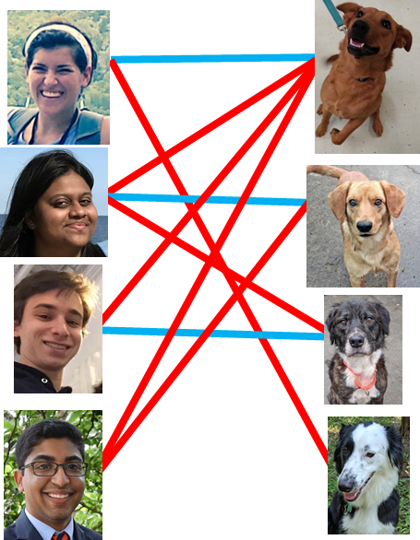
Maximum Bipartite Matching
Dog Lovers
Dogs

Slide 16
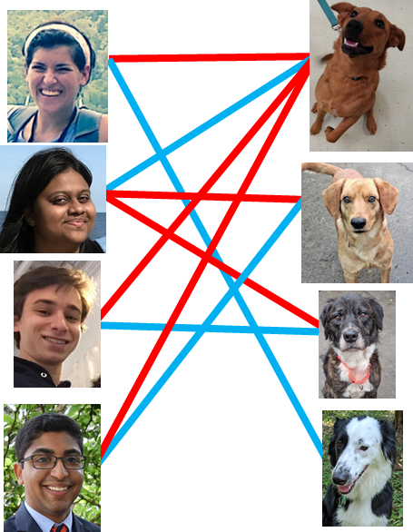
Maximum Bipartite Matching
Dog Lovers
Dogs

Slide 17
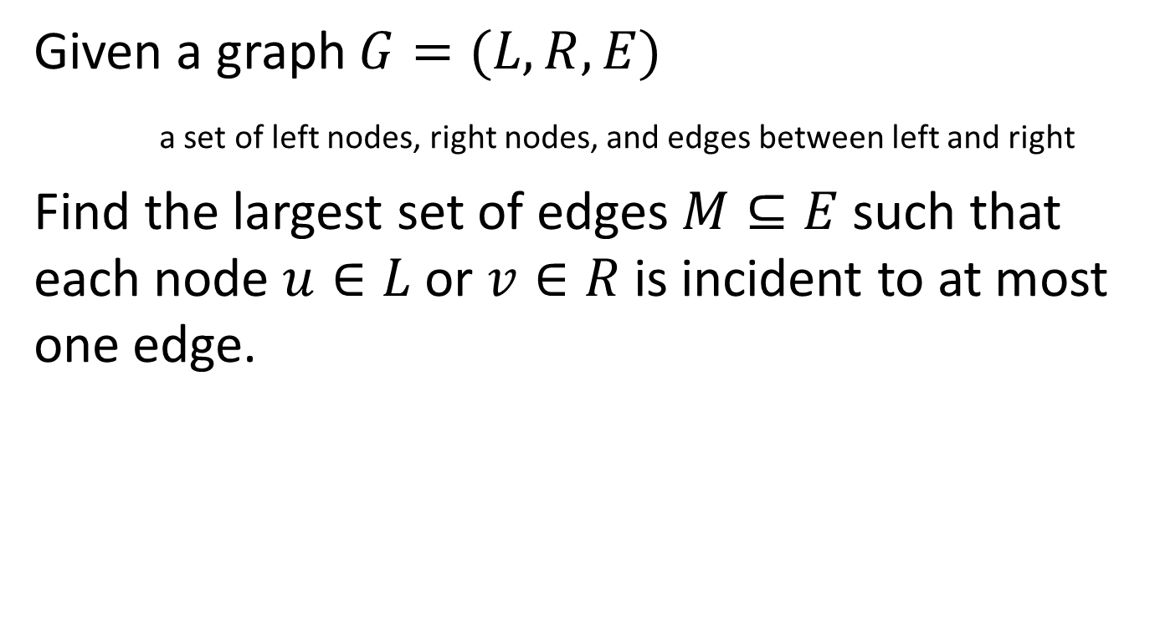
Maximum Bipartite Matching
Given a graph $G=(L,R,E)$
a set of left nodes, right nodes, and edges between left and right
Find the largest set of edges $M⊆E$ such that each node $u∈L$ or $v∈R$ is incident to at most one edge.

Slide 18
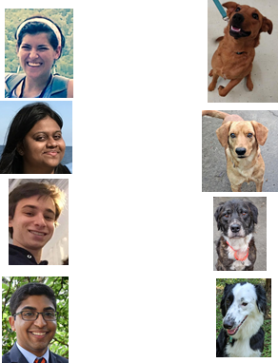
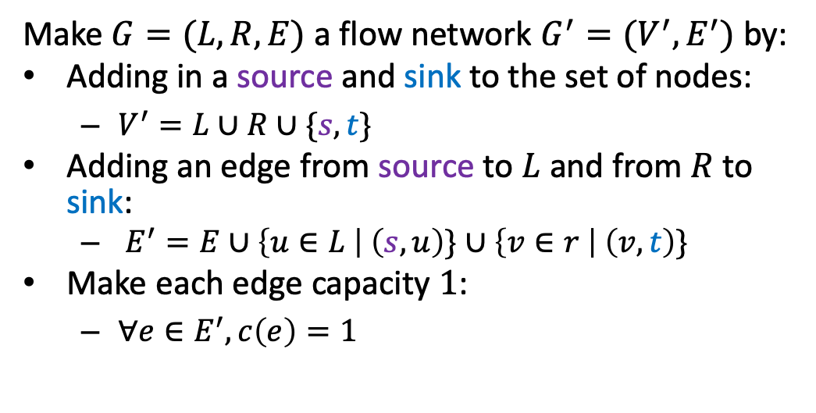


Maximum Bipartite Matching Using Max Flow
Make $G=(L,R,E)$ a flow network $G^{′}=(V^{′},E^{′})$ by:
Adding in a source and sink to the set of nodes:
$V^{′}=L∪R∪\{s,t\}$
Adding an edge from source to $L$ and from $R$ to sink:
$E^{′}=E∪\left\{u∈L \right| \left(s,u\right)\}∪\left\{v∈r \right| \left(v,t\right)\}$
Make each edge capacity $1$:
$∀e∈E^{′}, c\left(e\right)=1$
1
1
1
1
1
1
$$s$$
1
1
1
1
$$t$$
1
1
1
1
1
1
1

Slide 19
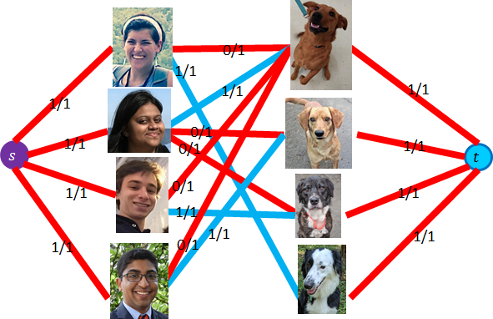


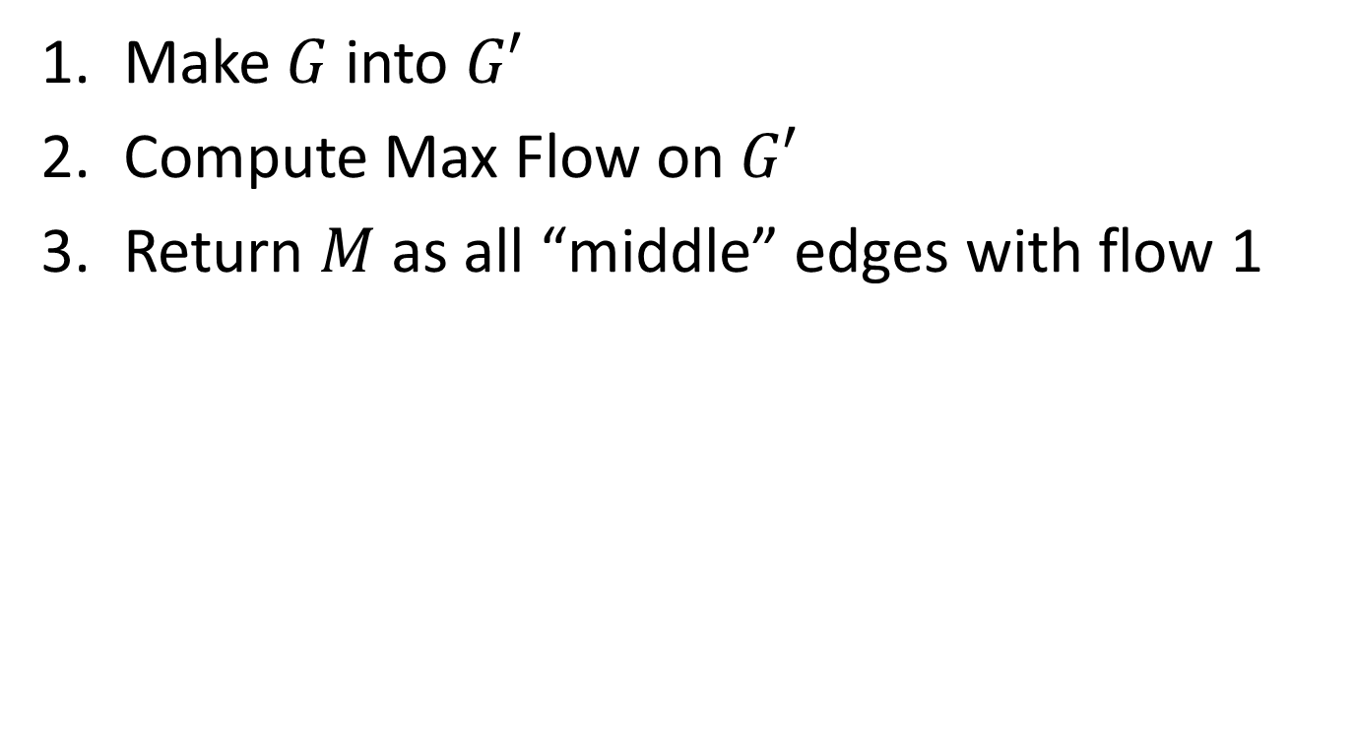



Run Time
$$Θ(E⋅V)$$
Make $G$ into $G′$
Compute Max Flow on $G′$
Return $M$ as all “middle” edges with flow 1
$$Θ(L+R)$$
$$Θ(E⋅V)$$
$$\left|f\right|≤L$$
$$Θ(L+R)$$

Slide 20
Reductions
Algorithm technique of supreme ultimate power
Convert instance of problem A to an instance of Problem B
Convert solution of problem B back to a solution of problem A

Slide 21


Reductions
Shows how two different problems relate to each other
MOVIE TIME!

Slide 22

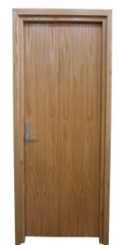
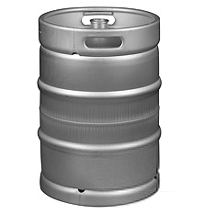

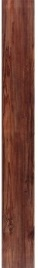

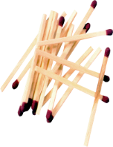




MacGyver’s Reduction
Problem we don’t know how to solve
Problem we do know how to solve
$$A$$
Opening a door
Aim duct at door, insert keg
Lighting a fire
$$B$$
How?
Solution for $A$
Solution for $B$
Keg cannon battering ram
Alcohol, wood, matches
Put fire under the Keg
Reduction

Slide 23
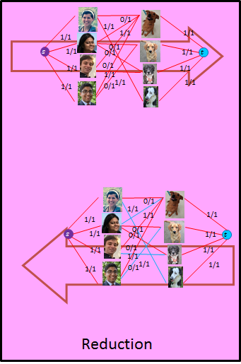






Bipartite Matching Reduction
Problem we don’t know how to solve
Problem we do know how to solve
Bipartite Matching
Max Flow
$$A$$
$$B$$
3
2
$$s$$
3
2
3
1
3
2
$$t$$
1
2
3
Ford Fulkerson
Solution for $B$
Solution for $A$
1
2
2
0
2
$$s$$
1
1
1
2
0
3
$$t$$
0
2
3
1
1
1
2

Slide 24
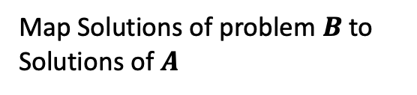

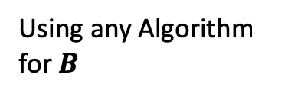

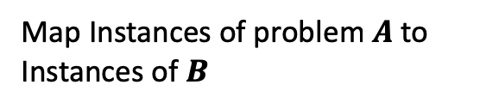



In General: Reduction
Problem we don’t know how to solve
Problem we do know how to solve
$$A$$
Map Instances of problem $A$to Instances of $B$
$$B$$
Using any Algorithm for $B$
Map Solutions of problem $B$to Solutions of $A$
Solution for $A$
Solution for $B$
$$X$$
$$Y$$
Reduction

Slide 25


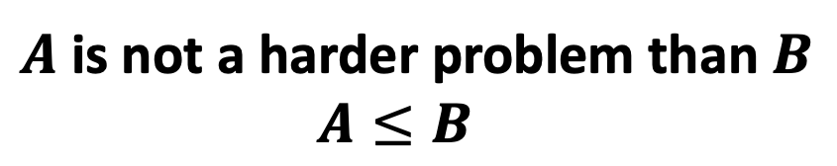

Worst-case lower-bound Proofs
Lighting a fire
Opening a door
$$A$$
reduces to
$$B$$
Problem B
Problem A
Alcohol, wood, matches
can be used to make
Keg cannon battering ram
$$Y$$
$$X$$
Algorithm for B
Algorithm for A
$A$ is not a harder problem than $B$
$A≤B$
The name “reduces” is confusing: it is in the opposite direction of the making

Slide 26

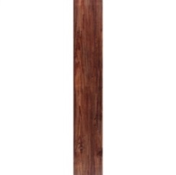
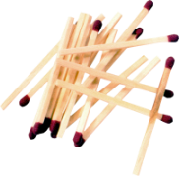







Proof of Lower Bound by Reduction
To Show: $Y$ is slow
$$X$$
1. We know X is slow
(e.g., X = some way to open the door)
$$Y$$
2. Assume Y is quick [toward contradiction]
(Y = some way to light a fire)
$$X$$
$$Y$$
3. Show how to use Y to perform X quickly
4. X is slow, but Y could be used to perform X quickly
conclusion: Y must not actually be quick

Slide 27
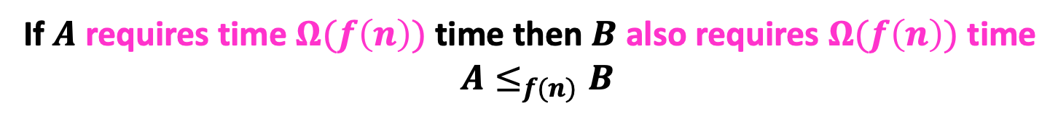
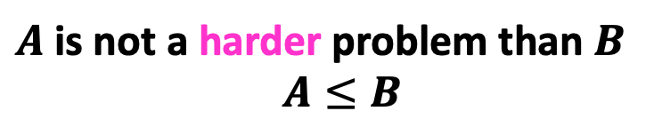






Reduction Proof Notation
$$A$$
$$B$$
$f(n)$-reduces to
Problem B
Problem A
$$Y$$
$$X$$
can be used to make
With $O(f\left(n\right))$ overhead
Algorithm for B
Algorithm for A
$A$ is not a harder problem than $B$
$A≤B$
If $A$ requires time $Ω(f\left(n\right))$ time then $B$ also requires $Ω(f\left(n\right))$ time
$A≤_{f(n)}B$

Slide 28
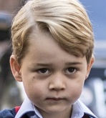

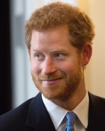
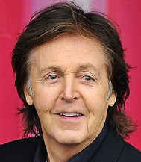
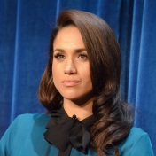
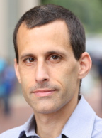
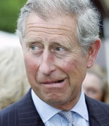



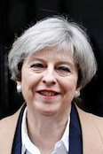
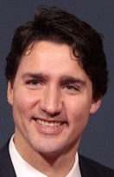
Party Problem
Draw Edges between people who don’t get along
Find the maximum number of people who get along

Slide 29
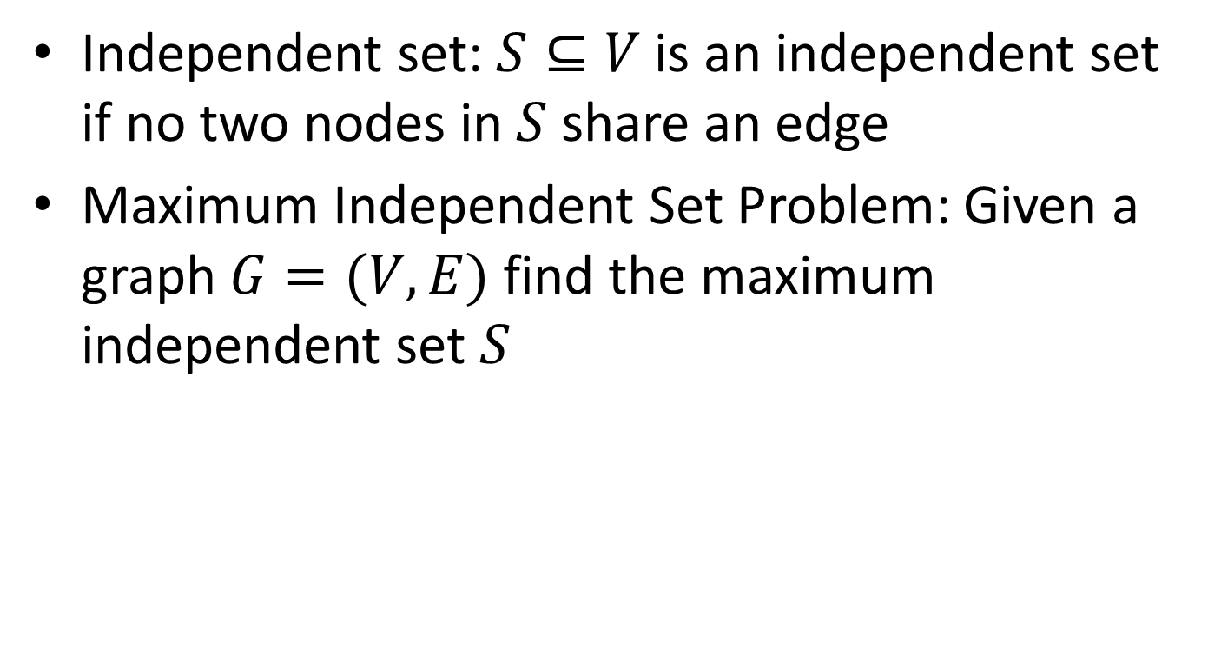
Maximum Independent Set
Independent set: $S⊆V$ is an independent set if no two nodes in $S$ share an edge
Maximum Independent Set Problem: Given a graph $G=(V,E)$ find the maximum independent set $S$

Slide 30
Example
Independent set of size 6

Slide 31
Generalized Baseball

Slide 32
Generalized Baseball
Need to place defenders on bases such that every edge is defended
What’s the fewest number of defenders needed?

Slide 33
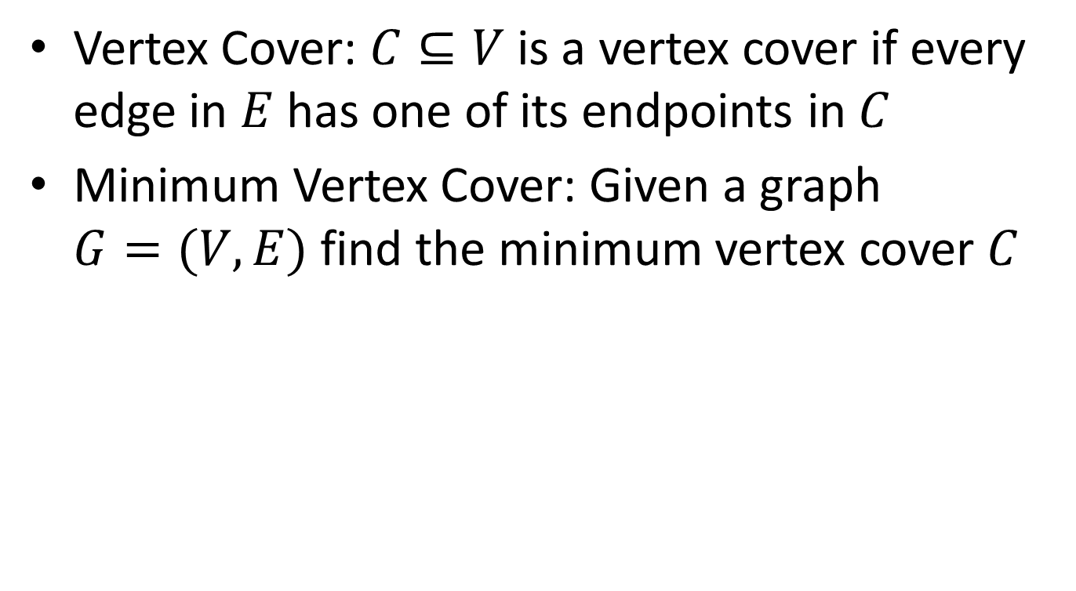
Minimum Vertex Cover
Vertex Cover: $C⊆V$ is a vertex cover if every edge in $E$ has one of its endpoints in $C$
Minimum Vertex Cover: Given a graph $G=(V,E)$ find the minimum vertex cover $C$

Slide 34
Example
Vertex cover of size 5

Slide 35















MaxIndSet$≤_{V}$MinVertCov
$$A$$
$$B$$
$O(V)$-reduces to
Problem B
Problem A
$$Y$$
$$X$$
can be used to make
With $O(V)$ overhead
Algorithm for B
Algorithm for A
If $A$ requires time $Ω(f\left(n\right))$ time then $B$ also requires $Ω(f\left(n\right))$ time
$A≤_{V}B$

Slide 36














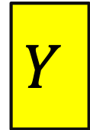

We need to build this Reduction
MaxIndSet
O(V) Time
MinVertCov
$$A$$
Relate Instances of MaxIndSet
to Instances of MinVertCov
$$B$$
Using any Algorithm for MinVertCov
Relate Solutions of MinVertCov to Solutions of MaxIndSet
Solution for MaxIndSet
Solution for MinVertCov
$$X$$
$$Y$$
Reduction

Slide 37









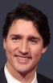
Reduction Idea
$S$ is an independent set of $G$ iff $V−S$ is a vertex cover of $G$
Independent Set
Vertex Cover

Slide 38
Reduction Idea
$S$ is an independent set of $G$ iff $V−S$ is a vertex cover of $G$
Vertex Cover
Independent Set

Slide 39


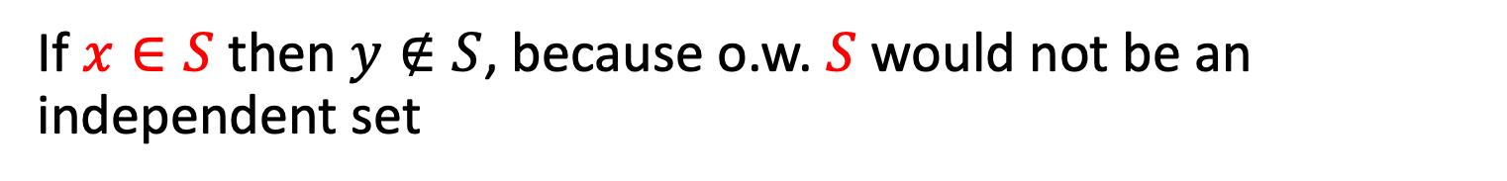
Proof: $⇒$
$S$ is an independent set of $G$ iff $V−S$ is a vertex cover of $G$
Let $S$ be an independent set
Consider any edge $\left(x,y\right)∈E$
If $x∈S$ then $y∉S$, because o.w. $S$ would not be an independent set
Therefore $y∈V−S$, so edge $(x,y)$ is covered by $V−S$

Slide 40
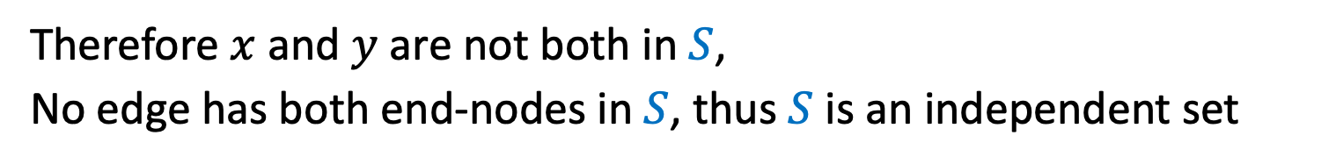

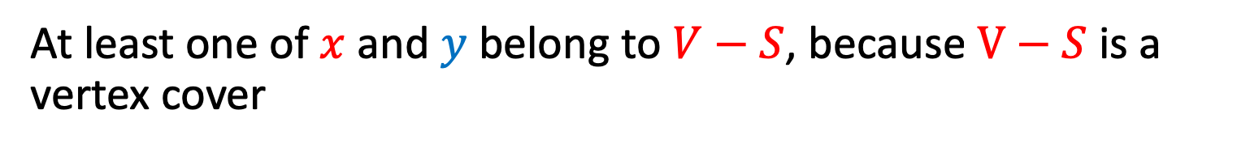
Proof: $⇐$
$S$ is an independent set of $G$ iff $V−S$ is a vertex cover of $G$
Let $V−S$ be a vertex cover
Consider any edge $\left(x,y\right)∈E$
At least one of $x$ and $y$ belong to $V−S$, because $V−S$ is a vertex cover
Therefore $x$ and $y$ are not both in $S$,
No edge has both end-nodes in $S$, thus $S$ is an independent set

Slide 41

MaxVertCov $V$-Time Reducable to MinIndSet
MaxIndSet
O(V) Time
MinVertCov
$$A$$
$$B$$
Do nothing
Using any Algorithm for MinVertCov
Solution for MaxIndSet
Take complement of solution
Solution for MinVertCov
$$X$$
$$Y$$
Reduction

Slide 42

MaxIndSet $V$-Time Reducable to MinVertCov
MaxIndSet
MinVertCov
O(V) Time
$$A$$
$$B$$
Do nothing
Using any Algorithm for MaxIndSet
Solution for MinVertCov
Take complement of solution
Solution for MaxIndSet
$$X$$
$$Y$$
Reduction

Slide 43
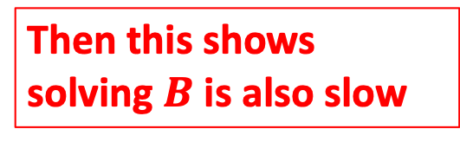
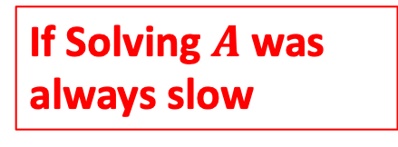
Corollary
MaxIndSet
O(V) Time
MinVertCov
$$A$$
$$B$$
Do nothing
Using any Algorithm for MinIndSet
If Solving $A$ was always slow
Then this shows solving $B$ is also slow
Solution for MaxIndSet
Take complement of solution
Solution for MinVertCov
$$X$$
$$Y$$
Reduction

Slide 44
Corollary
MaxIndSet
MinVertCov
O(V) Time
$$A$$
$$B$$
Do nothing
Using any Algorithm for MaxVertCov
If Solving $A$ was always slow
Then this shows solving $B$ is also slow
Solution for MinVertCov
Take complement of solution
Solution for MaxIndSet
$$X$$
$$Y$$
Reduction

Slide 45
Conclusion
MaxIndSet and MinVertCov are either both fast, or both slow
Spoiler alert: We don’t know which!
(But we think they’re both slow)
Both problems are NP-Complete
Next time!

