Slide 1
CS4102 Algorithms
Fall 2018
Warm up
Build a Max Heap from the following Elements:
4, 15, 22, 6, 18, 30, 14, 21

Slide 2
Heap
Heap Property: Each node must be larger than its children
30
21
1
22
19
2
15
4
3
14
4
5
6
7
6
30
21
22
19
15
4
14
6
8
0
1
2
3
4
5
6
7
8

Slide 3
Today’s Keywords
Sorting
Quicksort
Sorting Algorithm Characteristics
Insertion Sort
Bubble Sort
Heap Sort
Linear time Sorting
Counting Sort
Radix Sort

Slide 4
CLRS Readings
Chapter 6
Chapter 8

Slide 5
Homeworks
Hw3 Due 11pm Monday Oct 1
Divide and conquer
Written (use LaTeX!)
Hw4 released soon
Sorting
Written

Slide 6
Strategy: Decision Tree
Conclusion: Worst Case Optimal run time of sorting is $Θ(n\log{n})$
There is no (comparison-based) sorting algorithm with run time $o(n\log{n})$
One comparison
Possible execution path
Result of comparison
<
>or<?
>
<
>or<?
>
<
>or<?
>
<
>or<?
>
<
>or<?
<
>or<?
>
<
>or<?
>
$$\log\left(n!\right)$$
>
>or<?
>or<?
>or<?
>or<?
>or<?
>or<?
>or<?
>or<?
$$Θ(n log{n})$$
…
…
…
…
…
…
Permutation of sorted list
[1,2,3,4,5]
[2,1,3,4,5]
[5,2,4,1,3]
[5,4,3,2,1]
$n!$Possible permutations

Slide 7




Sorting, so far
Sorting algorithms we have discussed:
Mergesort
Quicksort
Other sorting algorithms
Bubblesort
Insertionsort
Heapsort
$$O(n\log{n})$$
Optimal!
$$O(n\log{n})$$
Optimal!
$$O(n^{2})$$
$$O(n^{2})$$
$$O(n\log{n})$$
Optimal!

Slide 8
Speed Isn’t Everything
Important properties of sorting algorithms:
Run Time
Asymptotic Complexity
Constants
In Place (or In-Situ)
Done with only constant additional space
Adaptive
Faster if list is nearly sorted
Stable
Equal elements remain in original order
Parallelizable
Runs faster with multiple computers

Slide 9
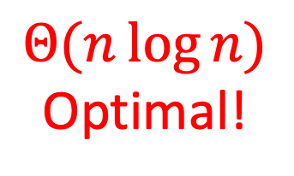
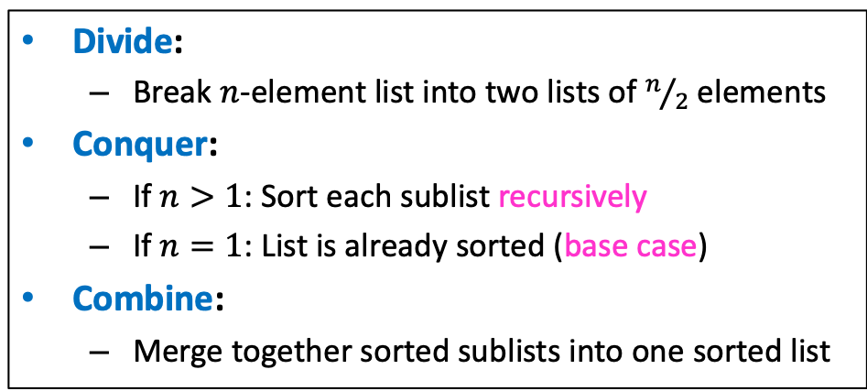
Mergesort
Divide:
Break $n$-element list into two lists of $n/2$ elements
Conquer:
If $n>1$: Sort each sublist recursively
If $n=1$: List is already sorted (base case)
Combine:
Merge together sorted sublists into one sorted list
Run Time?
$$Θ(n\log{n})$$
Optimal!
In Place?
Adaptive?
Stable?
No
No
Yes!
(usually)

Slide 10
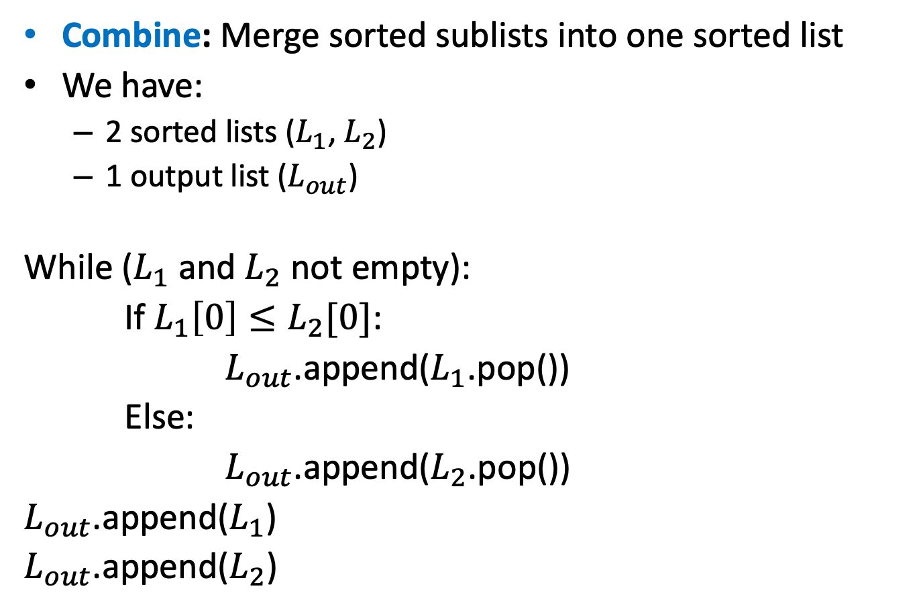
Merge
Combine: Merge sorted sublists into one sorted list
We have:
2 sorted lists ($L_{1}$, $L_{2}$)
1 output list ($L_{out}$)
While ($L_{1}$ and $L_{2}$ not empty):
If $L_{1}\left[0\right]≤L_{2}[0]$:
$L_{out}$.append($L_{1}$.pop())
Else:
$L_{out}$.append($L_{2}$.pop())
$L_{out}$.append($L_{1}$)
$L_{out}$.append($L_{2}$)
Stable:
If elements are equal, leftmost comes first

Slide 11
Mergesort
Divide:
Break $n$-element list into two lists of $n/2$ elements
Conquer:
If $n>1$: Sort each sublist recursively
If $n=1$: List is already sorted (base case)
Combine:
Merge together sorted sublists into one sorted list
Run Time?
$$Θ(n\log{n})$$
Optimal!
In Place?
Adaptive?
Stable?
Parallelizable?
No
No
Yes!
(usually)
Yes!

Slide 12
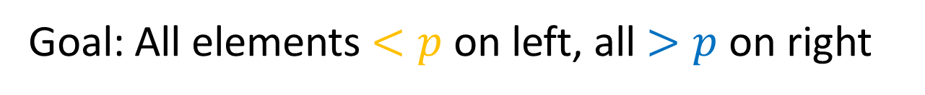
Mergesort
Parallelizable:
Allow different machines to work on each sublist
Divide:
Break $n$-element list into two lists of $n/2$ elements
Conquer:
If $n>1$:
Sort each sublist recursively
If $n=1$:
List is already sorted (base case)
Combine:
Merge together sorted sublists into one sorted list

Slide 13
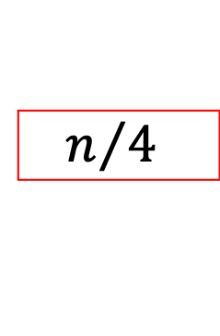


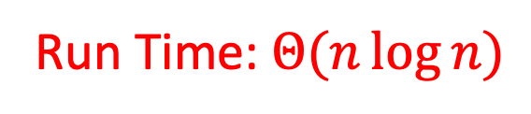
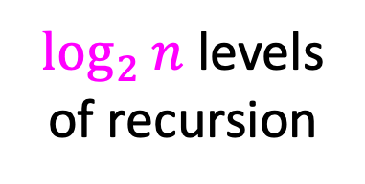

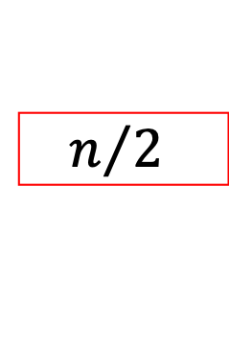



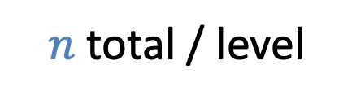





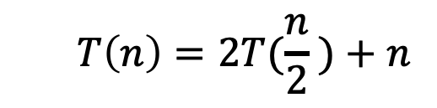








Mergesort (Sequential)
$$T\left(n\right)=2T(\frac{n}{2} )+n$$
$$n$$
$$n$$
$n$ total / level
$$\frac{n}{2}$$
$$\frac{n}{2}$$
$$n/2$$
$$n/2$$
$$\frac{n}{4}$$
$$\frac{n}{4}$$
$$\frac{n}{4}$$
$$\frac{n}{4}$$
$\log_{2}⁡n$ levels
of recursion
$$n/4$$
$$n/4$$
$$n/4$$
$$n/4$$
…
…
…
…
$$1$$
$$1$$
$$1$$
…
$$1$$
$$1$$
$$1$$
$$1$$
$$1$$
$$1$$
$$1$$
$$1$$
$$1$$
Run Time: $Θ(n\log{n})$

Slide 14

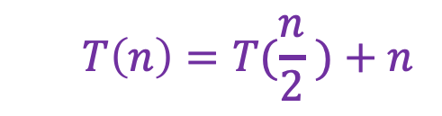


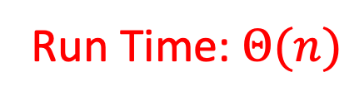
Mergesort (Parallel)
$$T\left(n\right)=T(\frac{n}{2} )+n$$
$$n$$
Done in Parallel
$$n$$
$$\frac{n}{2}$$
$$\frac{n}{2}$$
$$\frac{n}{2}$$
$$n/2$$
$$n/2$$
$$\frac{n}{4}$$
$$\frac{n}{4}$$
$$\frac{n}{4}$$
$$\frac{n}{4}$$
$$\frac{n}{4}$$
$$n/4$$
$$n/4$$
$$n/4$$
$$n/4$$
…
…
…
…
$$1$$
$$1$$
$$1$$
$$1$$
…
$$1$$
$$1$$
$$1$$
$$1$$
$$1$$
$$1$$
$$1$$
$$1$$
$$1$$
Run Time: $Θ(n)$

Slide 15
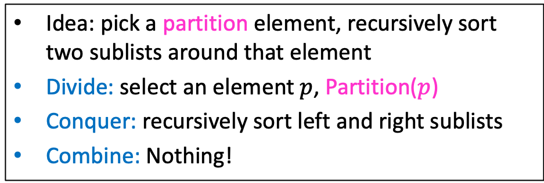
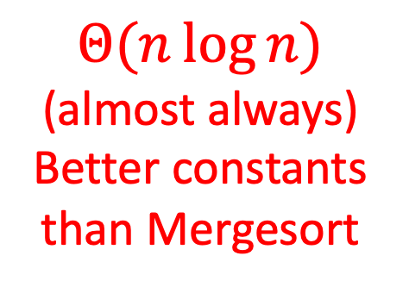
Quicksort
Run Time?
Idea: pick a partition element, recursively sort two sublists around that element
Divide: select an element $p$, Partition($p$)
Conquer: recursively sort left and right sublists
Combine: Nothing!
$$Θ(n\log{n})$$
(almost always)
Better constants than Mergesort
In Place?
Adaptive?
Stable?
Parallelizable?
kinda
No!
No
Yes!
Uses stack for recursive calls

Slide 16
Bubble Sort
Idea: March through list, swapping adjacent elements if out of order, repeat until sorted
8
5
7
9
12
10
1
2
4
3
6
11
5
8
7
9
12
10
1
2
4
3
6
11
5
7
8
9
12
10
1
2
4
3
6
11
5
7
8
9
12
10
1
2
4
3
6
11

Slide 17
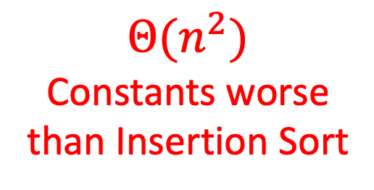
Bubble Sort
Run Time?
Idea: March through list, swapping adjacent elements if out of order, repeat until sorted
$$Θ(n^{2})$$
Constants worse than Insertion Sort
In Place?
Adaptive?
Yes
Kinda
“Compared to straight insertion […], bubble sorting requires a more complicated program and takes about twice as long!” –Donald Knuth

Slide 18
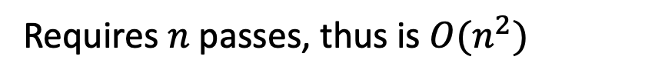
Bubble Sort is “almost” Adaptive
Idea: March through list, swapping adjacent elements if out of order
1
2
3
4
5
6
7
8
9
10
11
12
1
2
3
4
5
6
7
8
9
10
11
12
Only makes one “pass”
2
3
4
5
6
7
8
9
10
11
12
1
After one “pass”
2
3
4
5
6
7
8
9
10
11
1
12
Requires $n$ passes, thus is $O(n^{2})$

Slide 19
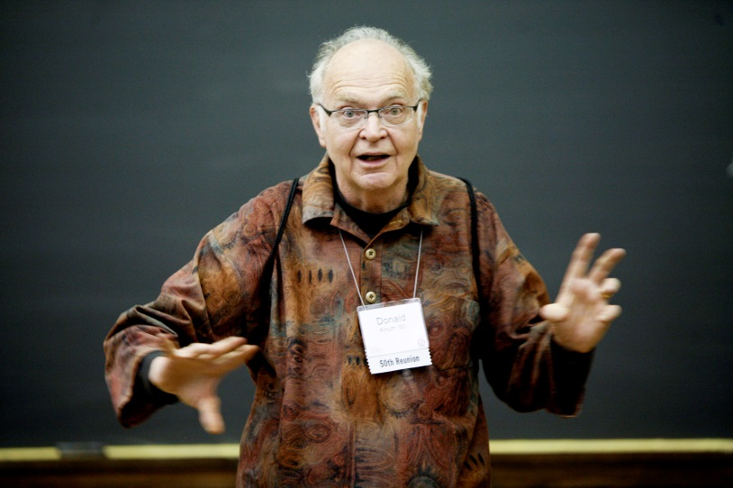
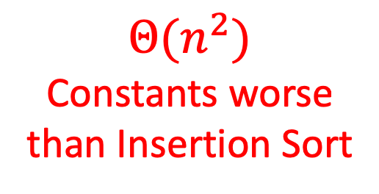
Bubble Sort
Run Time?
Idea: March through list, swapping adjacent elements if out of order, repeat until sorted
$$Θ(n^{2})$$
Constants worse than Insertion Sort
In Place?
Adaptive?
Stable?
Parallelizable?
Yes!
Kinda
Not really
Yes
No
"the bubble sort seems to have nothing to recommend it, except a catchy name and the fact that it leads to some interesting theoretical problems” –Donald Knuth, The Art of Computer Programming

Slide 20
Insertion Sort
Idea: Maintain a sorted list prefix, extend that prefix by “inserting” the next element
Sorted Prefix
3
5
7
8
10
12
9
2
4
6
1
11
3
5
7
8
10
9
12
2
4
6
1
11
3
5
7
8
9
10
12
2
4
6
1
11
Sorted Prefix
3
5
7
8
9
10
12
2
4
6
1
11

Slide 21
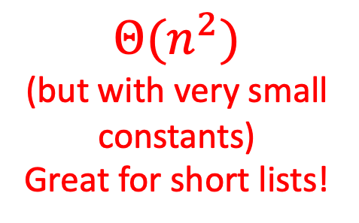
Insertion Sort
Run Time?
Idea: Maintain a sorted list prefix, extend that prefix by “inserting” the next element
$$Θ(n^{2})$$
(but with very small constants)
Great for short lists!
In Place?
Adaptive?
Yes!
Yes

Slide 22
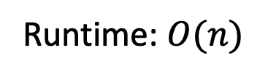
Insertion Sort is Adaptive
Idea: Maintain a sorted list prefix, extend that prefix by “inserting” the next element
Sorted Prefix
1
2
3
4
5
6
7
8
9
10
11
12
Sorted Prefix
1
2
3
4
5
6
7
8
9
10
11
12
Only one comparison needed per element!
Runtime: $O(n)$

Slide 23
Insertion Sort
Run Time?
Idea: Maintain a sorted list prefix, extend that prefix by “inserting” the next element
$$Θ(n^{2})$$
(but with very small constants)
Great for short lists!
In Place?
Adaptive?
Stable?
Yes!
Yes
Yes

Slide 24
Insertion Sort is Stable
Idea: Maintain a sorted list prefix, extend that prefix by “inserting” the next element
Sorted Prefix
3
5
7
8
10
12
10’
2
4
6
1
11
3
5
7
8
10
10’
12
2
4
6
1
11
Sorted Prefix
3
5
7
8
10
10’
12
2
4
6
1
11
The “second” 10 will stay to the right

Slide 25
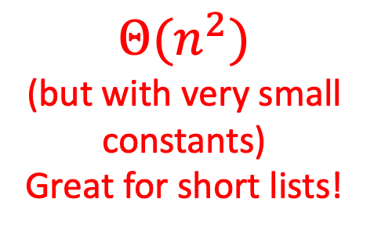
Insertion Sort
Run Time?
Idea: Maintain a sorted list prefix, extend that prefix by “inserting” the next element
$$Θ(n^{2})$$
(but with very small constants)
Great for short lists!
In Place?
Adaptive?
Stable?
Parallelizable?
Yes!
Yes
Yes
No
Can sort a list as it is received, i.e., don’t need the entire list to begin sorting
Online?
Yes
“All things considered, it’s actually a pretty good sorting algorithm!” –Nate Brunelle

Slide 26
Heap Sort
Idea: Build a Heap, repeatedly extract max element from the heap to build sorted list Right-to-Left
10
9
6
8
7
5
2
4
1
3
0
1
2
3
4
5
6
7
8
9
10
Max Heap Property: Each node is larger than its children
10
9
1
6
8
2
7
5
3
2
4
5
6
7
4
1
3
8
9
10

Slide 27
Heap Sort
Remove the Max element (i.e. the root) from the Heap: replace with last element, call Heapify(root)
3
9
6
8
7
5
2
4
1
0
1
2
3
4
5
6
7
8
9
10
Max Heap Property: Each node is larger than its children
3
9
1
6
8
2
7
5
3
2
4
5
6
7
4
1
Heapify(node): if node satisfies heap property, done. Else swap with largest child and recurse on that subtree
8
9

Slide 28
Heap Sort
Remove the Max element (i.e. the root) from the Heap: replace with last element, call Heapify(root)
9
3
6
8
7
5
2
4
1
0
1
2
3
4
5
6
7
8
9
10
Max Heap Property: Each node is larger than its children
9
3
1
6
8
2
7
5
3
2
4
5
6
7
4
1
Heapify(node): if node satisfies heap property, done. Else swap with largest child and recurse on that subtree
8
9

Slide 29
Heap Sort
Remove the Max element (i.e. the root) from the Heap: replace with last element, call Heapify(root)
9
8
6
3
7
5
2
4
1
0
1
2
3
4
5
6
7
8
9
10
Max Heap Property: Each node is larger than its children
9
8
1
6
3
2
7
5
3
2
4
5
6
7
4
1
Heapify(node): if node satisfies heap property, done. Else swap with largest child and recurse on that subtree
8
9

Slide 30
Heap Sort
Remove the Max element (i.e. the root) from the Heap: replace with last element, call Heapify(root)
9
8
6
4
7
5
2
3
1
0
1
2
3
4
5
6
7
8
9
10
Max Heap Property: Each node is larger than its children
9
8
1
6
4
2
7
5
3
2
4
5
6
7
3
1
Heapify(node): if node satisfies heap property, done. Else swap with largest child and recurse on that subtree
8
9

Slide 31
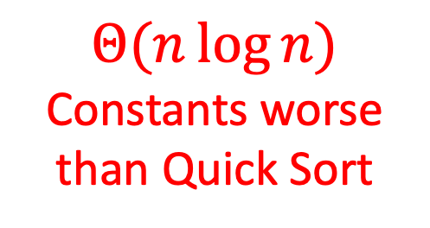
Heap Sort
Run Time?
Idea: Build a Heap, repeatedly extract max element from the heap to build sorted list Right-to-Left
$$Θ(n\log{n})$$
Constants worse than Quick Sort
In Place?
When removing an element from the heap, move it to the (now unoccupied) end of the list
Yes!

Slide 32
In Place Heap Sort
Idea: When removing an element from the heap, move it to the (now unoccupied) end of the list
10
9
6
8
7
5
2
4
1
3
0
1
2
3
4
5
6
7
8
9
Max Heap Property: Each node is larger than its children
10
10
9
1
6
8
2
7
5
3
2
4
5
6
7
4
1
3
8
9
10

Slide 33
In Place Heap Sort
Idea: When removing an element from the heap, move it to the (now unoccupied) end of the list
3
9
6
8
7
5
2
4
1
10
0
1
2
3
4
5
6
7
8
9
Max Heap Property: Each node is larger than its children
10
3
9
1
6
8
2
7
5
3
2
4
5
6
7
4
1
8
9

Slide 34
In Place Heap Sort
Idea: When removing an element from the heap, move it to the (now unoccupied) end of the list
9
8
6
4
7
5
2
3
1
10
0
1
2
3
4
5
6
7
8
9
Max Heap Property: Each node is larger than its children
10
9
8
1
6
4
2
7
5
3
2
4
5
6
7
3
1
8
9

Slide 35
In Place Heap Sort
Idea: When removing an element from the heap, move it to the (now unoccupied) end of the list
8
7
6
4
1
5
2
3
9
10
0
1
2
3
4
5
6
7
8
9
Max Heap Property: Each node is larger than its children
10
8
7
1
6
4
2
1
5
3
2
4
5
6
7
3
8

Slide 36
In Place Heap Sort
Idea: When removing an element from the heap, move it to the (now unoccupied) end of the list
7
4
6
3
1
5
2
8
9
10
0
1
2
3
4
5
6
7
8
9
Max Heap Property: Each node is larger than its children
10
7
4
1
6
3
2
1
5
3
2
4
5
6
7

Slide 37
Heap Sort
Run Time?
Idea: Build a Heap, repeatedly extract max element from the heap to build sorted list Right-to-Left
$$Θ(n\log{n})$$
Constants worse than Quick Sort
In Place?
Adaptive?
Stable?
Parallelizable?
Yes!
No
No
(HW4)
No

Slide 38
Sorting in Linear Time
Cannot be comparison-based
Need to make some sort of assumption about the contents of the list
Small number of unique values
Small range of values
Etc.

Slide 39
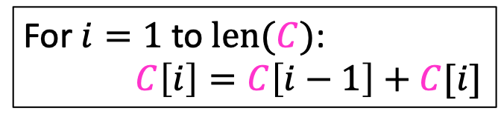


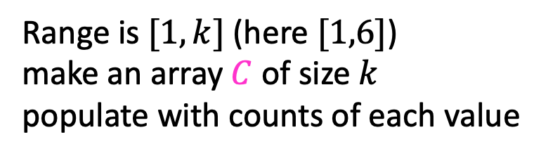
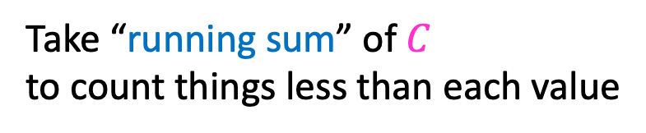

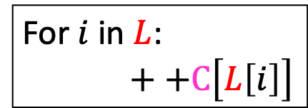
Counting Sort
Idea: Count how many things are less than each element
$$L=$$
3
6
6
1
3
4
1
6
1
2
3
4
5
6
7
8
1.
Range is $[1,k]$ (here $[1,6]$)
make an array $C$ of size $k$
populate with counts of each value
$$C=$$
2
0
2
1
0
3
1
2
3
4
5
6
For $i$ in $L$:
$++C\left[L\left[i\right]\right]$
running sum
2.
Take “running sum” of $C$
to count things less than each value
$$C=$$
2
2
4
5
5
8
1
2
3
4
5
6
For $i=1$ to $len(C)$:
$C\left[i\right]=C\left[i−1\right]+C[i]$
To sort: last item of value 3 goes at index 4

Slide 40
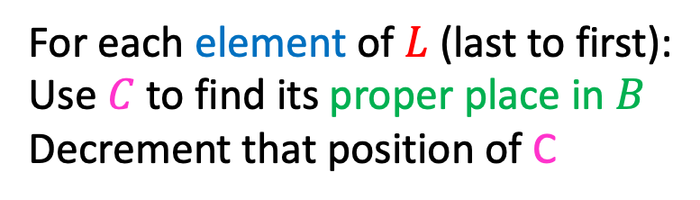

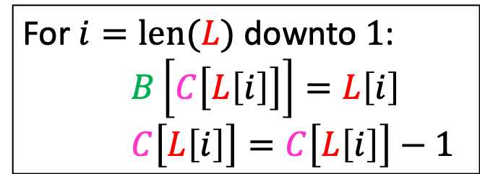


Counting Sort
Idea: Count how many things are less than each element
$$L=$$
3
6
6
1
3
4
1
6
$$C=$$
2
2
4
5
5
8
7
1
2
3
4
5
6
7
8
1
2
3
4
5
6
Last item of value 6 goes at index 8
For each element of $L$ (last to first):
Use $C$ to find its proper place in $B$
Decrement that position of C
For $i=len(L)$ downto $1$:
$B\left[C\left[L\left[i\right]\right]\right]=L\left[i\right]$
$C\left[L\left[i\right]\right]=C\left[L\left[i\right]\right]−1$
$$B=$$
6
1
2
3
4
5
6
7
8

Slide 41
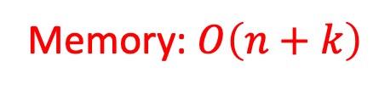
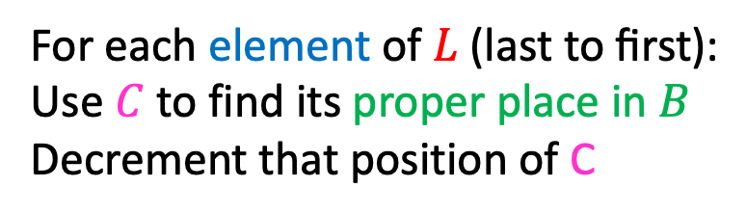
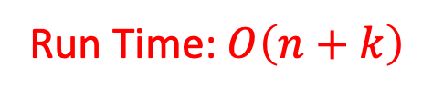
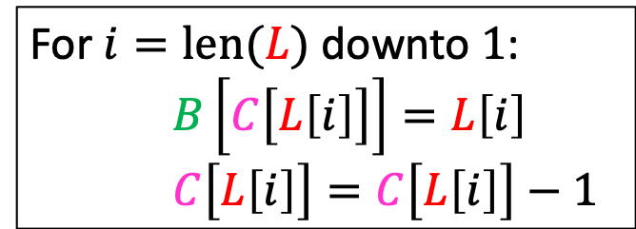
Counting Sort
Idea: Count how many things are less than each element
$$L=$$
3
6
6
1
3
4
1
6
$$C=$$
2
2
4
5
5
7
1
1
2
3
4
5
6
7
8
1
2
3
4
5
6
Last item of value 1 goes at index 2
For each element of $L \text{(}\text{last} \text{to} \text{first}\text{)}$:
Use $C$ to find its proper place in $B$
Decrement that position of C
For $i=len(L)$ downto $1$:
$B\left[C\left[L\left[i\right]\right]\right]=L\left[i\right]$
$C\left[L\left[i\right]\right]=C\left[L\left[i\right]\right]−1$
Run Time: $O\left(n+k\right)$
$$B=$$
1
6
1
2
3
4
5
6
7
8
Memory: $O\left(n+k\right)$

Slide 42
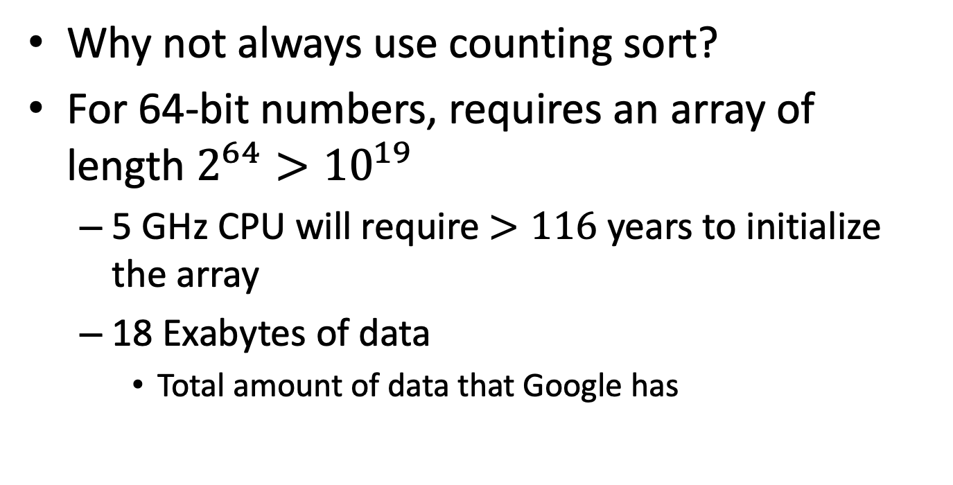
Counting Sort
Why not always use counting sort?
For 64-bit numbers, requires an array of length $2^{64}>{10}^{19}$
5 GHz CPU will require $>116$ years to initialize the array
18 Exabytes of data
Total amount of data that Google has
42

Slide 43
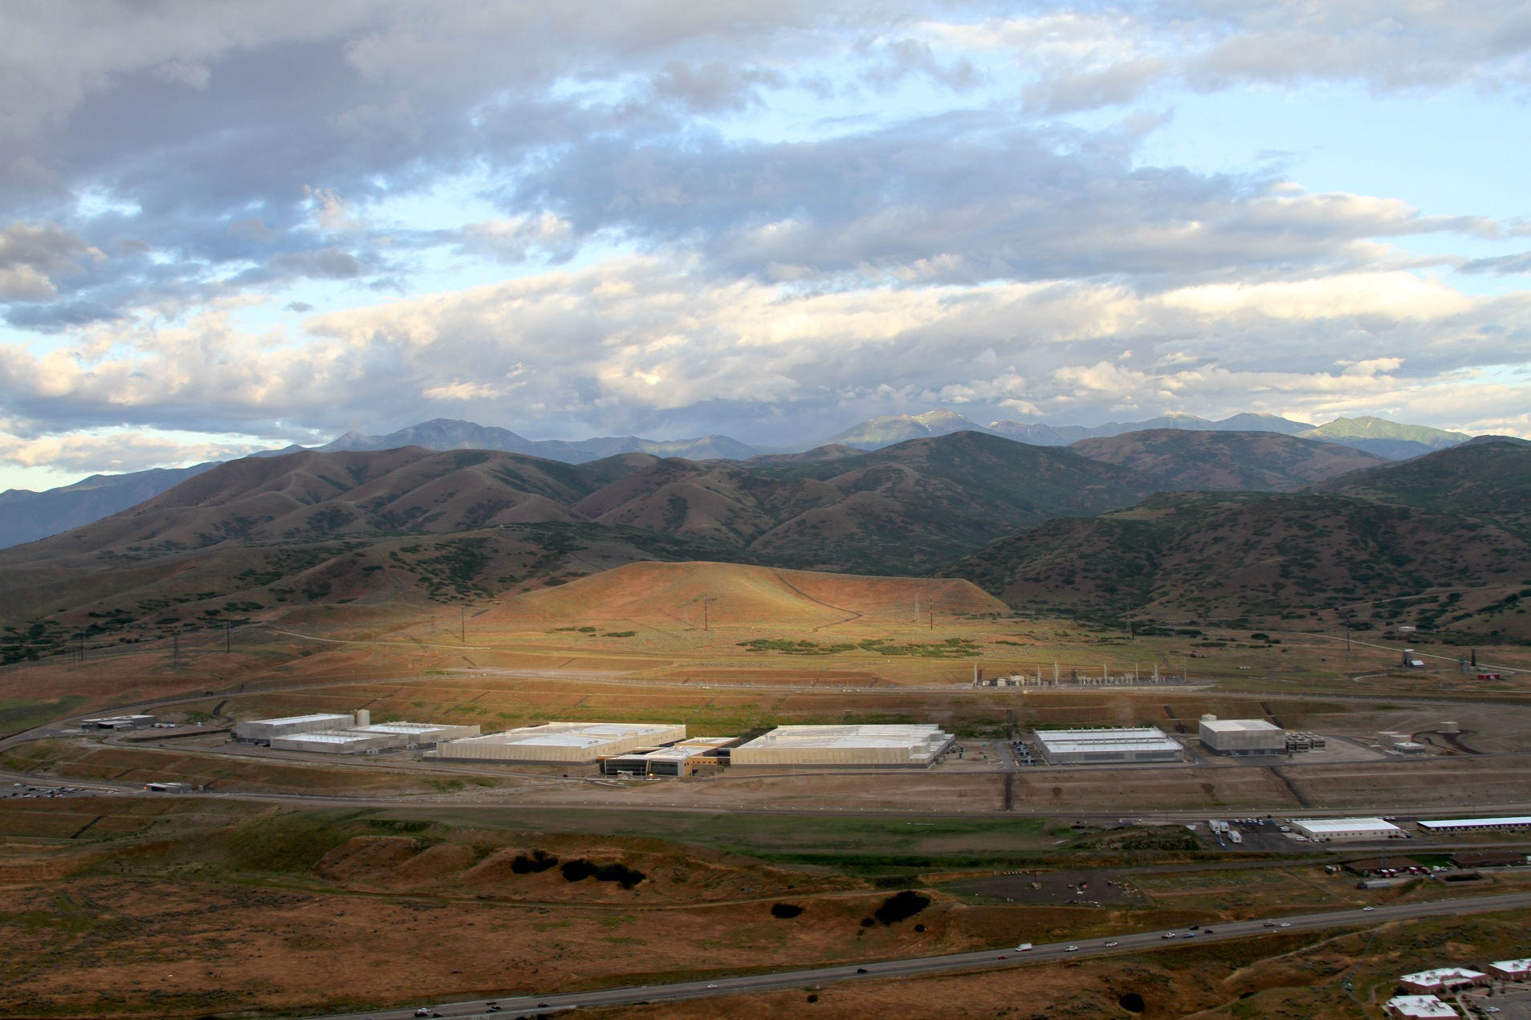
12 Exabytes

Slide 44
Radix Sort
Idea: Stable sort on each digit, from least significant to most significant
103
801
401
323
255
823
999
101
113
901
555
512
245
800
018
121
0
1
2
3
4
5
6
7
8
9
10
11
12
13
14
15
Place each element into a “bucket” according to its 1’s place
800
801
401
101
901
121
512
103
323
823
113
255
555
245
018
999
0
1
2
3
4
5
6
7
8
9

Slide 45
Radix Sort
Idea: Stable sort on each digit, from least significant to most significant
800
801
401
101
901
121
512
103
323
823
113
255
555
245
018
999
Place each element into a “bucket” according to its 10’s place
0
1
2
3
4
5
6
7
8
9
800
801
401
101
901
103
512
113
018
121
323
823
245
255
555
999
0
1
2
3
4
5
6
7
8
9

Slide 46
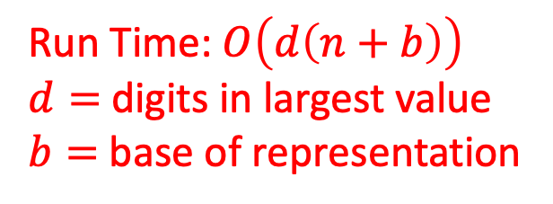
Radix Sort
Idea: Stable sort on each digit, from least significant to most significant
800
801
401
101
901
103
512
113
018
121
323
823
245
255
555
999
Place each element into a “bucket” according to its 100’s place
0
1
2
3
4
5
6
7
8
9
018
101
103
113
121
245
255
323
401
512
555
800
801
823
901
999
Run Time: $O\left(d\left(n+b\right)\right)$
$d=$digits in largest value
$b=$ base of representation
0
1
2
3
4
5
6
7
8
9

Slide 47

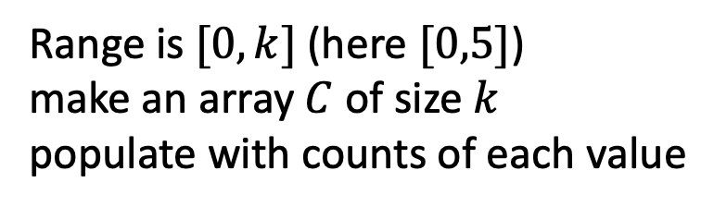

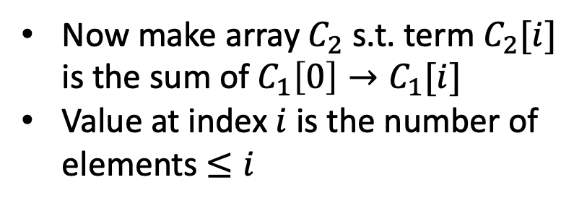
Generalized Counting Sort
Idea: For each element, count how many elements come before it in sorted order
2
5
3
0
2
3
0
5
0
1
2
3
4
5
6
7
Range is $[0,k]$ (here $[0,5]$)
make an array $C$ of size $k$
populate with counts of each value
$$C_{1}=$$
2
0
2
3
0
1
0
1
2
3
4
5
Now make array $C_{2}$ s.t. term $C_{2}[i]$ is the sum of $C_{1}\left[0\right]→C_{1}[i]$
Value at index $i$ is the number of elements $≤i$
$$C_{2}=$$
2
2
3
7
7
8
0
1
2
3
4
5

Slide 48

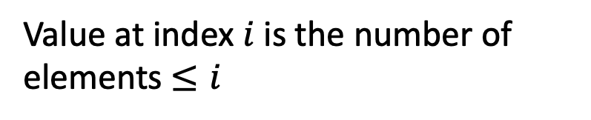
Generalized Counting Sort
Idea: For each element, count how many elements come before it in sorted order
2
5
3
0
2
3
0
5
0
1
2
3
4
5
6
7
Value at index $i$ is the number of elements $≤i$
$$C_{2}=$$
2
2
3
7
7
8
0
1
2
3
4
5

