Slide 1
CS4102 Algorithms
Fall 2018
Warm up:
Modify Dijkstra’s Algorithm to find the shortest paths by product of edge weights (assume all weights are at least 1)

Slide 2
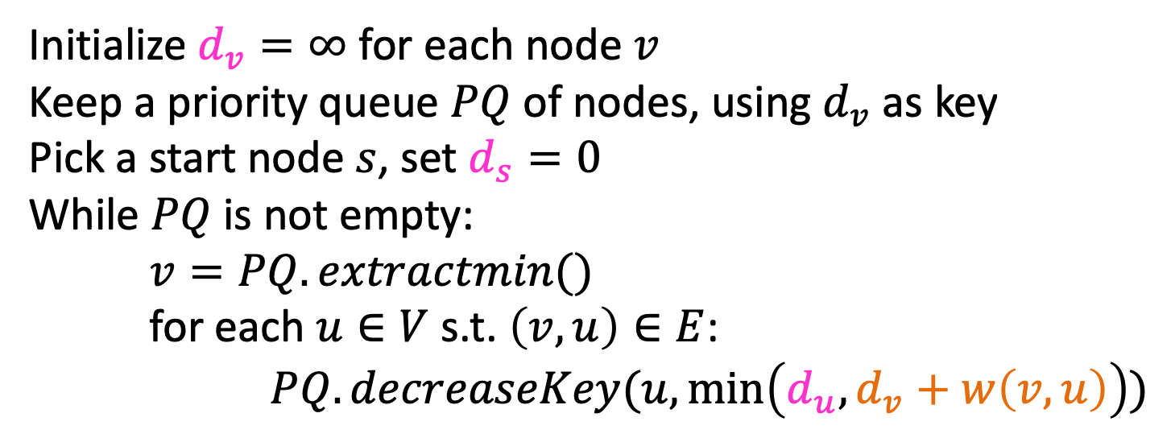
Dijkstra’s Algorithm
Initialize $d_{v}=∞$ for each node $v$
Keep a priority queue $PQ$ of nodes, using $d_{v}$ as key
Pick a start node $s$, set $d_{s}=0$
While $PQ$ is not empty:
$v=PQ.extractmin()$
for each $u∈V$ s.t. $\left(v,u\right)∈E$:
$PQ.decreaseKey(u,\min\left(d_{u}, d_{v}+w\left(v,u\right)\right))$
Modify Dijkstra’s Algorithm to find the shortest paths by product of edge weights (assume all weights are at least 1)

Slide 3







Dijkstra’s Algorithm (for min product)
Initialize $d_{v}=∞$ for each node $v$
Keep a priority queue $PQ$ of nodes, using $d_{v}$ as key
Pick a start node $s$, set $d_{s}=1$
While $PQ$ is not empty:
$v=PQ.extractmin()$
for each $u∈V$ s.t. $\left(v,u\right)∈E$:
$PQ.decreaseKey(u,\min\left(d_{u}, d_{v}⋅w\left(v,u\right)\right))$
How do we know this works?
$$∞$$
$$∞$$
B
8
10
E
$$∞$$
6
0
7
H
A
9
$$∞$$
2
D
5
$$∞$$
9
I
12
3
$$∞$$
C
3
$$∞$$
$$∞$$
11
G
1
F
7

Slide 4
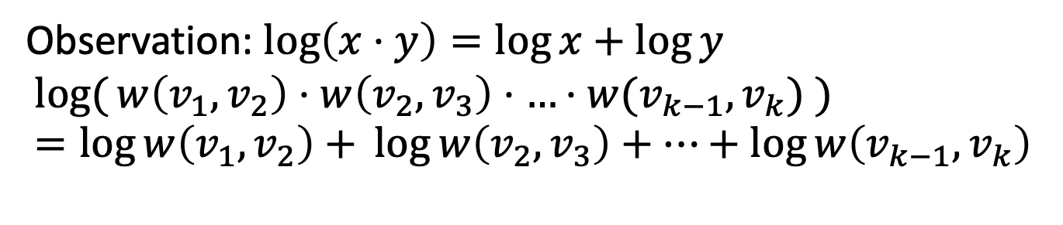
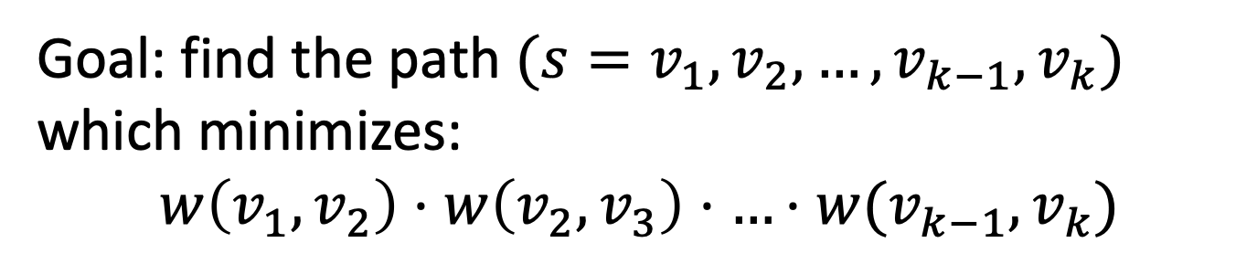
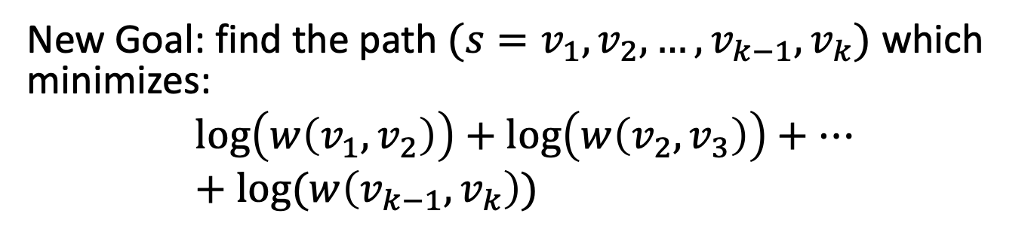
Shortest path by product
Goal: find the path $({s=v}_{1},v_{2},…,v_{k−1},v_{k})$ which minimizes:
$$w\left(v_{1},v_{2}\right)⋅w\left(v_{2},v_{3}\right)⋅…⋅w(v_{k−1},v_{k})$$
Observation: $\log\left(x⋅y\right)=\log{x}+\log{y}$
$$log({w\left(v_{1},v_{2}\right)⋅w\left(v_{2},v_{3}\right)⋅…⋅w(v_{k−1},v_{k}) })=\log{w\left(v_{1},v_{2}\right)+ }\log{w\left(v_{2},v_{3}\right)+…+\log{w\left(v_{k−1},v_{k}\right) }}$$
New Goal: find the path $({s=v}_{1},v_{2},…,v_{k−1},v_{k})$ which minimizes:
$$\log\left(w\left(v_{1},v_{2}\right)\right)+\log\left(w\left(v_{2},v_{3}\right)\right)+…+log⁡(w\left(v_{k−1},v_{k}\right))$$

Slide 5
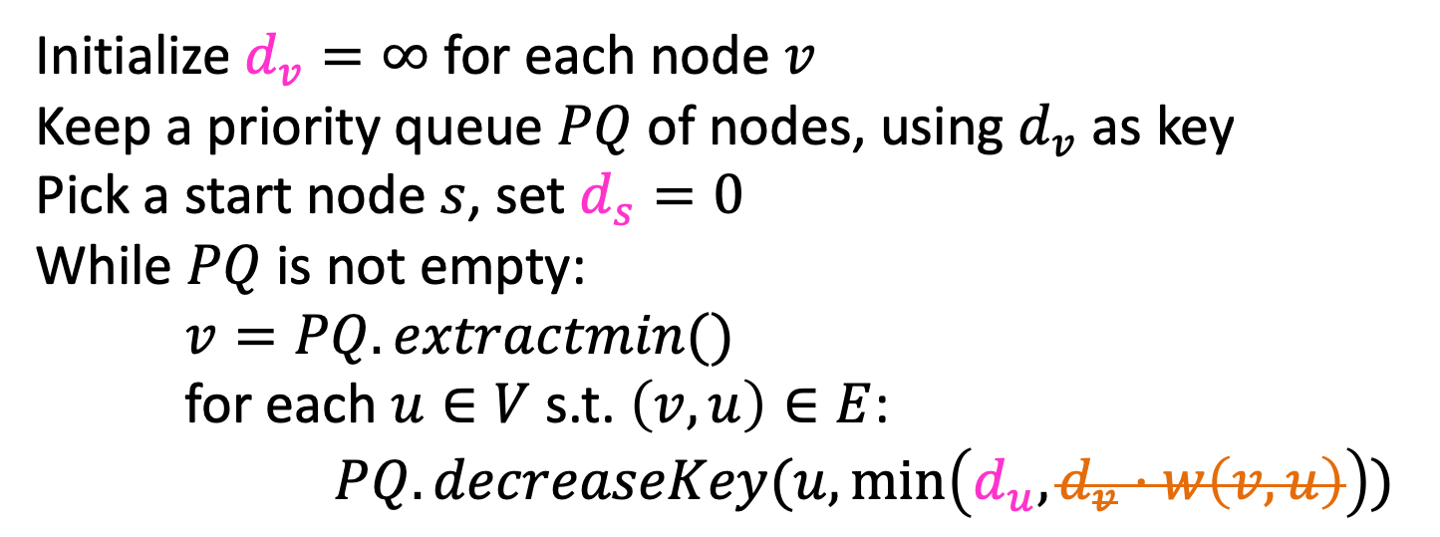
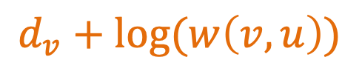
Dijkstra’s Algorithm (for min product)
Initialize $d_{v}=∞$ for each node $v$
Keep a priority queue $PQ$ of nodes, using $d_{v}$ as key
Pick a start node $s$, set $d_{s}=0$
While $PQ$ is not empty:
$v=PQ.extractmin()$
for each $u∈V$ s.t. $\left(v,u\right)∈E$:
$PQ.decreaseKey(u,\min\left(d_{u}, d_{v}⋅w\left(v,u\right)\right))$
$$d_{v}+log⁡(w\left(v,u\right))$$
$$∞$$
log 8
$$∞$$
log 10
B
E
log 6
$$∞$$
0
log 7
H
A
$$∞$$
log 2
log 9
log 5
$$∞$$
D
log 9
I
log 12
log 3
$$∞$$
C
log 3
$$∞$$
$$∞$$
log 11
G
log 1
F
log 7

Slide 6
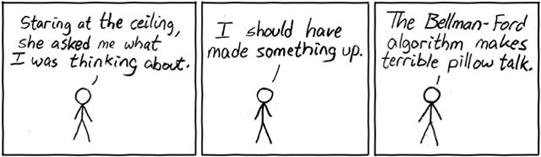
Today’s Keywords
Graphs
Shortest path
Bellman-Ford
OG DP
Floyd-Warshall

Slide 7
CLRS Readings
Chapter 22
Chapter 23
Chapter 24

Slide 8
Homeworks
HW7 Released
Due Saturday April 21, 11pm
Written (use latex)
Graphs

Slide 9
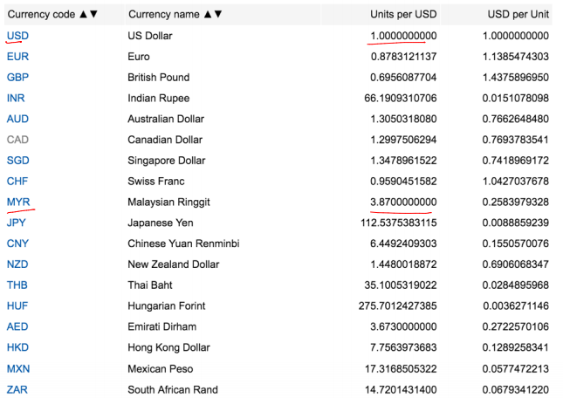
Currency Exchange
1 Dollar = 0.8783121137 Euro
1 Dollar = 3.87 Ringgit

Slide 10
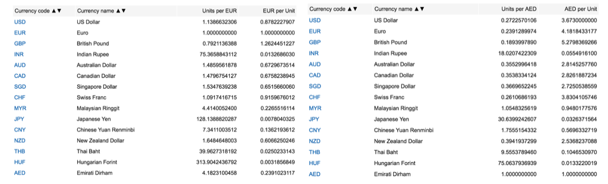
Currency Exchange
1 Dollar = 3.87 Ringgit
1 Dollar = 0.8783121137 Euro
1 Euro= 4.1823100458 Dirham
1 Dirham= 1.0548325619 Ringgit
1 Dollar= 0.8783121137 * 4.1823100458 * 1.0548325619 Ringgit
= 3.87479406049 Ringgit

Slide 11
Currency Exchange
1 Dollar = 3.87479406049 Ringgit
1 Ringgit = 0.2583979328 Dollar
1 Dollar = 3.87479406049 * 0.2583979328 Dollar
= 1.00123877526 Dollar
Free Money!

Slide 12
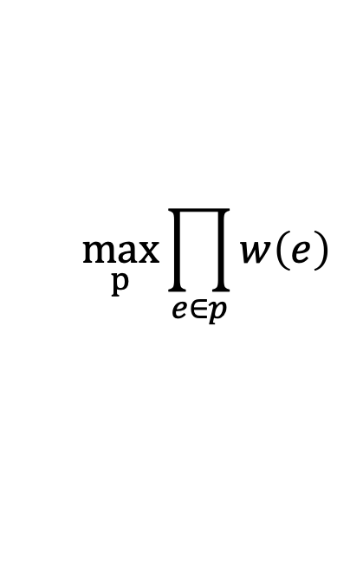
Best Currency Exchange
Best way to transfer USD to MYR:
Given a graph of currencies (edges are exchange rates)
find the shortest path by product of edge weights
$$\max_{p}{\prod_{e∈p}{w\left(e\right)}}$$
Invert edge weights to make it a minimization problem
3.87479406049
USD
MYR
0.2583979328
0.8783121137
1.0548325619
Euro
4.1823100458
AED

Slide 13
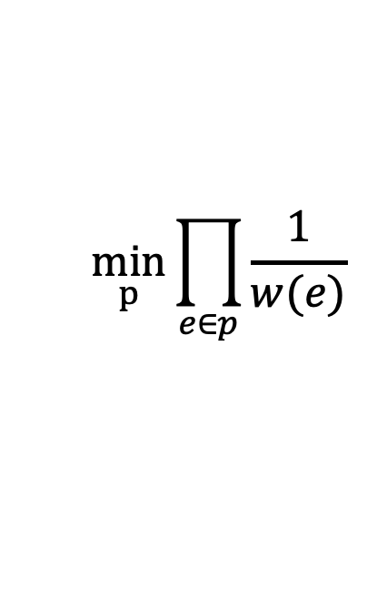
Best Currency Exchange
Best way to transfer USD to MYR:
Given a graph of currencies (edges are exchange rates)
find the shortest path by product of edge weights
$$\min_{p}{\prod_{e∈p}{\frac{1}{w(e)}}}$$
Take log of edge weights to make summation
0.26
USD
MYR
3.87
1.14
Euro
0.95
0.24
AED

Slide 14
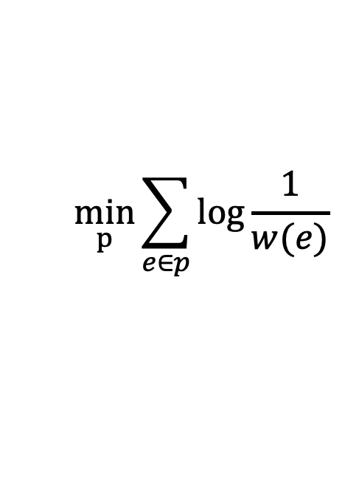
Best Currency Exchange
Best way to transfer USD to MYR:
Given a graph of currencies (edges are exchange rates)
find the shortest path by product of edge weights
$$\min_{p}{\sum_{e∈p}{\log{\frac{1}{w(e)}}}}$$
Now a shortest path problem!
-0.585
USD
MYR
0.57
0.06
Euro
-.02
-0.63
AED
Negative Edge Weights!

Slide 15

Problem with negative edges
B
E
H
A
D
I
12
3
C
-5
11
G
1
F
7
$$w\left(C,F,D,C\right)=−1$$
There is no shortest path from A to I!
What we need: an algorithm that finds the shortest path in graphs with negative edge weights (if one exists)
Weight if we take the cycle 0 times: 31
Weight if we take the cycle 1 time: 30
Weight if we take the cycle 2 times: 29
…

Slide 16


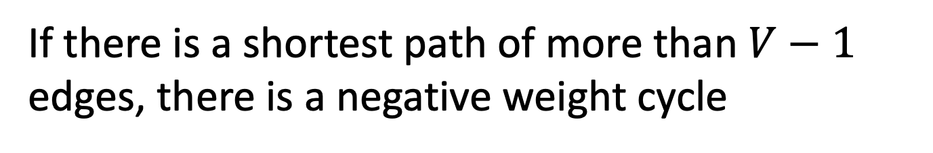
Note
Any simple path has at most $V−1$ edges
Pigeonhole Principle!
More than $V−1$ edges means some node appears twice (i.e., there is a cycle)
If there is a shortest path of more than $V−1$ edges, there is a negative weight cycle

Slide 17


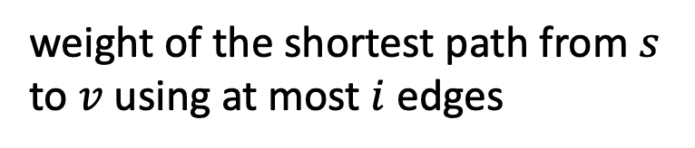



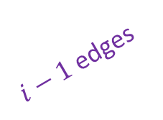


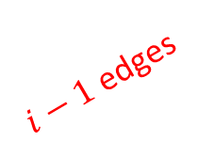

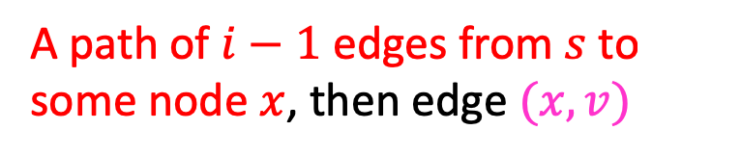


Bellman-Ford
Idea: Use Dynamic Programming!
weight of the shortest path from $s$ to $v$ using at most $i$ edges
$$Short\left(i,v\right)=$$
A path of $i−1$ edges from $s$ to some node $x$, then edge $(x,v)$
$$x$$
$$s$$
$i−1$ edges
Two options:
$$v$$
OR
A path from $s$ to $v$ of at most $i−1$ edges
$$v$$
$$s$$
$i−1$ edges
$$\min_{x}({Short(i−1,x)}+w(x,v))$$
$$Short\left(i,v\right)=\min{ }$$
$$Short(i−1,v)$$

Slide 18


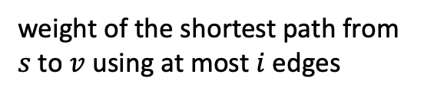





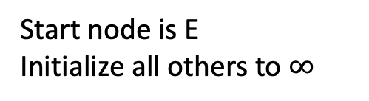


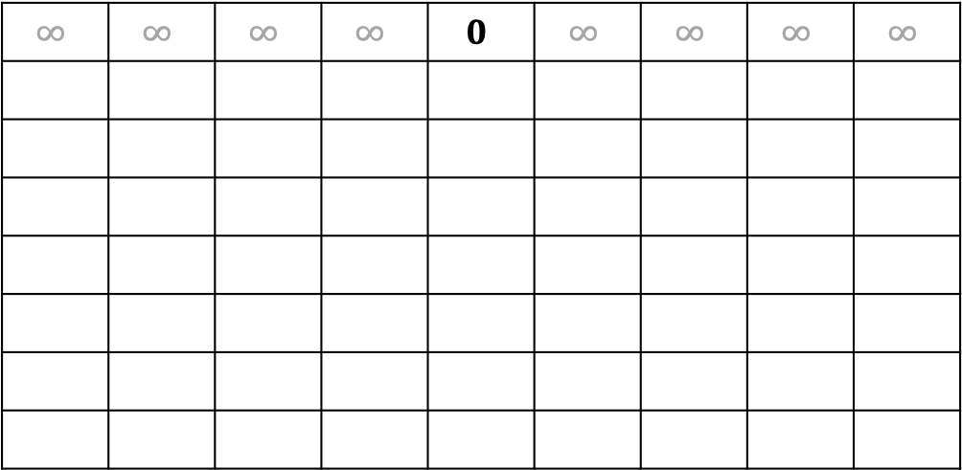




Bellman Ford
8
10
B
E
5
Start node is E
Initialize all others to $∞$
7
H
A
-4
2
D
5
9
weight of the shortest path from $s$ to $v$ using at most $i$ edges
I
$$Short\left(i,v\right)=$$
-12
3
C
-3
$$\min_{x}({Short(i−1,x)}+w(x,v))$$
G
-4
$$Short\left(i,v\right)=\min{ }$$
1
F
6
$$Short(i−1,v)$$
$$v=$$
A
B
C
D
E
F
G
H
I
$$i=$$
$$0$$
$$∞$$ | $$∞$$ | $$∞$$ | $$∞$$ | $$0$$ | $$∞$$ | $$∞$$ | $$∞$$ | $$∞$$
$$1$$
$$2$$
$$3$$
$$4$$
$$5$$
$$6$$
$$7$$

Slide 19

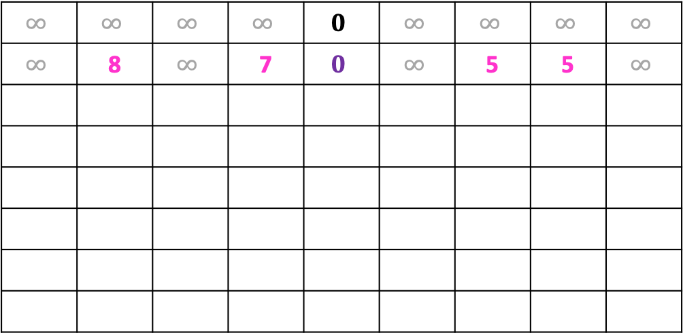
Bellman Ford
8
10
B
E
5
Start node is E
Initialize all others to $∞$
7
H
A
-4
2
D
5
9
weight of the shortest path from $s$ to $v$ using at most $i$ edges
I
$$Short\left(i,v\right)=$$
-12
3
C
-3
$$\min_{x}({Short(i−1,x)}+w(x,v))$$
G
-4
$$Short\left(i,v\right)=\min{ }$$
1
F
6
$$Short(i−1,v)$$
$$v=$$
A
B
C
D
E
F
G
H
I
$$i=$$
$$0$$
$$∞$$ | $$∞$$ | $$∞$$ | $$∞$$ | $$0$$ | $$∞$$ | $$∞$$ | $$∞$$ | $$∞$$
$$∞$$ | 8 | $$∞$$ | 7 | $$0$$ | $$∞$$ | 5 | 5 | $$∞$$
$$1$$
$$2$$
$$3$$
$$4$$
$$5$$
$$6$$
$$7$$

Slide 20
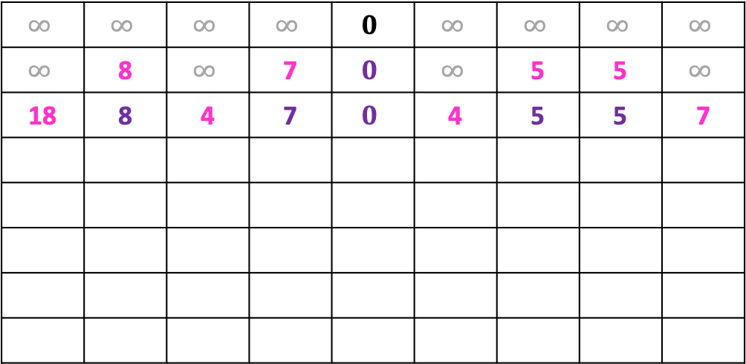
Bellman Ford
8
10
B
E
5
Start node is E
Initialize all others to $∞$
7
H
A
-4
2
D
5
9
weight of the shortest path from $s$ to $v$ using at most $i$ edges
I
$$Short\left(i,v\right)=$$
-12
3
C
-3
$$\min_{x}({Short(i−1,x)}+w(x,v))$$
G
-4
$$Short\left(i,v\right)=\min{ }$$
1
F
6
$$Short(i−1,v)$$
$$v=$$
A
B
C
D
E
F
G
H
I
$$i=$$
$$0$$
$$∞$$ | $$∞$$ | $$∞$$ | $$∞$$ | $$0$$ | $$∞$$ | $$∞$$ | $$∞$$ | $$∞$$
$$∞$$ | 8 | $$∞$$ | 7 | $$0$$ | $$∞$$ | 5 | 5 | $$∞$$
18 | 8 | 4 | 7 | $$0$$ | 4 | 5 | 5 | 7
$$1$$
$$2$$
$$3$$
$$4$$
$$5$$
$$6$$
$$7$$

Slide 21
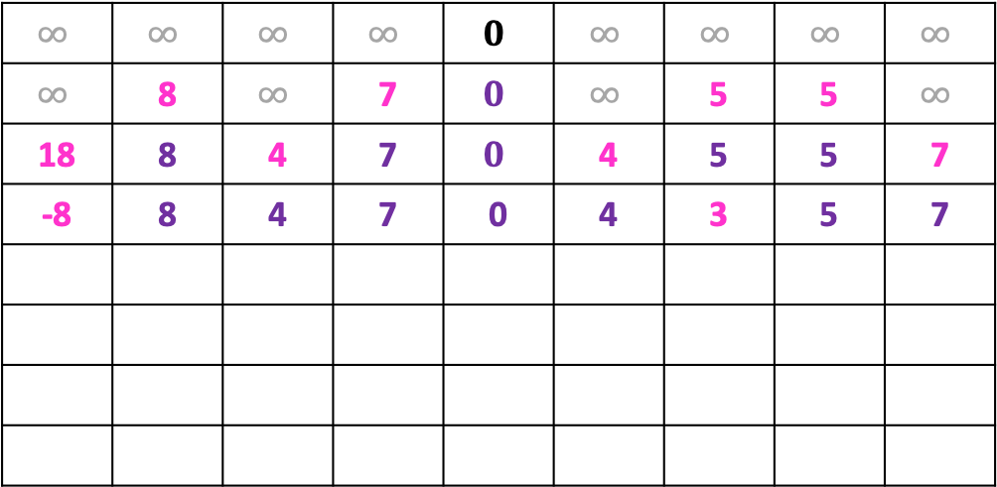
Bellman Ford
8
10
B
E
5
Start node is E
Initialize all others to $∞$
7
H
A
-4
2
D
5
9
weight of the shortest path from $s$ to $v$ using at most $i$ edges
I
$$Short\left(i,v\right)=$$
-12
3
C
-3
$$\min_{x}({Short(i−1,x)}+w(x,v))$$
G
-4
$$Short\left(i,v\right)=\min{ }$$
1
F
6
$$Short(i−1,v)$$
$$v=$$
A
B
C
D
E
F
G
H
I
$$i=$$
$$0$$
$$∞$$ | $$∞$$ | $$∞$$ | $$∞$$ | $$0$$ | $$∞$$ | $$∞$$ | $$∞$$ | $$∞$$
$$∞$$ | 8 | $$∞$$ | 7 | $$0$$ | $$∞$$ | 5 | 5 | $$∞$$
18 | 8 | 4 | 7 | $$0$$ | 4 | 5 | 5 | 7
-8 | 8 | 4 | 7 | 0 | 4 | 3 | 5 | 7
$$1$$
$$2$$
$$3$$
$$4$$
$$5$$
$$6$$
$$7$$

Slide 22
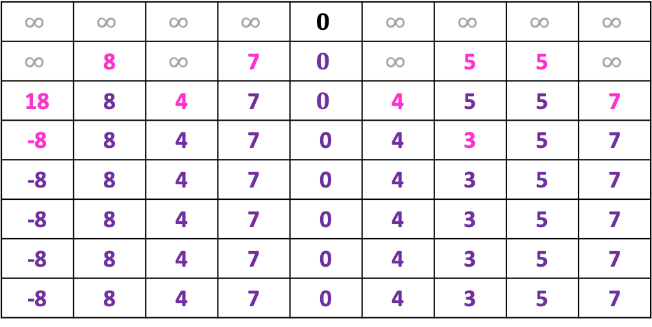
Bellman Ford
8
10
B
E
5
Start node is E
Initialize all others to $∞$
7
H
A
-4
2
D
5
9
weight of the shortest path from $s$ to $v$ using at most $i$ edges
I
$$Short\left(i,v\right)=$$
-12
3
C
-3
$$\min_{x}({Short(i−1,x)}+w(x,v))$$
G
-4
$$Short\left(i,v\right)=\min{ }$$
1
F
6
$$Short(i−1,v)$$
$$v=$$
A
B
C
D
E
F
G
H
I
$$i=$$
$$0$$
$$∞$$ | $$∞$$ | $$∞$$ | $$∞$$ | $$0$$ | $$∞$$ | $$∞$$ | $$∞$$ | $$∞$$
$$∞$$ | 8 | $$∞$$ | 7 | $$0$$ | $$∞$$ | 5 | 5 | $$∞$$
18 | 8 | 4 | 7 | $$0$$ | 4 | 5 | 5 | 7
-8 | 8 | 4 | 7 | 0 | 4 | 3 | 5 | 7
-8 | 8 | 4 | 7 | 0 | 4 | 3 | 5 | 7
-8 | 8 | 4 | 7 | 0 | 4 | 3 | 5 | 7
-8 | 8 | 4 | 7 | 0 | 4 | 3 | 5 | 7
-8 | 8 | 4 | 7 | 0 | 4 | 3 | 5 | 7
$$1$$
$$2$$
$$3$$
$$4$$
$$5$$
$$6$$
$$7$$

Slide 23


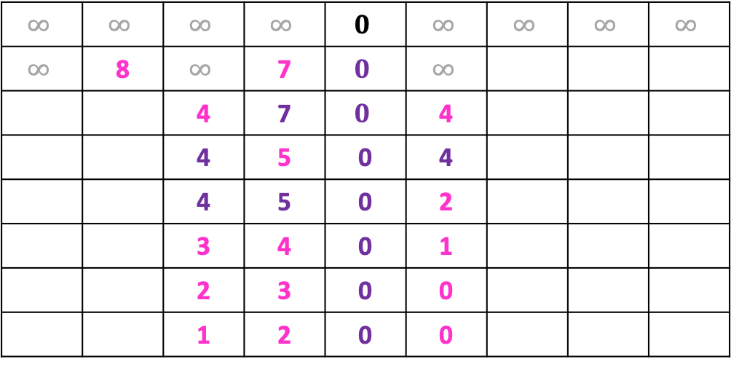

Bellman Ford: Negative cycles
8
10
B
E
5
Start node is E
Initialize all others to $∞$
7
H
A
-4
2
D
5
9
weight of the shortest path from $s$ to $v$ using at most $i$ edges
I
$$Short\left(i,v\right)=$$
-12
1
C
-3
$$\min_{x}({Short(i−1,x)}+w(x,v))$$
G
-4
$$Short\left(i,v\right)=\min{ }$$
1
F
6
$$Short(i−1,v)$$
$$v=$$
A
B
C
D
E
F
G
H
I
$$i=$$
$$0$$
$$∞$$ | $$∞$$ | $$∞$$ | $$∞$$ | $$0$$ | $$∞$$ | $$∞$$ | $$∞$$ | $$∞$$
$$∞$$ | 8 | $$∞$$ | 7 | $$0$$ | $$∞$$
 |  | 4 | 7 | $$0$$ | 4
 |  | 4 | 5 | 0 | 4
 |  | 4 | 5 | 0 | 2
 |  | 3 | 4 | 0 | 1
 |  | 2 | 3 | 0 | 0
 |  | 1 | 2 | 0 | 0
If we computed row V, values change
There is a negative weight cycle!
$$1$$
$$2$$
$$3$$
$$4$$
$$5$$
$$6$$
$$7$$

Slide 24



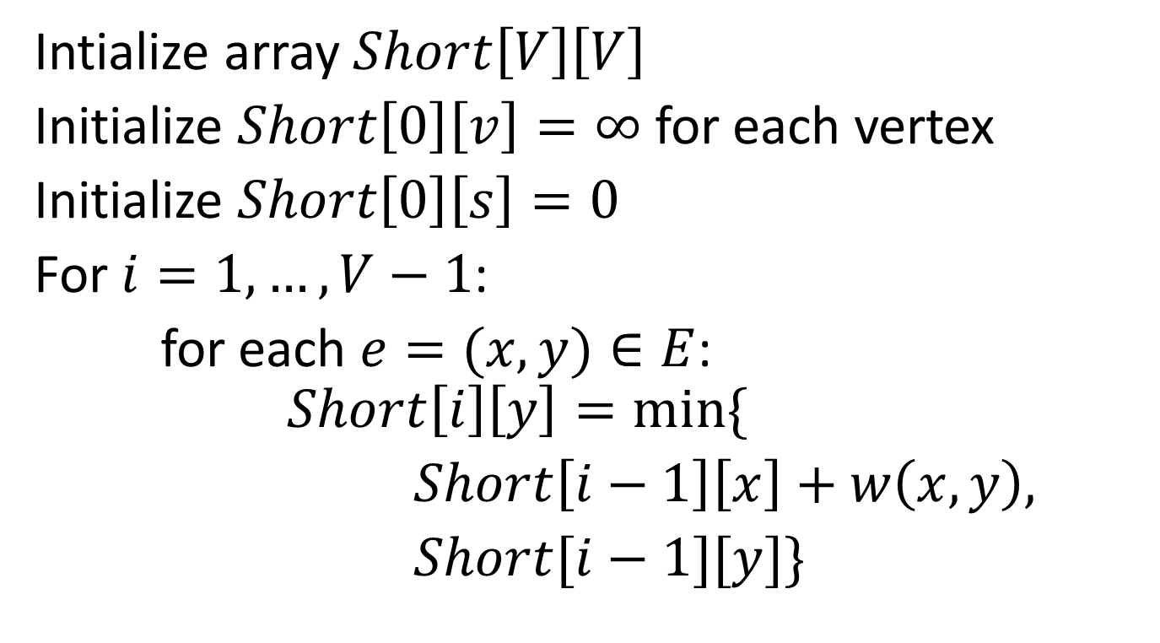



Bellman Ford Run Time
Intialize array $Short\left[V\right]\left[V\right]$
Initialize $Short\left[0\right]\left[v\right]=∞$ for each vertex
Initialize $Short\left[0\right]\left[s\right]=0$
For $i=1, …, V−1$:
for each $e=(x,y)∈E$: $Short\left[i\right]\left[y\right]=min⁡\{$
$Short\left[i−1\right]\left[x\right]+w\left(x,y\right),$
$Short[i−1][y]\}$
$$V^{2}$$
$$V$$
$$1$$
$V$ times
$E$ times
$1$

Slide 25
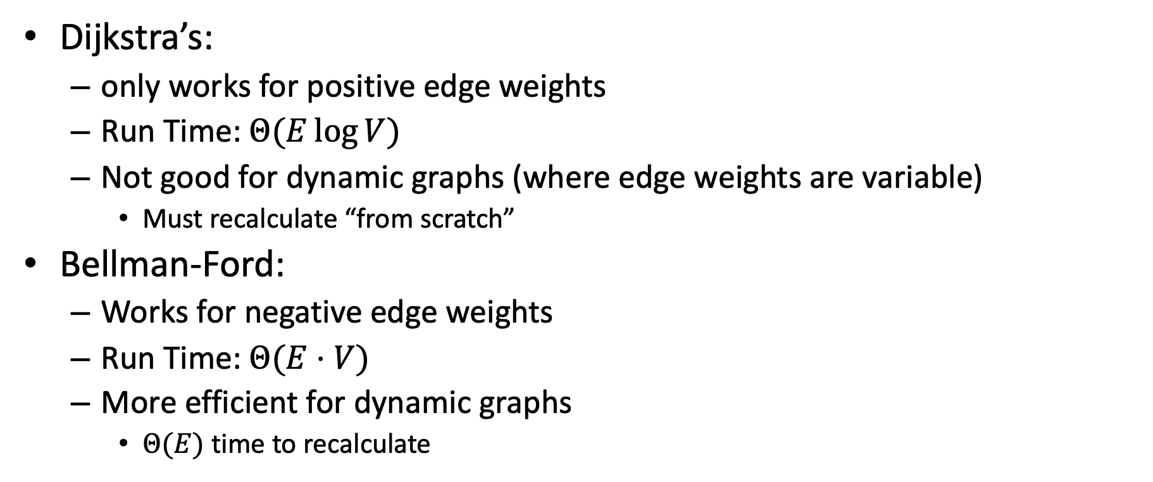
Why Use Bellman-Ford?
Dijkstra’s:
only works for positive edge weights
Run Time: $Θ(E\log{V})$
Not good for dynamic graphs (where edge weights are variable)
Must recalculate “from scratch”
Bellman-Ford:
Works for negative edge weights
Run Time: $Θ(E⋅V)$
More efficient for dynamic graphs
$Θ(E)$ time to recalculate

Slide 26
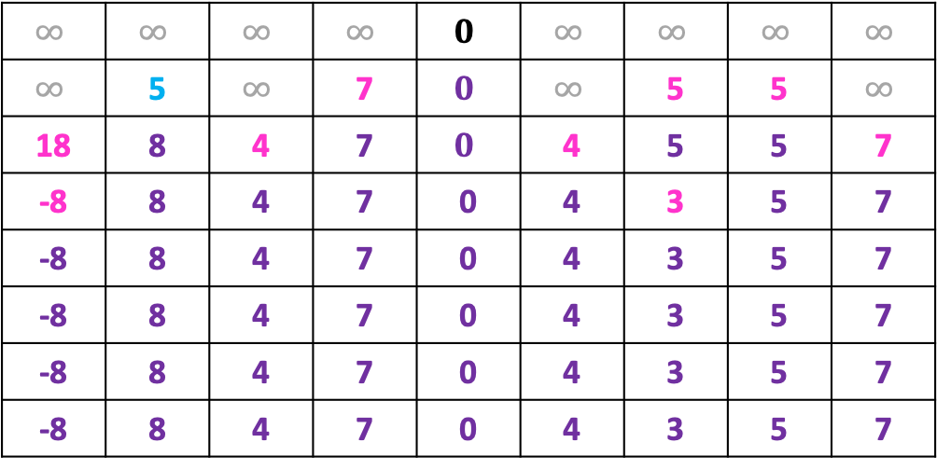
Bellman Ford: Dynamic
8
5
10
B
E
5
Each node will update its neighbors if edge weight changes
7
H
A
-4
2
D
5
9
weight of the shortest path from $s$ to $v$ using at most $i$ edges
I
$$Short\left(i,v\right)=$$
-12
3
C
-3
$$\min_{x}({Short(i−1,x)}+w(x,v))$$
G
-4
$$Short\left(i,v\right)=\min{ }$$
1
F
6
$$Short(i−1,v)$$
$$v=$$
A
B
C
D
E
F
G
H
I
$$i=$$
$$0$$
$$∞$$ | $$∞$$ | $$∞$$ | $$∞$$ | $$0$$ | $$∞$$ | $$∞$$ | $$∞$$ | $$∞$$
$$∞$$ | 5 | $$∞$$ | 7 | $$0$$ | $$∞$$ | 5 | 5 | $$∞$$
18 | 8 | 4 | 7 | $$0$$ | 4 | 5 | 5 | 7
-8 | 8 | 4 | 7 | 0 | 4 | 3 | 5 | 7
-8 | 8 | 4 | 7 | 0 | 4 | 3 | 5 | 7
-8 | 8 | 4 | 7 | 0 | 4 | 3 | 5 | 7
-8 | 8 | 4 | 7 | 0 | 4 | 3 | 5 | 7
-8 | 8 | 4 | 7 | 0 | 4 | 3 | 5 | 7
$$1$$
$$2$$
$$3$$
$$4$$
$$5$$
$$6$$
$$7$$

Slide 27
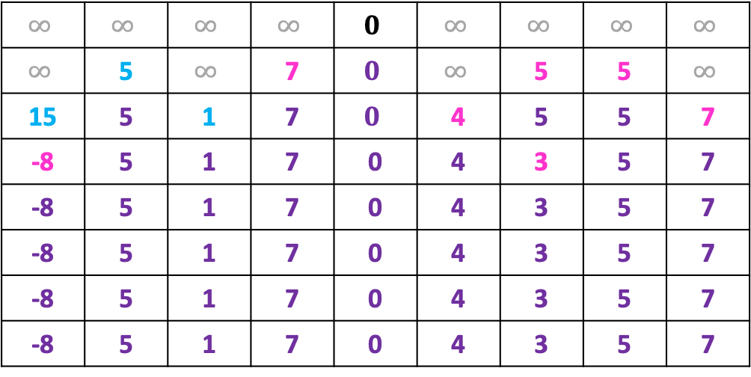
Bellman Ford: Dynamic
8
5
10
B
E
5
Each node will update its neighbors if edge weight changes
7
H
A
-4
2
D
5
9
weight of the shortest path from $s$ to $v$ using at most $i$ edges
I
$$Short\left(i,v\right)=$$
-12
3
C
-3
$$\min_{x}({Short(i−1,x)}+w(x,v))$$
G
-4
$$Short\left(i,v\right)=\min{ }$$
1
F
6
$$Short(i−1,v)$$
$$v=$$
A
B
C
D
E
F
G
H
I
$$i=$$
$$0$$
$$∞$$ | $$∞$$ | $$∞$$ | $$∞$$ | $$0$$ | $$∞$$ | $$∞$$ | $$∞$$ | $$∞$$
$$∞$$ | 5 | $$∞$$ | 7 | $$0$$ | $$∞$$ | 5 | 5 | $$∞$$
15 | 5 | 1 | 7 | $$0$$ | 4 | 5 | 5 | 7
-8 | 5 | 1 | 7 | 0 | 4 | 3 | 5 | 7
-8 | 5 | 1 | 7 | 0 | 4 | 3 | 5 | 7
-8 | 5 | 1 | 7 | 0 | 4 | 3 | 5 | 7
-8 | 5 | 1 | 7 | 0 | 4 | 3 | 5 | 7
-8 | 5 | 1 | 7 | 0 | 4 | 3 | 5 | 7
$$1$$
$$2$$
$$3$$
$$4$$
$$5$$
$$6$$
$$7$$

Slide 28
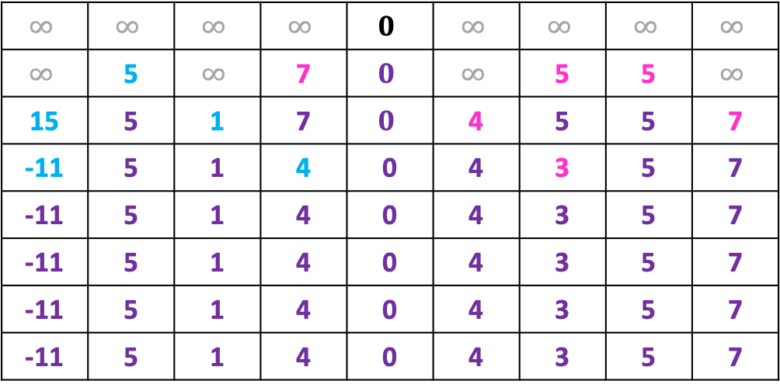
Bellman Ford: Dynamic
8
5
10
B
E
5
Each node will update its neighbors if edge weight changes
7
H
A
-4
2
D
5
9
weight of the shortest path from $s$ to $v$ using at most $i$ edges
I
$$Short\left(i,v\right)=$$
-12
3
C
-3
$$\min_{x}({Short(i−1,x)}+w(x,v))$$
G
-4
$$Short\left(i,v\right)=\min{ }$$
1
F
6
$$Short(i−1,v)$$
$$v=$$
A
B
C
D
E
F
G
H
I
$$i=$$
$$0$$
$$∞$$ | $$∞$$ | $$∞$$ | $$∞$$ | $$0$$ | $$∞$$ | $$∞$$ | $$∞$$ | $$∞$$
$$∞$$ | 5 | $$∞$$ | 7 | $$0$$ | $$∞$$ | 5 | 5 | $$∞$$
15 | 5 | 1 | 7 | $$0$$ | 4 | 5 | 5 | 7
-11 | 5 | 1 | 4 | 0 | 4 | 3 | 5 | 7
-11 | 5 | 1 | 4 | 0 | 4 | 3 | 5 | 7
-11 | 5 | 1 | 4 | 0 | 4 | 3 | 5 | 7
-11 | 5 | 1 | 4 | 0 | 4 | 3 | 5 | 7
-11 | 5 | 1 | 4 | 0 | 4 | 3 | 5 | 7
$$1$$
$$2$$
$$3$$
$$4$$
$$5$$
$$6$$
$$7$$

Slide 29









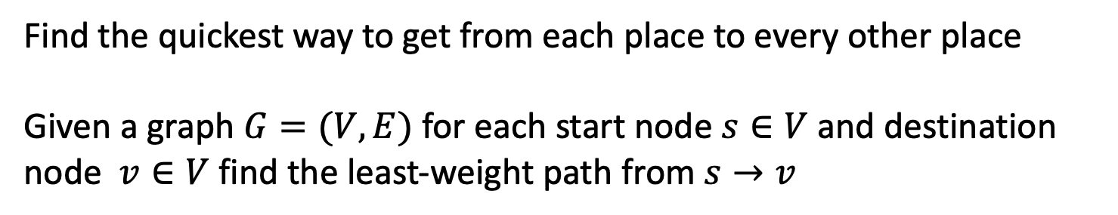
All Pairs Shortest Path
8
-10
8
7
2
9
-5
9
12
-3
3
11
1
6
Find the quickest way to get from each place to every other place
Given a graph $G=(V,E)$ for each start node $s∈V$ and destination node $v∈V$ find the least-weight path from $s→v$

Slide 30
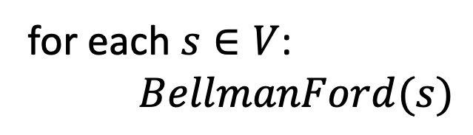



All-Pairs Shortest Path
Can clearly be found in $O(V^{2}⋅E)$
Run Bellman-Ford with each node being the start
for each $s∈V$:
$BellmanFord(s)$
$V$ times
$$O(V⋅E)$$

Slide 31




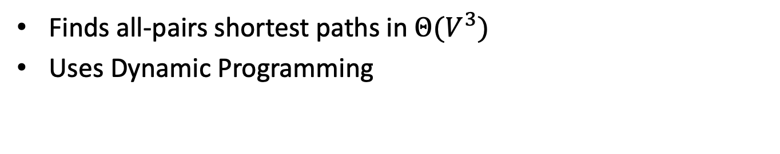




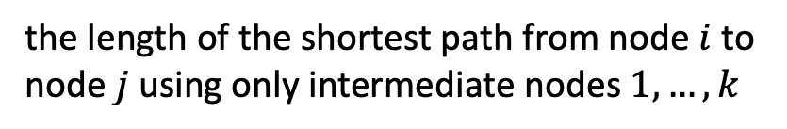


Floyd-Warshall
Finds all-pairs shortest paths in $Θ(V^{3})$
Uses Dynamic Programming
the length of the shortest path from node $i$ to node $j$ using only intermediate nodes $1,…,k$
$$Short\left(i,j,k\right)=$$
$$k$$
Shortest path from $i$ to $j$ includes $k$
$$i$$
Two options:
$$j$$
OR
Shortest path from $i$ to $j$ excludes $k$
$$j$$
$$k$$
$$i$$
$$Short(i,k,k−1)+Short(k,j,k−1)$$
$$Short\left(i,j,k\right)=\min{ }$$
$$Short(i,j,k−1)$$

