Slide 1
CS4102 Algorithms
Fall 2018
Warm up:
Grab cookies!
Start with 2, leftovers will be at regrade office hours
Vegan & Gluten-free are available
Courtesy of Nate and Robbie

Slide 2
Today’s Keywords
Reductions
Bipartite Matching
Vertex Cover
Independent Set
NP-Completeness

Slide 3
CLRS Readings
Chapter 34

Slide 4
Homeworks
HW9 due Friday 12/7 at 11pm
Written (use LaTeX)
Graphs

Slide 5
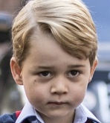

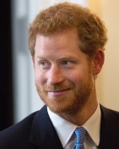
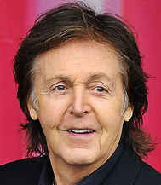
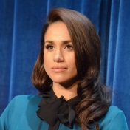
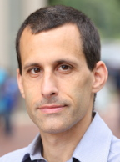
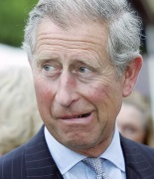
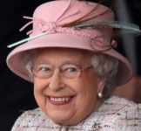
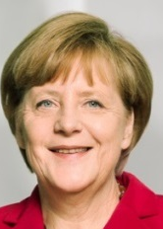
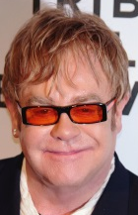
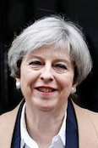
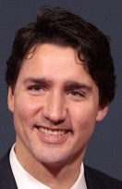

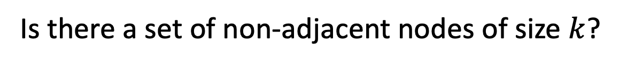
$k$ Independent Set
Is there a set of non-adjacent nodes of size $k$?

Slide 6
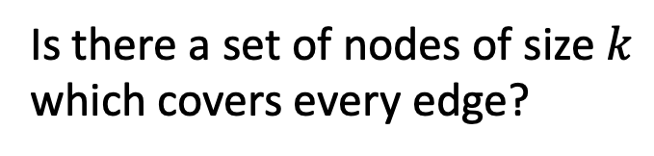

$k$ Vertex Cover
Is there a set of nodes of size $k$ which covers every edge?

Slide 7









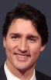
Reduction Idea
$S$ is an independent set of $G$ iff $V−S$ is a vertex cover of $G$
Independent Set
Vertex Cover

Slide 8
Reduction Idea
$S$ is an independent set of $G$ iff $V−S$ is a vertex cover of $G$
Vertex Cover
Independent Set

Slide 9

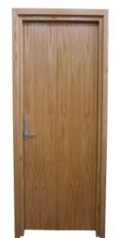
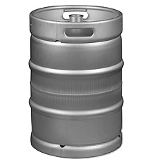

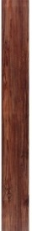

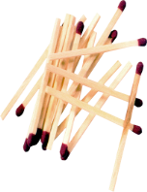




MacGyver’s Reduction
Problem we don’t know how to solve
Problem we do know how to solve
$$A$$
Opening a door
Aim duct at door, insert keg
Lighting a fire
$$B$$
How?
Solution for $A$
Solution for $B$
Keg cannon battering ram
Alcohol, wood, matches
Put fire under the Keg
Reduction

Slide 10

























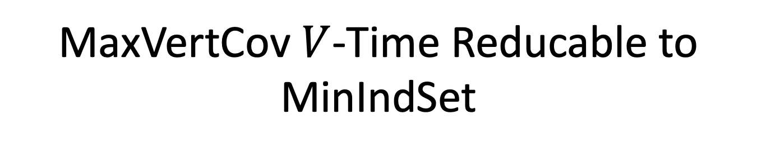

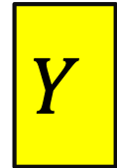

MaxVertCov $V$-Time Reducable to MinIndSet
MaxIndSet
O(V) Time
MinVertCov
$$A$$
$$B$$
Do nothing
Using any Algorithm for MinVertCov
Solution for MaxIndSet
Take complement of solution
Solution for MinVertCov
$$X$$
$$Y$$
Reduction

Slide 11
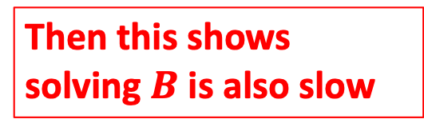
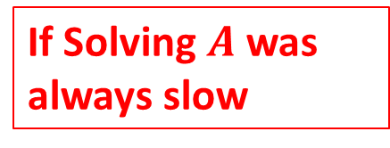
Corollary
MaxIndSet
O(V) Time
MinVertCov
$$A$$
$$B$$
Do nothing
If Solving $A$ was always slow
Using any Algorithm for MinIndSet
Then this shows solving $B$ is also slow
Solution for MaxIndSet
Take complement of solution
Solution for MinVertCov
$$X$$
$$Y$$
Reduction

Slide 12

MaxIndSet $V$-Time Reducable to MinVertCov
MaxIndSet
MinVertCov
O(V) Time
$$A$$
$$B$$
Do nothing
Using any Algorithm for MaxIndSet
Solution for MinVertCov
Take complement of solution
Solution for MaxIndSet
$$X$$
$$Y$$
Reduction

Slide 13
Corollary
MaxIndSet
MinVertCov
O(V) Time
$$A$$
$$B$$
Do nothing
If Solving $A$ was always slow
Using any Algorithm for MaxVertCov
Then this shows solving $B$ is also slow
Solution for MinVertCov
Take complement of solution
Solution for MaxIndSet
$$X$$
$$Y$$
Reduction

Slide 14
Conclusion
MaxIndSet and MinVertCov are either both fast, or both slow
Spoiler alert: We don’t know which!
(But we think they’re both slow)
Both problems are NP-Complete

Slide 15
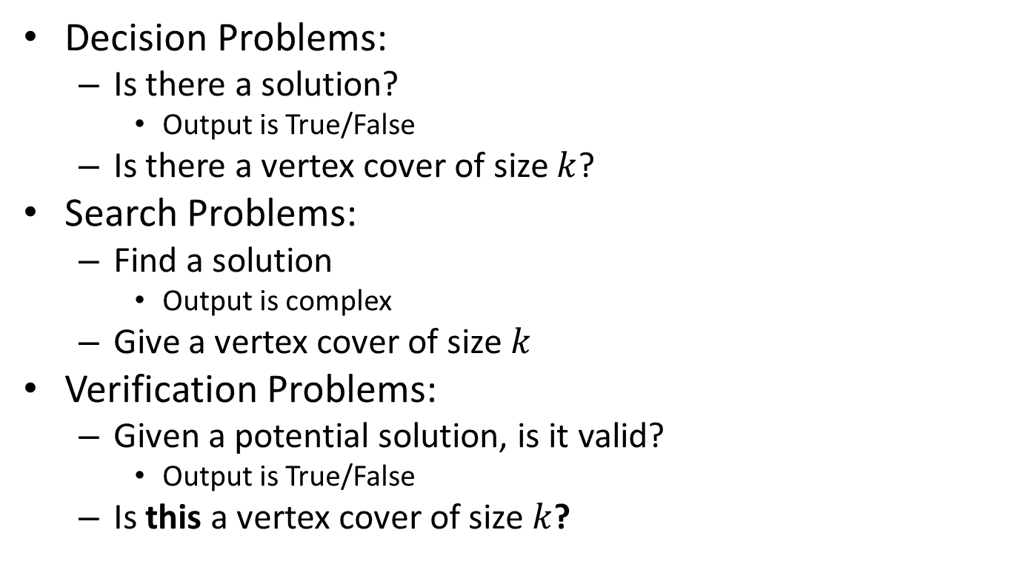
Problem Types
If we can solve this
Decision Problems:
Is there a solution?
Output is True/False
Is there a vertex cover of size $k$?
Search Problems:
Find a solution
Output is complex
Give a vertex cover of size $k$
Verification Problems:
Given a potential solution, is it valid?
Output is True/False
Is this a vertex cover of size $k$?
Then we can solve this

Slide 16
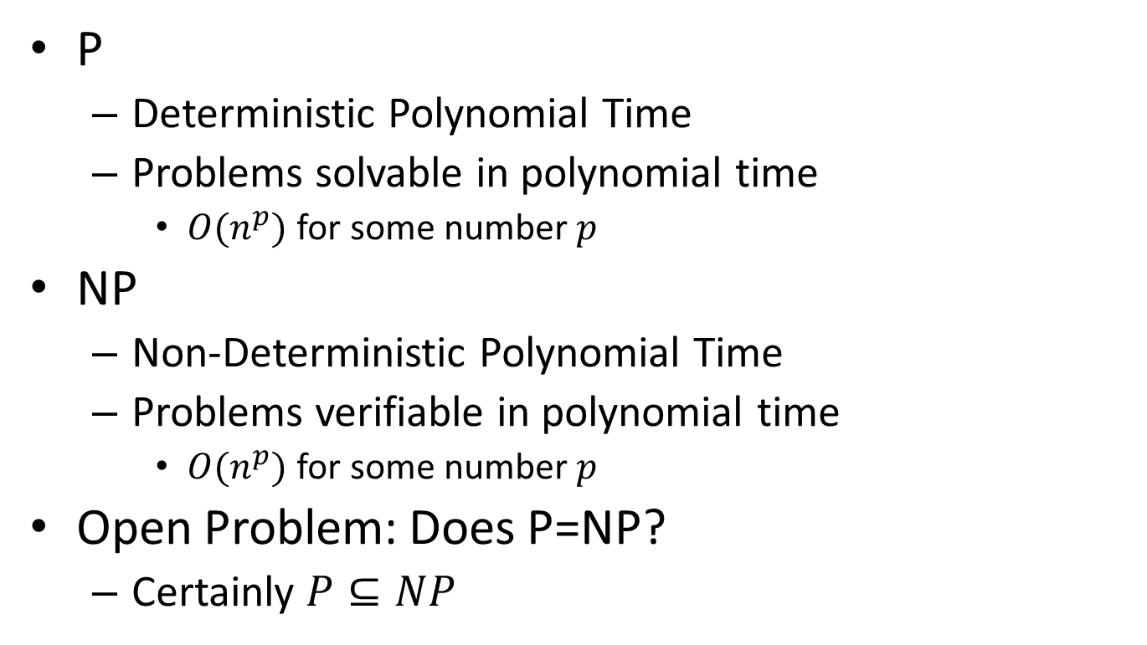
P vs NP
P
Deterministic Polynomial Time
Problems solvable in polynomial time
$O(n^{p})$ for some number $p$
NP
Non-Deterministic Polynomial Time
Problems verifiable in polynomial time
$O(n^{p})$ for some number $p$
Open Problem: Does P=NP?
Certainly $P⊆NP$
NP
P

Slide 17
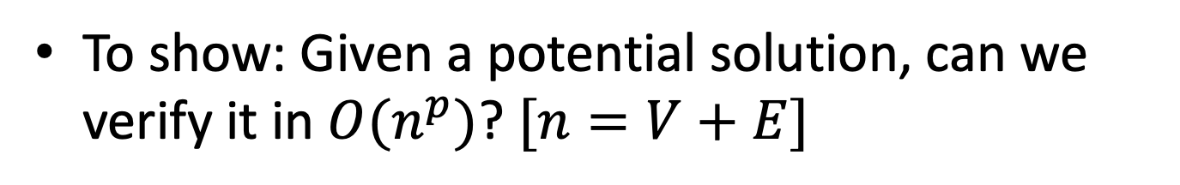

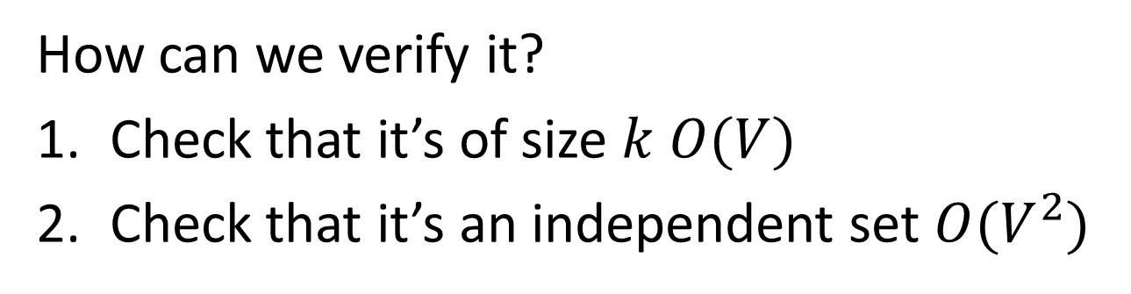
$k$-Independent Set is NP
To show: Given a potential solution, can we verify it in $O(n^{p})$? $[n=V+E]$
How can we verify it?
Check that it’s of size $k$ $O(V)$
Check that it’s an independent set $O(V^{2})$

Slide 18

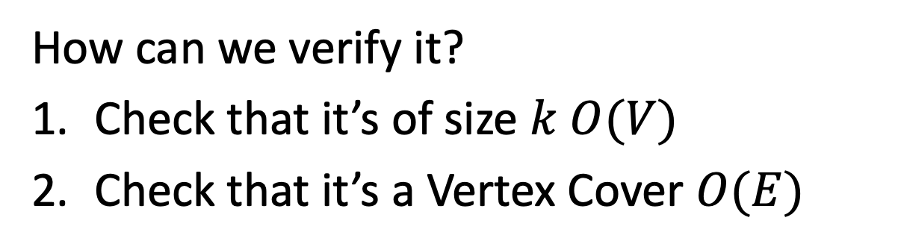
$k$-Vertex Cover is NP
To show: Given a potential solution, can we verify it in $O(n^{p})$? $[n=V+E]$
How can we verify it?
Check that it’s of size $k$ $O(V)$
Check that it’s a Vertex Cover $O(E)$

Slide 19
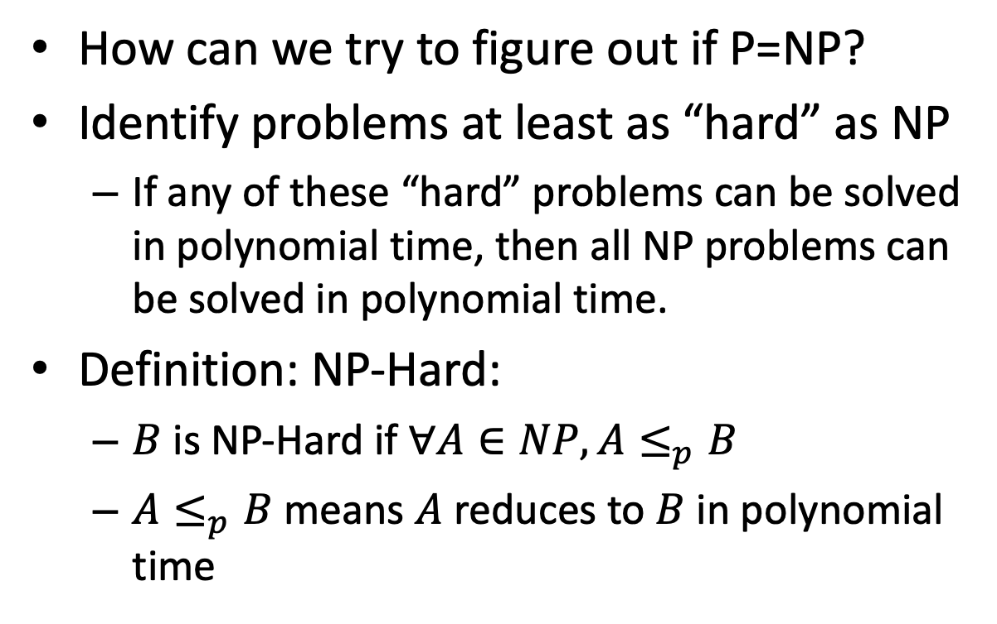
NP-Hard
How can we try to figure out if P=NP?
Identify problems at least as “hard” as NP
If any of these “hard” problems can be solved in polynomial time, then all NP problems can be solved in polynomial time.
Definition: NP-Hard:
$B$ is NP-Hard if $∀A∈NP, A≤_{p}B$
$A≤_{p}B$ means $A$ reduces to $B$ in polynomial time
NP-H
At least as “hard” as NP
NP
P

Slide 20



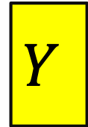


NP-Hardness Reduction
Any NP-Hard Problem
$$O(n^{p})$$
Problem to show is NP-Hard
$$A$$
$$B$$
If This could be done in Polynomial time
Then this could be done in polynomial time
Solution for $A$
Solution for $B$
$$X$$
$$Y$$
Reduction

Slide 21
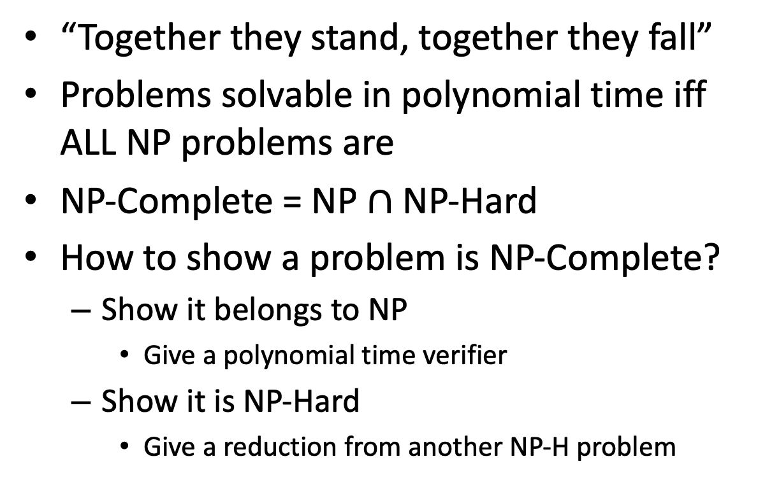
NP-Complete
“Together they stand, together they fall”
Problems solvable in polynomial time iff ALL NP problems are
NP-Complete = NP $∩$ NP-Hard
How to show a problem is NP-Complete?
Show it belongs to NP
Give a polynomial time verifier
Show it is NP-Hard
Give a reduction from another NP-H problem
NP-H
NP-C
NP
P
We now just need a FIRST NP-Hard problem

Slide 22
NP-Completeness
Any NP-Complete Problem
$$O(n^{p})$$
Any other NP-Complete Problem
$$A$$
$$B$$
If This could be done in Polynomial time
Then this could be done in polynomial time
Solution for $A$
Solution for $B$
$$X$$
$$Y$$
Reduction

Slide 23
NP-Completeness
Any NP-Complete Problem
$$O(n^{p})$$
Any other NP-Complete Problem
$$A$$
$$B$$
If this cannot be done in polynomial time
Then this cannot be done in polynomial time
Solution for $A$
Solution for $B$
$$X$$
$$Y$$
Reduction

Slide 24
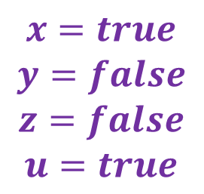
3-SAT
Shown to be NP-Hard by Cook and Levin (independently)
Given a 3-CNF formula (logical AND of clauses, each an OR of 3 variables), Is there an assignment of true/false to each variable to make the formula true?
$$\left(x∨y∨z\right)∧\left(x∨\overline{y}∨y\right)∧\left(u∨y∨\overline{z}\right)∧\left(z∨\overline{x}∨u\right)∧(\overline{x}∨\overline{y}∨\overline{z})$$
Clause
$$x=true$$
$$y=false$$
$$z=false$$
$$u=true$$
Variables

Slide 25
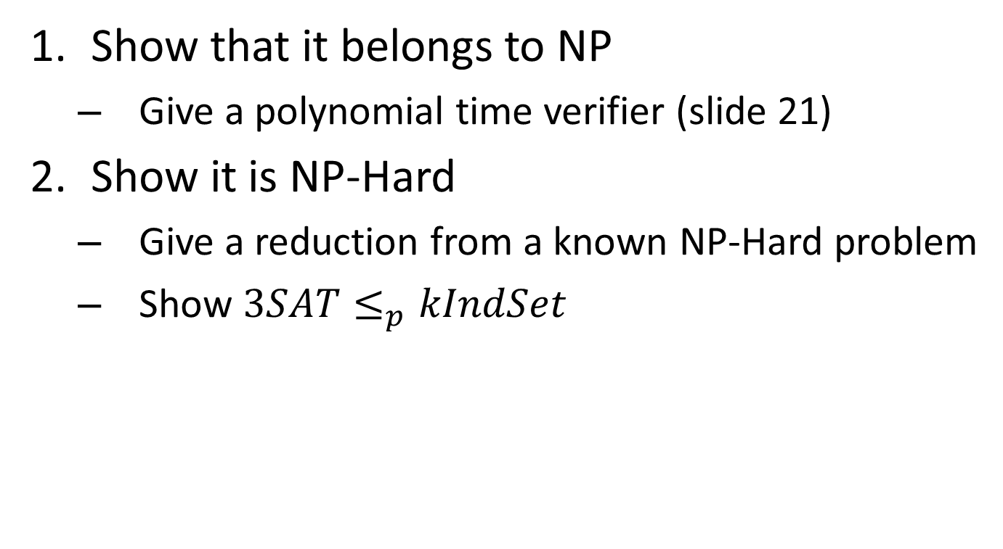
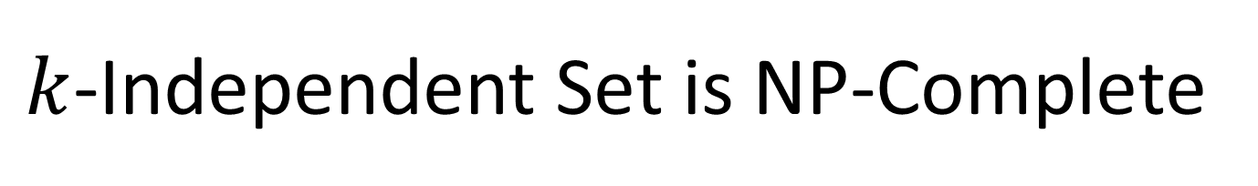
$k$-Independent Set is NP-Complete
Show that it belongs to NP
Give a polynomial time verifier (slide 21)
Show it is NP-Hard
Give a reduction from a known NP-Hard problem
Show $3SAT≤_{p}kIndSet$

Slide 26



$$3SAT≤_{p}kIndSet$$
3SAT
$$O(n^{p})$$
$k$-Ind Set
$$A$$
$$B$$
Solution for 3SAT
Solution for $k$-Ind Set
$$X$$
$$Y$$
Reduction

Slide 27














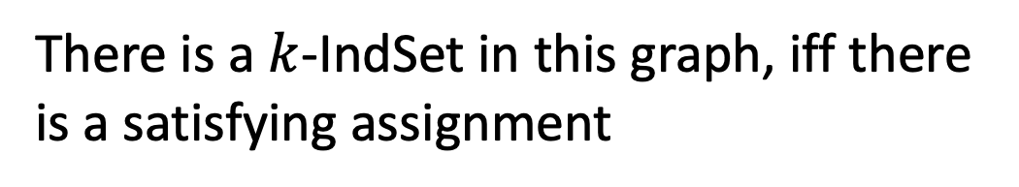



Instance of 3SAT to Instance of $k$IndSet
$$\left(x∨y∨z\right)∧\left(x∨\overline{y}∨y\right)∧\left(u∨y∨\overline{z}\right)∧\left(z∨\overline{x}∨u\right)∧(\overline{x}∨\overline{y}∨\overline{z})$$
$$x$$
$$u$$
$$z$$
$$\overline{u}$$
$$x$$
$$y$$
$$\overline{y}$$
$$\overline{z}$$
$$y$$
$$u$$
$$\overline{x}$$
$$\overline{z}$$
$$\overline{y}$$
$$z$$
$$y$$
For each clause, produce a triangle graph with its three variables as nodes
Connect each node to all of its opposites
Let $k=$ number of clauses
There is a $k$-IndSet in this graph, iff there is a satisfying assignment

Slide 28







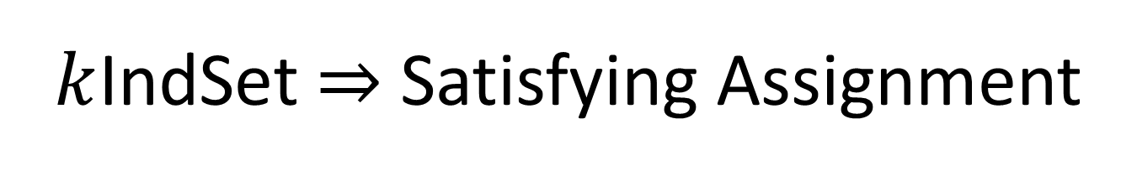

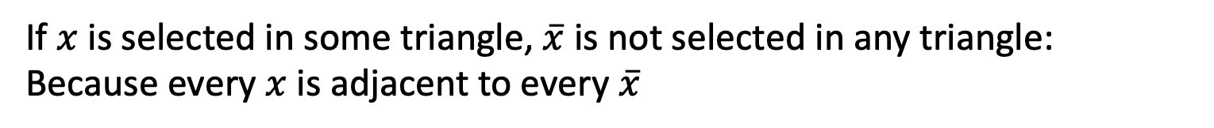






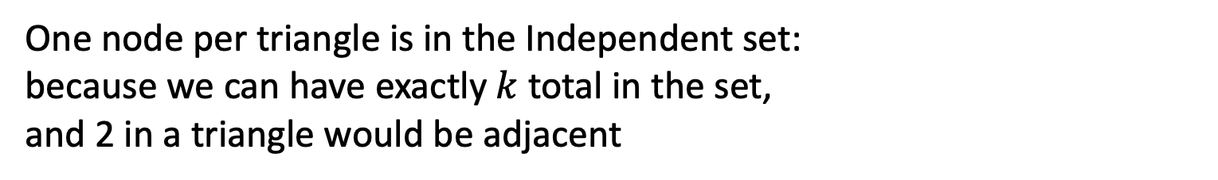


$k$IndSet $⇒$ Satisfying Assignment
$$\left(x∨y∨z\right)∧\left(x∨\overline{y}∨y\right)∧\left(u∨y∨\overline{z}\right)∧\left(z∨\overline{x}∨u\right)∧(\overline{x}∨\overline{y}∨\overline{z})$$
$$x$$
$$u$$
$$z$$
$$\overline{u}$$
$$x$$
$$y$$
$$\overline{y}$$
$$\overline{z}$$
$$y$$
$$u$$
$$\overline{x}$$
$$\overline{z}$$
$$\overline{y}$$
$$z$$
$$y$$
$$x=true$$
$$y=false$$
$$z=false$$
$$u=true$$
One node per triangle is in the Independent set:
because we can have exactly $k$ total in the set,
and 2 in a triangle would be adjacent
If $x$ is selected in some triangle, $\overline{x}$ is not selected in any triangle:
Because every $x$ is adjacent to every $\overline{x}$
Set the variable which each included node represents to “true”

Slide 29
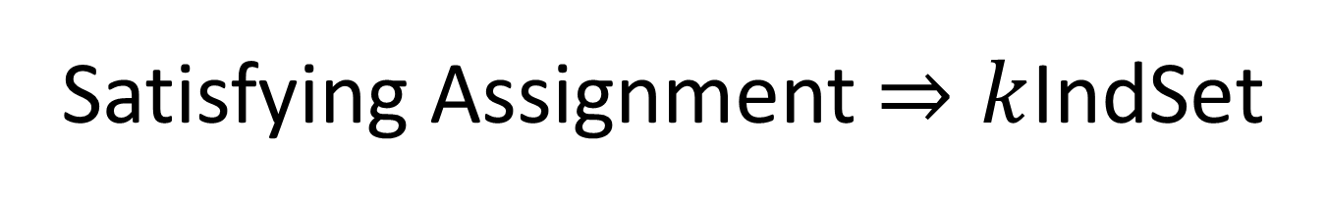
Satisfying Assignment $⇒k$IndSet
$$\left(x∨y∨z\right)∧\left(x∨\overline{y}∨y\right)∧\left(u∨y∨\overline{z}\right)∧\left(z∨\overline{x}∨u\right)∧(\overline{x}∨\overline{y}∨\overline{z})$$
$$x$$
$$u$$
$$z$$
$$\overline{u}$$
$$x$$
$$y$$
$$\overline{y}$$
$$\overline{z}$$
$$y$$
$$u$$
$$\overline{x}$$
$$\overline{z}$$
$$\overline{y}$$
$$z$$
$$y$$
$$x=true$$
$$y=false$$
$$z=false$$
$$u=true$$
Use one true variable from the assignment for each triangle
The independent set has $k$ nodes, because there are $k$ clauses
If any variable $x$ is true then $\overline{x}$ cannot be true

Slide 30
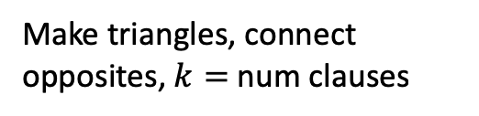
$$3SAT≤_{p}kIndSet$$
3SAT
$$O(n^{p})$$
$k$-Ind Set
$$A$$
$$B$$
Make triangles, connect opposites, $k=$ num clauses
If This could be done in Polynomial time
Then This could be done in polynomial time
Solution for 3SAT
Assign true to variables from selected nodes
Solution for $k$-Ind Set
$$X$$
$$Y$$
Reduction

Slide 31
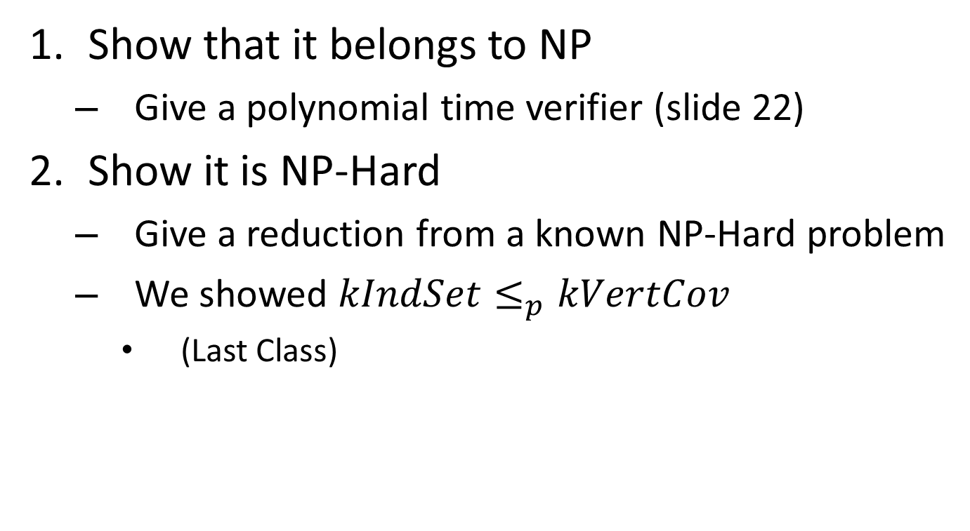
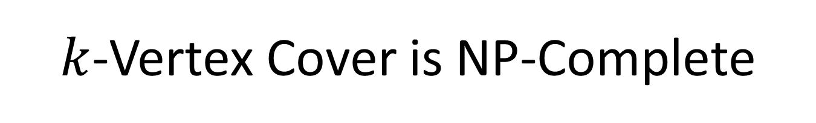
$k$-Vertex Cover is NP-Complete
Show that it belongs to NP
Give a polynomial time verifier (slide 22)
Show it is NP-Hard
Give a reduction from a known NP-Hard problem
We showed $kIndSet≤_{p}kVertCov$
(Last Class)

Slide 32






$$kIndSet≤_{p}kVertCov$$
$$kIndSet$$
$$O(n^{p})$$
$$kVertCov$$
$$A$$
$$B$$
$$k=V−k$$
If This could be done in Polynomial time
Then This could be done in polynomial time
Solution for $kIndSet$
Take Complement of nodes
Solution for $kVertCov$
$$X$$
$$Y$$
Reduction

Slide 33
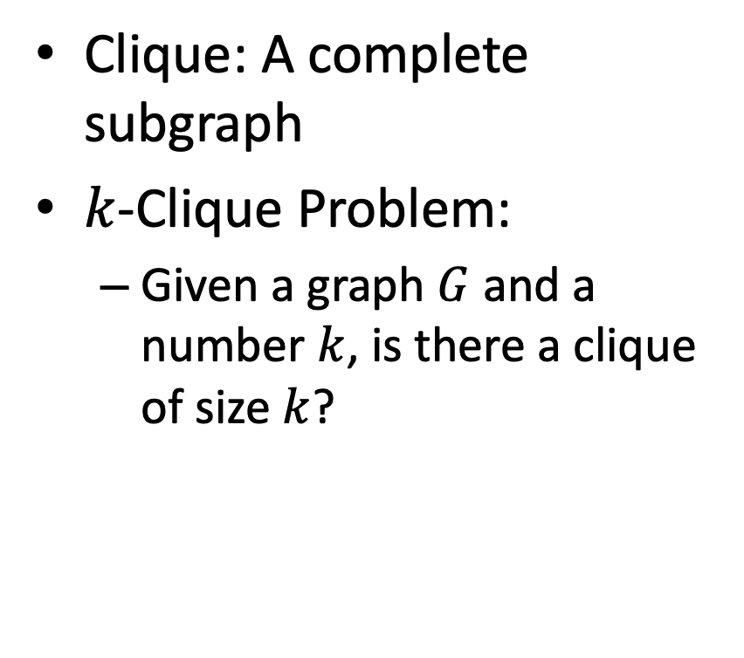

$k$-Clique Problem
Clique: A complete subgraph
$k$-Clique Problem:
Given a graph $G$ and a number $k$, is there a clique of size $k$?
4-Clique
3-Clique

Slide 34
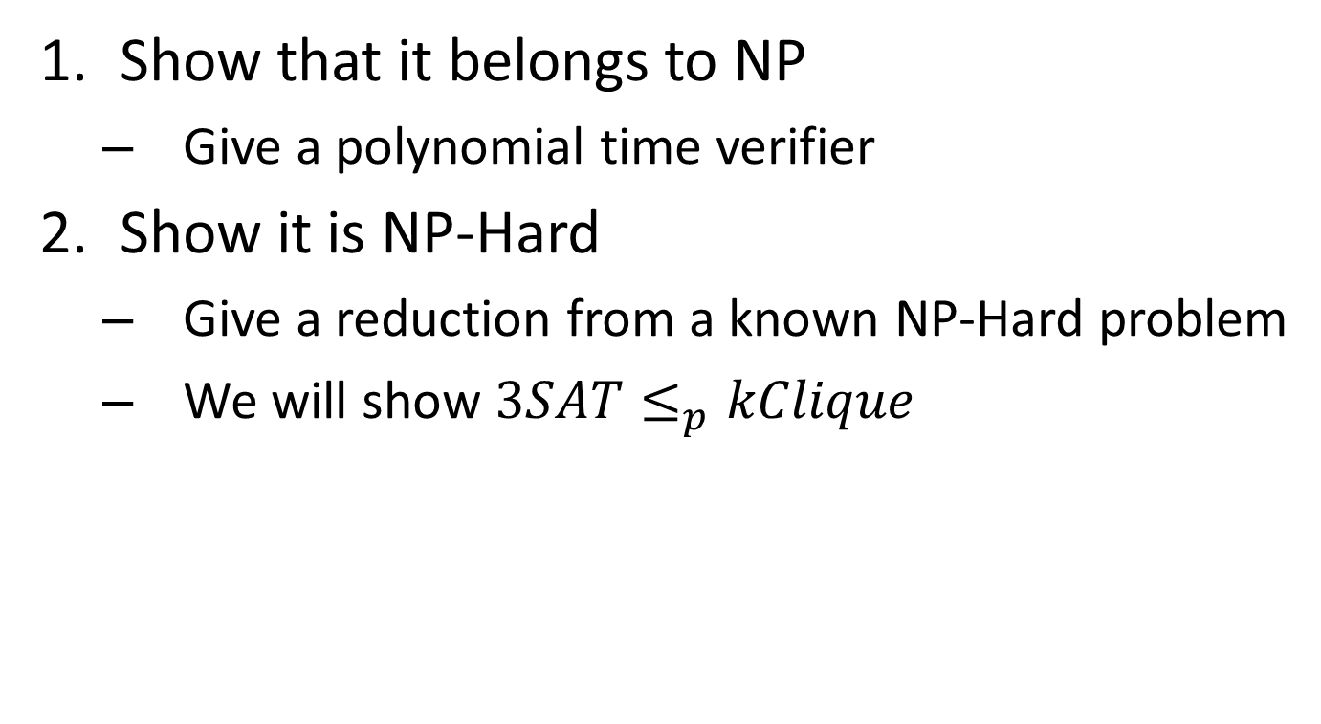

$k$-Clique is NP-Complete
Show that it belongs to NP
Give a polynomial time verifier
Show it is NP-Hard
Give a reduction from a known NP-Hard problem
We will show $3SAT≤_{p}kClique$

Slide 35
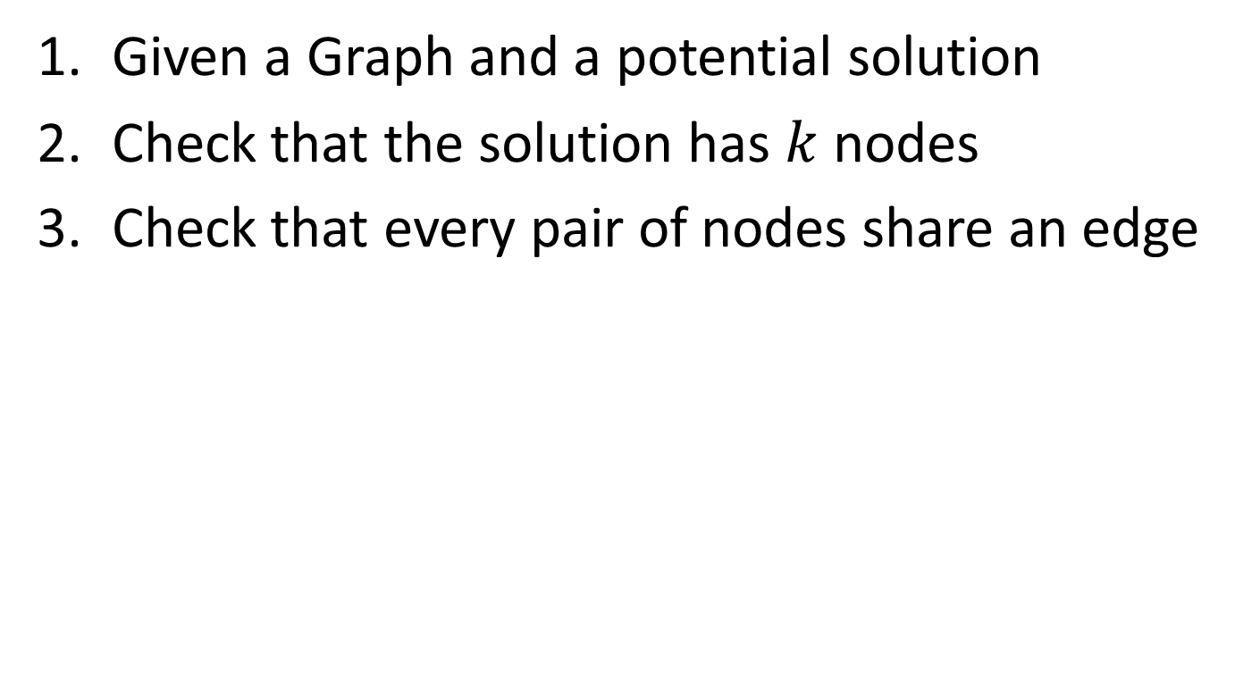

$k$-Clique is NP
Given a Graph and a potential solution
Check that the solution has $k$ nodes
Check that every pair of nodes share an edge
4-Clique
3-Clique

Slide 36





$$3SAT≤_{p}kClique$$
$$3SAT$$
$$O(n^{p})$$
$$kClique$$
$$A$$
$$B$$
Solution for $3SAT$
Solution for$kClique$
$$X$$
$$Y$$
Reduction

Slide 37








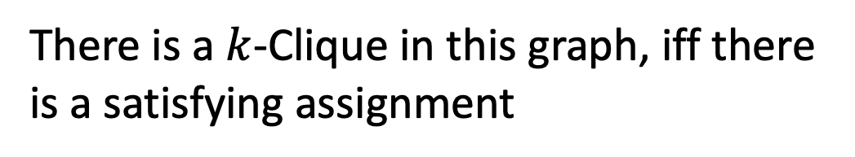







Instance of 3SAT to Instance of $k$Clique
$$\left(x∨y∨z\right)∧\left(x∨\overline{y}∨y\right)∧\left(u∨y∨\overline{z}\right)∧\left(z∨\overline{x}∨u\right)∧(\overline{x}∨\overline{y}∨\overline{z})$$
$$x$$
$$y$$
$$\overline{y}$$
$$u$$
$$z$$
$$x$$
$$\overline{x}$$
(also do this for the other clauses, omitted due to clutter)
$$z$$
$$y$$
$$\overline{y}$$
$$\overline{u}$$
$$y$$
$$\overline{z}$$
$$u$$
$$\overline{z}$$
For each clause, produce a node for each of its three variables
Connect each node to all non-contradictory nodes in the other clauses
(i.e., anything that’s not its negation)
Let $k=$ number of clauses
There is a $k$-Clique in this graph, iff there is a satisfying assignment

Slide 38

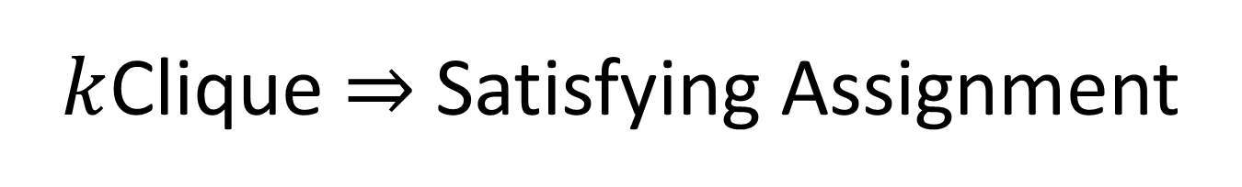


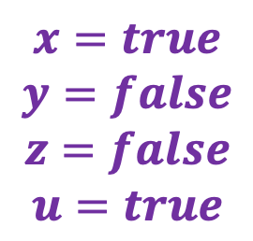


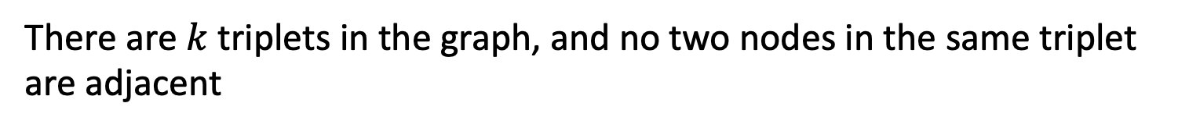
$k$Clique $⇒$ Satisfying Assignment
$$\left(x∨y∨z\right)∧\left(x∨\overline{y}∨y\right)∧\left(u∨y∨\overline{z}\right)∧\left(z∨\overline{x}∨u\right)∧(\overline{x}∨\overline{y}∨\overline{z})$$
$$x=true$$
$$y=false$$
$$z=false$$
$$u=true$$
$$x$$
$$y$$
$$\overline{y}$$
$$u$$
$$z$$
$$x$$
$$\overline{x}$$
$$z$$
$$y$$
$$\overline{y}$$
$$\overline{u}$$
$$y$$
$$\overline{z}$$
$$u$$
$$\overline{z}$$
There are $k$ triplets in the graph, and no two nodes in the same triplet are adjacent
To have a $k$-Clique, must have one node from each triplet
Cannot select a node for both a variable and its negation
Therefore selection of nodes is a satisfying assignment

Slide 39
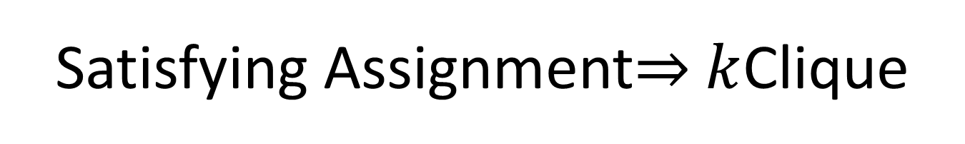

Satisfying Assignment$⇒$ $k$Clique
$$\left(x∨y∨z\right)∧\left(x∨\overline{y}∨y\right)∧\left(u∨y∨\overline{z}\right)∧\left(z∨\overline{x}∨u\right)∧(\overline{x}∨\overline{y}∨\overline{z})$$
$$x=true$$
$$y=false$$
$$z=false$$
$$u=true$$
$$x$$
$$y$$
$$\overline{y}$$
$$u$$
$$z$$
$$x$$
$$\overline{x}$$
$$z$$
$$y$$
$$\overline{y}$$
$$\overline{u}$$
$$y$$
$$\overline{z}$$
$$u$$
$$\overline{z}$$
Select one node for a true variable from each clause
There will be $k$ nodes selected
We can’t select both a node and its negation
All nodes will be non-contradictory, so they will be pairwise adjacent

Slide 40
$$3SAT≤_{p}kClique$$
$$3SAT$$
$$O(n^{p})$$
$$kClique$$
$$A$$
Make a triplet per clause, connect non-contraditcory nodes among clauses
$$B$$
If This could be done in Polynomial time
Then This could be done in polynomial time
Solution for $3SAT$
Assign each variable selected to True
Solution for$kClique$
$$X$$
$$Y$$
Reduction

Slide 41




Reduction
$k$-VertexCover Solver
$k$-VertexCover Decider
$$A$$
Remove a node, etc…
$$B$$
Using any Algorithm for $B$
Relate Solutions of problem $B$to Solutions of $A$
Solution for $A$
Solution for $B$
$$X$$
$$Y$$
Reduction

Slide 42
Problem Types
If we can solve this
Decision Problems:
Is there a solution?
Output is True/False
Is there a vertex cover of size $k$?
Search Problems:
Find a solution
Output is complex
Give a vertex cover of size $k$
Verification Problems:
Given a potential solution, is it valid?
Output is True/False
Is this a vertex cover of size $k$?
Then we can solve this

Slide 43


Using a $k$-VertexCover decider to build a searcher
Set $i=k−1$
Remove nodes (and incident edges) one at a time
Check if there is a vertex cover of size $i$
If so, then that removed node was part of the $k$ vertex cover, set $i=i−1$
Else, it wasn’t

Slide 44


$5$ Vertex Cover (Decision)
Is there a set of nodes of size $5$ which covers every edge?
Yes!

Slide 45


$4$ Vertex Cover (Decision)
Is there a set of nodes of size $4$ which covers every edge?
No!

Slide 46
$4$ Vertex Cover (Decision)
Is there a set of nodes of size $4$ which covers every edge?
Yes!

Slide 47


$3$ Vertex Cover (Decision)
Is there a set of nodes of size $3$ which covers every edge?
No!

