Slide 1
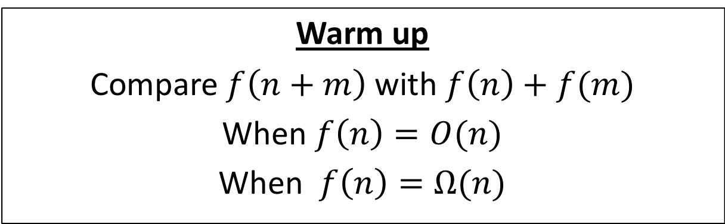
CS4102 Algorithms
Fall 2018
Warm up
Compare $f\left(n+m\right)$ with $f\left(n\right)+f(m)$
When $f\left(n\right)=O(n)$
When $f\left(n\right)=Ω(n)$

Slide 2
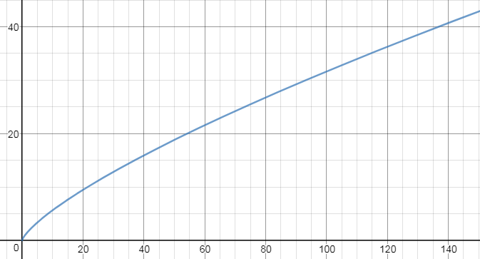



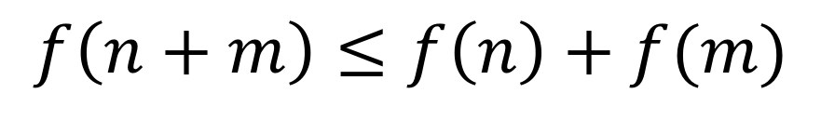

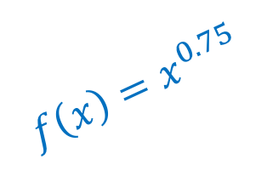




$$f\left(n\right)=O(n)$$
$$f(m)$$
$$f\left(x\right)=x^{0.75}$$
$$f(n)$$
$$f(m)$$
$$f(n)$$
$$n$$
$$m$$
$$n+m$$
$$f\left(n+m\right)≤f\left(n\right)+f(m)$$

Slide 3
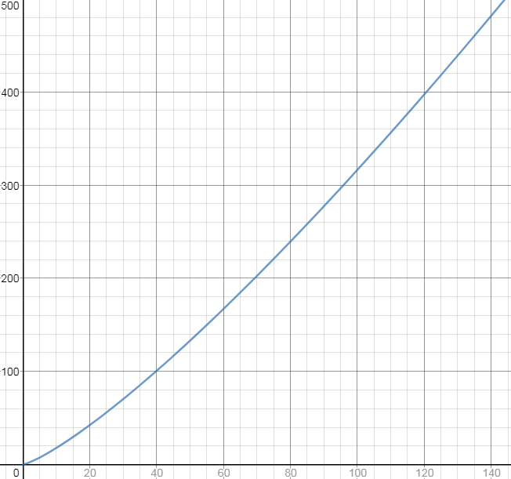







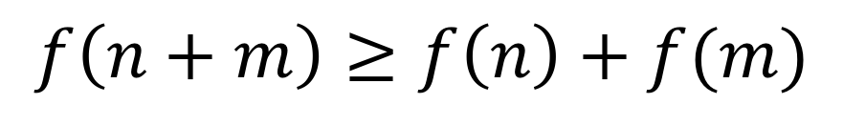


$$f\left(n\right)=Ω(n)$$
$$f(m)$$
$$f\left(x\right)=x^{1.25}$$
$$f(m)$$
$$f(n)$$
$$f(n)$$
$$n$$
$$m$$
$$n+m$$
$$f\left(n+m\right)≥f\left(n\right)+f(m)$$

Slide 4
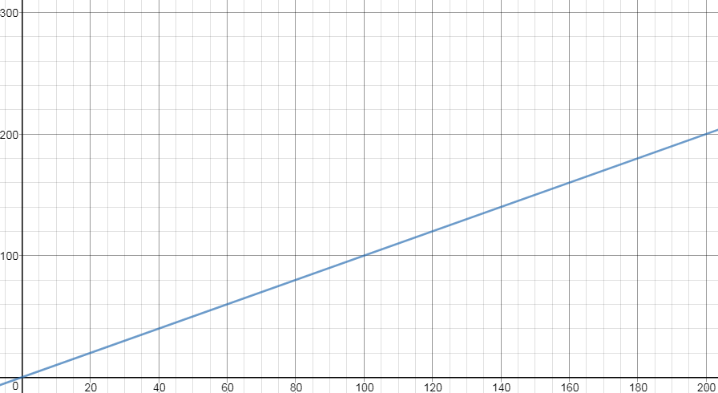



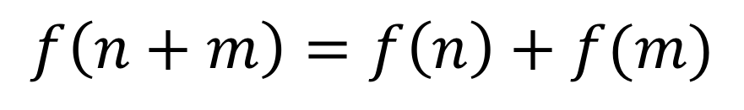


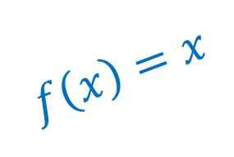

$$f\left(n\right)=Θ(n)$$
$$f(m)$$
$$f\left(x\right)=x$$
$$f(n)$$
$$f(m)$$
$$f(n)$$
$$n$$
$$m$$
$$n+m$$
$$f\left(n+m\right)=f\left(n\right)+f(m)$$

Slide 5
Today’s Keywords
Divide and Conquer
Sorting
Quicksort
Median
Order statistic
Quickselect
Median of Medians

Slide 6
CLRS Readings
Chapter 7

Slide 7
Homeworks
More on HW2
You must read from garden.txt file automatically (it’s a fixed filename)
That file has a list of pairs of floats (not ints)
You must only output one floating point number (minimum distance)
Uploaded files:
One python file, or
One or more java files (uploaded individually)
Don’t use packages!
Don’t use subdirectories!
DO NOT upload a zip file!
Try it yourself:
Put the files you are going to upload in a directory (with a garden.txt file)
python closestpair_mst3k.py
javac *.java java ClosestPair
Use the one for your language and you should get a result
Hw2 due 11pm Friday!
Programming (use Python or Java!)
Divide and conquer
Closest pair of points
Hw3 released soon
Divide and conquer
Written (use LaTeX!)

Slide 8
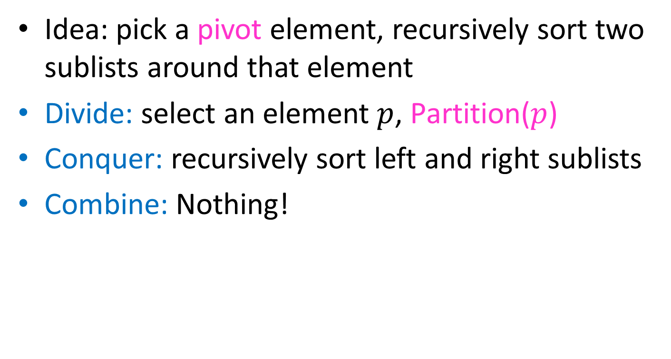
Quicksort
Idea: pick a pivot element, recursively sort two sublists around that element
Divide: select an element $p$, Partition($p$)
Conquer: recursively sort left and right sublists
Combine: Nothing!

Slide 9


Partition (Divide step)
Given: a list, a pivot $p$
Start: unordered list
8
5
7
3
12
10
1
2
4
9
6
11
Goal: All elements $<p$ on left, all $>p$ on right
5
7
3
1
2
4
6
8
12
10
9
11

Slide 10
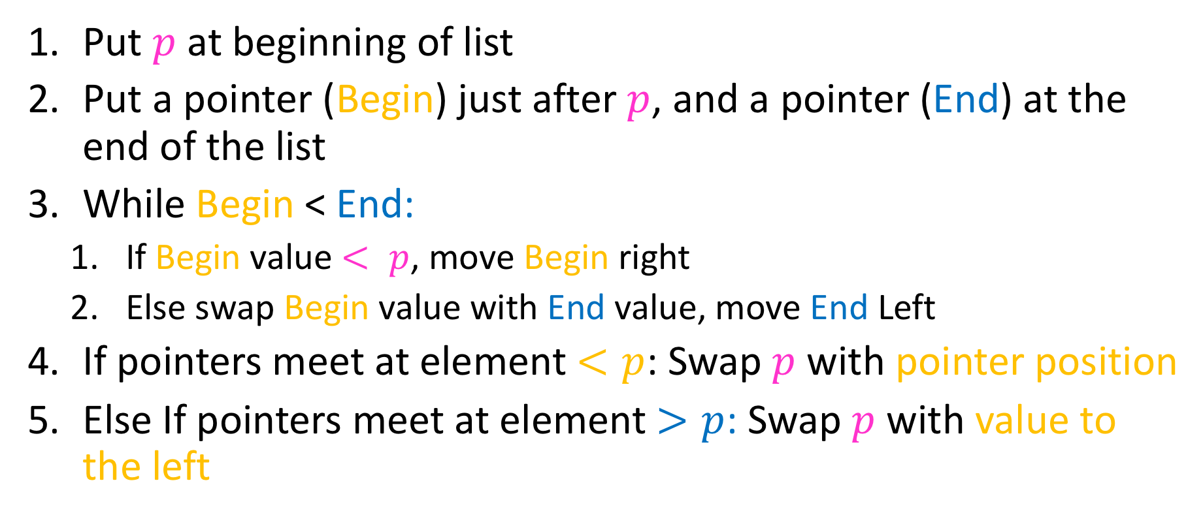
Partition Summary
Put $p$ at beginning of list
Put a pointer (Begin) just after $p$, and a pointer (End) at the end of the list
While Begin < End:
If Begin value $< p$, move Begin right
Else swap Begin value with End value, move End Left
If pointers meet at element $<p$: Swap $p$ with pointer position
Else If pointers meet at element $>p$: Swap $p$ with value to the left

Slide 11

Quicksort Run Time
If the pivot is always the median:
2
5
1
3
6
4
7
8
10
9
11
12
2
1
3
5
6
4
7
8
9
10
11
12
Then we divide in half each time
$$T\left(n\right)=2T\left(\frac{n}{2}\right)+n$$
$$T\left(n\right)=O(n\log{n})$$

Slide 12
Quicksort Run Time
If the partition is always unbalanced:
1
5
2
3
6
4
7
8
10
9
11
12
1
2
3
5
6
4
7
8
10
9
11
12
Then we shorten by 1 each time
$$T\left(n\right)=T\left(n−1\right)+n$$
$$T\left(n\right)=O(n^{2})$$

Slide 13
Good Pivot
What makes a good Pivot?
Roughly even split between left and right
Ideally: median
Can we find median in linear time?
Yes!
Quickselect

Slide 14
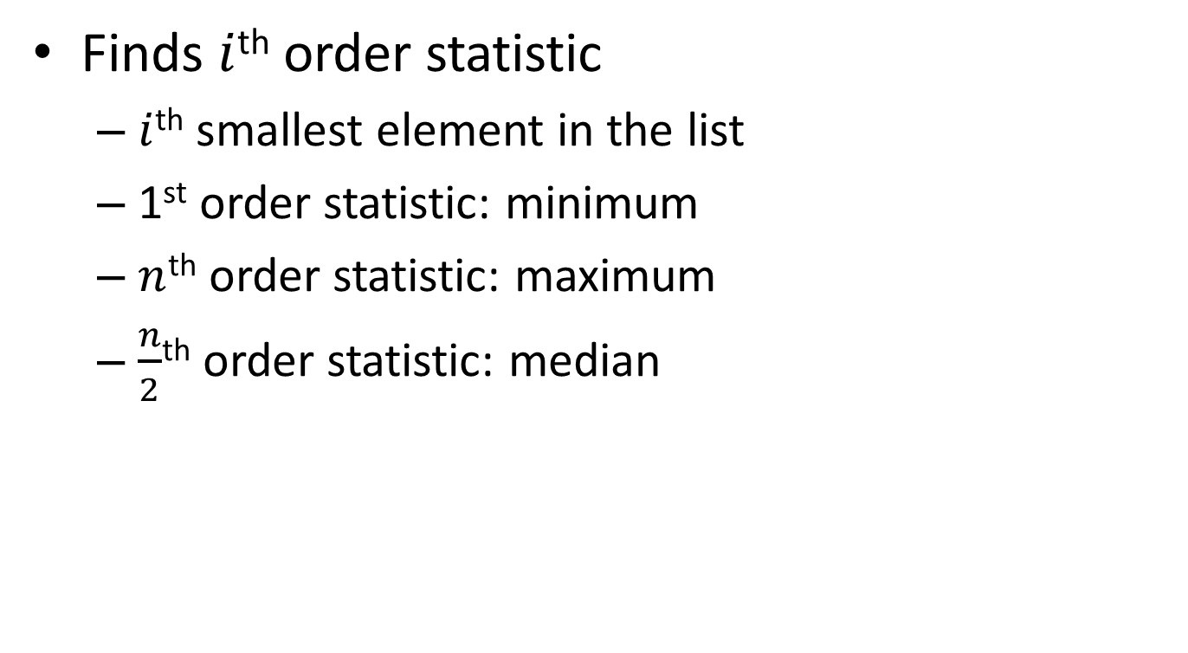
Quickselect
Finds $i$^{th} order statistic
$i$^{th} smallest element in the list
1st order statistic: minimum
$n$^{th} order statistic: maximum
$\frac{n}{2}$^{th} order statistic: median

Slide 15
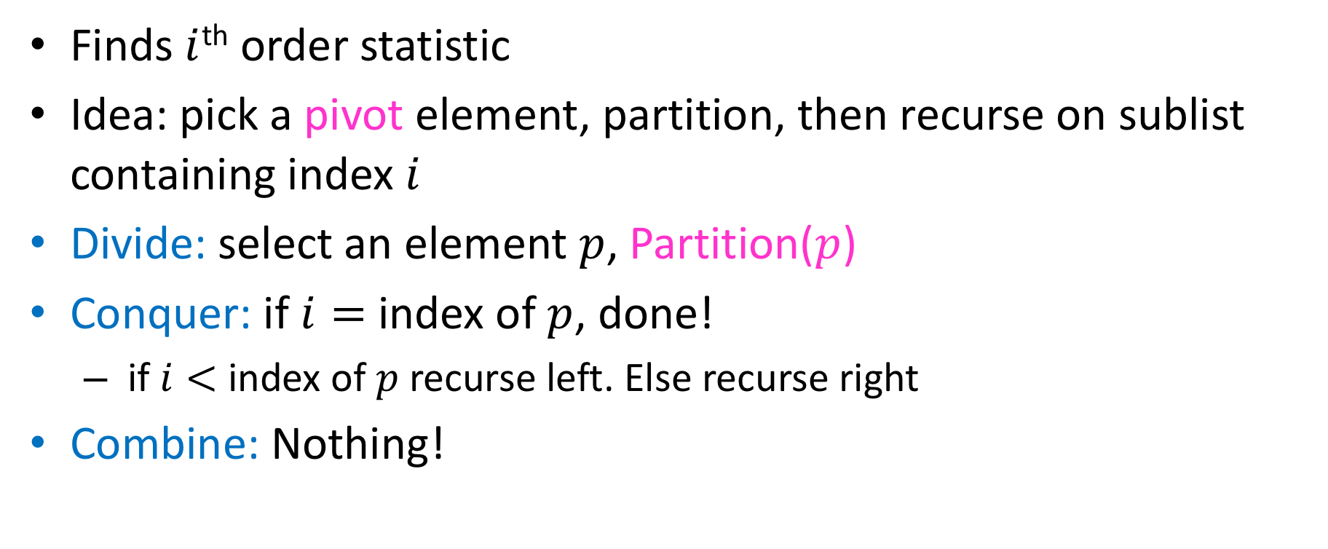
Quickselect
Finds $i$^{th} order statistic
Idea: pick a pivot element, partition, then recurse on sublist containing index $i$
Divide: select an element $p$, Partition($p$)
Conquer: if $i=$ index of $p$, done!
if $i<$ index of $p$recurse left. Else recurse right
Combine: Nothing!

Slide 16

Partition (Divide step)
Given: a list, a pivot value $p$
Start: unordered list
8
5
7
3
12
10
1
2
4
9
6
11
Goal: All elements $<p$ on left, all $>p$ on right
5
7
3
1
2
4
6
8
12
10
9
11

Slide 17
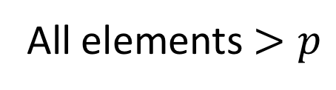
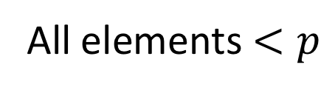
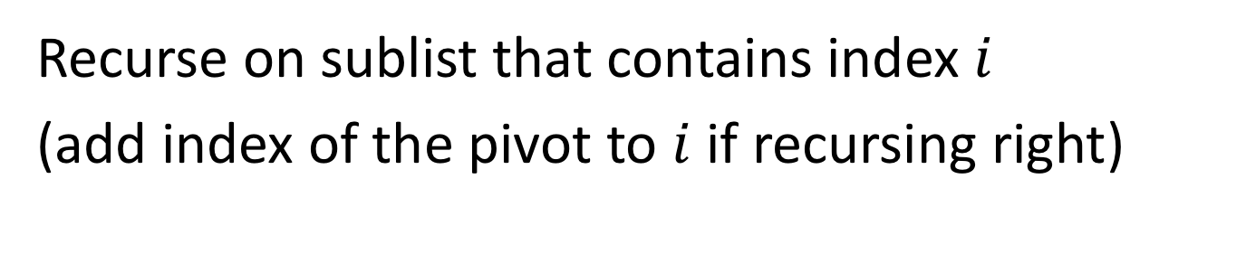
Conquer
2
5
7
3
6
4
1
8
10
9
11
12
All elements $<p$
All elements $>p$
Exactly where it belongs!
Recurse on sublist that contains index $i$
(add index of the pivot to $i$ if recursing right)

Slide 18

Quickselect Run Time
If the pivot is always the median:
2
5
1
3
6
4
7
8
10
9
11
12
2
1
3
5
6
4
7
8
9
10
11
12
Then we divide in half each time
$$S\left(n\right)=S\left(\frac{n}{2}\right)+n$$
$$S\left(n\right)=O(n)$$

Slide 19
Quickselect Run Time
If the partition is always unbalanced:
1
5
2
3
6
4
7
8
10
9
11
12
1
2
3
5
6
4
7
8
10
9
11
12
Then we shorten by 1 each time
$$S\left(n\right)=S\left(n−1\right)+n$$
$$S\left(n\right)=O(n^{2})$$

Slide 20
Good Pivot
What makes a good Pivot?
Roughly even split between left and right
Ideally: median
Here’s what’s next:
An algorithm for finding a “rough” split
This algorithm uses Quickselect as a subroutine
Déjà vu?

Slide 21
Good Pivot
What makes a good Pivot?
Both sides of Pivot >30%
>30%
Select Pivot from this range
Or
>30%

Slide 22
Median of Medians
Fast way to select a “good” pivot
Guarantees pivot is greater than 30% of elements and less than 30% of the elements
Idea: break list into chunks, find the median of each chunk, use the median of those medians

Slide 23
Median of Medians
1. Break list into chunks of size 5
2. Find the median of each chunk
3. Return median of medians (using Quickselect)

Slide 24









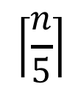















Why is this good?
Each chunk sorted, chunks ordered by their medians
MedianofMedians is Greater than all of these
$$<$$
$$<$$
$$<$$
$$<$$
$$<$$
$$5$$
$$<$$
$$<$$
$$<$$
$$<$$
$$<$$
$$<$$
$$<$$
$$<$$
$$<$$
$$<$$
$$<$$
$$<$$
$$<$$
$$<$$
$$<$$
$$<$$
$$<$$
$$<$$
$$\left\lceil \frac{n}{5}\right\rceil$$

Slide 25
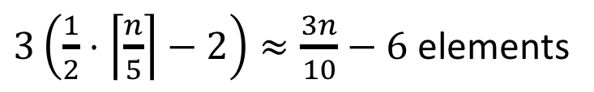


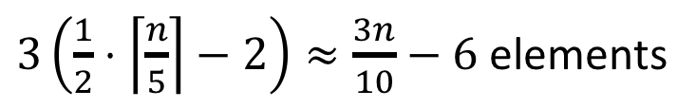

Why is this good?
MedianofMedians is larger than all of these
$$<$$
$$<$$
$$<$$
$$<$$
$$<$$
$$<$$
$$<$$
$$<$$
$$<$$
$$<$$
$$<$$
$$<$$
$$<$$
$$<$$
$$<$$
$$<$$
$$<$$
$$<$$
$$<$$
$$<$$
$$<$$
$$<$$
$$<$$
Larger than 3 things in each (but one) list to the left
$$\left\lceil \frac{n}{5}\right\rceil$$
$3\left(\frac{1}{2}⋅\left\lceil \frac{n}{5}\right\rceil −2\right)≈\frac{3n}{10}−6$ elements
$$<$$
Similarly:
$3\left(\frac{1}{2}⋅\left\lceil \frac{n}{5}\right\rceil −2\right)≈\frac{3n}{10}−6$ elements
$$>$$

Slide 26
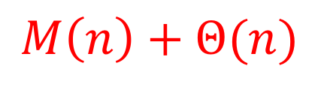
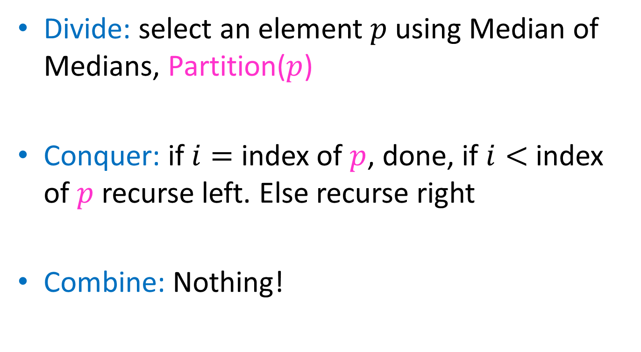
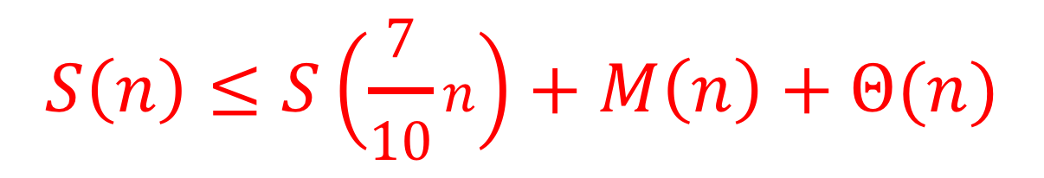
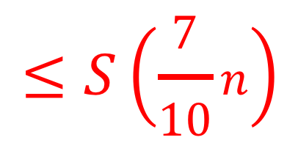
Quickselect
Divide: select an element $p$ using Median of Medians, Partition($p$)
Conquer: if $i=$ index of $p$, done, if $i<$ index of $p$recurse left. Else recurse right
Combine: Nothing!
$$M\left(n\right)+Θ(n)$$
$$≤S\left(\frac{7}{10}n\right)$$
$$S\left(n\right)≤S\left(\frac{7}{10}n\right)+M\left(n\right)+Θ(n)$$

Slide 27
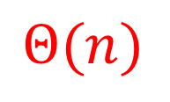

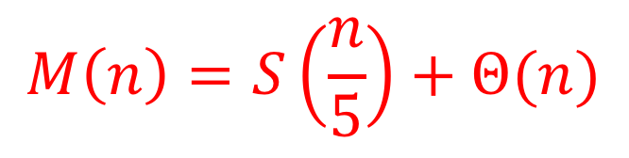
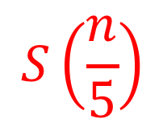
Median of Medians, Run Time
1. Break list into chunks of 5
$$Θ(n)$$
2. Find the median of each chunk
$$Θ(n)$$
3. Return median of medians (using Quickselect)
$$S\left(\frac{n}{5}\right)$$
$$M\left(n\right)=S\left(\frac{n}{5}\right)+Θ(n)$$

Slide 28

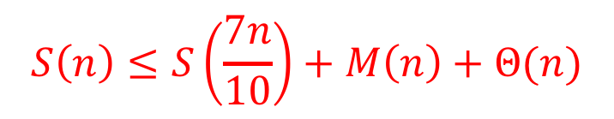
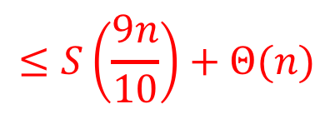
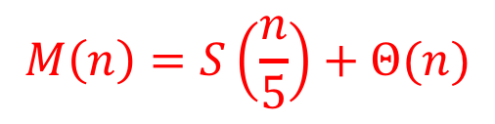
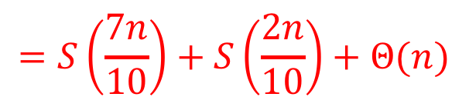

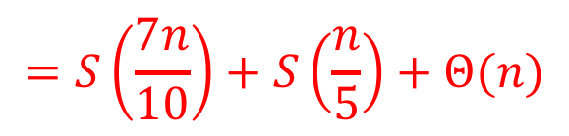
Quickselect
$$S\left(n\right)≤S\left(\frac{7n}{10}\right)+M\left(n\right)+Θ(n)$$
$$M\left(n\right)=S\left(\frac{n}{5}\right)+Θ(n)$$
$$=S\left(\frac{7n}{10}\right)+S\left(\frac{n}{5}\right)+Θ(n)$$
$$=S\left(\frac{7n}{10}\right)+S\left(\frac{2n}{10}\right)+Θ(n)$$
$$≤S\left(\frac{9n}{10}\right)+Θ(n)$$
Because $S\left(n\right)=Ω(n)$
Master theorem Case 3!
$$S\left(n\right)=O(n)$$

Slide 29

Phew! Back to Quicksort
Using Quickselect, with a median-of-medians partition:
2
5
1
3
6
4
7
8
10
9
11
12
2
1
3
5
6
4
7
8
9
10
11
12
Then we divide in half each time
$$T\left(n\right)=2T\left(\frac{n}{2}\right)+Θ(n)$$
$$T\left(n\right)=Θ(n\log{n})$$

Slide 30
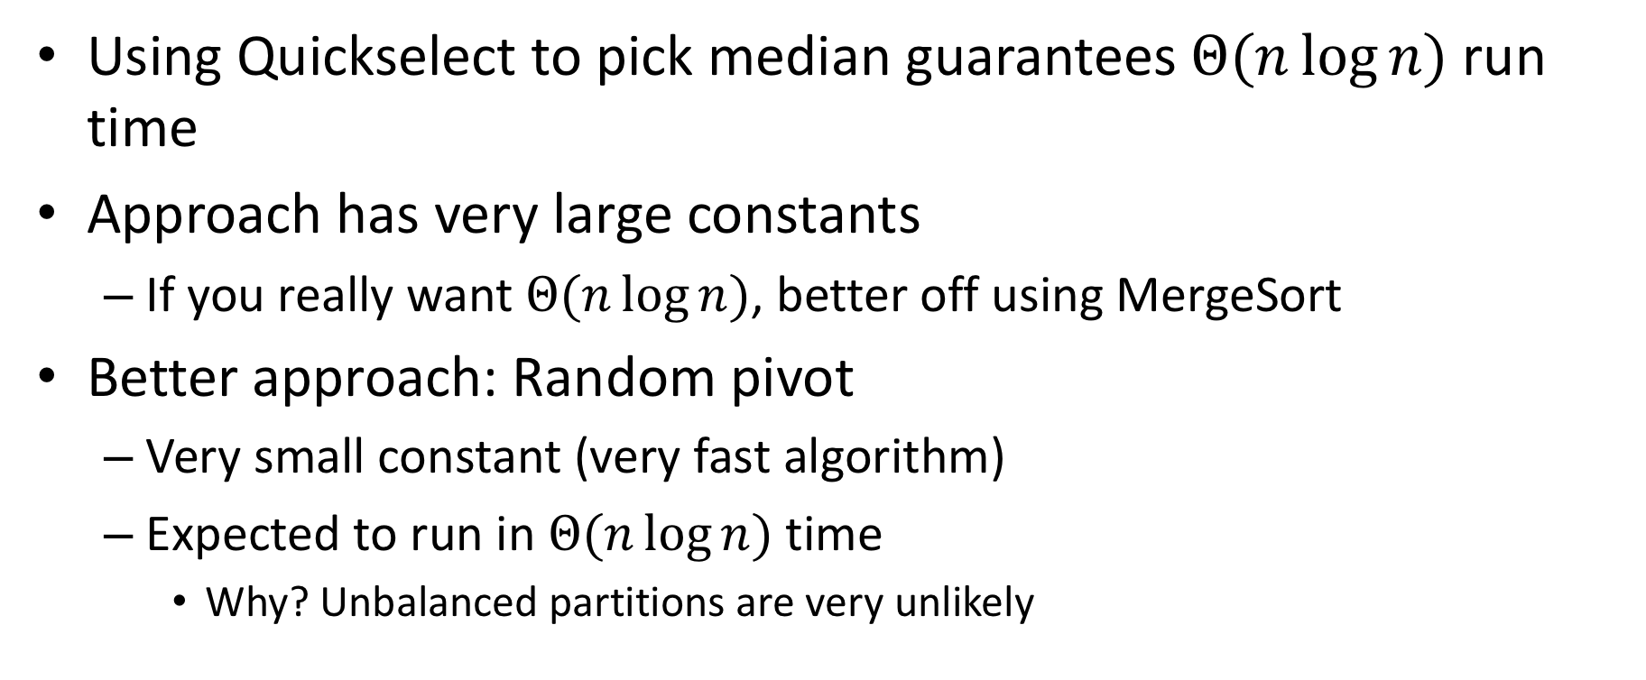
Is it worth it?
Using Quickselect to pick median guarantees $Θ(n\log{n})$ run time
Approach has very large constants
If you really want $Θ(n\log{n})$, better off using MergeSort
Better approach: Random pivot
Very small constant (very fast algorithm)
Expected to run in $Θ(n\log{n})$ time
Why? Unbalanced partitions are very unlikely

Slide 31


Quicksort Run Time
If the pivot is always $\frac{n}{10}$^{th} order statistic:
$$T\left(n\right)=T\left(\frac{n}{10}\right)+T\left(\frac{9n}{10}\right)+n$$

Slide 32



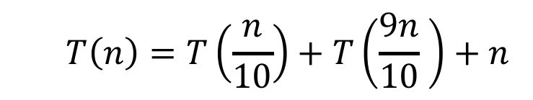

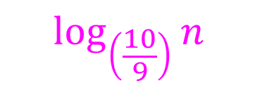













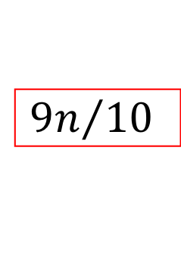







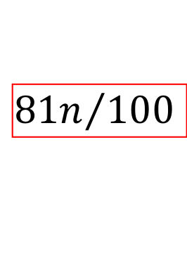




$$T\left(n\right)=T\left(\frac{n}{10}\right)+T\left(\frac{9n}{10} \right)+n$$
$$n$$
$$n$$
$$n$$
$$n/10$$
$$9n/10$$
$$n$$
$$n/{10}$$
$$+$$
$${9n}/{10}$$
$$n/100$$
$9n/$100
$$9n/100$$
$$81n/100$$
$$n/{100}$$
$$+$$
$${9n}/{100}$$
$$+$$
$${9n}/{100}$$
$$+$$
$${81n}/{100}$$
$$n$$
$$\log_{\left(\frac{10}{9}\right)}⁡n$$
…
…
…
$$1$$
$$1$$
$$+$$
…
$$1$$
$$1$$
$$+$$
$$1$$
$$1$$
$$+$$
$$1$$
$$1$$

Slide 33
Quicksort Run Time
If the pivot is always $\frac{n}{10}$^{th} order statistic:
$$T\left(n\right)=T\left(\frac{n}{10}\right)+T\left(\frac{9n}{10}\right)+n$$
$$T\left(n\right)=Θ(n\log{n})$$

Slide 34

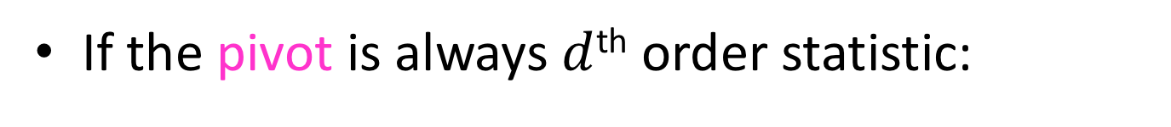
Quicksort Run Time
If the pivot is always $d$^{th} order statistic:
1
5
2
3
6
4
7
8
10
9
11
12
1
2
3
5
6
4
7
8
10
9
11
12
Then we shorten by $d$ each time
$$T\left(n\right)=T\left(n−d\right)+n$$
$$T\left(n\right)=O(n^{2})$$
What’s the probability of this occurring?

Slide 35

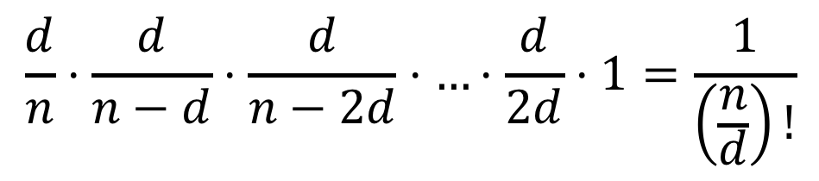


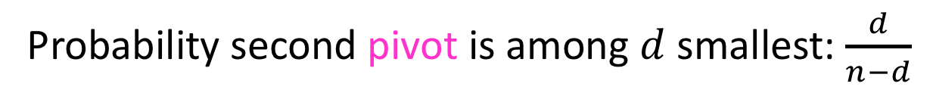
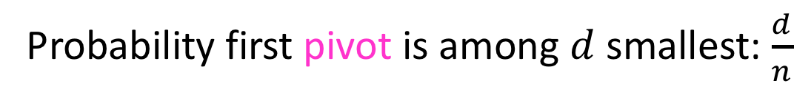
Probability of $n^{2}$ run time
We must consistently select pivot from within the first $d$ terms
Probability first pivot is among $d$ smallest: $\frac{d}{n}$
Probability second pivot is among $d$ smallest: $\frac{d}{n−d}$
Probability all pivots are among $d$ smallest:
$$\frac{d}{n}⋅\frac{d}{n−d}⋅\frac{d}{n−2d}⋅…⋅\frac{d}{2d}⋅1=\frac{1}{\left(\frac{n}{d}\right)!}$$

Slide 36
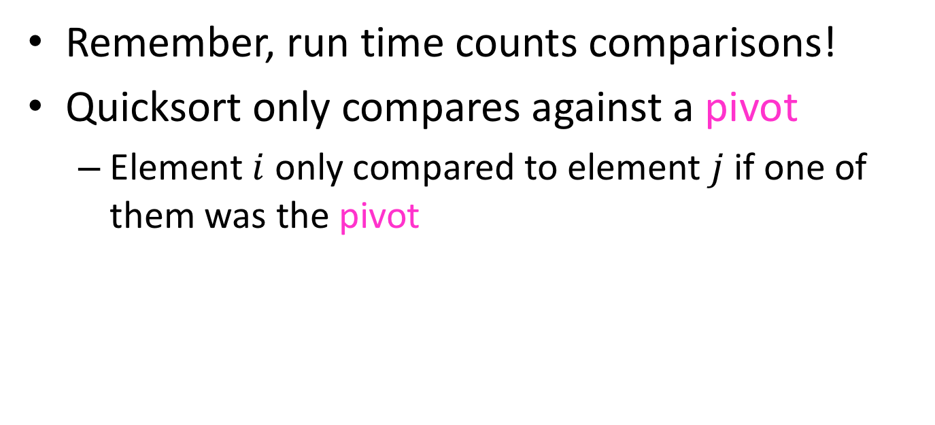

Formal Argument for $n\log{n}$ Average
Remember, run time counts comparisons!
Quicksort only compares against a pivot
Element $i$ only compared to element $j$ if one of them was the pivot

Slide 37
Formal Argument for $n\log{n}$ Average
What is the probability of comparing two given elements?
1
2
3
4
5
6
7
8
9
10
11
12
(Probability of comparing 3 and 4) = 1
Why? Otherwise I wouldn’t know which came first
ANY sorting algorithm must compare adjacent elements

Slide 38
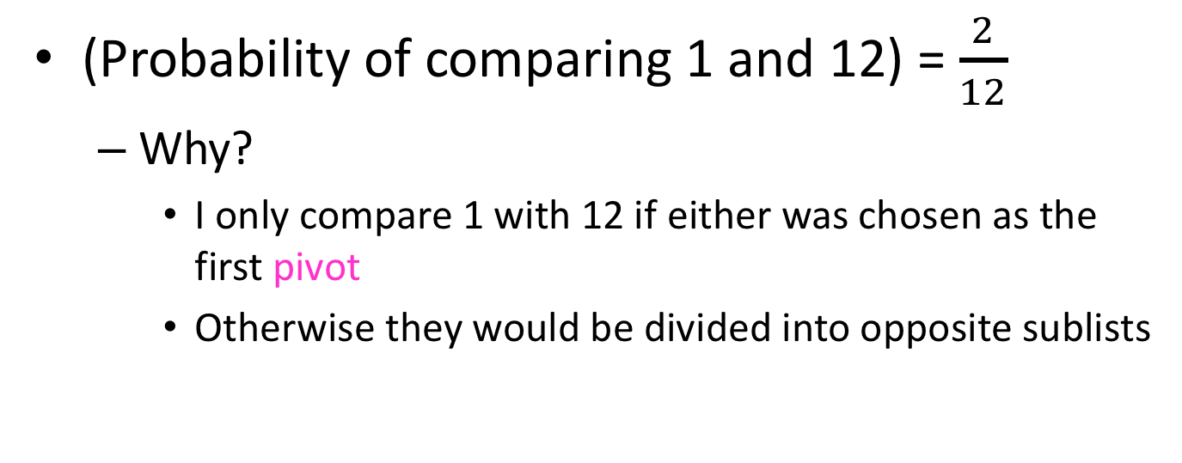
Formal Argument for $n\log{n}$ Average
What is the probability of comparing two given elements?
1
2
3
4
5
6
7
8
9
10
11
12
(Probability of comparing 1 and 12) = $\frac{2}{12}$
Why?
I only compare 1 with 12 if either was chosen as the first pivot
Otherwise they would be divided into opposite sublists

Slide 39
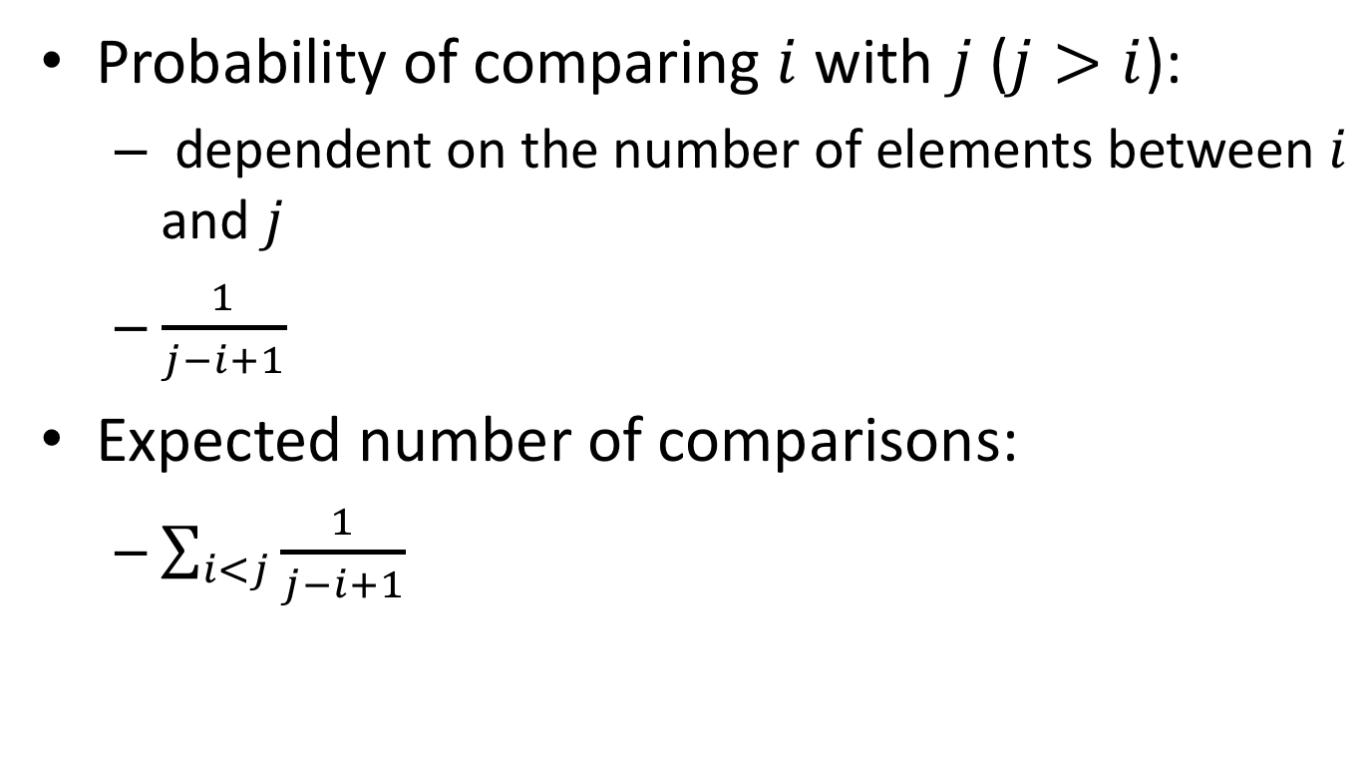
Formal Argument for $n\log{n}$ Average
Probability of comparing $i$ with $j$ ($j>i$):
dependent on the number of elements between $i$ and $j$
$\frac{1}{j−i+1}$
Expected number of comparisons:
$\sum_{i<j}{\frac{1}{j−i+1}}$

Slide 40
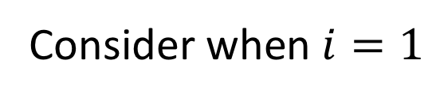
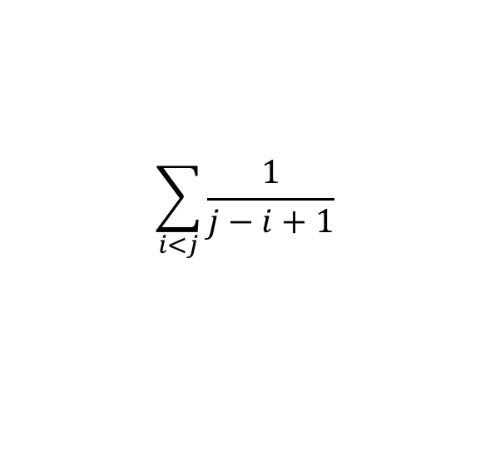
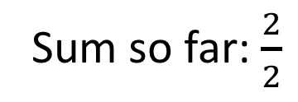
Expected number of Comparisons
$$\sum_{i<j}{\frac{1}{j−i+1}}$$
Consider when $i=1$
1
2
3
4
5
6
7
8
9
10
11
12
Compared if 1 or 2 are chosen as pivot
(these will always be compared)
Sum so far: $\frac{2}{2}$

Slide 41
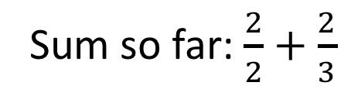
Expected number of Comparisons
$$\sum_{i<j}{\frac{1}{j−i+1}}$$
Consider when $i=1$
1
2
3
4
5
6
7
8
9
10
11
12
Compared if 1 or 3 are chosen as pivot
(but never if 2 is ever chosen)
Sum so far: $\frac{2}{2}+\frac{2}{3}$

Slide 42
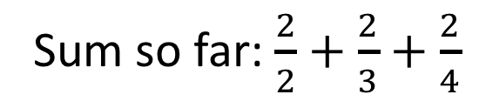
Expected number of Comparisons
$$\sum_{i<j}{\frac{1}{j−i+1}}$$
Consider when $i=1$
1
2
3
4
5
6
7
8
9
10
11
12
Compared if 1 or 4 are chosen as pivot
(but never if 2 or 3 are chosen)
Sum so far: $\frac{2}{2}+\frac{2}{3}+\frac{2}{4}$

Slide 43
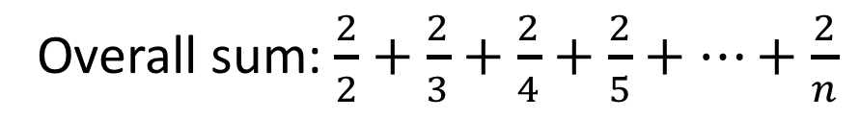
Expected number of Comparisons
$$\sum_{i<j}{\frac{1}{j−i+1}}$$
Consider when $i=1$
1
2
3
4
5
6
7
8
9
10
11
12
Compared if 1 or 12 are chosen as pivot
(but never if 2 -> 11 are chosen)
Overall sum: $\frac{2}{2}+\frac{2}{3}+\frac{2}{4}+\frac{2}{5}+…+\frac{2}{n}$

Slide 44






Expected number of Comparisons
$$\sum_{i<j}{\frac{1}{j−i+1}}$$
When $i=1$: $2\left(\frac{1}{2}+\frac{1}{3}+\frac{1}{4}+…+\frac{1}{n}\right)$
$n$ terms overall
$$\sum_{i<j}{\frac{1}{j−i+1}}≤2n\left(\frac{1}{2}+\frac{1}{3}+…+\frac{1}{n}\right)$$
$$Θ(\log{n})$$
Quicksort overall: expected $Θ\left(n\log{n}\right)$

Slide 45







$$f\left(n\right)=Ω(n)$$
$$f\left(n\right)≥c_{1}⋅n$$
$$f\left(m\right)≥c_{2}⋅m$$
$$f\left(n\right)+f\left(m\right)≥{c_{1}⋅n+c}_{2}⋅m$$
$$f\left(n+m\right)≥c(n+m)$$
$$=c⋅n+c⋅m$$
$$≈ f(n)+f(m)$$
Similarly, $f\left(n\right)=O\left(n\right)⇒f\left(n+m\right)≤f\left(n\right)+f(m)$

Slide 46





Probability of $n^{2}$ run time
Probability all partitions are among $d$ smallest:
$$\frac{d}{n}⋅\frac{d}{n−d}⋅\frac{d}{n−2d}⋅…⋅\frac{d}{2d}⋅1$$
$$=\frac{d}{d\left(\frac{n}{d}\right)}⋅\frac{d}{d\left(\frac{n}{d}−1\right)}⋅\frac{d}{d\left(\frac{n}{d}−2\right)}⋅…⋅\frac{d}{d\left(2\right)}⋅\frac{d}{d\left(1\right)}$$
$$=\frac{1}{\left(\frac{n}{d}\right)}⋅\frac{1}{\left(\frac{n}{d}−1\right)}⋅\frac{1}{\left(\frac{n}{d}−2\right)}⋅…⋅\frac{1}{2}⋅\frac{1}{1}$$
$$=\frac{1}{\left(\frac{n}{d}\right)! }$$

