Slide 1
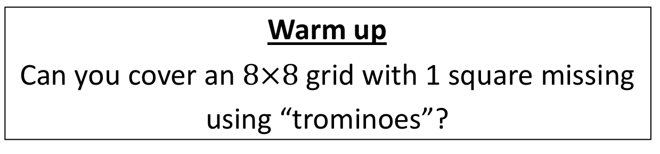
CS4102 Algorithms
Fall 2018
Warm up
Can you cover an $8×8$ grid with 1 square missing
using “trominoes”?
Can you cover this?
With these?

Slide 2
Today’s Keywords
Recursion
Recurrences
Asymptotic notation
Divide and Conquer
Trominos
Merge Sort

Slide 3
CLRS Readings
Chapters 3 & 4

Slide 4
Homeworks
Hw0 due 11pm Wednesday, Sept 5
Submit 2 attachments (zip and pdf)
Hw1 released Monday, Sept 3
Due 11pm Wednesday, Sept 12
Written (use Latex!)
Asymptotic notation
Recurrences
Divide and conquer

Slide 5
Attendance
How many people are here today?
Naïve algorithm
Everyone stand
Professor walks around counting people
When counted, sit down
Run time?
Class of n students
O(n)
Other suggestions?

Slide 6
Better Attendance
What was the run time of this algorithm?
Everyone Stand
Initialize your “count” to 1
Greet a neighbor who is standing: share your name, full date of birth(pause if odd one out)
If you are older: give “count” to younger and sit. Else if you are younger: add your “count” with older’s
If you are standing and have a standing neighbor, go to 3
What are we going to count?

Slide 7



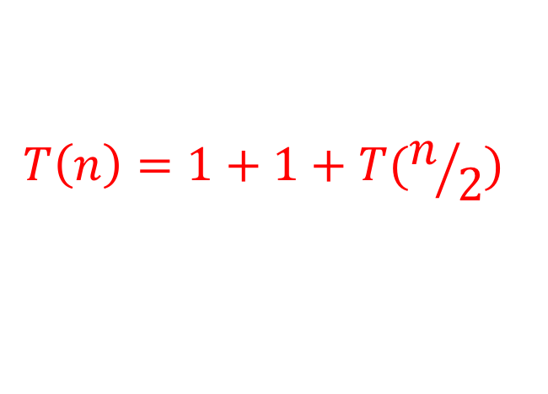

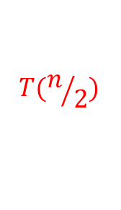
Attendance Algorithm Analysis
1.
Stand
2. count=1
3.
Greet
4.
Add/sit
5.
Repeat
$$T(n)=$$
$$1$$
$$1$$
$$T(n/2)$$
Constant Initialization
$$T\left(n\right)=1+1+T(n/2)$$
How can we “solve” this?
$$T\left(1\right)=3$$
Base case?
Do not need to be exact, asymptotic bound is fine.
Why?

Slide 8



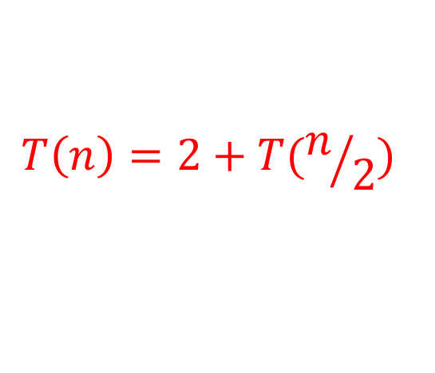
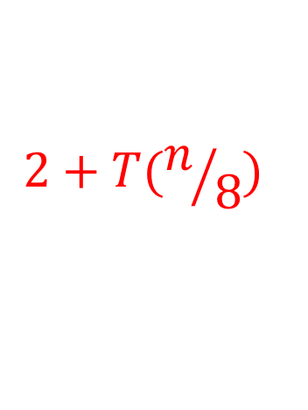
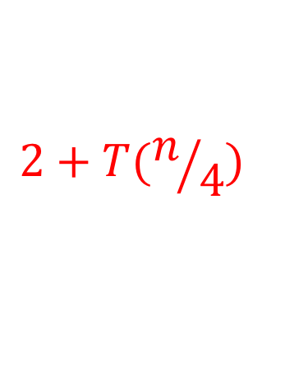
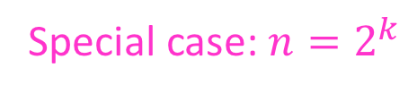
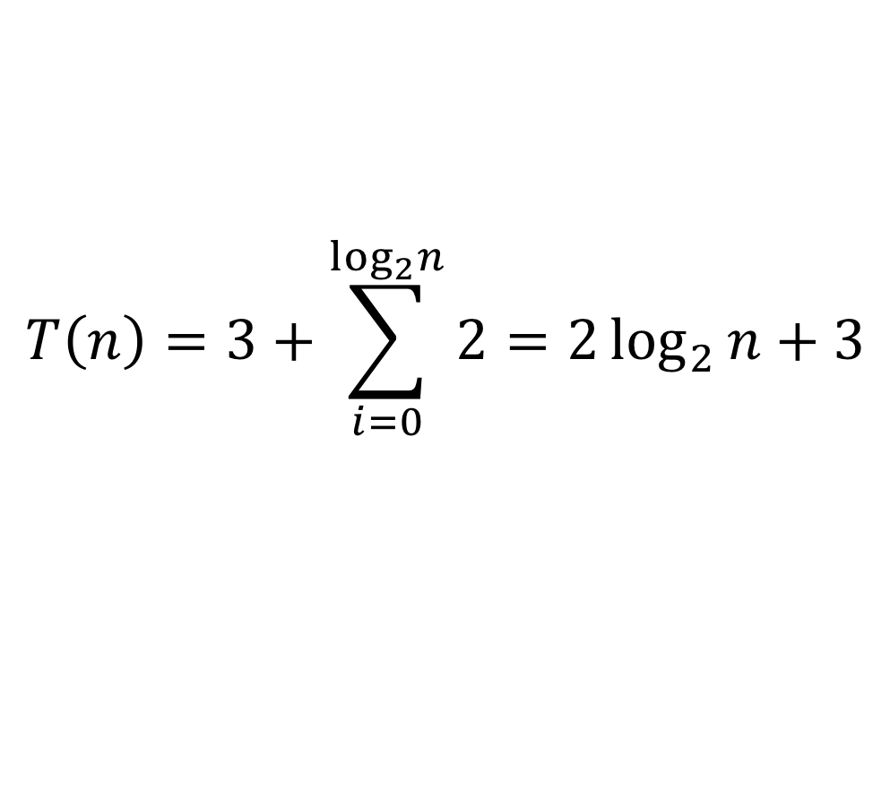
Let’s solve the recurrence!
Special case: $n=2^{k}$
$$T\left(1\right)=3$$
$$T\left(n\right)=2+T(n/2)$$
$$2+T(n/4)$$
$$k$$
$$2+T(n/8)$$
…
$$3$$
$$T\left(n\right)=3+\sum_{i=0}^{\log_{2}n}{2}=2\log_{2}{n}+3$$

Slide 9



What if $n≠2^{k}$?
More people in the room → more time
$∀ 0<n<m, T\left(n\right)<T\left(m\right)$
$T\left(n\right)≤T\left(2^{\left\lceil \log_{2}{n}\right\rceil }\right)=2 \left\lceil \log_{2}{n}\right\rceil +3$
$$=O(\log{n})$$
These are unimportant.
Why?

Slide 10
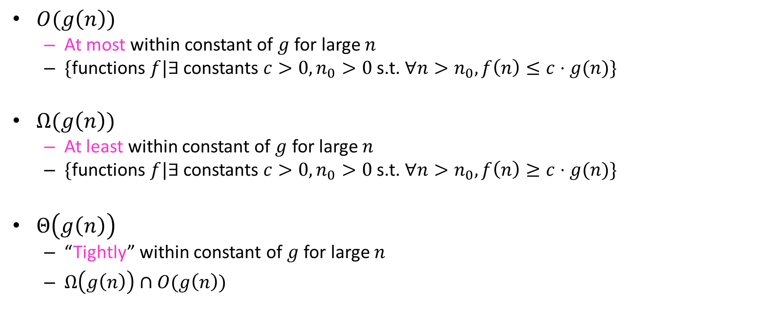
Asymptotic Notation*
$O(g\left(n\right))$
At most within constant of $g$ for large $n$
$\{$functions $f|∃$constants $c>0, n_{0}>0$ s.t. $∀n>n_{0}, f\left(n\right)≤c⋅g(n)\}$
$Ω(g\left(n\right))$
At least within constant of $g$ for large $n$
$\{$functions $f|∃$constants $c>0, n_{0}>0$s.t. $∀n>n_{0}, f\left(n\right)≥c⋅g(n)\}$
$Θ\left(g\left(n\right)\right)$
“Tightly” within constant of $g$ for large $n$
$Ω\left(g\left(n\right)\right)∩O(g\left(n\right))$
*CLRS Chapter 3

Slide 11
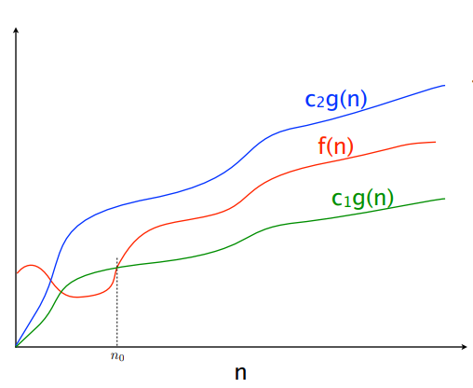



$$f(n)=O(g\left(n\right))$$
$$f(n)=Θ(g\left(n\right))$$
$$f(n)=Ω(g\left(n\right))$$

Slide 12

Asymptotic Notation Example
To Show: $n\log{n}∈O\left(n^{2}\right)$
Find $c, n_{0}>0$ s.t. $∀n>n_{0}, n\log{n}≤c⋅n^{2}$
Let $c=1, n_{0}=1$
$\left(1\right)\log{(1)}=0, 1⋅1^{2}=1$
$∀n≥1,\log\left(n\right)<n⇒n\log{n}≤n^{2}$

Slide 13
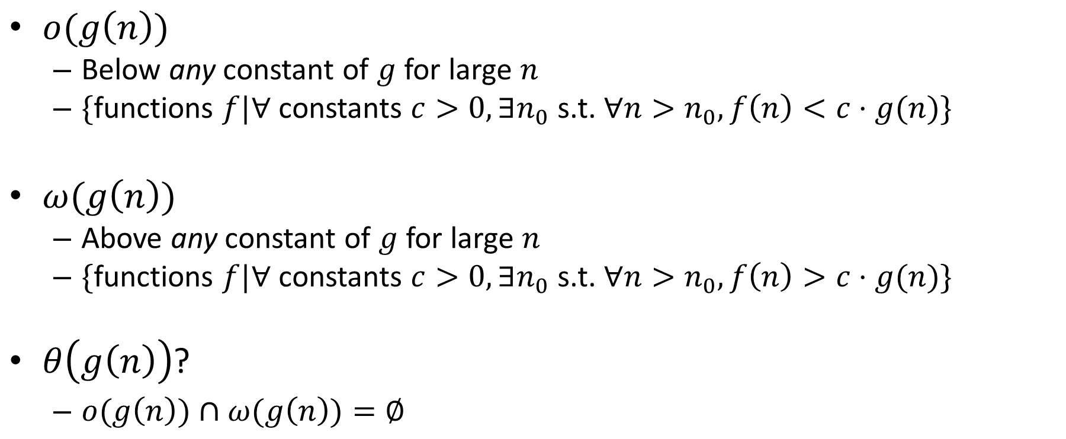
Asymptotic Notation
$o(g\left(n\right))$
Below any constant of $g$ for large $n$
$\{$functions $f|∀$constants $c>0, {∃n}_{0}$ s.t. $∀n>n_{0}, f\left(n\right)<c⋅g(n)\}$
$ω(g\left(n\right))$
Above any constant of $g$ for large $n$
$\{$functions $f|∀$constants $c>0, {∃n}_{0}$ s.t. $∀n>n_{0}, f\left(n\right)>c⋅g(n)\}$
$θ\left(g\left(n\right)\right)$?
$o(g\left(n\right))∩ω(g\left(n\right))=∅$

Slide 14
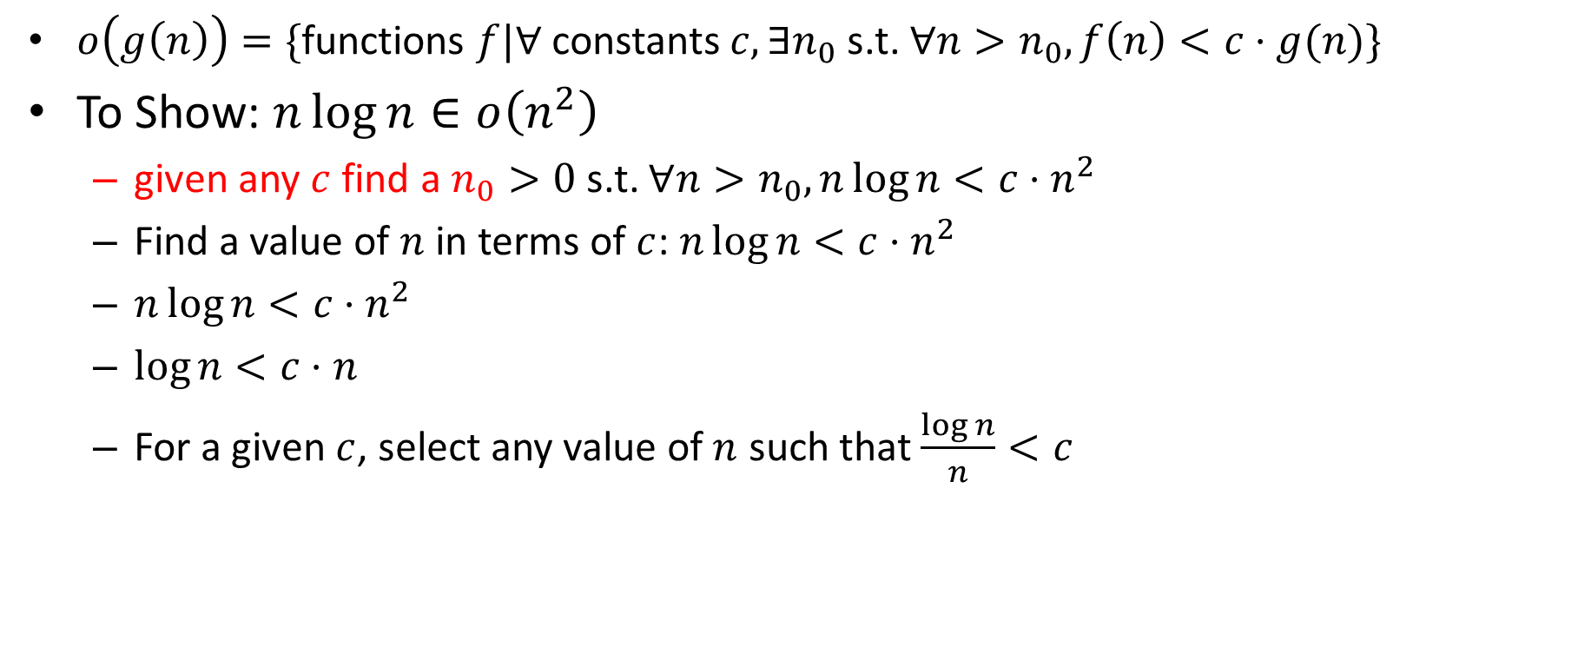
Asymptotic Notation Example
$o\left(g\left(n\right)\right)=\{$functions $f|∀$constants $c, {∃n}_{0}$ s.t. $∀n>n_{0}, f\left(n\right)<c⋅g(n)\}$
To Show: $n\log{n}∈o\left(n^{2}\right)$
given any $c$ find a $n_{0}>0$ s.t. $∀n>n_{0}, n\log{n}<c⋅n^{2}$
Find a value of $n$ in terms of $c$: $n\log{n}<c⋅n^{2}$
$n\log{n}<c⋅n^{2}$
$\log{n<c⋅n}$
For a given $c$, select any value of $n$ such that $\frac{\log{n}}{n}<c$

Slide 15

Trominoes Puzzle Solution
$$2^{n}$$
$$2^{n}$$
What about larger boards?

Slide 16
Trominoes Puzzle Solution
Divide the board into quadrants

Slide 17
Trominoes Puzzle Solution
Place a tromino to occupy the three quadrants without the missing piece

Slide 18
Trominoes Puzzle Solution
Each quadrant is now a smaller subproblem

Slide 19
Trominoes Puzzle Solution
Solve Recursively

Slide 20
Divide and Conquer
Our first algorithmic technique!

Slide 21
Trominoes Puzzle Solution

Slide 22
Divide and Conquer*
When is this a good strategy?
Divide:
Break the problem into multiple subproblems, each smaller instances of the original
Conquer:
If the suproblems are “large”:
Solve each subproblem recursively
If the subproblems are “small”:
Solve them directly (base case)
Combine:
Merge together solutions to subproblems
*CLRS Chapter 4

Slide 23
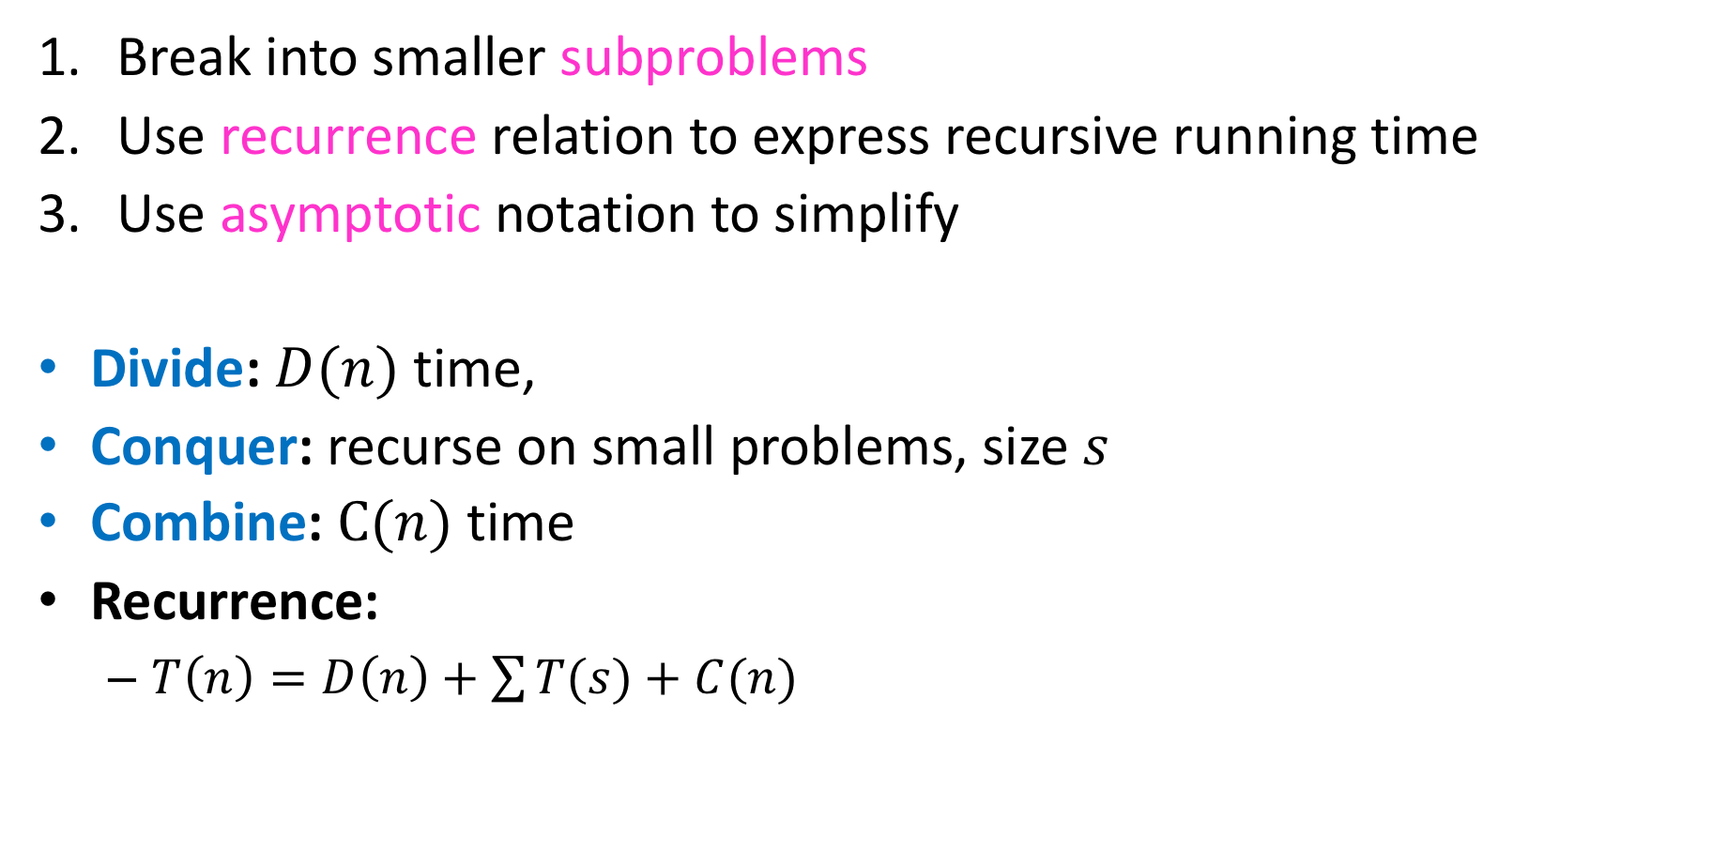
Analyzing Divide and Conquer
Break into smaller subproblems
Use recurrence relation to express recursive running time
Use asymptotic notation to simplify
Divide: $D(n)$ time,
Conquer: recurse on small problems, size $s$
Combine: $C(n)$ time
Recurrence:
$T\left(n\right)=D\left(n\right)+\sum{T(s)}+C(n)$

Slide 24


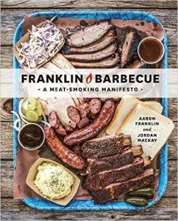
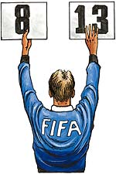
Recurrence Solving Techniques
Tree
Guess/Check
“Cookbook”
Substitution
?

Slide 25
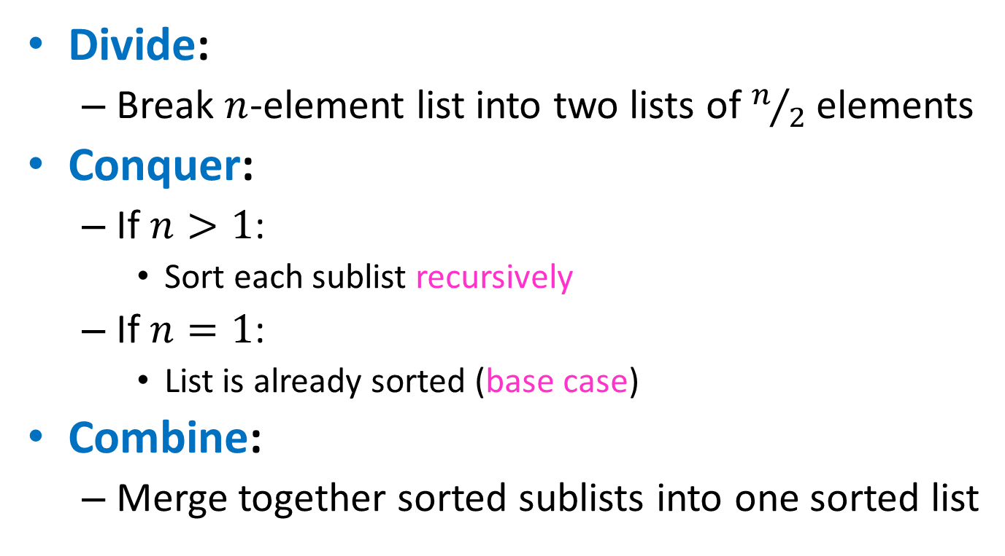
Merge Sort
Divide:
Break $n$-element list into two lists of $n/2$ elements
Conquer:
If $n>1$:
Sort each sublist recursively
If $n=1$:
List is already sorted (base case)
Combine:
Merge together sorted sublists into one sorted list

Slide 26
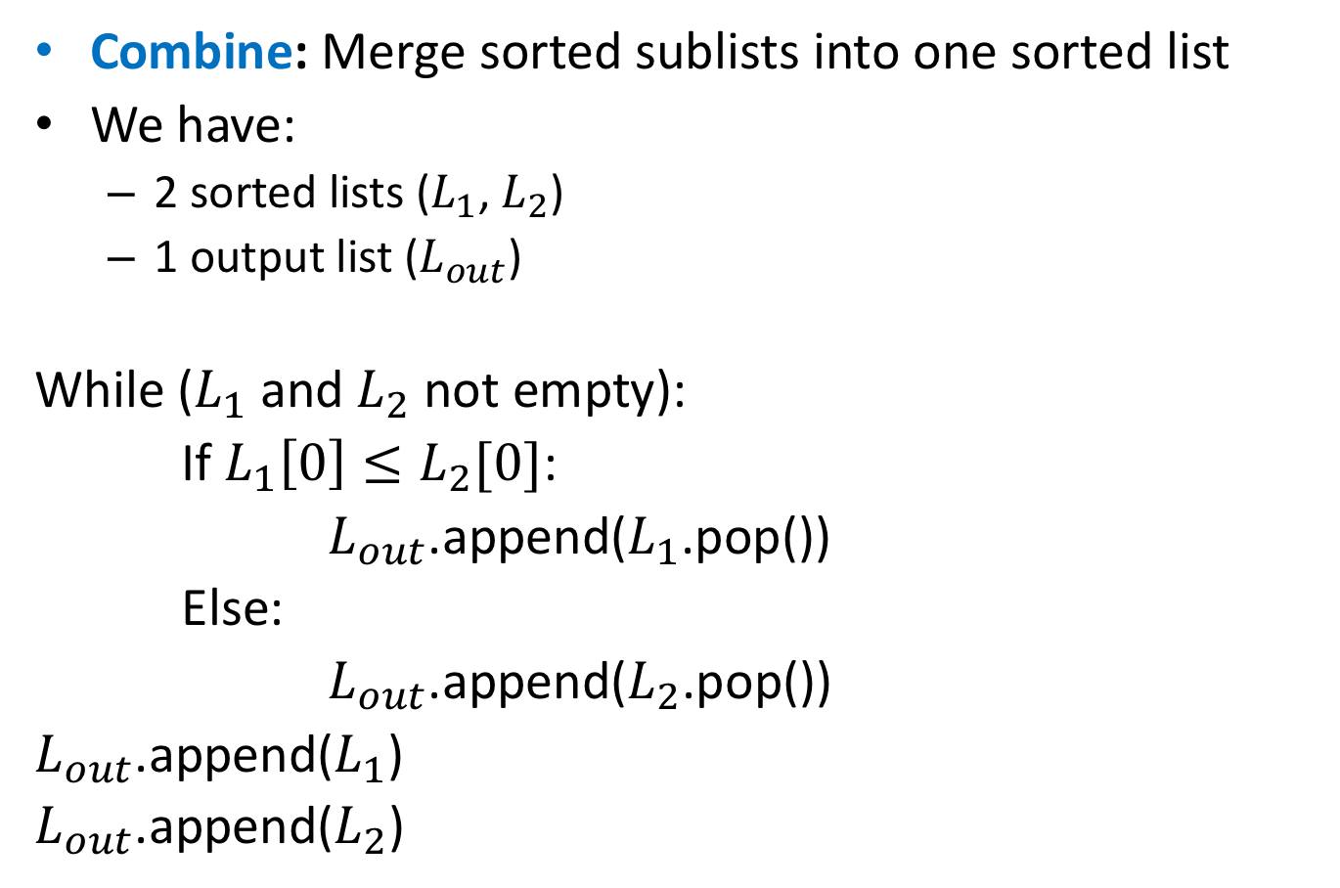
Merge
Combine: Merge sorted sublists into one sorted list
We have:
2 sorted lists ($L_{1}$, $L_{2}$)
1 output list ($L_{out}$)
While ($L_{1}$ and $L_{2}$ not empty):
If $L_{1}\left[0\right]≤L_{2}[0]$:
$L_{out}$.append($L_{1}$.pop())
Else:
$L_{out}$.append($L_{2}$.pop())
$L_{out}$.append($L_{1}$)
$L_{out}$.append($L_{2}$)

Slide 27
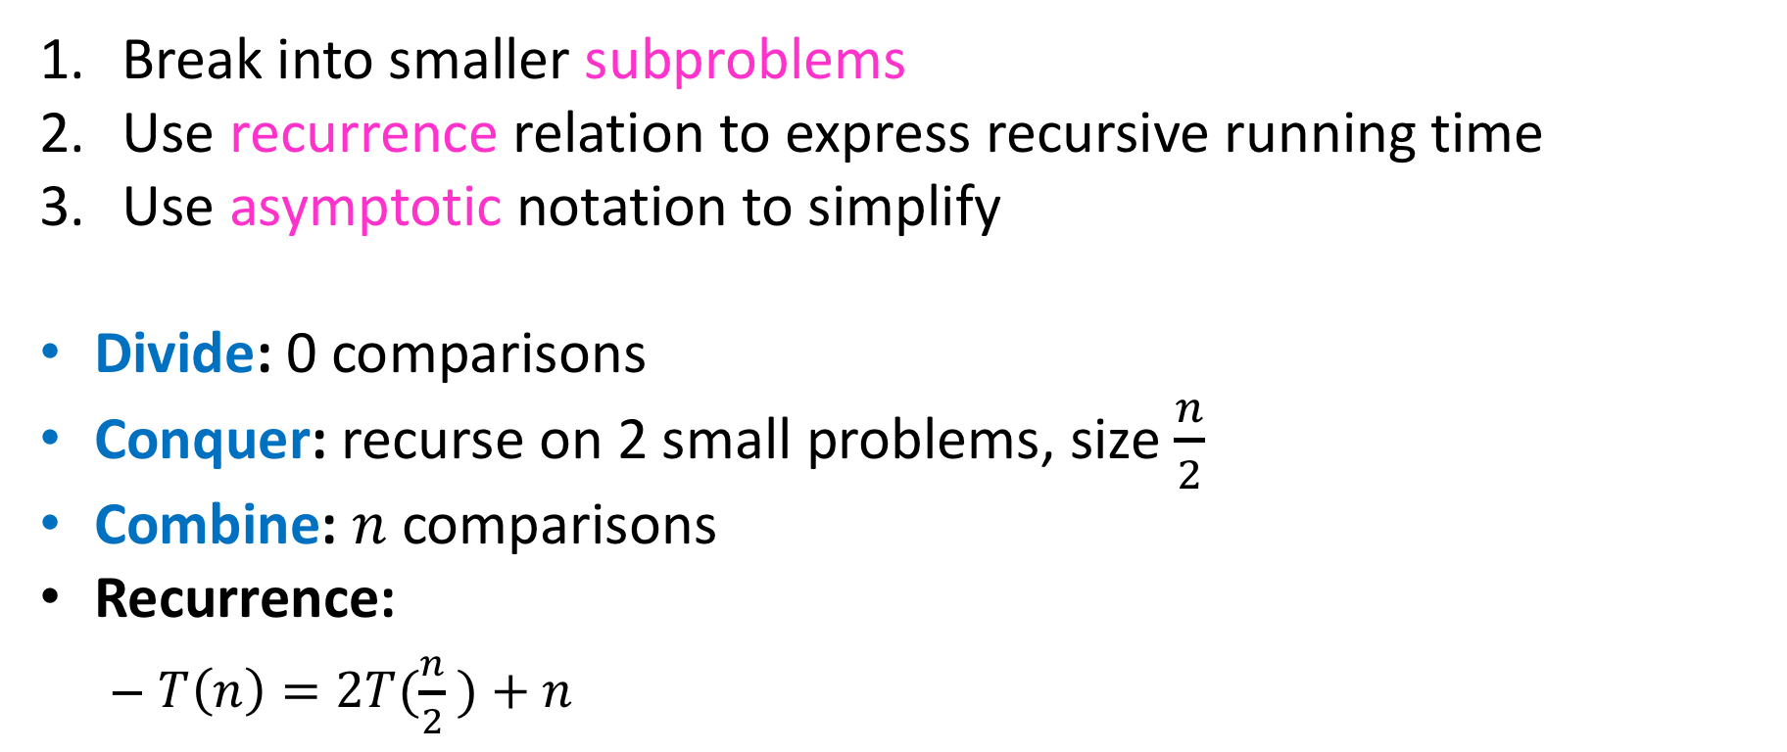
Analyzing Merge Sort
Break into smaller subproblems
Use recurrence relation to express recursive running time
Use asymptotic notation to simplify
Divide: 0 comparisons
Conquer: recurse on 2 small problems, size $\frac{n}{2}$
Combine: $n$ comparisons
Recurrence:
$T\left(n\right)=2T(\frac{n}{2} )+n$

Slide 28
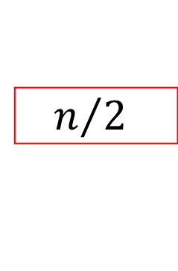

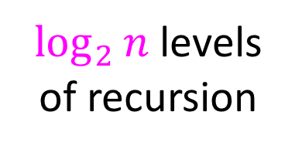


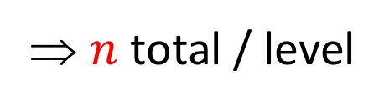
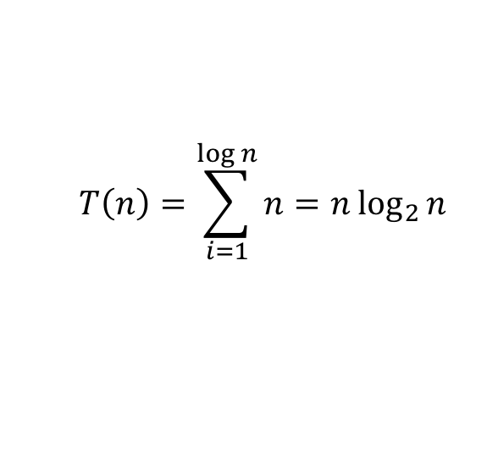
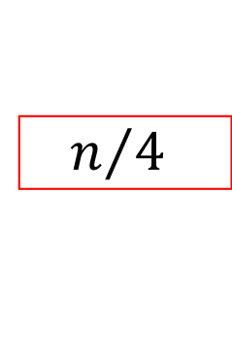
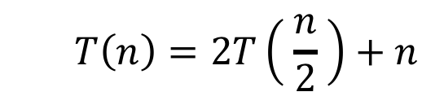





Tree method
$$T\left(n\right)=2T\left( \frac{n}{2} \right)+n$$
$$n$$
⇒ $n$ total / level
$$n/2$$
$$n/2$$
$\log_{2}⁡n$ levels
of recursion
$$n/4$$
$$n/4$$
$$n/4$$
$$n/4$$
…
…
…
…
…
$$1$$
$$1$$
$$1$$
$$1$$
$$1$$
$$1$$
$$T\left(n\right)=\sum_{i=1}^{\log{n}}{n}=n\log_{2}{n}$$

