Slide 1
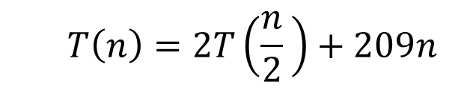
CS4102 Algorithms
Fall 2018
Warm Up
What is the asymptotic run time of MergeSort if its recurrence is
$$T\left(n\right)=2T\left(\frac{n}{2} \right)+209n$$

Slide 2
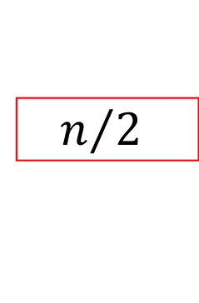

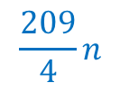
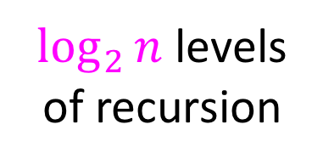


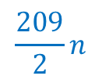
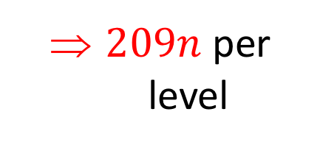
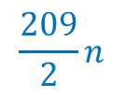
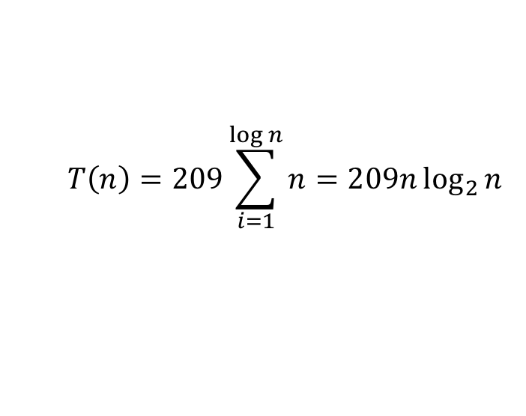

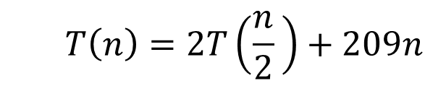

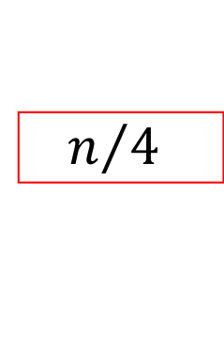
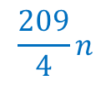



Tree method
$$T\left(n\right)=2T\left(\frac{n}{2} \right)+209n$$
$$209n$$
$$n$$
$209n$ per level
$$n/2$$
$$\frac{209}{2}n$$
$$n/2$$
$$\frac{209}{2}n$$
$$\frac{209}{4}n$$
$$\frac{209}{4}n$$
$$\frac{209}{4}n$$
$$\frac{209}{4}n$$
$\log_{2}⁡n$ levels
of recursion
$$n/4$$
$$n/4$$
$$n/4$$
$$n/4$$
…
…
…
…
…
$$1$$
$$1$$
$$1$$
$$1$$
$$1$$
$$1$$
$$1$$
$$1$$
$$1$$
$$T\left(n\right)=209\sum_{i=1}^{\log{n}}{n}=209n\log_{2}{n}$$

Slide 3
Today’s Keywords
Karatsuba
Guess and check Method
Induction
Master Theorem

Slide 4
CLRS Readings
Chapter 4

Slide 5
Homework
Hw1 due 11pm Wednesday, Sept 12
Written (use Latex!)
Asymptotic notation
Recurrences
Divide and conquer

Slide 6
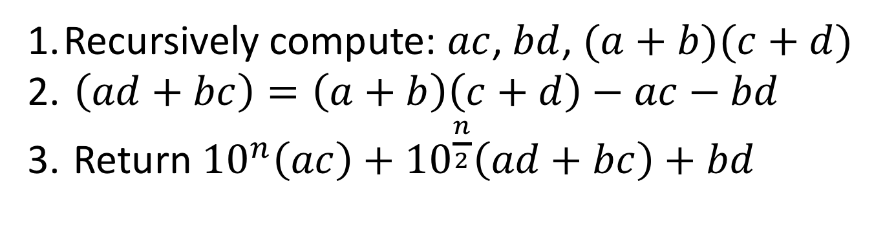

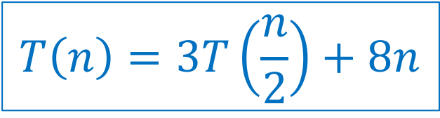
Karatsuba Algorithm
a
b
$$×$$
c
d
Recursively compute: $ac$, $bd$, $(a+b)(c+d)$
$\left(ad+bc\right)=\left(a+b\right)\left(c+d\right)−ac−bd$
Return ${10}^{n}\left(ac\right)+{10}^{\frac{n}{2}}\left(ad+bc\right)+bd$
$$T\left(n\right)=3T\left(\frac{n}{2}\right)+8n$$
Pseudo-code
x = Karatsuba(a,c)
y = Karatsuba(a,d)
z = Karatsuba(a+b,c+d)-x-y
Return 10^{n}x +10^{n/2}z+y

Slide 7












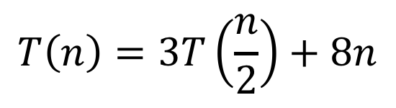



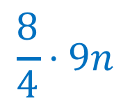




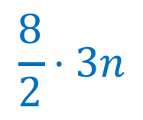
















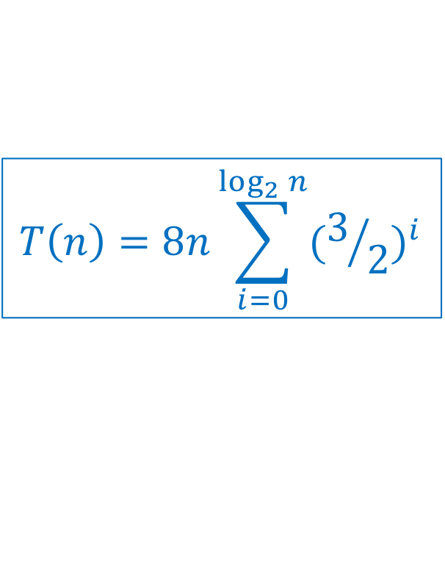
Karatsuba
$$T\left(n\right)=8n\sum_{i=0}^{\log_{2}{n}}{{(3/2)}^{i}}$$
3. Use asymptotic notation to simplify
$$T\left(n\right)=3T\left(\frac{n}{2}\right)+8n$$
$$n$$
$$8n$$
$$8⋅1n$$
$$\frac{n}{2}$$
$$\frac{8n}{2}$$
$$\frac{n}{2}$$
$$\frac{8n}{2}$$
$$\frac{n}{2}$$
$$\frac{8n}{2}$$
$$\frac{8}{2}⋅3n$$
$$\frac{n}{4}$$
$$\frac{n}{4}$$
$$\frac{n}{4}$$
…
$$\frac{n}{4}$$
$$\frac{n}{4}$$
$$\frac{n}{4}$$
$$\frac{8}{4}⋅9n$$
$$\frac{8n}{4}$$
$$\frac{8n}{4}$$
$$\frac{8n}{4}$$
$$\frac{8n}{4}$$
$$\frac{8n}{4}$$
$$\frac{8n}{4}$$
…
…
…
…
…
…
…
$$\frac{8}{2^{\log_{2}{n}}}⋅3^{\log_{2}{n}}n$$
…
$$8$$
$$8$$
$$8$$
$$8$$
$$8$$
$$8$$
$$8$$
$$8$$
$$8$$
$$8$$
$$1$$
$$1$$
$$1$$
$$1$$
$$1$$
$$1$$
$$1$$
$$1$$
$$1$$
$$1$$

Slide 8

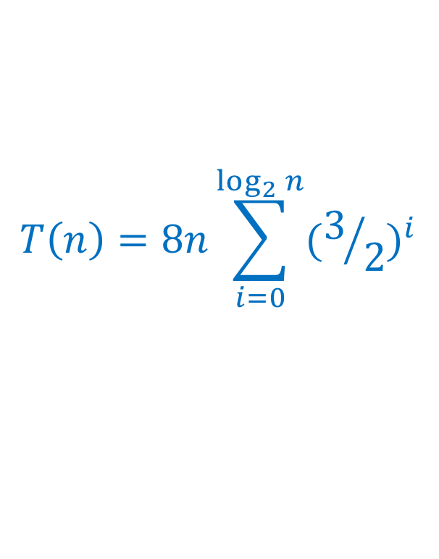
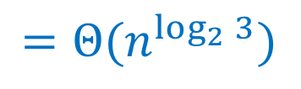

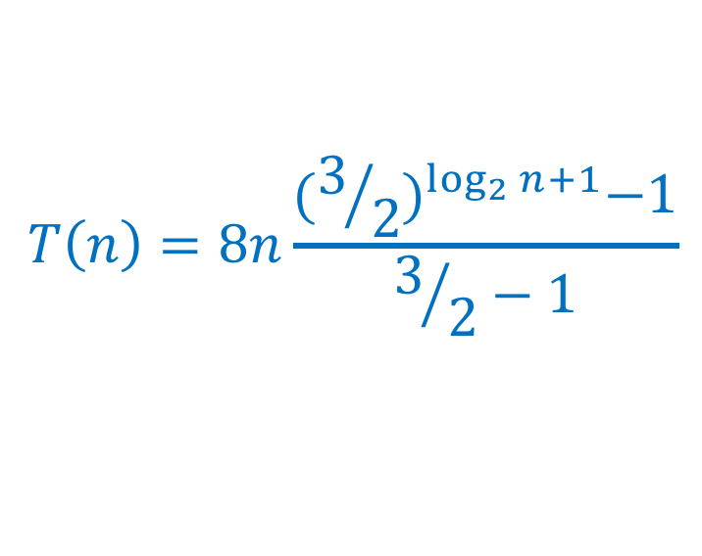
Karatsuba
3. Use asymptotic notation to simplify
$$T\left(n\right)=3T\left(\frac{n}{2}\right)+8n$$
$$T\left(n\right)=8n\sum_{i=0}^{\log_{2}{n}}{{(3/2)}^{i}}$$
$$T\left(n\right)=8n\frac{{(3/2)}^{\log_{2}{n}+1}−1}{3/2−1}$$
Math, math, and more math…(on board, see lecture supplemental)
$$T\left(n\right)=24\left(n^{\log_{2}{3}}\right)−16n$$
$$=Θ(n^{\log_{2}{3}})$$
$$≈Θ(n^{1.585})$$

Slide 9
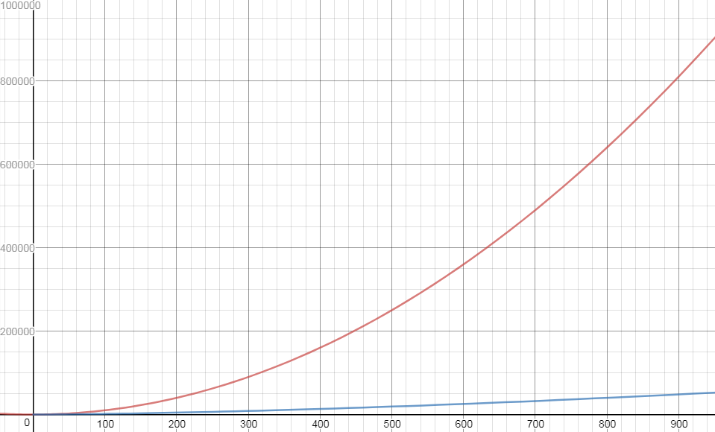


$$n^{2}$$
$$n^{1.585}$$

Slide 10



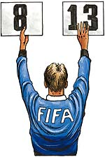
Recurrence Solving Techniques
Tree
Guess/Check
“Cookbook”
Substitution
?
(induction)

Slide 11


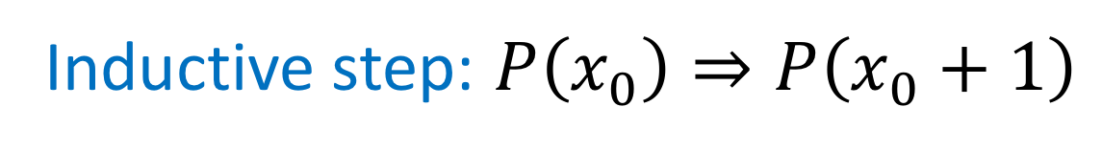

Induction (review)
Goal: $∀k, P(k)$ holds
Base case(s): $P\left(1\right)$ holds
Hypothesis: $∀x≤x_{0}, P\left(x\right)$ holds
Inductive step: $P\left(x_{0}\right)⇒P\left(x_{0}+1\right)$

Slide 12
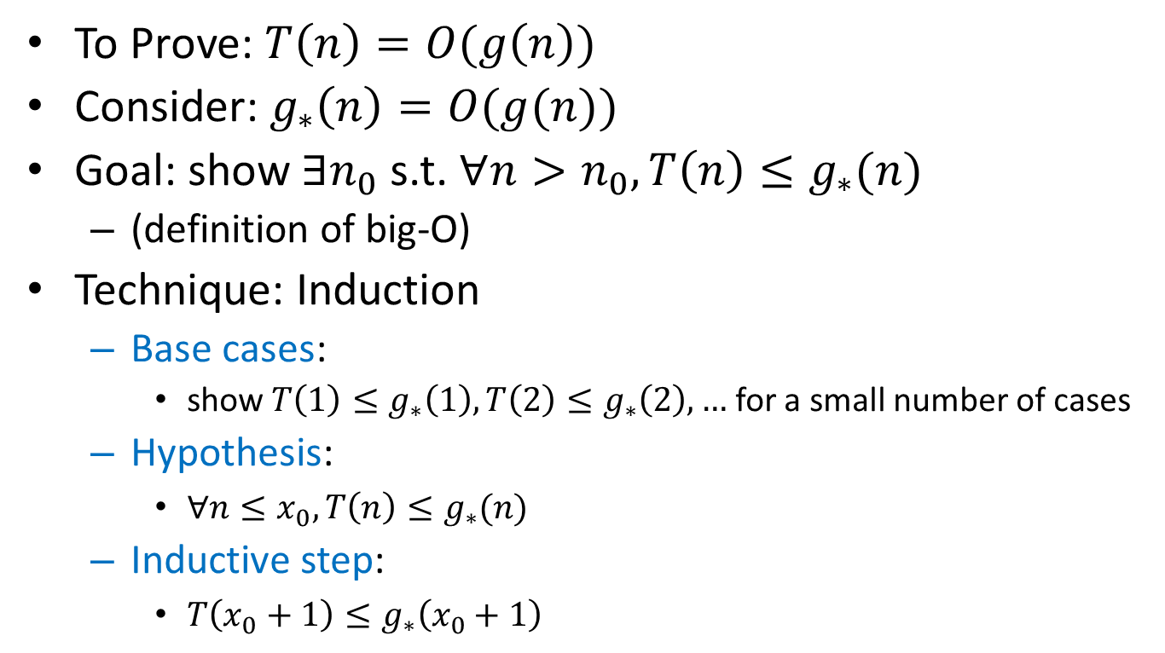
Guess and Check Intuition
To Prove: $T\left(n\right)=O(g\left(n\right))$
Consider: $g_{∗}\left(n\right)=O(g(n))$
Goal: show $∃n_{0}$s.t. $∀n>n_{0},T\left(n\right)≤g_{∗}(n)$
(definition of big-O)
Technique: Induction
Base cases:
show $T\left(1\right)≤g_{∗}\left(1\right), T\left(2\right)≤g_{∗}\left(2\right),…$ for a small number of cases
Hypothesis:
$∀n≤x_{0}, T\left(n\right)≤g_{∗}(n)$
Inductive step:
$T\left(x_{0}+1\right)≤g_{∗}\left(x_{0}+1\right)$

Slide 13
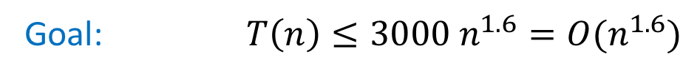
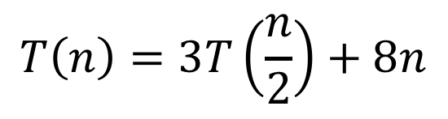
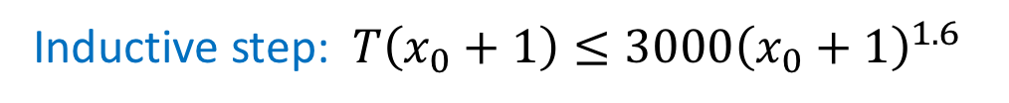
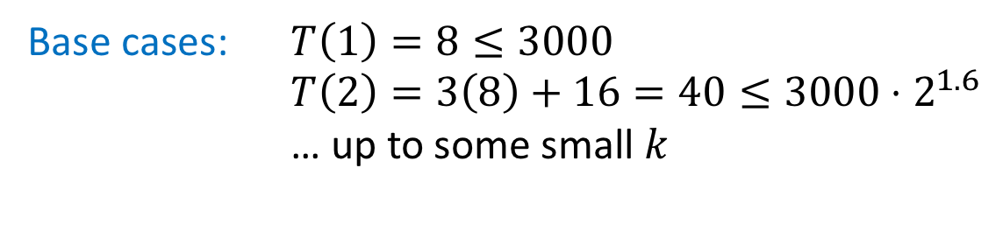
Karatsuba Guess and Check (Loose)
$$T\left(n\right)=3T\left(\frac{n}{2}\right)+8n$$
Goal: $T\left(n\right)≤3000 n^{1.6}=O(n^{1.6})$
Base cases: $T\left(1\right)=8≤3000$
$T\left(2\right)=3\left(8\right)+16=40≤3000⋅2^{1.6}$
… up to some small $k$
Hypothesis: $∀n≤x_{0}, T\left(n\right)≤3000n^{1.6}$
Inductive step: $T\left(x_{0}+1\right)≤3000{\left(x_{0}+1\right)}^{1.6}$

Slide 14
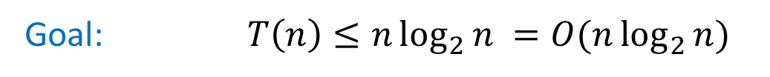
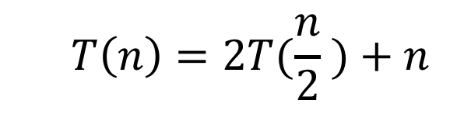
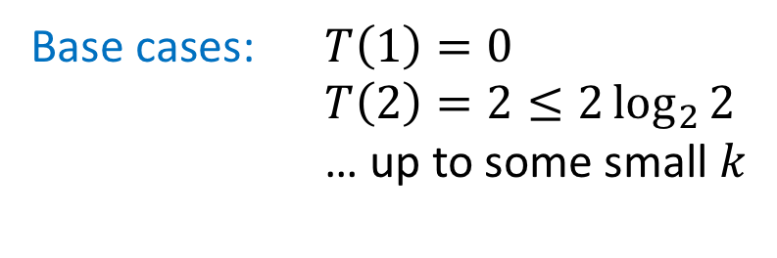
Mergesort Guess and Check
$$T\left(n\right)=2T(\frac{n}{2} )+n$$
Goal: $T\left(n\right)≤n\log_{2}{n} =O(n\log_{2}{n})$
Base cases: $T\left(1\right)=0$
$T\left(2\right)=2≤2\log_{2}{2}$
… up to some small $k$
Hypothesis: $∀n≤x_{0} T\left(n\right)≤n\log_{2}{n}$
Inductive step: $T\left(x_{0}+1\right)≤\left(x_{0}+1\right)\log_{2}{(x_{0}+1)}$

Slide 15
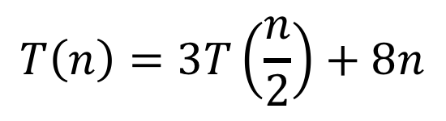
Karatsuba Guess and Check
$$T\left(n\right)=3T\left(\frac{n}{2}\right)+8n$$
Goal: $T\left(n\right)≤{24n}^{\log_{2}{3}}−16n=O(n^{\log_{2}{3}})$
Base cases: by inspection, holds for small $n$ (at home)
Hypothesis: $∀n≤x_{0}, T\left(n\right)≤24n^{\log_{2}{3}}−16n$
Inductive step: $T\left(x_{0}+1\right)≤{24(x_{0}+1)}^{\log_{2}{3}}−16(x_{0}+1)$

Slide 16

What if we leave out the $−16n$?
$$T\left(n\right)=3T\left(\frac{n}{2}\right)+8n$$
Goal: $T\left(n\right)≤{24n}^{\log_{2}{3}}−16n=O(n^{\log_{2}{3}})$
Base cases: by inspection, holds for small $n$ (at home)
Hypothesis: $∀n≤x_{0}, T\left(n\right)≤{24n}^{\log_{2}{3}}−16n$
Inductive step: $T\left(x_{0}+1\right)≤{24(x_{0}+1)}^{\log_{2}{3}}−16(x_{0}+1)$
What we wanted: $T\left(x_{0}+1\right)≤{24(x_{0}+1)}^{\log_{2}{3}}$
Induction failed!
What we got: $T\left(x_{0}+1\right)≤{24(x_{0}+1)}^{\log_{2}{3}}+8(x_{0}+1)$

Slide 17
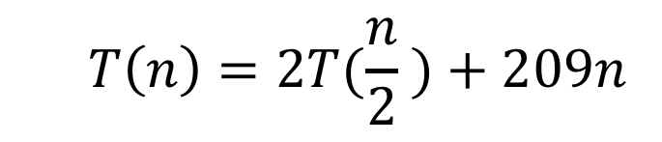
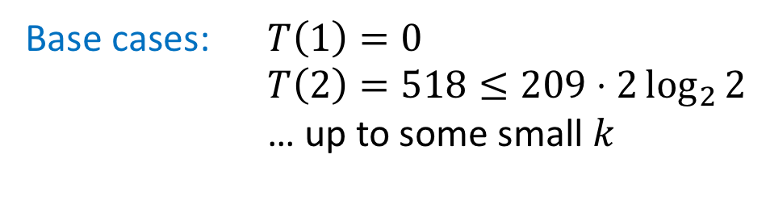
“Bad Mergesort” Guess and Check
$$T\left(n\right)=2T(\frac{n}{2} )+209n$$
Goal: $T\left(n\right)≤209n\log_{2}{n} =O(n\log_{2}{n})$
Base cases: $T\left(1\right)=0$
$T\left(2\right)=518≤209⋅2\log_{2}{2}$
… up to some small $k$
Hypothesis: $∀n≤x_{0}, T\left(n\right)≤209n\log_{2}{n}$
Inductive step: $T\left(x_{0}+1\right)≤209\left(x_{0}+1\right)\log_{2}{(x_{0}+1)}$

Slide 18
Recurrence Solving Techniques
Tree
Guess/Check
“Cookbook”
Substitution
?

Slide 19
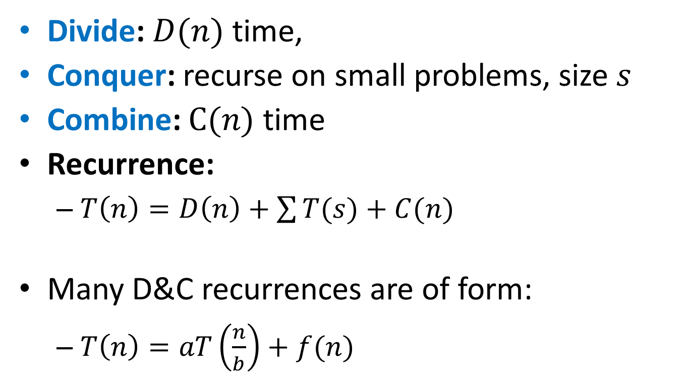
Observation
Divide: $D(n)$ time,
Conquer: recurse on small problems, size $s$
Combine: $C(n)$ time
Recurrence:
$T\left(n\right)=D\left(n\right)+\sum{T(s)}+C(n)$
Many D&C recurrences are of form:
$T\left(n\right)=aT\left(\frac{n}{b}\right)+f(n)$

Slide 20

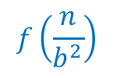



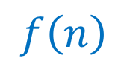
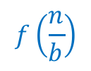



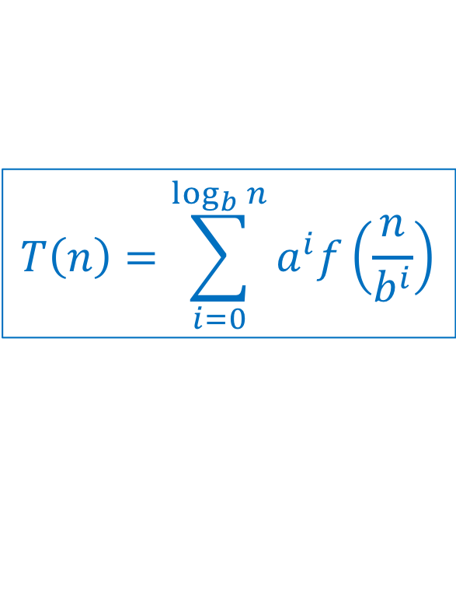
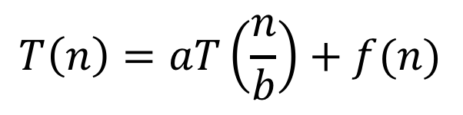



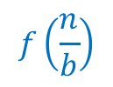


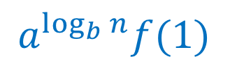
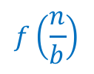



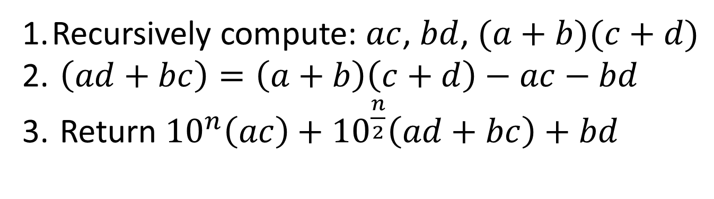

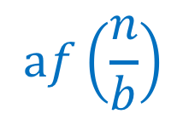


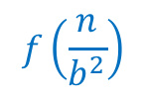



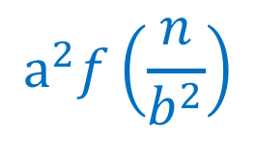
General
$$T\left(n\right)=\sum_{i=0}^{\log_{b}{n}}{a^{i}f\left(\frac{n}{b^{i}}\right)}$$
$$T\left(n\right)=aT\left(\frac{n}{b}\right)+f(n)$$
$$n$$
$$f(n)$$
$$f\left(n\right)$$
$$af\left(\frac{n}{b}\right)$$
$$\frac{n}{b}$$
$$f\left(\frac{n}{b}\right)$$
$$\frac{n}{b}$$
$$f\left(\frac{n}{b}\right)$$
…
$$\frac{n}{b}$$
$$f\left(\frac{n}{b}\right)$$
$$\frac{n}{b^{2}}$$
$$\frac{n}{b^{2}}$$
…
$$\frac{n}{b^{2}}$$
…
$$\frac{n}{b^{2}}$$
$$a^{2}f\left(\frac{n}{b^{2}}\right)$$
$$f\left(\frac{n}{b^{2}}\right)$$
…
$$f\left(\frac{n}{b^{2}}\right)$$
$$f\left(\frac{n}{b^{2}}\right)$$
$$f\left(\frac{n}{b^{2}}\right)$$
…
…
…
…
…
…
…
…
$$f(1)$$
$$f(1)$$
$$f(1)$$
$$f(1)$$
$$f(1)$$
$$f(1)$$
$$f(1)$$
$$1$$
$$1$$
$$1$$
$$1$$
$$a^{\log_{b}{n}}f(1)$$
$$1$$
$$1$$
$$1$$

Slide 21
3 Cases
$$T\left(n\right)=f\left(n\right)+af\left(\frac{n}{b}\right)+a^{2}f\left(\frac{n}{b^{2}}\right)+a^{3}f\left(\frac{n}{b^{3}}\right)+…+a^{L}f(\frac{n}{b^{L}})$$
Case 1:
Most work happens at the leaves
Case 2:
Work happens consistently throughout
Case 3:
Most work happens at top of tree

Slide 22
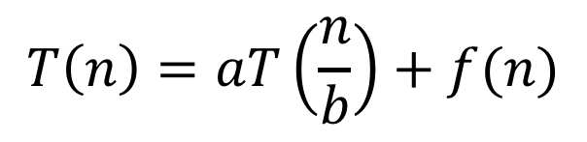
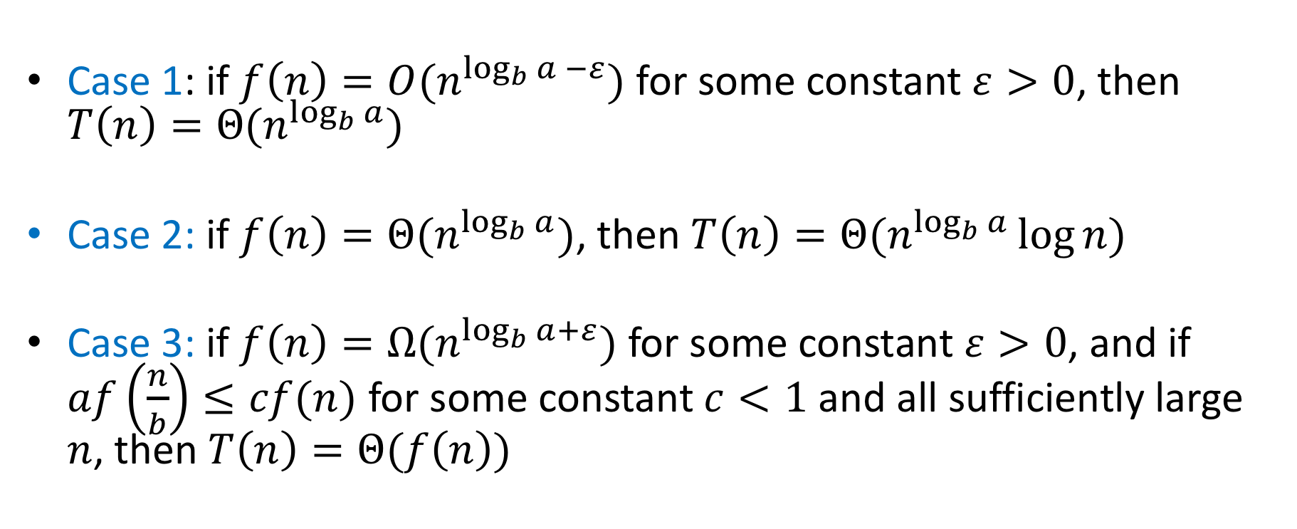
Master Theorem
$$T\left(n\right)=aT\left(\frac{n}{b}\right)+f(n)$$
Case 1: if $f\left(n\right)=O(n^{\log_{b}{a} −ε})$ for some constant $ε>0$, then $T\left(n\right)=Θ(n^{\log_{b}{a}})$
Case 2: if $f\left(n\right)=Θ(n^{\log_{b}{a}})$, then $T\left(n\right)=Θ(n^{\log_{b}{a}}\log{n})$
Case 3: if $f\left(n\right)=Ω(n^{\log_{b}{a+ε}})$ for some constant $ε>0$, and if $af\left(\frac{n}{b}\right)≤cf(n)$ for some constant $c<1$ and all sufficiently large $n$, then $T\left(n\right)=Θ(f\left(n\right))$

Slide 23

Proof of Case 1
$T\left(n\right)=\sum_{i=0}^{\log_{b}{n}}{a^{i}f\left(\frac{n}{b^{i}}\right)}$,
$$f\left(n\right)=O\left(n^{\log_{b}{a}−ε}\right)⇒f\left(n\right)≤c⋅n^{\log_{b}{n}−ε}$$
Insert math here…
Conclusion: $T\left(n\right)=O(n^{\log_{b}{a}})$

Slide 24




Master Theorem Example 1
$$T\left(n\right)=aT\left(\frac{n}{b}\right)+f(n)$$
Case 1: if $f\left(n\right)=O(n^{\log_{b}{a} −ε})$ for some constant $ε>0$, then $T\left(n\right)=Θ(n^{\log_{b}{a}})$
Case 2: if $f\left(n\right)=Θ(n^{\log_{b}{a}})$, then $T\left(n\right)=Θ(n^{\log_{b}{a}}\log{n})$
Case 3: if $f\left(n\right)=Ω(n^{\log_{b}{a+ε}})$ for some constant $ε>0$, and if $af\left(\frac{n}{b}\right)≤cf(n)$ for some constant $c<1$ and all sufficiently large $n$, then $T\left(n\right)=Θ(f\left(n\right))$
$$T\left(n\right)=2T\left(\frac{n}{2}\right)+n$$
Case 2
$$Θ\left(n^{\log_{2}{2}}\log{n}\right)=Θ(n\log{n})$$

Slide 25























Tree method
$$T\left(n\right)=2T\left(\frac{n}{2} \right)+n$$
$$n$$
$$n$$
$$n$$
$$n/2$$
$$n/2$$
$$n$$
$$n/2$$
$$+$$
$$n/2$$
$$\log_{2}⁡n$$
$$n/4$$
$$n/4$$
$$n/4$$
$$n/4$$
$$+$$
$$n/4$$
$$n/4$$
$$+$$
$$n/4$$
$$n/4$$
$$n$$
$$+$$
…
…
…
…
$$1$$
…
$$1$$
$$1$$
$$1$$
$$1$$
$$1$$
$$n$$
$$1$$
$$+$$
$$1$$
$$+$$
$$1$$
$$+$$
$$1$$
$$+$$
$$1$$
$$+$$
$$1$$

Slide 26



Master Theorem Example 2
$$T\left(n\right)=aT\left(\frac{n}{b}\right)+f(n)$$
Case 1: if $f\left(n\right)=O(n^{\log_{b}{a} −ε})$ for some constant $ε>0$, then $T\left(n\right)=Θ(n^{\log_{b}{a}})$
Case 2: if $f\left(n\right)=Θ(n^{\log_{b}{a}})$, then $T\left(n\right)=Θ(n^{\log_{b}{a}}\log{n})$
Case 3: if $f\left(n\right)=Ω(n^{\log_{b}{a+ε}})$ for some constant $ε>0$, and if $af\left(\frac{n}{b}\right)≤cf(n)$ for some constant $c<1$ and all sufficiently large $n$, then $T\left(n\right)=Θ(f\left(n\right))$
$$T\left(n\right)=4T\left(\frac{n}{2}\right)+5n$$
Case 1
$$Θ\left(n^{\log_{2}{4}}\right)=Θ(n^{2})$$

Slide 27





























Tree method
$$T\left(n\right)=4T\left(\frac{n}{2}\right)+5n$$
$$n$$
$$5n$$
$$5n$$
$$\frac{n}{2}$$
$$\frac{5n}{2}$$
$$\frac{n}{2}$$
$$\frac{5n}{2}$$
$$\frac{n}{2}$$
$$\frac{5n}{2}$$
$$\frac{n}{2}$$
$$\frac{5n}{2}$$
$$\frac{4}{2}⋅5n$$
$$\frac{n}{4}$$
$$\frac{n}{4}$$
$$\frac{n}{4}$$
$$\frac{n}{4}$$
…
$$\frac{n}{4}$$
$$\frac{n}{4}$$
$$\frac{n}{4}$$
$$\frac{n}{4}$$
$$\frac{16}{4}⋅5n$$
$$\frac{5n}{4}$$
$$\frac{5n}{4}$$
$$\frac{5n}{4}$$
$$\frac{5n}{4}$$
$$\frac{5n}{4}$$
$$\frac{5n}{4}$$
$$\frac{5n}{4}$$
$$\frac{5n}{4}$$
…
…
…
…
…
…
…
…
…
…
$$5$$
$$5$$
$$5$$
$$5$$
$$5$$
$$5$$
$$5$$
$$2^{\log_{2}{n}}⋅5n$$
$$5$$
$$5$$
$$5$$
$$5$$
$$5$$
$$5$$
$$5$$
$$1$$
$$1$$
$$1$$
$$1$$
$$1$$
$$1$$
$$1$$
$$1$$
$$1$$
$$1$$
$$1$$
$$1$$
$$1$$
$$1$$

Slide 28



Master Theorem Example 3
$$T\left(n\right)=aT\left(\frac{n}{b}\right)+f(n)$$
Case 1: if $f\left(n\right)=O(n^{\log_{b}{a} −ε})$ for some constant $ε>0$, then $T\left(n\right)=Θ(n^{\log_{b}{a}})$
Case 2: if $f\left(n\right)=Θ(n^{\log_{b}{a}})$, then $T\left(n\right)=Θ(n^{\log_{b}{a}}\log{n})$
Case 3: if $f\left(n\right)=Ω(n^{\log_{b}{a+ε}})$ for some constant $ε>0$, and if $af\left(\frac{n}{b}\right)≤cf(n)$ for some constant $c<1$ and all sufficiently large $n$, then $T\left(n\right)=Θ(f\left(n\right))$
$$T\left(n\right)=3T\left(\frac{n}{2}\right)+8n$$
Case 1
$$Θ\left(n^{\log_{2}{3}}\right)≈Θ(n^{1.5})$$

Slide 29
Karatsuba
$$T\left(n\right)=3T\left(\frac{n}{2}\right)+8n$$
$$n$$
$$8n$$
$$8⋅1n$$
$$\frac{n}{2}$$
$$\frac{8n}{2}$$
$$\frac{n}{2}$$
$$\frac{8n}{2}$$
$$\frac{n}{2}$$
$$\frac{8n}{2}$$
$$\frac{8}{2}⋅3n$$
$$\frac{n}{4}$$
$$\frac{n}{4}$$
$$\frac{n}{4}$$
…
$$\frac{n}{4}$$
$$\frac{n}{4}$$
$$\frac{n}{4}$$
$$\frac{8}{4}⋅9n$$
$$\frac{8n}{4}$$
$$\frac{8n}{4}$$
$$\frac{8n}{4}$$
$$\frac{8n}{4}$$
$$\frac{8n}{4}$$
$$\frac{8n}{4}$$
…
…
…
…
…
…
…
$$\frac{8}{2^{\log_{2}{n}}}⋅3^{\log_{2}{n}}n$$
…
$$8$$
$$8$$
$$8$$
$$8$$
$$8$$
$$8$$
$$8$$
$$8$$
$$8$$
$$8$$
$$1$$
$$1$$
$$1$$
$$1$$
$$1$$
$$1$$
$$1$$
$$1$$
$$1$$
$$1$$

Slide 30


Master Theorem Example 4
$$T\left(n\right)=aT\left(\frac{n}{b}\right)+f(n)$$
Case 1: if $f\left(n\right)=O(n^{\log_{b}{a} −ε})$ for some constant $ε>0$, then $T\left(n\right)=Θ(n^{\log_{b}{a}})$
Case 2: if $f\left(n\right)=Θ(n^{\log_{b}{a}})$, then $T\left(n\right)=Θ(n^{\log_{b}{a}}\log{n})$
Case 3: if $f\left(n\right)=Ω(n^{\log_{b}{a+ε}})$ for some constant $ε>0$, and if $af\left(\frac{n}{b}\right)≤cf(n)$ for some constant $c<1$ and all sufficiently large $n$, then $T\left(n\right)=Θ(f\left(n\right))$
$$T\left(n\right)=2T\left(\frac{n}{2}\right)+15n^{3}$$
Case 3
$$Θ\left(n^{3}\right)$$

Slide 31















Tree method
$$T\left(n\right)=2T\left(\frac{n}{2} \right)+15n^{3}$$
$$15n^{3}$$
$$15n^{3}$$
$$n$$
$$\frac{15n^{3}}{4}$$
$$15{\left(\frac{n}{2}\right)}^{3}$$
$$15{\left(\frac{n}{2}\right)}^{3}$$
$$n/2$$
$$+$$
$$n/2$$
$$15{\left(\frac{n}{4}\right)}^{3}$$
$$15{\left(\frac{n}{4}\right)}^{3}$$
$$15{\left(\frac{n}{4}\right)}^{3}$$
$$15{\left(\frac{n}{4}\right)}^{3}$$
$$\log_{2}⁡n$$
$$\frac{15n^{3}}{16}$$
$$n/4$$
$$+$$
$$n/4$$
$$+$$
$$n/4$$
$$+$$
$$n/4$$
…
…
…
…
$$15$$
…
$$15$$
$$15$$
$$15$$
$$15$$
$$15$$
$$1$$
$$+$$
$$1$$
$$+$$
$$1$$
$$+$$
$$1$$
$$+$$
$$1$$
$$+$$
$$1$$
$$15\log_{2}{n}$$

Slide 32
Homework Help Algorithm
Algorithm: How to ask a question about homework (efficiently)
Check to see if your question is already on piazza
If it’s not on piazza, ask on piazza
Look for other questions you know the answer to, and provide answers to any that you see
TA office hours
Instructor office hours
Email, set up a meeting

