Slide 1
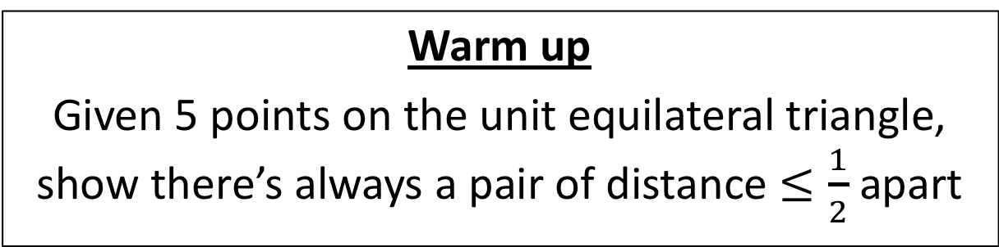
CS4102 Algorithms
Fall 2018
Warm up
Given 5 points on the unit equilateral triangle, show there’s always a pair of distance $≤\frac{1}{2}$ apart
1
1
1

Slide 2

If points $p_{1},p_{2}$ in same quadrant, then $δ\left(p_{1},p_{2}\right)≤\frac{1}{2}$
Given 5 points, two must share the same quadrant
Pigeonhole Principle!
1
1
1

Slide 3


Historical Aside: Master Theorem
No Picture Found
Jon Bentley
Dorothea Haken
James Saxe

Slide 4
Today’s Keywords
Substitution Method
Divide and Conquer
Closest Pair of Points

Slide 5
CLRS Readings
Chapter 4

Slide 6
Homework
Hw1 due 11pm Friday, Sept 14
Written (use Latex!)
Asymptotic notation
Recurrences
Divide and conquer
Hw2 released TODAY
Programming assignment (Python or Java)
Divide and conquer

Slide 7
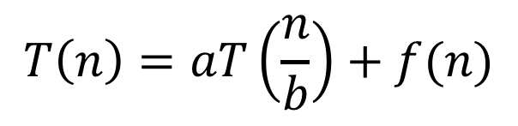
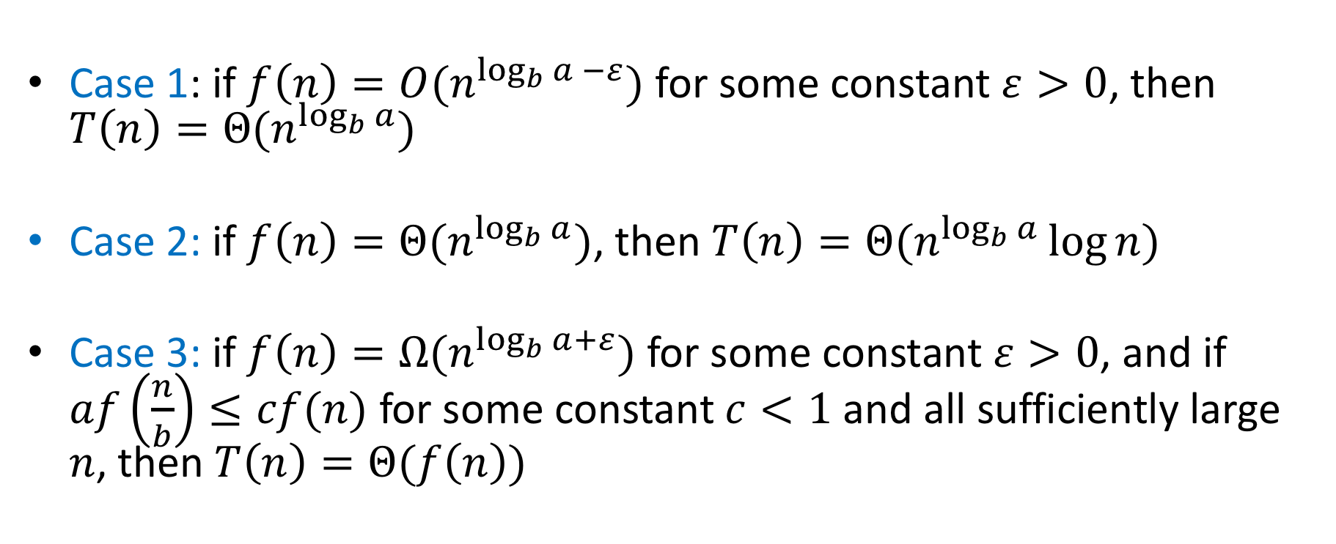
Master Theorem
$$T\left(n\right)=aT\left(\frac{n}{b}\right)+f(n)$$
Case 1: if $f\left(n\right)=O(n^{\log_{b}{a} −ε})$ for some constant $ε>0$, then $T\left(n\right)=Θ(n^{\log_{b}{a}})$
Case 2: if $f\left(n\right)=Θ(n^{\log_{b}{a}})$, then $T\left(n\right)=Θ(n^{\log_{b}{a}}\log{n})$
Case 3: if $f\left(n\right)=Ω(n^{\log_{b}{a+ε}})$ for some constant $ε>0$, and if $af\left(\frac{n}{b}\right)≤cf(n)$ for some constant $c<1$ and all sufficiently large $n$, then $T\left(n\right)=Θ(f\left(n\right))$

Slide 8
3 Cases
$$T\left(n\right)=f\left(n\right)+af\left(\frac{n}{b}\right)+a^{2}f\left(\frac{n}{b^{2}}\right)+a^{3}f\left(\frac{n}{b^{3}}\right)+…+a^{L}f(\frac{n}{b^{L}})$$
Case 1:
Most work happens at the leaves
Case 2:
Work happens consistently throughout
Case 3:
Most work happens at top of tree

Slide 9
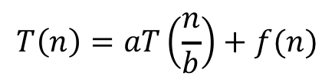
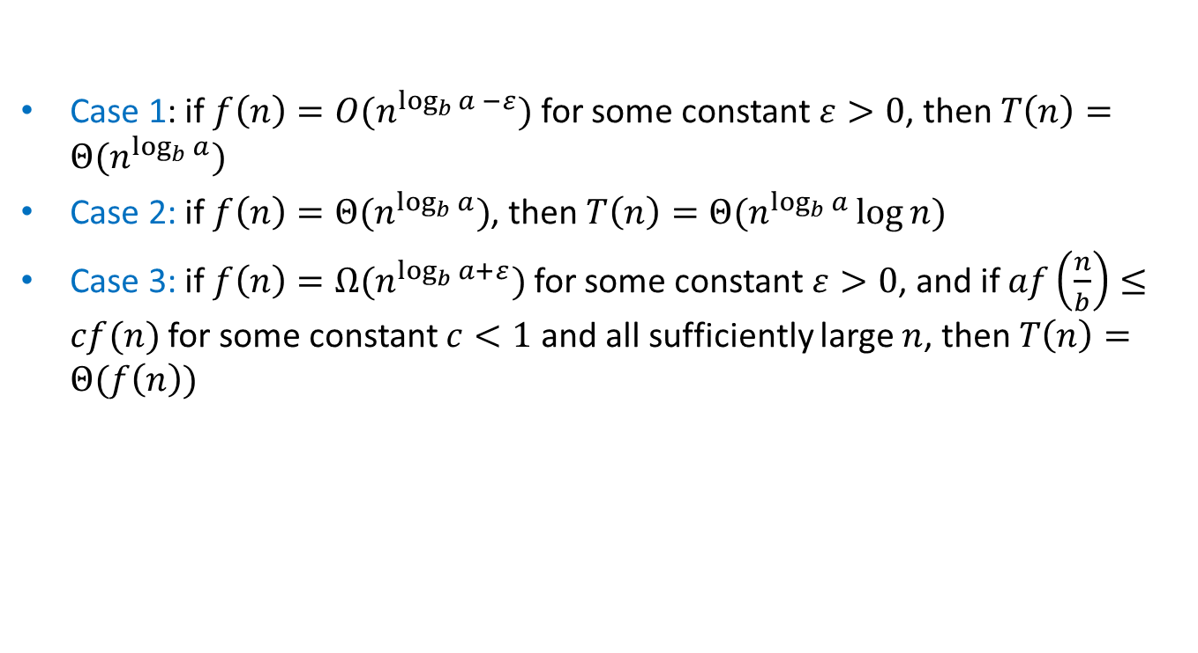
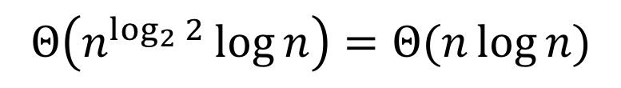
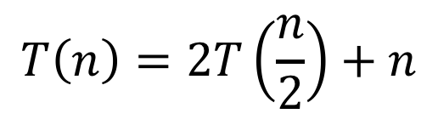
Master Theorem Example 1
$$T\left(n\right)=aT\left(\frac{n}{b}\right)+f(n)$$
Case 1: if $f\left(n\right)=O(n^{\log_{b}{a} −ε})$ for some constant $ε>0$, then $T\left(n\right)=Θ(n^{\log_{b}{a}})$
Case 2: if $f\left(n\right)=Θ(n^{\log_{b}{a}})$, then $T\left(n\right)=Θ(n^{\log_{b}{a}}\log{n})$
Case 3: if $f\left(n\right)=Ω(n^{\log_{b}{a+ε}})$ for some constant $ε>0$, and if $af\left(\frac{n}{b}\right)≤cf(n)$ for some constant $c<1$ and all sufficiently large $n$, then $T\left(n\right)=Θ(f\left(n\right))$
$$T\left(n\right)=2T\left(\frac{n}{2}\right)+n$$
Case 2
$$Θ\left(n^{\log_{2}{2}}\log{n}\right)=Θ(n\log{n})$$

Slide 10
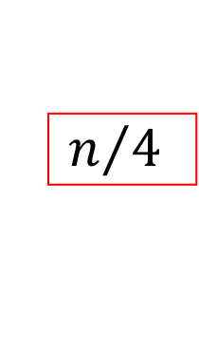



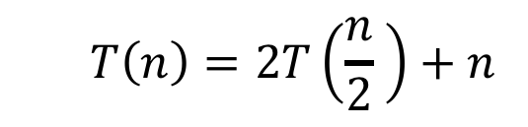

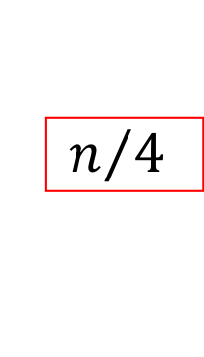







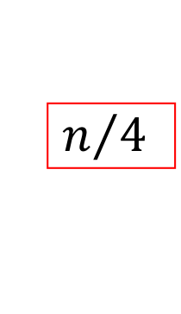


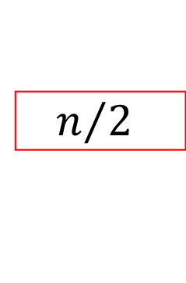











Tree method
$$T\left(n\right)=2T\left(\frac{n}{2} \right)+n$$
$$n$$
$$n$$
$$n$$
$$n/2$$
$$n/2$$
$$n$$
$$n/2$$
$$+$$
$$n/2$$
$$\log_{2}⁡n$$
$$n/4$$
$$n/4$$
$$n/4$$
$$n/4$$
$$+$$
$$n/4$$
$$n/4$$
$$+$$
$$n/4$$
$$n/4$$
$$n$$
$$+$$
…
…
…
…
$$1$$
…
$$1$$
$$1$$
$$1$$
$$1$$
$$1$$
$$n$$
$$1$$
$$+$$
$$1$$
$$+$$
$$1$$
$$+$$
$$1$$
$$+$$
$$1$$
$$+$$
$$1$$

Slide 11
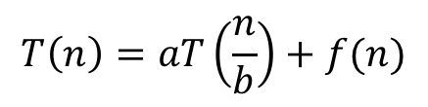
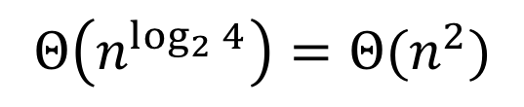
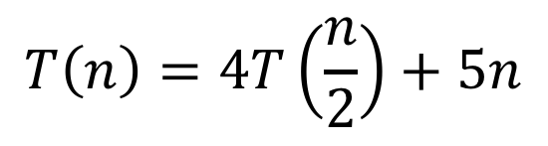
Master Theorem Example 2
$$T\left(n\right)=aT\left(\frac{n}{b}\right)+f(n)$$
Case 1: if $f\left(n\right)=O(n^{\log_{b}{a} −ε})$ for some constant $ε>0$, then $T\left(n\right)=Θ(n^{\log_{b}{a}})$
Case 2: if $f\left(n\right)=Θ(n^{\log_{b}{a}})$, then $T\left(n\right)=Θ(n^{\log_{b}{a}}\log{n})$
Case 3: if $f\left(n\right)=Ω(n^{\log_{b}{a+ε}})$ for some constant $ε>0$, and if $af\left(\frac{n}{b}\right)≤cf(n)$ for some constant $c<1$ and all sufficiently large $n$, then $T\left(n\right)=Θ(f\left(n\right))$
$$T\left(n\right)=4T\left(\frac{n}{2}\right)+5n$$
Case 1
$$Θ\left(n^{\log_{2}{4}}\right)=Θ(n^{2})$$

Slide 12








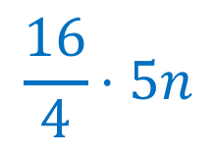





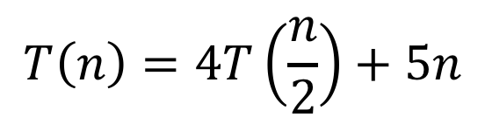




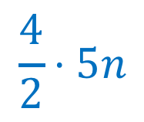




























Tree method
$$T\left(n\right)=4T\left(\frac{n}{2}\right)+5n$$
$$n$$
$$5n$$
$$5n$$
$$\frac{n}{2}$$
$$\frac{5n}{2}$$
$$\frac{n}{2}$$
$$\frac{5n}{2}$$
$$\frac{n}{2}$$
$$\frac{5n}{2}$$
$$\frac{n}{2}$$
$$\frac{5n}{2}$$
$$\frac{4}{2}⋅5n$$
$$\frac{n}{4}$$
$$\frac{n}{4}$$
$$\frac{n}{4}$$
$$\frac{n}{4}$$
…
$$\frac{n}{4}$$
$$\frac{n}{4}$$
$$\frac{n}{4}$$
$$\frac{n}{4}$$
$$\frac{16}{4}⋅5n$$
$$\frac{5n}{4}$$
$$\frac{5n}{4}$$
$$\frac{5n}{4}$$
$$\frac{5n}{4}$$
$$\frac{5n}{4}$$
$$\frac{5n}{4}$$
$$\frac{5n}{4}$$
$$\frac{5n}{4}$$
…
…
…
…
…
…
…
…
…
…
$$5$$
$$5$$
$$5$$
$$5$$
$$5$$
$$5$$
$$5$$
$$2^{\log_{2}{n}}⋅5n$$
$$5$$
$$5$$
$$5$$
$$5$$
$$5$$
$$5$$
$$5$$
$$1$$
$$1$$
$$1$$
$$1$$
$$1$$
$$1$$
$$1$$
$$1$$
$$1$$
$$1$$
$$1$$
$$1$$
$$1$$
$$1$$

Slide 13
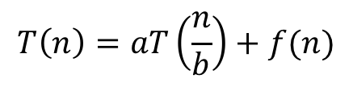
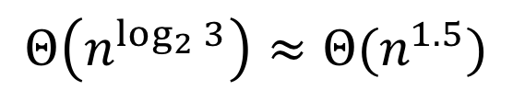
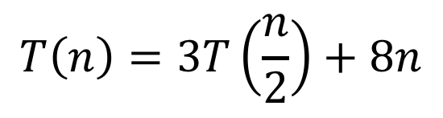
Master Theorem Example 3
$$T\left(n\right)=aT\left(\frac{n}{b}\right)+f(n)$$
Case 1: if $f\left(n\right)=O(n^{\log_{b}{a} −ε})$ for some constant $ε>0$, then $T\left(n\right)=Θ(n^{\log_{b}{a}})$
Case 2: if $f\left(n\right)=Θ(n^{\log_{b}{a}})$, then $T\left(n\right)=Θ(n^{\log_{b}{a}}\log{n})$
Case 3: if $f\left(n\right)=Ω(n^{\log_{b}{a+ε}})$ for some constant $ε>0$, and if $af\left(\frac{n}{b}\right)≤cf(n)$ for some constant $c<1$ and all sufficiently large $n$, then $T\left(n\right)=Θ(f\left(n\right))$
$$T\left(n\right)=3T\left(\frac{n}{2}\right)+8n$$
Case 1
$$Θ\left(n^{\log_{2}{3}}\right)≈Θ(n^{1.5})$$

Slide 14



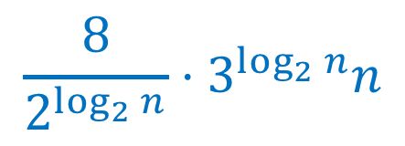


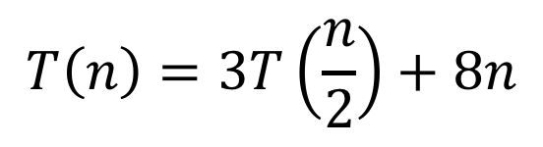

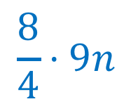


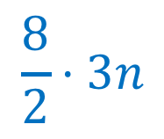






Tree Method
$$T\left(n\right)=3T\left(\frac{n}{2}\right)+8n$$
$$n$$
$$8n$$
$$8⋅1n$$
$$\frac{n}{2}$$
$$\frac{8n}{2}$$
$$\frac{n}{2}$$
$$\frac{8n}{2}$$
$$\frac{n}{2}$$
$$\frac{8n}{2}$$
$$\frac{8}{2}⋅3n$$
$$\frac{n}{4}$$
$$\frac{n}{4}$$
$$\frac{n}{4}$$
…
$$\frac{n}{4}$$
$$\frac{n}{4}$$
$$\frac{n}{4}$$
$$\frac{8}{4}⋅9n$$
$$\frac{8n}{4}$$
$$\frac{8n}{4}$$
$$\frac{8n}{4}$$
$$\frac{8n}{4}$$
$$\frac{8n}{4}$$
$$\frac{8n}{4}$$
…
…
…
…
…
…
…
$$\frac{8}{2^{\log_{2}{n}}}⋅3^{\log_{2}{n}}n$$
…
$$8$$
$$8$$
$$8$$
$$8$$
$$8$$
$$8$$
$$8$$
$$8$$
$$8$$
$$8$$
$$1$$
$$1$$
$$1$$
$$1$$
$$1$$
$$1$$
$$1$$
$$1$$
$$1$$
$$1$$

Slide 15

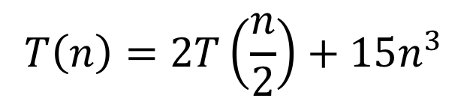
Master Theorem Example 4
$$T\left(n\right)=aT\left(\frac{n}{b}\right)+f(n)$$
Case 1: if $f\left(n\right)=O(n^{\log_{b}{a} −ε})$ for some constant $ε>0$, then $T\left(n\right)=Θ(n^{\log_{b}{a}})$
Case 2: if $f\left(n\right)=Θ(n^{\log_{b}{a}})$, then $T\left(n\right)=Θ(n^{\log_{b}{a}}\log{n})$
Case 3: if $f\left(n\right)=Ω(n^{\log_{b}{a+ε}})$ for some constant $ε>0$, and if $af\left(\frac{n}{b}\right)≤cf(n)$ for some constant $c<1$ and all sufficiently large $n$, then $T\left(n\right)=Θ(f\left(n\right))$
$$T\left(n\right)=2T\left(\frac{n}{2}\right)+15n^{3}$$
Case 3
$$Θ\left(n^{3}\right)$$

Slide 16
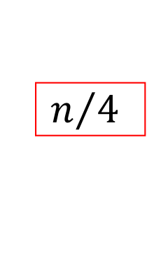


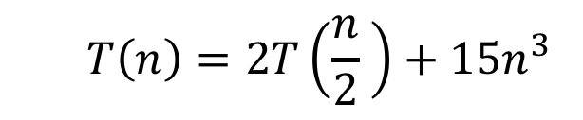

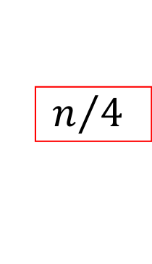






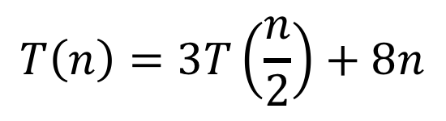




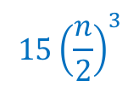


Tree method
$$T\left(n\right)=2T\left(\frac{n}{2} \right)+15n^{3}$$
$$15n^{3}$$
$$15n^{3}$$
$$n$$
$$\frac{15n^{3}}{4}$$
$$15{\left(\frac{n}{2}\right)}^{3}$$
$$15{\left(\frac{n}{2}\right)}^{3}$$
$$n/2$$
$$+$$
$$n/2$$
$$15{\left(\frac{n}{4}\right)}^{3}$$
$$15{\left(\frac{n}{4}\right)}^{3}$$
$$15{\left(\frac{n}{4}\right)}^{3}$$
$$15{\left(\frac{n}{4}\right)}^{3}$$
$$\log_{2}⁡n$$
$$\frac{15n^{3}}{16}$$
$$n/4$$
$$+$$
$$n/4$$
$$+$$
$$n/4$$
$$+$$
$$n/4$$
…
…
…
…
$$15$$
…
$$15$$
$$15$$
$$15$$
$$15$$
$$15$$
$$1$$
$$+$$
$$1$$
$$+$$
$$1$$
$$+$$
$$1$$
$$+$$
$$1$$
$$+$$
$$1$$
$$15\log_{2}{n}$$

Slide 17




Recurrence Solving Techniques
Tree
Guess/Check
“Cookbook”
Substitution
?

Slide 18
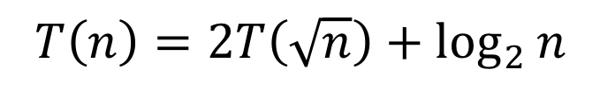
Substitution Method
Idea: take a “difficult” recurrence, re-express it such that one of our other methods applies.
Example:
$$T\left(n\right)=2T\left(\sqrt{n}\right)+\log_{2}{n}$$

Slide 19
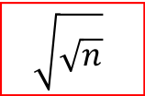

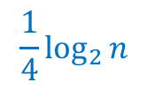

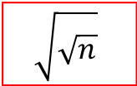



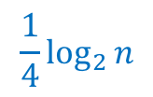
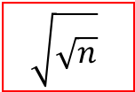




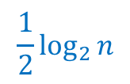





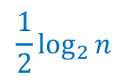

Tree method
$$T\left(n\right)=2T(\sqrt{n})+\log_{2}{n}$$
$$\log_{2}{n}$$
$$\log_{2}{n}$$
$$n$$
$$\frac{1}{2}\log_{2}{n}$$
$$\frac{1}{2}\log_{2}{n}$$
$$\log_{2}{n}$$
$$\sqrt{n}$$
$$+$$
$$\sqrt{n}$$
$$\frac{1}{4}\log_{2}{n}$$
$$\frac{1}{4}\log_{2}{n}$$
$$\frac{1}{4}\log_{2}{n}$$
$$\frac{1}{4}\log_{2}{n}$$
$$\log_{2}⁡\log_{2}{n}$$
$$\sqrt{\sqrt{n}}$$
$$+$$
$$\sqrt{\sqrt{n}}$$
$$+$$
$$\sqrt{\sqrt{n}}$$
$$+$$
$$\sqrt{\sqrt{n}}$$
$$\log_{2}{n}$$
…
…
…
…
$$1$$
…
$$1$$
$$1$$
$$1$$
$$1$$
$$1$$
$$\log_{2}{n}$$
$$2$$
$$+$$
$$2$$
$$+$$
$$2$$
$$+$$
$$2$$
$$+$$
$$2$$
$$+$$
$$2$$
$$T\left(n\right)=O(\log_{2}{n}⋅\log_{2}{\log_{2}{n}})$$

Slide 20
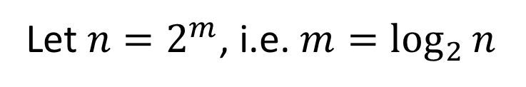
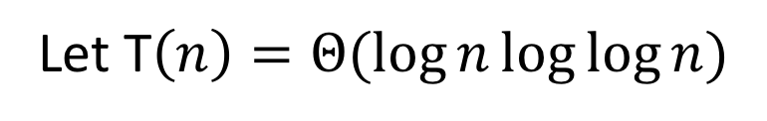
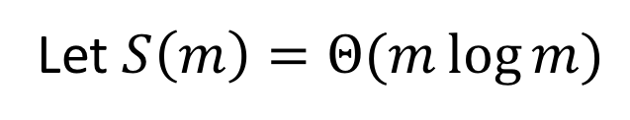
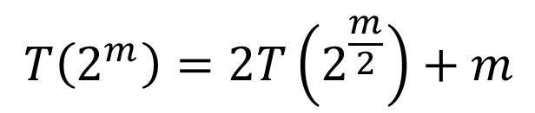
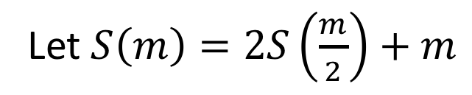
Substitution Method
Idea: take a “difficult” recurrence, re-express it such that one of our other methods applies.
Example:
$$T\left(n\right)=2T\left(\sqrt{n}\right)+\log_{2}{n}$$
Let $n=2^{m}$, i.e. $m=\log_{2}{n}$
$$T\left(2^{m}\right)=2T\left(2^{\frac{m}{2}}\right)+m$$
Rewrite in terms of exponent!
Let $S\left(m\right)=2S\left(\frac{m}{2}\right)+m$
Case 2!
Let $S\left(m\right)=Θ(m\log{m})$
Substitute Back
Let T$\left(n\right)=Θ(\log{n}\log{\log{n}})$

Slide 21
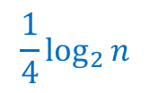




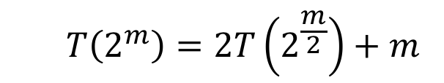





Tree method
$$T\left(2^{m}\right)=2T\left(2^{\frac{m}{2}}\right)+m$$
$$n=2^{m}$$
$$T\left(n\right)=2T(\sqrt{n})+\log_{2}{n}$$
$$\log_{2}{n}$$
$$\log_{2}{n}$$
$$n$$
$$2^{m}$$
$$\frac{1}{2}\log_{2}{n}$$
$$\frac{1}{2}\log_{2}{n}$$
$$\log_{2}{n}$$
$$\sqrt{n}$$
$$+$$
$$\sqrt{n}$$
$$2^{m/2}$$
$$2^{m/2}$$
$$\frac{1}{4}\log_{2}{n}$$
$$\frac{1}{4}\log_{2}{n}$$
$$\frac{1}{4}\log_{2}{n}$$
$$\frac{1}{4}\log_{2}{n}$$
$$\log_{2}⁡\log_{2}{n}$$
$$\sqrt{\sqrt{n}}$$
$$+$$
$$\sqrt{\sqrt{n}}$$
$$+$$
$$\sqrt{\sqrt{n}}$$
$$+$$
$$\sqrt{\sqrt{n}}$$
$$\log_{2}{n}$$
$$2^{m/4}$$
$$2^{m/4}$$
$$2^{m/4}$$
$$2^{m/4}$$
…
…
…
…
$$1$$
…
$$1$$
$$1$$
$$1$$
$$1$$
$$1$$
$$\log_{2}{n}$$
$$2$$
$$+$$
$$2$$
$$+$$
$$2$$
$$+$$
$$2$$
$$+$$
$$2$$
$$+$$
$$2$$

Slide 22
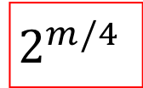



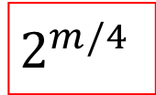
















Tree method
$$n=2^{m}$$
$$T\left(2^{m}\right)=2T(2^{m/2})+m$$
$$m$$
$$m$$
$$2^{m}$$
$$\frac{m}{2}$$
$$\frac{m}{2}$$
$$m$$
$$2^{m/2}$$
$$+$$
$$2^{m/2}$$
$$\frac{m}{4}$$
$$\frac{m}{4}$$
$$\frac{m}{4}$$
$$\frac{m}{4}$$
$$\log_{2}m$$
$$2^{m/4}$$
$$+$$
$$2^{m/4}$$
$$+$$
$$2^{m/4}$$
$$+$$
$$2^{m/4}$$
$$m$$
…
…
…
…
$$1$$
…
$$1$$
$$1$$
$$1$$
$$1$$
$$1$$
$$m$$
$$2^{1}$$
$$+$$
$$2^{1}$$
$$+$$
$$2^{1}$$
$$+$$
$$2^{1}$$
$$+$$
$$2^{1}$$
$$+$$
$$2^{1}$$

Slide 23










Tree method
$$n=2^{m}$$
$$T\left(2^{m}\right)=S(m)$$
$$S\left(m\right)=2S\left(\frac{m}{2}\right)+m$$
$$m$$
$$m$$
$$m$$
$$\frac{m}{2}$$
$$\frac{m}{2}$$
$$m$$
$$m/2$$
$$+$$
$$m/2$$
$$\frac{m}{4}$$
$$\frac{m}{4}$$
$$\frac{m}{4}$$
$$\frac{m}{4}$$
$$\log_{2}m$$
$$m/4$$
$$+$$
$$m/4$$
$$+$$
$$m/4$$
$$+$$
$$m/4$$
$$m$$
…
…
…
…
$$1$$
…
$$1$$
$$1$$
$$1$$
$$1$$
$$1$$
$$m$$
$$1$$
$$+$$
$$1$$
$$+$$
$$1$$
$$+$$
$$1$$
$$+$$
$$1$$
$$+$$
$$1$$
$$T\left(n\right)=O(m⋅\log_{2}{m})$$
$$=O(\log_{2}{n}⋅\log_{2}{\log_{2}{n}})$$

Slide 24


Nate’s Garden
2
5
4
6
7
Need to find:
Closest Pair of Tomatoes
3

Slide 25
Closest Pair of Points
Given:
A list of points
Return:
Pair of points with smallest distance apart
2
1
5
4
6
7
3
8

Slide 26

Closest Pair of Points: Naïve
Given:
A list of points
Return:
Pair of points with smallest distance apart
2
1
5
4
6
$$O(n^{2})$$
Algorithm:
Test every pair of points, return the closest.
7
3
8

Slide 27
Closest Pair of Points: D&C
Divide:
How?
2
1
At median x coordinate
Conquer:
5
4
6
7
3
8
27

Slide 28
Closest Pair of Points: D&C
Divide:
2
1
At median x coordinate
Conquer:
5
4
Recursively find closest pairs from Left and Right
6
Combine:
7
3
8
28
LeftPoints
RightPoints

Slide 29
Closest Pair of Points: D&C
Divide:
2
1
At median x coordinate
Conquer:
5
4
Recursively find closest pairs from Left and Right
6
Combine:
7
Return min of Left and Right pairs
?
Problem?
3
8
29
LeftPoints
RightPoints

Slide 30
Closest Pair of Points: D&C
Combine:
2 Cases:
2
1
1. Closest Pair is completely in Left or Right
5
4
6
2. Closest Pair Spans our “Cut”
7
Need to test points across the cut
?
3
8
30
LeftPoints
RightPoints

Slide 31




Spanning the Cut
Combine:
2. Closest Pair Spanned our “Cut”
2
1
$$δ_{L}$$
Need to test points across the cut
5
$$δ_{R}$$
4
6
Compare all points within $δ=min⁡\{δ_{L}, δ_{R}\}$ of the cut.
7
How many are there?
3
$$2δ$$
8
31
LeftPoints
RightPoints

Slide 32




Spanning the Cut
Combine:
2. Closest Pair Spanned our “Cut”
2
1
$$δ_{L}$$
Need to test points across the cut
4
5
$$δ_{R}$$
Compare all points within $δ=min⁡\{δ_{L}, δ_{R}\}$ of the cut.
6
7
How many are there?
3
$$2δ$$
8
$$T\left(n\right)=2T\left(\frac{n}{2}\right)+{\left(\frac{n}{2}\right)}^{2}=Θ\left(n^{2}\right)$$
LeftPoints
RightPoints
32

Slide 33

Spanning the Cut
Combine:
2. Closest Pair Spanned our “Cut”
2
1
$$δ_{L}$$
Need to test points across the cut
4
5
$$δ_{R}$$
We don’t need to test all pairs!
6
7
Only need to test points within $δ$ of one another
3
$$2δ$$
8
33
LeftPoints
RightPoints

Slide 34




Reducing Search Space
$$2⋅δ$$
Combine:
2. Closest Pair Spanned our “Cut”
Need to test points across the cut
Divide the “runway” into square cubbies of size $\frac{δ}{2}$
Each cubby will have at most 1 point!
$$\frac{δ}{2}$$
$$\frac{δ}{\sqrt{2}}$$
34

Slide 35


Reducing Search Space
$$2⋅δ$$
Combine:
2. Closest Pair Spanned our “Cut”
Need to test points across the cut
13
14
15
Divide the “runway” into square cubbies of size $\frac{δ}{2}$
9
10
11
12
How many cubbies could contain a point $<δ$ away?
5
6
7
8
Each point compared to $≤15$ other points
1
7
2
3
4

Slide 36
Closest Pair of Points: D&C
0. Sort points by x
1. Divide: At median x
2
1
2. Conquer: If >2 points Recursively find closest pair on left and right
$$δ_{L}$$
5
$$δ_{R}$$
4
3. Combine:
6
a. List points in “runway” in order according to y value
b. Compare each point to the next 15 above it, save best found
7
3
c. Return min from left, right, and 3b
8
36

Slide 37

Listing points in “Runway”
Given: y-sorted lists from left and right
Return: y-sorted points in “runway”
Target run time?
2
1
$$O(n)$$
5
Left, sorted by y
Right, sorted by y
4
6
3
7
5
1
8
6
4
2
Merged, sorted by y
8
3
7
6
4
5
1
2
7
Runway, still sorted by y!
8
7
6
5
2
3
8
37

Slide 38








Run Time
0. Sort points by x
$$Θ(n\log{n})$$
1. Divide: At median x
$$Θ(1)$$
2. Conquer: If >2 points, Recursively find closest pair on left and right
$$T\left(\frac{n}{2}\right)$$
3. Combine:
a. Merge points to sort by y
$$Θ(n)$$
$$T\left(n\right)=2T\left(\frac{n}{2}\right)+Θ(n)$$
b. Compare each runway point to the next 15 runway points, save closest pair
Case 2!
$$Θ(n)$$
$$T\left(n\right)=Θ(n\log{n})$$
c. Return y-sorted points and min from left, right, and 3b
$$Θ(1)$$

Slide 39






Matrix Multiplication
$$n$$
$$\left[\begin{matrix}1 & 2 & 3 \\ 4 & 5 & 6 \\ 7 & 8 & 9\end{matrix}\right]×\left[\begin{matrix}2 & 4 & 6 \\ 8 & 10 & 12 \\ 14 & 16 & 18\end{matrix}\right]$$
$$n$$
$$=\left[\begin{matrix}2+16+42 & 4+20+48 & 6+24+54 \\ ⋅ & ⋅ & ⋅ \\ ⋅ & ⋅ & ⋅\end{matrix}\right]$$
$$=\left[\begin{matrix}60 & 72 & 84 \\ 132 & 162 & 192 \\ 204 & 252 & 300\end{matrix}\right]$$
Run time?
$$O(n^{3})$$

Slide 40



Matrix Multiplication D&C
Multiply $n×n$ matrices ($A$ and $B$)
Divide:
$$A=\left[\begin{matrix}a_{1} & a_{2} & a_{3} & a_{4} \\ a_{5} & a_{6} & a_{7} & a_{8} \\ a_{9} & a_{10} & a_{11} & a_{12} \\ a_{13} & a_{14} & a_{15} & a_{16}\end{matrix}\right]$$
$$B=\left[\begin{matrix}b_{1} & b_{2} & b_{3} & b_{4} \\ b_{5} & b_{6} & b_{7} & b_{8} \\ b_{9} & b_{10} & b_{11} & b_{12} \\ b_{13} & b_{14} & b_{15} & b_{16}\end{matrix}\right]$$

Slide 41










Matrix Multiplication D&C
Multiply $n×n$ matrices ($A$ and $B$)
$$A=\left[\begin{matrix}a_{1} & a_{2} & a_{3} & a_{4} \\ a_{5} & a_{6} & a_{7} & a_{8} \\ a_{9} & a_{10} & a_{11} & a_{12} \\ a_{13} & a_{14} & a_{15} & a_{16}\end{matrix}\right]$$
$$A_{1,1}$$
$$A_{1,2}$$
$$B=\left[\begin{matrix}b_{1} & b_{2} & b_{3} & b_{4} \\ b_{5} & b_{6} & b_{7} & b_{8} \\ b_{9} & b_{10} & b_{11} & b_{12} \\ b_{13} & b_{14} & b_{15} & b_{16}\end{matrix}\right]$$
$$B_{1,1}$$
$$B_{1,2}$$
$$A_{2,1}$$
$$A_{2,2}$$
$$B_{2,1}$$
$$B_{2,2}$$
Combine:
$$AB=\left[\begin{matrix}A_{1,1}B_{1,1}+A_{1,2}B_{2,1} & A_{1,1}B_{1,2}+A_{1,2}B_{2,2} \\ A_{2,1}B_{1,1}+A_{2,2}B_{2,1} & A_{2,1}B_{1,2}+A_{2,2}B_{2,2}\end{matrix}\right]$$
$$T\left(n\right)=8T\left(\frac{n}{2}\right)+4{\left(\frac{n}{2}\right)}^{2}$$
Cost of additions
Run time?

Slide 42





Matrix Multiplication D&C
$$T\left(n\right)=8T\left(\frac{n}{2}\right)+4{\left(\frac{n}{2}\right)}^{2}$$
$$T\left(n\right)=8T\left(\frac{n}{2}\right)+n^{2}$$
$$a=8, b=2, f\left(n\right)=n^{2}$$
Case 1!
$$n^{\log_{b}{a}}=n^{\log_{2}{8}}=n^{3}$$
$$T\left(n\right)=Θ(n^{3})$$
We can do better…

Slide 43
Matrix Multiplication D&C
Multiply $n×n$ matrices ($A$ and $B$)
$$A=\left[\begin{matrix}a_{1} & a_{2} & a_{3} & a_{4} \\ a_{5} & a_{6} & a_{7} & a_{8} \\ a_{9} & a_{10} & a_{11} & a_{12} \\ a_{13} & a_{14} & a_{15} & a_{16}\end{matrix}\right]$$
$$A_{1,1}$$
$$A_{1,2}$$
$$B=\left[\begin{matrix}b_{1} & b_{2} & b_{3} & b_{4} \\ b_{5} & b_{6} & b_{7} & b_{8} \\ b_{9} & b_{10} & b_{11} & b_{12} \\ b_{13} & b_{14} & b_{15} & b_{16}\end{matrix}\right]$$
$$B_{1,1}$$
$$B_{1,2}$$
$$A_{2,1}$$
$$A_{2,2}$$
$$B_{2,1}$$
$$B_{2,2}$$
$$AB=\left[\begin{matrix}A_{1,1}B_{1,1}+A_{1,2}B_{2,1} & A_{1,1}B_{1,2}+A_{1,2}B_{2,2} \\ A_{2,1}B_{1,1}+A_{2,2}B_{2,1} & A_{2,1}B_{1,2}+A_{2,2}B_{2,2}\end{matrix}\right]$$
Idea: Use a Karatsuba-like technique on this

Slide 44


















Strassen’s Algorithm
Multiply $n×n$ matrices ($A$ and $B$)
$$A=\left[\begin{matrix}a_{1} & a_{2} & a_{3} & a_{4} \\ a_{5} & a_{6} & a_{7} & a_{8} \\ a_{9} & a_{10} & a_{11} & a_{12} \\ a_{13} & a_{14} & a_{15} & a_{16}\end{matrix}\right]$$
$$A_{1,1}$$
$$A_{1,2}$$
$$B=\left[\begin{matrix}b_{1} & b_{2} & b_{3} & b_{4} \\ b_{5} & b_{6} & b_{7} & b_{8} \\ b_{9} & b_{10} & b_{11} & b_{12} \\ b_{13} & b_{14} & b_{15} & b_{16}\end{matrix}\right]$$
$$B_{1,1}$$
$$B_{1,2}$$
$$A_{2,1}$$
$$A_{2,2}$$
$$B_{2,1}$$
$$B_{2,2}$$
Calculate:
Find $AB$:
$$Q_{1}=\left(A_{1,1}+A_{2,2}\right)(B_{1,1}+B_{2,2})$$
$$\left[\begin{matrix}Q_{1}+Q_{4}−Q_{5}+Q_{7} & Q_{3}+Q_{5} \\ Q_{2}+Q_{4} & Q_{1}−Q_{2}+Q_{3}+Q_{6}\end{matrix}\right]$$
$$Q_{2}=\left(A_{2,1}+A_{2,2}\right)B_{1,1}$$
$$Q_{3}=A_{1,1}(B_{1,2} −B_{2,2})$$
$$Q_{4}=A_{2,2}(B_{2,1}−B_{1,1})$$
$$\left[\begin{matrix}A_{1,1}B_{1,1}+A_{1,2}B_{2,1} & A_{1,1}B_{1,2}+A_{1,2}B_{2,2} \\ A_{2,1}B_{1,1}+A_{2,2}B_{2,1} & A_{2,1}B_{1,2}+A_{2,2}B_{2,2}\end{matrix}\right]$$
$$Q_{5}=\left(A_{1,1}+A_{1,2}\right)B_{2,2}$$
$$Q_{6}=\left(A_{2,1}−A_{1,1}\right)(B_{1,1}+B_{1,2})$$
Number Mults.: 7
Number Adds.: 18
$$Q_{7}=\left(A_{1,2}−A_{2,2}\right)(B_{2,1}+B_{2,2})$$
$$T\left(n\right)=7T\left(\frac{n}{2}\right)+\frac{9}{2}n^{2}$$

Slide 45




Strassen’s Algorithm
$$T\left(n\right)=7T\left(\frac{n}{2}\right)+\frac{9}{2}n^{2}$$
$$a=7, b=2, f\left(n\right)={\frac{9}{2}n}^{2}$$
Case 1!
$$n^{\log_{b}{a}}=n^{\log_{2}{7}}≈n^{2.807}$$
$$T\left(n\right)=Θ\left(n^{\log_{2}{7}}\right)≈Θ(n^{2.807})$$

Slide 46



$$n^{3}$$
$$n^{\log_{2}{7}}$$

Slide 47

Is this the fastest?
Best possible is unknown
May not even exist!

Slide 48
Closest Pair of Points: D&C
1. Sort points by x and y
2. Divide: At median x
2
1
3. Conquer: If <2 points Recursively find closest pair on left and right
$$δ_{L}$$
5
$$δ_{R}$$
4
4. Combine:
6
a. List points in “runway” in order according to y value
b. Compare each point to the next 15 above it, save best found
7
3
c. Return min from left, right, and 4b
8
48

