Slide 1
CS4102 Algorithms
Fall 2018

Slide 2
Today’s Keywords
Reductions
Bipartite Matching
Vertex Cover
Independent Set
NP-Completeness

Slide 3
CLRS Readings
Chapter 34

Slide 4
Homeworks
HW8 due Friday 11/30 at 11pm
Written (use LaTeX)
Graphs

Slide 5
Reductions
Algorithm technique of supreme ultimate power
Convert instance of problem A to an instance of Problem B
Convert solution of problem B back to a solution of problem A

Slide 6
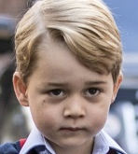


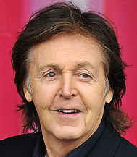
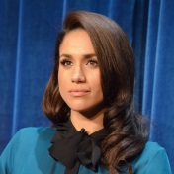
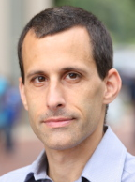
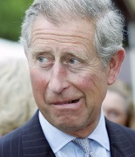



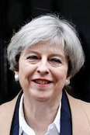
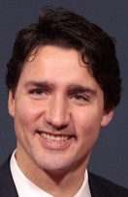
Party Problem
Draw Edges between people who don’t get along
Find the maximum number of people who get along

Slide 7
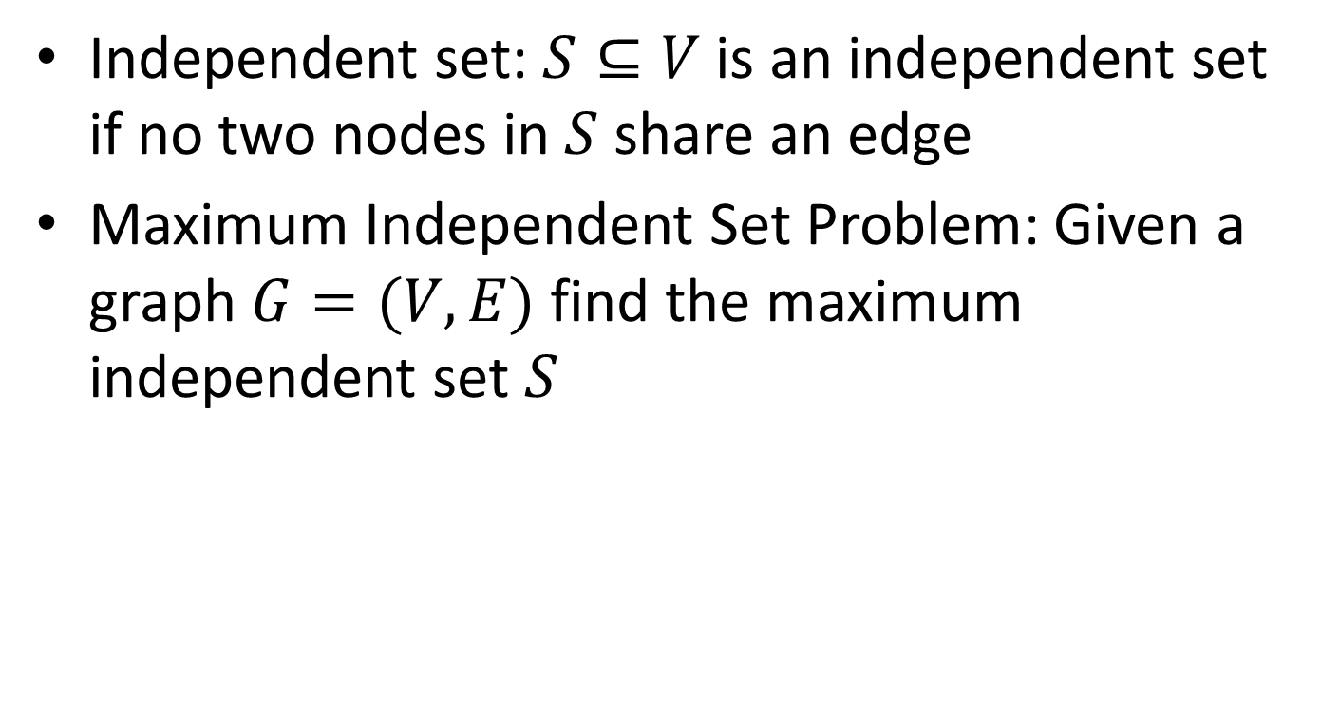
Maximum Independent Set
Independent set: $S⊆V$ is an independent set if no two nodes in $S$ share an edge
Maximum Independent Set Problem: Given a graph $G=(V,E)$ find the maximum independent set $S$

Slide 8
Example
Independent set of size 6

Slide 9
Generalized Baseball

Slide 10
Generalized Baseball
Need to place defenders on bases such that every edge is defended
What’s the fewest number of defenders needed?

Slide 11
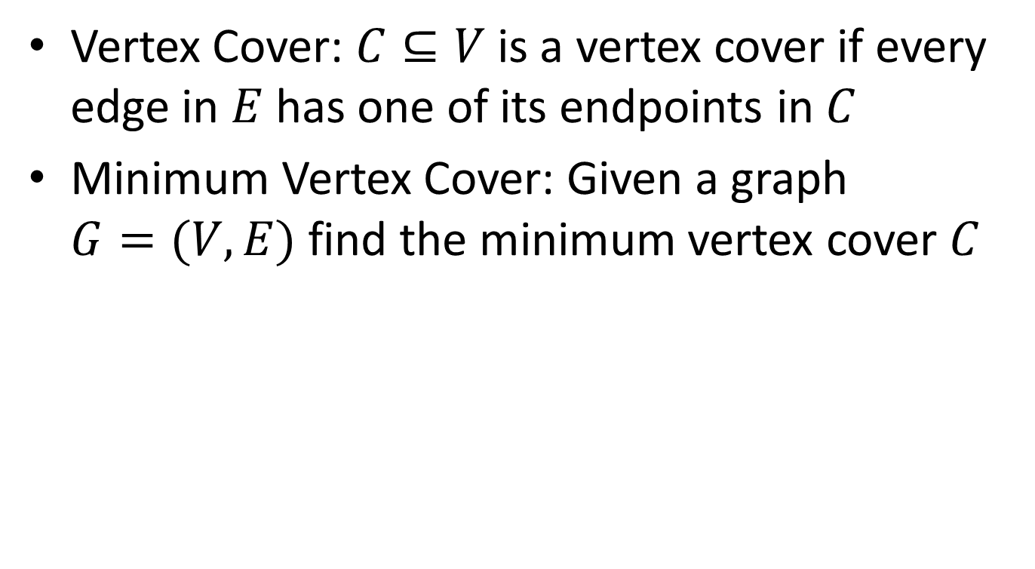
Minimum Vertex Cover
Vertex Cover: $C⊆V$ is a vertex cover if every edge in $E$ has one of its endpoints in $C$
Minimum Vertex Cover: Given a graph $G=(V,E)$ find the minimum vertex cover $C$

Slide 12
Example
Vertex cover of size 5

Slide 13









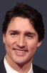
Reduction Idea
$S$ is an independent set of $G$ iff $V−S$ is a vertex cover of $G$
Independent Set
Vertex Cover

Slide 14
Reduction Idea
$S$ is an independent set of $G$ iff $V−S$ is a vertex cover of $G$
Vertex Cover
Independent Set

Slide 15


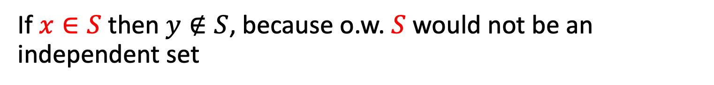
Proof: $⇒$
$S$ is an independent set of $G$ iff $V−S$ is a vertex cover of $G$
Let $S$ be an independent set
Consider any edge $\left(x,y\right)∈E$
If $x∈S$ then $y∉S$, because o.w. $S$ would not be an independent set
Therefore $y∈V−S$, so edge $(x,y)$ is covered by $V−S$

Slide 16
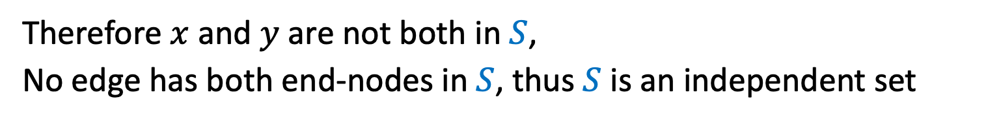

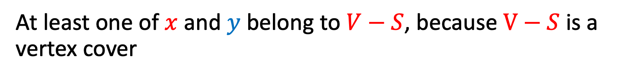
Proof: $⇐$
$S$ is an independent set of $G$ iff $V−S$ is a vertex cover of $G$
Let $V−S$ be a vertex cover
Consider any edge $\left(x,y\right)∈E$
At least one of $x$ and $y$ belong to $V−S$, because $V−S$ is a vertex cover
Therefore $x$ and $y$ are not both in $S$,
No edge has both end-nodes in $S$, thus $S$ is an independent set

Slide 17


Reductions
Shows how two different problems relate to each other
MOVIE TIME!

Slide 18

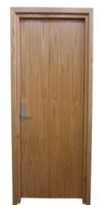
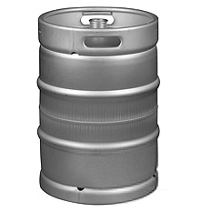

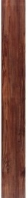

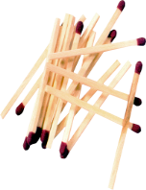




MacGyver’s Reduction
Problem we don’t know how to solve
Problem we do know how to solve
$$A$$
Opening a door
Aim duct at door, insert keg
Lighting a fire
$$B$$
How?
Solution for $A$
Solution for $B$
Keg cannon battering ram
Alcohol, wood, matches
Put fire under the Keg
Reduction

Slide 19
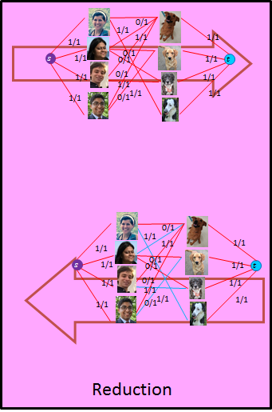








Bipartite Matching Reduction
Problem we don’t know how to solve
Problem we do know how to solve
Bipartite Matching
Max Flow
$$A$$
$$B$$
3
2
$$s$$
3
2
3
1
3
2
$$t$$
1
2
3
Ford Fulkerson
Solution for $B$
Solution for $A$
1
2
2
0
2
$$s$$
1
1
1
2
0
3
$$t$$
0
2
3
1
1
1
2

Slide 20
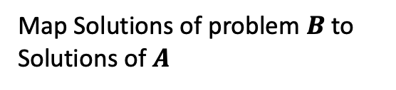

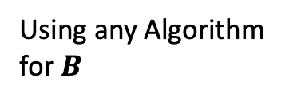

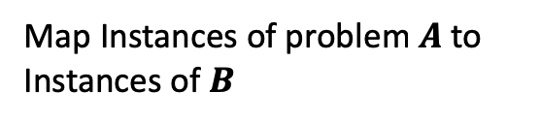


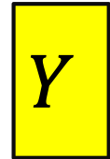
In General: Reduction
Problem we don’t know how to solve
Problem we do know how to solve
$$A$$
Map Instances of problem $A$to Instances of $B$
$$B$$
Using any Algorithm for $B$
Map Solutions of problem $B$to Solutions of $A$
Solution for $A$
Solution for $B$
$$X$$
$$Y$$
Reduction

Slide 21


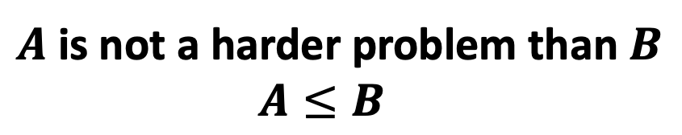

Worst-case lower-bound Proofs
Lighting a fire
Opening a door
$$A$$
reduces to
$$B$$
Problem B
Problem A
Alcohol, wood, matches
can be used to make
Keg cannon battering ram
$$Y$$
$$X$$
Algorithm for B
Algorithm for A
$A$ is not a harder problem than $B$
$A≤B$
The name “reduces” is confusing: it is in the opposite direction of the making

Slide 22

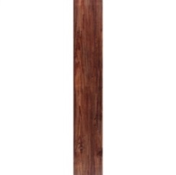
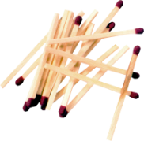


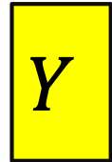


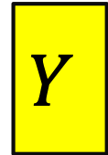

Proof of Lower Bound by Reduction
To Show: $Y$ is slow
$$X$$
1. We know X is slow
(e.g., X = some way to open the door)
$$Y$$
2. Assume Y is quick [toward contradiction]
(Y = some way to light a fire)
$$X$$
$$Y$$
3. Show how to use Y to perform X quickly
4. X is slow, but Y could be used to perform X quickly
conclusion: Y must not actually be quick

Slide 23
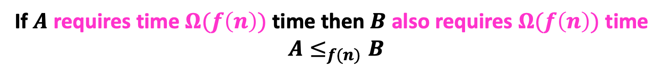
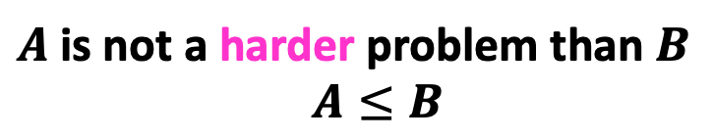


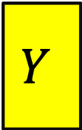



Reduction Proof Notation
$$A$$
$$B$$
$f(n)$-reduces to
Problem B
Problem A
$$Y$$
$$X$$
can be used to make
With $O(f\left(n\right))$ overhead
Algorithm for B
Algorithm for A
$A$ is not a harder problem than $B$
$A≤B$
If $A$ requires time $Ω(f\left(n\right))$ time then $B$ also requires $Ω(f\left(n\right))$ time
$A≤_{f(n)}B$

Slide 24















MaxIndSet$≤_{V}$MinVertCov
$$A$$
$$B$$
$O(V)$-reduces to
Problem B
Problem A
$$Y$$
$$X$$
can be used to make
With $O(V)$ overhead
Algorithm for B
Algorithm for A
If $A$ requires time $Ω(f\left(n\right))$ time then $B$ also requires $Ω(f\left(n\right))$ time
$A≤_{V}B$

Slide 25














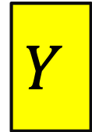

We need to build this Reduction
MaxIndSet
O(V) Time
MinVertCov
$$A$$
Relate Instances of MaxIndSet
to Instances of MinVertCov
$$B$$
Using any Algorithm for MinVertCov
Relate Solutions of MinVertCov to Solutions of MaxIndSet
Solution for MaxIndSet
Solution for MinVertCov
$$X$$
$$Y$$
Reduction

Slide 26

MaxVertCov $V$-Time Reducable to MinIndSet
MaxIndSet
O(V) Time
MinVertCov
$$A$$
$$B$$
Do nothing
Using any Algorithm for MinVertCov
Solution for MaxIndSet
Take complement of solution
Solution for MinVertCov
$$X$$
$$Y$$
Reduction

Slide 27

MaxIndSet $V$-Time Reducable to MinVertCov
MaxIndSet
MinVertCov
O(V) Time
$$A$$
$$B$$
Do nothing
Using any Algorithm for MaxIndSet
Solution for MinVertCov
Take complement of solution
Solution for MaxIndSet
$$X$$
$$Y$$
Reduction

Slide 28
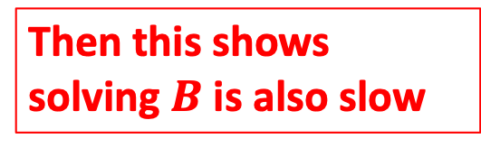
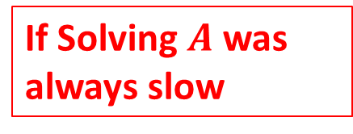
Corollary
MaxIndSet
O(V) Time
MinVertCov
$$A$$
$$B$$
Do nothing
If Solving $A$ was always slow
Using any Algorithm for MinIndSet
Then this shows solving $B$ is also slow
Solution for MaxIndSet
Take complement of solution
Solution for MinVertCov
$$X$$
$$Y$$
Reduction

Slide 29
Corollary
MaxIndSet
MinVertCov
O(V) Time
$$A$$
$$B$$
Do nothing
If Solving $A$ was always slow
Using any Algorithm for MaxVertCov
Then this shows solving $B$ is also slow
Solution for MinVertCov
Take complement of solution
Solution for MaxIndSet
$$X$$
$$Y$$
Reduction

Slide 30
Conclusion
MaxIndSet and MinVertCov are either both fast, or both slow
Spoiler alert: We don’t know which!
(But we think they’re both slow)
Both problems are NP-Complete

Slide 31
Mid-class warm up:
What is a Decision Problem?

Slide 32
Max Independent Set
Find the largest set of non-adjacent nodes

Slide 33

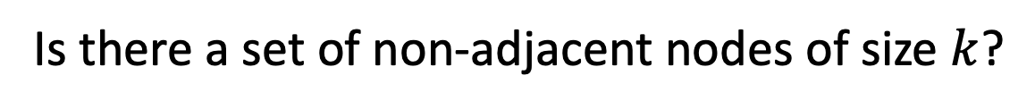
$k$ Independent Set
Is there a set of non-adjacent nodes of size $k$?

Slide 34
Maximum Independent Set
Independent set: $S⊆V$ is an independent set if no two nodes in $S$ share an edge
Maximum Independent Set Problem: Given a graph $G=(V,E)$ find the maximum independent set $S$

Slide 35
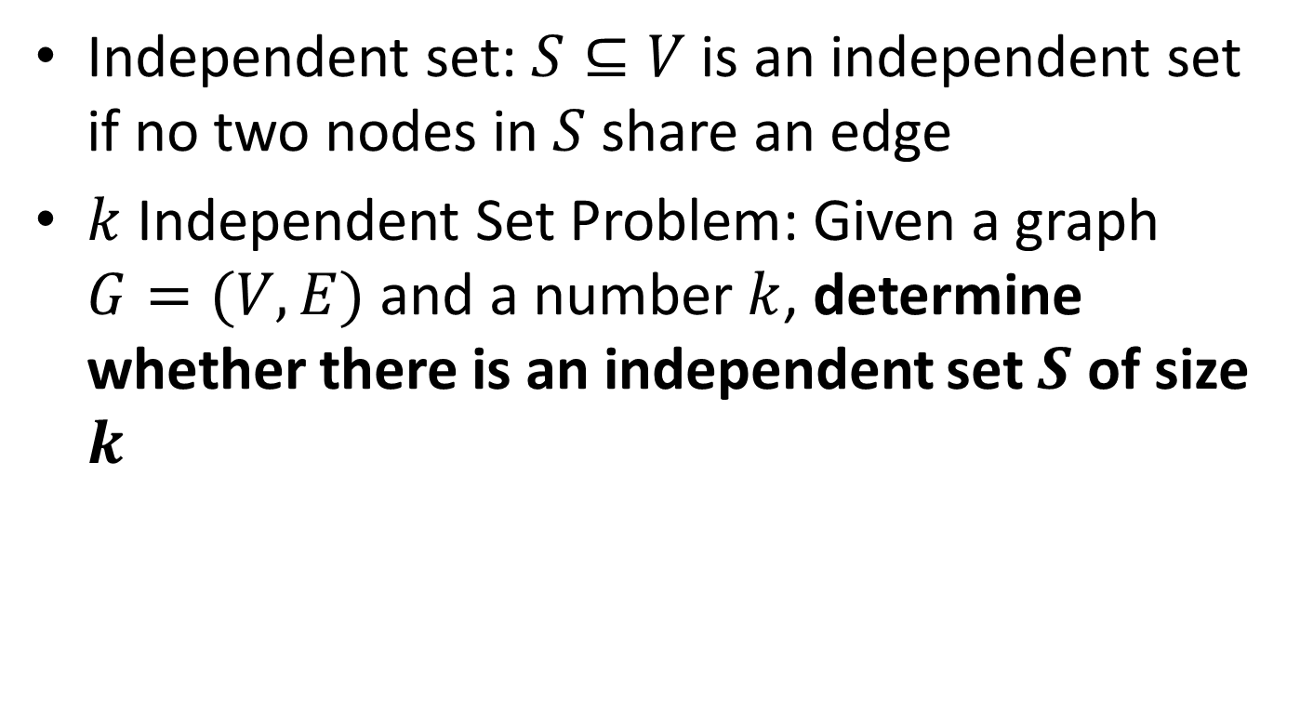
$k$ Independent Set
Independent set: $S⊆V$ is an independent set if no two nodes in $S$ share an edge
$k$ Independent Set Problem: Given a graph $G=(V,E)$ and a number $k$, determine whether there is an independent set $S$ of size $k$

Slide 36
Min Vertex Cover
Find the smallest set of nodes which covers every edge

Slide 37
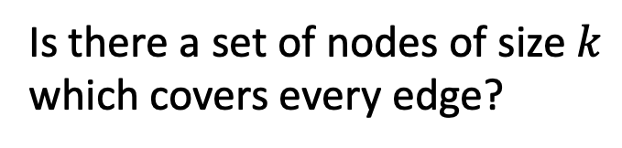

$k$ Vertex Cover
Is there a set of nodes of size $k$ which covers every edge?

Slide 38
Minimum Vertex Cover
Vertex Cover: $C⊆V$ is a vertex cover if every edge in $E$ has one of its endpoints in $C$
Minimum Vertex Cover: Given a graph $G=(V,E)$ find the minimum vertex cover $C$

Slide 39
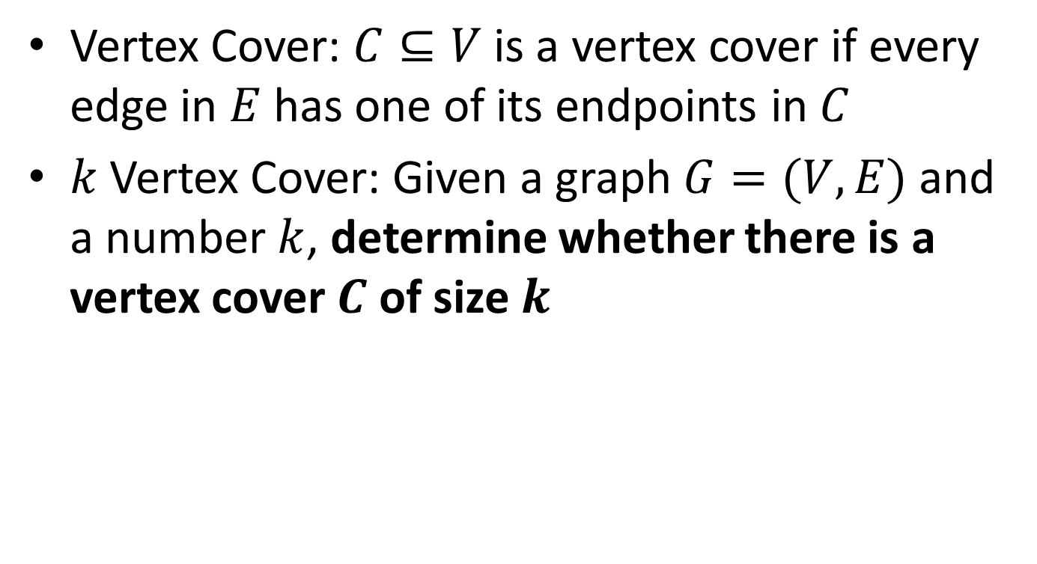
$k$ Vertex Cover
Vertex Cover: $C⊆V$ is a vertex cover if every edge in $E$ has one of its endpoints in $C$
$k$Vertex Cover: Given a graph $G=(V,E)$ and a number $k$, determine whether there is a vertex cover $C$ of size $k$

Slide 40
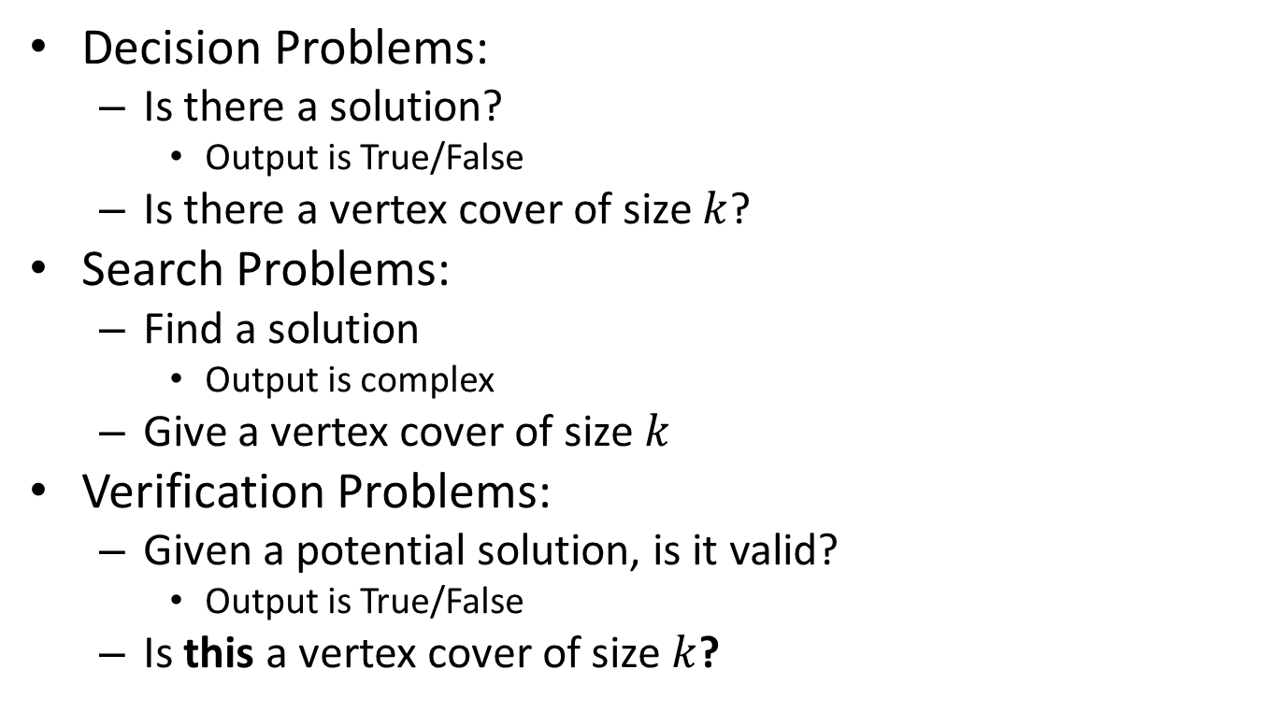
Problem Types
If we can solve this
Decision Problems:
Is there a solution?
Output is True/False
Is there a vertex cover of size $k$?
Search Problems:
Find a solution
Output is complex
Give a vertex cover of size $k$
Verification Problems:
Given a potential solution, is it valid?
Output is True/False
Is this a vertex cover of size $k$?
Then we can solve this

Slide 41


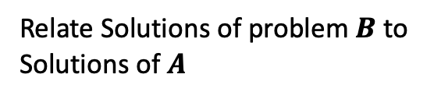
Reduction
$k$-VertexCover Solver
$k$-VertexCover Decider
$$A$$
Remove a node, etc…
$$B$$
Using any Algorithm for $B$
Relate Solutions of problem $B$to Solutions of $A$
Solution for $A$
Solution for $B$
$$X$$
$$Y$$
Reduction

Slide 42
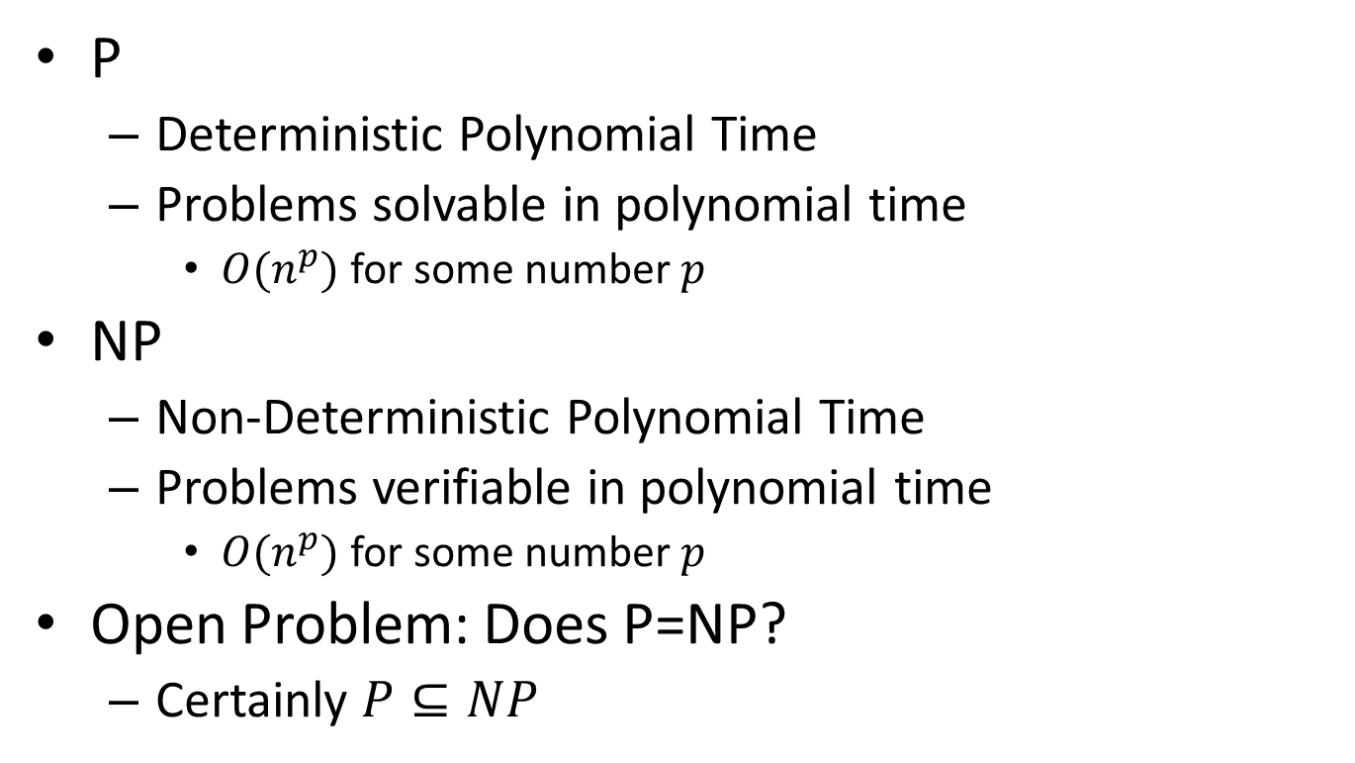
P vs NP
P
Deterministic Polynomial Time
Problems solvable in polynomial time
$O(n^{p})$ for some number $p$
NP
Non-Deterministic Polynomial Time
Problems verifiable in polynomial time
$O(n^{p})$ for some number $p$
Open Problem: Does P=NP?
Certainly $P⊆NP$
NP
P

Slide 43


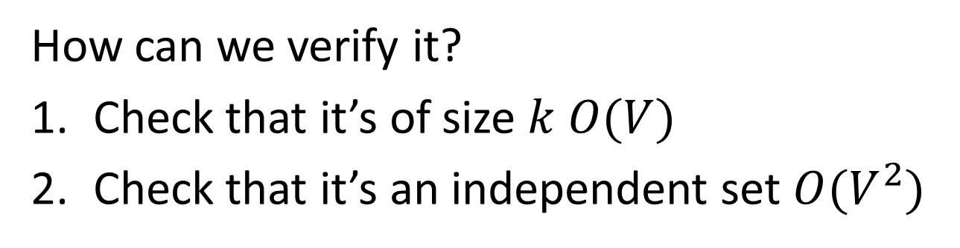
$k$-Independent Set is NP
To show: Given a potential solution, can we verify it in $O(n^{p})$? $[n=V+E]$
How can we verify it?
Check that it’s of size $k$ $O(V)$
Check that it’s an independent set $O(V^{2})$

Slide 44

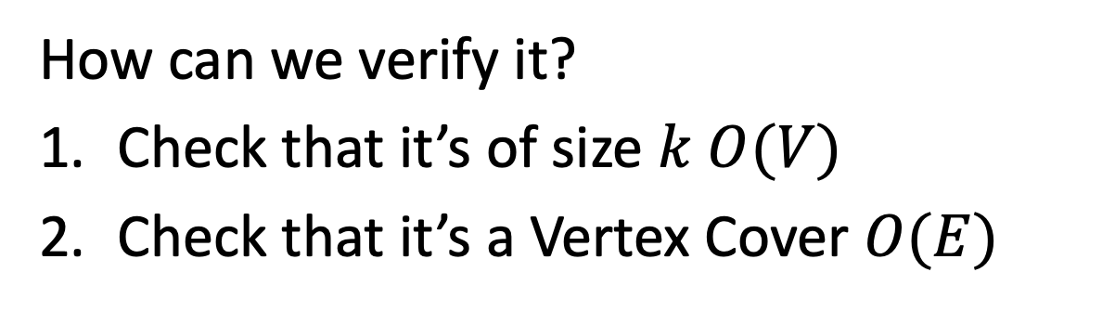
$k$-Vertex Cover is NP
To show: Given a potential solution, can we verify it in $O(n^{p})$? $[n=V+E]$
How can we verify it?
Check that it’s of size $k$ $O(V)$
Check that it’s a Vertex Cover $O(E)$

Slide 45
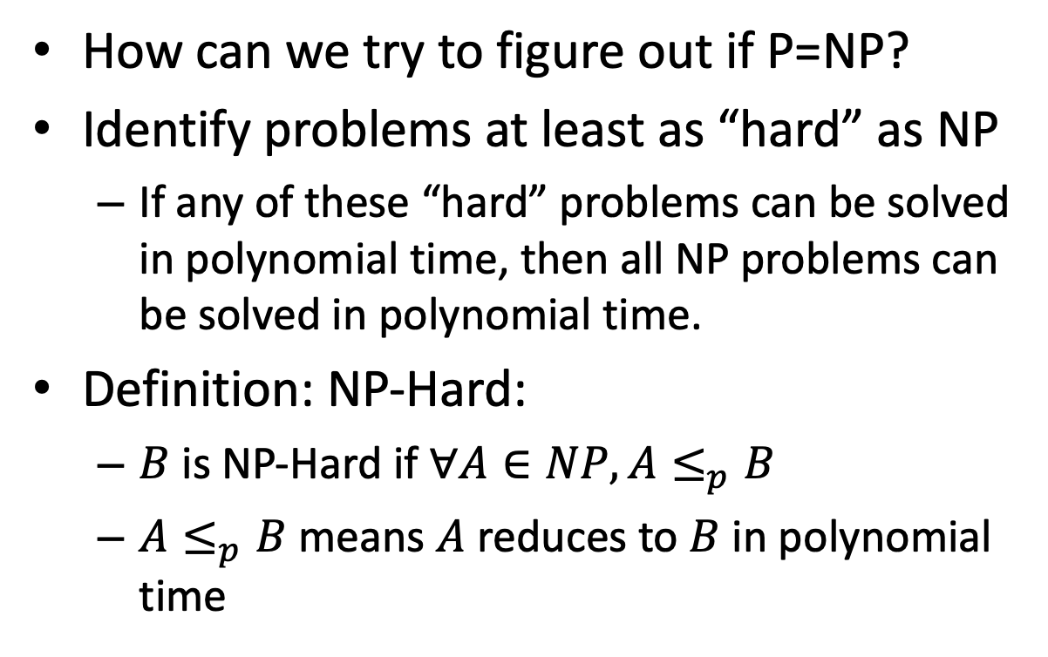
NP-Hard
How can we try to figure out if P=NP?
Identify problems at least as “hard” as NP
If any of these “hard” problems can be solved in polynomial time, then all NP problems can be solved in polynomial time.
Definition: NP-Hard:
$B$ is NP-Hard if $∀A∈NP, A≤_{p}B$
$A≤_{p}B$ means $A$ reduces to $B$ in polynomial time
NP-H
At least as “hard” as NP
NP
P

Slide 46

NP-Hardness Reduction
Any NP-Hard Problem
$$O(n^{p})$$
Problem to show is NP-Hard
$$A$$
$$B$$
If This could be done in Polynomial time
Then this could be done in polynomial time
Solution for $A$
Solution for $B$
$$X$$
$$Y$$
Reduction

Slide 47
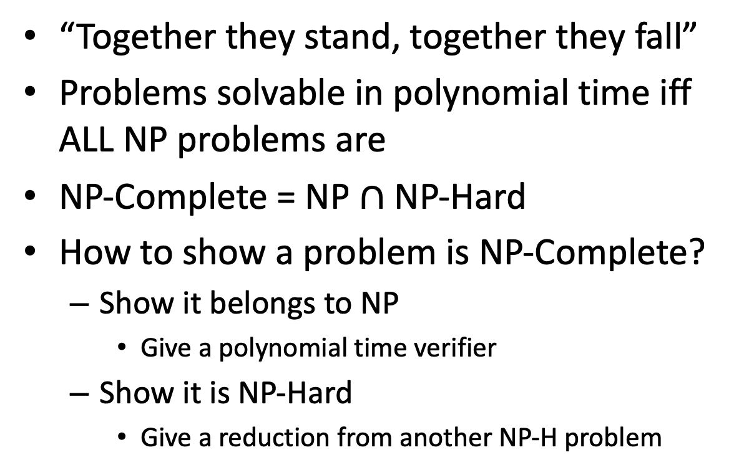
NP-Complete
“Together they stand, together they fall”
Problems solvable in polynomial time iff ALL NP problems are
NP-Complete = NP $∩$ NP-Hard
How to show a problem is NP-Complete?
Show it belongs to NP
Give a polynomial time verifier
Show it is NP-Hard
Give a reduction from another NP-H problem
NP-H
NP-C
NP
P
We now just need a FIRST NP-Hard problem

Slide 48
NP-Completeness
Any NP-Complete Problem
$$O(n^{p})$$
Any other NP-Complete Problem
$$A$$
$$B$$
If This could be done in Polynomial time
Then this could be done in polynomial time
Solution for $A$
Solution for $B$
$$X$$
$$Y$$
Reduction

Slide 49
NP-Completeness
Any NP-Complete Problem
$$O(n^{p})$$
Any other NP-Complete Problem
$$A$$
$$B$$
If this cannot be done in polynomial time
Then this cannot be done in polynomial time
Solution for $A$
Solution for $B$
$$X$$
$$Y$$
Reduction

Slide 50
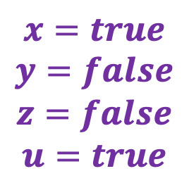
3-SAT
Shown to be NP-Hard by Cook and Levin (independently)
Given a 3-CNF formula (logical AND of clauses, each an OR of 3 variables), Is there an assignment of true/false to each variable to make the formula true?
$$\left(x∨y∨z\right)∧\left(x∨\overline{y}∨y\right)∧\left(u∨y∨\overline{z}\right)∧\left(z∨\overline{x}∨u\right)∧(\overline{x}∨\overline{y}∨\overline{z})$$
Clause
$$x=true$$
$$y=false$$
$$z=false$$
$$u=true$$
Variables

Slide 51
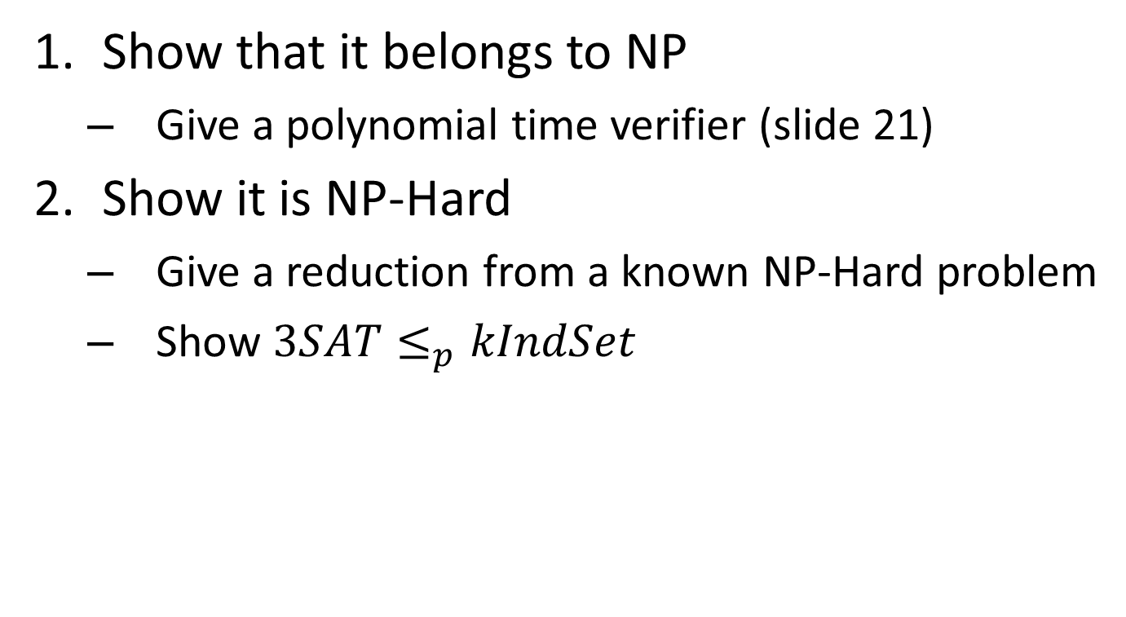
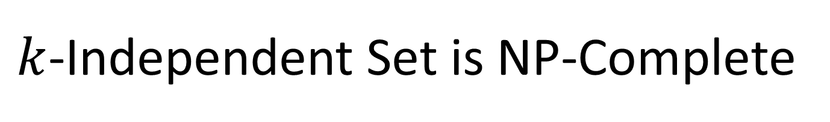
$k$-Independent Set is NP-Complete
Show that it belongs to NP
Give a polynomial time verifier (slide 21)
Show it is NP-Hard
Give a reduction from a known NP-Hard problem
Show $3SAT≤_{p}kIndSet$

Slide 52



$$3SAT≤_{p}kIndSet$$
3SAT
$$O(n^{p})$$
$k$-Ind Set
$$A$$
$$B$$
Solution for 3SAT
Solution for $k$-Ind Set
$$X$$
$$Y$$
Reduction

Slide 53














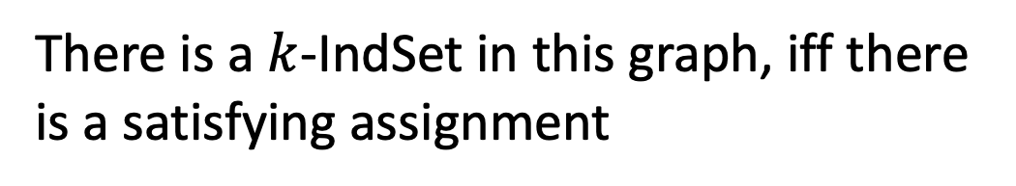



Instance of 3SAT to Instance of $k$IndSet
$$\left(x∨y∨z\right)∧\left(x∨\overline{y}∨y\right)∧\left(u∨y∨\overline{z}\right)∧\left(z∨\overline{x}∨u\right)∧(\overline{x}∨\overline{y}∨\overline{z})$$
$$x$$
$$u$$
$$z$$
$$\overline{u}$$
$$x$$
$$y$$
$$\overline{y}$$
$$\overline{z}$$
$$y$$
$$u$$
$$\overline{x}$$
$$\overline{z}$$
$$\overline{y}$$
$$z$$
$$y$$
For each clause, produce a triangle graph with its three variables as nodes
Connect each node to all of its opposites
Let $k=$ number of clauses
There is a $k$-IndSet in this graph, iff there is a satisfying assignment

Slide 54







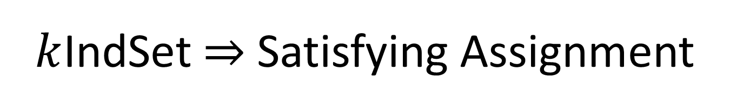











$k$IndSet $⇒$ Satisfying Assignment
$$\left(x∨y∨z\right)∧\left(x∨\overline{y}∨y\right)∧\left(u∨y∨\overline{z}\right)∧\left(z∨\overline{x}∨u\right)∧(\overline{x}∨\overline{y}∨\overline{z})$$
$$x$$
$$u$$
$$z$$
$$\overline{u}$$
$$x$$
$$y$$
$$\overline{y}$$
$$\overline{z}$$
$$y$$
$$u$$
$$\overline{x}$$
$$\overline{z}$$
$$\overline{y}$$
$$z$$
$$y$$
$$x=true$$
$$y=false$$
$$z=false$$
$$u=true$$
One node per triangle is in the Independent set:
because we can have exactly $k$ total in the set,
and 2 in a triangle would be adjacent
If $x$ is selected in some triangle, $\overline{x}$ is not selected in any triangle:
Because every $x$ is adjacent to every $\overline{x}$
Set the variable which each included node represents to “true”

Slide 55

Satisfying Assignment $⇒k$IndSet
$$\left(x∨y∨z\right)∧\left(x∨\overline{y}∨y\right)∧\left(u∨y∨\overline{z}\right)∧\left(z∨\overline{x}∨u\right)∧(\overline{x}∨\overline{y}∨\overline{z})$$
$$x$$
$$u$$
$$z$$
$$\overline{u}$$
$$x$$
$$y$$
$$\overline{y}$$
$$\overline{z}$$
$$y$$
$$u$$
$$\overline{x}$$
$$\overline{z}$$
$$\overline{y}$$
$$z$$
$$y$$
$$x=true$$
$$y=false$$
$$z=false$$
$$u=true$$
Use one true variable from the assignment for each triangle
The independent set has $k$ nodes, because there are $k$ clauses
If any variable $x$ is true then $\overline{x}$ cannot be true

Slide 56

$$3SAT≤_{p}kIndSet$$
3SAT
$$O(n^{p})$$
$k$-Ind Set
$$A$$
$$B$$
Make triangles, connect opposites, $k=$ num clauses
If This could be done in Polynomial time
Then This could be done in polynomial time
Solution for 3SAT
Assign true to variables from selected nodes
Solution for $k$-Ind Set
$$X$$
$$Y$$
Reduction

Slide 57


$k$-Vertex Cover is NP-Complete
Show that it belongs to NP
Give a polynomial time verifier (slide 22)
Show it is NP-Hard
Give a reduction from a known NP-Hard problem
We showed $kIndSet≤_{p}kVertCov$
(Last Class)

Slide 58






$$kIndSet≤_{p}kVertCov$$
$$kIndSet$$
$$O(n^{p})$$
$$kVertCov$$
$$A$$
$$B$$
$$k=V−k$$
If This could be done in Polynomial time
Then This could be done in polynomial time
Solution for $kIndSet$
Take Complement of nodes
Solution for $kVertCov$
$$X$$
$$Y$$
Reduction

Slide 59


$k$-Clique Problem
Clique: A complete subgraph
$k$-Clique Problem:
Given a graph $G$ and a number $k$, is there a clique of size $k$?
4-Clique
3-Clique

Slide 60


$k$-Clique is NP-Complete
Show that it belongs to NP
Give a polynomial time verifier
Show it is NP-Hard
Give a reduction from a known NP-Hard problem
We will show $3SAT≤_{p}kClique$

Slide 61


$k$-Clique is NP
Given a Graph and a potential solution
Check that the solution has $k$ nodes
Check that every pair of nodes share an edge
4-Clique
3-Clique

Slide 62





$$3SAT≤_{p}kClique$$
$$3SAT$$
$$O(n^{p})$$
$$kClique$$
$$A$$
$$B$$
Solution for $3SAT$
Solution for$kClique$
$$X$$
$$Y$$
Reduction

Slide 63
















Instance of 3SAT to Instance of $k$Clique
$$\left(x∨y∨z\right)∧\left(x∨\overline{y}∨y\right)∧\left(u∨y∨\overline{z}\right)∧\left(z∨\overline{x}∨u\right)∧(\overline{x}∨\overline{y}∨\overline{z})$$
$$x$$
$$y$$
$$\overline{y}$$
$$u$$
$$z$$
$$x$$
$$\overline{x}$$
(also do this for the other clauses, omitted due to clutter)
$$z$$
$$y$$
$$\overline{y}$$
$$\overline{u}$$
$$y$$
$$\overline{z}$$
$$u$$
$$\overline{z}$$
For each clause, produce a node for each of its three variables
Connect each node to all non-contradictory nodes in the other clauses
(i.e., anything that’s not its negation)
Let $k=$ number of clauses
There is a $k$-Clique in this graph, iff there is a satisfying assignment

Slide 64








$k$Clique $⇒$ Satisfying Assignment
$$\left(x∨y∨z\right)∧\left(x∨\overline{y}∨y\right)∧\left(u∨y∨\overline{z}\right)∧\left(z∨\overline{x}∨u\right)∧(\overline{x}∨\overline{y}∨\overline{z})$$
$$x=true$$
$$y=false$$
$$z=false$$
$$u=true$$
$$x$$
$$y$$
$$\overline{y}$$
$$u$$
$$z$$
$$x$$
$$\overline{x}$$
$$z$$
$$y$$
$$\overline{y}$$
$$\overline{u}$$
$$y$$
$$\overline{z}$$
$$u$$
$$\overline{z}$$
There are $k$ triplets in the graph, and no two nodes in the same triplet are adjacent
To have a $k$-Clique, must have one node from each triplet
Cannot select a node for both a variable and its negation
Therefore selection of nodes is a satisfying assignment

Slide 65


Satisfying Assignment$⇒$ $k$Clique
$$\left(x∨y∨z\right)∧\left(x∨\overline{y}∨y\right)∧\left(u∨y∨\overline{z}\right)∧\left(z∨\overline{x}∨u\right)∧(\overline{x}∨\overline{y}∨\overline{z})$$
$$x=true$$
$$y=false$$
$$z=false$$
$$u=true$$
$$x$$
$$y$$
$$\overline{y}$$
$$u$$
$$z$$
$$x$$
$$\overline{x}$$
$$z$$
$$y$$
$$\overline{y}$$
$$\overline{u}$$
$$y$$
$$\overline{z}$$
$$u$$
$$\overline{z}$$
Select one node for a true variable from each clause
There will be $k$ nodes selected
We can’t select both a node and its negation
All nodes will be non-contradictory, so they will be pairwise adjacent

Slide 66
$$3SAT≤_{p}kClique$$
$$3SAT$$
$$O(n^{p})$$
$$kClique$$
$$A$$
Make a triplet per clause, connect non-contraditcory nodes among clauses
$$B$$
If This could be done in Polynomial time
Then This could be done in polynomial time
Solution for $3SAT$
Assign each variable selected to True
Solution for$kClique$
$$X$$
$$Y$$
Reduction

Slide 67
Reduction
$k$-VertexCover Solver
$k$-VertexCover Decider
$$A$$
Remove a node, etc…
$$B$$
Using any Algorithm for $B$
Relate Solutions of problem $B$to Solutions of $A$
Solution for $A$
Solution for $B$
$$X$$
$$Y$$
Reduction

Slide 68
Problem Types
If we can solve this
Decision Problems:
Is there a solution?
Output is True/False
Is there a vertex cover of size $k$?
Search Problems:
Find a solution
Output is complex
Give a vertex cover of size $k$
Verification Problems:
Given a potential solution, is it valid?
Output is True/False
Is this a vertex cover of size $k$?
Then we can solve this

Slide 69


Using a $k$-VertexCover decider to build a searcher
Set $i=k−1$
Remove nodes (and incident edges) one at a time
Check if there is a vertex cover of size $i$
If so, then that removed node was part of the $k$ vertex cover, set $i=i−1$
Else, it wasn’t

Slide 70


$5$ Vertex Cover (Decision)
Is there a set of nodes of size $5$ which covers every edge?
Yes!

Slide 71


$4$ Vertex Cover (Decision)
Is there a set of nodes of size $4$ which covers every edge?
No!

Slide 72
$4$ Vertex Cover (Decision)
Is there a set of nodes of size $4$ which covers every edge?
Yes!

Slide 73


$3$ Vertex Cover (Decision)
Is there a set of nodes of size $3$ which covers every edge?
No!

