Slide 1
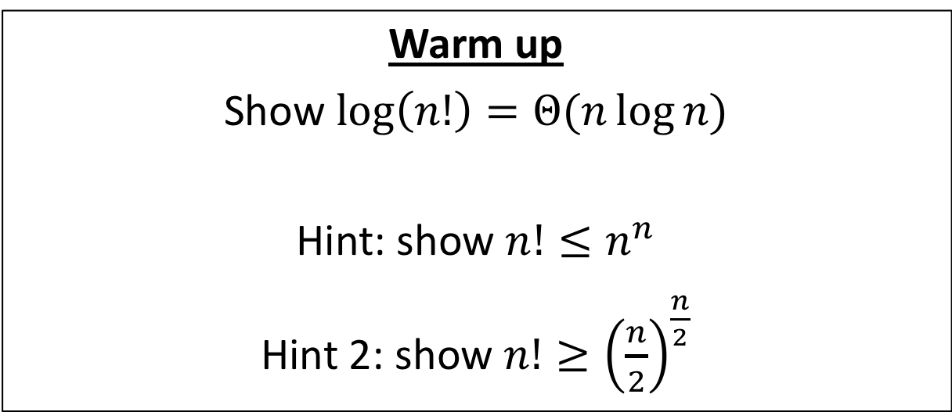
CS4102 Algorithms
Fall 2018
Warm up
Show $\log\left(n!\right)=Θ(n\log{n})$
Hint: show $n!≤n^{n}$
Hint 2: show $n!≥{\left(\frac{n}{2}\right)}^{\frac{n}{2}}$

Slide 2

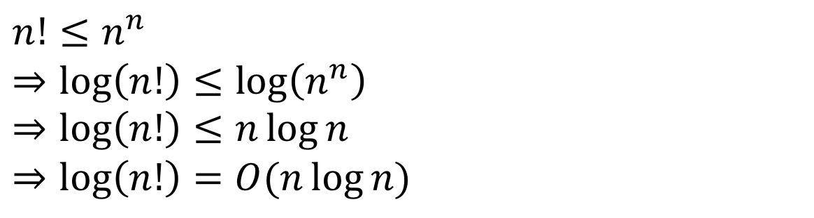



$$\log{n!}=O\left(n\log{n}\right)$$
$$n!=n⋅\left(n−1\right)⋅\left(n−2\right)⋅…⋅2⋅1$$
$$=$$
$$<$$
$$<$$
$$<$$
$$<$$
$$n^{n}=n⋅ n ⋅ n ⋅…⋅n⋅n$$
$$n!≤n^{n}$$
$$⇒\log\left(n!\right)≤\log\left(n^{n}\right)$$
$$⇒\log\left(n!\right)≤n\log{n}$$
$$⇒\log\left(n!\right)=O(n\log{n})$$

Slide 3
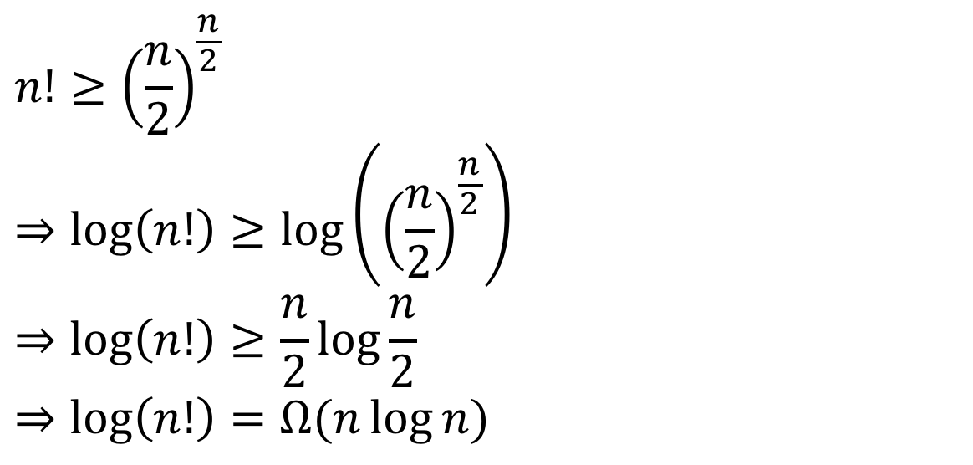
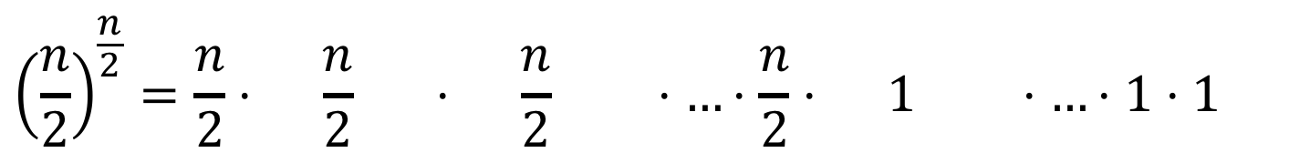

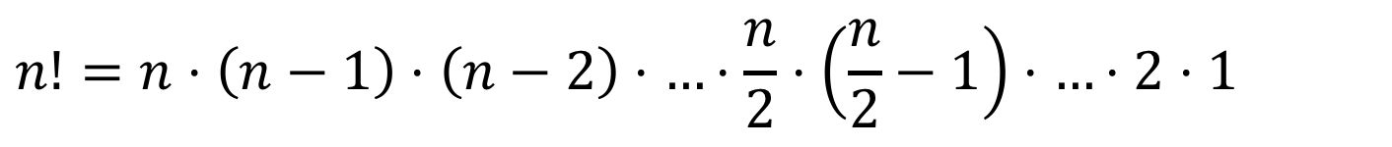





$$\log{n!}=Ω\left(n\log{n}\right)$$
$$n!=n⋅\left(n−1\right)⋅\left(n−2\right)⋅…⋅\frac{n}{2}⋅\left(\frac{n}{2}−1\right)⋅…⋅2⋅1$$
$$>$$
$$>$$
$$>$$
$$=$$
$$>$$
$$>$$
$$=$$
$${\left(\frac{n}{2}\right)}^{\frac{n}{2}}=\frac{n}{2}⋅ \frac{n}{2} ⋅ \frac{n}{2} ⋅…⋅\frac{n}{2}⋅ 1 ⋅…⋅1⋅1$$
$$n!≥{\left(\frac{n}{2}\right)}^{\frac{n}{2}}$$
$$⇒\log\left(n!\right)≥\log\left({\left(\frac{n}{2}\right)}^{\frac{n}{2}}\right)$$
$$⇒\log\left(n!\right)≥\frac{n}{2}\log{\frac{n}{2}}$$
$$⇒\log\left(n!\right)=Ω(n\log{n})$$

Slide 4
Today’s Keywords
Divide and Conquer
Sorting
Quicksort
Decision Tree
Worst case lower bound

Slide 5
CLRS Readings
Chapter 7
Chapter 8

Slide 6
Homeworks
Hw3 Due 11pm Monday Oct. 1
Divide and conquer
Written (use LaTeX!)
Hw2 Grace Period
Opens 4pm today, closes 4pm tomorrow
Do NOT ask TAs for help on Hw2 (grace period is for formatting)
See your email for specific details

Slide 7
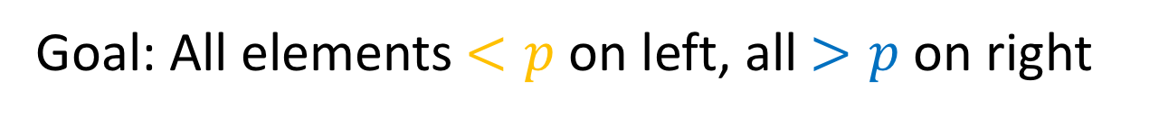
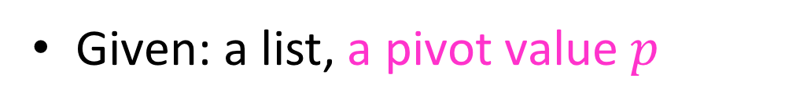
Partition (Divide step)
Given: a list, a pivot value $p$
Start: unordered list
8
5
7
3
12
10
1
2
4
9
6
11
Goal: All elements $<p$ on left, all $>p$ on right
5
7
3
1
2
4
6
8
12
10
9
11

Slide 8
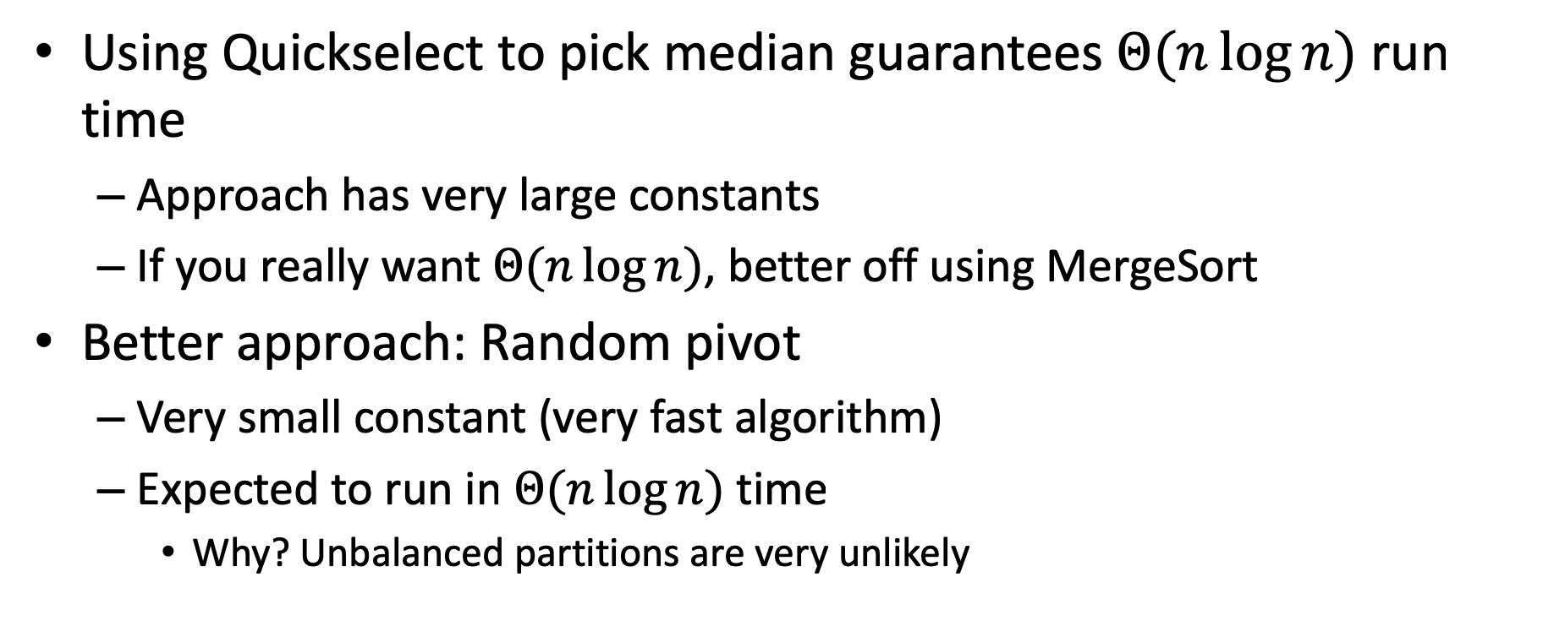
Is it worth it?
Using Quickselect to pick median guarantees $Θ(n\log{n})$ run time
Approach has very large constants
If you really want $Θ(n\log{n})$, better off using MergeSort
Better approach: Random pivot
Very small constant (very fast algorithm)
Expected to run in $Θ(n\log{n})$ time
Why? Unbalanced partitions are very unlikely

Slide 9


Quicksort Run Time
If the partition is always $\frac{n}{10}$^{th} order statistic:
$$T\left(n\right)=T\left(\frac{n}{10}\right)+T\left(\frac{9n}{10}\right)+n$$

Slide 10
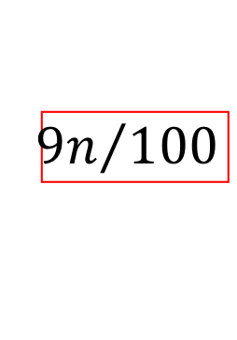



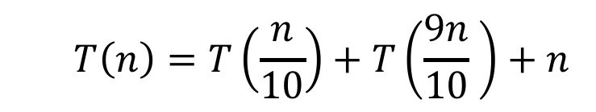

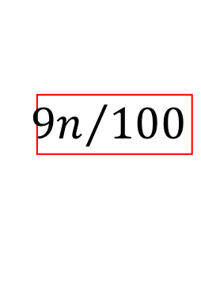







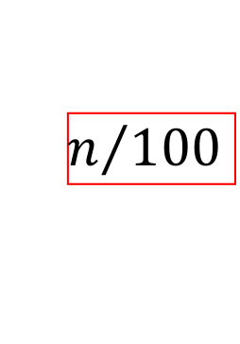


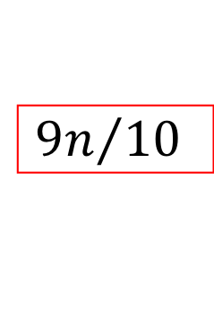





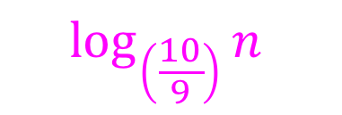
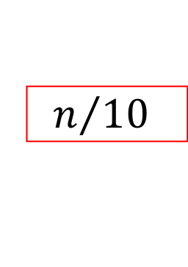
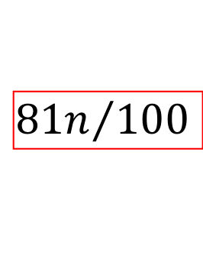




$$T\left(n\right)=T\left(\frac{n}{10}\right)+T\left(\frac{9n}{10} \right)+n$$
$$n$$
$$n$$
$$n$$
$$n/10$$
$$9n/10$$
$$n$$
$$n/{10}$$
$$+$$
$${9n}/{10}$$
$$n/100$$
$9n/$100
$$9n/100$$
$$81n/100$$
$$n/{100}$$
$$+$$
$${9n}/{100}$$
$$+$$
$${9n}/{100}$$
$$+$$
$${81n}/{100}$$
$$n$$
$$\log_{\left(\frac{10}{9}\right)}⁡n$$
…
…
…
…
$$1$$
$$1$$
$$+$$
$$1$$
$$1$$
$$+$$
$$1$$
$$1$$
$$+$$
$$1$$
$$1$$

Slide 11
Quicksort Run Time
If the partition is always $\frac{n}{10}$^{th} order statistic:
$$T\left(n\right)=T\left(\frac{n}{10}\right)+T\left(\frac{9n}{10}\right)+n$$
$$T\left(n\right)=Θ(n\log{n})$$

Slide 12
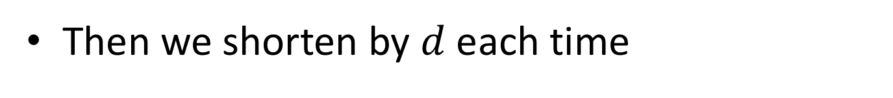
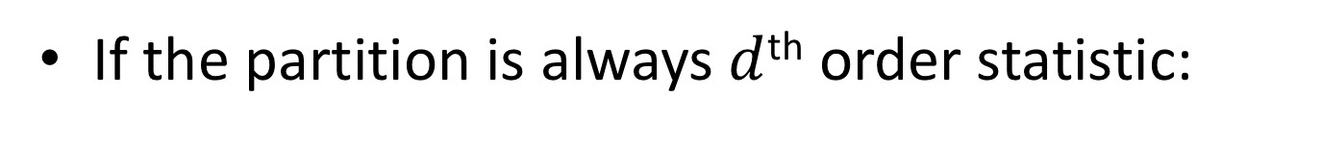
Quicksort Run Time
If the partition is always $d$^{th} order statistic:
1
5
2
3
6
4
7
8
10
9
11
12
1
2
3
5
6
4
7
8
10
9
11
12
Then we shorten by $d$ each time
$$T\left(n\right)=T\left(n−d\right)+n$$
$$T\left(n\right)=O(n^{2})$$
What’s the probability of this occurring?

Slide 13

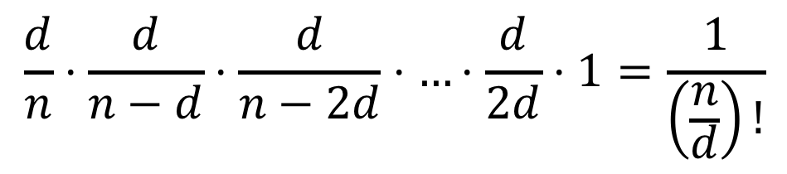

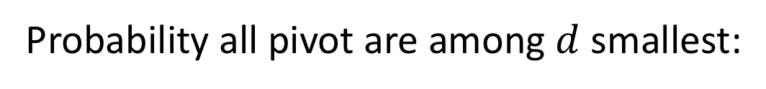
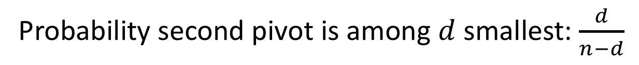
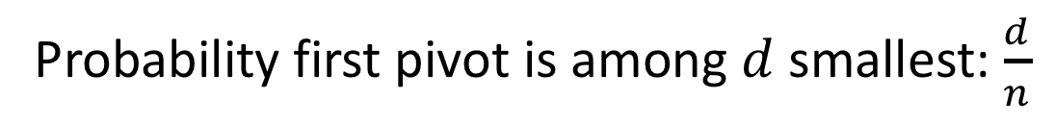
Probability of $n^{2}$ run time
We must consistently select pivot from within the first $d$ terms
Probability first pivot is among $d$ smallest: $\frac{d}{n}$
Probability second pivot is among $d$ smallest: $\frac{d}{n−d}$
Probability all pivot are among $d$ smallest:
$$\frac{d}{n}⋅\frac{d}{n−d}⋅\frac{d}{n−2d}⋅…⋅\frac{d}{2d}⋅1=\frac{1}{\left(\frac{n}{d}\right)!}$$

Slide 14
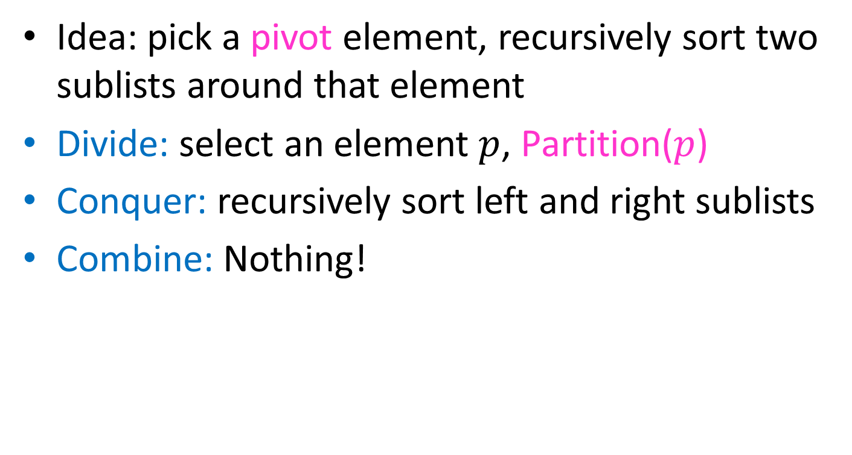
Quicksort
Idea: pick a pivot element, recursively sort two sublists around that element
Divide: select an element $p$, Partition($p$)
Conquer: recursively sort left and right sublists
Combine: Nothing!

Slide 15
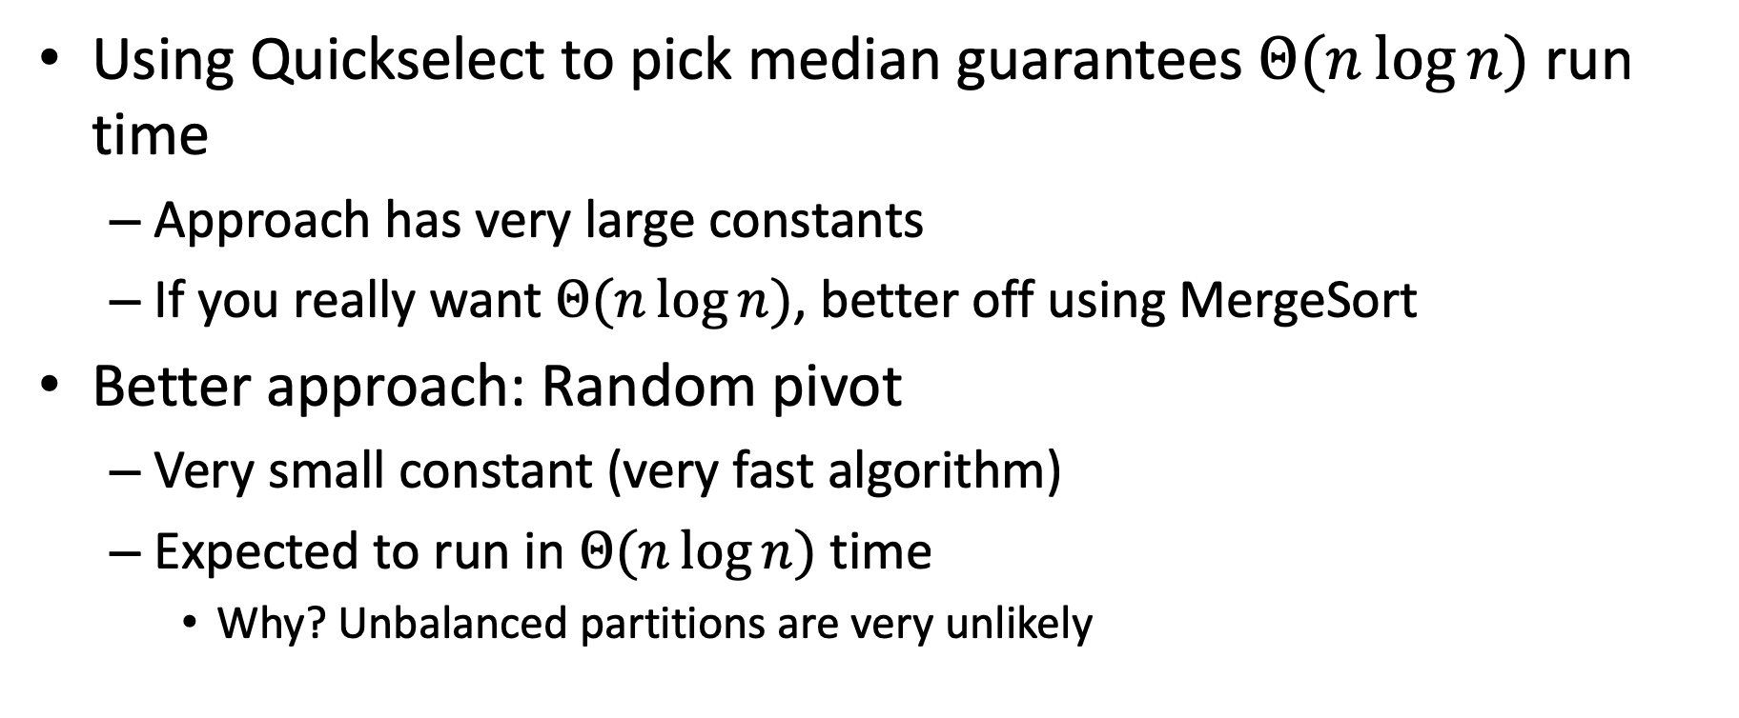
Random Pivot
Using Quickselect to pick median guarantees $Θ(n\log{n})$ run time
Approach has very large constants
If you really want $Θ(n\log{n})$, better off using MergeSort
Better approach: Random pivot
Very small constant (very fast algorithm)
Expected to run in $Θ(n\log{n})$ time
Why? Unbalanced partitions are very unlikely

Slide 16
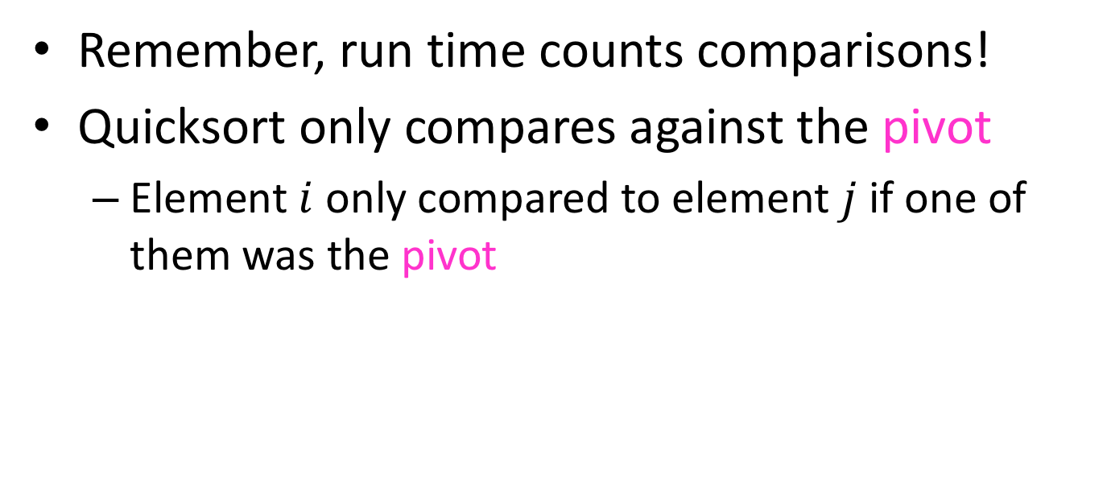

Formal Argument for $n\log{n}$ Average
Remember, run time counts comparisons!
Quicksort only compares against the pivot
Element $i$ only compared to element $j$ if one of them was the pivot

Slide 17
Partition (Divide step)
Given: a list, a pivot value $p$
Start: unordered list
8
5
7
3
12
10
1
2
4
9
6
11
Goal: All elements $<p$ on left, all $>p$ on right
5
7
3
1
2
4
6
8
12
10
9
11

Slide 18
Formal Argument for $n\log{n}$ Average
What is the probability of comparing two given elements?
1
2
3
4
5
6
7
8
9
10
11
12
(Probability of comparing 3 and 4) = 1
Why? Otherwise I wouldn’t know which came first
ANY sorting algorithm must compare adjacent elements

Slide 19
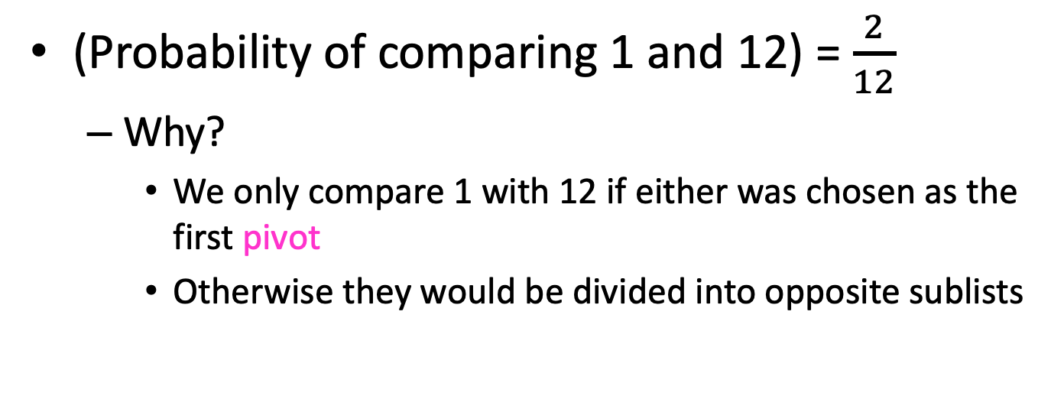
Formal Argument for $n\log{n}$ Average
What is the probability of comparing two given elements?
1
2
3
4
5
6
7
8
9
10
11
12
(Probability of comparing 1 and 12) = $\frac{2}{12}$
Why?
We only compare 1 with 12 if either was chosen as the first pivot
Otherwise they would be divided into opposite sublists

Slide 20
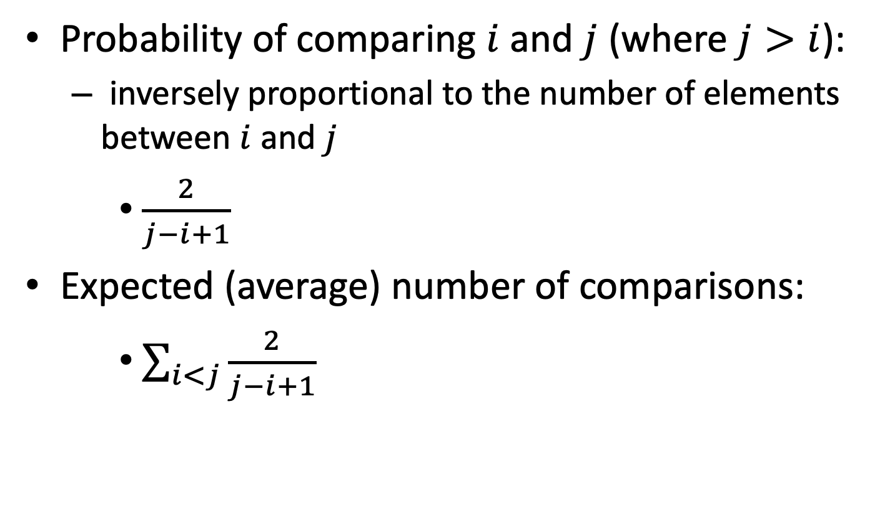
Formal Argument for $n\log{n}$ Average
Probability of comparing $i$ and $j$ (where $j>i$):
inversely proportional to the number of elements between $i$ and $j$
$\frac{2}{j−i+1}$
Expected (average) number of comparisons:
$\sum_{i<j}{\frac{2}{j−i+1}}$

Slide 21
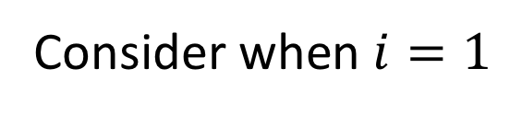
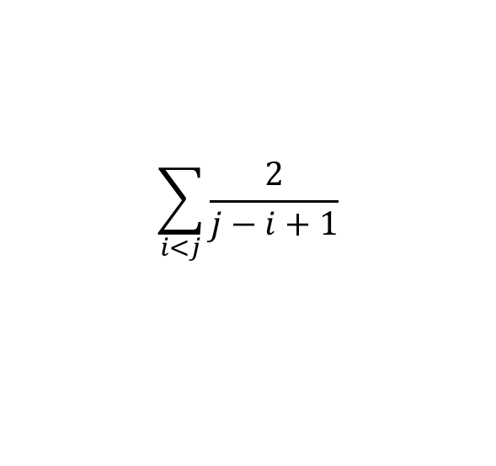
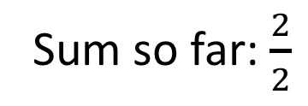
Expected number of Comparisons
$$\sum_{i<j}{\frac{2}{j−i+1}}$$
Consider when $i=1$
1
2
3
4
5
6
7
8
9
10
11
12
Compared if 1 or 2 are chosen as pivot
(these will always be compared)
Sum so far: $\frac{2}{2}$

Slide 22
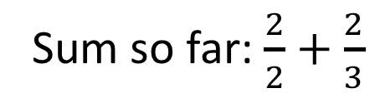
Expected number of Comparisons
$$\sum_{i<j}{\frac{2}{j−i+1}}$$
Consider when $i=1$
1
2
3
4
5
6
7
8
9
10
11
12
Compared if 1 or 3 are chosen as pivot
(but not if 2 is ever chosen)
Sum so far: $\frac{2}{2}+\frac{2}{3}$

Slide 23
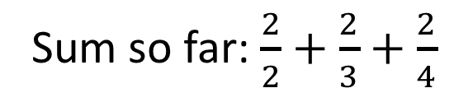
Expected number of Comparisons
$$\sum_{i<j}{\frac{2}{j−i+1}}$$
Consider when $i=1$
1
2
3
4
5
6
7
8
9
10
11
12
Compared if 1 or 4 are chosen as pivot
(but not if 2 or 3 are chosen)
Sum so far: $\frac{2}{2}+\frac{2}{3}+\frac{2}{4}$

Slide 24
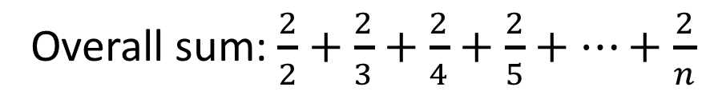
Expected number of Comparisons
$$\sum_{i<j}{\frac{2}{j−i+1}}$$
Consider when $i=1$
1
2
3
4
5
6
7
8
9
10
11
12
Compared if 1 or 12 are chosen as pivot
(but not if 2 -> 11 are chosen)
Overall sum: $\frac{2}{2}+\frac{2}{3}+\frac{2}{4}+\frac{2}{5}+…+\frac{2}{n}$

Slide 25
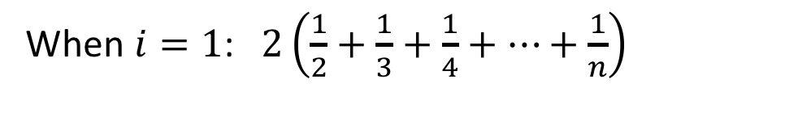
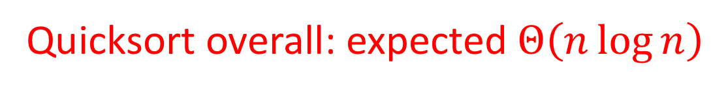
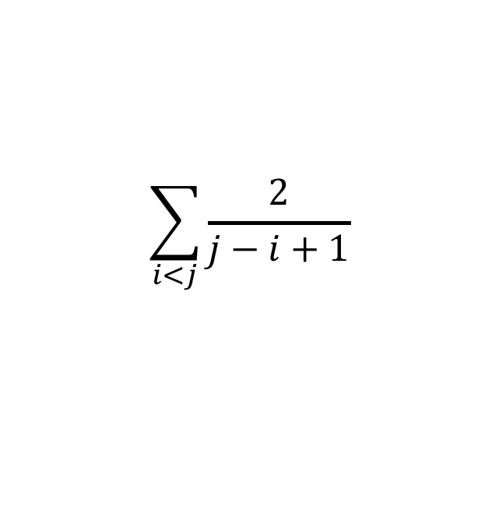
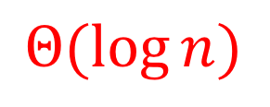
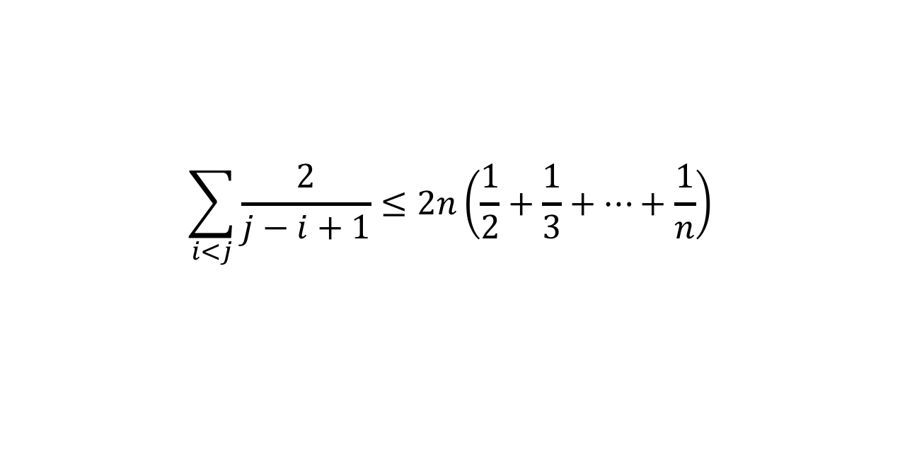
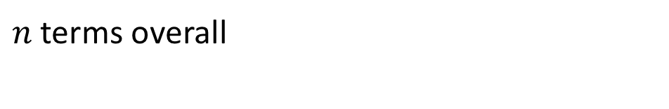
Expected number of Comparisons
$$\sum_{i<j}{\frac{2}{j−i+1}}$$
When $i=1$: $2\left(\frac{1}{2}+\frac{1}{3}+\frac{1}{4}+…+\frac{1}{n}\right)$
$n$ terms overall
$$\sum_{i<j}{\frac{2}{j−i+1}}≤2n\left(\frac{1}{2}+\frac{1}{3}+…+\frac{1}{n}\right)$$
$$Θ(\log{n})$$
Quicksort overall: expected $Θ\left(n\log{n}\right)$

Slide 26


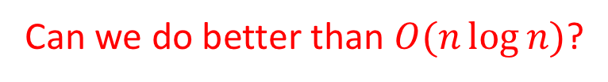


Sorting, so far
Sorting algorithms we have discussed:
Mergesort
Quicksort
Other sorting algorithms (will discuss):
Bubblesort
Insertionsort
Heapsort
$$O(n\log{n})$$
$$O(n\log{n})$$
$$O(n^{2})$$
$$O(n^{2})$$
$$O(n\log{n})$$
Can we do better than $O(n\log{n})$?

Slide 27
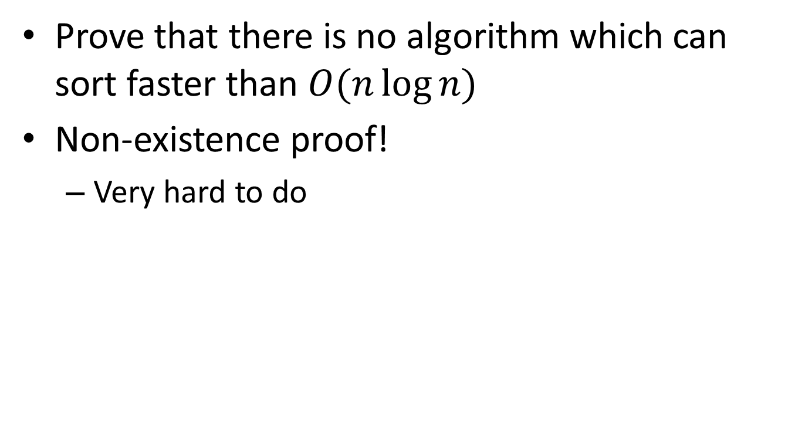
Worst Case Lower Bounds
Prove that there is no algorithm which can sort faster than $O(n\log{n})$
Non-existence proof!
Very hard to do

Slide 28
Strategy: Decision Tree
Sorting algorithms use comparisons to figure out the order of input elements
Draw tree to illustrate all possible execution paths
One comparison
Possible execution path
Result of comparison
<
>or<?
>
<
>or<?
>
<
>or<?
>
<
>or<?
>
<
>or<?
<
>or<?
>
<
>or<?
>
>
>or<?
>or<?
>or<?
>or<?
>or<?
>or<?
>or<?
>or<?
…
…
…
…
…
…
Permutation of sorted list
[1,2,3,4,5]
[2,1,3,4,5]
[5,2,4,1,3]
[5,4,3,2,1]

Slide 29



Strategy: Decision Tree
Worst case run time is the longest execution path
i.e., “height” of the decision tree
One comparison
Possible execution path
Result of comparison
<
>or<?
>
<
>or<?
>
<
>or<?
>
<
>or<?
>
<
>or<?
<
>or<?
>
<
>or<?
>
$$\log\left(n!\right)$$
>
>or<?
>or<?
>or<?
>or<?
>or<?
>or<?
>or<?
>or<?
$$Θ(n log{n})$$
…
…
…
…
…
…
Permutation of sorted list
[1,2,3,4,5]
[2,1,3,4,5]
[5,2,4,1,3]
[5,4,3,2,1]
$n!$Possible permutations

Slide 30
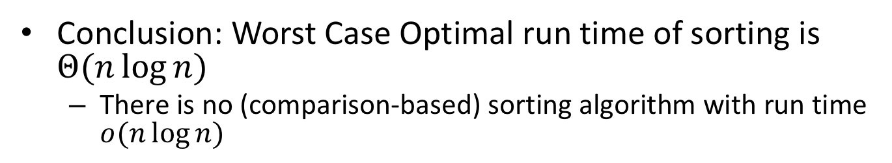
Strategy: Decision Tree
Conclusion: Worst Case Optimal run time of sorting is $Θ(n\log{n})$
There is no (comparison-based) sorting algorithm with run time $o(n\log{n})$
One comparison
Possible execution path
Result of comparison
<
>or<?
>
<
>or<?
>
<
>or<?
>
<
>or<?
>
<
>or<?
<
>or<?
>
<
>or<?
>
$$\log\left(n!\right)$$
>
>or<?
>or<?
>or<?
>or<?
>or<?
>or<?
>or<?
>or<?
$$Θ(n log{n})$$
…
…
…
…
…
…
Permutation of sorted list
[1,2,3,4,5]
[2,1,3,4,5]
[5,2,4,1,3]
[5,4,3,2,1]
$n!$Possible permutations

Slide 31
Sorting, so far
Sorting algorithms we have discussed:
Mergesort
Quicksort
Other sorting algorithms
Bubblesort
Insertionsort
Heapsort
$$O(n\log{n})$$
Optimal!
$$O(n\log{n})$$
Optimal!
$$O(n^{2})$$
$$O(n^{2})$$
$$O(n\log{n})$$
Optimal!

Slide 32
Speed Isn’t Everything
Important properties of sorting algorithms:
Run Time
Asymptotic Complexity
Constants
In Place (or In-Situ)
Done with only constant additional space
Adaptive
Faster if list is nearly sorted
Stable
Equal elements remain in original order
Parallelizable
Runs faster with many computers

Slide 33
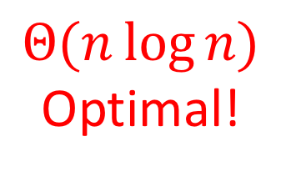
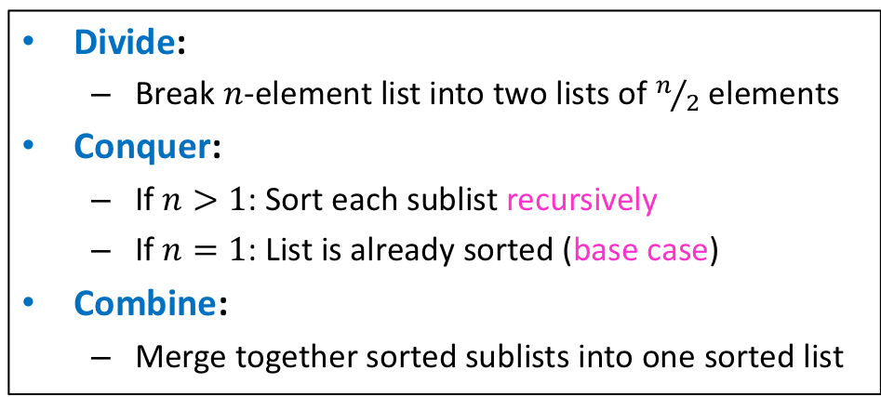
Mergesort
Divide:
Break $n$-element list into two lists of $n/2$ elements
Conquer:
If $n>1$: Sort each sublist recursively
If $n=1$: List is already sorted (base case)
Combine:
Merge together sorted sublists into one sorted list
Run Time?
$$Θ(n\log{n})$$
Optimal!
In Place?
Adaptive?
Stable?
No
No
Yes!
(usually)

Slide 34
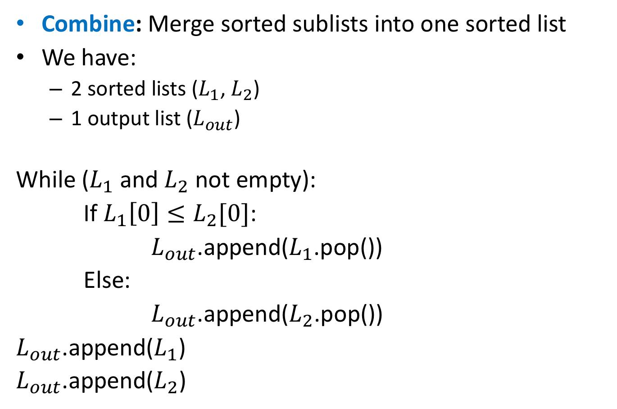
Merge
Combine: Merge sorted sublists into one sorted list
We have:
2 sorted lists ($L_{1}$, $L_{2}$)
1 output list ($L_{out}$)
While ($L_{1}$ and $L_{2}$ not empty):
If $L_{1}\left[0\right]≤L_{2}[0]$:
$L_{out}$.append($L_{1}$.pop())
Else:
$L_{out}$.append($L_{2}$.pop())
$L_{out}$.append($L_{1}$)
$L_{out}$.append($L_{2}$)
Adaptive:
If elements are equal, leftmost comes first

Slide 35
Mergesort
Divide:
Break $n$-element list into two lists of $n/2$ elements
Conquer:
If $n>1$: Sort each sublist recursively
If $n=1$: List is already sorted (base case)
Combine:
Merge together sorted sublists into one sorted list
Run Time?
$$Θ(n\log{n})$$
Optimal!
In Place?
Adaptive?
Stable?
Parallelizable?
No
No
Yes!
(usually)
Yes!

Slide 36
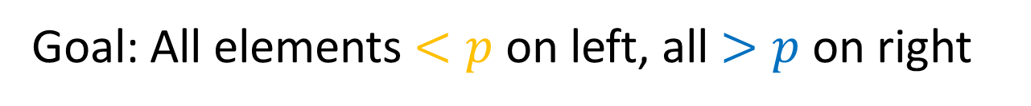
Mergesort
Parallelizable:
Allow different machines to work on each sublist
Divide:
Break $n$-element list into two lists of $n/2$ elements
Conquer:
If $n>1$:
Sort each sublist recursively
If $n=1$:
List is already sorted (base case)
Combine:
Merge together sorted sublists into one sorted list

Slide 37
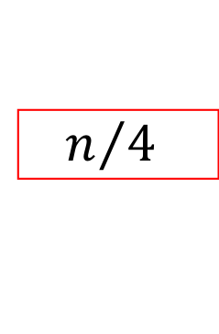


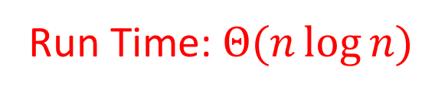
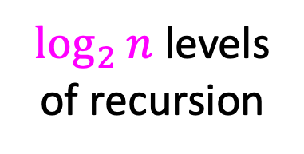

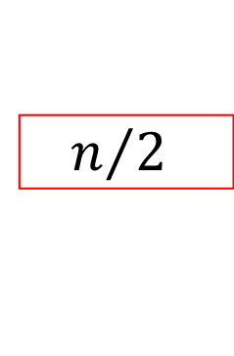













Mergesort (Sequential)
$$T\left(n\right)=2T\left(\frac{n}{2}\right)+n$$
$$n$$
$$n$$
$n$ total / level
$$\frac{n}{2}$$
$$\frac{n}{2}$$
$$n/2$$
$$n/2$$
$$\frac{n}{4}$$
$$\frac{n}{4}$$
$$\frac{n}{4}$$
$$\frac{n}{4}$$
$\log_{2}⁡n$ levels
of recursion
$$n/4$$
$$n/4$$
$$n/4$$
$$n/4$$
…
…
…
…
$$1$$
$$1$$
$$1$$
…
$$1$$
$$1$$
$$1$$
$$1$$
$$1$$
$$1$$
$$1$$
$$1$$
$$1$$
Run Time: $Θ(n\log{n})$

Slide 38





Mergesort (Parallel)
$$T\left(n\right)=T\left(\frac{n}{2} \right)+n$$
$$n$$
$$n$$
Done in Parallel
$$\frac{n}{2}$$
$$\frac{n}{2}$$
$$\frac{n}{2}$$
$$n/2$$
$$n/2$$
$$\frac{n}{4}$$
$$\frac{n}{4}$$
$$\frac{n}{4}$$
$$\frac{n}{4}$$
$$\frac{n}{4}$$
$$n/4$$
$$n/4$$
$$n/4$$
$$n/4$$
…
…
…
…
$$1$$
$$1$$
$$1$$
$$1$$
…
$$1$$
$$1$$
$$1$$
$$1$$
$$1$$
$$1$$
$$1$$
$$1$$
$$1$$
Run Time: $Θ(\log{n})$

Slide 39


Quicksort
Run Time?
Idea: pick a partition element, recursively sort two sublists around that element
Divide: select an element $p$, Partition($p$)
Conquer: recursively sort left and right sublists
Combine: Nothing!
$$Θ(n\log{n})$$
Optimal!
(almost always)
In Place?
Adaptive?
Stable?
Parallelizable?
No…
No!
No
Yes!

Slide 40
Strategy: Decision Tree
>or<?
>or<?
>or<?
>or<?
>or<?
>or<?
>or<?
>or<?
>or<?
>or<?
>or<?
>or<?
>or<?
>or<?
>or<?
…
…
…
…
…
…
[1,2,3,4,5]
[2,1,3,4,5]
[5,2,4,1,3]
[5,4,3,2,1]

