Slide 1
CS4102 Algorithms
Solutions to HW6 and HW8 up front
Fall 2018
Warm up:
Pick up a slip of paper from the front
Take out a coin
(Pennies up front if you need one)
(please return them at end)
Think of embarrassing yes/no questions to ask me

Slide 2
Today’s Keywords
Differential Privacy
NP Completeness
Impagliazzo’s 5 Worlds

Slide 3
CLRS Readings
None

Slide 4
Homeworks
HW9 due Friday 12/7 at 11pm
Written (use LaTeX)
Reductions
Optional HW10 out
Due at time of opposite exam
Replaces lowest HW from entire semester
Programming assignment (should be familiar)

Slide 5
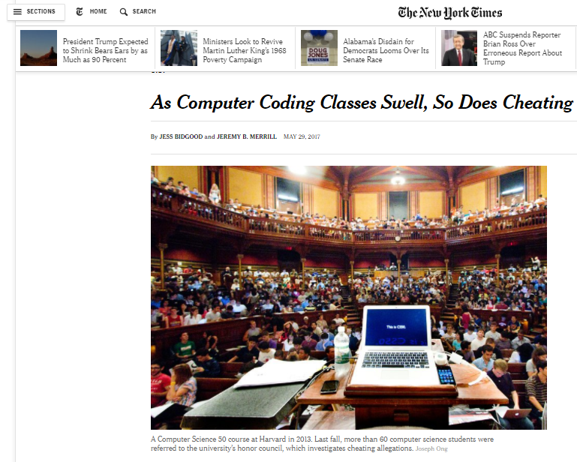
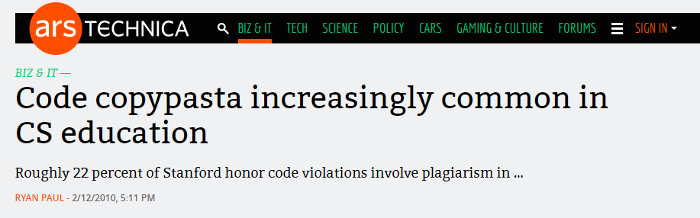
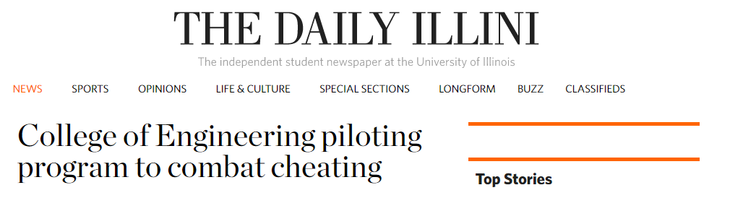

Slide 6
Differential Privacy
Gives a way to probabilistically answer questions about data without giving away its content
You can get statistical certainty on the answer
We’re going to use a simple example

Slide 7
Scheme
Flip a coin:
If Heads, respond “yes”
If Tails, truthfully answer an embarrassing question:
Questions
Do Nate and I share a minecraft server?
Have you ever blacked out?
Are you a virgin?
Can you give us the answers to the final ahead of time?

Slide 8
Scheme
Flip a coin:
If Heads, respond “yes”
If Tails, truthfully answer an embarrassing question:
Have I ever tried to impress a girl with algo and failed epically?
Have I ever streaked the lawn?
Have I ever drank before class?
Have I ever cheated
Is the 11am section better than the 2pm?
Do I find any of my coworkers attractive?
Do I have any tats or piercings?
Have I ever had an awkward date?
Do I drive a red punch buggy?
Have I ever pooped myself as a teenage+?
Do I think I’m smart enough to have something named after me?
Was UVA my second/ worst choice to work at?

Slide 9
Scheme
Flip a coin:
If Heads, respond “yes”
If Tails, truthfully answer an embarrassing question:
Have I ever been mistaken for a student?
Have I ever been drinking at the corner and came upon a student?
Have I ever had an encounter with the fuzz
Would I like a soup or a salad?
Have I ever used bubblesort?
Have I ever actually used bogosort?
Do I discuss algorithms on dates?
Am I on Tinder/bumble?
Have I ever used a CS pickup line?
Do I compare myself to Mark Floryan?
Is there a better programmer in the CS department?
Disp

Slide 10
How does it work
Assume everyone participates honestly
We know 50% of “yes” answers were from the coin landing heads
If 100 people participate, eliminate 50 “yes” responses
Proportion of “yes” answers given by remaining “yes” answers over 50
Consider a person who answers “no”
We know this person didn’t cheat
Consider a person who answers “yes”
Most people who answered “yes” only did so because the coin landed heads
It’s still more likely that this person did not cheat

Slide 11
Example: How many people have streaked the lawn?
Flip a coin:
If Heads, respond “yes”
If Tails, truthfully answer an embarrassing question:
Have you ever streaked the lawn?
On the slip of paper, put a 1 in column 1, put a 1 in column 2 if you answered yes (else a 0 in column 2)
Pass the slip to your left

Slide 12
Impagliazzo’s 5 Worlds
Describes what computer science might look like depending on how certain open questions are answered.
Algorithmica
Heuristica
Pessiland
Minicrypt
Cryptomania

Slide 13
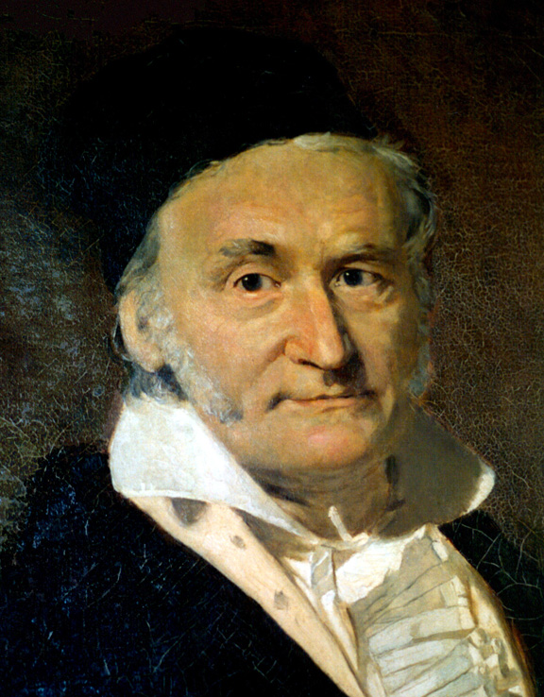
Gauss vs. Büttner
Büttner’s goal: embarrass Gauss
Come up with a problem which Gauss finds difficult but Büttner can solve quickly
Come up with a graph and a Vertex Cover together
Give the graph to Gauss
When Gauss is stumped show the Vertex Cover

Slide 14
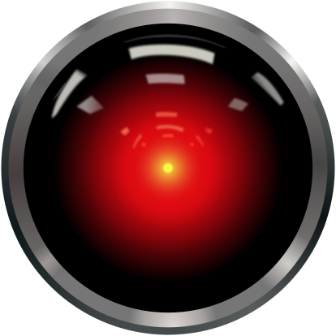
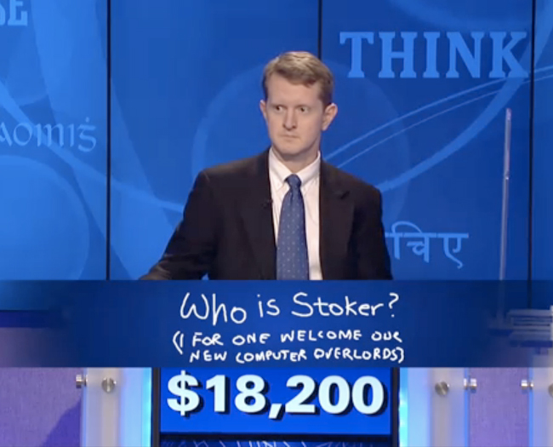
Algorithmica
P=NP
NP problems solvable efficiently
Gauss can quickly find the solution to Buttner’s problem
Gauss is not embarrassed
Advantages:
VLSI Design
Strong AI
Cure for cancer?
Disadvantages:
No privacy
Computers take over

Slide 15
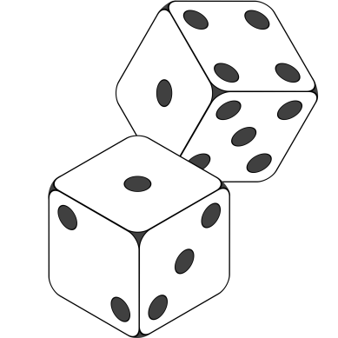
Heuristica
P≠NP in worst case, P=NP on average
Time to come up with a problem ≈ time to solve it
Büttner can give hard problems, but it’s hard to find them
Gauss is not embarrassed
Advantages:
Maybe similar to Algorithmica
Depends on real-world distributions
Disadvantages:
Bad real world distributions could make things hard to solve

Slide 16
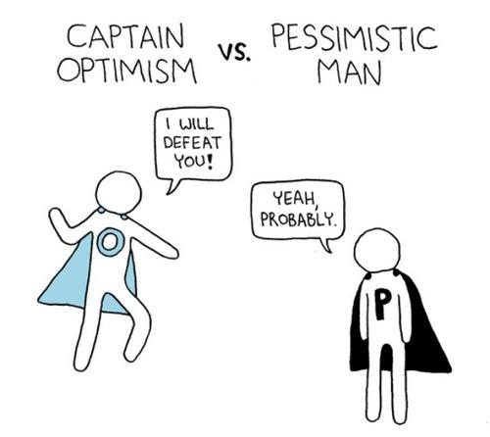
Pessiland
P≠NP on average, one-way functions don’t exist
Hard problems easy to find, but solved hard problems difficult to find
Gauss can be stumped, but Büttner does no better
Advantages:
Universal Compression
Reverse Engineering
Derandomization
Disadvantages:
No crypto
No algorithmic advantages
Progress is slow

Slide 17
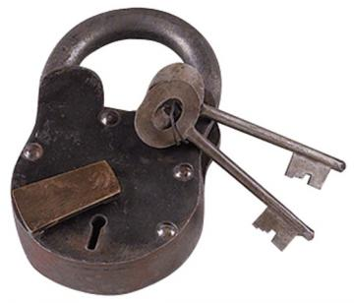
Minicrypt
One-way functions exist, no public key cryptography
Büttner can give hard problems to Gauss and also know their solutions
Gauss is embarrassed
Advantages:
Private key crypto
Can prove identity
Disadvantages:
No electronic currencies

Slide 18
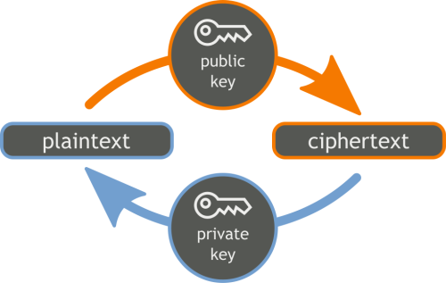
Cryptomania
Public Key Crypto Exists
Büttner can come up with problems and solutions, then share the solution with all other students
Gauss is very embarrassed
Advantages:
Secure computation
Signatures
Bitcoin, etc.
Disadvantages:
Algorithmic progress will be slow

Slide 19
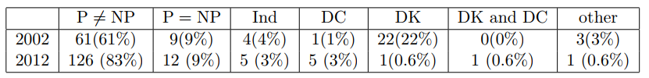
Does P=NP?

Slide 20
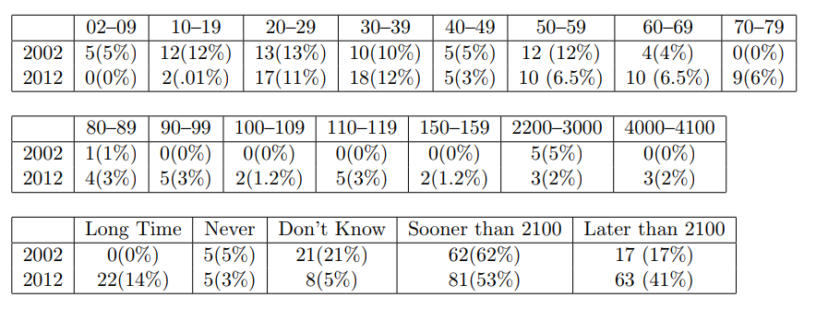
When Will P=NP be resolved?

Slide 21
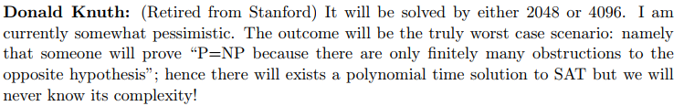
Notable Statements on P vs NP
Suggested rephrased question:

